Slide 1
Adult Social Care Experience Survey
Getting People involved in Adult Social Care

Slide 2
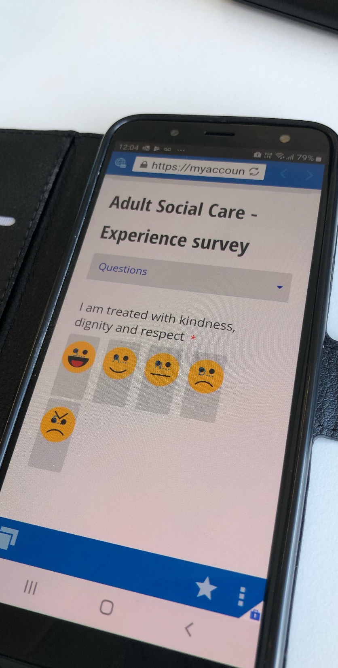
Background and Context
Key element of Quality Assurance is seeking feedback from our customers, clients and carers alike
This traditionally takes the form of two national postal surveys - annual Adult Social Care Survey and biennial Carers Survey – All local authorities must complete these surveys
Results from the surveys are used to some of Adult Social Care Outcomes Framework (ASCOF) indicators. For example (3A) ‘Overall satisfaction of people who use service with their care and support’
Most services now seek feedback immediately after a service is provided, whether it’s a hospital, the dentist, a restaurant etc.

Slide 3
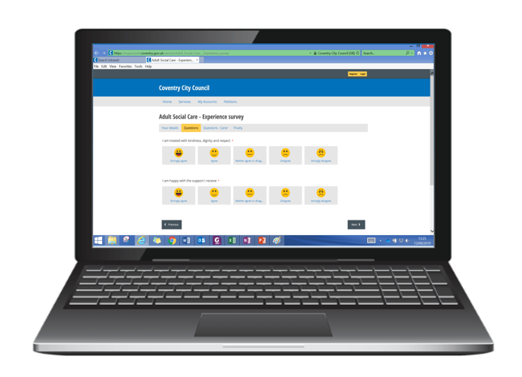
Background and Context
We wanted to develop more ‘real time’ approaches to understanding the experience of those who access our support and to encourage more people to ‘get involved’. This will help us improve our adult social care support and promote a coproduction culture
We held a pilot earlier in the year with the Older People’s reviewing team and Carers Assessment Workers.
Key part of strength-based approaches to adult social care

Slide 4
What’s the point?
We know only certain people respond to postal surveys
Seeking feedback from a range of people helps us get a better sense of how things are working (good and bad)
Often feedback to commissioning is seen as anecdotal or isolated but this will help gather more overarching themes / concerns and maybe pick up on concerns at an earlier stage
Will help us have a better understanding of what interventions work well or could be improved.

Slide 5
The Experience Survey
An online experience survey has been developed consisting of a series of statements from either the perspective of the client (person with support needs) or a carer
Intentionally high level, intended to elicit general responses regarding people’s experience rather than specific types of service. They are however aligned to the questions within the ASCOF
It’s not a mechanism to gain feedback about individual practitioners but to determine how effective interventions and support have been through Adult Social Care.
Practitioner to support people to complete the survey at the point of a ‘review’

Slide 6
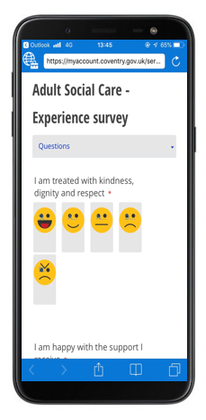
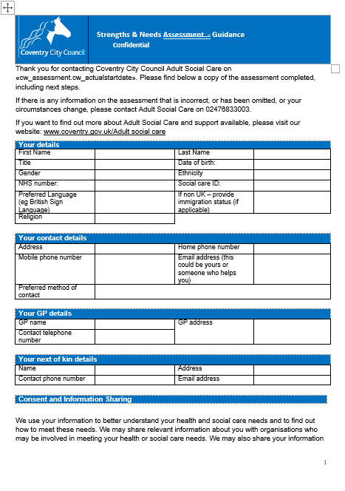
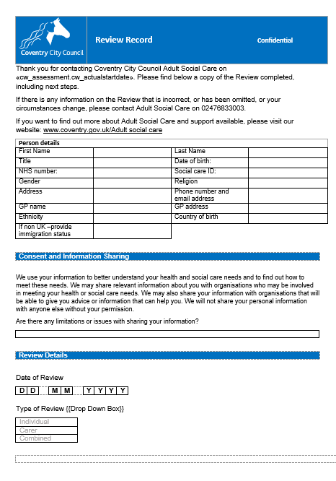
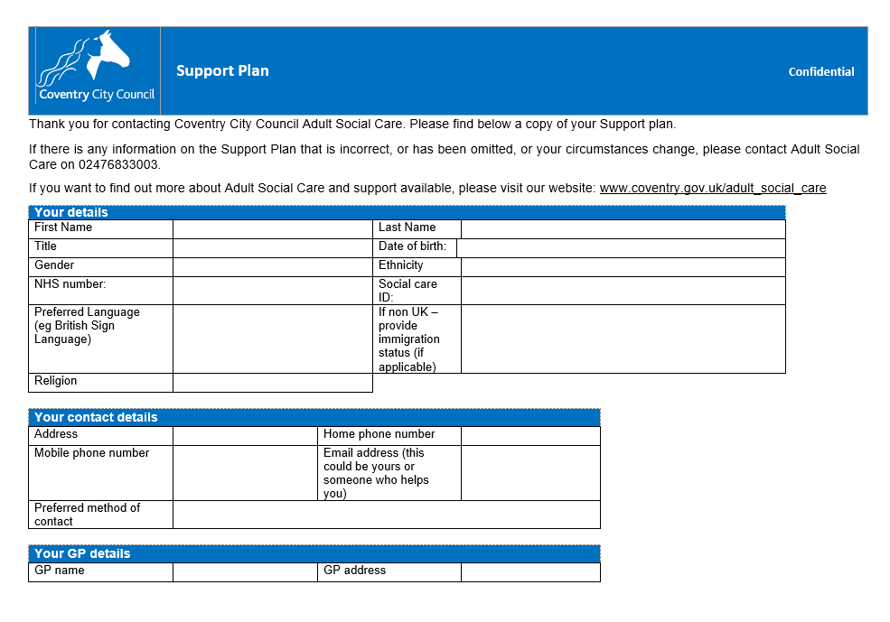
Process
Assessment and Support Plan
Initial 6 week review / annual review
Complete survey at the end of the review

Slide 7
The Experience Survey
The client based statements are;
I am treated with kindness, dignity and respect
I am happy with the support I receive
I have enough choice and/or control over the support I receive
I am supported to live as independently as possible
Information about my support is easily available to me and those who need it
I have as much contact with people as I would like
The support I receive helps me feel safe
The carer centred statements are;
I am treated with kindness, dignity and respect
I am happy with the support I receive
I have been involved and listened to in the planning for the person I care for
Information I have needed to support me in my caring role has been easily available
I am able to manage my social life alongside my caring role

Slide 8
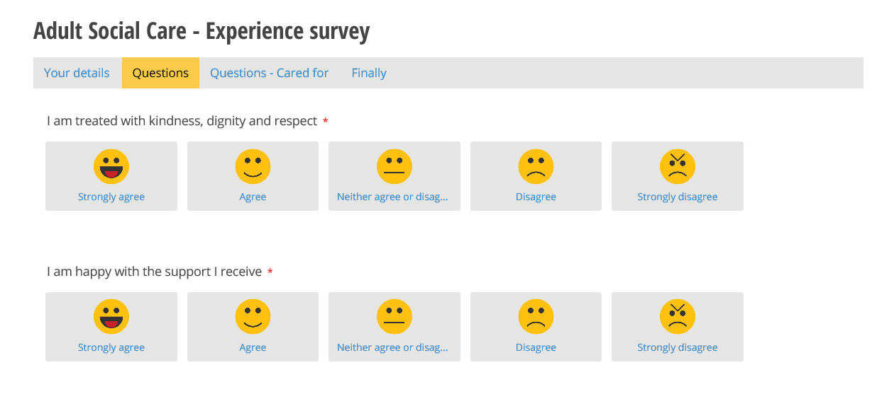
The Experience Survey

Slide 9
The Experience Survey

Slide 10
Options for Getting Involved
Discussion or focus groups
Surveys and questionnaires
Adult Social Care Stakeholder Group
Adult Social Care Annual Report
Training

Slide 11
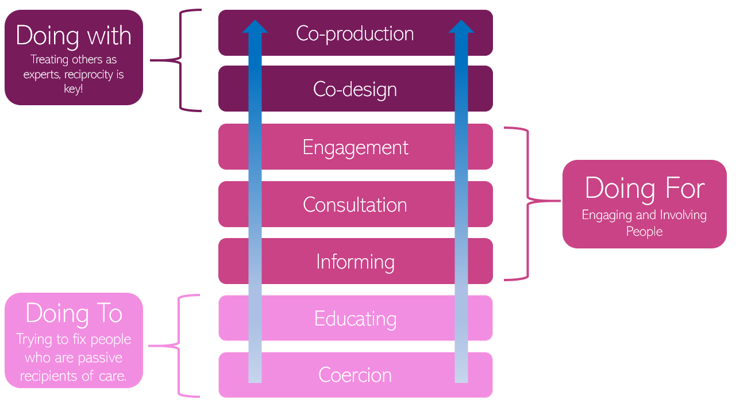
How do we currently involve people?

Slide 12
Adult Social Care Stakeholders Group
Group meet every other month to discuss any developments in Adult Social Care.
People using services and carers attend alongside some representatives from the Vol. Sector.
There is an open group.

Slide 13
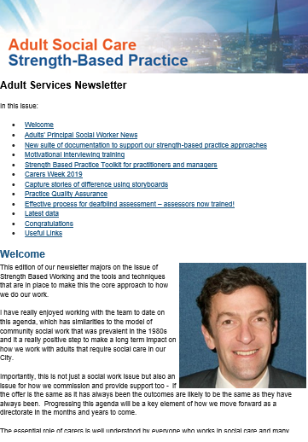
Adult Social Care Bulletin
Quarterly Bulletin for anyone who wishes to be kept informed of developments within Adult Social Care.

Slide 14
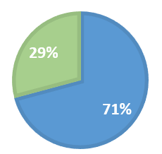
Final Questions
What would you change about the support you receive if you could?
Would you be interested in getting involved in improving adult social care?
Yes = 7
No = 17
The wordle above shows the words used regularly by respondents, the size of the words shows the number of occurrences.
Note: Only 24 of the 28 people surveyed responded to the question

Slide 15
Getting it set up
1
Open to link in the email to the survey on your work phone:
2
The link will open in the Browser App (in workspace)
3
Add the link as a bookmark for future reference
Remember you will need the CD Number for the person to start the survey.

Slide 16
The Experience Survey
Live from 1st October with staff briefings planned to be held in September
Able to report on survey results via ASC Balanced Scorecard
Results will be discussed at the the Adult Social Care Stakeholder Group
There is a leaflet that can be given to families to explain the survey
Any questions?

