Slide 1
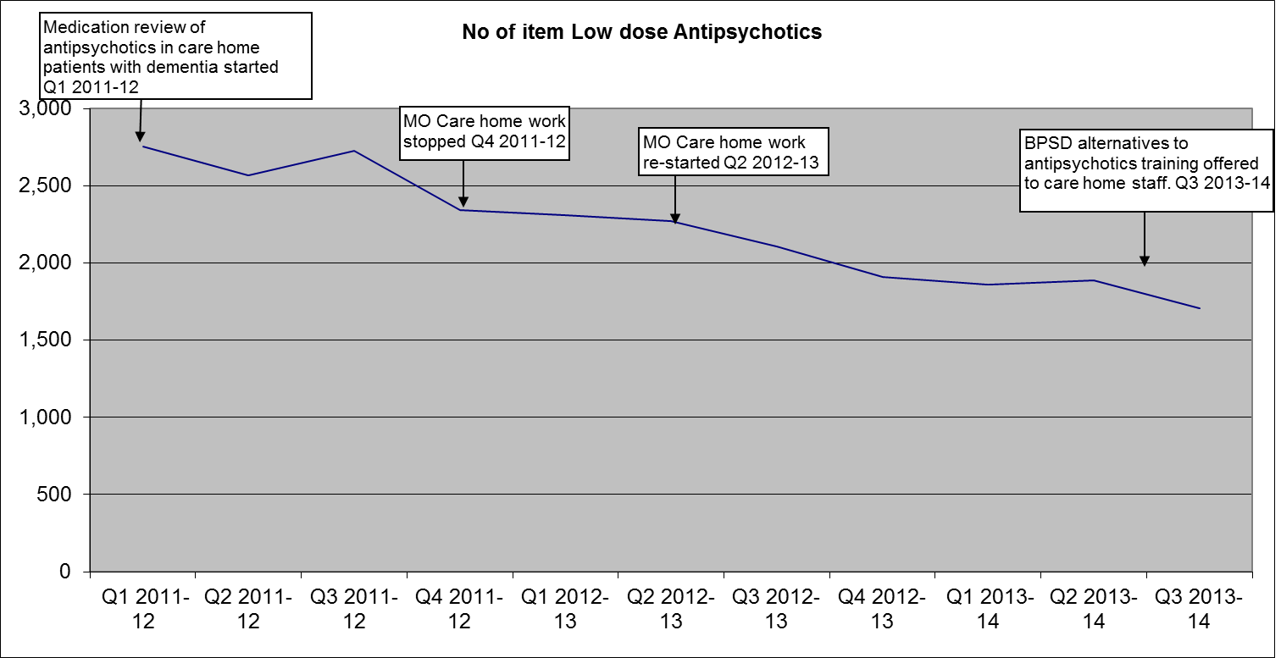
Care Homes-Steady Reduction

Slide 2
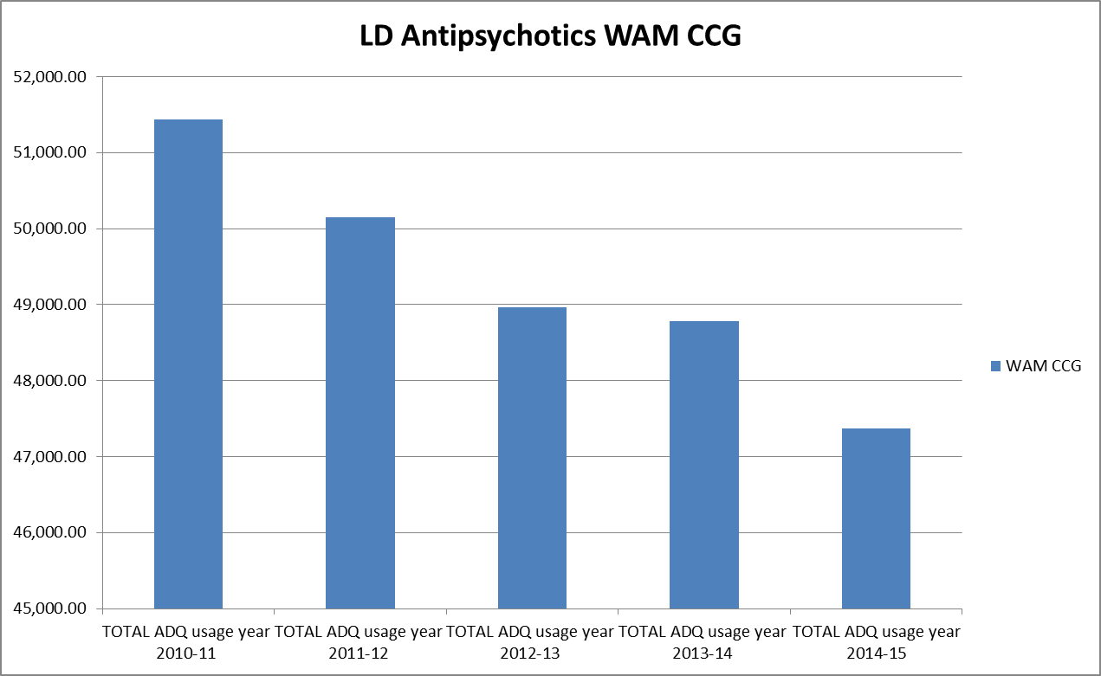
WAM –Downward Trend

