Slide 1
Voxelotor for treating haemolytic anaemia in people with sickle cell disease
Part 1 slides for public – fully redacted
Technology appraisal committee D [7th December 2022]
Chair: Dr Megan John
Lead team: David Meads, John Watkins, Malcolm Oswald
Evidence assessment group: Liverpool Reviews and Implementation Group
Technical team: Nigel Gumbleton, Carl Prescott, Linda Landells
Company: Global Blood Therapeutics
© NICE 2022. All rights reserved. Subject to Notice of rights.

Slide 2
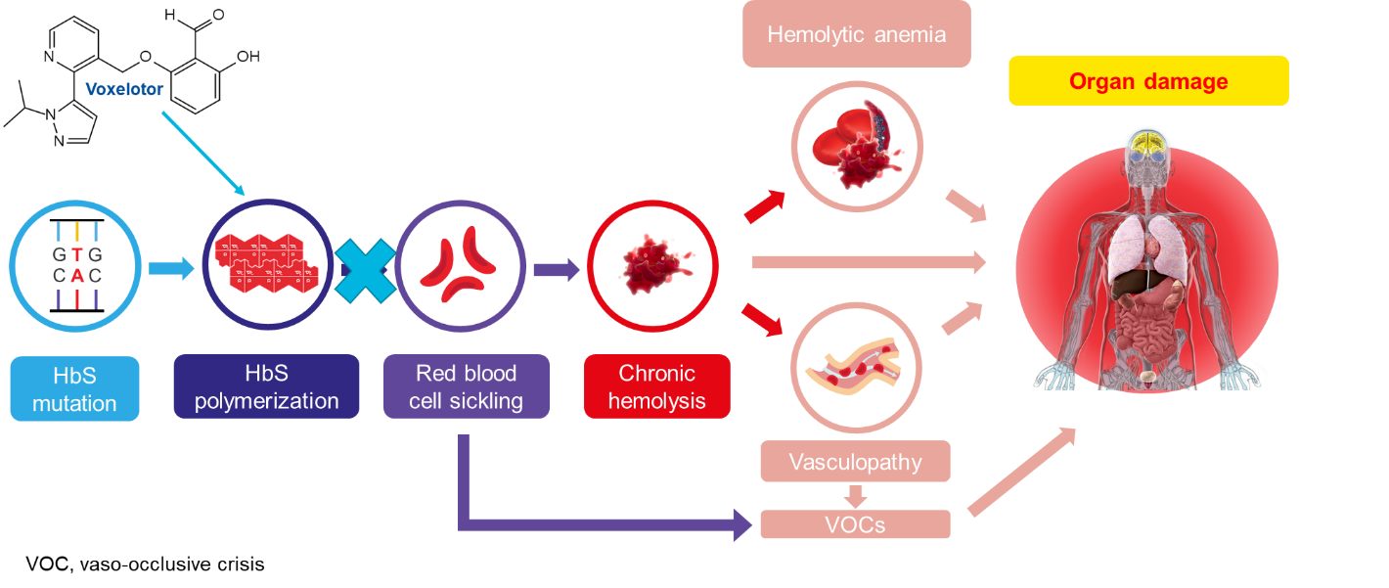
Background on haemolytic anaemia in sickle cell disease (1/2)
Causes
Hb is a protein in RBC that carries oxygen from the lungs to the rest of the body
Gene mutation results in sickle Hb variant → RBCs distort into a rigid sickle shape when in low oxygen, and unsickle in high oxygen. This process leads to irreversibly sickled RBCs, which are then broken down (haemolysis), leading to haemolytic anaemia, blood vessel damage and vaso-occlusion
Figure 1 Disease process in SCD
Abbreviations: Hb, haemoglobin; HbS, sickle beta-globin haemoglobin; RBC, red blood cells; SCD, sickle cell disease; VOC, vaso-occlusive crisis
Notes:
Figure 1 adapted from figure 1 in company submission

Slide 3
Background on haemolytic anaemia in sickle cell disease (2/2)
Epidemiology
SCD is a rare, severe, inherited disorder that predominantly affects people of African, Caribbean, Middle Eastern or South Asian family background
In 2018/2019, 299 babies diagnosed with SCD in England
Approximately 12,500–15,000 people are living with SCD in England
Chronic haemolytic anaemia is experienced by all people with SCD to various degrees
Symptoms and prognosis
Sustained haemolytic anaemia causes symptoms such as fatigue, weakness, tachycardia, dizziness and confusion. Also leads to deterioration in tissue and organ function
Abbreviations: SCD, sickle cell disease

Slide 4
Patient perspectives
Lack of innovation and investment in SCD. Only 2 licenced treatments; one of which has only been available from February 2022
Submissions from AOFAC Foundation, Cianna’s Smile, Sickle Cell Society, Essenelle Foundation
SCD is a debilitating condition
Severe painful crises are unpredictable and common
Affects multiple organs causing strokes, organ and bone damage, sight loss and other symptoms
Patients and carers:
Can suffer physically, emotionally, and financially
Home and working lives are badly disrupted by hospital admissions and sleep deprivation
“Life-threatening condition with no cure and very few meaningful treatments”
Long-term morbidities in SCD directly relate to degree of anaemia and/or haemolysis (breaking down of RBC). Voxelotor has the option to target both
Burden of SCD is significant. Profound impact on QoL, including school, further education, work and relationships.
High unmet need for effective additional disease modifying treatments for SCD. Evidenced by the All Party Parliamentary Group’s inquiry report on serious health inequalities associated with SCD
Abbreviations: AOFAC, Anthonia Oyindamola Folakemi Afelumo Coshar Foundation; RBC, red blood cells; SCD, sickle cell disease; QoL, quality of life

Slide 5
Clinical perspectives
Submission from RCPath and 2 clinical experts
“Need for alternative treatment that can improve haemoglobin and haemolysis”
Voxelotor is an “alternative for people who do not respond or tolerate first-line treatment with HC” or “who cannot or will not receive blood transfusions”
“Some of the long-term morbidities in sickle cell disorder are directly related to the degree of anaemia and/or haemolysis and voxelotor can target both anaemia and haemolysis”
“Potentially very beneficial for a subgroup of sickle cell disorder with primarily haemolysis-driven symptoms”
Mild to moderate gastrointestinal side effects during first 1-2 weeks of therapy
Sickle cell disease is associated with severe impairment of health and life expectancy
Voxelotor is a novel treatment for SCD, which historically has very few available options
Abbreviations: HC, hydroxycarbamide; RCPath, The Royal College of Pathologists; SCD, sickle cell disease

Slide 6
Equalities Previous NICE appraisals
Technology appraisal | Drug | Population*
NICE TA743 (2021) | Crizanlizumab | Prevention of recurrent vaso occlusive crises (VOCs) in people with sickle cell disease aged 16 years and older
NICE ID1403 (2022) | Voxelotor | Treatment of haemolytic anaemia due to sickle cell disease (SCD) in adults and paediatric patients 12 years of age and older
*Note: the population in TA743 is a different SCD subpopulation to that being considered today
Committee equality conclusions in TA743:
Unmet need for effective treatments for people with SCD
Acknowledged potential health inequalities faced by people with SCD
SCD mostly seen in certain minority ethnic populations, and those populations suffered worse health outcomes and barriers to treatment
People with SCD face health inequalities because the condition is not well understood, results in disability, and is more common in people of African or African-Caribbean family origin, who tend to have poorer health outcomes than other ethnicities
Access to crizanlizumab may help address these inequalities
Departing from NICE's usual range needs to be done with caution, as it risks displacing funding from more cost-effective treatments elsewhere in the NHS, with an overall net loss of health gain
Abbreviations: SCD, sickle cell disease

Slide 7
Equalities SCD Population suffers from health and socio-economic inequalities
Company:
High unmet need with few treatment options, in a patient population that suffers from health and socio-economic inequalities
Clinical expert:
Several reports (including the All Party Parliamentary Group report ‘No one is listening’) highlight the inequality in NHS health care and inadequate social support available to people and carers living with SCD compared to chronic conditions such as haemophilia and cystic fibrosis
SCD is a condition which is common in people whose family origins are African and African Caribbean
People with SCD are disadvantaged particularly on account of race and socioeconomic status
Patient expert:
Limited access to new safe, effective treatments for SCD widens health inequalities for SCD community
Decisions around availability of SCD treatments primarily affect people from ethnic minorities who have a chronic life-long health condition, many of whom are also socio-economically disadvantaged and subject to health inequalities
A number of people with SCD are members of Jehovah’s Witness communities and do not wish to receive blood products
What account should be taken of health inequalities in the evaluation of voxelotor for treating haemolytic anaemia in people with sickle cell disease?
Abbreviations: SCD, sickle cell disease

Slide 8
Unresolved Key issues
Issue | ICER impact
The modelled impact of treatment with voxelotor on HRQoL is not supported by trial evidence | Large
Uncertainty around the proportions of patients receiving regular transfusion therapy Impact of voxelotor on RTT use Modelling of RTT benefits | Large
Methods used by the company to generate TTE probabilities are not robust | Small
The company’s positioning of voxelotor as a ‘second-line treatment’ is problematic | Unknown
It is unclear if an increase in Hb of >1g/dL is clinically meaningful for SCD patients with haemolytic anaemia | Unknown
The impact of voxelotor on long-term complications is unknown | Unknown
Large
Small
Unknown
Abbreviations: Hb, haemoglobin; HRQoL, health related quality of life; SCD, sickle cell disease; TTE, time to event

Slide 9
Voxelotor (Oxbryta, Global Blood Therapeutics)
CONFIDENTIAL
Marketing authorisation | Treatment of haemolytic anaemia due to sickle cell disease (SCD) in adults and paediatric patients 12 years of age and older as monotherapy or in combination with HC
Mechanism of action | Voxelotor is a haemoglobin S (HbS) polymerisation inhibitor increasing the affinity of Hb for oxygen. Voxelotor inhibits RBC sickling and improves RBC deformability.
Administration | Recommended dosage of voxelotor is 3 x 500 mg film-coated tablets taken orally once daily with or without food
Price | List price 90 x 500mg tablets: XXXXXX List price for 12 months of treatment: ≈XXXXXX per patient per year A confidential patient access scheme in the form of a simple discount has been submitted and approved by NHS England
Abbreviations: HC, hydroxycarbamide; RBC, red blood cell; SCD, sickle cell disease

Slide 10
Decision problem: Population narrower than the scope
 | Final scope | Company | EAG comment
Population | Haemolytic anaemia in people with sickle cell disease | 2nd line treatment after HC consideration | MHRA EAMS indication supports use of voxelotor as a monotherapy or in combination with HC and does not limit use to 2nd line after HC
Intervention | Voxelotor
Comparator | Established clinical management without voxelotor including: HC blood transfusions (exchange and top-ups) best supportive care | Established clinical management without voxelotor in people who are ineligible for, intolerant of or unwilling to take HC, or for whom HC alone is insufficiently effective. Includes supportive care and HC and/or blood transfusions | Company presented clinical effectiveness evidence for voxelotor from HOPE trial. This compares efficacy of voxelotor+SoC versus placebo+SoC (where SoC does not include regular blood transfusions, but ad hoc transfusions allowed in both arms)
Outcomes | Changes to haematological parameters (haemoglobin levels); number and severity of sickle cell crises; complications arising from sickle cell disease; markers of haemolysis; mortality; adverse effects of treatment; health-related quality of life
Abbreviations: EAMS, early access to medicines scheme; HC, hydroxycarbamide; MHRA, Medicines and Healthcare products Regulatory Agency; SCD, sickle cell disease

Slide 11
Clinical effectiveness

Slide 12
Treatment pathway
Figure 2 Treatment pathway for haemolytic anaemia in sickle cell disease
Haemolytic anaemia in sickle cell disease
Supportive care: lifestyle advice (adequate hydration, body temperature regulation), infection prevention and pain management (paracetamol, NSAIDs, opioids)
1st line
Voxelotor? (not company preferred)
HC
Hydroxycarbamide ineligible, intolerant, inadequate efficacy or unwilling to use
Company proposed positioning of voxelotor
2nd line
Voxelotor** +/- HC
Regular blood transfusions
Allogeneic stem cell transplant
(Severe SCD not responding to other therapies)
Is this pathway consistent with UK clinical practice?
Abbreviations: HC, hydroxycarbamide; NSAIDs, non-steroidal anti-inflammatory drugs; SCD, sickle cell disease

Slide 13
Key issue: The company position of voxelotor is problematic (1/2)
Background
Company has used the term ‘second line’ (2L) to describe positioning of voxelotor
EAG comments
Positioning as ‘2nd line treatment after HC’ not appropriate. Clinical advice is voxelotor should be considered for all people with SCD with low Hb, regardless of whether they are taking/have previously taken HC/never taken HC
In HOPE trial, 64% voxelotor and 63% in placebo had HC at baseline. Therefore, HOPE population is not limited to those who are receiving voxelotor as a second-line treatment after HC
MHRA EAMS indication supports use of voxelotor as monotherapy or combination with HC and does not limit use of voxelotor to after HC
Company TE response
2nd line positioning chosen after consultation with 9 UK clinicians. Focuses on those with highest unmet need, i.e. ineligible for, intolerant of or unwilling to take HC, or for whom HC alone is insufficiently effective. → where most likely be used in NHS
HC is ‘1st line treatment’ as recommended by British Society of Haematology for all people with SCD
HOPE population is sufficiently representative of submission population
Abbreviations: EAMS, early access to medicines scheme; MHRA; Medicines and Healthcare products Regulatory Agency; HC, hydroxycarbamide; SCD, sickle cell disease

Slide 14
Key issue: The company position of voxelotor is problematic (2/2)
EAG critique of company TE response
People who had previously taken, were currently taking, and who had never taken HC were enrolled in HOPE
Agree with company that some people would be taking voxelotor as 2nd line i.e. those who had taken HC but stopped taking it, and those taking HC at baseline and continued to take HC
But people ineligible for, intolerant of or unwilling to take HC would be taking voxelotor as a 1st line treatment given that they had not received prior treatment with HC, regardless of whether it had been offered
Therefore, not appropriate to label voxelotor as a 2nd line treatment
Patient and clinical expert comments
HC acknowledged to be 1st line therapy for most people with SCD, but in practice, a significant proportion of people refuse to take it
Positioning of voxelotor is clear and makes clinical sense → no problem in considering voxelotor 2nd line, when first line therapy (HC) has been offered, but refused
Is the company positioning of voxelotor appropriate?
Would everyone with SCD be eligible for this intervention in NHS practice? If not, how would eligibility be defined?
Abbreviations: HC, hydroxycarbamide; SCD, sickle cell disease

Slide 15
Key clinical trial - HOPE
Phase 3, multicentre, double-blind, placebo-controlled RCT
60 sites in 12 countries (UK, Canada, USA, France, Italy, Netherlands, Turkey, Egypt, Lebanon, Oman, Kenya and Jamaica)
Figure 3 HOPE study design
Population (n=274)
Aged 12 to 65 years with confirmed sickle cell disease
Had a Hb level between 5.5 and 10.5 g/dL during screening
Had between 1 to 10 VOCs in the past 12 months
Participants taking HC must be on stable dose for at least 3 months prior
Randomised 1:1:1
Voxelotor 1500mg (n=90)
Licensed dose
Voxelotor 900mg (n=92)
Not the licensed dose
Placebo (n=92)
72-week treatment-period
HOPE OLE trial (n=178)
Primary endpoint at week 24
Primary endpoint:
Hb response rate, % of people with > 1.0g/dL increase at 24 weeks
Key secondary endpoints:
Haemolysis markers, change from baseline to week 24
Hb level, change from baseline to week 24
Annualised incidence of VOCs, final analysis at 72 weeks
Abbreviations: Hb, haemoglobin; HC, hydroxycarbamide; OLE, open-label extension; RCT, randomised controlled trial; SCD, sickle cell disease; VOC, vaso-occlusive crisis

Slide 16
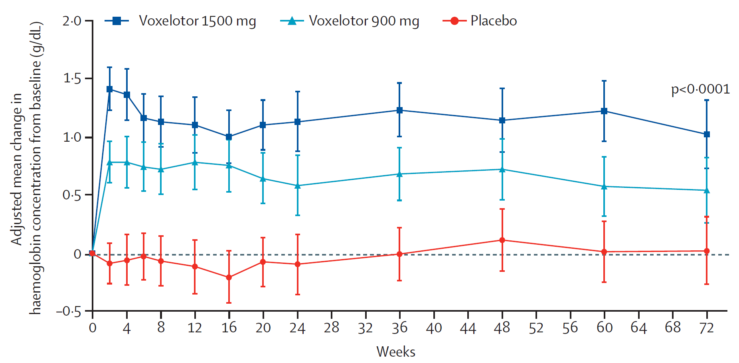
HOPE trial results At week 24, voxelotor 1500mg* has higher proportion of people with Hb increase of >1g/dL than placebo
CONFIDENTIAL
 | Voxelotor 1500 mg (N = 90) | Voxelotor 900 mg* (N = 92) | Placebo (N = 92)
Response, n (%) | 46 (51.1%) [95% CI: 41, 61] | 30 (32.6%) | 6 (6.5%) [95% CI: 1, 12 ]
Figure 4 Secondary outcome, Hb change from baseline, ITT population
To inform the economic model, treatment effect data from voxelotor 1500mg arm of HOPE stratified by use of HC. The impact of Hb changes on SCD complications is based on time-to-event analysis using evidence from UK CPRD-HES database
*1500mg is licensed dose. People on placebo & 900mg switched to 1500mg in OLE extension trial (next slide)
Abbreviations: CI, confidence interval; Hb, haemoglobin; ITT, intention to treat; SCD, sickle cell disease; VOC, vaso-occlusive crisis
Notes:
Table 9 company submission

Slide 17
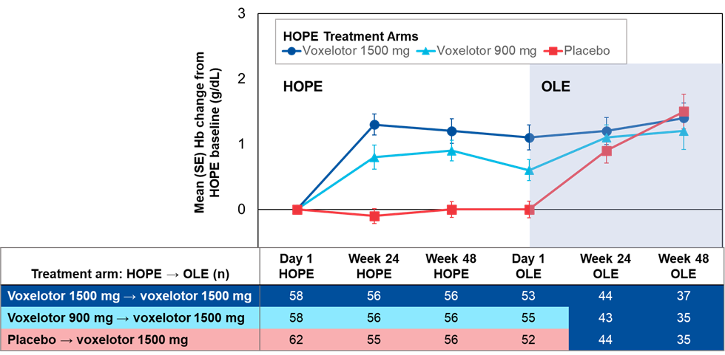
HOPE trial open-label extension (OLE)
People in placebo and voxelotor 900mg* arms in HOPE switched to voxelotor 1500mg in HOPE OLE
Median duration of voxelotor exposure in HOPE OLE = 69.9 weeks (range: 1.9-102.0 weeks)
78 people treated for ≥72 weeks. Of these, 52 previously received voxelotor in HOPE
People who received placebo in HOPE and subsequently received voxelotor 1500mg as part of HOPE OLE had a 1.3 g/dL Hb increase from baseline to Week 48 in HOPE OLE
People who received voxelotor 1500mg in HOPE and in HOPE OLE maintained Hb response until end of OLE
Figure 5 change in Hb response from HOPE study baseline to HOPE OLE week 48
*900mg voxelotor dose is not the licensed dose
Abbreviations: CPRD, Clinical Practice Research Database; HES, hospital episode statistics; Hb, haemoglobin; OLE, open label extension; SCD, sickle cell disease

Slide 18
Key issue: Unclear if an increase in Hb of >1g/dL is clinically meaningful for people with SCD (1/3)
Background
HOPE trial showed statistically significant difference in favour of voxelotor over placebo in numbers of people who experienced an increase in Hb of at least 1g/dL at week 24
EAG comments
Unclear whether an increase in Hb of > 1g/dL is clinically meaningful
Although statistically significant, effect of >1g/dL increase in Hb level on long term outcomes for HOPE trial population is not known
European Medicines Agency considers treatment with voxelotor has resulted in beneficial effect in terms of reduction in haemolysis and increase in Hb, which are considered of clinical relevance
Company
Clinical relevance confirmed by regulatory bodies
Increased Hb with voxelotor is a marker of reduced disease activity. Same is not true for transfusions, where increase in Hb not related to improvement in disease activity
Considerable evidence for relationship between higher Hb and improved outcomes in SCD
Evidence on non-Hb outcomes seen with voxelotor e.g. reduction in leg ulcers in HOPE trial, and reduction in hospitalisations and use of concomitant medication in Symphony database
Abbreviations: Hb, haemoglobin; SCD, sickle cell disease

Slide 19
Key issue: Unclear if an increase in Hb of >1g/dL is clinically meaningful for people with SCD (2/3) Real world evidence
Company
Symphony database
November 2019 = Voxelotor approved in US
Symphony database (Nov 2019 to June 2021) included people aged ≥12 years with SCD who started treatment with voxelotor
74 people had at least 1 Hb value measured both before and after treatment with voxelotor → Hb responses evaluated
Of these, 60.8% had change in Hb >1 g/dL at any time during follow-up. Increase in mean Hb concentration between pre- and post-index values was 1.1g/dL
HES/CPRD
Analysis of people with SCD in England by Telfer et al. found an increase in Hb of 1g/dL associated with statistically significant reduction in risk for 6 common EOD outcomes and clinical complications (leg ulcer, pulmonary hypertension, chronic kidney disease, end-stage renal disease, acute chest syndrome and stroke)
In response to TE, company used HES-CPRD dataset directly to derive TTE equations
Abbreviations: CPRD, Clinical Practice Research Database; EOD, end organ damage; Hb, haemoglobin; HES, hospital episode statistics; SCD, sickle cell disease; TTE, time to event; VOC, vaso-occlusive crisis

Slide 20
Key issue: Unclear if an increase in Hb of >1g/dL is clinically meaningful for people with SCD (3/3)
Patient and clinical expert comments
Real world evidence shows increase in haemoglobin of >1g/dL is clinically meaningful
Sustained increase in haemoglobin level by 1g/dL without a concomitant increase in frequency of vaso-occlusive episodes would be a clinically significant treatment response
From clinical trials and early access schemes, improved haemoglobin during treatment with voxelotor is associated with improved energy levels and improved functionality
Subgroup with very low haemoglobin level at steady state, for whom transfusion is not possible would have a clinically meaningful benefit from treating anaemia
EAG critique of company TE response
EAG reaffirmed its position that although HOPE trial showed statistically significant difference for voxelotor compared with placebo in number of people who had a Hb response, the effect of this improvement in Hb on long term outcomes is not known
Is an increase in Hb of >1g/dL clinical meaningful for people with SCD and clinicians?
Abbreviations: Hb, haemoglobin

Slide 21
Key issue: Impact of voxelotor on long-term complications is uncertain (1/2)
Background
Clinical effectiveness data from HOPE and OLE trial for a maximum of 144 weeks
EAG comments
Trial data do not provide evidence for long-term impact of voxelotor on development of SCD complications
Company TE response
HOPE trial not designed to show an effect on long-term complications
Modelled long-term outcomes using associations with Hb based on TTE equations derived from HES/CPRD databases and validated using equations from Symphony database
Use surrogate endpoints in chronic conditions. Relationship between Hb and complications robust
Endpoints in HOPE were Hb-related and not designed or powered to study impact on VOCs or other SCD-related complications. Voxelotor arm had numerically lower VOCs than placebo and a potential clinical benefit for leg ulcers (although not statistically significant)
Real-world evidence from US where voxelotor has been commercially available since 2019 → Published analysis demonstrated statistically significant reductions in annualised rates of hospitalisations, transfusions and VOCs, and reduced use of iron chelation and opioids
Abbreviations: CPRD, Clinical Practice Research Database; Hb, haemoglobin; HES, hospital episode statistics; OLE, open label extension; SCD, sickle cell disease; TTE, time to event; VOC, vaso-occlusive crisis

Slide 22
Key issue: Impact of voxelotor on long-term complications is uncertain (2/2)
EAG critique of company TE response
Considers RWE analysis of Symphony database to be at a high risk of bias because simple before and after study
Symphony database analysis results showed changes in event rates for people treated with voxelotor that were not reflected in HOPE trial results
Clinical expert comments
From clinical trials and early access schemes, improved Hb with voxelotor is associated with improved energy levels and improved functionality
Unknown if risk of certain chronic complications can be reduced through raising haemoglobin level by 1g/dL during treatment with voxelotor → area of uncertainty which will be hard to resolve until results of long-term follow-up studies on treatment are available
A reduction in risk of complications and time to onset of these chronic complications would be meaningful
Does voxelotor improve long-term complications of SCD compared with HC?
Abbreviations: Hb, haemoglobin; RWE, real world evidence; SCD, sickle cell disease

Slide 23
Cost effectiveness

Slide 24
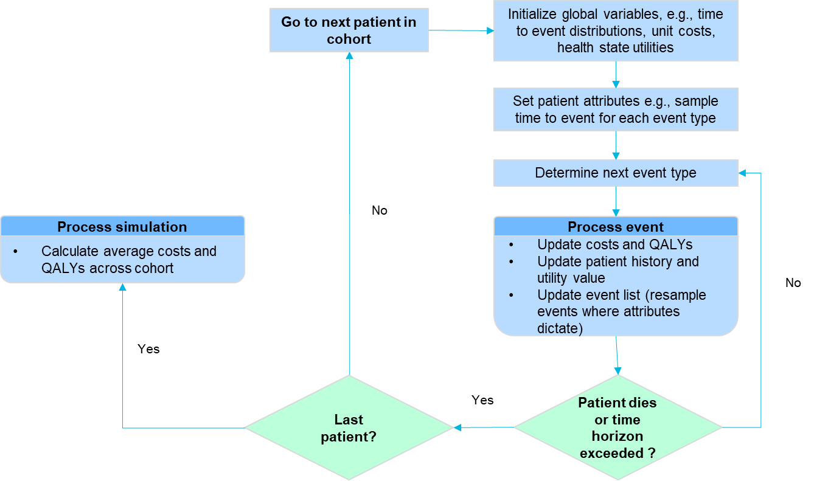
Company’s model overview
Figure 6 Company model structure
DES model where possible events are modelled on time to event basis.
Events modelled were SCD-related complications and death, treatment discontinuations
Biggest model driver is proportions of people in voxelotor and SoC arms who receive RTT
Complications included: ARF, arrythmias, CKD, ESRD, gallstones, heart failure, leg ulcers, osteomyelitis, osteonecrosis, pulmonary hypertension, sepsis, stroke, VOC
Abbreviations: ARF, acute renal failure; CKD, chronic kidney disease; DES: Discrete Event Simulation; ESRD, end stage renal disease; HC, hydroxycarbamide; RTT, regular transfusion therapy; SCD, sickle cell disease; SoC, standard of care; VOC, vaso-occlusive crisis

Slide 25
How company incorporated evidence into model
Table 6 Input and evidence sources
Input | Assumption and evidence source
Baseline characteristics | HES-CPRD database
Intervention efficacy | Proportion of Hb responders (>1g/dL increase in Hb) and Hb change from baseline from HOPE trial in the voxelotor 1500mg arm, by HC status
Comparator efficacy | Proportion of Hb responders (>1g/dL increase in Hb) and Hb change from baseline from HOPE trial in the placebo arm, by HC status
Utilities | Adjusted UK HRQoL population norms to match (for age and sex) HES-CPRD population then applied utility decrements due to complications and treatments from literature
Costs | Symptomatic management (opioids, ESA and RTT) costs based on weighted average of proportions from expert opinion Monitoring costs based on TA743 (crizanlizumab for preventing sickle cell crises in sickle cell disease) Acute and chronic complications and AE’s from NHS Reference Costs 2019/2020 and HOPE trial
Abbreviations: AE, adverse events; CPRD, Clinical Practice Research Database; ESA: erythropoietin stimulating agents; HC, hydroxycarbamide; HES, hospital episode statistics; RTT, regular transfusions therapy

Slide 26
Key issue: Uncertainty around the proportions of people receiving regular transfusion therapy (1/3) Impact of voxelotor on RTT use
CONFIDENTIAL
Background
In its model company assumed XX% in voxelotor arm and XXX% in SoC arm require RTT at baseline
Company
Recognise necessary to include RTT as a treatment in SoC arm
Consulted 9 English SCD clinicians in a modified Delphi panel exercise. In absence of any other data on proportion of people requiring RTT, this is best available data source
XXX% requiring RTT in SoC derived from a weighted average between those willing to take HC (XX%) and those unwilling (XX%)
Abbreviations: RTT, regular transfusion therapy; SCD, sickle cell disease; SoC, standard of care

Slide 27
Key issue: Uncertainty around the proportions of people receiving regular transfusion therapy (2/3) Impact of voxelotor on RTT use
CONFIDENTIAL
EAG comments
Potential cost effectiveness of voxelotor is dependent on preventing RTT
HOPE = no difference in use of rescue transfusion therapy, between voxelotor and placebo arms
Delphi panel → provided wide range of responses about level of RTT following treatment with:
Voxelotor (XX% to XX%) and
Standard of care (willing to take HC: XXX% to XXX%; unwilling to take HC: XX%)
Values used in model estimated by taking weighted average (methodology not reported)
EAG: voxelotor arm uses XX%; counterintuitive weighted average, given range was between XX% and XX%
With TA743 (crizanlizumab) committee accepted treatment led to RTT reduction, but:
Level of reduction derived from analysing data, rather than Delphi panel
Assumption considered highly uncertain
Inappropriate to include baseline differences in RTT rates and should have assumed same RTT rate in both arms or, preferably, modelled risk of having RTT at baseline
Will voxelotor use reduce RTT or stop RTT?
Is an assumption of XX% in voxelotor arm and XX% in SoC arm requiring RTT at baseline appropriate?
Abbreviations: HC, hydroxycarbamide; RTT, regular transfusion therapy; SoC, standard of care

Slide 28
Key issue: Uncertainty around the proportions of people receiving regular transfusion therapy (3/3) Modelling of RTT benefits
CONFIDENTIAL
Background
Model assumes people who receive RTT have an increase in Hb of XXX g/dL based on analysis of Symphony data
RTT use biggest factor influencing costs
Company
In Symphony, 28 days after infusion people experience Hb increase of XX g/dL. Company clinical advice was RTT involves a transfusion every 6 weeks, and increase in Hb level that occurs following a transfusion declines after 3 weeks. Therefore, divided value derived from Symphony, XX g/dL in half = XXX g/dL
EAG comments
EAG considers approach to deriving an estimate for effect of RTT on Hb level is not logical
Symphony data analysis relates to Hb level at 4 weeks following a transfusion, and therefore Hb increase seen at 3 weeks (XX g/dL) should be at least as high as increase seen at 4 weeks
In model, RTT costs XXXXX per year, generates disutility of XXX and has limited effect on Hb level (and, therefore, on long term complications) → question if model failing to adequately capture RTT benefits
Does the model adequately capture any benefits of RTT?
Is a XXX g/dL or XXX g/dL increase in Hb following RTT appropriate?
Abbreviations: dL, decilitre; Hb, haemoglobin; RTT, regular transfusion therapy; SCD, sickle cell disease; SoC, standard of care

Slide 29
Key issue: modelled impact of treatment with voxelotor on HRQoL is not supported by trial evidence (1/3)
CONFIDENTIAL
Background
Company assumed increase in Hb with voxelotor in HOPE translates into increase in utility.
However, no evidence of this from EQ-5D data in HOPE at 72 weeks
Company used analysis of EQ-5D data from the Patient Journey Survey of people with SCD to assess relationship between Hb levels and HRQoL. Used linear models of utilities as a function of Hb.
Estimated utility per 1g/dL increase in Hb was XXXX using EQ-5D → applied in model irrespective of treatment arm
EAG comments
EAG considers the trial finding can be interpreted in one of four ways:
voxelotor does not improve Hb levels enough to influence utility as measured by EQ-5D
EQ-5D not a useful tool for capturing changes in HRQoL in people with changing Hb levels
people experience HRQoL benefit from raised Hb levels, but is outweighed by AEs linked to voxelotor
other issues not relating to Hb
No evidence from HOPE to demonstrate raised Hb levels in voxelotor arm resulted in increased utility → casts doubt on whether company should have included such a benefit in its model
Abbreviations: AE, adverse events; Hb, haemoglobin; SCD, sickle cell disease; SoC, standard of care; QoL, quality of life

Slide 30
Key issue: modelled impact of treatment with voxelotor on HRQoL is not supported by trial evidence (2/3)
CONFIDENTIAL
Company TE response
Common for Phase III trials and in rare diseases, to show no significant difference in HRQoL
Company comments | Explanation
Missing data from HOPE trial | XXX90 in placebo and XXX90 in voxelotor arms had baseline EQ-5D. XX and XX respectively had change from baseline value at week 24, and XX in both arms at week 72
High baseline EQ-5D values | Mean baseline utilities higher than literature values and very close to population norms. Baseline EQ-5D not reflect burden of disease and difficult to detect improvements
Effect of long term complications on HRQoL not captured in HOPE | Voxelotor’s HRQoL benefit is through prevention of long-term complications. Not captured in trial EQ-5D data due to short duration
Validity of EQ-5D in SCD | OHE report generic measures of HRQoL like EQ-5D in certain contexts fail to capture relevant aspects of QoL. In SCD there has been little research testing validity of EQ-5D. Fatigue, a major component of SCD, is also not captured explicitly in EQ-5D and may lack validity
Abbreviations: OHE, Office of Health Economics; SCD, sickle cell disease; QoL, quality of life

Slide 31
Key issue: modelled impact of treatment with voxelotor on HRQoL is not supported by trial evidence (3/3)
EAG critique of company TE response
Disagree HOPE trial utilities very close to population norms and EQ-5D not valid in SCD
In HOPE, voxelotor arm had a mean age of 24 years and a mean utility of 0.86, vs. general population, utility decrement for SCD without RTT is approx. 0.08
0.08 utility decrement suggests EQ-5D is valid measure in SCD
Considers relationship between Hb and utility is complex and unlikely linear
EQ-5D completion rates <100% at baseline and declining over time does not invalidate HOPE trial finding that change in utility value over time was not statistically significant
Clinical and patient expert comments
Trial did not adequately capture range of decrement in QoL experienced by people living with SCD who might be eligible for voxelotor → likely due to not fit for purpose nature of QoL questionnaires used
Baseline QoL in SCD completely different from general population and not same as other people with SCD
HRQoL instruments are “not fit for purpose” for people living with chronic disorders
Is there an impact of voxelotor on HRQoL?
Has the impact of voxelotor on HRQoL been captured appropriately in the model?
Abbreviations: Hb, haemoglobin; RTT, regular transfusion therapy; SCD, sickle cell disease

Slide 32
Key issue: Methods to generate TTE probabilities are not robust (1/2)
Background
Company carried out accelerated failure time regression analyses to link Hb levels from HOPE with SCD complications over model time horizon
Used Symphony (US based population) database to derive TTE data due to larger sample size and more complete recording of Hb levels than UK source (HES-CPRD database)
To improve applicability of Symphony to UK SCD population, MAIC was undertaken match population to UK SCD population characteristics found in HES-CPRD
Company
In original submission, used Symphony equations, however, following concerns over matching methodology, and with new parameterisation of equations, company updated base case after technical engagement using HES-CPRD equations
No longer requirement to match US Symphony database to UK SCD population
Provided scenario analyses with Symphony database → small impact on cost-effectiveness results
Abbreviations: AFT, accelerated failure time; CPRD, Clinical Practice Research Database; Hb, haemoglobin; HES, hospital episode statistics; SCD, sickle cell disease; TTE, time to event; VOC, vaso-occlusive crisis

Slide 33
Key issue: Methods to generate TTE probabilities are not robust (2/2)
EAG comments
HES-CPRD included those who had ≥3 confirmed SCD secondary care interactions before baseline Hb
Company state this was “to identify a subgroup of patients with SCD who experienced severe disease requiring hospital treatment which may indicate unmet clinical need, despite standard treatment, and thus may benefit from novel treatments”
HES-CPRD → included only 34.85% of people who had a VOC during 12 months before
In contrast, all people in HOPE had at least 1 VOC during 12 months before enrolment and approximately 60% had at least 2 VOCs
Unclear whether company TTE analysis relates to a population with more or less severe disease than HOPE trial population. Also unclear why analysis was not limited to those who met HOPE inclusion criteria → 1-10 VOCs in last 12 months
Mean age in TTE analysis = XX years; median age in HOPE trial = 24 years. Age difference suggests TTE analysis probabilities may not be directly applicable to HOPE trial population
Using index Hb level to generate TTE probabilities is overly simplistic. Company TTE probabilities relate to only 1 Hb level at a specific point in time and not to how changes to Hb level affect probability of experiencing a complication
Is the company updated method to generate TTE probabilities using equations directly from HES-CPRD appropriate?
Abbreviations: CPRD, Clinical Practice Research Database; HES, hospital episode statistics; SCD, sickle cell disease; TTE, time to event; TE, technical engagement; VOC, vaso-occlusive crisis

Slide 34
CONFIDENTIAL
Summary of company and EAG base case assumptions
Assumption | Company base case | EAG base case
Efficacy data | HOPE trial | HOPE trial
RTT benefit | XX% in voxelotor arm and XXX% in SoC arm require RTT at baseline. Benefit of RTT = increase in Hb of XXX g/dL | RTT rate of XX% for voxelotor and for SoC. Benefit of RTT = increase in Hb of XX g/dL
Utility benefit | Utility increment per 1g/dL increase in Hb was calculated to be XXXXXXXXXXXX | No utility benefit associated with increase in Hb level
RTT and HC discontinuations | RTT: 5% / HC: 5% | RTT: 5% / HC: 5%
Voxelotor discontinuation rates | Stratified by responder (XXX%) and non-responder (XXX%) per year | Stratified by responder (XXX%) and non-responder (XXX%) per year
Population | Proposed population is second line. Comparator is mix of HC, RTT, RTT+HC or nothing. | All patients eligible for voxelotor
Waning effect | Not included | Not included
TTE equations | HES/CPRD | HES/CPRD
Abbreviations: CPRD, Clinical Practice Research Database; Hb, haemoglobin; HC, hydroxycarbamide; HES, hospital episode statistics; RTT, regular transfusion therapy; SCD, sickle cell disease; TTE, time to event; VOC, vaso-occlusive crisis

Slide 35
QALY weightings for severity (1/3)
New severity modifier calculations and components:
QALY weight | Absolute shortfall (AS) | Proportional shortfall (PS)
1 | Less than 12 | Less than 0.85
X 1.2 | 12 to 18 | 0.85 to 0.95
X 1.7 | At least 18 | At least 0.95
QALYs people without the condition (A)
QALYs people with the condition (B)
Health lost by people with the condition:
Absolute shortfall: total = A – B
Proportional shortfall: fraction = ( A – B ) / A
*Note: The QALY weightings for severity are applied based on whichever of absolute or proportional shortfall implies the greater severity. If either the proportional or absolute QALY shortfall calculated falls on the cut-off between severity levels, the higher severity level will apply
Abbreviations: QALY, quality-adjusted life year

Slide 36
CONFIDENTIAL
QALY weightings for severity (2/3)
 | QALYs of people without condition (based on trial population characteristics) | QALYs with the condition on current treatment | Absolute QALY shortfall (has to be >12) | Proportional QALY shortfall (has to be >0.85)
Company base case | XXXX | XXXX | XXXX | XXXX
EAG base case | XXXX | XXXX | XXXX | XXXX
Background
In its original submission, company base case met the x1.2 modifier. However, following changes at clarification, it no longer meets the QALY shortfall
Company
Calculation does not fully capture severity of SCD in those who would be treated with voxelotor
SCD is a rare life-long genetic condition which may be clinically impactful from an early age
SCD is progressive and associated with a wide range of acute and chronic complications, progressive organ damage, and a 20-30-year reduction in life expectancy
Estimated mean age of death in model for SoC is XX years. Implies a material loss in life expectancy versus average age of general population
Despite SCD being acknowledged as a severe disease, it does not meet highest levels of severity
Strongly believe should qualify for highest level of severity, which reflects 1.7 QALY weight
Abbreviations: SCD, sickle cell disease; SoC, standard of care; QALY, quality-adjusted life year

Slide 37
QALY weightings for severity (3/3)
Company
Calculation also does not fully capture QALY shortfall of people entering the model
People enter the model at 35 years old and will have had sickle cell disease since birth
Therefore, the calculation does not incorporate 35 years of QALY loss compared to the general population
Suggests a limitation of the severity modifier methodology, that biases against conditions which are inherited at birth, but for which treatment might begin later
Technical team comments
Characteristics of the population in the company model does not reflect the population covered by the marketing authorisation or the population included in the HOPE clinical trial e.g. marketing authorisation and HOPE trial younger than model population
The 2022 NICE health technology evaluations manual states the severity of the condition is defined as the future health lost by people living with the condition treated with standard care in the NHS
Has the company model accurately captured severity of disease?
Abbreviations: QALY: quality-adjusted life year

Slide 38
CONFIDENTIAL
Cost-effectiveness results and scenarios
All ICERs are reported in PART 2 slides because they include confidential discounts
Company base case ICER > £30,000/QALY
EAG base case ICER > £30,000/QALY
Company base case assumptions
Utility increment per 1g/dL increase in Hb was calculated to be XXXX
XX% in voxelotor arm and XX% in SoC arm requiring RTT at baseline
XXX g/dL increase in Hb with RTT
Multiplicative utility values for SCD complications
TTE dataset from HES-CPRD
HOPE trial Hb evaluation at 24 weeks
EAG revisions applied to company base case
No direct utility increase associated with an increase in Hb level
Setting the RTT rate to be XX% for the voxelotor and Soc arms
Scenarios applied to company base case:
Utility values for SCD-associated complications applied additively
TTE dataset from Symphony
HOPE trial Hb evaluation: at 72 weeks
HOPE trial Hb evaluation: over 72 weeks
Hb level increases by XX g/dL for patients receiving RTT
EAG base case
Abbreviations: CPRD, Clinical Practice Research Database; HB, haemoglobin; HES, hospital episode statistics; RTT, regular transfusion therapy; SCD, sickle cell disease; TTE, time to event

Slide 39
Innovation: Company consider voxelotor innovative
Company
Innovative, addresses unmet need, in a population that suffers health and socio-economic inequalities
Granted Promising Innovative Medicine status and was selected for Early Access to Medicines Scheme
Only approved treatment to address HbS polymerisation
Monotherapy or in addition to HC → step change in management for second-line treatment after HC and may otherwise require chronic transfusions
Effects of voxelotor have potential to produce benefits that are not captured in QALY calculation:
oral treatment and alternative to blood transfusions, reducing need for transfusion-related hospital visits and reducing anxiety over potential adverse effects from transfusions
benefits for NHS from reduced demand for blood transfusions in people with SCD
increase ability to study and work
reduce anxiety about long-term progression of symptoms
Clinical expert:
For a subset with very low haemoglobin, symptomatic anaemia and who cannot have transfusions, voxelotor may be only treatment option, and if not available, would deprive this group of potentially life-saving therapy
HRQoL instruments are not fit for purpose for people living with chronic disorders
Have any benefits of voxelotor not been captured in the model?
Is voxelotor a step-change in treatment of SCD?
Abbreviations: EMA, European Medicines Agency; HbS; sickle β-globin haemoglobin; HC, hydroxycarbamide; HRQoL, health related quality of life; MHRA, Medicines and Healthcare products Regulatory Agency; RBC, red blood cells; SCD, sickle cell disease

Slide 40
Managed access (1/2)
Criteria for a managed access recommendation
The committee can make a recommendation with managed access if:
the technology cannot be recommended for use because the evidence is too uncertain
the technology has the plausible potential to be cost effective at the currently agreed price
new evidence that could sufficiently support the case for recommendation is expected from ongoing or planned clinical trials, or could be collected from people having the technology in clinical practice
data could feasibly be collected within a reasonable timeframe (up to a maximum of 5 years) without undue burden.

Slide 41
Managed access (2/2)
The company have not submitted a managed access proposal
Voxelotor, as a promising new medicine with potential resolvable uncertainty, may be a candidate for managed access through the Innovative Medicines Fund
To consider a recommendation with managed access, the committee need a managed access proposal (requested as part of the company submission) along with a feasibility assessment from NICE (normally expected approximately 4 weeks prior to the committee meeting)
The managed access team have been in contact with the company to discuss managed access and request a managed access proposal
The company has not made a managed access proposal for this medicine
Are the uncertainties potentially resolvable through a period of managed access?
Does the company plan to submit a managed access proposal?

Slide 42
Thank you.
© NICE 2022. All rights reserved. Subject to Notice of rights.

