Slide 1
Antimicrobials evaluation committee
Pre-meeting briefing
Ceftazidime with avibactam (CAZ-AVI) for treating severe aerobic Gram-negative bacterial infections
January 2022

Slide 2
Information on slide set
This slide set is the pre-meeting briefing for this evaluation. It has been prepared by the NICE technical team with input from the committee chair, and vice-chair and lead team. It is sent to the committee before the committee meeting as part of the committee papers. It summarises:
the assessment report from EEPRU (the Policy Research Unit in Economic Methods of Evaluation in Health & Social Care Interventions)
the key evidence and views submitted by the company
consultation comments received on EEPRU’s report from Pfizer, BSAC (British Society for Antimicrobial Chemotherapy) and RCPath (Royal College of Pathologists), Intensive Care Society, Clinical expert, ANTRUK (Antibiotic Research UK), MSD, APRHAI (Advisory Committee on Antimicrobial Prescribing, Resistance and Healthcare Associated Infections), NHS England and Improvement, Shionogi and BIA (British Infection Association)
It highlights key issues for discussion at the committee meeting and should be read with the full supporting documents for this evaluation.
It does not include EEPRU’s response to consultation comments (provided separately).
The lead team may use, or amend, some of these slides for their presentation at the committee meeting.

Slide 3
Table of contents
Context and background for the evaluation
Overview of EEPRU’s modelling approach
Clinical effectiveness evidence
Economic analysis
Company economic model
EEPRU model methods
Estimating patient-level QALYS for high value clinical scenarios
Estimating population-level QALYS for high value clinical scenarios
Estimating population-level QALYS for expected usage
EEPRU model results
Per-patient results
Population results
Additional elements of value
Key issues for committee discussion

Slide 4
Context and background for the evaluation

Slide 5
Evaluation background
Antimicrobial resistance a global challenge
Despite ↓ antimicrobial use, drug-resistant bloodstream infections in humans ↑ by 35% from 2013–2017 in England.
There are few alternative products in development, and fewer that target priority pathogens.
Investment in novel antimicrobials as commercially unattractive – high R&D costs and low returns have led to market failure.
The market for antimicrobials may be limited in several ways
New products active against priority pathogens should be subject to strict stewardship and used on a last in line basis. In the absence of significant outbreaks of drug-resistant infections, sales could be minimal
Under such strict stewardship, it might be several years before sales increase ie the majority of the value might be after the patent period, and manufacturers won’t recoup costs
New products offering alternative options to existing antibiotics, which could potentially be valuable as part of “cycling” stewardship regimes, tend not to be used due to their high cost compared to existing products (many of which are generics)
NICE are working with NHS England and NHS Improvement (NHSE&I) to test a new health technology evaluation process and a new payment model. This will mean the payments made to companies are based primarily on their value to the NHS, and not linked to the volumes of antimicrobial sold.

Slide 6
What is the aim of the evaluation?
Committee estimate the total value of the antimicrobial to the NHS in England, measured in population incremental net health effects (quality-adjusted life years [QALYs])
NSHE&I and company agree fixed annual fee for company for contract duration, regardless of volume of drug sold (‘delinked payment model’)

Slide 7
The contract
Subscription-based payments, independent of volumes sold
Payments based on value of benefits to patients and NHS
value estimated through NICE committee evaluation, informed by EEPRU analysis
Payments capped at £10 million per year, per drug
3–10 year term
Confidential hospital purchase price, set to encourage appropriate use and discourage inappropriate use
Contract also includes performance requirements to ensure availability and stewardship
minimum stock holding within England and within supply chain
compliance with stewardship, manufacturing, environmental and surveillance requirements

Slide 8
6 key questions for committee
What are the most relevant comparators?
What is the total lifetime value (Incremental Net Health Effects [INHE]) of the antimicrobial to the NHS (QALYs)?
→ Refers to lifetime of product rather than lifetime of treated individuals.
Are there any benefits that haven’t been adequately captured in this value estimate?
What is the annual value of the antimicrobial for the 10-year contract duration (QALYs)?
→ Refers to proportion of lifetime value that should be attributed to contract in order to address market failure, rather than simply the value accrued in first 10 years of product lifetime
What are the committee’s stewardship recommendations?
How can data collection and surveillance be improved to capture missing data and reduce uncertainty?

Slide 9
Overview of EEPRU’s modelling approach
What do we mean by high value clinical scenarios and why do we need them?

Slide 10
CAZ-AVI has a broad marketing authorisation with a range of potential uses (not all expected in practice)
Marketing authorisation: Adults & paediatric patients (≥3 months) with complicated intra-abdominal infections; complicated urinary tract infection; hospital-acquired pneumonia, including ventilator-associated pneumonia; bacteraemia (adults only) associated with the aforementioned infections; and infections caused by aerobic gram-negative organisms with limited treatment options.”
The marketing authorisation covers:
Different pathogens (eg Enterobacterales, Pseudomonas aeruginosa, Acinetobacter baumannii)
Different resistance mechanisms
Carbapenemase-mediated (carbapenemases = enzymes that hydrolyse carbapenem antibiotics) eg Klebsiella pneumoniae carbapenemase (KPC), oxacillinase (OXA), metallo-beta-lactamases (MBL)
Non-carbapenemase-mediated: reduced cell membrane permeability to antibiotics eg overexpression of efflux pumps, downregulation of porins
Different infection sites (e.g. lung, urinary tract, bloodstream)
But CAZ-AVI does not have activity against all of these pathogens and resistance mechanisms

Slide 11
Not possible to model every population → EEPRU selected ‘high value clinical scenarios’ for patient-level model
High value clinical scenarios (HVCS) = populations where greatest clinical benefit expected
EEPRU identified HVCS in consultation with clinical advisors during scoping and protocol development
Several HVCS, divided across 2 settings that CAZ-AVI would be used, included in patient-level model:
Empiric treatment for clinically urgent infections - strong clinical suspicion (risk) of the pathogen-resistance mechanism, based on fulfilling one of the following criteria:
patient previously hospitalised in setting with high prevalence of pathogen of interest
ward outbreak
previous cultures (during current/previous hospital stay) show infection/colonisation
Microbiology directed treatment for slower progressing infections - treatment based on pathogen’s susceptibility profile (microbiological susceptibility testing and gene testing performed)
To reflect value of CAZ-AVI’s expected usage, EEPRU estimated QALYs in other populations (not included in model) by estimating patient numbers and assuming the same incremental health benefits as in HVCS.

Slide 12
Company’s definition of patients at high risk of a drug-resistant infection was broader than EEPRU’s
Company’s criteria for higher risks of resistance included any of the following:
previous admission to intensive care unit
longer admission times
critical illness
use of invasive devices
symptoms or signs starting more than 5 days after hospital admission
relevant comorbidity such as severe lung disease or immunosuppression
recent use of broad-spectrum antibiotics
colonisation with multi-drug-resistant bacteria
prior antibiotic therapy including cephalosporin, carbapenem or fluoroquinolone use
recent contact with a health or social care setting before current admission
What criteria should be used to define high-risk patients eligible for empiric treatment?

Slide 13
EEPRU’s approach to quantifying value in HVCS and extrapolating to expected usage in NHS
3. Population-level QALYs for expected usage (ie outside HVCS)
Rescaling of HVCS QALYs,
based on population sizes (PHE data) and assumptions (expert consultation)
2. Population-level QALYs for HVCS
Assessment of whether important sources of value missed from quantification (‘STEDI’ values) – see slides on economic analysis
Quantitative modelling, forecasting population size and trends in usage and resistance over time
1. Patient-level QALYs for HVCS
Quantitative modelling, similar to ‘normal’ NICE appraisal

Slide 14
High value clinical scenarios (patient-level model)
 | Microbiology-directed setting (MDS) | Risk-based empiric setting (ES)
Pathogen | Confirmed Enterobacterales with OXA-48 mechanisms of resistance | Suspected Enterobacterales with OXA-48 mechanisms of resistance
Infection site | complicated urinary tract infection (cUTI) hospital-acquired pneumonia & ventilator-associated pneumonia (HAP/VAP) | HAP/VAP
Intervention | CAZ-AVI as monotherapy (lack of in vivo or in vitro evidence about combination therapy) | Same as for microbiology-directed treatment
Outcomes | All-cause mortality Clinical cure (complete resolution of signs/symptoms of the index infection such that no further antimicrobial therapy is needed) Microbiologic eradication Emergence of resistance Hospital days and intensive care unit (ICU) days Readmission rate within 90 days of treatment Number of treatment days Health-related quality of life Adverse events (AE) (including those associated with Clostridium Difficile infection and renal toxicity) | Same as for microbiology-directed treatment

Slide 15
Additional expected usage
 | Expected usage included in EEPRU analysis | Potential uses not included in EEPRU analysis | Rationale for not including in EEPRU analysis
Pathogen | Only the pathogens described as part of the high value clinical scenarios | Pseudomonas Aeruginosa | Carbapenemase-mediated resistance is Pseudomonas Aeruginosa is rare, and usually via MBL production, against which CAZ-AVI has no activity
Resistance mechanism | Only the resistance mechanisms described as part of the high value clinical scenarios | KPC Serine carbapenemases Non-carbapenemase mechanisms | Other treatment options available → low priority
Site of infection | Bloodstream (including sepsis) Intra-abdominal
Patients with specific underlying conditions, with pathogen & infection site outside HVCS |  | burns renal complications compromised immune system cystic fibrosis | Uncertainty about whether these patients experience infections at different sites, or caused by different pathogens, to those defined in HVCS, where CAZ-AVI offers incremental benefit

Slide 16
Consultation comments – population
Population too narrow | Population appropriate | Population too broad
Pfizer: substantially more patients already receive CAZ-AVI in the UK (~1,400 patients) than are modelled by EEPRU + real world usage expected to increase in future – Population included should reflect current population and marketing authorisation MSD: High-value scenarios very narrow and may not reflect real world usage. APRHAI: should include non OXA-48 mechanisms of resistance Clinical expert: CAZ-AVI likely to be used in other scenarios including some non MBL producing Pseudomonas organisms and Serratia due to either toxicity, intolerability to other agents or drug interactions/ QTc prolongation | BSAC and RCPath: CAZ-AVI unlikely to be used in all populations covered by marketing authorisation; it will be restricted to select groups of vulnerable patients with resistant Gram-negative infections, mediated by carbapenemases. | BIA: Empiric use is not appropriate should not have been modelled BSAC and RCPath: Narrower use in empiric setting more accurate on short term – Broader use possible on long term BSAC and RCPath: use of meropenem in these infections will often mean that treatment is not escalated to CAZ-AVI BIA: Not all cases of HAP/VAP require antimicrobial treatment

Slide 17
Accounting for benefit in the expected usage population – key issues
Is the magnitude of incremental health benefit in the high value clinical scenarios generalisable to wider expected usage?
Are there groups of patients which have been excluded from the analysis, who are likely to benefit from the intervention compared with current treatment options?
Is the magnitude of incremental health benefit in any excluded population the same as the benefit in the high value clinical scenarios?

Slide 18
Comparators
Microbiology-directed setting
meropenem + colistin
fluoroquinolones (levofloxacin, ciprofloxacin) + meropenem
aminoglycosides (gentamicin, amikacin, tobramycin)
If low risk of ESBL and AmpC beta-lactamase suggested by susceptibility testing:
cephalosporins (ceftriaxone, cefepime, ceftazidime)
aztreonam + fosfomycin
aztreonam + colistin
For HAP/VAP the following comparators may be included also:
tigecycline + colistin
tigecycline + meropenem + colistin
aminoglycosides (gentamicin, amikacin, tobramycin) may be used in combination with fosfomycin instead of as monotherapy
Risk-based empiric setting
meropenem + colistin
fluoroquinolones (levofloxacin, ciprofloxacin) + meropenem
aminoglycosides (gentamicin, amikacin, tobramycin) + fosfomycin
tigecycline + colistin
tigecycline + meropenem + colistin
All comparators used in network meta-analysis to estimate relative effectiveness of CAZ-AVI
Simplified approach taken in model: patients classified by whether they're susceptible to colistin/aminoglycoside based therapy or not (see slide 59)
Have all appropriate comparators been captured?

Slide 19
Clinical effectiveness evidence

Slide 20
Company used RCT data to inform treatment efficacy in its economic model
Trial | Design | Comparator | Population | Endpoint
REPROVE | Non-inferiority | meropenem | Adult HAP/VAP | Proportion of clinically cured patients at test-of-cure (TOC) visit
RECAPTURE 1 and 2 | Non-inferiority | doripenem | Adult cUTI | Proportion of patients with symptomatic resolution of UTI-specific symptoms and both microbiological eradication and symptomatic resolution of UTI-specific symptoms at TOC
RECLAIM 1 and 2 | Non-inferiority | meropenem | Adult cIAI (Global trial) | Proportion of clinically cured patients at the TOC visit
RECLAIM 3 | Non-inferiority | meropenem | Adult cIAI (Asian population) | Same as RECLAIM 1 and 2
REPRISE | Superiority | best available therapy | Adult cUTI or cIAI | Proportion of patients with clinical response (cure, failure, or indeterminate) at the TOC visit
The RECLAIM trials and ANDI trial investigated CAZ-AVI in combination with metronidazole. All others focus on CAZ-AVI alone
Source: Company’s submission Table 45
CAZ/AVI: ceftazidime/avibactam; cIAI: complicated intra-abdominal infection; cUTI: complicated urinary tract infection; HAP: hospital-acquired pneumonia; VAP: ventilator-associated pneumonia.

Slide 21
EEPRU explored 3 possible sources of clinical evidence for economic analysis of HVCS
Source | Strengths | Limitations
RCT data | High internal validity (low risk of bias) | Non-inferiority trials in susceptible infections → data not generalisable to populations of interest (resistant infection)
Observational studies | Potential for larger sample sizes | High risk of confounding and uncertainty due to imbalance between baseline prognostic and/or predictive factors Need individual patient data for adjustment methods Single arm studies require advanced techniques
In vitro susceptibility studies | All drugs tested in same set of isolates: high internal validity and reduced heterogeneity between arms Specific to pathogen /resistance mechanism of interest Better coverage of comparators Larger sample sizes Can be used alongside highly relevant data from PHE | Need to link susceptibility surrogate to clinical outcomes Minimal literature on link → EEPRU relied on expert elicitation for 30-day survival, length of hospital stay and time spent on ward No data for treatment combinations Many sources of heterogeneity, including: lab methods and breakpoints (EUCAST or CLSI) sample selection criteria, age and location comparators in other countries International results may not be generalisable to UK (different distribution of pathogens & resistance)

Slide 22
Limitations of the studies identified
RCTs (EEPRU identified 4 studies)
Low relevance to HVCSs:
most RCTs not conducted exclusively in population of interest
2 studies included OXA-48 infections, but:
low numbers of OXA-48 infections
data for OXA-48 infections not reported separately
outcomes for comparator arms, and therefore relative treatment effect, not generalisable to highly resistant infections
Not possible to construct an evidence network with comparators of interest in sites of interest
Observational data (EEPRU identified 6 studies)
Low relevance to HVCSs:
All studies included OXA-48 infections but data for sites of interest (cUTI and HAP/VAP) not reported separately
Difficult to adjust for confounding (and therefore data couldn’t be used) because:
small sample sizes
highly heterogeneous in terms of characteristics and prognostic factors
insufficient time to obtain individual patient data from authors
Because of these limitations, EEPRU used in vitro susceptibility studies to estimate comparative effectiveness in its economic analyses

Slide 23
EEPRU developed its own tool to quality assess susceptibility studies (no published tools exist)
EEPRU’s tool to assess bias and relevance of susceptibility studies was based on:
2 tools developed for assessing prevalence studies (because studies report the prevalence of susceptibility)
risk of bias in non-randomised studies (ROBINS)-1 checklist for non-randomised studies (because studies are comparative, but non-randomised)
Cochrane’s risk of bias 2 (RoB2) tool (because EEPRU’s network meta-analysis assumes the study arms are equivalent to randomised arms of an RCT),
Newcastle Ottawa Scale for assessing observational studies (because susceptibility studies are observational).
Questions from all tools considered for inclusion and adapted to the specifics of this review
Tool reviewed by other members of the EEPRU team, but no further validation work undertaken

Slide 24
How is susceptibility to antimicrobials assessed?
Key terminology
Minimum inhibitory concentration (MIC): Lowest concentration of drug required to stop bacterial growth
MIC90 = the concentration at which 90% of isolates are inhibited
Clinical breakpoint for an isolate: A concentration threshold used to assess the likelihood of a treatment succeeding or failing
Interpretation
MIC ≤ clinical breakpoint: susceptible infection (treatment likely to succeed)
MIC > clinical breakpoint: resistant infection (treatment likely to fail)
Infections can be classed as intermediate susceptibility – definitions vary
Bacterial isolate taken from patient and cultures grown in vitro
Antimicrobial applied at increasing concentrations to separate cultures – degree of microbial growth assessed
Percentage of isolates susceptible at or below breakpoint reported
Example of susceptibility testing results for 3 drugs (10 isolates each) – green cells indicate concentrations at or below breakpoint for each drug. Final column reports total % of isolates at or below breakpoint
Concentration (mg/L) | 0.25 | 0.5 | 1.0 | 4.0 | >8.0 | % susceptible
Drug X Breakpoint 2 mg/L |  |  |  | 6 | 4 | 0%
Drug Y Breakpoint 0.5 mg/L | 5 | 5 |  |  |  | 100%
Drug Z Breakpoint 1 mg/L | 4 | 3 | 2 | 0 | 1 | 90%

Slide 25
Different approaches to setting clinical breakpoints
EU based: Recommended by British Society for Antimicrobial Chemotherapy → used in base case in EEPRU economic model
US based → used in scenario analyses in EEPRU economic model
Different organisations use different analytical and laboratory methodologies to set breakpoints and measure minimum inhibitory concentrations → not directly comparable, ideally use laboratory methodology and breakpoints from same organisation
Definitions of intermediate susceptibility vary between the organisations
Clinical breakpoints are routinely reassessed and can change over time based on new evidence or methodological changes
EEPRU used PHE data – it is unclear what breakpoints and laboratory methods were used in PHE dataset
EUCAST breakpoints are under review – update due in January 2022 (EUCAST have proposed no change, subject to consultation)

Slide 26
Network meta analysis informed by susceptibility evidence identified by systematic literature review, supplemented by PHE data
Studies which used EUCAST breakpoints and laboratory methods used in economic model base case, because EUCAST used in UK
Although the laboratory methods and breakpoints used in the PHE dataset were unclear, EEPRU assumed that majority would comply with BSAC recommendations (ie EUCAST), and therefore included PHE data in base case
Studies using CLSI breakpoints &/or laboratory methods excluded from base case, because unclear extent to which breakpoints and lab methods were interchangeable
Scenario analyses tested impact of using all studies (regardless of whether they used EUCAST or CLSI laboratory methods or breakpoints), using PHE data alone, or using EUCAST studies which focussed on the resistance mechanism of interest (ie OXA-48, without MBL-mediated resistance, Vazquez-Ucha 2021)
PHE data alone was not selected for the base case because of the following limitations:
Data haven’t always been routinely submitted to PHE, and only submitted for invasive infections (may not be representative of true distribution of OXA-48 susceptibilities in England)
Variation in testing methods (may affect comparative effectiveness estimates), EEPRU excluded isolates not tested for all comparators (may introduce selection bias), data missing for comparators of interest: fosfomycin, levofloxacin and ceftriaxone
Full details of sensitivity analyses for the NMA are available in section 4.5.4 and appendix 7 of EEPRU’s report– the following slides focus on networks used in economic model base case and scenario analyses

Slide 27
Data informing network meta analysis (NMA) of susceptibility studies
Comparators
Ceftazidime, ceftriaxone, cefepime, tobramycin, gentamicin, colistin, amikacin, levofloxacin, ciprofloxacin, fosfomycin, tigecycline, aztreonam, meropenem
EUCAST
CLSI
Breakpoint methods unclear
Breakpoints
2
studies (n=374)
PHE data
(n=85)
6 studies (n=800)
7 studies
(n=201)
Data sources
Used in economic model
Base case
3 scenario analyses used in economic model:
all studies, regardless of breakpoint method
PHE data only
EUCAST studies in isolates without co-existing MBL mechanisms of resistance (only 1 study: Vazquez-Ucha 2021)
n = number of isolates

Slide 28
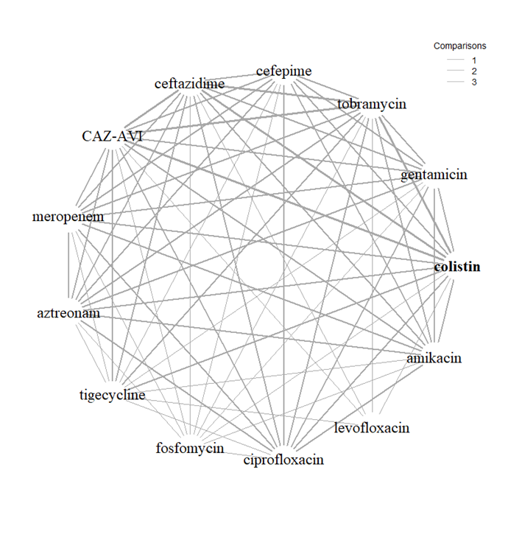
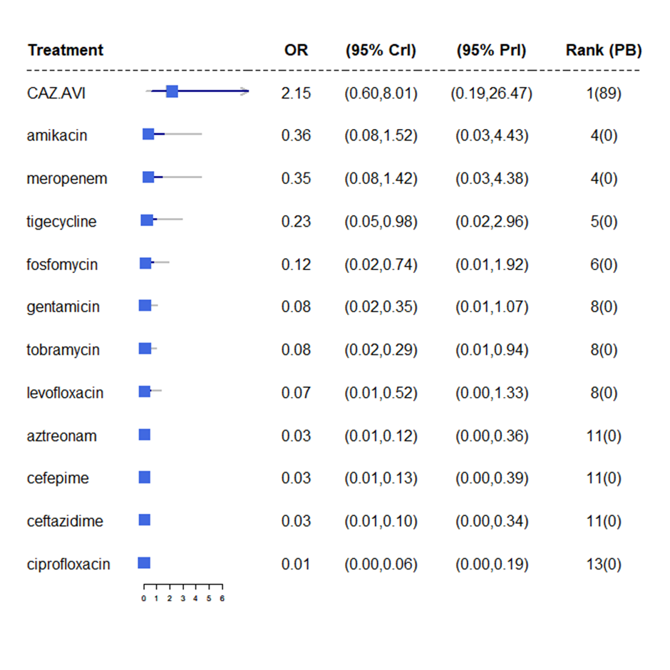
Susceptibility NMA results (1)
Base case network
Studies with EUCAST breakpoint and PHE data
Susceptibility relative to colistin
PB = probability of being the most effective treatment
CrI: Credible interval

Slide 29
Susceptibility NMA results used in model (2)
Scenario | Breakpoint | Data sources (n=number of studies) | Odds ratio versus colistin
Base Case | EUCAST | PHE data + all EUCAST studies (n=3) | 2.15 95% CrI 0.60 to 8.01 Not statistically significant
Scenario 2 | EUCAST+CLSI | PHE data + all studies regardless of lab methods/breakpoint (n=16) | 7.24 95% CrI 2.58 to 20.94 Statistically significant
Scenario 3 | Assumed EUCAST | PHE data only (n=1) | 1.56 95% CrI: 0.68 to 3.59 Not statistically significant
Scenario 4 | EUCAST | Studies of isolates without co-existing MBL mechanism of resistance (n=1) | 10.08 95% CrI: 3.54 to 28.70 Statistically significant
CrI: Credible interval

Slide 30
Consultation comments - Susceptibility evidence and breakpoints
BSAC and RCPath
Variation and lack of standardisation between EUCAST and CLSI decreased significantly thanks to standardisation work → CLSI widely used worldwide and acceptable alternative
Important that laboratories using EUCAST methodology interpret results using EUCAST breakpoints, similarly when using CLSI methodology interpret with CLSI breakpoints
Practice changed in the last 5 years for testing of colistin susceptibility → surveillance data may be unreliable.
Shionogi
NMA underestimates in vitro efficacy of CAZ-AVI compared with colistin:
CLSI recently removed category of ‘susceptible’ for colistin. EUCAST consulting on similar proposal.
CLSI and EUCAST don’t recommend colistin monotherapy because inadequate tissue concentration.
According to EEPRU’s modelling approach, any isolate previously considered susceptible to colistin should now be grouped with resistant isolates as ‘non-susceptible.’
Fosfomycin studies should be excluded from the NMA because methods aren’t relevant, robust or comparable with studies of other drugs. Fosfomycin is not a relevant comparator (expect in urinary tract infections).
Base case should combine EUCAST and CLSI data, because although breakpoints differ, methods are comparable → EUCAST breakpoints can be applied to data generated by CLSI method and vice versa.

Slide 31
Linking susceptibility data to clinical outcomes
Outcomes of interest
Mortality
Length of hospital stay
Type of hospital ward patients would stay
EEPRU’s assumptions
Outcomes the same regardless of the specific pathogen-mechanism causing the infection
Outcomes only change conditional upon pathogen’s susceptibility to treatment
Risk of AKI with aminoglycoside/colistin factored in
Results of literature review
Empiric setting:
2 studies reported mortality or length of hospital stay conditional on susceptibility to empiric treatment
Studies used for economic model
Microbiology-directed setting:
No relevant studies identified
Expert elicitation required
Is the relationship between susceptibility and outcomes likely to be constant across all antimicrobials?

Slide 32
Expert elicitation informed outcomes following microbiology-directed treatment in economic model
EEPRU’s assumptions:
Outcomes the same regardless of specific treatment given.
Outcomes the same regardless of the pathogen type and resistance mechanism, considering only those relevant to NICE evaluations of CAZ-AVI and cefiderocol i.e. Enterobacterales with OXA-48 or MBL resistance mechanism, or Pseudomonas aeruginosa with MBL resistance mechanism.
Outcomes only change conditional upon pathogen’s susceptibility to treatment.
Questions were asked separately for:
Each infection sites in the HVCSs: HAP/VAP and cUTI.
Pathogens susceptible to treatment in the microbiology-directed setting.
Pathogens not susceptible to any existing antibiotics (including CAZ-AVI and cefiderocol), and patient receives multi-drug salvage therapy instead.

Slide 33
Experts were asked to provide a point estimate and express their uncertainty using a histogram
Questions:
In this patient population, what proportion of patients will still be alive 30 days after starting microbiology directed treatment?
In the patient population described, what will be the average length of stay?
In the patient population described, what proportion of hospital stay would be spent on each of the following wards (intensive care unit [ICU], high dependency unit [HDU] and general medical ward)? This number should represent the average for all such patients, regardless of their outcome. Elicited as a deterministic value.

Slide 34
Results are presented as pooled summaries of responses from 5–7 experts
11 experts recruited, and 9 experts attempted the task
5 microbiologists
2 medical consultants
1 ICU consultant
1 pulmonary consultant
2 experts removed from base case analysis because EEPRU considered their responses implausible
Responses indicated that survival probability was lower in patients susceptible than not susceptible
2 experts stopped the exercise before answering all questions – their responses are included in the analyses for outcomes where they provided an estimate for both susceptible and not susceptible patients

Slide 35
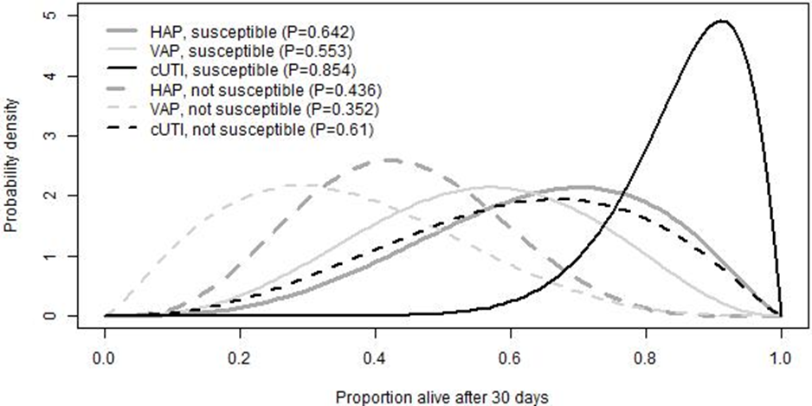
Expert elicitation results: 30-day survival
Survival lowest for VAP patients
Survival highest for cUTI patients
Susceptibility to treatment increases the probability of survival, for all 3 infection sites
Source: EEPRU’s report figure 39 - 30-day survival

Slide 36
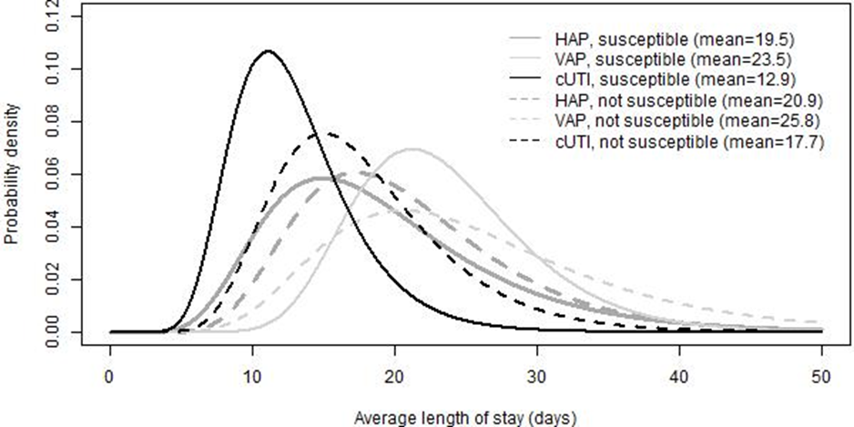
Expert elicitation results: length of hospital stay
Length of stay shortest in cUTI patients
Length of stay longest for patients with VAP
Susceptibility to treatment decreases length of stay, for all 3 infection sites
Source: EEPRU’s report figure 40 – Expected length of stay

Slide 37
Expert elicitation results: time spent on wards
Patients with VAP: most time in ICU and least time in general wards
Followed by HAP then cUTI
Patients susceptible to treatment expected to spend more time on general ward and less on ICU and HDU, for all 3 infection sites
 | ICU | HDU | General medical ward
HAP, susceptible | 24.3 | 19.0 | 56.7
VAP, susceptible | 60.0 | 13.3 | 26.7
cUTI, susceptible | 15.0 | 17.0 | 68.0
HAP, not susceptible | 39.3 | 20.7 | 40.0
VAP, not susceptible | 66.7 | 15.8 | 17.5
cUTI, not susceptible | 23.3 | 18.3 | 58.3
Source: EEPRU’s report Table 57 – Proportion (%) of hospital stay spent on ICU, HDU and general medical ward
HDU = high dependency unit; ICU = intensive care unit

Slide 38
EEPRU used UK study data to validate expert elicitation results for length of hospital stay
Source | Length of stay (LOS), days
Expert elicitation | 12.9–25.8 (mean)
Merrick et al. (UK) | 24 (median)
CARBAR (UK) | 47.2 (mean)
CARBAR study
Considerably longer LOS (47.2) than experts’ estimates.
But CARBAR measured LOS from hospital admission, rather than from start of microbiology directed treatment.
Time from hospitalisation to onset of infection was 8 days (median), but differed according to method of diagnosis: 16.8 days (mean) for sputum samples and 13.9 days (mean) for UTI-related samples.
Time from onset of infection to starting microbiology directed treatment was 5 days (median).
Assuming 13 (8 + 5) to 21.8 (16.8 + 5) days passed between admission and starting microbiology directed treatment, LOS from start of microbiology directed treatment in CARBAR (25.4 to 34.2 days) was comparable to experts’ estimates.
Merrick et al.
Mean LOS not reported.
Median LOS after infections caused by carbapenem-resistant organisms comparable to the mean estimates from experts.

Slide 39
Consultation comments – Expert elicitation
Pfizer
Approaches were not as robust or thorough as a Delphi Panel and not validated against historical data.
MSD
Support use of expert elicitation methodology to help fill evidence gaps but question robustness of results given small number of experts involved.
Shionogi
Expert elicitation should have been employed more extensively in areas of limited data.
Responses that lacked face validity were not addressed.

Slide 40
Consultation comments – Linking susceptibility data to clinical outcomes
Pfizer
In vitro data can’t always be extrapolated to clinical outcomes → underestimates the antibiotic’s effectiveness.
Shionogi
Implausible to assume susceptibility of pathogen is same as probability that patient will be clinically cured
Incorrect to assume outcomes do not differ according to specific antibiotic used or specific pathogen-mechanism causing the infection, conditional upon susceptibility to that antibiotic.
Inappropriate to use in vitro data as a surrogate for clinical outcomes, because it doesn’t account for factors that will affect in vivo efficacy eg different tissue penetration at different infection sites.

Slide 41
Economic analysis

Slide 42
Company economic model

Slide 43
Company economic model
Multi-state disease transmission model
4 main health states: susceptible (not colonised or infected with a pathogen of interest); infected with a pathogen of interest; colonised (but not infected) and dead. For infected and colonised patients: distinction made between sensitive/resistant pathogens
Infections caused by transmission from patient interactions and environmental exposure
Multi-state disease transmission model linked to decision-tree treatment pathway module to determine health economic impact of empiric usage of CAZ/AVI
Company’s model structure, Source: Company’s submission Figure 13

Slide 44
Company used UK sources to inform epidemiological parameters in its economic model
Source | Epidemiological input
ATLAS data (Pfizer) | Baseline resistance
ESPAUR 2018-2019 (PHE) | Baseline resistance and resistance time series
PHE AMR local indicator (fingertips) | Infection incidence
Health Protection Agency | Infection incidence
ONS Statistics | Daily mortality rates
NHS hospital activity data | Daily mortality rates
ATLAS: Antimicrobial testing Leadership and Surveillance, ESPAUR: English Surveillance Programme for Antimicrobial Utilisation and Resistance, PHE: Public Health England, ONS: Office for National Statistics

Slide 45
Comparison of company and EEPRU economic model (1)
Element | Company | EEPRU (patient-level)
Setting | 1,000 patients in single hospital with infectious environment. Results scaled-up to reflect 93,432 beds being occupied over a 10-year horizon. | Patient-level: 2 settings, microbiology-directed setting and empirical setting treatment
Model structure | Multi-state disease transmission model | Forecast-based approach, structure differs according to the setting: empiric treatment and microbiology-directed setting
Treatment pathways for HVCS | 20% of patients have confirmed pathogen-resistance mechanisms before treatment initiation and receive microbiology-directed treatment first line 80% of patients start with empiric risk-based treatment | All patients receive empiric risk-based treatment first
Pathogen-mechanism | Escherichia coli, Klebsiella pneumoniae, Pseudomonas aeruginosa Several mechanisms of resistance (not specified) | Enterobacterales with OXA-48 mechanism of resistance
Site of infection | cIAI, cUTI and HAP/VAP | cUTI and HAP/VAP

Slide 46
Comparison of company and EEPRU economic model (2)
Element | Company | EEPRU (patient-level)
Intervention | CAZ-AVI monotherapy CAZ-AVI is modelled as an additional treatment line in a 3-line diversified treatment sequence, and compared with a non-diversified 2-line treatment sequence made up of existing drugs | CAZ-AVI monotherapy
Comparators | meropenem (all indications) piperacillin/tazobactam (for cIAI and cUTI) colistin (for HAP/VAP) | EERPU included some of company’s comparators (meropenem in combination with colistin and/or other antimicrobials, colistin in combination with other antimicrobials), plus a range of additional comparators (see slide 18)

Slide 47
Comparison of company and EEPRU economic model (3)
Element | Company | EEPRU (patient-level)
Outcomes | Number of deaths Number of infections Number of patients eligible for CAZ-AVI LYs/QALYs lost due to infection | Death Survival no AKI Survival AKI Survival CKD LYs and QALYs
Elements of value as set out in the Evaluation Framework | Diversity value and transmission included Insurance and enablement value partially included | Insurance value quantified Enablement value partially quantified Transmission, spectrum and diversity value not quantified
Study designs | RCTs Observational studies National and international datasets | Susceptibility studies for effectiveness Other outcomes from observational data, meta-analyses, national datasets, RCT, structured expert elicitation
Threshold used to convert cost savings to health benefits | £30,000/QALY | £20,000/QALY
LY: Life years, QALY: Quality-adjusted life years, AKI: Acute kidney injury, CKD: Chronic kidney disease,
RCT: Randomised controlled trial

Slide 48
Company’s results – Base case analysis
Company’s results show effect of adding CAZ-AVI as additional treatment line: comparing CAZ-AVI within a 3-line diversified treatment sequence with a non-diversified 2-line treatment sequence made up of existing drugs
Infection | Treatment | QALYs lost due to infection | Incremental costs (£) | Incremental QALY gains
cUTI | CAZ-AVI | 3,392 | 9034.97 | 5,529
 | No CAZ-AVI | 8,921
cIAI | CAZ-AVI | 1,687 | 827.25 | 4,747
 | No CAZ-AVI | 6,434
HAP/VAP | CAZ-AVI | 10,090 | 5968.55 | 10,211
 | No CAZ-AVI | 20,302
All above combined | CAZ-AVI | 15,169 | 15830.78 | 20,487
 | No CAZ-AVI | 35,657
Source: Adapted from company’s submission, table 62, QALY: Quality adjusted life years
Model drivers: treatment efficacy, discount rate applied, utility values (health-related quality of life) after infection is cured/naturally resolves, life expectancy and the transmission and clearance rates.

Slide 49
EEPRU concerns with company model (1)
Analyses submitted by the company capture a bigger patient population
Analyses don’t focus on OXA-48 resistant pathogens, but include all Escherichia coli, Klebsiella pneumoniae, Pseudomonas aeruginosa
Assumption that 20% of patients have known resistance, so they don’t receive empiric treatment and have microbiology directed treatment in 1st line – EEPRU’s clinical advise is that most patients would start with empiric treatment and move to microbiology directed treatment in 2nd line
No evidence provided for the assumption that 20% of patients will be directly tested for resistance before starting treatment
For patients who receive first-line microbiology-directed treatment, model does not account for a delay of 3-5 days for test results - patient may die from infection and incur hospital costs due to bed occupancy during this time

Slide 50
EEPRU concerns with company model (2)
Company assume that complete eradication of colonisation with any pathogen (sensitive or resistant) is possible, and treatment increases the likelihood of this occurring.
EEPRU consider that complete eradication unlikely to happen as there will always be reservoir of pathogen remaining in gut (clinical advice)
EEPRU assumed patient can develop same infection again because pathogen stays dormant in gut, which can result in further transmission
Impact of assumption difficult to quantify in model but likely that company has overestimated the population health benefits of CAZ-AVI
Company estimates of incremental QALYs for CAZ-AVI expected to be driven by differences in mortality from infection, but unclear how company obtained final results because:
CAZ-AVI is never most effective option and efficacy improvements vs comparators modest
Sensitivity analyses don’t include information on relative contribution to incremental QALYs from treatment-related causes most likely to be driving mortality. Company not transparent about the relative contribution of the following to CAZ-AVI’s survival benefits:
static effects in model (direct patient benefits from relative clinical efficacy of CAZ-AVI)
different dynamic aspects of model influencing population-level benefits such as health benefits from reduced infection transmission and diversity strategies.

Slide 51
EEPRU concerns with company model (3)
Use of 2-line comparator treatment sequence – not clearly justified and not supported by evidence
EEPRU models treatment sequences which include 3 (or more) treatments
Patients who have exhausted all available antibiotic treatment options and fail to clear the infection naturally are assumed to die after three days. Addition of any drug to treatment sequence expected to generate an advantage when compared to a 2-line sequence.
Unclear if person-to-person transmission of resistance is greater in 2-line treatment lines compared to a 3-line sequence in the company’s model.
Concerns in incremental QALYs calculation
Uncertainty in appropriateness of population size used in calculations, not fully justified
Model appears to have overestimated health losses of patients from mortality, which is expected to advantage the per patient incremental QALYs of introducing CAZ-AVI.

Slide 52
EEPRU model methods

Slide 53
EEPRU’s approach to quantifying value in HVCS and extrapolating to expected usage in NHS
3. Population-level QALYs for expected usage (ie outside HVCS)
Rescaling of HVCS QALYs,
based on population sizes (PHE data) and assumptions (expert consultation)
2. Population-level QALYs for HVCS
Assessment of whether important sources of value missed from quantification (‘STEDI’ values) – see slides on economic analysis
Quantitative modelling, forecasting population size and trends in usage and resistance over time
1. Patient-level QALYs for HVCS
Quantitative modelling, similar to ‘normal’ NICE appraisal

Slide 54
EEPRU model methods
Estimating patient-level QALYs for high value clinical scenarios

Slide 55
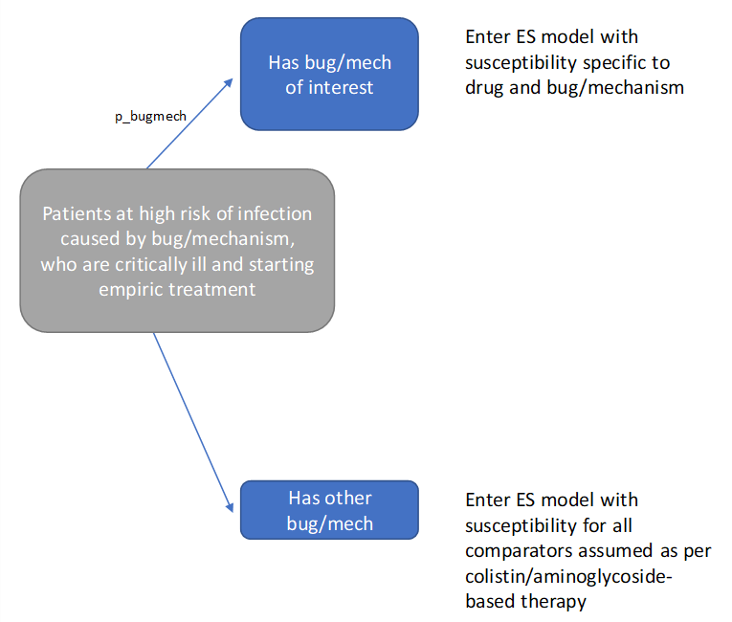
EEPRU’s model– empiric setting (ES)
Treatment susceptibility unknown before starting empiric treatment
Outcomes are modelled separately for patients who:
have the suspected drug-resistant pathogen-mechanism (‘correctly suspected’) → different treatment effectiveness
have a different causative pathogen or mechanism (‘wrongly suspected’) → same effectiveness regardless of the choice of empiric treatment (although safety differs)
Some patients have further treatment in microbiology-directed setting, via 3 possible pathways:
ES1: CAZ-AVI in empiric setting + existing treatments in microbiology-directed setting
ES2: existing therapies in both empiric setting and microbiology-directed setting
ES3: existing therapies in empiric setting + CAZ-AVI in microbiology-directed setting
First component of 30-day outcomes model for ES: risk of carrying pathogen-mechanism of concern
NB: Probability that a patient carries the pathogen-mechanism of interest (“p_bugmech”) is varied in scenario analyses
Source: EEPRU’s report, Figure 17

Slide 56
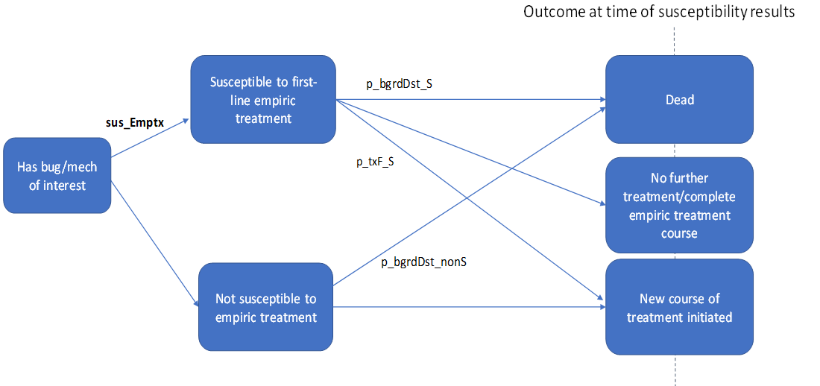
EEPRU’s model – empiric setting (ES)
Patients who have the suspected drug-resistant pathogen-mechanism (‘correctly suspected’) are classified as susceptible or not susceptible to empiric therapy → different treatment effectiveness
Note: differences in susceptibility to empiric treatments are modelled, even though clinicians will not observe it until patients start microbiology-directed treatment
Patients who received empiric treatment to which they are later found not to be susceptible all assumed to require further treatment in microbiology-directed setting
2nd component of 30-day outcomes model for empiric setting: outcomes at the point at which patients are assessed for microbiology-directed treatment
NB: Susceptibility probability varied with scenario analyses on NMA
Source: EEPRU’s report, Figure 18

Slide 57
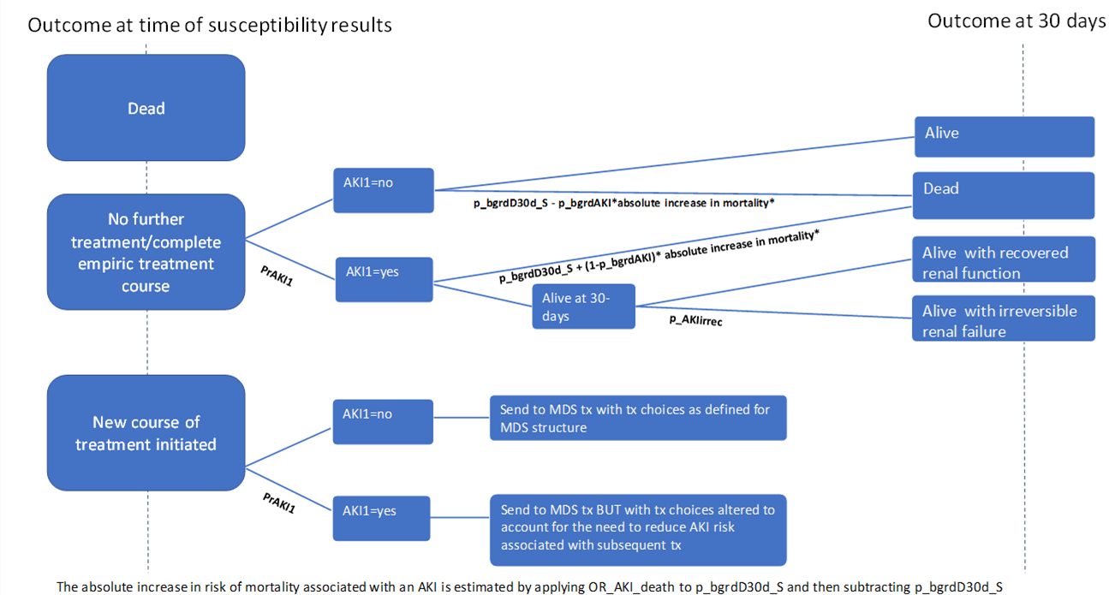
EEPRU’s model– empiric setting (ES)
3rd component of 30-day outcomes model for ES: 30-day outcomes following assessment for MDS treatment
Patients who survive until assessment for microbiology-directed treatment enter 3rd part of decision tree
Patients requiring no further treatment: outcomes depends on whether they have acute kidney injury (AKI)
Patients requiring further treatment enter the microbiology-directed setting component of model
NB: Long-term mortality varied in scenario analyses
Source: EEPRU’s report, Figure 19

Slide 58
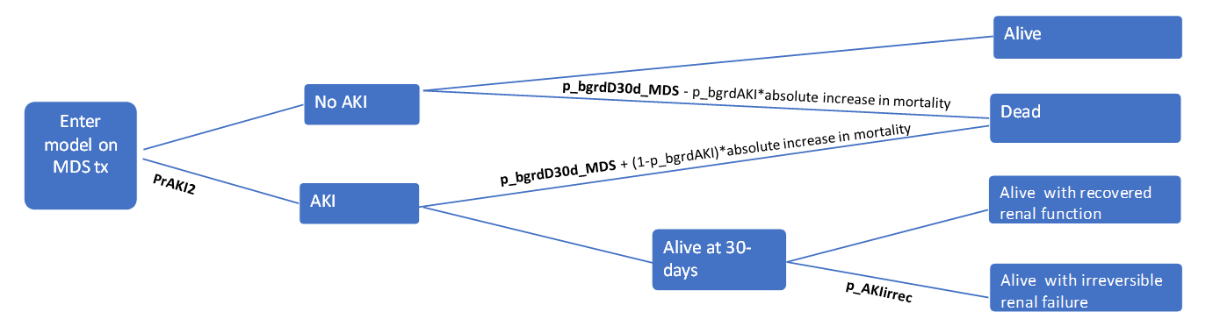
EEPRU’s model – Microbiology-directed setting (MDS)
Assumes susceptibility is the only predictor of treatment effectiveness
Following microbiology-directed treatment, patients experience 1 of 4 alternative 30-day outcomes:
death
alive no acute kidney injury (AKI)
alive post-AKI with recovered renal function
alive post-AKI with irreversible renal failure
Decision tree used to estimate distribution of patients across the 4 different 30-day outcomes
30-day outcomes determine long-term outcomes (e.g. post AKI recovery or chronic kidney disease [CKD])
NB: probability of AKI, odds ratio of AKI, mortality for AKI vs no AKI and long-term mortality varied in scenario analyses
Source: EEPRU’s report, Figure 15 Decision tree used to calculate impact of AKIs on 30-day outcomes in MDS
NB: Risk of CKD and associated mortality varied in scenario analyses
Source: EEPRU’s report, Figure 16, Markov model used to calculate post-30-day outcomes in patients with recovered renal function and irreversible renal failure

Slide 59
EEPRU’s model – Subgroups within MDS and treatment choice
In microbiology-directed setting, susceptibility to available treatment options is known → tailored treatment
Outcomes driven by the distribution of patients across the different susceptibility categories
Susceptibility to existing drugs | Susceptibility to CAZ-AVI | Therapy under existing care | Therapy with new drug available
Susceptible to one or more non-colistin/aminoglycosides option | Susceptible | Non-colistin/amino | Non-colistin/amino
 | Resistant | Non-colistin/amino | Non-colistin/amino
Susceptible only to colistin or aminoglycosides | Susceptible | Colistin/amino-based | CAZ-AVI
 | Resistant | Colistin/amino-based | Colistin/amino-based
Not susceptible to any available treatment options | Susceptible | Multi-drug salvage | CAZ-AVI
 | Resistant | Multi-drug salvage | Multi-drug salvage
Green: clinician initiates new treatment course with drug with appropriate efficacy and safety
Orange: clinician initiates new treatment course with drug with poor safety.
Red: clinician initiates new treatment course with drug with poor efficacy (and possibly poor safety).
Bold: patient groups for whom susceptibility evidence would indicate treatment with CAZ-AVI.
Source: EEPRU’s report, table 20

Slide 60
EEPRU’s model –data sources for patient level
Parameter | Source | Estimates
Probability patient has pathogen-resistance mechanism of interest | PHE Second Generation Surveillance System (SGSS) data on positives as a % of isolates tested | OXA-48 Enterobacterales: 20%
Susceptibility (to inform comparative effectiveness estimates) | EEPRU evidence synthesis: NMA of in vitro studies and PHE data | Various
Acute kidney injury (AKI) risk with non-aminoglycoside/colistin | Published systematic review | 31%
AKI risk with aminoglycoside/colistin | Published systematic review | 45%
Link between susceptibility and short-term clinical outcomes: AKI | Literature (published systematic review and observational study) | Various
Link between susceptibility and short-term clinical outcomes: 30-day mortality | Expert elicitation | Various
Link between susceptibility and short-term clinical outcomes: hospitalisation | Expert elicitation and literature (RCT) | Various
Long-term mortality | CARBAR study – Retrospective study | Median life expectancy 1.5 years

Slide 61
Consultation comments – comparators
Clinical expert:
Model assumes there will be non-colistin based alternatives to CAZ-AVI, but this will only be available in ~25% of cases, due to toxicity, intolerance or drug interactions.
BIA:
Aminoglycosides should not be grouped with colistin, because nephrotoxicity risk with aminoglycosides is half the risk with colistin.
Shionogi
A proportion of patients modelled as receiving colistin will not receive colistin in clinical practice due to renal concerns, contraindications or drug interactions.
Unclear what regimen(s) were included in non-colistin/aminoglycoside therapy options in microbiology-directed setting, since all comparators in EEPRU’s PICO table contain either colistin or aminoglycosides.
Treating patients with regimens that exclude colistin and/or aminoglycosides is not consistent with current practice.

Slide 62
Consultation comments – other model assumptions
Shionogi
Model doesn’t consider false negatives (infections that are not identified as OXA-48 in the empiric setting but are subsequently treated as such in the microbiology-directed setting) are omitted from the modelling
No option to discontinue CAZ-AVI after the pathogen and resistance mechanism has been confirmed, and substitute it for an equally efficacious product (part of good stewardship)
Incorrect to assume that if a patient is wrongly suspected of having the pathogen and resistance mechanism of interest, that all empiric treatments have the same effectiveness

Slide 63
EEPRU model methods
Estimating population-level QALYs for high value clinical scenarios and expected usage

Slide 64
Estimating population-level QALYs
To scale up patient-level QALY results to population-level QALYs, EEPRU needed to forecast changes in population size and trends in usage and resistance over time (see next slides 66-84 for detailed methods)
Population-level QALYs derived by multiplying patient-level QALYs by the population size
Patient-level QALYS for the infection sites defined in the high value clinical scenarios (cUTI and HAP/VAP) were estimated using the patient-level model (as described on previous slides)
Patient-level QALYS for the other expected uses of CAZ-AVI (blood stream infection and intra-abdominal infection) were assumed to be the same as in HAP/VAP and cUTI, respectively, based on the following feedback from clinical advisors:
BSI and HAP/VAP are both severe infections where CAZ-AVI is expected to be used predominantly empirically.
Consequences of intra-abdominal infection can be more severe than consequences of cUTI because they are very difficult to treat (requiring a combination of antimicrobials and surgery), but benefits of CAZ-AVI may be smaller in intra-abdominal infection than in cUTI due to complexity of treating these infections and the lesser role of antimicrobials compared to other treatment modalities in their management.

Slide 65
Estimating the patient population over time
AIM: Predict how the size of the patient population in the modelled clinical scenarios will change over the model time horizon (20 years)
1
2
3
How many patients currently eligible for treatment?
How will eligible population change over time?
How will rates of resistance to CAZ-AVI and its comparators change over time?
Notes:
Source: CAZ-AVI assessment report Section 7.2.5.1 (p141)

Slide 66
Estimating the patient population over time
1
2
3
How many patients currently eligible for treatment?
How will eligible population change over time?
How will rates of resistance to CAZ-AVI and its comparators change over time?
Notes:
Source: CAZ-AVI assessment report Section 7.2.5.1 (p141)

Slide 67
Determining size of current patient population
Data used to inform population estimates
Public Health England Second Generation Surveillance System (SGSS) Antimicrobial Resistance module – national database of laboratory data provided by 98% of hospital microbiology labs in England
Timeframe: October 2020 to April 2021 (because reporting of acquired carbapenemase-producing gram-negative bacteria became mandatory in October 2020)
Site of infection not available directly → inferred from specimen type
SGSS Data
PHE classification of infection sites
Several samples removed → clinical experts considered estimates conservative
Clinical expert classification of infection sites
Broader classification – may include samples that don’t relate to infections of interest
High value clinical scenarios
Other expected uses
HAP/
VAP
cUTI
Bloodstream infections (BSI)
Intra-abdominal infections (IAI)
Stenotro-phomonas
Notes:
Source: CAZ-AVI assessment report p151-157

Slide 68
The clinical expert classification of infection sites is broader than the PHE classification
 | HAP/VAP | cUTIs | BSIs | IAIs
PHE classification | Lower respiratory tract only | Urine/kidney specimens from all male patients. Nephrostomy specimens in male and female patients | Blood samples only | Wound specimens (surgical and traumatic wounds)
Clinical expert classification | Lower respiratory tract and other sites (including but not limited to lung, chest, sputum) | Urine/kidney specimens in scenario 1 in all hospitalised patients (both male and female), upper genital tract in male and female hospitalised patients | Blood samples and other samples (including but not limited to, heart valve, prosthesis, grafts, bone biopsy sample) | None additional to PHE

Slide 69
Scenarios for size of current population (/year)
 | HAP/VAP (tested) | cUTIs (confirmed positive) | BSIs (tested) | IAIs (confirmed positive) | Total
PHE classification | 24 | 82 | 161 | 36 | 303
Clinical expert classification | 166 | 132 | 161 | 36 | 495
BSIs, bloodstream infections; cUTIs, complicated urinary tract infections; HAP/VAP, hospital-acquired pneumonia or ventilator associated pneumonia; IAIs intraabdominal infections
Estimates based on SGGS: subject to considerable uncertainty due to issues with completeness of dataset
EEPRU conducted survey on HAP/VAP infections in empiric setting to provide alternative estimates
Survey targeted infectious disease specialists; disseminated to members of British Society for Antimicrobial Chemotherapy (BSAC) and EEPRU’s clinical advisors
Small sample size of respondents, and estimates varied considerably between experts → results not included in model
Notes:
Source: CAZ-AVI assessment report p153 – table 34

Slide 70
Estimating the patient population over time
1
2
3
How many patients currently eligible for treatment?
How will eligible population change over time?
How will rates of resistance to CAZ-AVI and its comparators change over time?
Notes:
Source: CAZ-AVI assessment report Section 7.2.5.1 (p141)

Slide 71
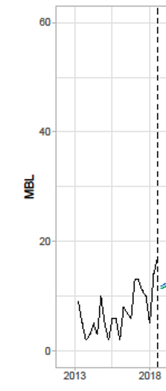
Predicting changes in population over time
How will the eligible population change over time?
Historical data used to inform the extrapolation (2012–2018)
Public Health England (PHE) antimicrobial resistance and healthcare associated infections (AMRHAI) national reference library
Timeframe available: 2004 to 2021. Excluded data before Oct 2012 due to small patient numbers. Excluded data after Mar 2018 due to “artificial” decrease in referrals caused by change in guidelines
Primary analysis: Invasive isolates (eg bloodstream infections) – assumed generalisable to HVCS)
Secondary analysis screening isolates (eg swabs, wounds) – only used to confirm trends
Methods used to perform the extrapolation
Time-series models with state-spaced exponential smoothing
Rationale for this approach, instead of other time-series models: can specify models which include a trend, and express uncertainty in forecasts
Historical population size data for pathogen of interest
Model time horizon – 20 years
Notes:
Source: CAZ-AVI report p141-144 and figure 20

Slide 72
Predicting changes in population over time
3 models were explored . . .
Persistent growth: Growth persists over time horizon
Damped trend: Growth in short term, stabilises in long term
No trend: Population remains constant over time
Model time horizon – 20 years
Assessed statistical measures of fit and visual evidence of trend
PHE data
Notes:
Source: CAZ-AVI report p141-144 and figure 20

Slide 73
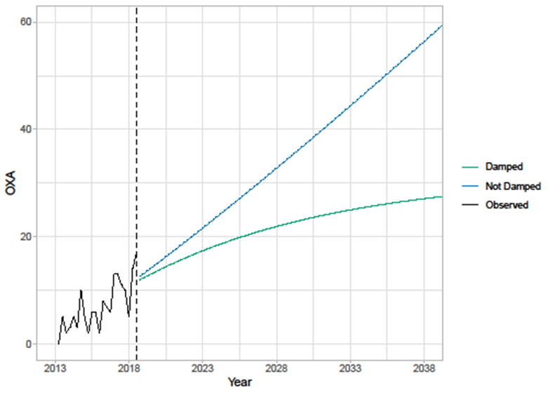
Estimating the patient population over time - Results
For both isolate types (invasive and screening isolate), the model with a persistent trend provides the best within-sample fit
However, difference in values relatively small but difference in extrapolations very large
largest population growth estimated for the screening isolates with a non-damped trend (‘persistent growth’)
smallest (non-constant) population growth was for the invasive isolates with a damped trend model
Visual evidence of a potential trend and little evidence to choose between models, except:
empirical evidence from the general time-series literature shows that long-term forecasts from models with damped trend generally outperform similar models without damped trend
continual improvements to antimicrobial stewardship strategies may lead to reduced rate of resistance gain (favouring the damped trend model)
Extrapolation of population size
(primary analysis – invasive isolates)
Long term estimates sensitive to choice of extrapolation → persistent growth and damped trend both considered in base case model
Notes:
Source: CAZ-AVI report p141-144 and figure 20

Slide 74
Consultation comments – Damped trend or persistent growth model
Shionogi:
Persistent growth model should be used because:
Data used to inform the extrapolation (which excluded data after 2018) does not reflect impact of COVID-19, which is likely to have increased antimicrobial use and therefore resistance.
Persistent growth model is a better fit to available time series data.
EEPRU do not provide rationale for assuming increases would not persist into the future.
Clinical experts consider it intuitively inaccurate to apply ‘damping’.

Slide 75
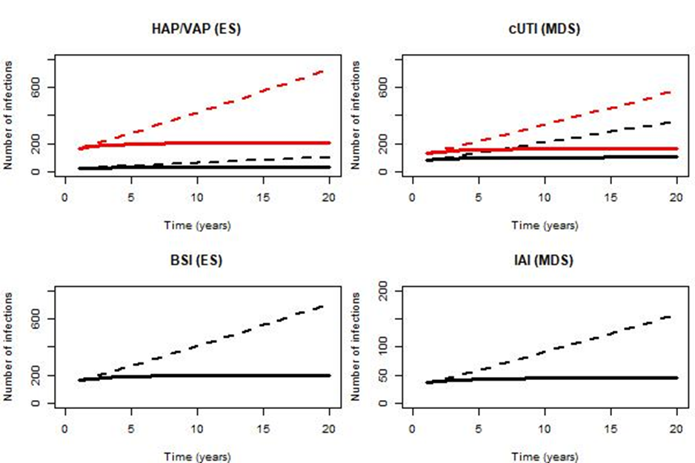
Estimating the population size over modelled time horizon
Population size over 20 years derived by applying year-on-year population growth to current annual population size (Slide 69)
Population size estimates used to rescale estimate of patient-level incremental net health effects (INHEs) to population-level INHEs
4 scenarios used to model eligible population over time:
P1G1: baseline population based on PHE categorisation of infection sites, damped growth rate (most conservative)
P1G2: baseline population based on PHE categorisation of infection sites, growth rate not damped
P2G1: Baseline population based on clinical advisors’ categorisation of infection sites, damped growth rate
P2G2: Baseline population based on clinical advisors’ categorisation of infection sites, growth rate not damped (least conservative)
Differences in scenarios largely driven by assumptions about long term growth in infection numbers
Notes:
Source: CAZ-AVI report p151-157 and figure 21

Slide 76
Estimating expected total drug usage of CAZ-AVI
Expected total drug usage for CAZ-AVI influences some of the scenarios relating to resistance emergence (see slides 72 to 75), as it is expected that resistance increases with increased use of antimicrobial
Derived by adjusting the population size for the proportion eligible for treatment with CAZ-AVI:
In the empiric setting, all infections assumed to be eligible for empiric treatment.
In the microbiology-directed treatment setting, infections confirmed to have the relevant resistance mechanisms adjusted for the mean proportion of patients who were not susceptible to non-colistin/aminoglycoside-based treatments, but were susceptible to CAZ-AVI
Total number of patients initiating CAZ-AVI over 20 years
 | HAP/VAP | cUTI | BSI | IAI
Scenario P1G1 | 576 | 588 | 3,866 | 257
Scenario P1G2 | 1,279 | 1,306 | 8,586 | 571
Scenario P2G1 | 3,990 | 943 | 3,866 | 257
Scenario P2G2 | 8,860 | 2,095 | 8,586 | 571

Slide 77
Estimating the patient population over time
1
2
3
How many patients currently eligible for treatment?
How will eligible population change over time?
How will rates of resistance to CAZ-AVI and its comparators change over time?
Notes:
Source: CAZ-AVI assessment report Section 7.2.5.1 (p141)

Slide 78
Predicting resistance over time
AIM: Predict how rates of resistance to antimicrobials will change over time
1
2
3
Predict future rates of resistance to current practice (ie the comparators)
Predict future rates of resistance to CAZ-AVI
Predict the impact of reduced comparator use on resistance to comparators
Evidence that resistance will develop to new antimicrobials as usage increases
Evidence mixed: reducing use of antimicrobials may increase, decrease or have no effect on resistance to them. Complicated by other drivers of resistance (use in other countries, use in animals etc.)
Attempted an analysis using similar methods to estimating changes in population size, but sparse data to inform extrapolations
Several scenarios exploring different rates of resistance to CAZ-AVl incorporated into model (1–30%) – see subsequent slides
Not incorporated into model
Not incorporated into model
Notes:
Source: CAZ-AVI report p144-148

Slide 79
Consultation comments – resistance to comparators
Pfizer
Resistance to all comparators should be modelled.
NHSEI and Shionogi
Should model increased resistance to current treatments, including low probability event but high impact catastrophic scenarios where high levels of resistance emerge, making existing treatments ineffective.
APRHAI
National trends in resistance have not necessarily followed reduced usage, for example cephalosporins.

Slide 80
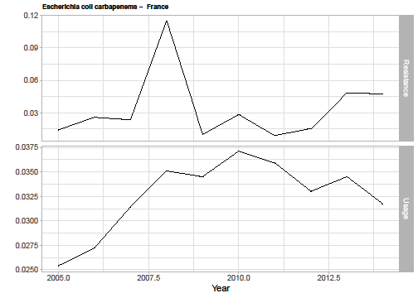
Data sources for estimating resistance to CAZ-AVI over time
Trends on resistance to CAZ-AVI available from PHE, but did not suggest any trend in resistance to CAZ-AVI over time → EEPRU use resistance data for established antimicrobials to predict how resistance to CAZ-AVI may change over time
Wide search for antimicrobial resistance data
Filtering of data to identify antimicrobial pathogen combinations most similar to CAZ-AVI
Data on resistance and usage over time used in analysis (example below for E.coli and carbapenems in France)
European Antimicrobial Resistance Surveillance Network (EARS-Net) – used for analysis
Included countries with data for:
Pathogens in high value clinical scenarios
Cephalosporins and carbapenems
≥5000 isolates
Low baseline resistance
Notes:
Source: CAZ-AVI report p144-148 (and appendices 15-17)

Slide 81
Linking antibiotic use to resistance over time
Methods used to link usage to resistance
AutoRegressive Integrated Moving Average (ARIMA) time series model
Rationale for this approach, instead of other time-series models: can fit models to include covariate effects
Differential equation model not used as provided biased parameter estimates
Estimated impact of increasing antimicrobial use on resistance in the following year
Results (Escherichia coli):
Escherichia coli (n=16)
Significant association (n=8)
Positive association (n=4)
Negative association (n=4) all cephalosporins
Data used:
16 pathogen-drug country combinations
Escherichia coli, carbapenems (n=4) and cephalosporins (n=12)
Coefficients for association (range 1.07 to 10.11) used in economic model to reflect weak and strong associations.
Notes:
Source: CAZ-AVI report p144-148 (and appendices 15-17)

Slide 82
Incorporating changes in resistance to CAZ-AVI into the economic model
Applying the strongest assumptions for changes in resistance over time to the estimated number of patients in the high value clinical scenarios treated with CAZ-AVI resulted in a small increase in resistance of 0.03% over 20 years
EEPRU considered this may be an underestimate – these projections don’t account for CAZ-AVI use outside of the UK and the relationship between usage and resistance is based on all tested isolates in community and hospital settings, whereas resistance may develop more quickly in the high value clinical scenarios
Performed scenario analyses using absolute increases in resistance bounded by the highest absolute increase (a projected 20 year increase of 33%)
EEPRU explored 4 assumptions in its base case model, of resistance reaching either 1%, 5%, 10% or 30% (the 30% scenario was considered extreme)

Slide 83
Consultation comments – PHE SGSS data limitations
SGSS data likely to underestimate patient numbers | SGSS data likely to overestimate patient numbers
Clinical expert: Variability in local laboratory diagnosis and failure to adequately culture blood or other relevant sites Shionogi: Not all hospitals have microbiology laboratories Only 98% of existing laboratories provide data (Shionogi consider this to be optimistic, because reporting rates to the system that preceded SGSS were only 45-70% ) Data often incomplete Under-reporting further exacerbated by COVID pressures | BSAC/RCPath: Estimates based on lower respiratory tract samples will significantly overestimate incidence, because HAP/VAP is diagnosed using clinical and radiological results (not just cultures).

Slide 84
Estimating the population over time – key questions
Is the true size of the expected population closer to estimates using PHE’s categorisation (conservative) or the clinical advisers’ categorisation (which results in higher estimates of population size)?
Is growth in the expected population mostly in the short-term (‘damped trend’) or will it persist over time?
What is the likely increase in resistance to CAZ-AVI over the 20-year time horizon? 1/5/10/30%?
Is resistance to comparator antimicrobials likely to change over time? In what direction?
Notes:
Source: CAZ-AVI report p144-148 (and appendices 15-17)

Slide 85
EEPRU model results
Per-patient results

Slide 86
Patient level model – Comparator pathway in empiric setting
3 possible pathways modelled in empiric to microbiology-directed setting:
ES1: CAZ-AVI in empiric setting + existing treatments in microbiology-directed setting
ES2: existing therapies in both empiric setting and microbiology-directed setting
ES3: existing therapies in empiric setting + CAZ-AVI in microbiology-directed setting
Empiric treatment | Microbiology-directed treatment (if indicated in the microbiology-directed setting)
CAZ-AVI | Existing therapies
Non-colistin or aminoglycoside-based | Existing therapies
Colistin or aminoglycoside-based | Existing therapies
Non-colistin or aminoglycoside-based | CAZ-AVI
Colistin or aminoglycoside-based | CAZ-AVI

Slide 87
Per-patient base case results (probabilistic): HAP/VAP, empiric setting
 | Incremental results
 | CAZ-AVI vs non colistin/aminoglycoside based | CAZ-AVI vs colistin/aminoglycoside based
Patients with OXA-48 Enterobacterales (‘correctly suspected’)
Total costs | -£9,779 | -£221
Life years | 0.459 | 0.218
QALYs | 0.322 | 0.152
Per person NHE (QALYs) | 0.811 | 0.163
Patients without OXA-48 Enterobacterales (‘wrongly suspected’)
Total costs | -£10 | -£574
Life years | 0.000 | 0.233
QALYs | 0.000 | 0.163
Per person NHE (QALYs) | 0.001 | 0.192
All patients in empiric setting (weighted average of correctly and wrongly suspected)
Total costs | -£1,928 | -£505
QALYs | 0.063 | 0.161
Per person NHE (QALYs) | 0.160 | 0.186
CAZ-AVI vs colistin/aminoglycoside based:
CAZ-AVI similar effectiveness to but improved safety in both individuals with and without OXA-48 Enterobacterales.
Per patient incremental net health effects (INHE) therefore similar in patients with and without OXA-48 Enterobacterales (0.16 and 0.19 QALYs respectively)
CAZ-AVI vs non colistin/aminoglycoside based:
Patients with OXA-48 Enterobacterales: CAZ-AVI associated with improved effectiveness and comparable safety. Large difference in effectiveness drives large per patient INHE of 0.81 QALYs.
Patients without OXA-48 Enterobacterales: CAZ-AVI and non-colistin/aminoglycoside-based therapy offer similar effectiveness and safety.
Key results and scenarios
Source: EEPRU’s report, adapted from table 36

Slide 88
Per-patient base case results (probabilistic): HAP/VAP and cUTI, microbiology-directed setting (MDS)
 | MDS pathway with CAZ-AVI | MDS pathway without CAZ-AVI | Incremental values
HAP/VAP
Total costs | £37,218 | £37,512 | -£295
Life years | 2.823 | 2.759 | 0.064
QALYs | 1.984 | 1.939 | 0.045
Per person NHE | 0.123 | 0.063 | 0.060
cUTI
Total costs | £20,110 | £20,410 | -£300
Life years | 3.944 | 3.896 | 0.049
QALYs | 2.772 | 2.738 | 0.034
Per person NHE | 1.767 | 1.718 | 0.049
CAZ-AVI benefits smaller in microbiology-directed setting than in the empiric setting, because once susceptibility results are known, many patients (65%) treated with a non-colistin/aminoglycoside-based option to which they are susceptible and do not receive CAZ-AVI.
Benefits of CAZ-AVI driven by avoiding safety issues of colistin and aminolygosides in patients susceptible to these agents (35% of the microbiology-directed setting patients).
Source: EEPRU’s report, adapted from table 38

Slide 89
Assumptions driving the results of patient-level economic model
For HAP/VAP in empirical setting, main areas of uncertainty relate to:
probability an individual has OXA-48 Enterobacterales,
the different scenarios on estimates of relative effectiveness (informed by NMA of susceptibility studies)
long-term survival following discharge from hospital.
For HAP/VAP and cUTI in microbiology-directed setting, main areas of uncertainty relate to:
the different scenarios on estimates of relative effectiveness (informed by NMA of susceptibility studies)
the impact of colistin/aminoglycoside-based therapy on acute kidney injury (AKI) risk and its long-term implications
long-term survival following discharge from hospital.

Slide 90
Consultation comments – Patient-level results
Pfizer
Per-patient QALY gains (approximately 0.1–0.2) lack face validity, given that the most probable outcome of unsuccessful treatment leads to death.
EEPRU’s model estimates similar treatment efficacy for CAZ-AVI as for the current standard of care, therefore failing to recognise additional clinical benefit of CAZ-AVI.

Slide 91
EEPRU model results
Population results

Slide 92
EEPRU was unable to select a base case for population-level results and present several approaches
Assumptions
PHE categorisation of infection sites
Short-term population growth (‘damped trend’)
30% increase in resistance to CAZ-AVI
Clinician classification of infection sites
Persistent population growth
1% increase in resistance to CAZ-AVI
Less QALYs (493)
Base case analysis
More QALYs (2,211)
Less QALYs (383)
Scenario analyses (no CAZ-AVI resistance) slide 95
More QALYs (3,312)
Less QALYs (–2 to 1,914)
Probabilistic sensitivity analysis (no CAZ-AVI resistance) slide 94
More QALYs (–33 to 6,897)

Slide 93
Total population incremental net health effect ranged from 493 to 2,211 QALYs in base case
QALY ranges bound by highest estimate of increase in resistance to CAZ-AVI (30%) and lowest estimate (1%)
Alternative base case assumptions |  |  | Incremental net health effect (QALYs)
Baseline population | Population growth rate | Patients initiating CAZ-AVI | HAP/VAP | cUTI | BSI | IAI | Total
PHE categorisation of infection sites | Short-term (‘damped trend’) P1G1 | 5,287 | 51-66 | 71-83 | 341-444 | 31-36 | 493-629
 | Persistent growth P1G2 | 11,742 | 37-137 | 140-171 | 652-916 | 61-75 | 950-1,299
Clinical advisors’ categorisation of infection sites | Short-term (‘damped trend’) P2G1 | 9,056 | 352-458 | 113-133 | 341-444 | 31-36 | 837-1,070
 | Persistent growth P2G2 | 20,112 | 673-946 | 225-274 | 652-916 | 61-75 | 1,611-2,211

Slide 94
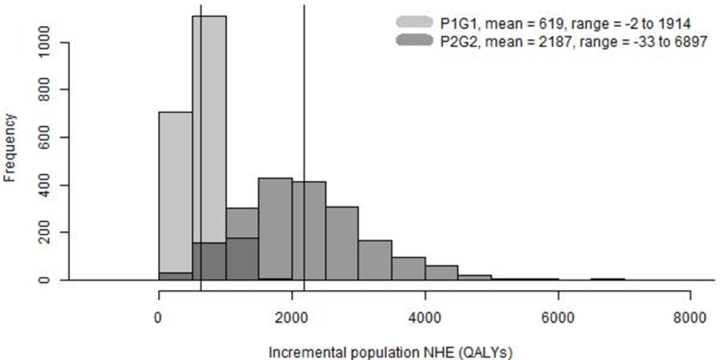
Probabilistic sensitivity analysis showed large degree of uncertainty: QALYs ranged from –33 to 6897
Figure: Distribution of total population incremental net health effects (INHE) of CAZ-AVI (2,000 simulations) – based on most conservative (P1G1) & highest (P2G2) estimates of
population size, under assumption of no CAZ-AVI resistance
P1G1 | mean = 619, range –2 to 1914
P2G2 | mean = 2187, range –33 to 6897
P1G1: baseline population based on PHE categorisation of infection sites, applying damped trend to population growth
P2G2: baseline population based on clinical advisor categorisation of infection sites, applying persistent growth rate
Right hand side of distribution may capture low probability high cost scenarios (ie insurance value)

Slide 95
Main areas of uncertainty: probability patient has OXA-48 Enterobacterales & relative effectiveness estimates
Scenario name | Base case assumption | Scenario analysis | INHE (QALYs, deterministic)
Base case |  |  | 633-2,231
p_bug_survey | Probability patient has OXA-48 Enterobacterales = 20% (PHE SGSS data) | Probability = 57% (based on BSAC survey data, n=9 respondents) | 738-2,619
p_bug_10 | Probability patient has OXA-48 Enterobacterales = 20% (PHE SGSS data) | Probability = 10% (hypothetical) | 383-1,316
p_bug_30 | Probability patient has OXA-48 Enterobacterales = 20% (PHE SGSS data) | Probability = 30% (hypothetical) | 765-2,712
p_bug_70 | Probability patient has OXA-48 Enterobacterales = 20% (PHE SGSS data) | Probability = 70% (hypothetical) | 727-2,575
S2 | Susceptibility based on network meta-analysis of EUCAST studies | Susceptibility based on network meta-analysis of all studies regardless of breakpoints (EUCAST & CLSI) | 779-2,780
S3 | Susceptibility based on network meta-analysis of EUCAST studies | Susceptibility based on PHE data only | 698-2,469
S4 | Susceptibility based on network meta-analysis of EUCAST studies | Susceptibility based on Vasquez-Ucha et al (no MBL co-carriage) | 941-3,312
INHE: incremental net health effect (range reflects lowest & highest population size estimates, assuming no CAZ-AVI resistance), p_bug: probability patient has OXA-48 Enterobacterales, S2 to S4: using different evidence in NMA of susceptibility studies

Slide 96
Additional elements of value

Slide 97
Additional elements of value
Several elements of value that are particularly important for or unique to antimicrobials,
Spectrum value – Benefits of a new antimicrobial replacing broad spectrum antimicrobials, reducing problems associated with their overuse
Transmission value – Benefits of a new antimicrobial reducing the rate of transmission of a given pathogen from patients treated with that product to other individuals, potentially reducing the rate of resistant infection.
Enablement value – Benefits of additional medical procedures being possible as a result of new antimicrobials being available to manage otherwise resistant infections with few alternative treatment options
Diversity value – Benefits of new antimicrobials adding to the range of treatments currently available, potentially reducing selection pressure on and resistance to other available treatments
Insurance value – Benefits of reserving a new antimicrobial until resistance eliminates current alternatives as options or as insurance against a catastrophic emergence of widespread multi drug resistant infections.
Notes:
Source: CAZ-AVI report p175-178 and table 43

Slide 98
Taking account of additional elements of value
At outset of evaluation it was clear that these elements of value may not be fully captured in the model
The following slides summarise EEPRU’s considerations regarding:
The extent to which the element of value has been captured in the economic model
The expected impact of each element of value on population net health benefits if not captured in the model
The degree of uncertainty around the magnitude of population net health benefit associated with each element of value
The extent to which these sources of value might be realised by CAZ-AVI
The views of consultees on whether each element of value has been captured are also noted
Other benefits which may not have been captured in the model have also been summarised
Notes:
Source: CAZ-AVI report p175-178 and table 43

Slide 99
Spectrum Value
Benefits of a new antimicrobial replacing broad spectrum antimicrobials, reducing problems associated with their overuse
Potential source of additional benefit | Included in AG model? | Rationale for excluding/additional comment if included
Reduced colonisation with drug-resistant bacteria, leading to reduced drug-resistance of future infections | No | CAZ-AVI has a broad spectrum of activity → clinical advisers and other stakeholders did not consider spectrum value to be a key driver of incremental population benefits
Company’s approach:
Spectrum value was not included in company’s submission
Is spectrum value relevant? If it is, has spectrum value been adequately captured in the QALY estimates? What is the magnitude of any uncaptured benefits?
Notes:
Source: CAZ-AVI report p175-178 and table 43

Slide 100
Transmission Value
Benefits of a new antimicrobial reducing the rate of transmission of a given pathogen from patients treated with that product to other individuals, potentially reducing the rate of resistant infection
Potential source of additional benefit | Included in AG model? | Rationale for excluding/additional comment if included
Reduced number of resistant infections | No | Challenging to model: drivers of transmission are broad, with countervailing effects (↓ length of hospital stay → ↓ transmission, but CAZ-AVI could ↑ hospital stay by reducing mortality in patients with poor prognosis) and driven by transmission beyond high value clinical scenarios. Clinical advisers indicated transmission value isn’t a key driver of incremental benefits, because CAZ-AVI has small impact on hospital stay (↓ by 0–1.1 days), and treatment doesn’t eradicate colonisation.
Company’s approach:
Included transmission value in model: assumes antimicrobial treatment can completely eradicate patients of colonisation and CAZ-AVI increases the likelihood of this, which in turns reduces transmission
Notes:
Source: CAZ-AVI report p175-178 and table 43

Slide 101
Transmission Value – Consultation comments
Pfizer:
Pfizer model demonstrates this value element within the disease transmission component of the model. This was excluded from the EEPRU model as clinical advisors indicated that the effect of CAZ-AVI was uncertain and the magnitude of the effect expected to be small.
Shionogi:
Counter-intuitive and contradictory to ethos of the STEDI values to assume that an antibiotic which will improve infection management will not have some transmission value.
Is CAZ-AVI likely to eradicate gut colonisation?
Has transmission value been adequately captured in the QALYs estimates?
What is the magnitude of any uncaptured benefits?

Slide 102
Enablement Value (1 of 2)
Benefits of additional medical procedures being possible as a result of new antimicrobials being available to manage otherwise resistant infections with few alternative treatment options
Potential source of additional benefit | Included in AG model? | Rationale for excluding/additional comment if included
Improved treatment of post-operative infections | Yes
Improved treatment of pre-operative infections | Partially | Partially quantified in HVCSs and extrapolation to expected usage. All patients who survive >30 days experience same survival outcomes, however patients whose infections are resolved quicker may benefit from having operations earlier.
Increasing the number of procedures that can go ahead (eg for patients for whom existing treatments are not an option) | No | EEPRU considers enablement value could be a driver of key incremental benefits if risk of multi-drug-resistant infection or clinicians' ability to treat these infections influences their decision to bring a patient in for a procedure (eg myeloma patients with renal impairment could not be treated with colistin), but did not model because of the uncertainty in the number of affected patients and consequences for patients not receiving planned therapy
Notes:
Source: CAZ-AVI report p175-178 and table 43

Slide 103
Enablement Value (2 of 2)
Benefits of additional medical procedures being possible as a result of new antimicrobials being available to manage otherwise resistant infections with few alternative treatment options
Potential source of additional benefit | Included in AG model? | Rationale for excluding/additional comment if included
Ability to keep wards open during an outbreak | No | EEPRU considered it unlikely that CAZ-AVI will have this effect as most patients have alternative treatment options available.
Reduced use of resources enabling procedures and healthcare for other patients | Yes | Where possible the impact of CAZ-AVI on resource use has been captured. When calculating population incremental net health benefit, cost savings have been converted to health benefits using standard measures of health opportunity cost.
Company’s approach:
Enablement value is partially captured within company’s model. Outcomes such as prophylactic antimicrobial use, gains in hospital capacity and enablement of procedures that would otherwise be foregone not explored in model. However, some of its elements included implicitly, as patients infected after surgical and medical procedures fell within modelled population.
Notes:
Source: CAZ-AVI report p175-178 and table 43

Slide 104
Enablement Value – Consultation comments
Pfizer:
Enablement value has broader implications than the benefits described in EEPRU's definition. Enablement value goes beyond direct use of CAZ-AVI and links to its impact on antimicrobial resistance.
Clinical expert:
Enablement value already observed now, particularly in cystic fibrosis where timely use of CAZ-AVI may contribute towards enabling lung transplantation. Also relevant to growing numbers of other immunocompromised patient populations.
Shionogi
Several aspects of enablement value are acknowledged but not captured. In particular the benefit of increasing number of viable procedures.
Has enablement value been adequately captured in the QALYs estimates?
What is the magnitude of any uncaptured benefits?

Slide 105
Diversity Value
Benefits of new antimicrobials adding to the range of treatments currently available, potentially reducing selection pressure on and resistance to other available treatments
Potential source of additional benefit | Included in AG model? | Rationale for excluding/additional comment if included
Adding to the range of treatments currently available, potentially reducing selection pressure on and resistance to other available treatments | No | Within HVCS: Clinical advisors indicated that diverse prescribing strategies unlikely to be appropriate given lack of safe and effective alternative treatments. Outside HVCS: Clinical advisors not supportive of CAZ-AVI use in broader populations as part of diverse prescribing strategies due to desire to reduce emergence of resistance to CAZ-AVI. Also uncertainty about how reduced use of existing agents due to availability of CAZ-AVI will impact resistant to these drugs
Company’s approach:
Company emphasised the potential for CAZ-AVI to be used alongside other therapeutic options in patients at high risk of a resistant infection. Diverse prescribing strategies included in company’s model
Notes:
Source: CAZ-AVI report p175-178 and table 43

Slide 106
Diversity Value – Consultation comments
Pfizer
Incorporating diversification prolongs the efficacy of existing antimicrobials, and introducing a new antimicrobial (CAZ-AVI) increases the effectiveness of diversification. Current EEPRU model does not assess the diversity value of novel antibiotics.
BSAC and RCPath
NHS Trusts are put under pressure to avoid prescribing carbapenems
Shionogi
Argument that diversity will result in a net zero benefit due to countervailing effects seems counter-intuitive and contradictory to the identification of diversity value as a potential uncaptured benefit
Scientific rationale for diverse prescribing widely accepted
Is diversity value relevant? If it is, has diversity value been adequately captured in the QALYs estimates? What is the magnitude of any uncaptured benefits?

Slide 107
Insurance Value
Benefits of reserving a new antimicrobial until resistance eliminates current alternatives as options or as insurance against a catastrophic emergence of widespread multi drug resistant infections
Potential source of additional benefit | Included in AG model? | Rationale for excluding/additional comment if included
Restricting usage of CAZ-AVI to preserve efficacy in the long term | Yes | Quantified in high value clinical scenarios – scenarios modelled reflect restricting usage
Avoidance for catastrophic health losses | Yes | Quantified in high value clinical scenarios (presented as distributions of population level net health benefits from the probabilistic sensitivity analysis) – but may be valued differently by society
Company’s approach:
Insurance value is reflected to a limited capacity in current model
Notes:
Source: CAZ-AVI report p175-178 and table 43

Slide 108
Insurance Value – Consultation comments
Pfizer
Neither Pfizer’s nor EEPRU’s model fully captured insurance value. There are well-established insurance modelling techniques which could capture value of new antibiotics in mitigating future probabilistic events - this value would likely need to be considered collectively across the antibiotic spectrum.
BSAC and RCPath
Insurance value is not fully captured. In the USA CAZ-AVI was initially kept in reserve, but use quickly became widespread as KPC-carbapenemases became prevalent.
Shionogi & NHSEI
[See earlier comments on comparator resistance]: Should model increased resistance to current treatments, including low probability event but high impact catastrophic scenarios where high levels of resistance emerge, making existing treatments ineffective.
Note: EEPRU working on additional scenario analyses relating to potential long term benefits
Has insurance value been adequately captured in the QALYs estimates?
What is the magnitude of any uncaptured benefits?

Slide 109
Summary of additional source of value
Value | Potential source of additional benefit | Driver of benefit of CAZ-AVI | Included in EEPRU model | Source of uncertainty*
Spectrum | Reduced colonisation with drug-resistant bacteria, leading to reduced drug-resistance of future infections | No | No | No
Transmission | Reduced number of resistant infections | No | No | Yes
Enablement | Improved treatment of post-operative infections | Yes | Yes | No
Enablement | Improved treatment of pre-operative infections | Yes | Partially | Yes
Enablement | Increasing the number of procedures that can go ahead | Yes | No | Yes
Enablement | Ability to keep wards open during an outbreak | No | No | No
Enablement | Reduced use of resources enabling procedures and healthcare for other patients | Yes | Yes | No
Diversity | Replacing broad spectrum antimicrobials with narrow spectrum antimicrobials | No | No | Yes
Insurance | Restricting usage of CAZ-AVI to preserve efficacy in the long term | Yes | Yes | Yes
Insurance | Avoidance for catastrophic health losses | Yes | Yes | Yes
*If included, EEPRU consider there is uncertainty in their assumptions.

Slide 110
Consultation comments – stewardship
Pfizer
Different antimicrobial stewardship strategies could be modelled and their impact on the emergence of resistance. If not possible to quantify diversity value, qualitative assessment considered - impact and appropriate usage of new antibiotics is critical factor in attempting to tackle the clear trend of increasing resistance.
MSD
The crucial stewardship component of the technology appraisals appears to have been omitted entirely, optimal usage scenario(s) are critical to balance individual clinical judgement with national guidance.

Slide 111
Considerations for apportioning value to the contract period

Slide 112
Total value and contract duration
The HTA estimates total value of the antimicrobial to the NHS in England, over a 20-year horizon
Contract duration: 10 years
What proportion of the total value should be assigned to the 10-year period?

Slide 113
Option 1: assign 100% of the total value to the contract duration
Advantages | Disadvantages
Simplest option | No economic rationale to pay for the drug after year 10
Provides the greatest reward to company and therefore most likely to support the delivery of a “pull incentive” | NHS likely to end up paying >100% of value if drug is used beyond contract period
May be appropriate if the Committee considers there to be additional benefits not captured in the health economic analyses

Slide 114
Option 2: assign <100% of the total value to the contract duration
Advantages | Disadvantages
Reserves some of the value for the post-contract period of use when normal market mechanisms will apply | Unclear what the appropriate percentage should be that should be rewarded
Lowers risk that the NHS will end up paying >100% of the total value over the period the drug (and future generics) will be on the UK market | Might not provide a sufficiently attractive reward for company (especially if total contract value ends up being lower than what they would be expected to make under normal market mechanisms)
 | May exacerbate under valuing INHB in the contract period if there are additional benefits not captured in the health economic analyses

Slide 115
What do the assessment reports tell us?
Across scenarios, the proportion of value accruing in the first 10 years is 41-65% for CAZ-AVI and 41-58% for cefiderocol
Scenarios where resistance increases more slowly see lower proportions of value accrue to the first 10 years
For other drugs (not AMs) where usage is expected to be stable over time, the proportion of value accruing in the first 10 years is 59% [1]
Value accruing in first 10 years of the AMs therefore is lower than for other drugs under normal market mechanisms
Policy aim of the project is to provide a ‘pull incentive’ – reward should therefore be at least as attractive as those typically received for other drugs
[1] Woods et al. Estimating the shares of the value of branded pharmaceuticals accruing to manufacturers and to patients served by health systems. Health Econ. 2021 Nov;30(11):2649-2666. doi: 10.1002/hec.4393. Epub 2021 Aug 2. PMID: 34342084.

Slide 116
Potential approach
To ensure that the antibiotics are treated at least as favourably as other drugs, the Committee should assign a minimum of 60% of the value to the 10 year contract period
To support a meaningful pull incentive, the Committee may wish to increase the proportion of the total value assigned to the contract period – so >60%
If the Committee considers that there may be uncaptured value even in its best estimate of INHB, the Committee could decide to assign 100% of the estimated INHB to the 10 year contract period.

Slide 117
Thank you
© NICE [insert year]. All rights reserved. Subject to Notice of rights.

