Slide 1
Chair presentation ACM2
Slides for public - redacted
Tafamidis for treating transthyretin amyloid cardiomyopathy
Lead team: Alex Cale, Iain McGowan, Stella O’Brien
ERG: University of Sheffield, ScHARR
Technical team: Stephen O’Brien, Thomas Paling, Nicola Hay, Jasdeep Hayre
Company: Pfizer
September 1 2020

Slide 2
Issues for consideration
Diagnosis of ATTR-CM, diagnosis delays, and assumptions | How is ATTR-CM diagnosed in clinical practice? Does this reflect the ATTR-ACT inclusion criteria? (criteria included in back-up slides) Can incidental findings of amyloid deposits from DPD scans be misinterpreted as amyloidosis? Would the introduction of tafamidis reduce diagnosis delays? Can any benefits from earlier diagnosis be attributed to tafamidis?
Continued treatment benefit | Will tafamidis treatment benefit continue after discontinuation? Will people discontinue tafamidis in NYHA 1 to 3 health states? Will people receive BSC after discontinuing tafamidis?
Other issues | Is the NYHA classification system used in clinical practice for ATTR-CM? Are starting and stopping rules for tafamidis based only on the NYHA classification system implementable?
 | Which overall survival extrapolation is most appropriate? Generalised gamma or log-normal?
 | Is the combined outcome measure used in clinical practice? Is a statistically significant difference in scores, clinically significant?
 | Do the subgroup results introduce uncertainty into the consideration of tafamidis efficacy in the overall population?
 | What is the most plausible ICER? Does tafamidis represent a step-change in the management of ATTR-CM? Equality considerations
Key issues
Other issues

Slide 3
ACD recommendation
Tafamidis is not recommended, within its marketing authorisation, for treating wild-type or hereditary transthyretin amyloidosis with cardiomyopathy (ATTR-CM) in adults.

Slide 4
Disease background
Transthyretin amyloidosis (ATTR) is caused by abnormal transthyretin (TTR) proteins being produced by the liver and accumulating as deposits in body tissues
ATTR cardiomyopathy (ATTR-CM) is a type of transthyretin amyloidosis in which most amyloid deposits accumulate in the heart → heart tissue to thicken and stiffen → heart failure
There are two causes of ATTR-CM:
Wildtype ATTR-CM
Hereditary ATTR-CM
ATTR-CM symptoms include: shortness of breath, palpitations and abnormal heart rhythms, ankle swelling, fatigue, fainting and chest pain
ATTR-CM is a progressive disease with people’s symptoms usually starting after the age of 70 years with wildtype ATTR-CM or 60 years with hereditary ATTR-CM
Death in most ATTR-CM cases is from sudden death or progressive heart failure

Slide 5
Treatment pathway
There are no UK treatment guidelines or approved disease-modifying treatments for ATTR-CM
Current treatment options for ATTR-CM are limited and mainly focus on symptom management and supportive care such as diuretics
The appropriate comparator is best supportive care (BSC)
Liver transplantation are rare
A small proportion of people with cardiomyopathy caused by transthyretin amyloidosis also have polyneuropathy
NICE recommendations for polyneuropathy
HST9 | Inotersen is recommended as an option for treating stage 1 and stage 2 polyneuropathy in adults with hereditary transthyretin amyloidosis
HST10 | Patisiran is recommended as an option for treating hereditary transthyretin amyloidosis in adults with stage 1 and stage 2 polyneuropathy

Slide 6
Tafamidis (Vyndaqel, Pfizer)
Description of technology | Binds to transthyretin (TTR) in the blood which stabilises the shape of TTR and prevents the formation of abnormal proteins. This then stops the formation of amyloid deposits
Marketing authorisation | The treatment of wild‑type or hereditary transthyretin amyloidosis in adult patients with cardiomyopathy (ATTR-CM)
Dosage and administration | Administered orally. Dose 61 mg once a day*
List price | £10,685 per pack of 30 - capsules Estimated annual cost at list price £130,089.88 A confidential commercial arrangement has been agreed (simple discount PAS, no change from ACM1)
Notes: *tafamidis doses used in main trial (20 mg and 80 mg) different to licensed dose (61 mg)

Slide 7
Recap: clinical effectiveness
 | ATTR-ACT N=441 | ATTR-ACT extension N = not reported
Design | Phase III, multicentre, international, double-blind, randomised placebo-controlled trial with 30-month follow-up | Phase III, multicentre, long-term extension study with a 60‑month follow-up
Population | Between 18 and 90 years of age with ATTR-CM | Cohort A: patients who completed 30 months of ATTR-ACT Cohort B: patients with ATTR-CM who did not participate in ATTR-ACT
Intervention | Tafamidis (20 mg or 80 mg) | Cohort A: tafamidis 20 mg or 80 mg. After protocol amendment → 61 mg Cohort B: tafamidis 61 mg
Clinical effectiveness results
Primary outcome Finkelstein-Schoenfeld | Average frequency of CV-related hospitalisations (per year) among those alive at month-30: 0.297 for tafamadis and 0.455 for placebo. Differences were statistically significant.
Secondary outcomes | Tafamidis associated with statistically significant reductions in: cardiovascular-related mortality cardiovascular-related hospitalisations mobility decline (assessed using the 6-minute walk test)

Slide 8
Recap: cost-effectiveness
Model schematic
Time horizon | Lifetime
NYHA transitions | Month 6-30: ATTR-ACT 6-monthly data Month 30+ ATTR-ACT extrapolated
Cost effectiveness results (with PAS) ICERs per QALY gained
Company base-case | £******
Technical team preferred ICER | £******
Committee preferred ICER range | £****** to £******
Source: adapted from figure 32 company submission

Slide 9
ACD key considerations
ATTR-CM diagnosis, early diagnosis and, early diagnosis assumptions (ACD 3.3, 3.7, 3.18) | Accurately diagnosing ATTR-CM is challenging and can take a long time. Clinical experts noted: Transthyretin amyloid deposits are often an incidental finding in of DPD scans. There is no defined point at which amyloid deposits become amyloidosis. It is unclear to what extent, if any, introducing tafamidis would reduce ATTR-CM diagnosis delays. The extent to which earlier diagnosis would lead to cost savings and reduced quality of life losses is unclear. The company’s early diagnosis assumptions are not supported by the evidence and therefore should not be considered for decision making.
Continued treatment benefit (ACD 3.15 and 3.16) | Assuming continued treatment benefits without a cost is overly optimistic and leads to underestimated cost-effectiveness estimates. ERG’s alternative analyses had limitations but provided realistic alternatives to the company’s optimistic assumptions.
Key issue
Key issue

Slide 10
ACD consultation responses
Web comments (n=6)
Including clinicians, professional and patient organisations
Patient group comments:
Cardiomyopathy UK
UK ATTR AMYLOIDOSIS PATIENTS’ ASSOCIATION (UKATPA)
Clinical expert & professional group comments:
British Cardiovascular Society (BCS)
Endorsed by the Royal College of Physicians (RCP)
British Society for Heart Failure
National Amyloidosis Centre (NAC)
NHS England
Company (Pfizer)

Slide 11
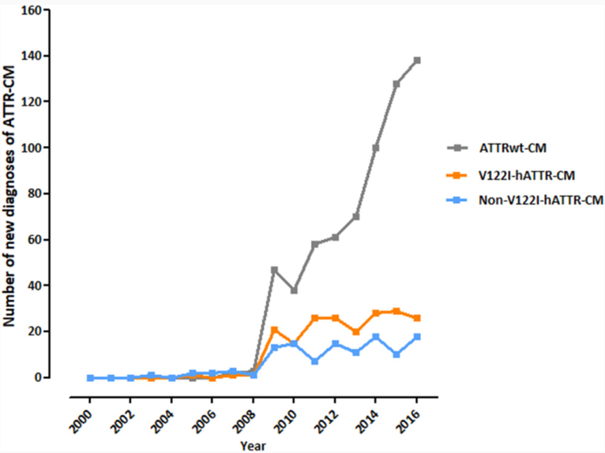
Web comments, n=6 (1)
ATTR-CM Diagnosis | ATTR-CM is an easily diagnosed disorder with increasing awareness Unclear if recommending tafamidis would reduce diagnosis delays Most diagnoses are (or can be) made using locally available tests Diagnostic algorithm will reduce delays Challenging to managing increasing numbers of diagnoses → a network hub and spoke centres is proposed to handle high volume of diagnoses Biomarker measurement combined with NYHA class is accepted in heart failure DPD scans are a sensitive tool for early ATTR-CM detection Highlighting incidental amyloid deposit findings as a barrier to diagnosis is questionable UK centres increasingly capable of diagnosing ATTR-CM → more DPD kits supplied
Key issue
Increasing numbers of referrals at the NAC
Source: Lane et al (2019) / figure 1, EAMS response web comment appendix

Slide 12
Web comment, n=6 (2)
Recommendation | Tafamidis is the first proven effective treatment to reduce mortality and cardiovascular admissions → patients should have it as an option Recommending tafamidis would improve outcomes and access No available alternatives → frustrating not having tafamidis as an option
ATTR-CM | ATTR-CM is unresponsive to standard heart failure therapies The condition has the most dire prognosis of all the heart failure causes
Evidence considerations | All of the relevant evidence has been considered Subgroups contain small numbers → not robust → not appropriate to consider Robust clinical trial evidence demonstrates tafamidis benefit Observational data from French Amyloidosis Centre support ATTR-ACT findings with respect to mortality benefits in NYHA 1-3
NYHA functional classification system | A lack of familiarity with the NHYA classification scale is clear in the ACD Despite limitations in terms of variability and reproducibility NYHA is used in clinical research because of its simplicity NAC and French Amyloidosis centre data show NYHA class can predict prognosis in untreated people NYHA is used to guide many recommendations in heart failure
Starting and stopping rules | No evidence of benefit in NYHA 4 → uncomplicated to stop treatment A stopping rule should be modelled to reflect discontinuation in ATTR-ACT
ICER | Clear benefit demonstrated in ATTR-ACT → accepting £20,000 ICER because of “high levels of uncertainty” is inappropriate given the evidence of → uncertainty is not unusual in the context of treatments for rare diseases

Slide 13
Patient group comments
Recommendation | Tafamidis is the only ATTR-CM treatment → should be reconsidered
Diagnosis of ATTR-CM | Earlier diagnosis can be achieved through education → already evident in EAMS → trend is likely to continue In EAMS diagnosis delays have reduced from years to months Introducing tafamidis could further reduce diagnosis delays
Starting and stopping rules for tafamidis | NYHA is subjective but a good indicator of disease stage Challenges of stopping medication will not be unique for tafamidis → clinicians and patients have experience of these challenges Early diagnosis and access to treatment is critical with ATTR-CM Stopping treatment on progression to NYHA 4 or based on a more objective measurement by clinicians could be considered in practice
Subgroups | Subgroups are too small to draw conclusions from Tafamidis is effective overall
Quality of life | Kansas City Cardiomyopathy Questionnaire (KCCQ) does not cover all important aspects to patients or fully capture tafamidis benefits
Key issue

Slide 14
Clinical expert & professional group comments
Diagnosis of ATTR-CM | Access to cardiac magnetic resonance and DPD scanning has improved ATTR-CM detection → reflected in increased referrals to the NAC ATTR-CM is now easily diagnosed Unclear if introducing tafamidis would reduce diagnosis delays
Continued benefit Key issue | No evidence of continued tafamidis benefit after discontinuation
NYHA functional classification system as a measure of clinical benefit | NYHA is commonly used method to categorise people in heart failure trials NYHA has been incorporated in other NICE recommendations NYHA status can vary day to day → ATTR-CM can be staged using the NAC ATTR staging system based on serum eGFR and NT-proBNP measurements NAC ATTR staging system did not exist when ATTR-ACT was designed → any baseline imbalances in NAC ATTR stage could explain observed tafamidis benefits in ATTR-ACT → data not available
Trial endpoints | Hospital admissions and survival are highly relevant to heart failure patients
Starting and stopping rules | No evidence to support the use of tafamidis in NYHA 1 It would be challenging to stop tafamidis on progression to NYHA 4
Subgroups | Avoid putting too much emphasis on underpowered subgroup results Subgroup results were favourable for tafamidis Lack of significance in advanced NYHA subgroups is common in heart failure trials → heart failure experts should attend the committee meeting
Key issue
Key issue

Slide 15
NHS England comments
We consider that all of the relevant evidence been taken into account
The summaries of clinical and cost effectiveness are reasonable interpretations of the evidence
The provisional recommendations do provide a sound and a suitable basis for guidance to the NHS

Slide 16
ATTR-CM diagnosis, delays, early diagnosis assumptions
Committee considerations
ACD sections 3.3, 3.7, 3.18
Clinical experts noted:
Transthyretin amyloid deposits are often an incidental finding in of DPD scans
There is no defined point at which amyloid deposits become amyloidosis
Company base-case assumed future benefits from earlier ATTR-CM diagnosis could be attributed to the introduction of tafamidis, including:
Reduced average age of diagnosis by 2.5 years
£20,000 cost saving from not having to attend avoidable appointment
Avoided 0.18 QALY losses from depression/anxiety resulting from diagnosis delay
Committee concluded:
Accurately diagnosing ATTR-CM is challenging and can take a long time
Committee concluded
Not enough evidence to support these assumptions → inappropriate to incorporate in its decision making

Slide 17
ATTR-CM diagnosis, delays, early diagnosis assumptions
Company’s ACD response
Company’s response (ACD response points 1, 5, 7, 13 and 14)
Only certain people are eligible for DPD scans → Those with heart failure, syncope, or bradyarrhythmia, with echocardiogram and/or CMR suggesting/indicating cardiac amyloid Validated non-invasive diagnostic algorithm (2016) → implemented at 17 EAMS sites using standard diagnostic equipment and tests → confirmatory tests in the diagnostic algorithm (nuclear scintigraphy, blood and urine tests for monoclonal protein) can be performed in 1 day According to the diagnostic algorithm only symptomatic individuals with a clinical phenotype are investigated with DPD scans → no incidental amyloid deposits Cardiologists specialising in heart failure routinely identify phenotypes from images/symptoms Diagnostics delays before 2019 were likely due to poor awareness of ATTR-CM 1 in 3 EAMS patients received a diagnosis in 6 months → with equity in access to confirmatory tests rapid diagnosis could be replicated at other centres → 2.5y reduction in diagnosis delays A greater proportion of people had their disease treated in NYHA classes 1/2 in EAMS (86%) compared with NAC diagnoses before EAMS (75%) → tafamidis has reduced delays During 3-year diagnosis delay avoidable costs are incurred from hospital attendances → estimates of cost savings reflect the proportion of patients they apply to and their reference cost Committee should acknowledge the quality of life detriment faced by people who experience symptoms without a diagnosis

Slide 18
ATTR-CM diagnosis, delays, early diagnosis assumptions
ERG’s comments
ATTR-CM diagnosis and diagnosis delays ACD reflects the experts view about DPD scans and incidental findings of amyloid deposit When ATTR-CM is suspected current diagnostic pathways may lead to quick diagnoses. This is not the case for people who have delays before reaching a ATTR-CM diagnosis The lack of a “validated and objective measures for assessing ATTR-CM” refers to the use of NYHA instead of the NAC diagnostic algorithm Company’s early diagnosis assumptions No evidence to suggest recommending tafamidis will reduce diagnosis delays to < 6mnts The 2 implications associated with earlier diagnosis noted by the company are: Treatment can be started in an earlier disease stage (NYHA 1 or 2): ERG: Assuming everyone starts treatment in NYHA 1 or 2 has a limited ICER impact People may avoid costs and QALY losses associated with diagnostic delays ERG: No calculations were presented for estimated £20,000/patient costs savings ERG: ACD does not state diagnosis delays will have no impact on quality of life, but notes that there is insufficient evidence to support such an effect

Slide 19
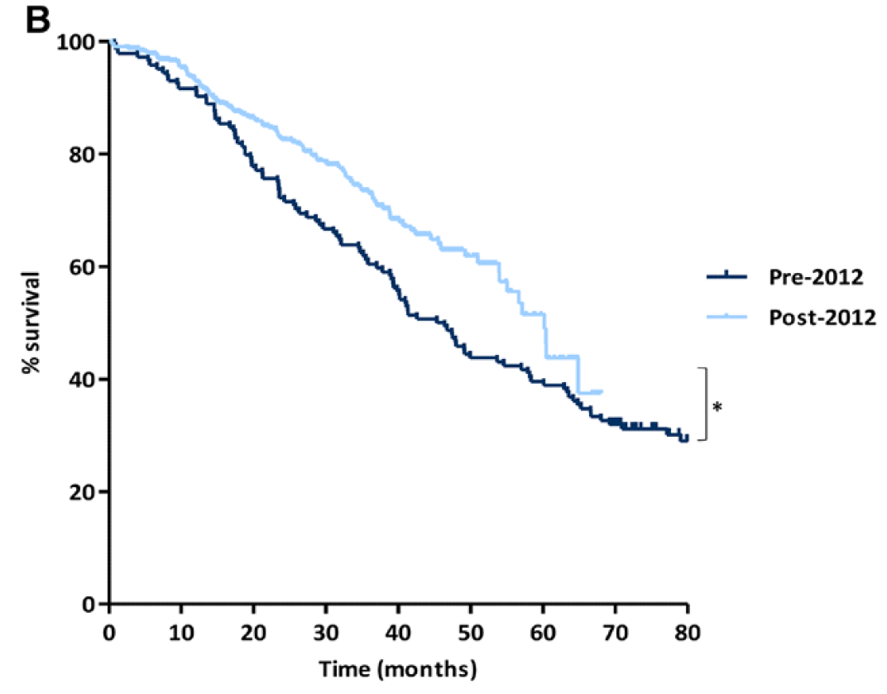
ATTR-CM diagnosis, delays, early diagnosis assumptions
Other comments: Web, patient and professional groups
Source: Lane et al 2019
Unclear if recommending tafamidis will reduce delays → no data to support this Increased ATTR-CM diagnoses started before ATTR-ACT and DPD adoption ATTR-CMwt survival data (RHS figure →) shows improvements in survival post-2012 without disease modifying treatment → could be explained by earlier diagnosis Diagnosis times have improved → trend will continue thanks to educational events Patisiran and inotersen improved time to diagnosis → tafamidis may improve things further
How would ATTR-CM be diagnosed in clinical practice? Does this match the ATTR-ACT population?
Can incidental amyloid deposits from DPD scans be misinterpreted as amyloidosis?
Would the introduction of tafamidis reduce time to diagnosis?
Could future benefits from earlier diagnosis be attributed to tafamidis?

Slide 20
Continuation of treatment benefits Committee considerations
ACD sections 3.15 and 3.16
The company analysis is overly optimistic and underestimates the ICERs
ERG alternative analyses (below) had limitations, but provided realistic alternatives
Committee considerations (ACD sections 3.15 and 3.16)
The company analysis assumed continued treatment benefits without a cost after stopping treatment → overly optimistic and leads to underestimated cost-effectiveness estimates
Company
base-case
People on tafamidis in NYHA 1 to 3 health states
After discontinuation
Log-normal discontinuation function
Treatment benefits continue and costs stops
During the observed clinical trial period
After the clinical trial period
ERG alternative analysis 1
Model treatment stopping in NYHA 1 to 3
Assume all people on tafamidis remain on treatment, continuing treatment benefits and costs
People on tafamidis in NYHA 1 to 3 health states
After discontinuation
ERG alternative analysis 2
Log-normal discontinuation function
Costs and outcomes revert to those of best supportive care

Slide 21
Continuation of treatment benefits
Company’s response (ACD response points 11)
ATTR-ACT had complete follow-up with no censoring or loss to follow-up → the impact of tafamidis discontinuation on efficacy was accounted for in the OS predictions Tafamidis reduces the cumulative exposure to amyloid → people discontinuing tafamidis have a better prognosis than those on BSC → longer time on treatment → greater benefits ERG analyses include unnecessary assumptions → company models the observed data
ERG’s comments:
The company’s analysis unreasonably assumes an increasing proportion of people are assumed to discontinue tafamidis while continuing benefits at zero cost Company acknowledged limitations with their approach at technical engagement but continue to prefer their base-case assumption → continued benefit at zero cost: The company illogically argues the benefits of using ATTR-ACT data to extrapolate discontinuation rates, but suggests data from the extension study should not be used
Other comments (NAC):
No evidence of a sustained benefit after stopping tafamidis New evidence suggests disease stabilisation doesn’t necessary inhibit amyloid formation → amyloid is likely to reaccumulate after treatment has discontinued
Will tafamidis treatment benefit continue after discontinuation?
Will people discontinue tafamidis in NYHA 1 to 3 health states?
Will people receive BSC after discontinuing tafamidis?

Slide 22
Other issues | Questions
NYHA functional classification system
Committee considerations (ACD 3.5, 3.6 and 3.23) NYHA is mainly used in practice to assess heart failure Challenging to identifying people who need treatment and those benefiting from it without an objective and validated measure for ATTR-CM Inappropriate to define starting and stopping rules for tafamidis based only on NYHA class | Is the NYHA functional classification system used to measure and categorise ATTR-CM disease severity? Would or could the NYHA functional classification system be used to make decisions about starting or stopping tafamidis? If yes, how would it be used to inform these decisions?
Company’s response (ACD response points 3, 4, and 6) NYHA is the most widely used in heart failure NYHA has been considered in other NICE guidelines NYHA limitations shouldn’t influence treatment starting rules → tafamidis benefits observed across broad population SmPC recommends starting treatment “as early as possible in the disease course when the clinical benefit on disease progression could be more evident” ATTR-ACT demonstrates greatest benefit starting treatment in NYHA 1 → delaying treatment removes the opportunity to halt disease progression and reduce mortality Evidence of discontinuation in NYHA 4 in ATTR-ACT Mechanism of action means its clinically appropriate to stop in NYHA 4
Other comments NYHA status can vary from day to day → could be staged with NAC system NYHA is subjective but a good indicator of disease stage No evidence to support the use of tafamidis in NYHA 1 It would be challenging to stop tafamidis on progression to NYHA 4

Slide 23
Other issues | Questions
Overall survival (OS) extrapolations
Committee considerations (ACD 3.17) Company changed its OS extrapolation function to generalised gamma → more favourable tafamidis results → unclear why → use original function (log-normal) | Which overall survival extrapolation is most appropriate? Log-normal or generalised gamma?
Company’s response (ACD response point 12) Despite switching from placebo to tafamidis after month 30 mortality risk in the placebo group continues to be greater in the placebo group than the tafamidis group → benefits increase inline with time on treatment → likely the estimated survival curves do not reflect expected tafamidis survival gains Extrapolations were similar in fit appropriate to use the more optimistic
ERG’s comments Generalised gamma was the worst-fitting model according to BIC Company’s justification is insufficient to use an alternative extrapolation
Clinical relevance of the primary outcome measure in ATTR-ACT
Committee considerations (ACD 3.9 and 3.23) ATTR-ACT primary outcome (combined measure) is not used in clinical practice Unclear if the trial results are relevant to people treated clinical practice | Is the combined outcome measure used in clinical practice? Is a statistically significant difference in scores, clinically significant?
Company’s response (ACD response point 9) Combined measure of CV-hospitalisation and mortality are relevant to patients Previous heart failure appraisals have considered primary composite endpoints
ERG’s comments Mortality and hospitalisation are relevant to people with ATTR-CM

Slide 24
Other issues | Questions
Subgroups
Committee considerations (ACD 3.6, 3.9, 3.10, 3.14, 3.18, and 3.23) In ATTR-ACT tafamidis reduces deaths and hospitalisation more than placebo Concerns about inconsistent results in different types and stages of ATTR-CM Experts questioned whether everyone would benefit from treatment with tafamidis No evidence showing difference in tafamidis effectiveness if started in NYHA 1/2 | Do the subgroup results introduce uncertainty into the consideration of tafamidis efficacy in the overall population?
Company’s response (ACD response point 12) Subgroup results acknowledged as underpowered → results in overall population should not be undermined No scientific basis supporting committee’s conclusions → no statistically significant interactions (differences) between the subgroups of ATTR-CM types (wildtype v hereditary) or NYHA stages (1/2 v 3)
ERG’s comments Subgroups were underpowered and did not control for type 1 errors Taken together, some of the statements in the ACD may appear to be inconsistent
Innovation
Committee considerations (ACD 3.26) Experts noted tafamidis mechanism of action may not be overly innovative | Does tafamidis represent a step-change in the management of ATTR-CM?
Company’s response (ACD response point 15) There is no published evidence to contradict the tafamidis mechanism of action
Other comments ATTR-ACT trial did not shed any light on tafamidis mechanism of action Verona et al (2017) shows ‘stabilization’ does not always stop amyloid formation

Slide 25
Cost-effectiveness results Including PAS | Inc QALYs | ICER (£/QALY)
Company’s base-case assumptions
Age adjusted utility values after trial period (month 30) Discontinuation modelled (exponential) in NYHA 1 to 3 after trial period: after discontinuation tafamidis benefits continue and costs are stopped Everyone achieves BSC utilities in NYHA 4 Generalised gamma OS distribution (tafamidis & BSC) Early diagnosis assumptions £20,000 cost saving QALY loss from depression/anxiety = 0.18 Lower diagnosis age by 2.5 years | ****** | ******
Committee’s preferred assumptions (amendments from company assumptions)
Using a log-normal extrapolation function to model overall survival Inclusion of drug wastage Removal of NYHA 4 stopping rule Tafamidis discontinuation (consider ERG’s alternative assumptions) Alternative 1 (ALT1): No discontinuation in NYHA 1 to 3 after observed trial period (month **): continued tafamidis benefits and costs, OR Alternative 2 (ALT2): Exponential discontinuation function in NYHA 1 to 3 BSC outcomes applied after tafamidis discontinuation | *****to ***** | *****to *****
Source: Company PAS letter and tech team calculations (checked by ERG)

Slide 26
Cost-effectiveness results Scenario analyses (including PAS) | ICER (£/QALY)
 | Company | Committee range
Scenarios |  | ALT1 | ALT2
Base-case* | ****** | ****** | ******
Early diagnosis assumptions
1) Reduce age of diagnosis 2.5 years to 71.95 | ****** | ****** | ******
2) QALY loss of 0.18: reduced anxiety/depression | ****** | ****** | ******
3) Including £20,000 cost savings | ****** | ****** | ******
4) All early diagnosis assumptions combined (1+2+3) | ******* | ****** | ******
Continued treatment benefit
5) Discontinuation modelled in NYHA 1 to 3 after trial period | ******* | ****** | ******
6) No discontinuation modelled in NYHA 1 to 3 after trial period | ****** | ******* | ******
7) BSC outcomes applied after tafamidis discontinuation | ****** | ****** | *******
NYHA 4 stopping rule
8) NYHA 4 stopping rule included | ******* | ****** | ******
9) NYHA 4 stopping rule removed | ****** | ******* | *******
Overall survival extrapolation
10) Generalised gamma OS extrapolation function | ******* | ****** | ******
11) Log-normal OS extrapolation function | ****** | ******* | *******
Key issue
Other issue
* base-case assumption, note: ICERs calculated by tech team checked by ERG

Slide 27
Equality concerns raised during consultation
Recommendations will promote inequality in minority groups disproportionately affected by ATTR-CM. This should be considered in decision making.
The most common transthyretin (TTR) variants associated with hereditary transthyretin amyloid cardiomyopathy (ATTR-CM) are Val122I, which is prevalent in people of African Caribbean family origin, and T60A, which is prevalent in white people and endemic to parts of Northern Ireland.
“Elderly people” not enrolled in EAMS will be denied a treatment that could maintain a state of health aging and reduce morbidity, while those in EAMS receive life saving therapy.
Penalising uncertainty by accepting a lower ICER threshold discriminates against those with rare diseases.

Slide 28
Issues for consideration
Diagnosis of ATTR-CM, diagnosis delays, and assumptions | How is ATTR-CM diagnosed in clinical practice? Does this reflect the ATTR-ACT inclusion criteria? (criteria included in back-up slides) Can incidental findings of amyloid deposits from DPD scans be misinterpreted as amyloidosis? Would the introduction of tafamidis reduce diagnosis delays? Can any benefits from earlier diagnosis be attributed to tafamidis?
Continued treatment benefit | Will tafamidis treatment benefit continue after discontinuation? Will people discontinue tafamidis in NYHA 1 to 3 health states? Will people receive BSC after discontinuing tafamidis?
Other issues | Is the NYHA classification system used in clinical practice for ATTR-CM? Are starting and stopping rules for tafamidis based only on the NYHA classification system implementable?
 | Which overall survival extrapolation is most appropriate? Generalised gamma or log-normal?
 | Is the combined outcome measure used in clinical practice? Is a statistically significant difference in scores, clinically significant?
 | Do the subgroup results introduce uncertainty into the consideration of tafamidis efficacy in the overall population?
 | What is the most plausible ICER? Does tafamidis represent a step-change in the management of ATTR-CM? Equality considerations
Key issues
Other issues

Slide 29
Back-up slide
ATTR-ACT inclusion criteria:
Medical history of Heart Failure (HF) with at least 1 prior hospitalisation for HF or clinical evidence of HF (without hospitalisation) manifested by signs or symptoms of volume overload or elevated intracardiac pressures (e.g., elevated jugular venous pressure, shortness of breath or signs of pulmonary congestion on x-ray or auscultation, peripheral edema) that required/requires treatment with a diuretic for improvement,
Evidence of cardiac involvement by echocardiography with an end-diastolic interventricular septal wall thickness > 12 mm,
Presence of amyloid deposits in biopsy tissue and presence of a variant TTR genotype and/or TTR precursor protein identification by immunohistochemistry, scintigraphy or mass spectrometry

Slide 30
Back-up slide Assessment of heart failure
New York Heart Association (NYHA) functional classification
Class | Patient symptoms
1 | No limitation of physical activity. Ordinary physical activity does not cause undue fatigue, palpitation, dyspnoea (shortness of breath).
2 | Slight limitation of physical activity. Comfortable at rest. Ordinary physical activity results in fatigue, palpitation, dyspnoea (shortness of breath).
3 | Marked limitation of physical activity. Comfortable at rest. Less than ordinary activity causes fatigue, palpitation, or dyspnoea.
4 | Unable to carry on any physical activity without discomfort. Symptoms of heart failure at rest. If any physical activity is undertaken, discomfort increases.
Source: American Heart Association, 2017

