Slide 1
NICE Evidence services
April 2016

Slide 2
Objectives and outcomes
Objectives:
to communicate up-coming changes to the NICE Evidence Services, including Evidence search and the redeveloped HDAS.
Learning outcomes:
a better understanding of how the NICE Evidence Services are delivered and the role of information professionals at NICE in delivering them
awareness of key changes in the pipeline for Evidence search and the implications for using the service
awareness and understanding of the upcoming changes to HDAS
opportunity to talk to NICE about NICE Evidence Services and how we can support library staff in their work

Slide 3
Today’s session
NICE Information Services
Evidence search:
recent changes
planned changes
advanced searching notes
promotional package
Core content update
HDAS update
features and benefits of the re-launch
timescales for change
plans for training materials
the process behind technical changes to the service
What can we do to support you?

Slide 4
Evidence Resources
Digital Services
Supports the digital requirements
of NICE
Information Resources
Supports the broad information requirements of NICE
Develops and delivers NICE Digital Services, including:
•NICE.org Website
•NICE Pathways
•NICE Evidence Services – BNF, BNFc, Journals and Databases, CKS, Evidence Search.
Commissioned Content and Access
procures and contract manages commissioned content on behalf of the NHS and makes this available via OpenAthens or IP range
Evidence Information Services
NICE Evidence Services
Information support for surveillance requirements
Guidance Information Services
Information support for guidance requirements
Corporate library services
Notes:
Quick recap – Darzi review recommended that NLH move to NICE to develop.
Relaunched as NHS Evidence in April 2009.
Information Resources – supports all the other directorates of NICE, along with Digital Services.
NICE Evidence search – renamed when NICE took on responsibility for social care (April 2014), and NHS Evidence was too narrow for our new focus.
Team of information specialists adding/checking content to search, developing the technology behind the search (Information Specialists in Digital Services team as well as other IS teams).

Slide 6
Evidence search – key messages
NICE Evidence search: make better, quicker evidence based decisions.
Evidence search provides access to selected and authoritative evidence in health, social care and public health.
Combines evidence on health, drugs and technologies, public health, social care, and healthcare management and commissioning in one place
Brings together high quality consolidated and synthesised evidence from hundreds of trusted sources

Slide 7
Key messages cont’d
Includes guidance, systematic reviews, evidence summaries and patient information
Freely available, without needing to log in
Content is refreshed regularly and up to date
Full text of the search results can be freely obtained in most cases
Offers filters to manage search results, allowing access to relevant information more quickly

Slide 8
Evidence search – style guide
In development…
Will provide: standardised name, strapline, key messages, logo/image, links

Slide 9
Evidence search - changes
Evidence search has a rolling development programme, with small changes or tweaks being released to the site as they are ready.
When there are bigger changes due to be released, we will publicise these with as much notice as possible.

Slide 10
Evidence search - changes
Recent changes:
filtering by date
single as well as double quotes for phrase searching
title, URL and tags searching
search hints if 0 results are returned
exporting search results

Slide 11
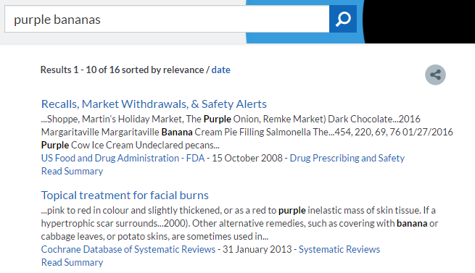
Notes:
Better hints/tips when 0 results are found

Slide 12
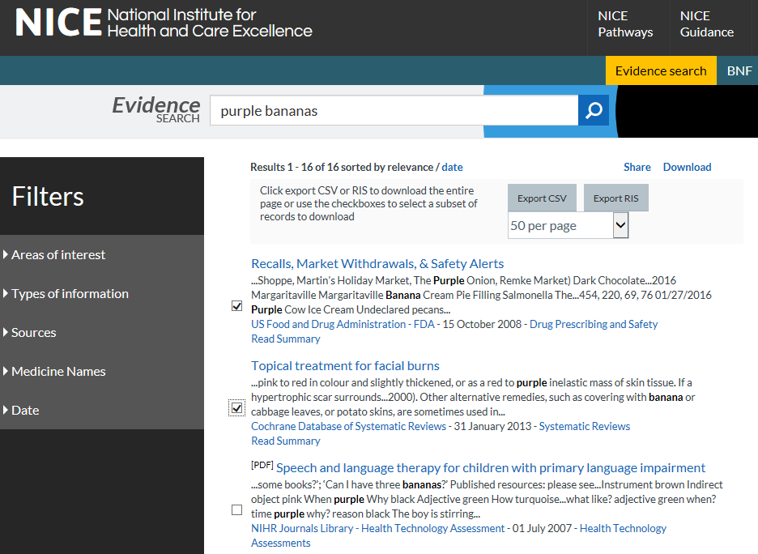
Notes:
Exporting results
Click on the Download option at the top of your search results.
Can either click to export the whole page, or select records yourself.
The number of records that can be exported at any one time is limited to the number of records showing on one page (250 records max by default).
no log in is required, it’s quick, two file formats are available, record selection within a page is possible, it should be clear how to access the function and instructions for use are available on the page.

Slide 13
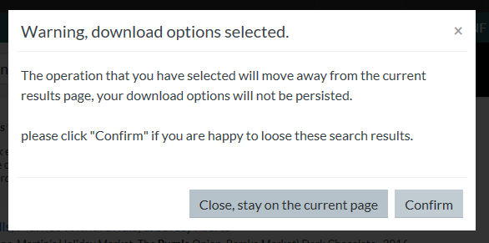
Notes:
Exporting:
One thing to note is that any interaction that changes the page (i.e. pagination, filtering, changing order etc) will remove any selections that have been made. Steps have been taken to warn users that selections are at risk when they do something that changes the page.

Slide 14
Evidence search - changes
Changes in development:
PDF/doc/xls/ppt files highlighted in search results
new filter presentation
advanced search page
Notes:
These changes are at different stages of development. Advanced search page in particular is only at analysis stage.

Slide 15
Evidence search – notes for advanced searchers
Produced to give some insight into how Evidence search works, explain what happens when different search features are used, and provide some hints/tips for searching.
https://www.nice.org.uk/Media/Default/About/NICE-Communities/Library-and-knowledge-services-staff/notes-for-advanced-searchers-jan2016i.pdf

Slide 16
Notes for advanced searchers
ranking of results
word stemming (lemmatisation)
synonym expansion
wildcard searching
phrase searching
Boolean operators
stop words
spelling correction
UK vs international

Slide 17
Library and knowledge services staff community pages
http://www.nice.org.uk/about/nice-communities/library-and-knowledge-services-staff
Training materials and help guides:
http://www.nice.org.uk/about/nice-communities/library-and-knowledge-services-staff/training-materials

Slide 18
Core content - update
Full text linking from Medline is fixed
not all going direct to article level, but this works in the new HDAS
Other requests are with Proquest as they need to resolve

Slide 19
Procurement: framework
National Framework
supplier event was held in January 2016 for bidders who had expressed an interest in tendering.
the meeting set out the new Framework specification and purchasing process.
the full tender pack will be published in mid- March, with the tender submission deadline end of April.
the new Framework will be in place for start of July 2016.

Slide 20
Procurement: access
Content support services:
AIMS Procurement - the PIN has been sent out, we are going through the DH approval process, the procurement process will begin on 30th March
Link Resolver Procurement
the PIN has been sent out
Supplier Day held on Tuesday 8th March
the procurement process will begin in May.
Notes:
PIN – prior information notice – intention to procure, before the invitation to tender

Slide 21
HDAS redevelopment project
What: to improve the stability and performance of HDAS and create a better user experience
Why: no investment for 12+ years
How:
cost split between NICE and HEE
technical team: NICE
Notes:
This project is the outcome of the HDAS review carried out in 2014

Slide 22
Governance
Project Board: NICE, HEE x 2, Public Health England, National Clinical Fellow
User reference group: information specialists and clinical input
Government Digital Services (GDS) principles https://gds.blog.gov.uk/
Notes:
User reference group: Jane Wroe, Laura Coysh, Tricia Rey, Jo Whitcomb – info specialists from LKS, Helen Outhwaite – info specialist from PHE, Sarah Glover – info specialist at NICE, clinical fellows.
Project Board co-chaired by NICE (Marion Spring) and HEE (Richard Osborn)

Slide 23
Project management
Discovery
Existing research
New user research: survey and observation
Desk research: what else is available
Development:
requirements, MoSCoW, minimum viable product
Agile approach; sprints and showcases
Alpha and beta testing
Continuous improvement

Slide 24
HDAS - timelines
Current version
early test site, lots of development work going on
Alpha version – imminent
Tested with a restricted group of testers, including library staff
Beta version – due end April
Available to everyone to test – FEEDBACK WANTED
New live version – due quarter 1 of 2016/17
Will run in parallel with old version for a period, to allow a switch-over
Notes:
New live version will have at least the minimum viable product (the set of features defined by the project board as being the minimum that had to be delivered – the “must have” list. These are based on the prioritised needs of users identified during the discovery phase of the project). It will also include many additional features that were on the “should have” list.
At launch HDAS will provide the essential functions, with further functionality and refinements being added over time. The library community will be involved in prioritising the additional functionality.

Slide 25
HDAS - improvements
Time saving method for searching
The new service will be more intuitive which should result in a reduction of time that librarians spend providing training on the system.
The experience will be more intuitive making the service more accessible to non-specialist users.
The improved interface will make it easier for users to create search strategies and use many of the other HDAS features available.
Notes:
More accessible – increase the potential user group for HDAS by making it easier to use.

Slide 26
HDAS - improvements
Improved performance and stability
Users will be provided with error handling messages to inform them if there is an error rather than the search strategy taking a long time to process.
Users will be informed of errors in their search syntax
When searching multiple databases, results are returned for each database when ready, rather than waiting for the slowest database

Slide 27
HDAS - improvements
Improvement to the search functions
We have reduced the steps to select which databases to search, and users will now open the site directly on the search page.
From the search page you will have easy access to the various databases, thesauri and limits as they apply to each database and choices over which fields you want your search to apply to.
A new feature added is the ability for users to see their search history in isolation or alongside the actual search results.
User preferences will be remembered, so they only need to be applied once.
Notes:
User preferences – eg, setting the number of results to display per page, showing titles/abstracts, limits opened out or not, show results or just search history.

Slide 28
HDAS - improvements
Easier to plug in new databases
Reactive to provider changes
Easier to identify issues and resolve them
Eg diagnosing whether a problem lies with HDAS or with the database providers

Slide 29
Current test version http://alpha.hdas.nice.org.uk/
Notes:
Note the Search help – i symbol. This is contextual – one page, but opens to the relevant bit, and moves with you.
If you want to have this open at the same time as your search page, you need to right click and choose to open in a new tab/window.

Slide 30
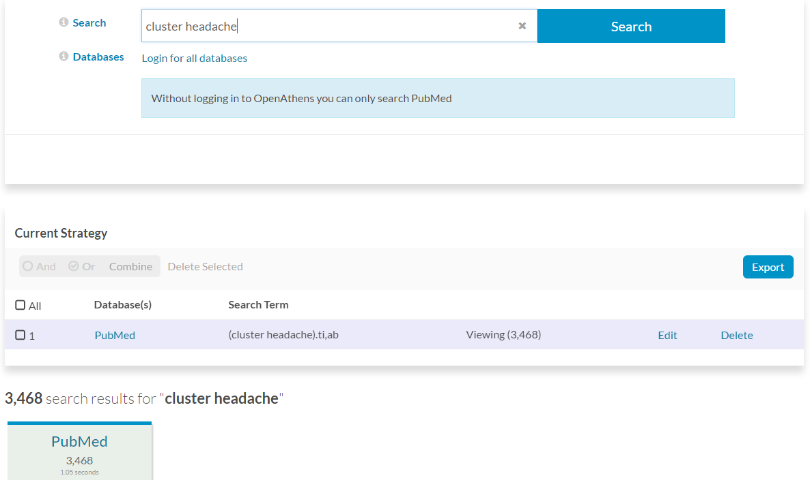

Slide 31
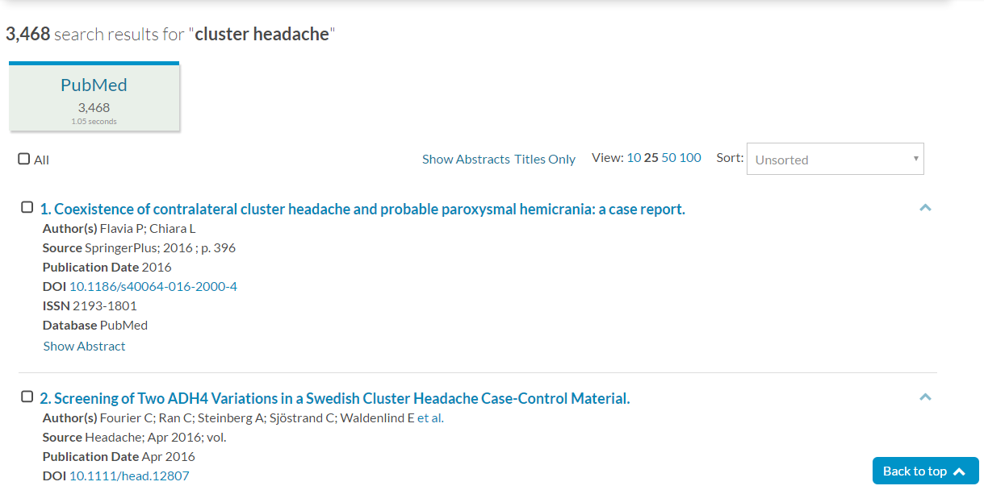

Slide 32
Logged in
Notes:
Logged in – note options for New Strategy, My Strategies and Saved Results at the top.
Note – the Search button doesn’t become available until you enter some search terms and choose your databases.
If you type in a term and hit Enter on your keyboard before you select a database, it highlights the databases in red to remind you.

Slide 33
Database selected, field and limit options

Slide 34
Keyword search
Notes:
NB: In the search history, shows as “Running” until results are in.
Will give error messages if there’s a problem, or a time out, etc.

Slide 35
“Lower search panel”
Notes:
This moves the search box below the search strategy – you can move it back to the top if you want, with the “Raise search panel” link

Slide 36
Error messages
Notes:
I typed .xx as a field code – it spotted that this isn’t right, and highlights in search history.
If you click on “Syntax error” in the history…

Slide 37
Notes:
…it gives a message about what’s wrong and gives you the option to change your search term and Update your search

Slide 38
Thesaurus searching

Slide 39
Thesaurus searching cont’d
Notes:
You then have options to see what it’s used for, select, explode, major, etc.
Not the search builder at the top of the screen – can choose how to add to your search.

Slide 40
Thesaurus - subheadings

Slide 41
Thesaurus results
Notes:
Thesaurus terms are shown in capitals, with quotation marks if more than one word, with the / at the end.

Slide 42
Current strategy
Notes:
Can save your current search strategy – give it a name, click Save Strategy.
Can edit and delete individual search lines.
Edit – amend database selection, search terms – click Update. Advanced option takes you back to the top of the screen with full options for fields and limits, etc.
Can also select a search line and choose to Re-run searches in another database.
Combining search rows – is now available. Able to select rows, and then have a “combine with AND or OR ” option. ‘NOT’ is not available as a button, but you can type this in. This is because of the user experience challenges of offering this as a button – as you need to specify the order of combining sets with ‘NOT’
Or you’ll be able to type, for example, 1 or 2 into the search box.

Slide 43
Re-run

Slide 44
Export
Notes:
Export – this will export records from search rows.
“Searches report” enables you to download your search strategy – doesn’t look very pretty at the moment, but is being styled.
Options for PDF/Word/RIS.

Slide 45
Search results
Notes:
Shows results from each database grouped together.
Defaults to show details for each record, but with options to show Abstracts or Titles Only
Can set number of results to view on a page – default is currently 25.
Sort options.
The current HDAS sort options are a mixture of things.
New version: results are displayed in the order in which the databases return them – no sorting is applied by us.
Because we display sets of results by database, you can only sort results from each database at a time.
The option to sort is by Publication Date. If you choose this option, HDAS re-sends your search to the database provider and asks them to return in publication date order – we don’t do that ourselves. This will sort the whole list from a particular provider, so isn’t limited to just 500 results.
Saving results: New HDAS does not have a clipboard – instead you can save search results.
If you save your strategy first, then the results you choose are saved against that strategy name.
Can select All – or tick individual ones. Then click on Save Selected button.
You can keep on adding to your saved results – the Save Selected button changes to “Add to Saved” once you have already saved some.

Slide 46
Saved Results
Notes:
Clicking the Strategy Name takes you back into that search strategy.
Clicking the Results saved takes you to just those results.
NB: save your strategy first, to give it a name. Otherwise, they’re just called “Autosave”.
Or, if you save them without a name, once you save your strategy, it gives them a name.

Slide 47
Saving search strategies
Notes:
Add a name – click on Save Strategy
Once it’s saved, a little “Saved” notice appears – then disappears, but the option to name the strategy is gone and your name displayed.

Slide 48
My Strategies: Saved Strategies
Notes:
These are searches that you have named and chosen to keep. These are saved until you choose to delete them.
You re-run the search by clicking on a Name.
Clone
This allows you to create a copy of a search, and then modify it and save it with a new name.
A bit like creating a template.
If you go into a Saved search and make changes, they are saved automatically.
If you use the Clone option, you are copying a search, which can then be amended and saved as a separate strategy.

Slide 49
My Strategies: Strategy History
Notes:
Every time you make a change to a search, it is saved here in your strategy history – in case of crashes, time outs, etc. So if something goes wrong, your work isn’t all lost.
This will be a rolling save – set to 28 days.

Slide 50
Still to be developed
Creating alerts
De-duplication

Slide 51
HDAS – the future
Continuous improvement
Change control requests
Up to 10 days development work
Currently prioritised by group internal to NICE

Slide 52
Keep in touch
HDAS – further updates and information
http://labs.nice.org.uk/hdas-redevelopment
Evidence search
http://www.nice.org.uk/evidence-feedback
For issues and defects
contactus@evidence.nhs.uk

Slide 53
What can we do to support you and your work?
Questions?

