Slide 1


Antimicrobial Resistance: Developing and testing innovative models for the evaluation and purchase of antimicrobials.
In support of the UK’s vision for AMR by 2040 and five-year national action plan
January2021

Slide 2
Housekeeping
Duration of webinar is approximately two hours​
Please note that this webinar, including Q&A will be recorded and may be published later.
Questions should be submitted using the ‘chat’ function. We will look to collate these and provide answers at the end of each section.

Slide 3
Key updates
Product selected for the new antimicrobial part of the project:
Cefiderocol (Fetcroja) manufactured by Shionogi
Product selected for the existing antimicrobial part of the project:
Ceftazidime with avibactam (Zavicefta) manufactured by Pfizer

Slide 4
Project overview
Aim: To develop and test an innovative payment model that reimburses companies for antimicrobials based primarily on their value to the NHS as opposed to volumes used.
Success criteria:
An agreed HTA valuation framework and complete value assessment of two products.
An agreed payment framework that leads to successful negotiation of payments for the two products, supporting good stewardship.
Other countries test models that, together, achieve pull incentives for antimicrobials and stimulate companies to increase investment.

Slide 5
Background
In 2015, a joint Government/ Industry AMR working group and a sub-group were established to consider reimbursement and evaluation of antimicrobials and the principle of an innovative payment model was agreed.
In 2017, The Economic Evaluation Policy Research Unit (EEPRU) was commissioned to consider a value assessment approach for antimicrobials.
In October 2018, EEPRU published a “Framework for value assessment of new antimicrobials”.
The UK five-year national action plan for AMR published in January 2019 commits to test a new evaluation and payment model for antimicrobials.
In 2019 and early 2020, NHS England & Improvement and NICE in conjunction with feedback from industry and international stakeholders, finalised proposals to evaluate antimicrobials based upon their value to the NHS and to reimburse based upon value rather than the quantity supplied.
In June 2020, a tender for one existing antimicrobial and one new antimicrobial was launched by NHS England and NHS Improvement / NICE project team
In December 2020, the process of selecting two antimicrobials to proceed to the NICE evaluation process and ultimately to be supplied via the new payment model was completed.

Slide 6
The payment model
The principle of the model is that companies are paid for antimicrobials based on the estimated value of benefits to patients and the NHS which is consistent with good stewardship rather than payments based on volumes used.
The value of the antimicrobials will be estimated by NICE through an adapted Health Technology Assessment with information from health economic modelling and expert opinion.
The model will capture value not just from the direct health gain to patients treated, but additional elements e.g. insurance value, diversity value, transmission value and enablement value
Value assessment will be used to inform commercial discussions, leading to payments to companies of an annual fixed fee in instalments.

Slide 7
Application of the model
The model is being tested through application to two antimicrobial products selected via competitive procurement exercise:
One existing (has received marketing authorisation in past 2-3 years)
One new to market (with expectation of a marketing authorisation by end 2020 and with plans to launch in UK)
Future policy for the evaluation and purchasing of antimicrobials will be informed by the outcomes from this project

Slide 8




Project outline
5. New payment model implemented
1. Project development and preparation:
Stakeholder engagement
Commercial and evaluation frameworks
Contract design
2. Selection of products for testing
3. Evaluation of the selected products
4. Commercial discussions
Jan to Dec 2021
Jan to April 2022
From April 2022
Completed
Completed
Start
Project launch: July 2019
Ongoing monitoring and evaluation of project, dissemination of learning and communication

Slide 9
The Selection Process

Slide 10
Stage 2: Selection Process
Stakeholder Engagement
Sept 19 to May 20
Supplier Qualification
Jun 20 to Jul 20
Supplier Dialogue & Contract Development
Aug 20 to Oct 20
Product Selection
Nov 20 to Dec 20
The process was designed specifically for this project.
Arrangements for routine commissioning may be very different
Further details are included in the procurement documents and draft contract available on the NICE website at: https://www.nice.org.uk/about/what-we-do/life-sciences/scientific-advice/models-for-the-evaluation-and-purchase-of-antimicrobials

Slide 11
Selection Process: Stakeholder Engagement
Significant engagement with industry and international stakeholders that informed the process
Payment model largely based upon industry proposals
THANK YOU to all those who contributed

Slide 12
Selection Process: Qualification & Selection Criteria
Qualification Requirements:
Technical and professional ability
Financial and economic standing
Grounds for exclusion
Project specific requirements
New antimicrobial licensed and launched between 01/01/20 and 31/12/2020.
Existing antimicrobial licensed and launched between 01/01/2017 – and 31/12/2019
Selection Requirements
Unmet Need
The WHO priority pathogens active against and included within its licensed indications
The level of UK unmet need it addressed
Performance against key determinants of antimicrobial resistance
The severity of clinical setting for the disease area covered by the licensed indications
Degree of Novelty
Surety of Supply
Antimicrobial Stewardship
Antimicrobial Surveillance
Cost – Any reduction to the maximum annual fee, offered by the supplier

Slide 13
Selection Process: Supplier Dialogue
Individual supplier meetings were invaluable to:
Develop the final form contract e.g.
Payment model
Surety of supply
Stewardship and surveillance requirements
Ensure understanding and reach agreement between suppliers and ourselves e.g.
An antimicrobials anticipated usage
A price (subject to NICE evaluation) that hospitals would purchase the antimicrobial
Performance requirements
Notes:
July 2019: Project launched
September 2019: Completion of stakeholder engagement on draft evaluation framework, product selection process and commercial model
October 2019: Stakeholder webinar covering outcomes from the targeted engagement and the need for compliance with Public Contracts Regulation 2015
February 2020: Project Advisory Group recruited
March 2020: Draft documents for procurement process (via competitive dialogue route) shared with stakeholders

Slide 14
Selection Process: Outputs
Two products selected
An agreed subscription type payment model
A contract ready for signing, subject to inserting the following that will be informed by the outcome of the NICE evaluation:
The annual contract value
The confidential hospital purchase price per pack
Any product specific adjustments to the stewardship & surveillance requirements
Notes:
July 2019: Project launched
September 2019: Completion of stakeholder engagement on draft evaluation framework, product selection process and commercial model
October 2019: Stakeholder webinar covering outcomes from the targeted engagement and the need for compliance with Public Contracts Regulation 2015
February 2020: Project Advisory Group recruited
March 2020: Draft documents for procurement process (via competitive dialogue route) shared with stakeholders

Slide 15
Selection Process: – Contract Highlights
Subscription type payment model (independent of quantity supplied)
Contract value set based upon value to NHS subject to cap of £10m pa
3-10 year term
Pressure relief mechanism in event of very significant and unanticipated increased usage
Confidential hospital purchase price to facilitate use of existing supply chains
Hospital purchase price to be set to encourage appropriate use and discourage inappropriate use and can be adjusted by mutual agreement.
A limited number of performance requirements
Minimum On Time in Full (OTIF)
Minimum stock holding within supply chain and physically within England
Compliance with stewardship, manufacturing, environmental and surveillance requirements
Notes:
July 2019: Project launched
September 2019: Completion of stakeholder engagement on draft evaluation framework, product selection process and commercial model
October 2019: Stakeholder webinar covering outcomes from the targeted engagement and the need for compliance with Public Contracts Regulation 2015
February 2020: Project Advisory Group recruited
March 2020: Draft documents for procurement process (via competitive dialogue route) shared with stakeholders

Slide 16
Evaluation of the selected products

Slide 17
Stage 3: The NICE evaluation
Dec 2020
Feb 2021
Sept 2021
Dec 2021
Draft scopes published for consultation
Final scopes, consultation comments and stakeholder list published
Assessment reports published
Draft guidance published
Scope consultation closed
Evaluation protocols published
Committee meetings
20 Jan 2021
March 2021
Nov 2021

Slide 18
Selected products for NICE evaluation
Cefiderocol – marketing authorisation
Infections due to aerobic Gram-negative organisms in adults with limited treatment options
Ceftazidime with avibactam – marketing authorisation
Complicated intra-abdominal infection
Complicated urinary tract infection, including pyelonephritis
Hospital-acquired pneumonia, including ventilator associated pneumonia
Bacteraemia that occurs in association with, or is suspected to be associated with, any of the infections listed above
Infections due to aerobic Gram-negative organisms in adults and paediatric patients aged 3 months and older with limited treatment options

Slide 19
Comparison to current NICE process and methods
 | NICE Technology Appraisal | NICE evaluation of antimicrobials
Purpose | Produce guidance on whether new medicine is effective and cost effective compared with currently prescribed drug Funding is mandatory | Produce guidance on plausible range of value of new antimicrobial and identify how drug is used (‘stewardship strategy’) Informs commercial discussions
Impact on NHS use of product | Guidance pivotal to whether or not, and under what circumstances, NHS uses technology | Guidance informs commercial terms rather than a binary ‘recommended/not recommended’ decision
Economic analysis output | Cost effectiveness: incremental cost effectiveness ratio (ICER), incremental cost per quality-adjusted life year (QALY) | Population net health benefit: QALYs
Benefits | Direct health effects to patients | Direct health effects to patients + additional elements of value (eg spectrum, transmission, enablement, diversity and insurance value)
https://www.nice.org.uk/Media/Default/About/what-we-do/Life-sciences/evaluation-framework.pdf

Slide 20
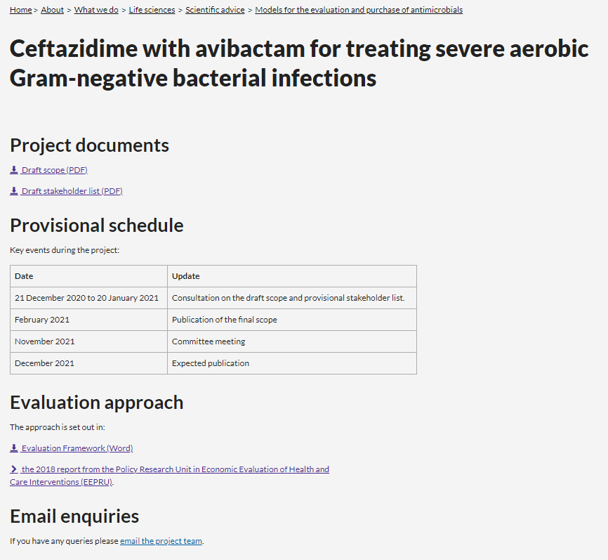
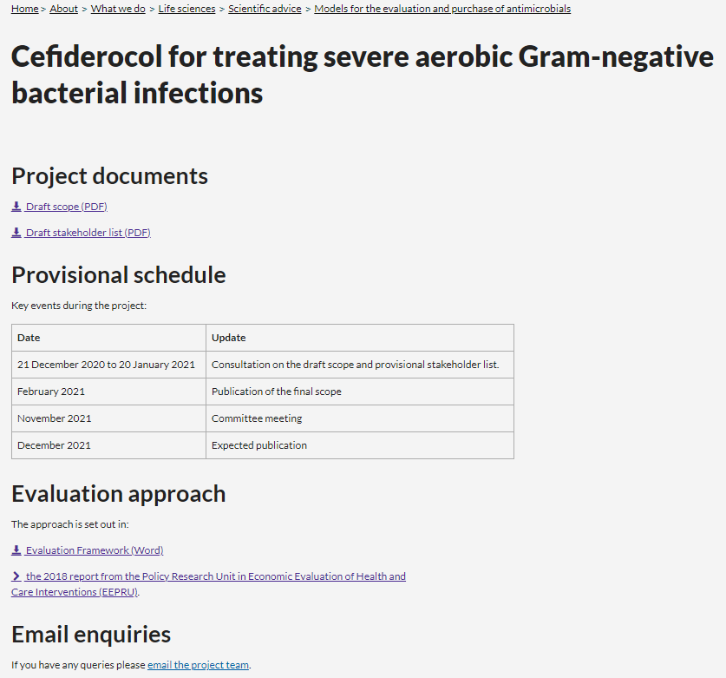
Nice evaluation: how to find out more
https://www.nice.org.uk/about/what-we-do/life-sciences/scientific-advice/models-for-the-evaluation-and-purchase-of-antimicrobials

Slide 21
International collaboration
UK represents only a small part of the global market for antimicrobials
For our work to have the full effect, we need other countries to test similar models that, together, achieve meaningful incentive for investment
Such models would need to be relevant to individual health contexts, but could include shared principles around:
Quantitative and/or qualitative assessment of the value of new antimicrobials coming to market
Delinking reimbursement to companies from volume of sales
Robust stewardship of new and existing antimicrobials
Incentivising good manufacturing practice and robust supply

Slide 22
International collaboration
Sharing project progress and learning is an important part of UK approach.
Stakeholder forum
Presenting at international fora
Meetings with international counterparts
G7 Presidency in 2021 provides potential opportunity
Notes:
To maximise the project’s chances of success, the UK is drawing on the breadth of national and international clinical, technical and industrial expertise. Sharing progress and learning from the project is an important part of the UK’s approach.
> We have established this Stakeholder Forum, with representation from industry, governments, public health bodies, academia - to act as global advocates to champion our approach and disseminate learning. (we’re delighted to see the wide range of national and international representatives and experts attending today’s session)
We have also promoted this project at international fora – including the World AMR Congress, the Gairdner Symposium and very recently the Milken Institute Future of Health Summit
We have also met with our counterparts in other countries – including those in Japan, the USA, Italy, Canada – to share learning and explore how the application of innovative evaluation and reimbursement models might be applied within different health systems.
The UK is pleased to be hosting the G7 Presidency this year and working with G7 partners on tackling the current pandemic, as well as looking at how can we can strengthen the global health security for the future, including around important issues such as pandemic preparedness and vaccines, therapeutics and diagnostics. This may provide a potential opportunity to push for novel and impactful joint action on AMR.

Slide 23
Questions

Slide 24
Thank you!
For any further questions or comments, please contact: abpaymentmodels@nice.org.uk.
More information about the project can be accessed at:
Models for the evaluation and purchase of antimicrobials | Scientific advice | Life sciences | What we do | About | NICE

