Slide 1
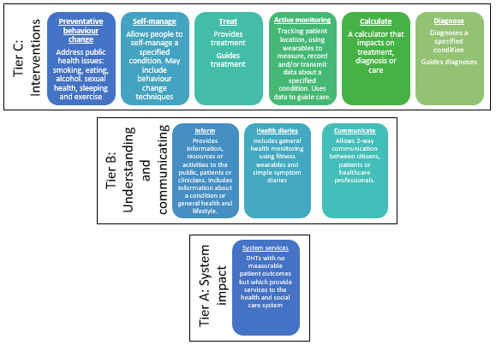





How to apply the NICE evidence standards framework
Choose the functional classification that best describes the main function of the digital health technology (DHT).
For technologies with more than 1 function, use the function in the highest applicable evidence tier.
Select the functional classification(s)
Identify the relevant evidence tier based on the highest functional classification.
There is an evidence table for each evidence tier.
Tier C: interventions
Find the highest evidence tier for those functions
Tier B: understanding and communicating
Tier A: system impact
Identify any specific risks
Are the users in vulnerable groups?
What are the consequences of DHT failure?
Is there professional oversight?
Is artificial intelligence used?
Is a very high cost expected?
Use the contextual questions to identify any potential specific risks associated with the DHT.
No specific risks:
use minimum evidence standards
Specific risks identified:
use best practice standards

