Slide 1

NICE’s real-world evidence framework
NICE makes recommendations that guide decisions in health, public health, and social care.
We want to make greater use of real-world data to learn from the delivery of health and social care and patient health and experiences to improve these recommendations.
The real-world evidence framework was developed to deliver on these ambitions by clearly describing:
When and how real-world data can be used to improve recommendations
Best practices for planning, conducting, and reporting studies
We do not set minimum standards for real-world evidence studies. Readers should refer to NICE methods guidance for further information on decision making
Health technology evaluations manual
Guidelines manual

Slide 2
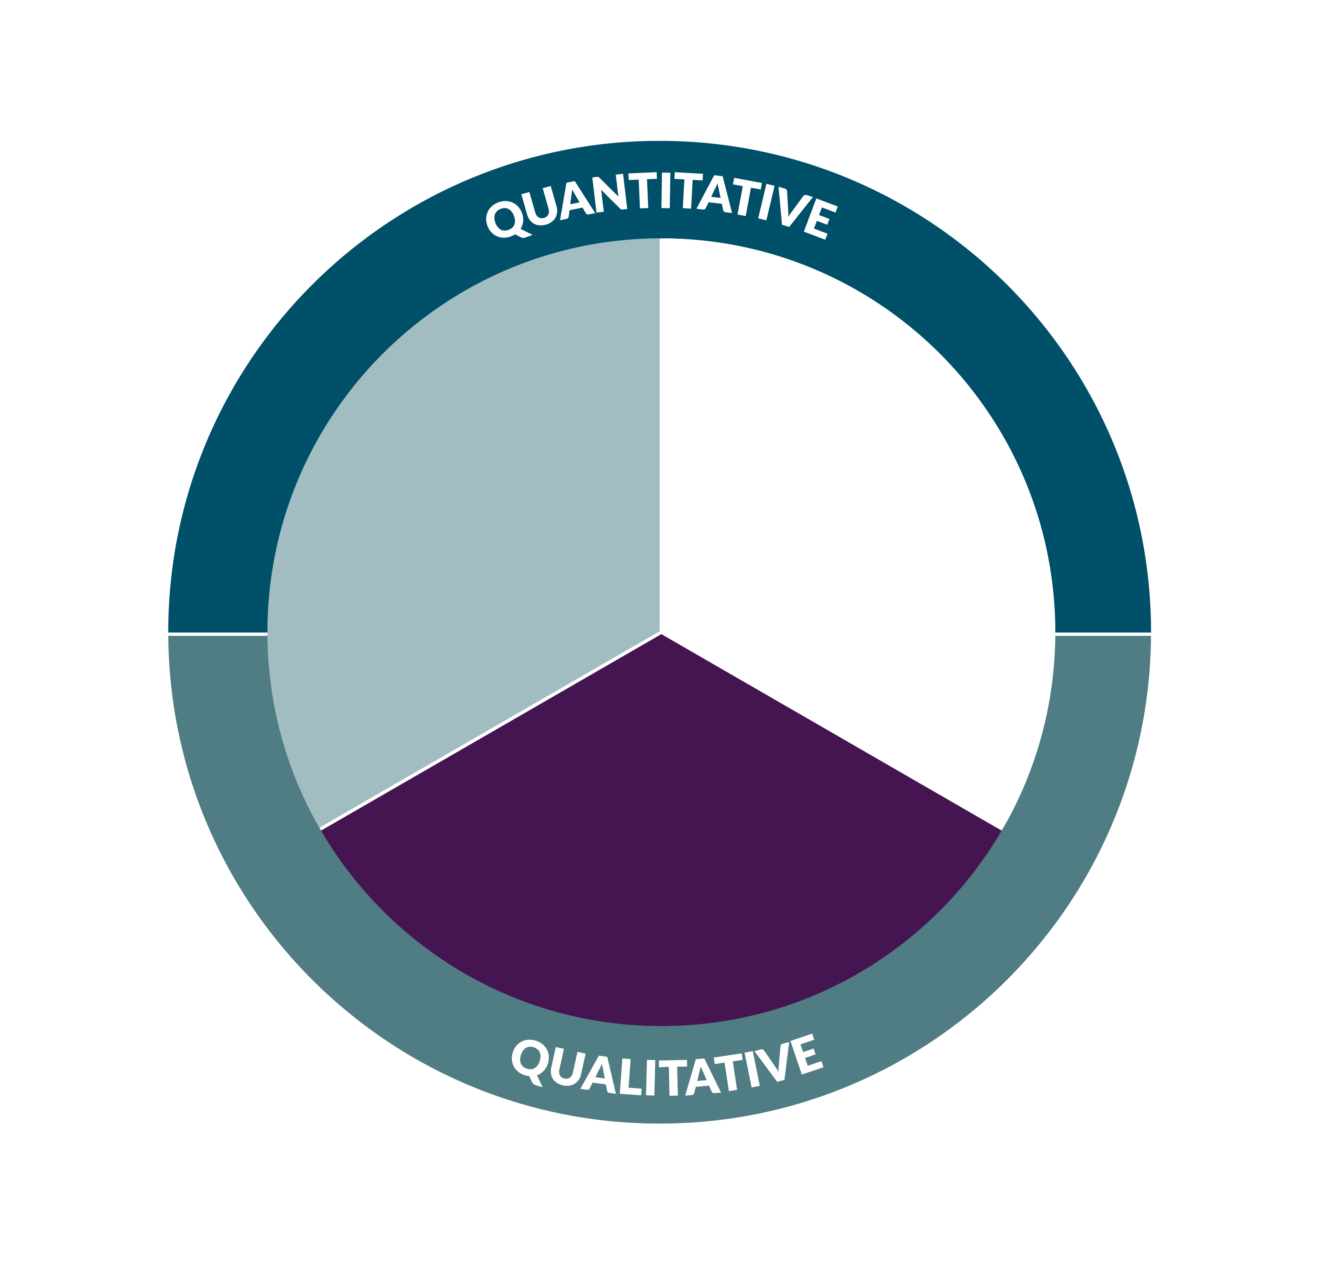



What is real-world data?
Data from service evaluations or audits or generated from patient devices
Real-world data is data relating to patient health or experience or care delivery collected outside of clinical trials
Routinely collected data:
patient health records, health service administrative records
Data collected for specific research projects: patient registries, cohort studies, surveys

Slide 3






Analysis of real-world data leads to Real-world evidence
Real-world evidence
leads to
Analysis of real-world data
Real-world evidence can improve our understanding of health and social care delivery, patient health and experiences, and the impacts of health technologies, including devices and digital health technologies, in routine settings.
Patient or user experiences
Effects of technologies on patient and system outcomes
Impact of tests on decisions about care
Populate and validate economic models
Impact of technologies on the delivery of care
Characterise disease, care delivery, and outcomes
Notes:
Real-world evidence can improve our understanding of health and social care delivery, patient health and experiences, and the impacts of health technologies, including devices and digital health technologies, in routine settings.

Slide 4
Principles of evidence generation
1
2
3
Transparency
Data suitability
Methods
Generate evidence in a transparent way and with integrity from study planning through to study conduct and reporting.
Ensure data is trustworthy, relevant and of sufficient quality to answer the research question.
Use analytical methods that minimise the risk of bias and characterise uncertainty.

Slide 5
Planning and conducting studies
Population
Who is the intended population for the technology?
Studies should be planned up front as far as possible including when using already collected data
Intervention
Plan studies in advance and share protocols where possible.
Clearly define the research question – use the PICO framework where applicable
What is the technology and how is it used?
Where in the care pathway will it be used?
Choose or collect data that is trustworthy and fit-for-purpose.
Comparator
Follow national laws, regulations, and codes of practice for data collection and use – in the UK consult the Health Research Authority
Only needed for comparative study designs
The ideal comparator is the current standard of care in the UK
Use appropriate study design and analytical methods
Use proportionate quality assurance
Outcomes
What are the patient and system outcomes that matter?
How are they measured and when?

Slide 6







Transparent reporting
Key content for reports:
Describe the data and methods
enables reviewers to understand what was done
builds confidence in the results
allows independent researchers to reproduce the results
Demonstrate data provenance and fitness-for-purpose
Fully describe data curation, study design, and analytical methods
Report results completely
Fully describe patient exclusions, participation rates, and loss to follow-up and present all important patient characteristics by intervention or subgroup
Results of all analyses, whether planned or unplanned

Slide 7
Assessing data suitability
Data provenance
Fitness for purpose
What was the purpose of data collection?
What data was collected, in what settings, how and by whom?
Data documentation and quality management
Data governance arrangements
How much data is missing on key study variables (see PICO)? Why is data missing?
How accurately is data recorded?
How was accuracy assessed?
Quality
Does the data source contain all relevant study variables?
Is the population similar to the intended population for the technology?
Are the care settings relevant to patient care in the NHS
Are the sample size and follow-up sufficient to generate reliable results?
Relevance

Slide 8
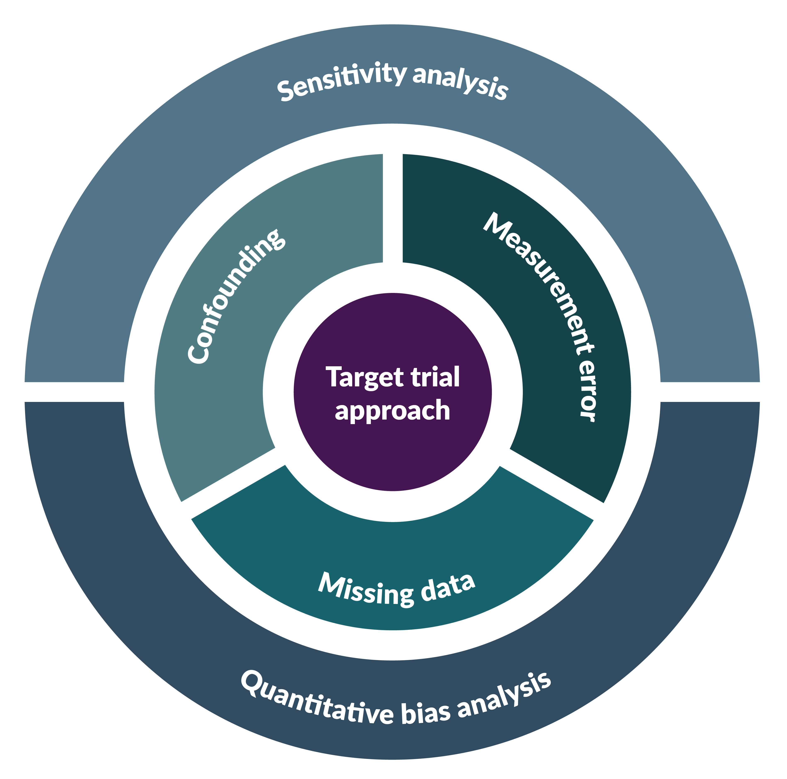
Real-world evidence studies of comparative effects
Real-world evidence can be used in the absence of trial evidence or to complement it to answer a broader range of questions about the effects of interventions in routine settings.
Here we present best-practices for cohort studies (including trials using real-world data to form external control). Other study designs including quasi-experimental designs might be most appropriate for some interventions.
Design studies to emulate the preferred randomised controlled trial – use a “target trial approach”
Identify potential confounders and address these considering observed and unobserved confounding
Consider the impact of bias from informative censoring, missing data, and measurement error – address appropriately where required
Use sensitivity and bias analysis to assess the robustness of study findings

