Slide 1
Board meeting presentation - Staff Survey 2022
NICE Key findings
1

Slide 2
Background and key aims
Annual Employee Survey with WorkL
Re-tendered for a new provider in 2022
Key aims of staff engagement surveys:
Align the questions to NICE culture
Understand employee views about different aspects of working for NICE
Measure engagement and satisfaction at the overall, directorate/centre and teams level, as well as amongst employee groups
Where possible compare results to the previous survey to identify areas that have improved or declined
Benchmarking the survey results against those of other organisations
Embed directorate specific action planning
Have the facility to explore areas further via pulse surveys

Slide 3
Response rates
The below table shows the responses breakdown by Directorate and Location. There is also a comparison to the 2021 response rate.
 | Total Staff Headcount | Total Respondents | 2022 % | 2021 %
Overall | 861 | 660 | 77% | 88%
Directorate
Centre for Health Technology | 238 | 173 | 73% | 87%
Chief Executive Office | 20 | 18 | 90% | -
Communications Directorate | 47 | 40 | 85% | 91%
Digital Information and Technology Directorate | 74 | 55 | 74% | 79%
Finance, corporate and commercial Directorate | 51 | 41 | 80% | 87%
Health and Social Care Directorate | 61 | 51 | 84% | 94%
NICE Centre for Guidelines | 258 | 188 | 73% | 87%
People and Places Directorate | 34 | 27 | 79% | -
Science, Evidence and Analytics Directorate | 78 | 67 | 86% | 91%
Location
Home | 64 | 53 | 83% | 90%
London | 210 | 152 | 72% | 79%
Manchester | 587 | 455 | 78% | 90%

Slide 4
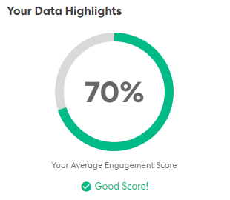
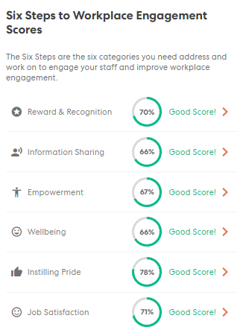
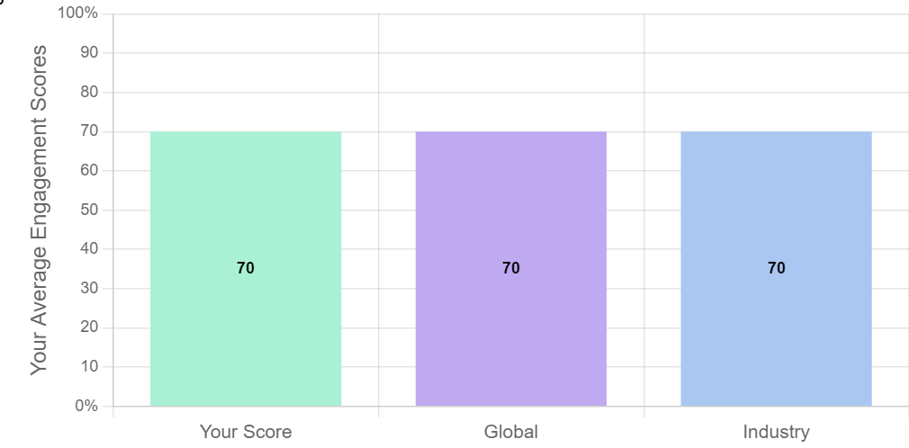
Data highlights - Engagement

Slide 5
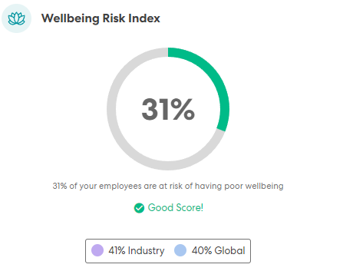
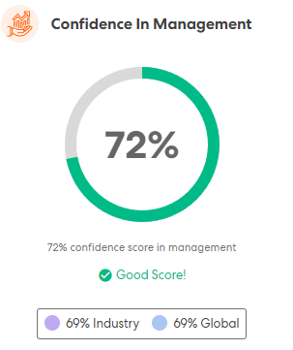
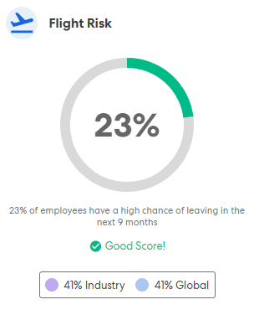
Data highlights continued….
The % of people at risk of having low/poor wellbeing. The lower the score the better.
The % of people who have a positive perception of how NICE is established and functioning. The higher the score the better.
The % of employees likely to leave NICE in the near future. The lower the score the better.

Slide 6
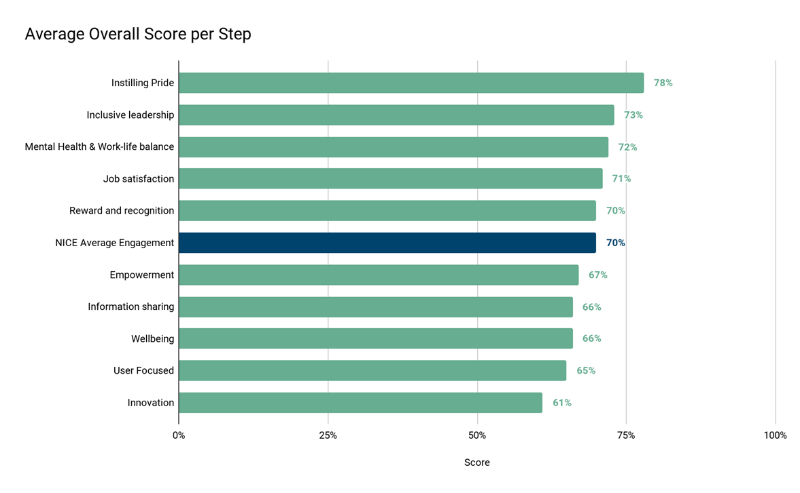
Overall NICE step scores
The above graph shows the average overall step score for NICE. The highest scoring step was Instilling Pride and lowest was Innovation, there is 17% difference between these two steps. All steps scored above 60% which is considered a good score.

Slide 7
Step scores continued…..
Inclusiveness
Higher proportion of staff saying they have experienced and observed incidence of abuse, bullying & harassment and discrimination than in 2021.
Learning and Development
Lower proportion of staff have had development and a higher proportion of staff have had an appraisal than in 2021.

Slide 8
NICE Overall – key findings

Slide 9
NICE overall – areas for celebration
Instilling Pride – proud to work for NICE and they do something worthwhile.
Job Satisfaction – positive relationships with management and work in a happy & safe environment.
Reward and Recognition – feeling of receiving recognition and happy with hours of work
Inclusive Leadership – feeling of commitment to E,D & I from management and leadership.
Mental Health and Work-Life Balance – feeling supported and adequate work-life balance.

Slide 10
NICE overall – areas for improvement
Wellbeing – stress due to work demands
Job Satisfaction – development
User focused – how aligned we are to a user focused approach
Innovation – the extent to which people’s ideas are given the time to grow
Learning & development – to extent to which people feel they are being developed, with a focus on appraisals
Inclusiveness – action taken to combat bullying, harassment and discrimination

Slide 11
Staff Engagement Surveys
Diagnostic to provide insights into priorities for improvement, as well as highlighting areas of success.
Pulse surveys enable regular focus on key areas and track progress of staff engagement scores.
Crowdsourcing
Action planning
The invaluable ideas gathered via the crowdsourcing platform are being used to inspire quick progress on actions.
NICE wide action plan to combat org wide issues.
Directorate specific action plans co-created with staff, locally owned and transparent.
Longer term business planning to address innovation and user focused issues.
11

Slide 12
Wellbeing– stress due to work demands
Clear direction and manageable objectives for focus in year 23/24.
3-5 year transformation roadmap, with clarity on focus for the year. Therefore workloads based on realistic outputs.
Management development programme equipped managers to support their teams effectively. Supporting staff experiencing stress at work will be a 23/24 module.
Inclusiveness– action taken to combat bullying, harassment & discrimination
Staff Development– level of development, with a focus on appraisals
Working group to help explore issues and suggest improvements.
Active bystander - everyone's responsibility to help address the problem.
Compliment current processes/ procedures.
Appraisal process refresh to include refreshed values.
PDP aligned to business planning / transformation roadmap.
Development of a talent management and succession planning strategy.
Launch of learning hub and development of an org wide L&D plan.

Slide 13
Thank you.

