Slide 1
Managing Atrial Fibrillation at a population based level
Clair Huckerby
Pharmaceutical Adviser- Medicines Optimisation Lead
Dudley CCG
Notes:
1 hour- 45 mins presentation and 15 mins questions
Interactive workshop style

Slide 2
Our mission
To improve the health and wellbeing of the population of Dudley through the safe and effective use of medicines and pharmacy services.
To make Dudley the safest place to take medicines in the UK.
To reduce the gap in health inequality and increase healthy life expectancy taking a population approach to managing medicines

Slide 3
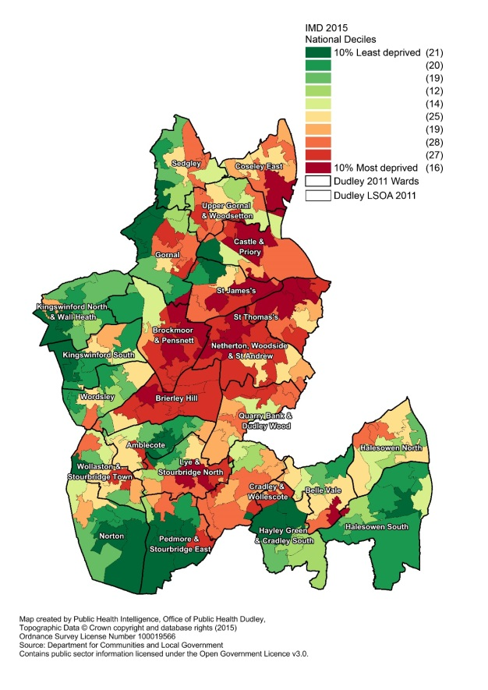
Dudley Health Economy
314,000 population
46 GP practices
1 CCG
1 LA
1 main acute hospital
2 mental health providers
£51m primary care drugs spend
Vanguard New Care Model- MCP
Notes:
Large variation between the most and least deprived wards, significant difference in life expectancy and needs of the population
Team has worked in Public Health and spent 3 years in the local council as a result of the reorganisation of the NHS in 2013- experience and expertise at working at a population level, transferring this to a delivering medicines management – we call this Pharmaceutical Care

Slide 4
Slope Index of Inequality
Deprivation gap
6 years
Deprivation gap
10 years
Notes:
The gap in life expectancy between people living in the most and least deprived areas in Dudley Borough is 9.5 years for males and 5.8 years for females based on 2010-2012 data. This indicates a clear link between life expectancy and deprivation.
Based on figures for 2009-2011, 454 male deaths and 341 female deaths would need to be prevented for the most deprived fifth of areas to achieve the life expectancy figures of the least deprived fifth of areas. Addressing circulatory disease, cancer and respiratory disease in the most deprived areas would therefore have the greatest impact in reducing inequality of life expectancy. (Source JSNA 2014)

Slide 5
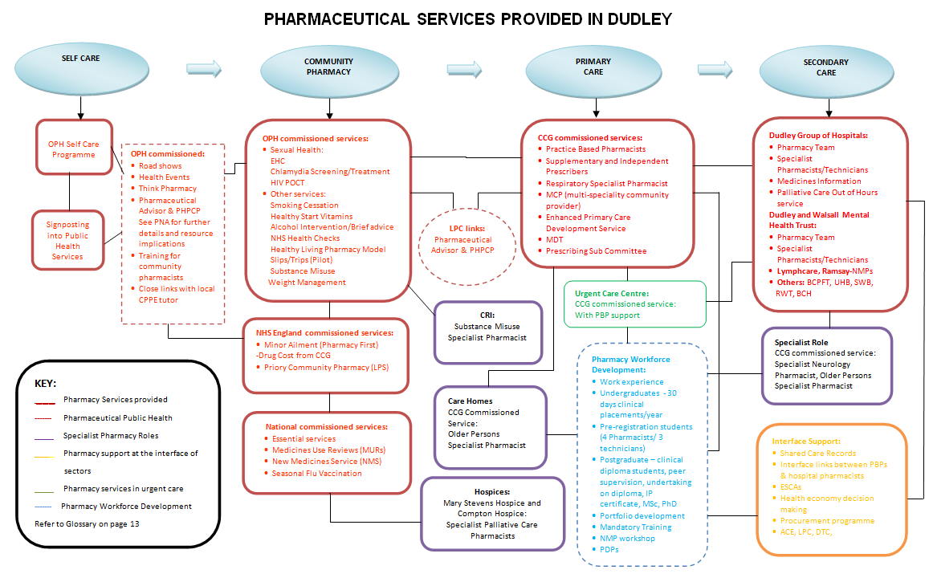
Pharmacy in the Dudley Health Economy

Slide 6
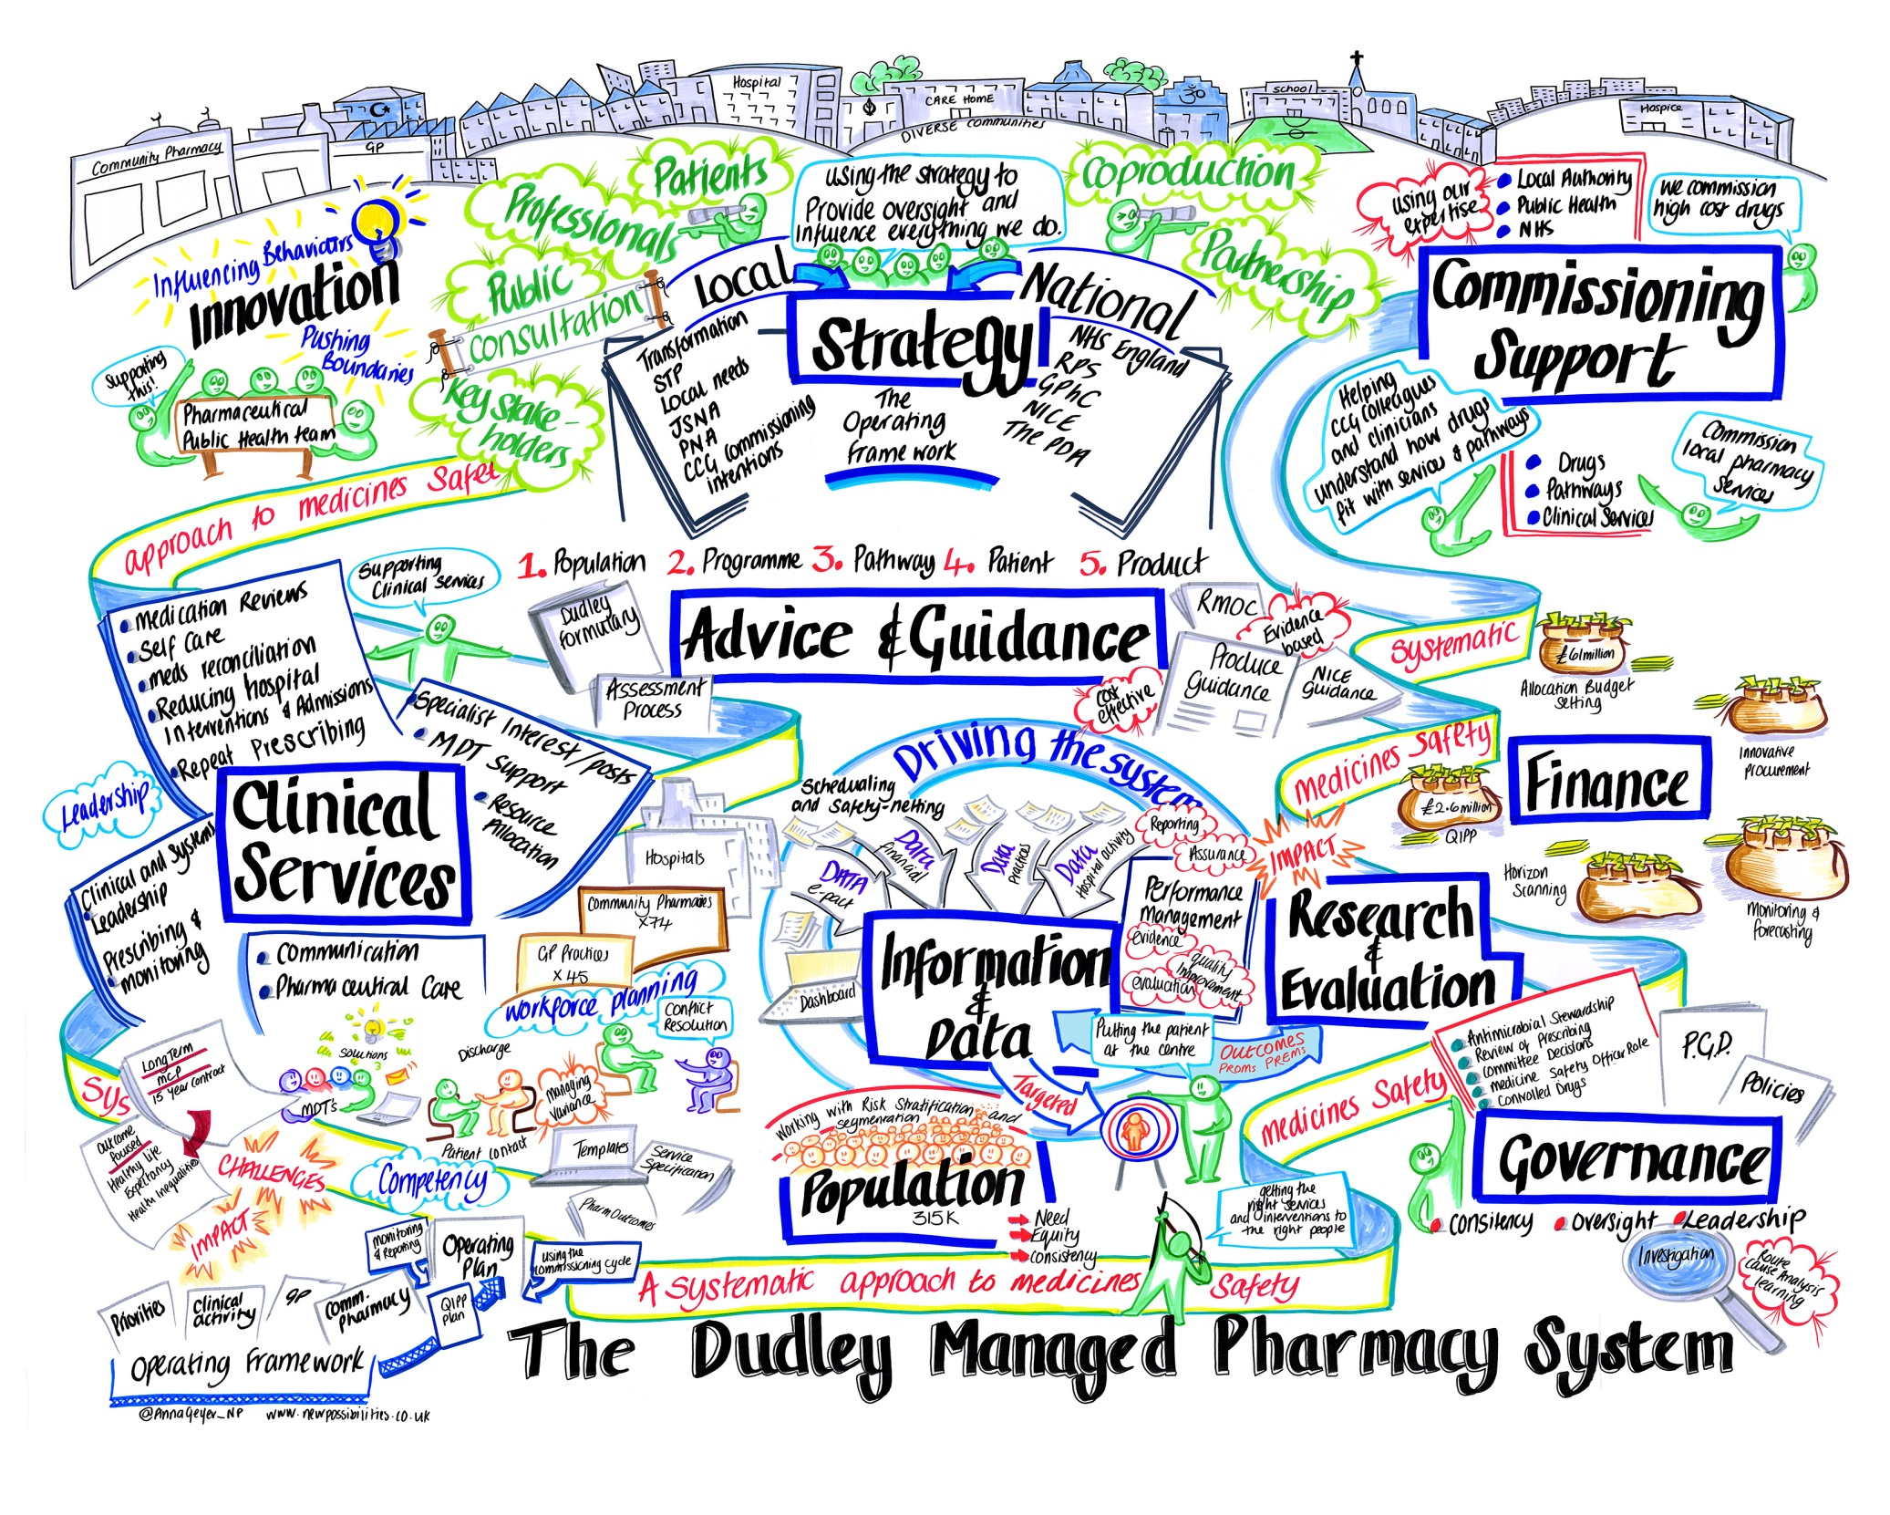

Slide 7
Aims
Case Study approach to population level Pharmaceutical Care
Atrial Fibrillation (AF)
Case finding
Risk stratification
The role of the Primary Care Pharmacist
Systematising approach using technology
Impact
Notes:
Will talk about NOACS/DOACS interchangeably
Now refer to the as DOACS

Slide 8
What are the issues for medicines optimisation in Stroke Prevention in AF?
NOACs vs. warfarin
Interpretation of NICE Technical Appraisal Guidance at a local level through to implementation
Prescriber confidence and competence
Patient selection
Practical issues- dosing and side effects
Coordination of approach
Notes:
A new class of drugs- how to manage the entry of a new class of drugs?
Variation in the interpretation of NICE guidelines and TAGs across the country- Dudley's approach
Education

Slide 9
What has been happening in Dudley?
Provision of anticoagulation services within Dudley CCG by DGNFT
No anticoagulant clinics in primary care
GPs only prescribe after specialist service initiate
DGNFT use RAID system for measuring INR which doesn’t current ‘talk’ to primary care EMIS WEB system
Notes:
Issues with capacity of current anticoag service

Slide 10
What has been happening in Dudley?
Health Economy approach
Anticoagulation Steering Group
Horizon scanning
Planning for NOACs- Rivaroxaban▼ , Dabigatran and Apixaban▼ (more recently Edoxaban)
Production of local briefing for GPs http://www.dudleyformulary.nhs.uk/page/26/2-cardiovascular-system-guidelines
Case finding and reviewing patients in Primary Care
Notes:
Anticoag steering group- membership
Initial apprehension, however excellent demonstration of a matrix approach to working
Communication across the primary and secondary care interface
Resulted in improved capacity
Referral forms and service efficiency

Slide 11
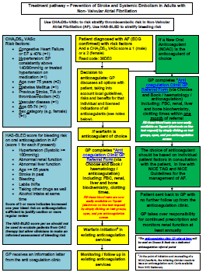
Dudley guidelines- NOAC brief
Treatment pathway
Renal function
HASBLED risk assessment
All NOACS in line with NICE TAGs and SPC’s
Clinician –patient discussions
FAQ’s
Notes:
Planned educational sessions for all prescribing / anticoag leads in each practice (minimum of one GP per practice to attend)
NICE has issued single Technology Appraisals for dabigatran (Pradaxa) TA249, rivaroxaban (Xarelto) TA256 and for apixaban (Eliquis) TA275 for the prevention of stroke and systemic embolism in atrial fibrillation.
In Dudley ALL NOACs are available in line with the individual NICE Technology Appraisals TAGs).

Slide 12
The HAS-BLED is a therapeutic bleeding risk stratification score for those on oral anticoagulants in atrial fibrillation.
HAS-BLED score for bleeding risk on oral anticoagulation in atrial fibrillation
HAS-BLED
Hypertension | 1
Abnormal renal or | 1
Abnormal liver function (>2-3 ULN) | 1
Stroke | 1
Bleeding | 1
Labile INR (TTR <60%) | 1
Elderly | 1
Drugs (NSAID, Steroid ) or Alcohol | 1
If >3 indicates high bleeding risk
A score of 3 or more indicates increased one year bleed risk on anticoagulation sufficient to justify caution or more regular review
(risk is for intracranial bleed, bleed requiring hospitalization or a haemoglobin drop > 2g/L or that needs transfusion.)

Slide 13
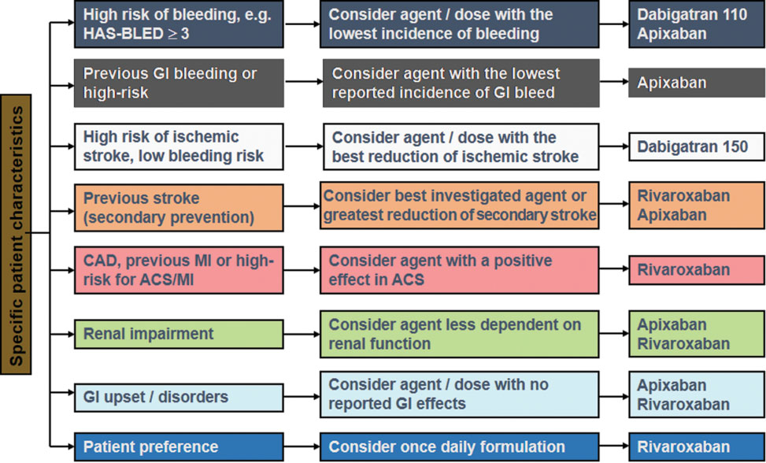
Possible considerations for selecting between NOACs based on patient characteristics

Slide 14
AF Audit
AF prevalence: 1.94% (n=6,120patients) (2013 data)
607 patients with CHADS₂ score >1 not on appropriate anticoagulation
2,936 patients exception reported
Health Economy AF Steering prioritised work plan
Locally agreed quality premium for AF for 2013/14
GRASP AF tool run in those practices with a lower than expected prevalence of AF
CHA₂DS₂VASc scoring was used to indicate need for anticoagulation
Notes:
Following on from the hypertension case study, looking at the management of AF, we had conducted an audit of the management post stroke using antiplatelets however we now wanted to look at the prevention of stroke
AF steering group consisting of key stakeholders- Cons Cardiologist, Haematologist, GP clinical lead for CVD, me, commissioning manager reviewed available data:
Following a detailed practice level analysis of QMAS data March 2013, the CCG has currently 6,120 patients (1.94% of total population) on the AF QoF register. 607 patients are currently have a CHADS2 score >1 and are not receiving the appropriate anticoagulation. An additional 2936 cases have been exception reported totalling 3543 cases that may need to be reviewed.
Agreed that our prevalence was less than we expected this to be and our stroke rate was higher, therefore agreed a programme of work to screen for AF and treat appropriately
PBP and primary care pharmacy role in QP activity- we already had a workforce of PBPs who played an active role in hypertension management and therefore was agreed to use the PBP team to screen patients working as part of the MDT to diagnose with a view to following the pathway for initiation of anticoagulation which the AF steering group had developed, bearing in mind:
Over the previous decade all anticoagulants were initiated by specialists in the anticoagulant clinic at the local hospital, whilst this meant that there were strict gate keeping practices and the commissioners got a low cost good value service, our GPs were deskilled in initiating anticoagulants
We knew that NOACs/DOACs had been launched and were subject to TAGs, therefore we were obliged to make these available to patients who fit the criteria within the TAG
Locally agreed QP approx £330K additional investment into improving services in primary care as reward for achieving the locally set target
We used the CHADSVASC scoring before this was a standard measure

Slide 15
Impact
At the end of March 2014, 928 patients had been reviewed, exceeding the local Quality Premium target
The AF register for Dudley CCG had increased by 286 by March 2014 (5.21%)
Of those 928 patient reviews, 130 were commenced on anticoagulation, 43 (33%) on warfarin and 87 (67%) on NOACs, in line with the local pathway and individual NICE Technology Appraisal Guidance
Two education sessions were run on the NOACs and each GP practice was represented at one of these sessions
Notes:
Within a year we had reviewed 928 patients therefore exceeding the number of those who required a review
We had increased the AF register by 5.21%
We had followed our locally developed pathway and where anticoagulation was initiated 2/3 started on a NOAC and a third on warfarin
At the same time we ran a series of GP education sessions which were aimed to increase the awareness and understanding of the positioning of NOACs in the management of AF with a view to develop a shift in skills to include primary care

Slide 16
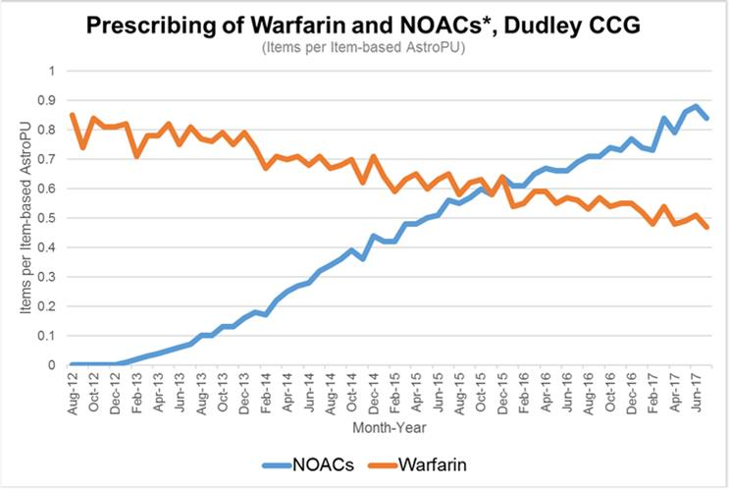
The Growth of NOACs
Notes:
To update

Slide 17
Safety and Governance
Clinical audit of NOACs
Anticoagulation declarations signed by each practice focussing on safe systems for prescribing anticoagulation- annual
Sharing best practice within the CCG
HARMs monitoring and RCA

Slide 18
NOAC Audit 2015
Objectives
NOAC prescribing for appropriate indication, baseline and regular follow up monitoring
Inclusion criteria
All patients with an acute/repeat prescription for apixaban, dabigatran or rivaroxaban.
Audit Standards
100% should be prescribed for a licensed indication
100% should have a CHA₂DS₂VASc or CHADS₂ score
100% should have a record of baseline bloods (FBC, renal, liver, bone, clotting times) done within the month prior to starting a NOAC
100% should have had renal function monitored in last 12 months
100% of patients should have their medication reviewed at least every 6 months (where treatment has been for >6 months)
Indication
Of 2156 patients taking a NOAC across 47 GP practices in Dudley, 97% (n=2093) were prescribed a NOAC for a documented licensed indication.
AF risk scoring
Of the 1984 NOAC patients with Atrial Fibrillation (AF), 1362 (69%) had a documented risk score for AF (CHA₂DS₂VASc or CHADS₂ score).
Baseline monitoring
88% of patients (n=1905) had a record of baseline bloods done within 1 month prior to initiation of the NOAC.
On-going renal function monitoring
92% of patients (n=1978) had their renal function checked in the last 12 months.
Medication review
58% of patients (n=1240) had a documented medication review in the previous 6 months.

Slide 19
Learning....
Translating this to a new era- post QOF as we know it...
Clinical systems approach
AF template implementation:
CHA₂DS₂VASc score
6 monthly review
Ensure renal function check at least annually for those on NOACs, unless clinical concern warrants more frequent testing
HAS-BLED risk assessment
Notes:
plans to automatically embed GRASP AF and AF pathway into AF section of LTC template

Slide 20
Task
Design a decision making tool for the management of AF
  Think about what are the main considerations?
  What would influence your choice of product?
  How will you share this decision making with the clinicians in your practice?
Notes:
Based on learning from 2015 Audit think about how you would design a decision making tool
What are the main factors?
How do you segment your population?
How is this information shared?

Slide 21
Anticoagulant Advisor
Public Health Pharmaceutical Team
Notes:
THIS IS OUR TOOL SOON TO BE ROLLED OUT:
Prior to the introduction of DOACs (Direct Oral Anti-Coagulants) there was limited patient choice for the management of Non-Valvular Atrial Fibrillation.
NICE has issued single TAGs for all the DOACs – Dabigatran, Rivaroxaban, Apixaban and Edoxaban.
Dudley CCG have worked closely with the DGoH anticoagulation department to promote the use of the most appropriate anticoagulant for patients in line with NICE guidance.
This has led to Dudley CCG being one of the top users of DOACs in the country.
Fits in the long term conditions framework
As DOACs are novel drugs, there are distinct differences between each of the drugs, such as:
- contra-indications;
- dosing differences - related to age, renal function, weight and drug interactions;
- storage in monitored dosage systems;
- patient factors i.e. swallowing difficulties, daily/twice daily regimes;
- The anticoagulant advisor will support prescribers in decision
making for patients

Slide 22
Development of the Anticoagulant Advisor
The following resources were used to develop a flow chart:
- Dudley Briefing on DOACs,
- NICE TAGs for individual DOACs,
- The Keele decision aid on anticoagulants,
- SPCs for individual anticoagulants,
- NEWT guidance,
- UKMI Medicines Compliance Aid database.
A program was developed by Dudley CCG (Dr Nic Boeckx, Tom Robinson) on Emis Web using the information provided in the flow chart.
Initial testing was conducted by Dr Boeckx and the Pharmaceutical Public Health Team with feedback on scenarios from the Anticoagulation Steering Group.
Amendments were made to the tool in-line with feedback and testing outcomes.
The anticoagulant advisor will support prescribers in decision
making for patients but does not replace individual clinical decision making

Slide 23
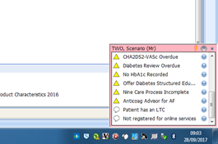
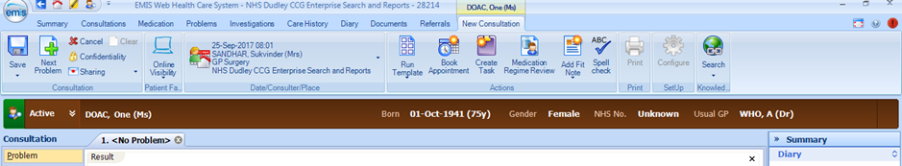
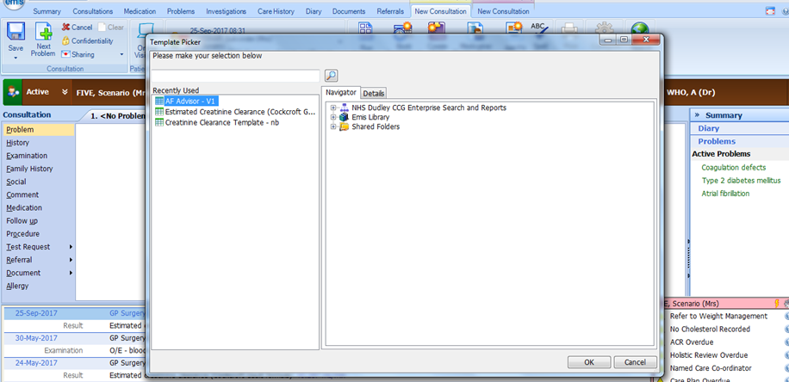
Activation of the Anticoagulation Advisor
Anticoag Advisor in Pink box
Click on Run
Template
Click on AF Advisor
Notes:
The Anticoagulation advisor will appear in the pink reminder box on the right hand side of the screen in Emis:
To activate the Anticoagulation Advisor:
Open a consultation in Emis and then click on the ‘Run Templates’ icon:
Question: Why can’t I just click onto AF Advisor on the pink box?
By entering the AF advisor by clicking on the pink box Step 1 – calculating Creatinine Clearance is missed. This can lead to the wrong decision on dosage appearing as an out-of-date creatinine clearance that has been saved will be used.

Slide 24
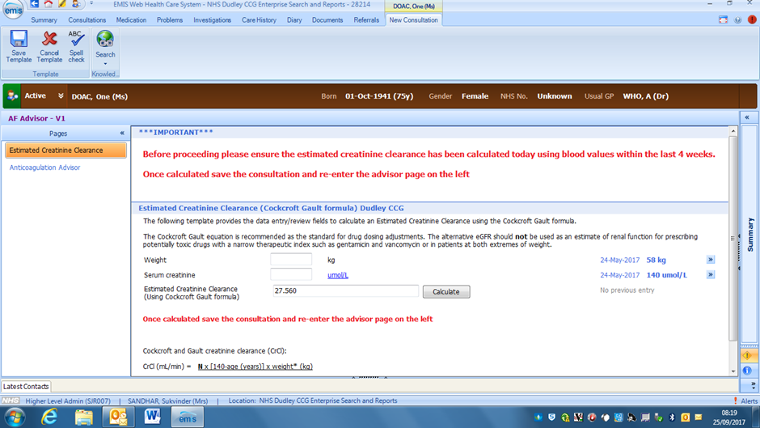
Step 1 – Calculation of Creatinine Clearance
The Anticoagulation advisor requires the creatinine clearance to be calculated to ensure the correct dose is recommended when a DOAC is appropriate:
Click on Estimated Creatinine Clearance
Notes:
Raised a series of issues regarding weight vs. BMI to calculate Se Cr, after much debate the decision locally was to use weight only as practical issues when calc. BMI re: height
Therefore BMI disabled for this particular calculation and Se Cr calculated this way
NB Edoxaban is the only DOAC where SPC states BMI
This was agreed by the clinical advisory group- anticoag steering group following extensive discussion

Slide 25
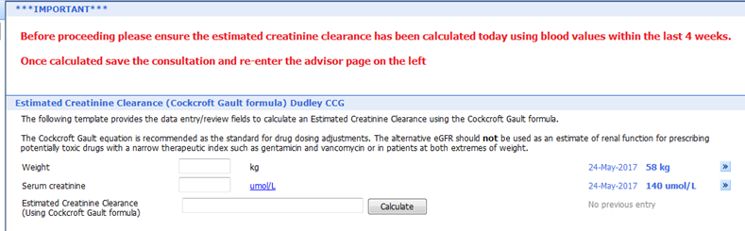
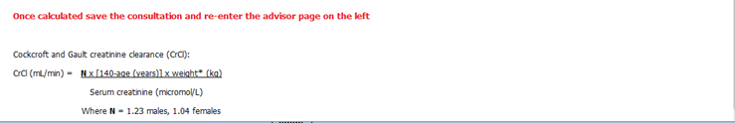
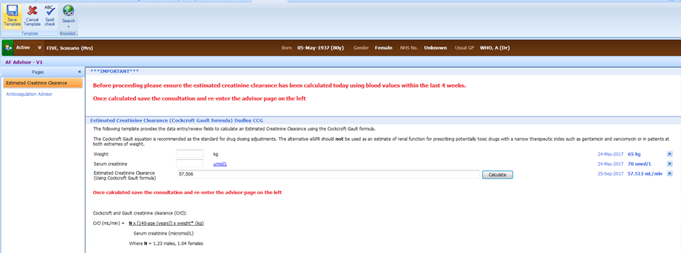
Step 1 – Calculation of Creatinine Clearance
Add weight or recorded weight if there’s no change
Press calculate button
Save the estimated Creatinine Clearance by pressing this button
Notes:
Raised a series of issues regarding weight vs. BMI to calculate Se Cr, after much debate the decision locally was to use weight only as practical issues when calc. BMI re: height
Therefore BMI disabled for this particular calculation and Se Cr calculated this way
NB Edoxaban is the only DOAC where SPC states BMI
This was agreed by the clinical advisory group- anticoag steering group following extensive discussion

Slide 26
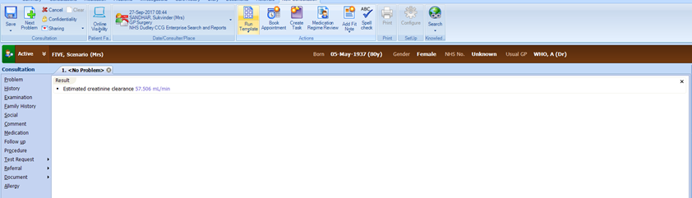
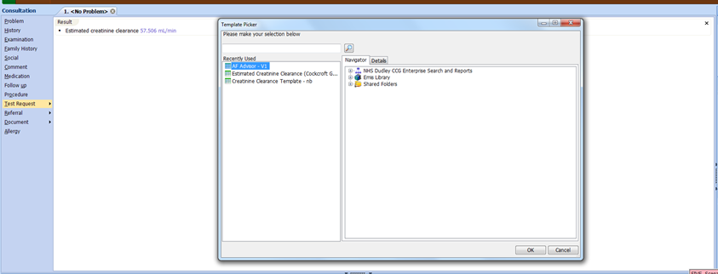
Step 2 – Anticoagulation Advisor
To open AF Advisor click on ‘Run Template’ icon in the current consultation:
Click on ‘Run Template’ icon
Once the template box appears, select the AF Advisor:
Select ‘AF Advisor’ template and click ‘OK’

Slide 27
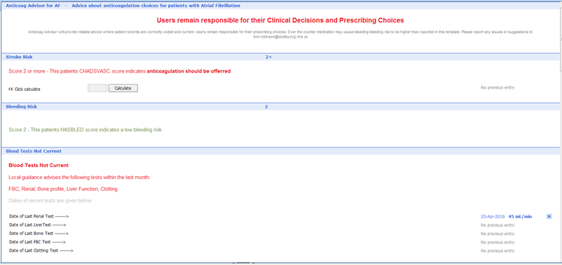
Anticoagulation Advisor
1. Provides advice and limitations of the tool
2. CHA2DS2VASc score is calculated. If score is unavailable click on calculate. Further information on management listed.
3. Bleeding risk score is calculated using HASBLED and further information is provided.
4. Relevant blood tests are listed and the date they were last tested. If the date is over 4 weeks a message will appear that blood teats are not current.
Notes:
Once activated….

Slide 28
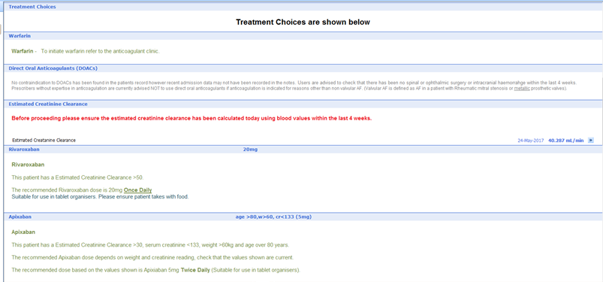
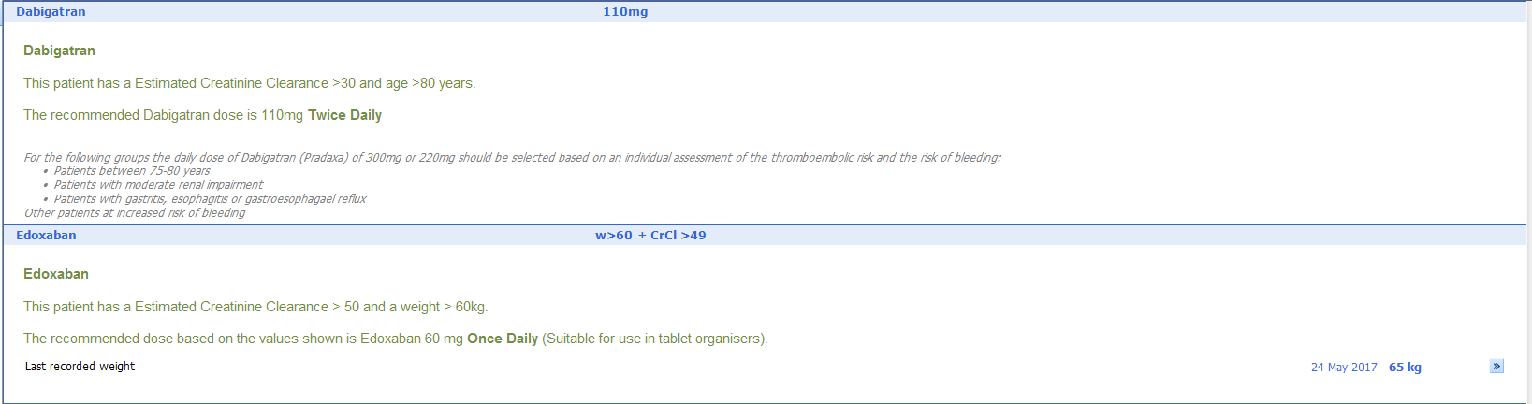
Anticoagulation Advisor
5. Treatment options will be provided based on data recorded in the PMR.
6. Dosage will be based on Creatinine Clearance, weight and age (dependent on drug) this information is listed.
7. Further information on whether the drug can be stored in a tablet organiser is listed if appropriate.
8. Further information to help with prescribing decisions is listed.

Slide 29
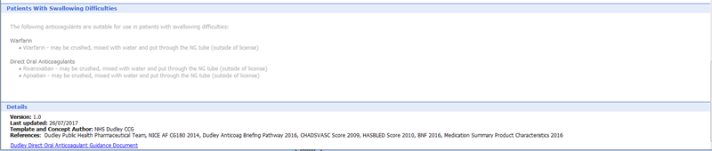
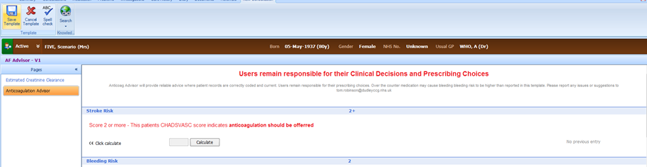
Anticoagulation Advisor
9. Further information is provided on treatment options for patients with swallowing difficulties.
10. On completion of the Anticoagulation Advisor click on the ‘Save Template’ icon.
Click on ‘Save Template’ icon.
Add further information to the consultation and save the consultation.

Slide 30
Scenario 1 – Di Doac
Aim of this scenario is to test drug options for non-valvular AF:
- 75 year old, female - CHA2DS2VASc = 3, HAS-BLED = 1
- non-valvular AF - indication for DOAC
- Creatinine = 90 (6/7/16), eGFR>90 (6/7/16)
- LFT= within normal ranges - Abnormal LFTs could be caution/CI for DOACs
- FBC= within normal ranges - Dudley Briefing requirement
- INR = within normal ranges - Dudley Briefing requirement
- Weight = 68kg - dosing for DOAC- apixaban and edoxaban
- No other medication

Slide 31
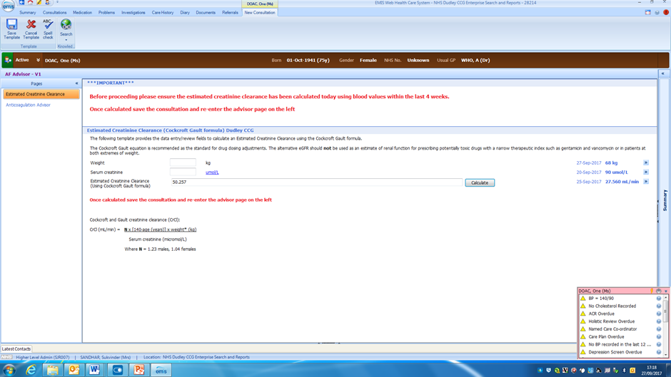

Slide 32
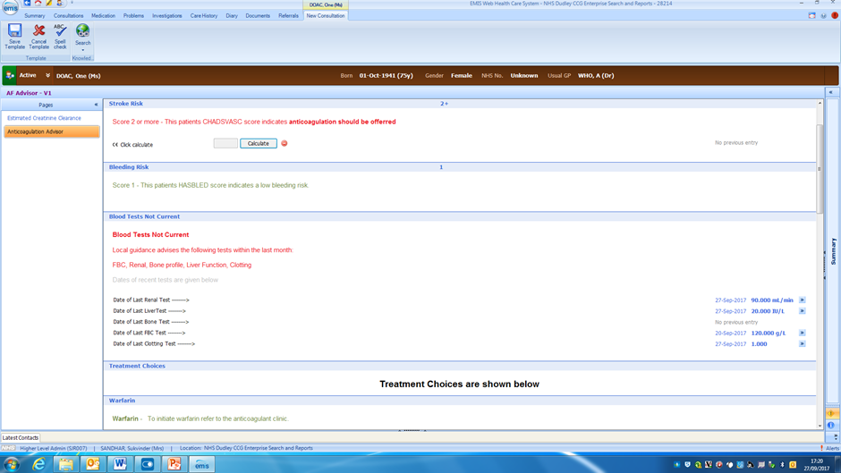

Slide 33
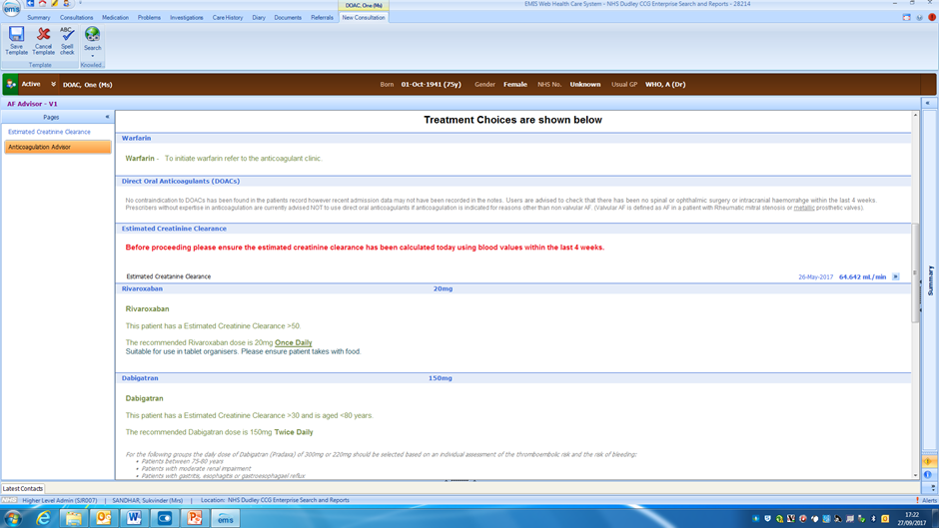

Slide 34
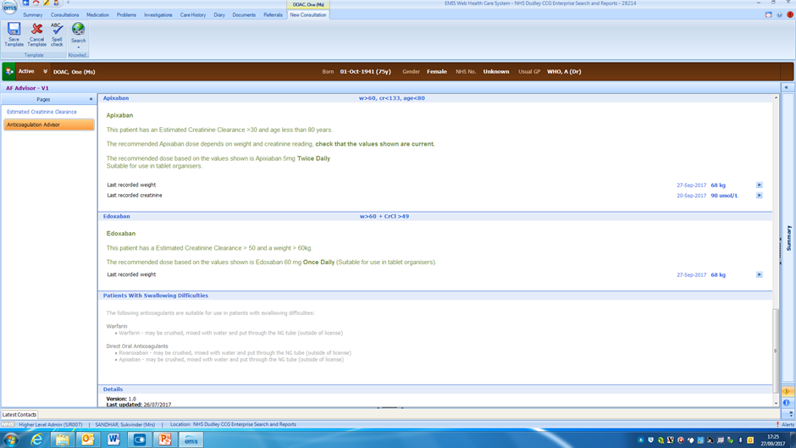

Slide 35
Scenario 2 – Do Doac
Aim of this scenario is to test dosing differences with DOACs
- 79 year old, female, type 2 diabetes – CHA2DS2VASc = 4
- non-valvular AF – indication for DOAC
- Alcohol intake = 5units/week, Aspirin 75mg od – HASBLED=2
- Creatinine= 77, CrCl=45ml/min – dosing of DOAC
- LFTS = normal (1/7/16) – Abnormal LFTs could be caution/CI for DOACs
- FBC = normal (1/7/16) – Dudley Briefing requirement
- INR = 1.0 (1/7/16) – Dudley Briefing requirement
- Weight = 56kg – dosing for DOAC- apixaban and edoxaban
- Prefers once daily treatment – apixaban and dabigatran BD dosing

Slide 36


Slide 37
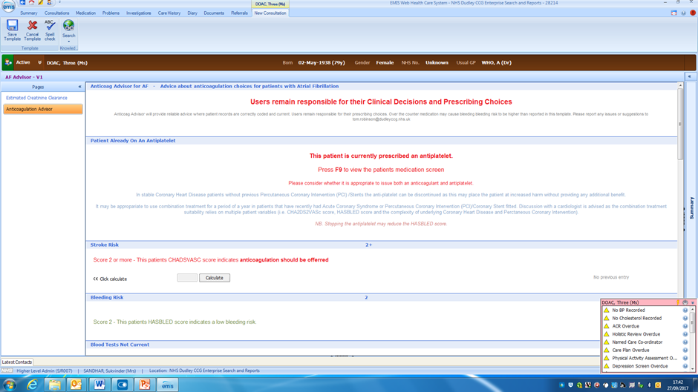
Notifies that patient is on an anti-platelet

Slide 38
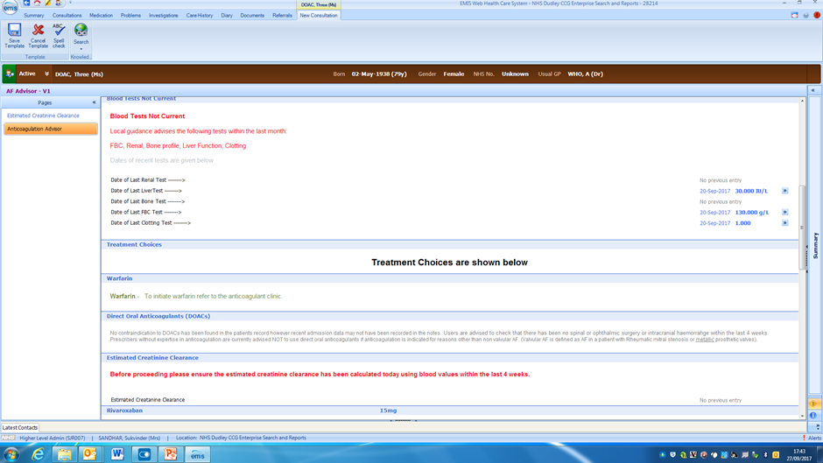

Slide 39
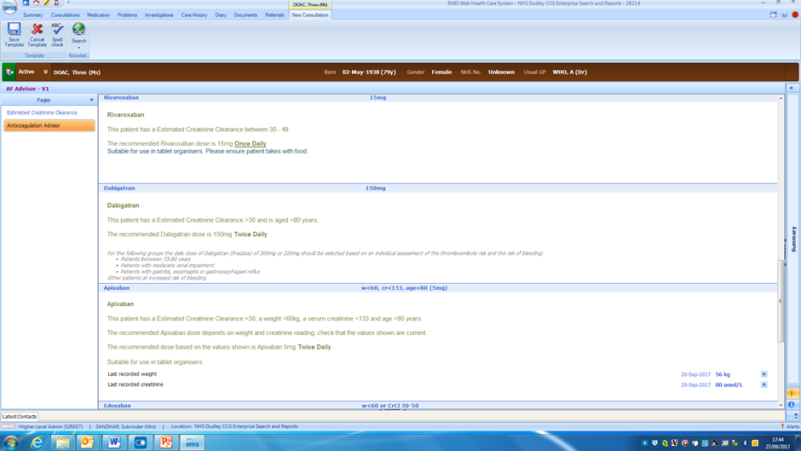

Slide 40
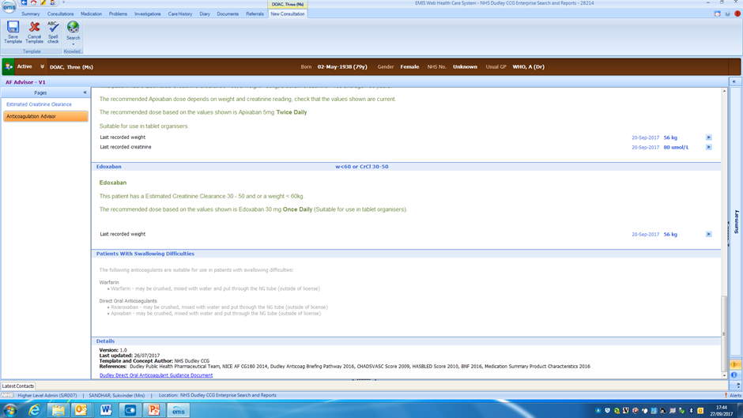

Slide 41
Scenario 3 – Mo DOAC
Aim of this scenario is to highlight the contraindication in cancer
- 66 year old, female, type 2 diabetes - CHA2DS2VASc = 4
- non-valvular AF - indication for DOAC
- oesophageal carcinoma undergoing chemotherapy - Contra-indication to anticoagulation
- nil alcohol consumption, BP<140/80, normal LFTs, renal function normal, on anti-hypertensives - HAS-BLED = 0
- weight = 50kg – dosing for DOAC – apixaban and edoxaban weight dependent
- difficulty swallowing - dabigatran and edoxaban not suitable to be crushed
- compliance is good - any DOAC is suitable - once daily or twice daily regimes

Slide 42
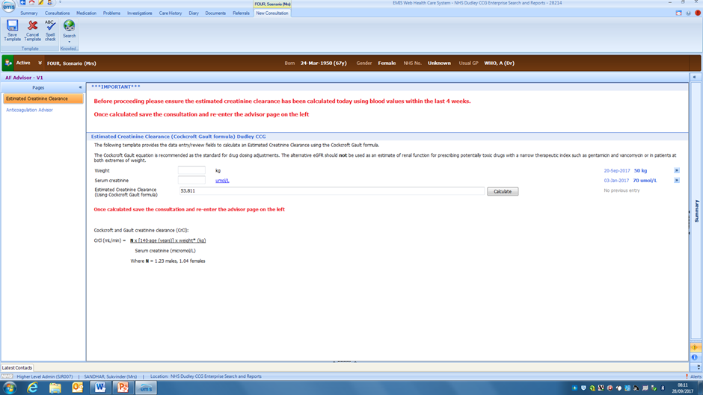

Slide 43
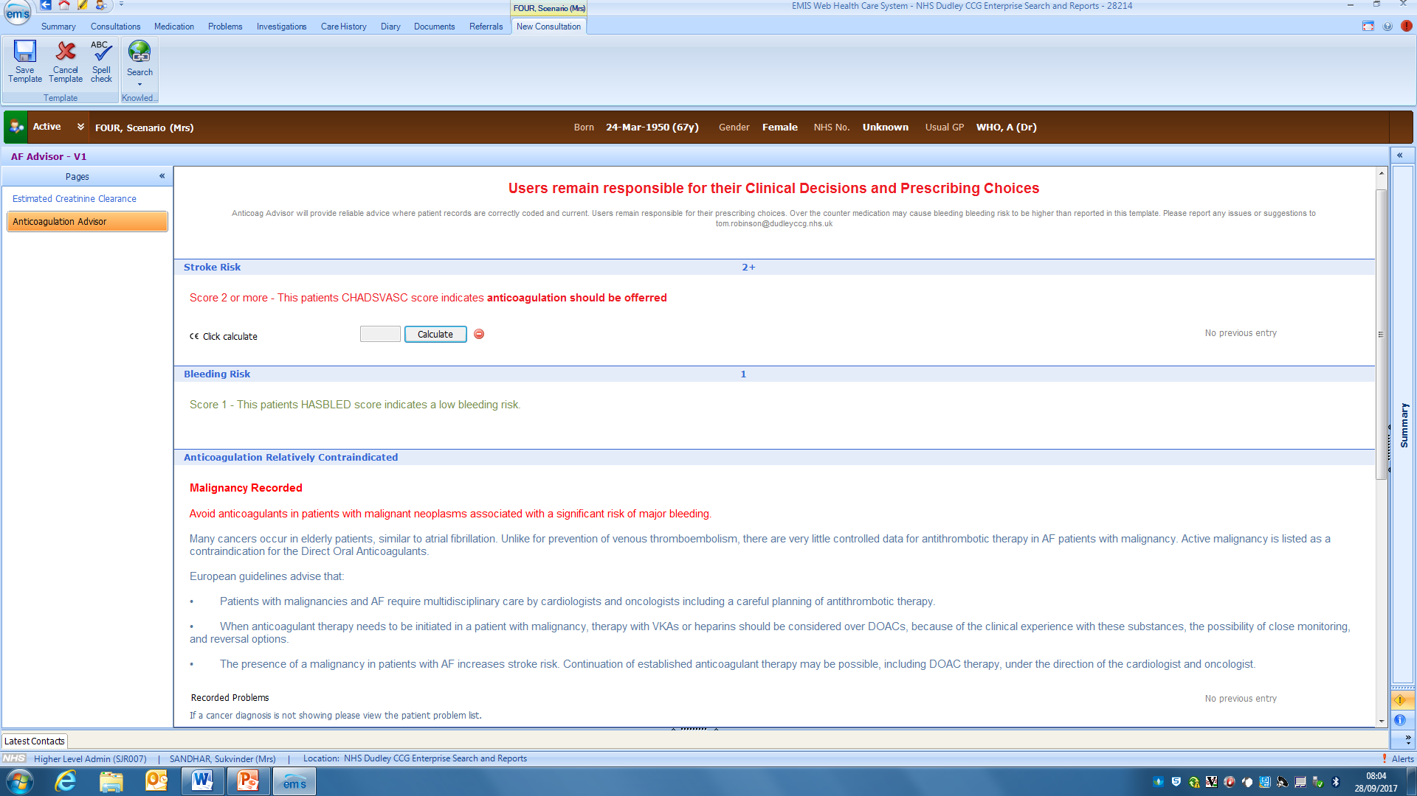
Notifies that there’s a contraindication

Slide 44
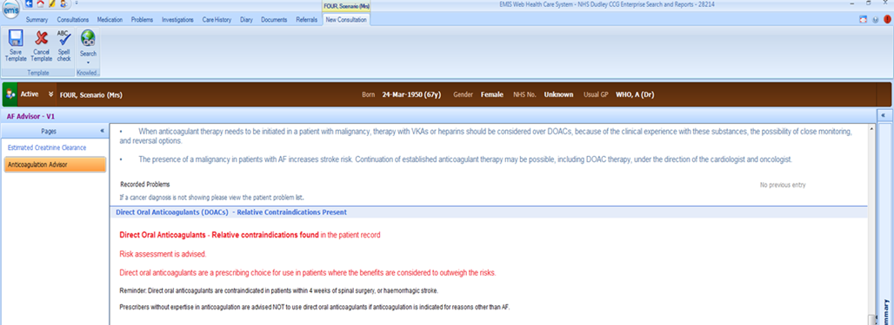
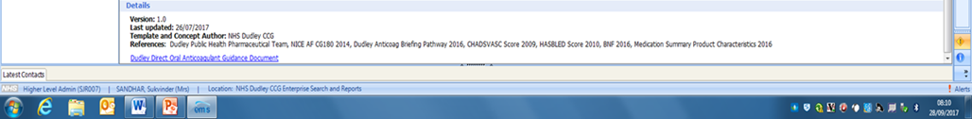
Notifies that DOACs are contraindicated

Slide 45
Scenario 4 – Me Doac
Aim of this scenario is to highlight the caution in impaired renal function
- 75 year old, male, type 2 diabetes - CHA2DS2VASc = 2
- non-valvular AF - indication for DOAC
- hypertension -166/90 (6/7/16)
- alcohol consumption – 12units/week - HAS-BLED = 4
- Creatinine =200, CrCl - 26 dosing of DOAC are CrCl dependent
- LFTs within normal range - Abnormal LFTs could be caution/CI for DOACs
- FBC within normal range - Dudley Briefing requirement
- INR = 1.0 - Dudley Briefing requirement

Slide 46
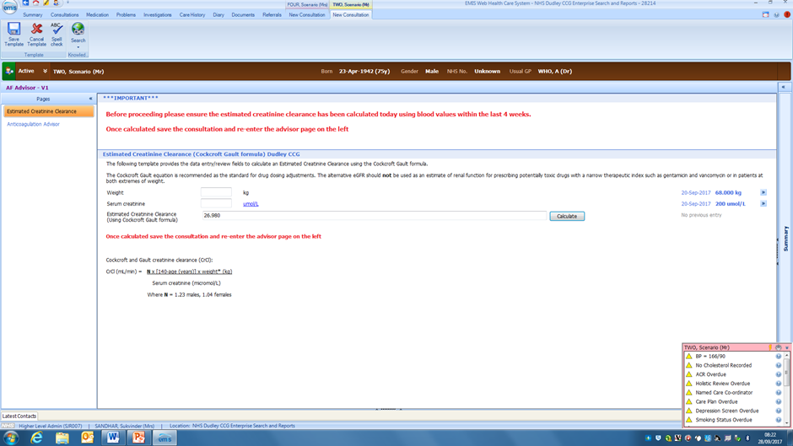

Slide 47
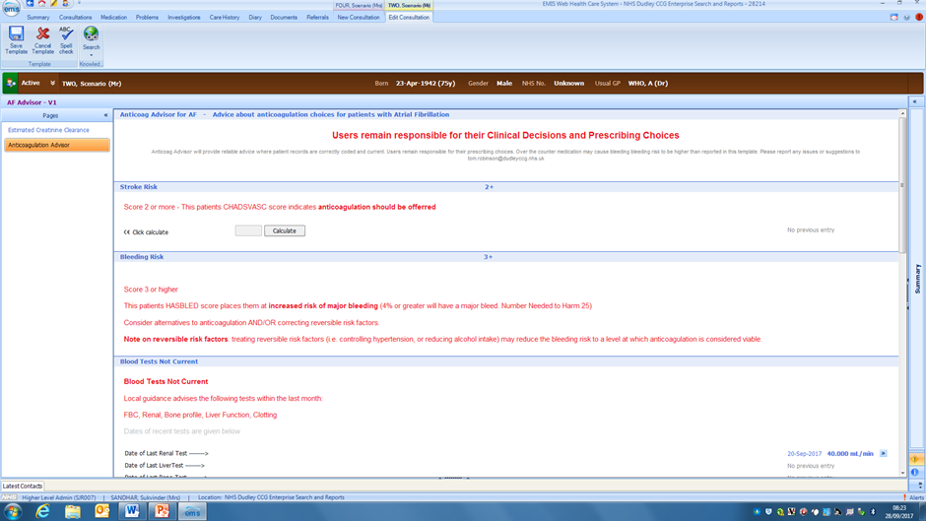

Slide 48
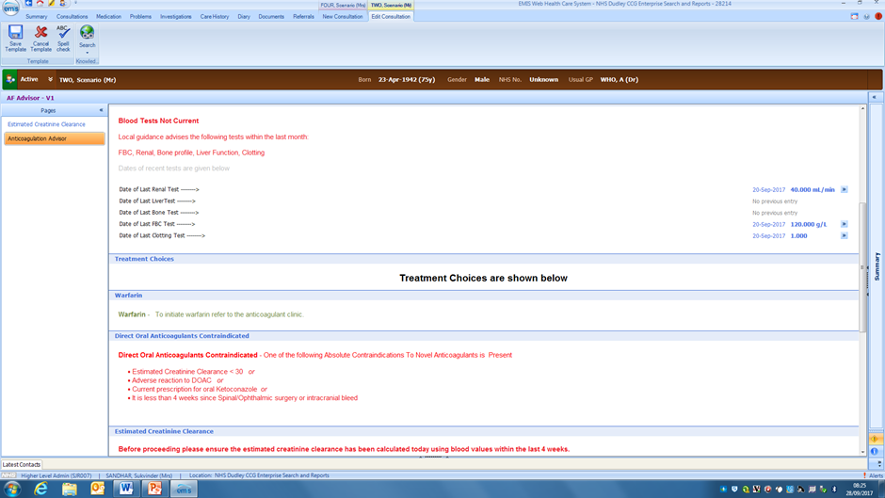
Notifies a contraindication

Slide 49
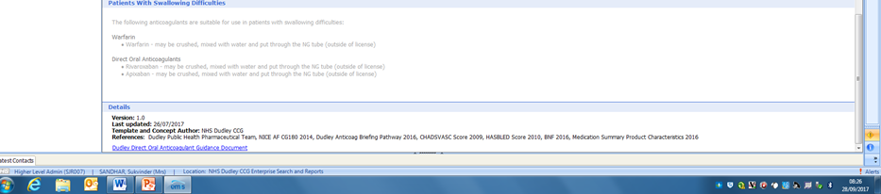

Slide 50


Slide 51
Population impact and ongoing management
Ongoing prescribing of DOACs
Pathway updated to reflect all DOACs and TAG
Increased skills within Primary Care
Introduction of AF Advisor Tool on EMISWeb
Outcomes- Stroke impact/ mortality data
Use of the Primary Care Practice Based Pharmacist
AF baseline data
Clinical Audit in Primary Care
Case finding
Medication Review
The role of incentives e.g. Quality Premium
Disruptive technology- decision tools
Notes:
Need some data on AF

Slide 52
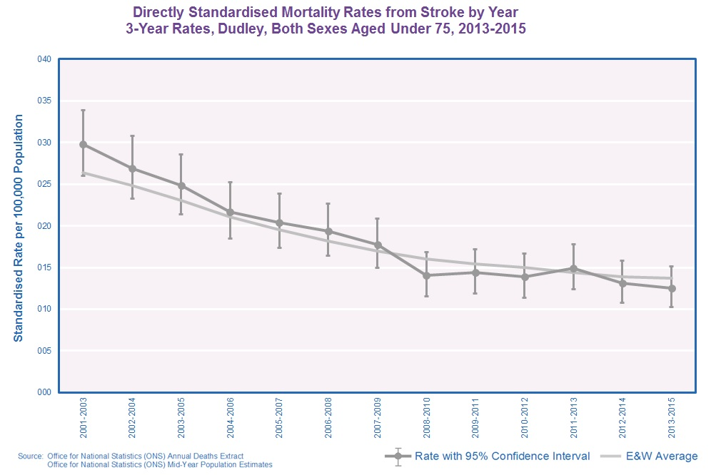
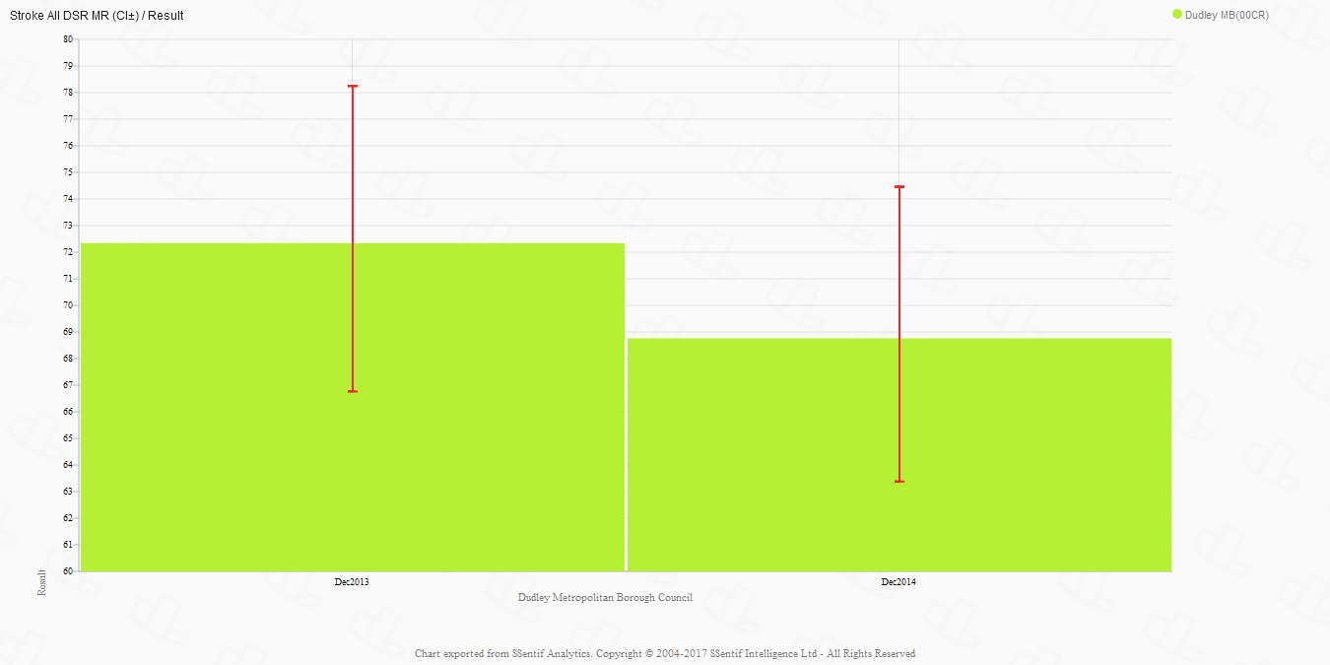
Directly Standardised Mortality Rate in Dudley for Stroke
Notes:
Following all of this work in the last decade which has also focussed on management of hypertension and antiplatelet use post stroke initially before we looked at stroke prevention

Slide 53
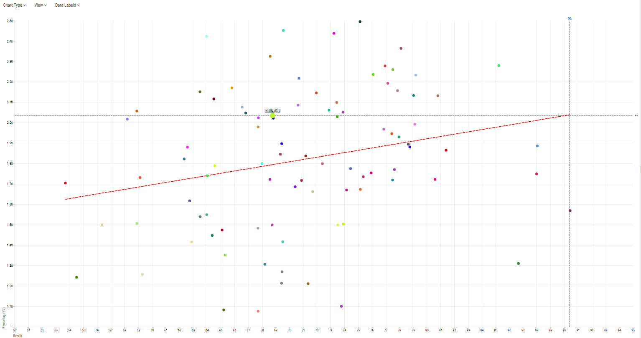
Directly Standardised Mortality Rate in Dudley for Stroke
Notes:
The Graph shows a red regression line which suggests the higher the prevalence the higher the Stroke DSR.
Although clearly there is a lot of variance.
The intersection line shows that in Dudley with a prevalence of 2.04% one would expect a Stoke DSR of 90.
Dudley has a Stroke DSR of 68.76: so better than expectation given the prevalence.

Slide 54
Role of the Primary Care Pharmacist
Case finding
Clinical audit
Patient assessment and medication review
Expertise in medicines- choice of DOAC
Interpretation of NICE guidance (TAG)
Leadership / Education at practice level in the utilisation of AF Advisor

Slide 55
Competence self-check
Are you competent to perform a medication review?
How will you make an impact on the management of AF?
Will your decision making be done in isolation/ team/ protocol driven?
Are you working at a specialist level?
How will you maintain and demonstrate competence?

Slide 56
Key tips for delivering Pharmaceutical Care at a Population level
Targeted medication review
Stakeholder engagement
Establishing the needs of the population
Prioritisation of resource
Disruptive technology
Implementing national and local guidance (NICE and formulary)
Measuring outcomes
Notes:
Targeted vs. adhoc med review
Making sure the right clinicians are involved, i.e. Role of public health and consultants, Gps- how are you going to deliver this at patient, practice, and population level?
Think outside of the basic medicines optimisation principles and focus on population health

Slide 57
Thank you for listening
For more information contact :
Clair.huckerby@nhs.net with thanks to:
Public Health Intelligence Team
Office of Public Health, Dudley for providing the information
Dudley CCG Contracts Management Team
Dudley Practice Based Pharmacists and GPs
Dudley Group of Hospitals Cardiology and Haematology Departments

