Slide 1
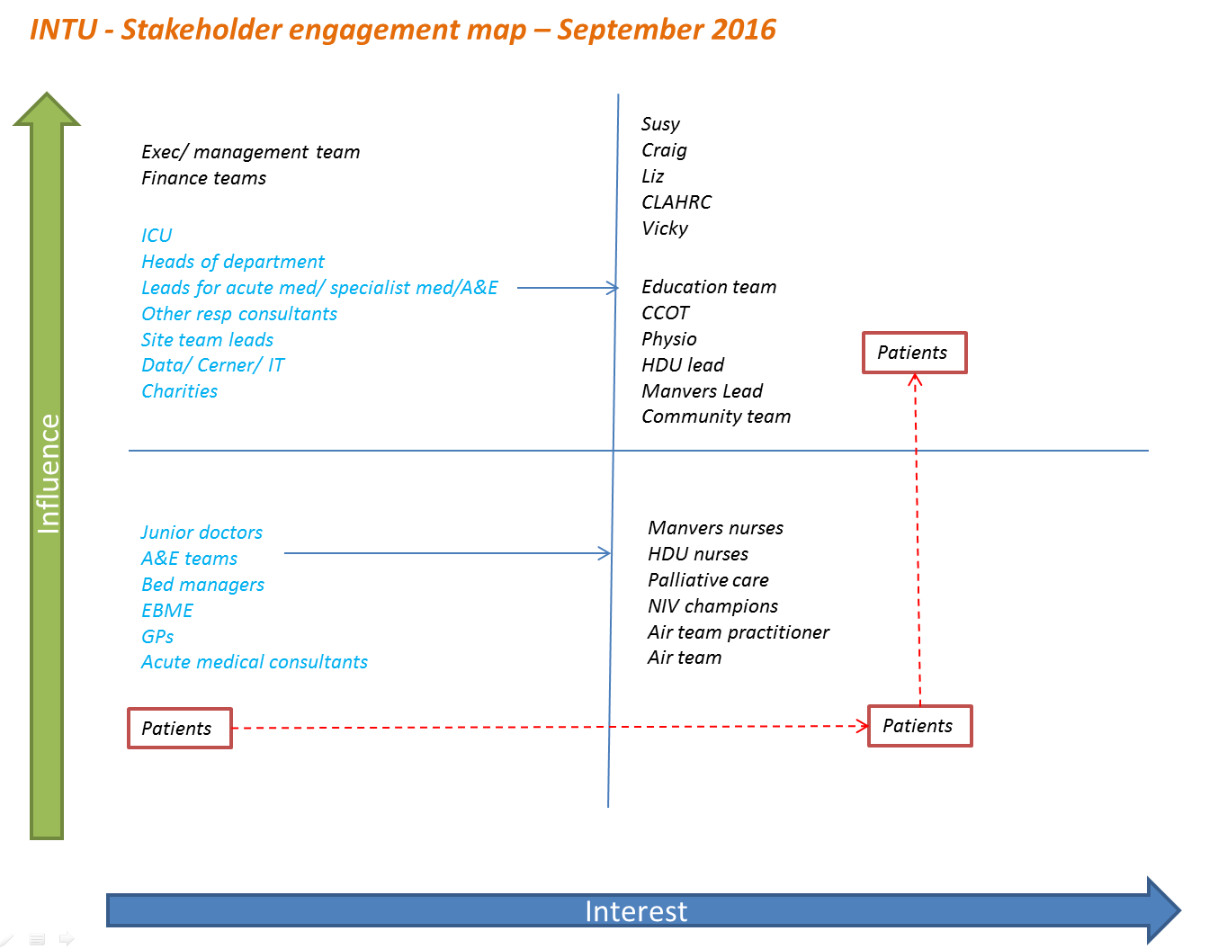

Slide 2
INTU (NIV)
Pre-emptive community and in education regarding NIV
NIV champions in the community
Attendance and use of resources
Formal “consent” / information discussion in hospital
Managing patient and carer expectations of what NIV will involve
Develop information resources
(written, video, Internet)
?Review or current and production of new accessible information?
Provision of appropriate information to patient and carer
Patient focus group
Quality of documentation
Adequate and timely documentation of management plan/ceiling of care
Patient and carer satisfaction
Opportunities to engage with patients and ask opinions
Patient champions/ educators
Patient and carer understanding of why NIV is used and what to expect
Patient and carer education
Development of a formal NIV MDT
To improve the quality of care for appropriate patients requiring Acute NIV
in hospital
Use of ACP
Practice educators on shop floor
Advanced care planning
Empower patients to be involved in decision making
Increased palliative care referral and pts declining NIV
Define standards of documentation
Shared decision making for appropriate use of NIV (and review)
MDT input for decision making for acute NIV care
Palliative care (are we trying to improve anything here?)
Review current practice to identify gaps in Knowledge
NIV champions in the hospital
Use of bundle
Patient centred NIV education programme
Clinical outcomes
Standardised high quality care across the patient journey
Provision of NIV Bundle and pathway
CERNER Template
Review current educational practice and feedback
Assess competency
Staff understanding of the patient experience
Design NIV bundle and describe pathway
Pathway mapping
Compliance with standards
Staff competence of NIV pathway
Describe the patient experience of NIV pathway
Emotional mapping
Ongoing measurement for improvement
Standardised and accessible NIV Equipment and resource
Define the key competencies of Staff assessing need and implementing NIV
Develop Bundle to standardise NIV care in line with BTS guidelines
= outcome
= process
Log of accessible NIV Equipment
Audit of current equipment and resources
= balance
= Essential to all areas

Slide 3



