Slide 1
Brexucabtagene autoleucel for treating relapsed or refractory mantle cell lymphoma after 2 or more systemic treatments [ID6325, review of TA677]
For projector – all CON information is redacted
Technology appraisal committee A [1st July 2025]
Chair: Radha Todd
Lead team: Richard Ballerand, Patrick De Barr, James Fotheringham
External assessment group: Birmingham Centre for Evidence and Implementation Science
Technical team: Luke Cowie, Alan Moore, Emily Crowe
Company: Gilead Sciences
© NICE 2025. All rights reserved. Subject to Notice of rights.

Slide 2
Brexucabtagene autoleucel for treating relapsed or refractory mantle cell lymphoma after 2 or more systemic treatments
Background and key issues
Clinical effectiveness
Modelling and cost effectiveness
Other considerations
Summary

Slide 3
Recap of committee conclusions from TA677 (October 2020)*
Difficult to quantify benefits of brexu-cel: immature survival data and single arm trial
Possibility of a “cure”, but long-term survival data from ZUMA-2 is too immature to establish this
People having treatment with brexu-cel likely to have higher mortality risks than general population, even if they are “cured”
Not clear if long-term survivors would have same health-related quality of life as people in general population of same age and sex
Patients' age when they start treatment has a significant effect on cost-effectiveness estimates
More data on progression-free, post-progression and overall survival up to 5 years will help clarify if treatment with brexu-cel improves long-term survival
Systemic Anti‑Cancer Therapy (SACT) data should provide more accurate costs and benefits for its use in clinical practice, as well as median age of the patients who would be offered treatment with brexu-cel
* EAG for TA677 was York Centre for Reviews and Dissemination

Slide 4
Background on relapsed or refractory mantle cell lymphoma
Each subsequent treatment line for MCL is associated with worsening prognosis
Causes
Rare fast-growing cancer of lymphatic system, caused by accumulation of abnormal B-cells in mantle zone of lymph nodes
Relapsed/ refractory MCL returns after remission (a period of disease decline or disappearance) or if it didn’t respond to initial treatment
Epidemiology
Approximately 590 people are diagnosed with MCL each year (UK)
Most commonly diagnosed at middle-age or older
Symptoms and prognosis
Painless swelling (because of enlarged lymph nodes), night sweats, high temperatures, weight loss and itching
Aim of treatment for R/R MCL is disease management and prolonging survival
Dependent on MCL International Prognostic Index risk category (low, medium or high), 5-year survival estimates at diagnosis are 60%, 40% and 15% respectively
MCL, mantle cell lymphoma; R/R, relapsed or refractory

Slide 5
Patient perspectives
“Before having the treatment, life was very difficult. I lost my hearing completely in one ear, had no appetite, and no energy. I went from being a very active person to someone who couldn’t do anything.”
Unmet need because of relapsing nature of MCL
Submissions from Lymphoma Action
MCL almost always relapses, so aim is to achieve as much time as possible cancer free in between treatments
Big psychological impact of MCL diagnosis, causing insomnia, anxiety and a constant fear of dying because of high risk of relapse and running out of viable treatment options
People first offered chemotherapy in combination with immunotherapy such as rituximab. If fit enough, they will be offered an intensive regimen including cytarabine - can be difficult to endure. Others will be offered alternative chemotherapy regimens
Without brexu-cel there will be an increase in unmet need for patients who have relapsed after an autologous stem cell transplant and who may not be able to find a donor match on the stem cell transplant register
“We need as many treatments at our disposal as possible given the high relapse rate. This is especially important for younger patients.”
MCL, mantle cell lymphoma

Slide 6
Clinical perspectives
Positive benefits for patients who respond well with prolonged remissions
Submissions from the Royal Marsden NHS Foundation Trust
Apart from small number of people who have alloSCT, treatment for MCL not expected to be curative. Aim of treatment is to reverse symptoms and give longest possible remission
MCL relapsing post ibrutinib therapy presents a significant challenge. CAR-T therapy appears most effective treatment available. Outcomes for those who relapse following ibrutinib therapy is poor with standard, non-CAR-T therapies
Side-effects of brexu-cel: cytokine release syndrome (CRS), immune effector cell associated neurological syndrome (ICANS), and infections in first month following treatment
Fatigue, low blood counts and risk of infection can persist following completion of treatment for several months
“Potentially a greater proportion of people will be able to return to work and / or their carers will have an improved QoL as a result of a good response and long remission with CAR-T”
“Challenges with getting patients to the point of cell infusion (30% of approved and 20% of harvested patients did not proceed with CAR-T therapy in the UK real world data),”
MCL, mantle cell lymphoma; QoL, quality of life; alloSCT, allogeneic stem cell transplant

Slide 7

Proposed positioning of brexu-cel in the relapsed/refractory MCL treatment pathway
R/R MCL
2nd line:
TA502 (ibrutinib)
When suitable, patients are treated 1st line with high-dose cytarabine auto-SCT, with or without rituximab
Patients for whom an auto-SCT is unsuitable are generally treated 1st line with immunochemotherapy, most commonly R-BAC
Brexu-cel
Palliative care
R-Chemo (usually R-BAC)
3rd line:
Palliative care
R-Chemo (usually R-BAC)
Is this pathway positioning for brexu-cel appropriate?
Is alloSCT an option after brexu-cel?
AlloSCT
R-BAC, rituximab, bendamustine and cytarabine; alloSCT, allogeneic stem cell transplant; R/R, relapsed or refractory; MCL, mantle cell lymphoma
Notes:
Adapted from company submission Figure 5

Slide 8
Brexucabtagene autoleucel (Tecartus, Gilead Sciences)
Marketing authorisation (EMA, Dec 2020) | Adult patients with relapsed or refractory mantle cell lymphoma who have previously received two or more lines of systemic therapy including a Bruton’s tyrosine kinase (BTK) inhibitor
Mechanism of action | Single-chain anti CD19 antibody fragment Patients undergo leukapheresis to harvest T-cells which are then engineered to express CD19 antigen-specific CAR, and given back to the patient enabling them to kill CD19-expressing tumour
Administration | Single-infusion containing anti-CD19 CAR T-cells in approximately 68 mL for a target dose of 2 x 106 CAR T-cells/kg body weight Prior to infusion, patients treated with a conditioning chemotherapy regimen of intravenous fludarabine and cyclophosphamide for 3 days
Price | List price: £316,118 A patient access scheme is applicable subject to a commercial agreement

Slide 9


Key Issues
Issue | ICER impact
Generalisability of ZUMA-2 trial to NHS care and choice of data source for extrapolating brexu-cel PFS and OS | Large
Average age of people with R/R MCL eligible for brexu-cel | Large
Choice of population for extrapolating R-BAC PFS and OS relative to subsequent alloSCT | Large
Modelling of pre-infusion period for brexu-cel | Large
Implementation of cure assumption (timing and magnitude) | Large
CAR-T Tariff application and ICU costs | Large
Utility values for health states | Small
Underestimation of IVIg costs | Small
Costs and usage of alloSCT | Small
PFS, progression-free survival; OS, overall survival; R/R, relapsed or refractory; MCL, mantle cell lymphoma; ICU, intensive care unit; IVIg, intravenous immunoglobulin; alloSCT; allogeneic stem-cell transplant

Slide 10
Brexucabtagene autoleucel for treating relapsed or refractory mantle cell lymphoma after 2 or more systemic treatments
Background and key issues
Clinical effectiveness
Modelling and cost effectiveness
Other considerations
Summary

Slide 11
Key clinical trial: ZUMA-2
 | ZUMA-2
Design | Phase 2, open-label, single-arm, multicentre (n=74 enrolled)
Population | Relapsed/refractory MCL whose disease had progressed on anthracycline- or bendamustine-containing chemotherapy, an anti-CD20 antibody, and a BTKi
Intervention | Brexucabtagene autoleucel (mITT population of people infused, n=68)
Comparator | None
Duration | 67.8 months of follow-up (range: 58.2 to 88.6)
Primary outcome | Objective response rate (proportion with partial response or complete response)
Key secondary outcomes | Overall survival Progression-free survival Duration of response Adverse effects of treatment Health-related quality of life
Locations | 33 site locations across North America and Europe (not UK)
Used in model? | PFS and OS
mITT, modified intention-to-treat; MCL, mantle cell lymphoma; PFS, progression-free survival; OS, overall survival

Slide 12
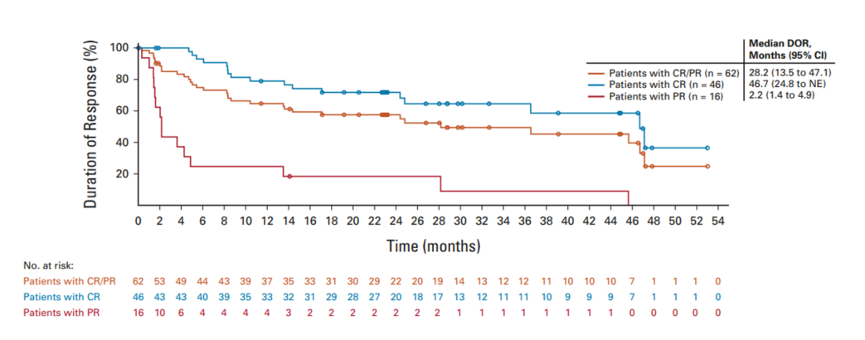
ZUMA-2 trial results: objective response rate & duration of response
ZUMA-2 objective response rate
ZUMA-2 duration of response
 | Brexu-cel
 | mITT (n = 68)
Objective response rate (CR + PR), n (%) [95% CI] | 62 (91) [50.1, 73.2]
Complete response rate, n (%) [95% CI] | 46 (68) [55.2, 78.5]
Partial response, n (%) [95% CI] | 16 (24) [14.1, 35.4]
Median duration of response = 28.2 months for 62 people with ORR, but 46.7 months for those with CR (n=46)
mITT, modified intention-to-treat; CR, complete response; PR, partial response; CI. Confidence interval; IRRC, Independent Radiology Review Committee

Slide 13
ZUMA-2 trial results: progression-free survival
CONFIDENTIAL
Progression-free survival is reported for the 5-year mITT data cut
Kaplan-Meier plot of PFS for old and current data-cuts of ZUMA-2
 | ZUMA-2 mITT (n=68)
Events, n (%) | 44 (65)
Median PFS, months [95% CI] | 25.3 (12.7-46.6)
Median follow up [95% CI] | 67.8
mITT, modified intention-to-treat; PFS, progression-free survival; CI, confidence interval

Slide 14
ZUMA-2 trial results: overall survival
CONFIDENTIAL
Overall survival is reported for the 5-year mITT data cut
Kaplan-Meier plot of OS for old and current data-cuts of ZUMA-2
 | ZUMA-2 mITT (n=68)
Events, n (%) | 44 (65)
Median OS, months [95% CI] | 46.5 (24.9–60.2)
mITT, modified intention-to-treat; OS, overall survival; CI, confidence interval

Slide 15
Key issues: Generalisability of ZUMA-2 (1)
Background
Company uses ZUMA-2 data in a naïve comparison to real-world data for R-BAC comparator
Company
RWE now available for brexu-cel, including SACT data collected following TA677
Model estimates higher survival than from SACT
Company state this is because production-related problems caused substantial delays to start brexu-cel treatment in SACT database for many of the first patients
No comparative evidence for brexu-cel compared with R-BAC (naïve comparison with McCulloch 2020, retrospective cohort study of people with MCL who had progressed after treatment with a BTKi)
EAG comments
In TA677 committee had concerns about generalisability of ZUMA-2 to NHS: No UK patients, and cohort was younger (8-10 years younger) than seen in NHS
Concerned ZUMA-2 overestimates efficacy of brexu-cel relative to RWE estimates of brexu-cel efficacy
RWE sources for base case analysis would provide more accurate efficacy of brexu-cel
BTKi. Bruton’s tyrosine kinase inhibitor; MCL, mantle cell lymphoma; RWE, real-world evidence; SACT, Systemic Anti-Cancer Therapy

Slide 16

Key issues: Generalisability of ZUMA-2 (2)
Baseline characteristics of ZUMA-2 trial and RWE studies
EAG comments (cont.)
SACT database better reflects UK treatment and patient characteristics. Other RWE sources report similar outcomes to SACT dataset, and their pooling considerably boosts the sample size
Reliance on naïve comparison unavoidable and makes estimates of relative efficacy uncertain
EAG utilises RWE to provide an extensive overview of generalisability, prognosis, and clinical effectiveness, in conjunction with latest follow-up data from ZUMA-2
RWE for brexu-cel encompasses four main sources:
  England Systemic Anti-Cancer Therapy (SACT) dataset for the Cancer Drugs Fund (CDF) NHS population
  a study by O'Reilly et al. (2024) representing patients from 12 institutions in the UK between February 2021 and June 2023
  DESCAR-T registry from France under the European Medicines Agency approval label, and
  US lymphoma CAR-T Consortium data
For the comparison with R-BAC (McCulloch), is it more appropriate to use ZUMA-2 alone or ZUMA-2 pooled with SACT and other RWE sources for brexu-cel?
RWE, real-world evidence; SACT, Systemic Anti-Cancer Therapy

Slide 17
Key issues: Average age of people eligible for brexu-cel
Background
Mean starting age in the company’s economic model is 63.2 years, taken from ZUMA-2
Company
Did scenario analysis using SACT median age: 67.5 years (based on 97 applications for brexu-cel between 19 January 2021 and 30 September 2023)
Agree that mean age of 63.2 years is younger than expected for people with R/R MCL in the UK but is likely reflective of people that would be eligible for CAR T-cell treatment in clinical practice
EAG comments
Median age from ZUMA-2 is 65 years. Median age from both O’Reilly and DESCAR-T is 68
In TA677, a clinical expert suggested that ZUMA-2 patients were 8–10 years younger than the typical NHS patients with R/R MCL
Prefer mean age of 66 years from SACT for their base case
Is population eligible for brexu-cel likely to be younger than broader R/R population?
Is 63.2 years the most appropriate starting age for the economic model?
R/R, relapsed or refractory; MCL, mantle cell lymphoma; SACT, Systemic Anti-Cancer Therapy

Slide 18
Key issues:
Choice of population for extrapolating R-BAC PFS and OS (1)
Background
Using outcomes from McCulloch 2020 possibly overestimates real-world efficacy of R-BAC
Company
Efficacy estimates for SoC sourced from McCulloch 2020, consistent with original submission
Study had higher than expected rate of subsequent alloSCT (31%), but company did not adjust for alloSCT proportions in its base case (scenarios provided for 15% and 40% having alloSCT)
EAG comments
Clinical expert advice to EAG that time-to-event data from McCulloch 2020 too optimistic compared with expected outcomes because of selection bias towards younger and fitter patients
PFS for people who had subsequent alloSCT reported separately, so possible to match these to PFS times for whole population, and remove them
Similar approach also possible for OS
EAG prefers to use population from McCulloch 2020 who did not receive subsequent alloSCT for extrapolating PFS and OS for R-BAC, as more closely aligned with real-world population
alloSCT, allogeneic stem-cell transplant; OS, overall survival; PFS, progression-free survival

Slide 19
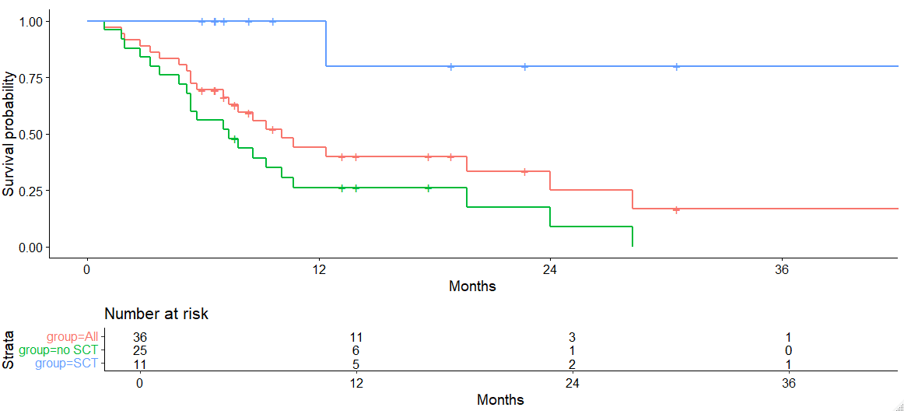
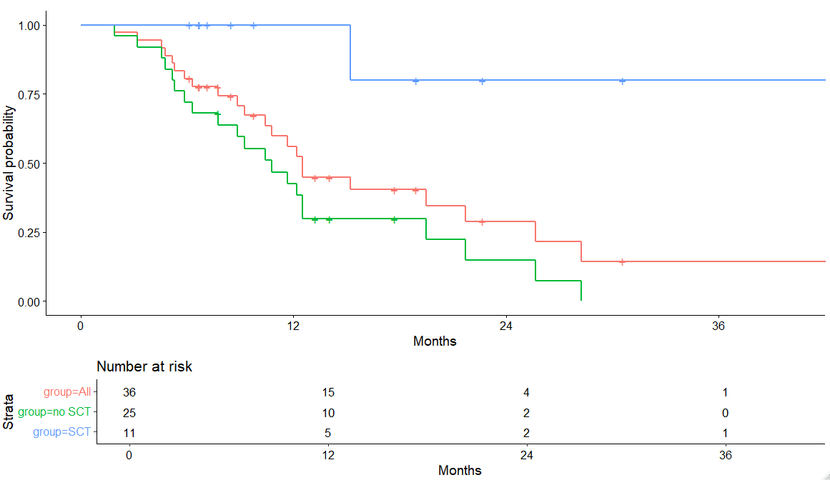
Key issues:
Choice of population for extrapolating R-BAC PFS and OS (2)
PFS from McCulloch et al. removing people with subsequent alloSCT
OS from McCulloch et al. removing people with subsequent alloSCT
Is it more appropriate to use company method or EAG-adjusted population from McCulloch 2020 for extrapolating PFS and OS for R-BAC?
PFS, progression-free survival; OS, overall survival; alloSCT, allogeneic stem cell transplant

Slide 20
Brexucabtagene autoleucel for treating relapsed or refractory mantle cell lymphoma after 2 or more systemic treatments
Background and key issues
Clinical effectiveness
Modelling and cost effectiveness
Other considerations
Summary

Slide 21
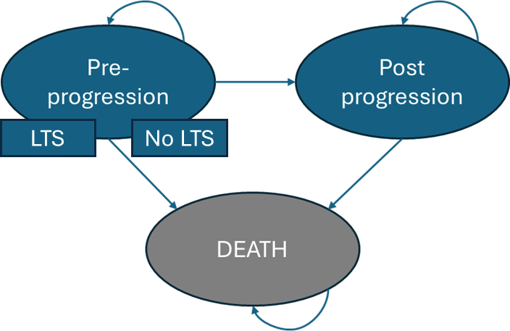
Company’s model overview: Partitioned Survival model
EAG says model structure is consistent with TA677 and is appropriate
Modelling assumptions with greatest effect on ICER:
Decision to include the leukapheresis period and broaden the population of brexu-cel
Whether to use RWE or trial data to extrapolate for brexu-cel, and choice of overall survival extrapolation
When and how to apply the cure assumption for brexu-cel
Whether to include effects of alloSCT in R-BAC data source
The proportion of people receiving subsequent alloSCT
3 health states: pre-progression, post-progression, and death
EAG comments:
Model differentiates long-term survivorship (LTS) in the pre-progression state, specifically for brexu-cel
Patients in the brexu-cel arm are assumed LTS after 48 months and follow age-adjusted ONS general population survival data, adjusted by a standardised mortality ratio
Mean age at start is 63.2 years (see tech team issue on average age of people with R/R MCL)
ONS, Office for National Statistics; RWE, real-world evidence; alloSCT, allogeneic stem cell transplant; R/R, relapsed or refractory; MCL, mantle cell lymphoma

Slide 22
How company incorporated evidence into model
Component | Application with the model | Source(s) for brexu-cel | Source(s) for SoC
PFS | Used to fit parametric survival curves to capture lifetime PFS estimates | ZUMA-2 Cohort 1, mITT population UK lifetables for background mortality Literature (Maurer et al., 2014) for LTS | McCulloch 2020 UK lifetables for background mortality
OS | Used to fit parametric survival curves to capture lifetime OS estimates
AE incidence | Informed the proportion of patients who incur the disutility associated with each AE | ZUMA-2 Cohort 1, mITT population | N/A
Utility values | Used to inform utility of pre-progression and post-progression | ZUMA-2 Cohort 1, mITT population (pre-progression) TA502 (ibrutinib for R/R MCL) for post-progression Ara and Brazier 2010 for LTS Wider literature (O’Reilly 2024, AE utility effects) | ZUMA-2 Cohort 1, mITT population (pre-progression) TA502 (ibrutinib for R/R MCL) for post-progression
Input and evidence sources
mITT, modified intention-to-treat; AE, adverse events; LTS, long-term survivorship; R/R, relapsed or refractory; MCL, mantle cell lymphoma; PFS, progression-free survival; OS, overall survival

Slide 23
Key issues: Modelling of pre-infusion period for brexu-cel (1)
Background
Unclear when in the CAR-T process is a fair starting point for comparison to R-BAC
Survival from leukapheresis not reported for majority of datasets, including SACT and ZUMA-2
Company
Base case does not account for outcomes of people leukapheresed but not infused, only costs
Brexu-cel manufactured for 71 patients leukapheresed (96%), administered to 68 patients (92%)
Median time from leukapheresis to infusion = 27 days (range: 19–134 days)
EAG comments
Evaluation population should include all leukapheresed patients: more accurate assessment of brexu-cel’s real-world feasibility and effectiveness
DESCAR-T study most appropriate source to estimate the survival of people not infused with CAR-T (ITT population from 181 patients in France, 26 of whom did not progress to infusion)
O’Reilly 2024: out of 119 approved applications for CAR-T, 104 people did leukapheresis (87.4%), and 83 were infused (69.7%)
High agreement with SACT data, where 95 people were infused from 135 applications (70.4%)
SACT, Systemic Anti‑Cancer Therapy; ITT, intention-to-treat

Slide 24
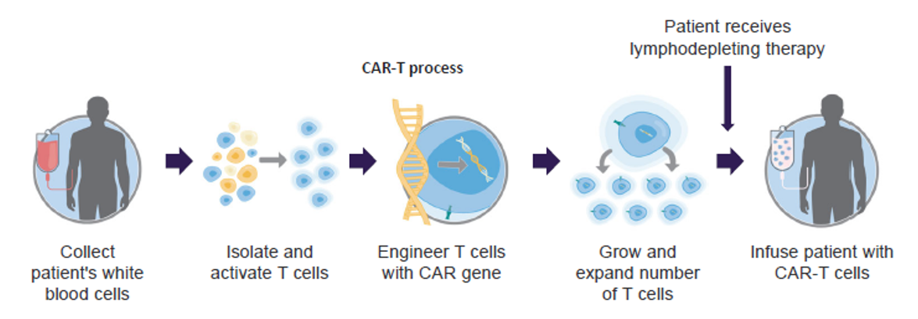
Key issues: Modelling of pre-infusion period for brexu-cel (2)
Leukapheresis is the first stage of the CAR-T process, in which white blood cells (leukocytes) are separated from a sample of blood
CAR T-cell therapy manufacturing and administration steps:
Is it appropriate to model costs and outcomes for people who undergo leukapheresis but are not infused?

Slide 25
Key issues: Implementation of cure assumption
SMR values
Background
Economic model includes long-term survivorship (LTS) in the pre-progression state
Very few disease-related deaths or progressions beyond 48 months in ZUMA-2
Company
Applied a 48-month LTS (cure assumption) timepoint, based on ZUMA-2 data and RWE (O’Reilly 2024), to reflect the reduced probability of disease progression or death after this point
People in the LTS group are assumed to follow age-adjusted general population survival curves, adjusted by a standardised mortality ratio (SMR) of 1.09 (Maurer et al 2014)
EAG comments
No evidence to support a plateau in survival curves prior to 60 months
Between 48 and 88 months, risk of death remains substantially higher than background mortality, and mortality ratio of 1.09 does not adequately account for this difference
Considers 60-month cure assumption more appropriate (as used in TA677 model)
SMR of 1.09 taken from a study of diffuse large B-cell lymphoma (not CAR-T therapy)
EAG prefers ratio of 3.00, accepted by committee in TA893 (brexu-cel for relapsed or refractory B-cell acute lymphoblastic leukaemia)
Is a cure assumption timepoint of 48 months or 60 months more appropriate?
Is a mortality ratio of 1.09 or 3.00 more appropriate to adjust background mortality?

Slide 26
Key issues: CAR-T Tariff application and ICU costs
CAR-T tariff details
Background
Company model uses outdated CAR-T tariff cost (£41,101), and does not include costs for ICU
Company
Brexu-cel costs: drug acquisition, bridging therapy, conditioning chemotherapy, and a CAR-T tariff (encapsulates leukapheresis, infusion, monitoring, hospitalisation, AE management in first 100 days)
Model uses CAR-T tariff of £41,101; covers primary hospitalisation and management of CAR-T-related toxicities, in line with TA872 (axicabtagene ciloleucel for DLBCL)
Contests this tariff, highlights that NHS efficiencies have likely reduced CAR-T costs over time
EAG comments
A more robust approach, informed by prior Committee experience, involves using the tariff cost of £58,964 for CAR-T infusion and monitoring, in addition to ICU-related expenses
NHS England confirmed that costs associated with ICU are not included in CAR-T tariff
NICE notes that updated CAR-T tariff of £60,462 has been provided by NHSE for 2025/26
Is it appropriate to use the 2025/26 CAR-T tariff cost in the economic model?
Is it appropriate to also include supplementary ICU costs in the model?
AE, adverse events; ICU, intensive care unit; DLBCL, diffuse large B-cell lymphoma

Slide 27
Key issues: Utility values for health states (1)
CONFIDENTIAL
Background
Utility values taken from ZUMA-2, but some of these are higher than the UK general population
Company
Pre-progression utility estimate of xxxx taken from EQ-5D-5L data from ZUMA-2
Post-progression utility estimate of 0.724 derived from TA502* (limited data from ZUMA-2)
For long-term survivors, company use general population utility values: utility value of xxxx for patients aged around 67 years (aligns with TA502)
Incorporates disutility values for grade 3 and 4 adverse events into model (brexu-cel arm only)
EAG comments
Where utility values exceed general population, EAG prefers to cap at general population values
Pre-progression utility value of xxxxxxxxxxxxxxxxxxxxxxxxxxxxxxxxxxxxxxxxxxxxxxxxxx x (xxxx and may be justifiable if adverse event disutilities are excluded
Deriving post-progression utility from the difference between TA502 utilities lacks methodological robustness. EAG proposes either calculating post-progression utility proportionally (e.g., xxxxxxxxxxxxxx or directly adopting the TA502 post-progression value of 0.68 directly
For long-term survivors, utility assumption too optimistic, should be capped at general population
* TA502: ibrutinib for relapsed or refractory mantle cell lymphoma

Slide 28
Key issues: Utility values for health states (2)
CONFIDENTIAL
Utility values used in company model
Health state | Utility value | Source
Pre-progression | xxxx | Derived from EQ-5D-5L data in the ZUMA-2 trial
Pre-progression, LTS | xxxxx | General population (HSE data, aged around 67 years)
Post-progression | 0.724 | Based on an estimate from TA502 (ibrutinib for R/R MCL)
Utility values accepted in TA677
Health state | Utility value | Source
Pre-progression | xxxxx | Derived from EQ-5D-5L data in the ZUMA-2 trial
Pre-progression, after 5 years (cure point) | 0.797 | Based on general population (Ara and Brazier, 2010)
Post-progression | 0.724 | Based on an estimate from TA502 (ibrutinib for R/R MCL)
TA677 conclusion
Not clear if long-term survivors would have the same health-related quality of life as people in the general population of the same age and sex
EAG base case
Pre-Progression: Capped at general population utility (decrement by AE impacts)
LTS: Capped at general population utility
Post-Progression: Direct TA502 value (0.68)
Which are the most appropriate utility values to use?
AE, adverse events; LTS, long-term survivorship; HSE, Health Survey for England; R/R, relapsed or refractory; MCL, mantle cell lymphoma

Slide 29
Key issues: Underestimation of IVIg costs
CONFIDENTIAL
Background
IVIg for management of adverse events, including hypogammaglobulinaemia
Company
AE costs included within the CAR-T tariff, except for hypogammaglobulinemia, which necessitates long-term IVIg therapy
Company use xx% incidence rate for IVIg from ZUMA-2 (for hypogammaglobulinaemia grade 3 or above) and assume 1 year of treatment
EAG comments
xx% incidence rate from ZUMA-2 likely underrepresents proportion requiring IVIg
Wang et al. 2023 (median follow-up 35.6 months) reports 38% having IVIg (ZUMA-2, any cause)
32% previously accepted in TA677
Clinical expert advice: 30–40% of patients will require IVIg for a duration of 1 to 2 years
Assumption of 12-month IVIg treatment duration after brexu-cel aligns with TA559 (axicabtagene ciloleucel for DLBCL after 2 or more systemic therapies), but not with TA567 (tisagenlecleucel for R/R DLBCL after 2 or more systemic therapies: 36-month IVIg treatment duration)
EAG prefers using 38% for patients requiring IVIg for 1 year
What are committee’s preferred assumptions for IVIg treatment incidence & duration?
IVIg, intravenous immunoglobulin; AE, adverse events; DLBCL, diffuse large B-cell lymphoma; R/R, relapsed or refractory

Slide 30
Key issues: Costs and usage of alloSCT
CONFIDENTIAL
Background
Subsequent alloSCT of 31% for R-BAC (McCulloch 2020) in company’s model may be too high
Company
In TA677, 2 clinical experts estimated subsequent alloSCT proportions following R-BAC to be below 30% and below 15%. Use 31% for R-BAC (0% for brexu-cel) to model costs for alloSCT
At clarification, alloSCT costs revised to £106,393, with £1,927 for harvesting and £56,957 for follow-up, aligning with TA893 methodology (brexu-cell for R/R B-cell ALL)
EAG comments
Company’s revision at clarification does now include stem cell harvesting and follow-up costs, but revised costs still appear lower than those in TA893 Prefers subsequent alloSCT costs used in TA893 as a more appropriate source (£117,751)
Not clear why rate of alloSCT after R-BAC would differ from the rate following brexu-cel
Prefers to model same rate (xxx%) for both arms when estimating subsequent treatment costs
What is committee’s preferred rate of subsequent alloSCT for each treatment arm?
Does committee consider company’s or EAG’s alloSCT costs to be more appropriate?
alloSCT, allogeneic stem-cell transplant; R/R, relapsed or refractory; B-cell ALL, B-cell acute lymphoblastic leukaemia

Slide 31
Decision modifier (1)
NICE methods and processes manual changed in 2022
Brexu-cel was originally assessed under the end-of-life (EOL) criteria, and was considered to have met this criteria, as outlined in TA677
NICE’s January 2022 update replaced these criteria with the severity modifier
Company considers the ongoing review an extension of the initial appraisal rather than a new assessment and maintains that applying the severity modifier retrospectively would contradict the established Cancer Drugs Fund exit process
NICE considers that the EOL criteria no longer apply due to the methods and process manual changes in 2022
Company recently submitted a calculation for the severity modifier
The committee will have to consider the particular circumstances in this evaluation, in particular the application of the end-of-life criteria in TA677, and whether the change to the severity modifier requires the committee to apply any flexibility here.
MCL, mantle cell lymphoma;

Slide 32
Decision modifier (2)
Severity modifier analysis
Parameter | Input | Reference
Age | 63.2 years | ZUMA-2
% female in the patient population | 16% | ZUMA-2
QALYs of patients untreated | 1.39 | Company base case
Discount rate | 3.5% | NICE Methods
Remaining QALYs
Without the disease | 11.90
With the disease | 1.39
Absolute shortfall | 10.51
Proportional shortfall | 88.32%
EAG comments
Company’s shortfall calculations and 1.2 QALY weighting considered appropriate by the EAG
Company has not provided an updated model or base case that incorporates the application of the severity modifier
MCL, mantle cell lymphoma;

Slide 33
Summary of company and EAG base case assumptions (1)
Area of change | Company’s Value/approach | EAG’s value/approach
Population approach and extrapolation | Intervention: Using the mITT from ZUMA-2 Comparator: R-BAC based on McCulloch (2020) | Intervention: Using ITT population (leukapheresed patients) from real world sources. Comparator: Comparator: R-BAC based on McCulloch (2020) with using the updated extrapolation with excluding alloSCT effects
Time horizon | fixed 50-year time horizon | 100 years minus starting age
Half-cycle correction | Using cycle midpoints | Average health state occupancy for half-cycle correction
Cure time point | Using the 48-month LTS timepoint. | Using the 60-month LTS timepoint
Mortality Rate Adjustment Factor (MRAF) | Using the MRAF of 1.09 | Using the MRAF of 3.00

Slide 34
Summary of company and EAG base case assumptions (2)
CONFIDENTIAL
Area of change | Company’s Value/approach | EAG’s value/approach
Proportion receiving alloSCT and associated costs | Including alloSCT in both arms (xxx% in brexu-cel and 31% in R-BAC) with updated costs | Including alloSCT in both arms (xxx% in brexu-cel and xxx% in R-BAC) with updated costs
IVIg Therapy Needs | Using xxx% for patients requiring IVIg therapy for a period of one year | Using 38% for patients requiring IVIg therapy for a period of one year
Adverse events source | Incidence rates that are reported in the main submission | Using the most updated incidence rates
CAR-T tariff costs | Using the tariff costs for CAR-T infusion and monitoring, valued at £41,101 | Using the tariff costs for CAR-T infusion and monitoring, valued at £58,964 + ICU costs (with the probability of 27% for requiring ICU)
Pre/Post-Progression, and LTS HRQoL Estimates | Pre-Progression; ZUMA-2 value (xxxx), Post-Progression: xxxx, LTS: general population utility | Pre-Progression; general population utility, Post-Progression: Direct TA502* value (0.68), LTS: general population utility
* TA502: ibrutinib for relapsed or refractory mantle cell lymphoma

Slide 35
Cost-effectiveness results:
Cost effectiveness results cannot be reported here because of confidential discounts for included technologies
Company base case ICER is above £30,000 per QALY gained
EAG base case ICER is above £30,000 per QALY gained
All results are presented in Part 2 slides for committee
Abbreviations: ICER; incremental cost effectiveness ratio, QALY; quality adjusted life year

Slide 36
Brexucabtagene autoleucel for treating relapsed or refractory mantle cell lymphoma after 2 or more systemic treatments
Background and key issues
Clinical effectiveness
Modelling and cost effectiveness
Other considerations
Summary

Slide 37
Equality considerations
No equalities issues identified
Mantle cell lymphoma is more prevalent in men than women
No other equalities issues were identified during scoping. This does not constitute an equalities issue that needs to be addressed by the committee in its evaluation of the technology
Are there any other equalities issues to consider?

Slide 38
Brexucabtagene autoleucel for treating relapsed or refractory mantle cell lymphoma after 2 or more systemic treatments
Background and key issues
Clinical effectiveness
Modelling and cost effectiveness
Other considerations
Summary

Slide 39
Key Issues
Issue | ICER impact
Generalisability of ZUMA-2 trial to NHS care and choice of data source for extrapolating brexu-cel PFS and OS | Large
Tech team key issue: Average age of people with R/R MCL eligible for brexu-cel | Large
Choice of population for extrapolating R-BAC PFS and OS relative to subsequent alloSCT | Large
Modelling of pre-infusion period for brexu-cel | Large
Implementation of cure assumption (timing and magnitude) | Large
CAR-T Tariff application and ICU costs | Large
Utility values for health states | Small
Underestimation of IVIg costs | Small
Costs and usage of alloSCT | Small
PFS, progression-free survival; OS, overall survival; R/R, relapsed or refractory; MCL, mantle cell lymphoma; ICU, intensive care unit; IVIg, intravenous immunoglobulin; alloSCT; allogeneic stem-cell transplant

Slide 40
Brexucabtagene autoleucel for treating relapsed or refractory mantle cell lymphoma after 2 or more systemic treatments
Supplementary appendix

Slide 41
Baseline characteristics of ZUMA-2 trial compared with RWE studies of brexu-cel and R-BAC (1)
 |  | ZUMA-2 trial cohort 1 enrolled population (ITT; n =74) | O'Reilly et al. 2024 (n=119) | CDF patients reported as SACT (n=92) | DESCAR registry (n=152) | US consortium (n=144) | McCulloch 2020 (n=36)
Age | Median (range), years | 65 (38-79) | 68 (41–80) | 67.5 (41-78) | 68.0 (39-83) | 67 (34-89) | 66 (43–81)
Male, n (%) |  | 62 (84) | 87 (73) | 71 (77) | 131 (86.2) | NR | 29 (80.6)
ECOG performance status score, n (%) | 0 | 47 (64) | 42 (35) | 15 (16) | 125 (88.0) | NR | NR
 | 1 | 27 (36) | 77 (65) | 33 (36) |  | NR | NR
 | ≥ 2 | 0 | 0 | 2 (2) | 17 (12) | 18 (13) | 7 (19.5)
 | Missing | NA | NA | 42 (46) | NR | NR | NR
Simplified MIPI, n (%) | Low risk | 29 (39) | 23 (23) | NR | 27 (19.9)** | 46 (32) | 5 (13.9)**
 | Intermediate risk | 30 (41) | 31 (31) | NR | 54 (39.7)** | 75 (52) | 6 (16.7)**
 | High risk | 13 (18) | 47 (47) | NR | 55 (40.4)** | 23 (16) | 15 (41.7)**
 | Missing | 2 (3) | 18 (15) | NR | 16 (10.5) | NR | NR
Ki-67 proliferation index ≥ 30%, n (%) |  | 40 (54.1) | 49 (78) | NR | 85 (79.4) | 102 (70.8) | NR
ECOG, Eastern Cooperative Oncology Group; s MIPI, simplified-Mantle Cell Lymphoma International Prognostic Index
**MIPI has been reported. For the McCulloch et al. (2020), MIPI at start of R-BAC has been used.

Slide 42
Baseline characteristics of ZUMA-2 trial compared with RWE studies of brexu-cel and R-BAC (2)
CONFIDENTIAL
 |  | ZUMA-2 trial cohort 1 enrolled population (ITT; n =74) | O'Reilly et al. 2024 (n=119) | CDF patients reported as SACT (n=92) | DESCAR registry (n=152) | US consortium (n=144) | McCulloch 2020 (n=36)
Morphology, n (%) | Blastoid | 19 (26) | 29 (37) | NR | 41 (31.1) | 59 (41) | 7 (19.5)
 | Pleomorphic | 4 (5) | 4 (5) | NR | NR |  | NR
TP53 mutation, n (%) |  | 6 (8.1) | 21 (17.6) | NR | 29 (30.2) | 54 (50) | NR
POD24, n (%) |  | 33 (48.5)ª | 67 (57) | NR | NR | 71 (49) | NR
Extranodal disease, n (%) |  | 43 (58) | 90 (76) | NR | NR | NR | NR
Prior therapy, n (%) | AutoSCT | 31 (42) | 40 (34) | 25 (27) | 60 (39.5) | NR | 15 (41.7)
 | AlloSCT | 0 (0) | 15 (13) | 14 (15) | 9 (5.9) | NR | 2 (5.6)
Received bridging therapy, n (%) |  | xxxxx) | 94 (79) | 84 (91) | 126 (82.9) | NR | NA
Back to generalisability key issue
alloSCT, allogeneic stem cell transplant; autoSCT, autologous stem cell transplant; CDF, cancer drugs fund; SACT, Systemic Anti‑Cancer Therapy
ª Calculated from mITT population with 68 patients

Slide 43
ZUMA-2 v RWE: progression-free survival
CONFIDENTIAL
RWE, real-world evidence

Slide 44
ZUMA-2 v RWE: overall survival
CONFIDENTIAL
RWE, real-world evidence

Slide 45
EAG preferred extrapolation for brexu-cel PFS (log-normal)
PFS, progression-free survival

Slide 46
EAG preferred extrapolation for brexu-cel OS (log-normal)
OS, overall survival

Slide 47
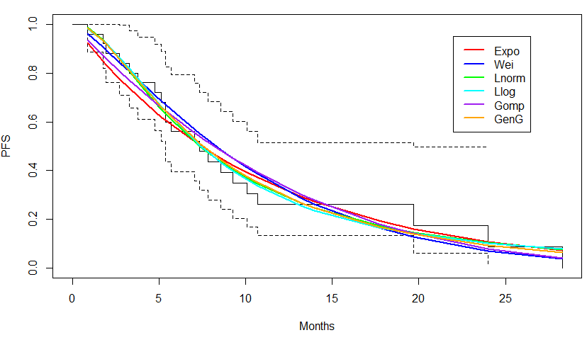
Parametric models fitted to EAG preferred R-BAC PFS data
PFS, progression-free survival

Slide 48
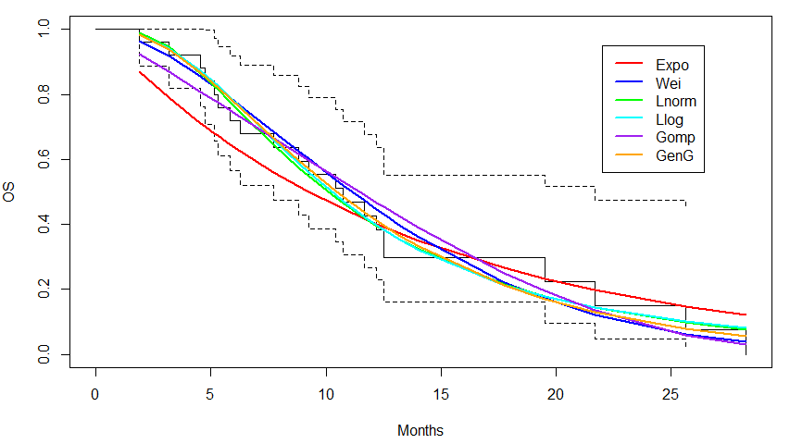
Parametric models fitted to EAG preferred R-BAC OS data
OS, overall survival

Slide 49
Variation in mortality ratios from ID6325 and TA677
CONFIDENTIAL
Cure assumption: people in the LTS group are assumed to follow age-adjusted general population survival curves, adjusted by a standardised mortality ratio (SMR)
 | SMR | Source
Company preference (TA677 and ID6325) | 1.09 | Maurer et al 2014: data from a French cohort of people with DLBCL having alloSCT, accepted in TA559 (axicabtagene ciloleucel for treating DLBCL after 2 or more systemic therapies, 2019)
Committee preference (TA677) | 2.36 | Eskelund et al 2016: reports up to 15 years of follow up (median 11.4 years) of 160 newly diagnosed patients with MCL after first-line treatment with chemotherapy then autoSCT (SMR range considered in TA677, 2020 = 2.36 to 4.37)
EAG preference (ID6325) | 3.00 | Comparing ZUMA-2 data over period of 60 to 88 months with general population mortality produces an average SMR of xxx (SD xxx), indicating that the company’s selected value underestimates the mortality risk. SMR of 3.00 (SD 0.39) accepted in TA893 (brexu-cel for R/R B-ALL, 2023)
Back to cure assumption key issue
DLBCL, diffuse large B‑cell lymphoma; MCL, mantle cell lymphoma; B-ALL, B‑cell acute lymphoblastic leukaemia; alloSCT, allogeneic stem-cell transplant; R/R, relapsed or refractory; autoSCT, autologous stem-cell transplant

Slide 50
CAR-T tariff cost for 2025/2026
Back to CAR-T tariff key issue
CAR T tariff for 2025/2026 is £60,462
This is the annual uplift applied to the 2024/25 figure of £58,953
Items included in the CAR-T tariff cost
Costs associated with | Included in NHS tariff?
Leukapheresis | Yes
CAR-T therapy delivery in hospital | Yes
Adverse events in hospital | Yes
Monitoring for 100 days | Yes
Training | Yes
Conditioning and bridging chemotherapy acquisition, administration and delivery | No
CAR-T product acquisition | No
Subsequent treatments | No
Subsequent allo-SCT | No
DLBCL, diffuse large B‑cell lymphoma; MCL, mantle cell lymphoma; B-ALL, B‑cell acute lymphoblastic leukaemia; alloSCT, allogeneic stem-cell transplant; R/R, relapsed or refractory; autoSCT, autologous stem-cell transplant

