Slide 1
Cabozantinib for treating advanced neuroendocrine tumours that have progressed after systemic treatment [ID6474]
Part 1 – confidential information redacted
Technology appraisal committee D [10th September 2025]
Chair: Megan John
Lead Team: Paul Caulfield, Savvas Vlachos, David Meads
Evidence review group: BMJ TAG
Technical team: Harsimran Sarpal, Caron Jones, Ross Dent
Company: Ipsen
© NICE 2025. All rights reserved. Subject to Notice of rights.

Slide 2
Cabozantinib for treating advanced neuroendocrine tumours that have progressed after systemic treatment [ID6474]
Key issues & decision problem
Clinical effectiveness
Modelling and cost effectiveness
Other considerations
Summary

Slide 3
Background: Advanced neuroendocrine tumours
Classification and epidemiology
Heterogenous group of rare tumours which can sometimes present asymptomatically and can develop throughout the body
Grouping based on location of primary tumour site → pancreas (pancreatic neuroendocrine tumours: pNETs) or any other location (extra-pancreatic neuroendocrine tumours: epNETs)
Usually classified by primary tumour site, histological characteristics, stage and functional status
~3,600 estimated people eligible in England
Causes
Family history of cancers (lung, stomach, pancreas, small intestine, colon and appendix)
High BMI, diabetes, smoking and alcohol are potential risk factors
Symptoms and prognosis
Depends on location of tumour and examples may include pain, tiredness, diarrhoea, nausea, rectal bleeding, shortness of breath, hypoglycaemia and weight loss
5-year survival rates for stage 4 are less than 50% regardless of primary site, with the lowest being lung (12%), colon (18%), stomach (21%), rectum (22%) and pancreas (26%)
Abbreviations: BMI, body mass index

Slide 4
Clinical perspectives
Submissions from UKINETS and clinical experts
Aim of treatment
The main aim is to control symptoms, delay tumour progression, improve overall and/or progression-free survival and quality of life
Unmet need/current treatment options
Unmet need for NETs, particularly lung NETs → overall survival remains poor
For epNETs, there are limited treatment options after progression on 1 or 2 lines of systemic therapy
Unmet need for an additional treatment option to delay disease progression and improve outcomes for people with advanced NETs
Cabozantinib
Improved progression-free survival in people with pNETs and epNETs which is clinically significant
Common grade 3 or higher treatment-related adverse events include hypertension, fatigue, diarrhoea and thromboembolic events, but no toxicity signals of concern around use of cabozantinib
Resource use issues
No anticipated additional infrastructure or staff costs required
Abbreviations: epNETs, extra-pancreatic neuroendocrine tumours; NETs, neuroendocrine tumours; pNETs, pancreatic neuroendocrine tumours

Slide 5
Patient perspectives
Submissions from Insulinoma Support Network and Neuroendocrine Cancer UK
“The impact on daily living is profound, affecting relationships, employment, and social engagement.”
Living with NETs
People and their families describe living with NETs as facing an uncertain and unpredictable future
Lifelong medical appointments, invasive tests, and complex treatment regimens
Symptoms can fluctuate daily → impacting on health and overall well-being
Treating NETs
Often a delay in receiving an accurate diagnosis and timely access to treatment
Not all therapies are suitable for individuals and not everyone will receive treatment in the same sequence
Available therapies can cause mouth sores, digestive problems, diarrhoea & nausea
Cabozantinib
Oral treatment, no need to travel to the hospital
Meets an unmet need, especially for those with limited / no alternative treatment options beyond supportive care alone
AEs with cabozantinib similar to other treatments or the disease itself → people previously treated with other TKIs (e.g., everolimus) have found cabozantinib more tolerable
“NHS care for metastatic insulinomas lacks consistent pathways, management varies widely between centres of excellence and local NHS hospitals and no national protocol exists, leading to delays, missed treatments, uncertainty and on occasions, death”
Abbreviations: AEs, adverse events; NETs, neuroendocrine tumours; PFS, progression-free survival; TKI, tyrosine kinase inhibitors

Slide 6

Equalities issues
One stakeholder identified that people may experience inequalities linked to age, disability, mobility, financial circumstances, or geographical distance from specialist NET centres
It was noted that differences can arise from language and culture, which may limit understanding of treatment and side effect management
Lead team comments
Literature suggests:
  Higher incidence of NETs and worse survival in people of Black family background:
    particularly poorer outcomes for Black men
    social determinants, support mechanisms, and access to health care may be contributing factors
Does the committee consider that there are any relevant equality issues that it should consider in its decision making and, if so, how?
Abbreviations: NETs, neuroendocrine tumours

Slide 7
Key issues for committee discussion
Key issues for committee discussion |  | Key issue for committee discussion | ICER impact
Decision problem | 1 | Is the company’s positioning of cabozantinib appropriate? - If not, are PRRT, everolimus or sunitinib relevant comparators? | Large
Clinical effectiveness | 2 | Is it appropriate to group lung NETs with other extra-pancreatic NETS? | Large
 | 3 | Is there a reason to not use the more mature data cut-off? | Large
Cost effectiveness | 4 | Is the company’s or EAG’s modelling approach for PFS more appropriate? | Small
 | 5 | Is the company’s or EAG’s modelling approach for OS more appropriate? | Large
 | 6 | Is it appropriate to consider HR of 1 for all comparisons? | Large
 | 7 | Which progression-free and progressed-disease utility values are appropriate? | Small
 | 8 | Which approach to modelling concomitant SSA is more appropriate? | Large
 | 9 | Which approach to modelling subsequent treatments is more appropriate? | Large
Abbreviations: HR, hazard ratio; ICER, incremental cost-effectiveness ratio; NETs, neuroendocrine tumours; OS, overall survival; PFS, progression-free survival; PRRT, peptide receptor radionuclide therapy; SSA, somatostatin analogue

Slide 8
Cabozantinib (Cabometyx, Ipsen)
CONFIDENTIAL
Technology details
Anticipated marketing authorisation | ‘For the treatment of adult patients with unresectable or metastatic well-differentiated extra-pancreatic (epNET) and pancreatic (pNET) neuroendocrine tumours who have progressed following at least one prior systemic therapy other than somatostatin analogues.’ Anticipated MA: X n X (MHRA IRP route)
Mechanism of action | 3rd generation small molecule that inhibits the enzymatic activity of multiple tyrosine kinases implicated in tumour growth and angiogenesis, pathologic bone remodelling, drug resistance, and metastatic progression of cancer
Administration | Oral: 60 mg tablet orally once daily
Price | List price: £5,143 (30 x 60 mg tablets) per 30-day pack There is a simple patient access scheme (PAS) discount for cabozantinib
Abbreviations: epNETs, extra-pancreatic neuroendocrine tumours; IRP: International Recognition Procedure; MA, marketing authorisation; MHRA, Medicines and Healthcare products Regulatory Agency; pNETs, pancreatic neuroendocrine tumours
Notes:
Source: table 2, CS

Slide 9
Treatment pathway: pNETs and epNETs
1st line
The company positions cabozantinib as a later line alternative to BSC
2nd line
3rd line
NETs population
Proposed position
epNETs
SSAs e.g. lanreotide and octreotide
pNETs
Lung NETs
GI NETs
Functional
Non-functional
Functional
Non-functional
SSA
SSA
SSA
SSA
SSA
SSTR+
SSTR-
SSTR+
SSTR-
PRRT or sunitinib or everolimus
Everolimus
PRRT
Everolimus
PRRT
Everolimus
3rd line
3rd line
4th line
3rd line
3rd line
2nd line
Cabozantinib
BSC (SSA)
Is the treatment pathway reflective of NHS clinical practice?
Is company’s positioning as a later line treatment appropriate? (narrower than MA)
EAG:
According to MA, cabozantinib could be used as an earlier line alternative to PRRT, sunitinib or everolimus
Company positioning is only as a later line alternative to BSC
Abbreviations: BSC, best supportive care; epNETs, extra-pancreatic neuroendocrine tumours; MA, marketing authorisation; NETs, neuroendocrine tumours; pNETs, pancreatic neuroendocrine tumours; PRRT, peptide receptor radionuclide therapy; SSA, somatostatin analogue; SSTR, somatostatin receptor
Notes:
Source: Figure 1 BIM

Slide 10
Key clinical trial: CABINET
 | CABINET
Design | Phase 3, multi-centre, double-blind, randomised, placebo-controlled trial
Location | US: 62 centres
Population | Adults with pNETs or epNETs whose disease has progressed after prior systemic therapy, n=298
Intervention | Cabozantinib (60 mg once daily)
Comparator | Placebo (60 mg once daily)
Outcomes | Primary: PFS (assessed by blinded independent review committee [BIRC]) Secondary: OS, ORR, safety and tolerability Exploratory: duration of response, disease control rate, HRQoL, and concordance between the investigator and BIRC response assessments
Abbreviations: epNETs, extra-pancreatic neuroendocrine tumours; HRQoL, health-related quality of life; pNETs, pancreatic neuroendocrine tumours; PFS, progression-free survival; ORR, objective response rate; OS, overall survival
Notes:
Source: table 7, CS

Slide 11
CABINET trial schema
Cabozantinib(n=64)
PD
Progressed after systemic therapy excluding SSAs
pNETs
R 2:1
Placebo(n=31)
PD
Cabozantinib
Crossover
Cabozantinib(=134)
PD
Company explored 3 methods to adjust for crossover
epNETs
R 2:1
Crossover
Placebo (n=69)
PD
Cabozantinib
People were randomised (2:1) to either cabozantinib (60mg) or placebo (60mg)
People in placebo arm eligible to crossover to cabozantinib on progression
Recruitment was terminated early due to compelling PFS observed during interim analyses: study was unblinded to allow crossover from placebo
Within CABINET, a sub-study (A021602-HO1) was conducted to capture HRQoL using EORTC QLQ-30
Abbreviations: epNETs, extra-pancreatic neuroendocrine tumours; EORTC, European Organisation for Research and Treatment of Cancer; HRQoL, health-related quality of life; PFS, progression-free survival; pNETs; pancreatic neuroendocrine tumours; SSA, somatostatin analogue; QLQ; quality of life questionnaire
Notes:
Source: Figure 5, CS

Slide 12
Baseline characteristics: CABINET
Baseline |  | pNET cohort |  | epNET cohort
 |  | CAB (n=64) | Placebo (n=31) | CAB (n=134) | Placebo(n=69)
Functional status | Functional | 11 (17%) | 5 (16%) | 41 (31%) | 25 (36%)
 | Non-functional | 48 (75%) | 22 (71%) | 75 (56%) | 34 (49%)
Prior systemic treatments | SSA n (%) | 63 (98%) | 30 (97%) | 124 (93%) | 64 (93%)
 | Mean (SD) | 2.7 (1.54) | 2.6 (1.74) | 1.9 (1.04) | 1.8 (1.07)
 | ≥3 | 33 (52%) | 12 (39%) | 35 (26%) | 15 (22%)
Types of prior systemic treatment | Everolimus, n (%) | 51 (80%) | 25 (81%) | 96 (72%) | 44 (64%)
 | PRRT, n (%) | 38 (59%) | 18 (58%) | 81 (60%) | 41 (59%)
 | Sunitinib | 18 (28%) | 7 (23%) | 4 (3.0%) | 1 (1.4%)
 | Anti-VEGFR TKI | 19 (30%) | 8 (26%) | 7 (5.2%) | 6 (8.7%)
 | Other anti-VEGFR TKI | 1 (1.6%) | 1 (3.2%) | 3 (2.2%) | 5 (7.2%)
 | Cytotoxic chemotherapy regimens | 44 (69%) | 18 (58%) | 51 (38%) | 23 (33%)
 | Other | 6 (9.4%) | 3 (9.7%) | 10 (7.5%) | 2 (2.9%)
EAG
Baseline characteristics reasonable reflection of people in the NHS (heavily pretreated) rather than the potential use earlier in the treatment pathway allowed by the marketing authorisation
Due to a lack of evidence, EAG experts would not want to use cabozantinib as an earlier treatment line than reflected in CABINET
Abbreviations: BSC, best supportive care; epNETs, extra-pancreatic neuroendocrine tumours; pNETs, pancreatic neuroendocrine tumours; PRRT, Peptide receptor radionuclide therapy; SD, standard deviation; SSA, somatostatin analogue; TKI, tyrosine kinase inhibitor; VEGFR, vascular endothelial growth factor receptor
Notes:
Source table 16 EAG report

Slide 13

Issue 1: Relevant comparators
Large impact
Only relevant if company positioning not appropriate
Background CABINET does not fully reflect MA population and company’s intended position for cabozantinib
Company
MA is broad and does not restrict by primary tumour site, grade, SSTR expression and functional status
Heterogeneity and restricted indications of available treatments means there is no consistent treatment pathway
Systemic treatment after progression are individualised and usually based on specific patient characteristics
BSC is the only relevant comparator for cabozantinib, so no other comparisons were provided
EAG
CABINET population was heavily pretreated → people had mean number of 3 systemic treatments excluding SSAs (see slide)
Considers 2 populations relevant to assessment:
  “heavily pre-treated” (>3 treatments/later line): BSC relevant comparator
  “less heavily pre-treated” (1 prior treatment/earlier line): PRRT, everolimus or sunitinib, relevant comparators
Provided CE results separately for sub-populations and presented exploratory ITCs for comparison with sunitinib and everolimus (see slide)
% with 1 prior systemic treatment | CABINET
 | Cabozantinib | Placebo
pNETs | 27% | 32%
epNETs | 44% | 48%
Are PRRT, everolimus or sunitinib relevant comparators for cabozantinib?
Abbreviations: BSC, best supportive care; CE, cost-effectiveness; epNETs, extra-pancreatic neuroendocrine tumours; ITC, indirect treatment comparison; MA, marketing authorisation; pNETs, pancreatic neuroendocrine tumours; PRRT, Peptide receptor radionuclide therapy; SSTR, somatostatin receptor

Slide 14
Cabozantinib for treating advanced neuroendocrine tumours that have progressed after systemic treatment [ID6474]
Key issues & decision problem
Clinical effectiveness
Modelling and cost effectiveness
Other considerations
Summary

Slide 15
Issue 2: Grouping approach for epNET
Large impact
Background
Company grouped GI NETs, lung NETs and other types of epNETs as epNETS
Lung NETs have worse prognosis and fewer treatment options than other epNETs → grouping may be inappropriate
Company:
Provided post-hoc analyses (PFS & OS) for lung NETs and epNETs (without lung NETs)
CABINET included small lung NET population with some differences in baseline characteristics between cabozantinib and placebo → race, disease duration, grade 1 tumour and proportion with functional disease (see slide)
EAG:
Lung NETs have fewer treatment options and grouping could mask treatment response
Acknowledge uncertainties & differences in baseline characteristics, but an important subgroup
Statistically significant improvements in PFS with cabozantinib (larger improvement for lung NETs)
Results should be interpreted with caution due to imbalance in baseline characteristics → may bias towards cabozantinib (suggests slightly worse prognosis in placebo group)
Is it appropriate to group lung NETs with other epNETs?
Abbreviations: BSC, best supportive care; epNETs, extra-pancreatic neuroendocrine tumours; GI NETs, gastrointestinal neuroendocrine tumour; NETs, neuroendocrine tumours; OS, overall survival; PFS, progression-free survival
Notes:
Source: table 21 EAG report

Slide 16
CABINET results: Progression-free survival
CONFIDENTIAL
PFS | pNETs |  | epNETs
 | Cabozantinib (n=64) | Placebo (n=31) | Cabozantinib (n=134) | Placebo (n=69)
Number of events, n (%) | 32 (50) | 25 (81) | 71 (53) | 40 (58)
Median PFS (months) | 13.83 | 4.47 | 8.48 | 3.98
HR (95% CI) | 0.23 (0.12 to 0.42) |  | 0.38 (0.25 to 0.58)
p value | <0.0001 |  | <0.0001
PFS | Lung NETs |  | epNETs (without lung)
 | Cabozantinib (n=33) | Placebo (n=16) | Cabozantinib (n=101) | Placebo (n=53)
Number of events, n (%) | XX | XX | XX | XX
Median PFS (months) | XX | XX | XX | XX
Unstratified HR (95% CI) | XX |  | XX
EAG: both lung NETs and epNETs (without lung) showed statistically significant improvements in PFS with cabozantinib, but a larger benefit was seen for the lung NETs group
Abbreviations: CI, confidence intervals; epNETs, extra-pancreatic neuroendocrine tumours; HR, hazard ratio; pNETs, pancreatic neuroendocrine tumours; PFS, progression-free survival
See slide: interim analysis
Notes:
Source: table 19 EAG report

Slide 17
Issue 3: Overall survival data cut off
CONFIDENTIAL
Background
Company used the August 2023 DCO, while the EAG preferred an updated DCO (additional 12-months data)
Company:
Agreed that August 2023 DCO immature, but prefer it due to some limitations of updated DCO:
  Imbalance of prognostic factors across treatment arms, high censoring and high proportion of people who received subsequent treatments, including crossover cabozantinib for placebo
EAG:
August 2023 DCO immature → median OS exceeded the median follow-up time & imbalance in prognostic factors not an issue related to using mature data
Imbalance in people with 3 or more prior systemic treatments was similar: XX cabozantinib; XX placebo and XX cabozantinib; XX placebo for updated DCO vs August 2023 DCO
Consider similar imbalances in grade 1 & 3 tumours and ECOG status were also apparent in August 2023 DCO
Does not consider censoring in updated DCO invalidates its use because censoring was observed in first DCO:
  For pNETs: cabozantinib vs placebo was XXvs XX (updated DCO) and 67% vs. 65% (Aug 23 DCO)
  For epNETs: cabozantinib vs placebo was XXvs XX (updated DCO) and 55% vs. 46% (Aug 23 DCO)
Higher proportion in placebo had subsequent treatments in updated DCO → likely to reflect clinical practice
Abbreviations: DCO, data cut-off; ECOG, Eastern Cooperative Oncology Group; epNETs, extra-pancreatic neuroendocrine tumours; OS, overall survival; pNETs, pancreatic neuroendocrine tumours
Is there a reason to not use the more mature DCO?
Notes:
Source: 16 EAG report

Slide 18
Choice of method to adjust for crossover
CONFIDENTIAL
Only relevant if lung NETs are grouped with epNETS (slide 15)
If separate→ HR for lung NETs very similar using all methods and for epNETs (without lung), all >1 (slide 19)
Company
Explored RPSFTM, IPCW and two-stage method and preferred IPCW
Two-stage method not feasible due to small sample size and small number of OS events for people eligible to crossover
Preferred IPCW over RPSFTM, as IPCW could account for prognostic factors in the estimation of weights, treatment effect and adjust the ITT HRs close to 1 more robustly
Tumour | Cross over | Eligible
pNET | XX | XX
epNET | XX | XX
EAG
Company presented insufficient evidence of ‘no unmeasured confounder’ assumption, necessary for IPCW
Due to small numbers and high percentage of people crossing over → IPCW weights are unstable, leading to considerable uncertainty
Disagreed that RPSFTM is less robust than IPCW: studies validating IPCW and RPSFTM methodology were conducted in larger population than CABINET → consider RPSFTM more appropriate
Which method is more appropriate to adjust for crossover?
Abbreviations; epNETs, extra-pancreatic neuroendocrine tumours; HR, hazard ratio; IPCW, inverse probability of censoring weights; ITT, intention-to-treat; NETs, neuroendocrine tumours; OS, overall survival; pNETs, pancreatic neuroendocrine tumours; RPSFTM, rank preserving structural failure time model
Notes:
Source table 21 EAG report

Slide 19
CABINET results: Overall survival
CONFIDENTIAL
Company: first DCO, IPCW with lung NETS grouped into epNETS
Stratified HR (95% CI) | ITT Analysis | RPSFTM | IPCW
First DCO (cabozantinib vs placebo)
pNET | 0.95 (0.45 to 2.00) | XX | 0.74 (0.36 to 1.52)
epNET | 0.86 (0.56 to 1.31) | X X | 0.65 (0.39 to 1.07)
Updated DCO (cabozantinib vs placebo)
pNET | XX | XX | XX
epNET | X X | X X | X X
EAG prefer: updated DCO, RPSFTM and lung NETs separated
Method of crossover adjustment only matters if using updated DCO and lung NETs grouped as part of epNETs (HRs above or below 1 depending on method)
epNETS separated | Lung NETs |  |  | epNETs (without lung)
 | ITT | RPSFTM | IPCW | ITT | RPSFTM | IPCW
Updated DCO (cabozantinib vs placebo)
Unstratified HR (95% CI) | XX | XX | XX | XX | XX | XX
Abbreviations: CI, confidence intervals; DCO, data cut-off; epNETs, extra-pancreatic neuroendocrine tumours; IPCW, inverse probability of censoring weights; ITT, intent-to-treat; HR, hazard ratio; NETs, neuroendocrine tumours; OS, overall survival; pNETs, pancreatic neuroendocrine tumours; RPSFTM, rank preserving structural failure time model
Notes:
Source table 22 and 23 EAG report

Slide 20
Indirect treatment comparison (ITC)
Only relevant if evaluating across whole MA and not company’s later line position
Company
Company considered BSC to be the most appropriate comparator for cabozantinib → did not present ITCs for other comparators in NICE scope (everolimus, sunitinib & PRRT)
Feasibility study suggested that due to small sample size in CABINET, differences in population and treatment effect modifiers, robust ITCs could not be conducted
EAG
Performed simple Bucher exploratory ITCs between cabozantinib vs. everolimus and sunitinib for PFS and OS → used HR from CABINET & relevant trials for PFS and OS instead of IPD data
Did not perform a systematic literature review, but used 4 trials from TA449 and TA539:
  RADIANT-3, RADIANT-4, NETTER-1 and Raymond et al 2011
NETTER-1: PRRT & octreotide vs octreotide, was excluded as it only included people with midgut NETs, and did not include BSC as a common comparator → EAG excluded PRRT from its analysis
ITCs are associated with some limitations, such as differences in populations and number of prior therapies. Also lung NET patients are only eligible for cabozantinib if they have non-functional tumours and prior chemotherapy – not presented separately in the evidence, ITCs include patients who will not be eligible for cabozantinib → ITC results should be interpreted in context of exploratory analyses
More advanced methods such as MAICs, could resolve some uncertainties associated with its ITCs
Results (see slide)
PFS HR < 1 for cabozantinib (favours cabozantinib), but OS HR >1 for cabozantinib (favours comparators)
Abbreviations: BSC, best supportive care; HR, hazard ratio; IPD, individual patient data; ITC, indirect treatment comparison; MAICs, matching-adjusted indirect comparison; NETs, neuroendocrine tumour; OS, overall survival; PFS, progression-free survival; PRRT, peptide receptor radionuclide therapy
Notes:
Source: 16 EAG report

Slide 21
Issue 6: Cabozantinib survival benefit
Large impact
CABINET: recruitment
Company
CABINET used interim design → 2 analyses planned (when 33% & 66% PFS events) followed by final analysis
Due to compelling efficacy for PFS in both pNET and epNET, recruitment stopped, resulting in fewer recruited than planned
Tumour | Planned | Actual | Recruitment- deficit
pNET (n) | 185 | 85 | 54%
epNET (n) | 210 | 203 | 3%
EAG
Effect estimates are highly uncertain:
  August 2023 DCO estimates numerically favoured cabozantinib in all analyses
  numerically favoured placebo when using updated DCO (except for lung NETs and epNETs - IPCW) - see slide 19
Trials in TA449 and TA539 suggested numerical OS advantage for everolimus and sunitinib vs. placebo but not statistical significance with similar follow-up period → indicates follow-up too short to observe survival benefit
Prefer to use OS HR of 1 (see slide) in base case for cabozantinib vs BSC, except for lung NETS and for cabozantinib vs everolimus and sunitinib if they are appropriate comparators
  more plausible than using HRs>1 suggested by RPSFTM in updated DCO
Is it appropriate to consider HR of 1 for comparisons?
Abbreviations: BSC, best supportive care; DCO, data cut-off; epNETs, extra-pancreatic neuroendocrine tumours; IPCW, inverse probability of censoring weights ITT, intention-to-treat; NETs, neuroendocrine tumours; OS, overall survival; pNETs, pancreatic neuroendocrine tumours; PFS, progression-free survival; RPSFTM, rank preserving structural failure time model; SSA, somatostatin analogue; SSTR, somatostatin receptor; TA, technology appraisal
Notes:
Source: 18 EAG Report

Slide 22
Cabozantinib for treating advanced neuroendocrine tumours that have progressed after systemic treatment [ID6474]
Key issues & decision problem
Clinical effectiveness
Modelling and cost effectiveness
Other considerations
Summary

Slide 23
Company’s model overview
Company
Partition survival model in line with previous TA and clinical experts agreed with the proposed structure
3 – mutually exclusive states, people enter in PF with stable disease and remain until disease progression or death
Progression free-survival
Progressed disease
Affects QALYs by:
Delaying disease progression
Increasing survival
Affects costs by:
Higher total costs than current treatments
Death
EAG
Broadly agree with the model structure
Abbreviations: NETs, neuroendocrine tumours; PF, progression-free; QALYs; quality-adjusted life years; TA, technology appraisal
Notes:
Source: Figure 13 EAG report

Slide 24
How company incorporated evidence into model
 | Assumptions and evidence source
Baseline characteristics | CABINET
Time horizon | Lifetime (40 years)
Cycle length | 4 weeks
Treatment effect | CABINET
Utilities | PF: Derived from CABINET (EORTC QLQ-C30) PD: A relative decrement applied to CABINET PF utility values calculated from Swinburn et al 2012
Resource use | Healthcare resource use (HCRU) SLR (Casciano et al. [2013])
Costs | PSSRU, BNF, National schedule of costs
Perspective | NHS and PSS
Abbreviations: BNF, British National Formulary; EORTC, European Organisation for Research and Treatment of Cancer; PF, progression-free; PD, progressed disease; PSS, Personal Social Services; PSSRU, Personal Social Services Research Unit; SLR, systematic literature review; QLQ; quality of life questionnaire
Notes:
Source: table 38 EAG report

Slide 25

Issue 4 : Modelling progression-free survival 1/2
Small Impact
Background: Uncertainty around choice of curves and the PH assumption used in the model
Company
Used lognormal curve for cabozantinib pNET and epNET PFS and applied stratified trial HR (derived with a Cox PH model) to derive PFS for BSC (stratified by SSA concomitant use and primary tumour site)
Lognormal → had lowest AIC and BIC in both subgroups
All curves provide similar fit to KM data except for exponential → also aligned with 10-year PFS data by Fröss-Baron et al. 2021 (real-world study)
Explored spline models which resulted in overfitted models to KM data
EAG
PH assumptions do not hold → cabozantinib less effective earlier than later for pNET and vice versa for epNET
Using the Cox model from the trial not appropriate or justified → HR should be derived for the same parametric model used to estimate the respective survival curves to maintain internal validity
A lognormal curve is not appropriate to use with a fixed HR
Lognormal PFS overpredicted survival with cabozantinib by ~ 18 and 28 months
Prefer to use Weibull for cabozantinib - both pNET and epNET → more conservative fit to PFS KM data
Prefer to use lognormal for BSC → best statistical fit. Did a scenario using Weibull for BSC (see slide)
Clinical rationale for using different distributions → cabozantinib is an active treatment
Abbreviations: AIC, Akaike Information Criterion; BIC, Bayesian Information Criterion; BSC, best supportive care; epNETs, extra-pancreatic neuroendocrine tumours; HR, hazard ratio; KM, Kaplan-Meier; PFS, progression-free survival; PH, proportional hazard; pNETs, pancreatic neuroendocrine tumours; SSA, somatostatin analogue

Slide 26
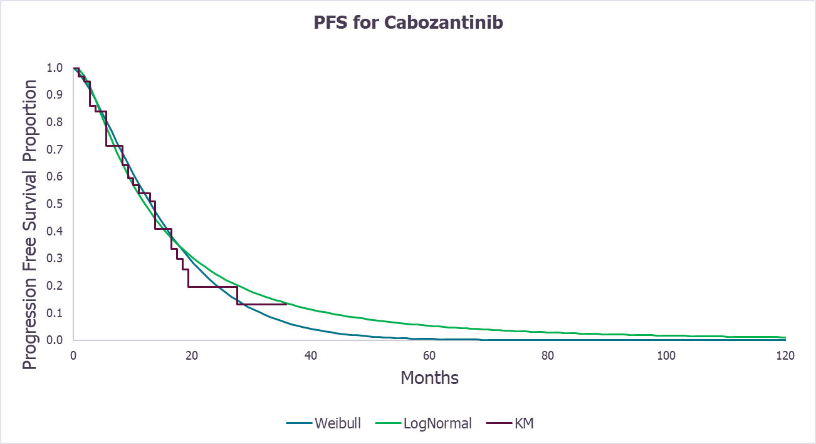
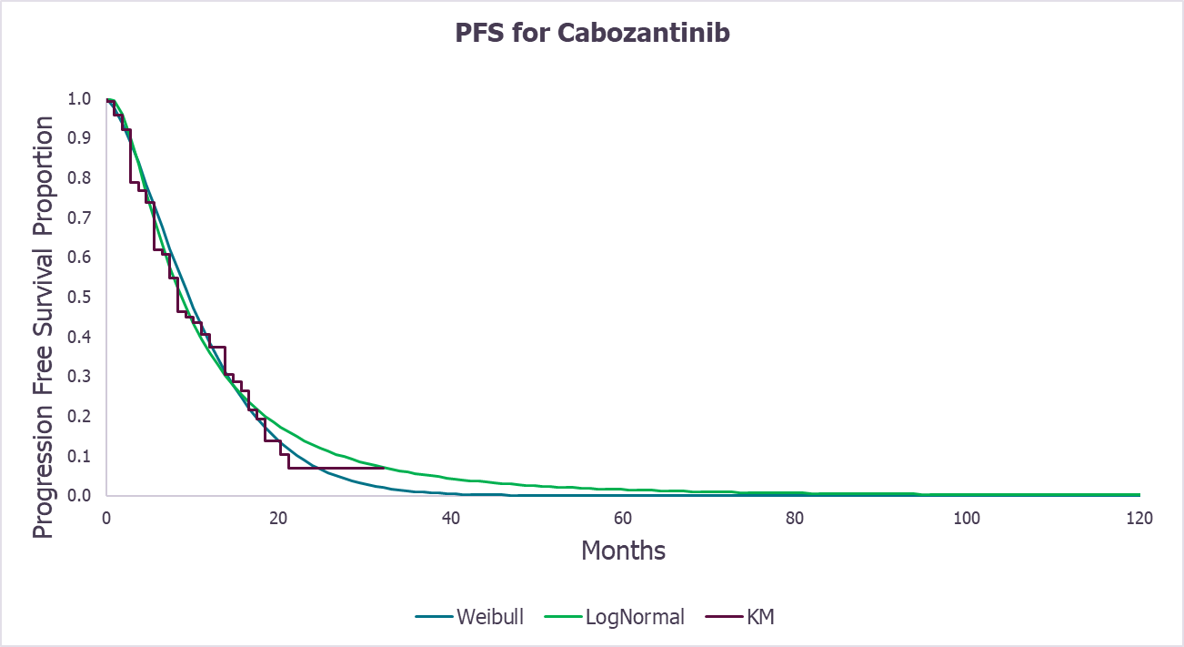
Issue 4 : Modelling progression-free survival 2/2
pNET: 10-year extrapolation and KM curve
epNET: 10-year extrapolation and KM curve
Company
EAG
Company
EAG
Are the company’s or EAG’s PFS curves more appropriate?
Abbreviations: epNETs, extra-pancreatic neuroendocrine tumours; KM, Kaplan-Meier; pNETs, pancreatic neuroendocrine tumours; PFS, progression-free survival
Notes:
Source: Figure 26 and 27 EAG report

Slide 27
Issue 5 : Modelling overall survival
CONFIDENTIAL
Large impact
Company
Base case using original August 2023 DCO → exponential for pNETs and loglogistic for epNETs
  Weibull for lung NETs and loglogistic for epNETs without lung (scenarios)
For the updated DCO scenario → loglogistic for pNETs and epNETs based on AIC and BIC and curves matching clinician landmark survival estimates for OS in cabozantinib
  Gompertz and loglogistic for lung NETs and epNETs without lung (scenarios)
EAG
Loglogistic curves not compatible with fixed hazard ratios → loglogistic curves imply time-varying hazards
Preferred exponential for pNETs; Weibull for epNETs & lung NETs → best fitting curves & compatible with fixed HRs
Very uncertain OS benefit with cabozantinib except lung NETs → HR for all other groups above 1 (see slide)
Assume HR=1 for comparisons where HRs>1 suggested by RPSFTM in updated DCO
Subgroup** | Company base case* |  | EAG base case
 | Cabozantinib | BSC IPCW-adjusted HR | Cabozantinib | BSC
pNET | Exponential | 0.74 (0.36, 1.52) | Weibull | HR = 1
epNET | Loglogistic | 0.65 (0.39, 1.07) | Weibull | HR = 1
Lung NET | - | - | Weibull | Unstratified RPSFTM adjusted HR =XXX
epNET (w/o lung) | - | - | Exponential | HR = 1
Abbreviations: AIC, Akaike Information Criterion; BIC, Bayesian Information Criterion; CI, confidence intervals; DCO, data cut-off; epNETs, extra-pancreatic neuroendocrine tumours; IPCW, inverse probability of censoring weights; HR, hazard ratio; pNETs, pancreatic neuroendocrine tumours; OS, overall survival; pNETs, pancreatic neuroendocrine tumours; RPSFTM, rank preserving structural failure time model
-* Company base case used August 2023 DCO
- ** Company base case assumes epNET should be assessed as whole population
Notes:
Source: table 44 EAG report

Slide 28
Issue 5 : Modelling overall survival – original DCO
CONFIDENTIAL
Company base case OS extrapolations for pNETs and epNETs using August 2023 DCO
pNETs: OS extrapolations (cabozantinib)
epNETs: OS extrapolations (cabozantinib)
Company
See slide for company OS extrapolations for pNETs and epNETs without lung using original DCO

Slide 29
Issue 5 : Modelling overall survival – updated DCO
CONFIDENTIAL
pNETs: OS extrapolations (cabozantinib)
epNETs: OS extrapolations (cabozantinib)
Company
Company
EAG
EAG
Lung NETs: OS extrapolations (cabozantinib)
epNETs (w/o lung NET): OS extrapolations (cabozantinib)
EAG
EAG
Abbreviations: epNETs, extra-pancreatic neuroendocrine tumours; KM, Kaplan-Meier; OS, overall survival; pNETs, pancreatic neuroendocrine tumours
Is the company’s or EAG’s modelling approach for OS more appropriate?
Notes:
Source: 36-40 EAG report

Slide 30
Issue 7: Health-state utility values
CONFIDENTIAL
Small Impact
Company
Derived utility values for PF health state from EORTC QLQ-30 data collected in sub-study of CABINET
IPD were mapped to EQ-5D and then fitted to regression analysis to derive utility values
Due to lack of post-progression data from sub-study, it used a relative decrement (sourced from Swinburn et al) to the CABINET PF data to inform the PD utility values
EAG
Disagree with company approach → concerns with sub-study and methodology
  Enrolment of trial participation was optional, insufficient justification of using linear MMRM method, fitted coefficients or p-value estimates were not provided and did not provide key statistics related to the modelling approach. Did not provide any evidence to select the fixed term effect in model.
  Preferred to use PF and PD utilities from Swinburn et al and RADIANT-4 for pNETs and epNETs respectively but with some limitations: Swinburn et al sourced from vignette study & less robust than if derived from an RCT and RADIANT-4 not directly applicable
Would consider using CABINET sub-study data if further information is provided by company
State | Company |  |  | EAG
 | pNETs | epNETS | Source | pNETs | epNETS | Source
PF | XX | XX | CABINET* | 0.771 | 0.807 | pNETs: Swinburn et al. epNETs: RADIANT-4
PD | XX | XX | Swinburn et al. | 0.612 | 0.725
Abbreviations:, epNETs, extra-pancreatic neuroendocrine tumours; EORTC, European Organisation for Research and Treatment of Cancer; PD, progressed disease; PF, progression-free PRRT, peptide receptor radionuclide therapy; pNETs, pancreatic neuroendocrine tumours; NETs, neuroendocrine tumours, QLQ; quality of life questionnaire
Which PF & PD utility values are most appropriate?
* Simplified Regression model
Notes:
Source: table 48 EAG report
Further information: missing data and drop out
Updated regression analyses
Fitted coefficients, estimated p-values, goodness-of-fit statistics, and diagnostic plots for the updated regression analyses
Full justification for the selection of terms for inclusion in the full regression model;
Justification for use of a linear MMRM rather than a generalised model

Slide 31
Issue 8: Modelling concomitant treatment duration
Large impact
Background: Uncertainty around the use of concomitant SSA in the model
Company
Assume concomitant SSAs would stop upon discontinuation of cabozantinib
Duration of SSA treatment in BSC aligned with TTD for placebo in CABINET, and acquisition cost and administration of SSAs were applied until TTD for each subgroup
Separately, a proportion of people incurred costs for subsequent treatment with SSAs → applied when people entered the PD health state
EAG
No reason why concomitant SSAs would be stopped at the point of discontinuing systemic treatment → SSAs are used for continued symptom management (systemic and symptomatic use of SSAs is different)
Use of TTD data for placebo from CABINET is inappropriate to cost the use of concomitant SSAs in BSC arm
Clinical advice: most people receiving systemic SSAs would stop on starting another systemic treatment
Disagreed people receiving concomitant SSAs in model could be informed by the proportion of people having SSAs at baseline in CABINET
Preferred people having concomitant SSA continue from baseline until death and admin costs based on Thorn et al. 2020 (15 min nurse time instead of 1 hour) and PSSRU 2023 (EAG, £28.60 vs. £55.95 company)
Presented a scenario where concomitant SSA stop on progression of disease
Abbreviations: BSC, best supportive care; PD, progressed disease; PSSRU, Personal Social Services Research Unit; SSA, somatostatin analogue; TTD, time to treatment discontinuation
Which approach to modelling concomitant SSA is more appropriate?

Slide 32
Issue 9: Subsequent treatments
Large impact
Company
Subsequent treatment costs applied as a one-off cost when entering PD health state → based on how many people had subsequent treatments in CABINET and rescaled to sum to 100% (assuming people could only have one subsequent treatment)
Proportions having subsequent treatments informed clinical expert opinion (see slide) → CABINET does not reflect UK practice
EAG
Proportions of people having each individual subsequent treatment in the company base not robust → not informed using an appropriate elicitation approach
Clinical opinion to EAG → distributions used in model not reflective of UK practice
Some people would have multiple lines of subsequent treatments → inappropriate to scale individual proportions of people having each subsequent treatment to sum to 100%
Company’s approach does not account people leaving the PD health state to death health state each cycle → could underestimate subsequent treatment costs
Prefer to implement subsequent treatment costs to people leaving the PF state. For people moving from PF to death state → proportions of people having subsequent treatments were taken as proportions of the whole population, rather than proportions of people surviving to progression (see slide)
In the EAG base case, subsequent treatments were excluded for the less heavily pretreated population
Is the company or EAG’s approach to modelling subsequent treatments more appropriate?
Abbreviations: PD, progressed disease; PF, progression-free
Notes:
Table 61: EAG report

Slide 33
Summary of company and EAG base case assumptions
Assumptions |  | Company base case | EAG base case
Subgroups |  | pNETs & epNETs | pNETs & epNETS, lung NETs
Data cut-off |  | August 2023 | Updated (additional 12 months)
Crossover adjustment |  | IPCW | RPSFTM
PFS | pNET | Lognormal | Weibull
 | epNET
 | Lung NET | NA
OS | pNET | Exponential | Exponential
 | epNET | Loglogistic | Weibull
 | Lung NET | NA
Utilities | PF | CABINET (pNETs & epNETs) | pNETs: Swinburn et al.; epNETs: RADIANT-4
 | PD | Swinburn (decrement): (pNETs & epNETs) | pNETs: Swinburn et al.; epNETs: RADIANT-4
Concomitant SSA use |  | Discontinue upon stopping cabozantinib | Continue from baseline until death
Subsequent treatment costs |  | Applied while entering PD state with recalling sum to 100% people having subsequent treatments | Applied while leaving PF instead of entering PD state and without rescaling sum to 100% people having subsequent treatment
Abbreviations: DCO, data cut-off; epNETs, extra-pancreatic neuroendocrine tumours; IPCW, inverse probability of censoring weights; NA, not applicable; OS, overall survival; PF, progression-free; PFS, progression-free survival; PD, progressed disease; pNETs, pancreatic neuroendocrine tumours; RPSFTM, rank preserving structural failure time model

Slide 34


QALY weightings for severity (1/2)
Severity modifier calculations and components:
QALY weight | Absolute shortfall | Proportional shortfall
1 | Less than 12 | Less than 0.85
X 1.2 | 12 to 18 | 0.85 to 0.95
X 1.7 | At least 18 | At least 0.95
QALYs people without the condition (A)
QALYs people with the condition (B)
Health lost by people with the condition:
Absolute shortfall: total = A – B
Proportional shortfall: fraction = ( A – B ) / A
*Note: The QALY weightings for severity are applied based on whichever of absolute or proportional shortfall implies the greater severity. If either the proportional or absolute QALY shortfall calculated falls on the cut-off between severity levels, the higher severity level will apply
Abbreviations: QALY, quality-adjusted life year

Slide 35
QALY weightings for severity (2/2)
Population | QALE general population | Current treatment | Total QALE (living with NETs) | Absolute QALE shortfall | Proportional shortfall | Severity weighting
Company base case
pNETs | 12.61 | BSC | 2.23 | 10.39 | 0.82 | 1.00
epNETs | 11.61 | BSC | 1.13 | 10.48 | 0.90 | 1.20
EAG base case (CABINET population – later line treatment)
pNETs | 12.61 | BSC | 2.19 | 10.42 | 0.83 | 1.00
epNET lung | 11.61 | BSC | 0.68 | 10.93 | 0.94 | 1.20
epNET w/o lung | 11.61 | BSC | 1.89 | 9.72 | 0.84 | 1.00
EAG base case (less heavily pretreated population – earlier line treatment)
pNETs | 12.61 | Sunitinib | 2.28 | 10.34 | 0.82 | 1.00
epNET lung | 11.61 | Everolimus | 1.36 | 10.25 | 0.88 | 1.20
epNET w/o lung | 11.61 | Everolimus | 1.91 | 9.70 | 0.84 | 1.00
EAG
Consider the company’s calculations uncertain → QALE was informed by OS for BSC and derived by applying a crossover-adjusted HR to OS for cabozantinib
Used latest DCO → curves for cabozantinib vs BSC calculated by applying RPSFTM adjustment and capping OS HRs for BSC at 1
EAG preferred utility values for PF and PD health states and EAG preferred AE disutilities
Abbreviations: AE, adverse events; BSC, best supportive care; DCO, data cut-off, epNETs, extra-pancreatic neuroendocrine tumours; HR, hazard ratio; OS, overall survival; PD, progressed disease; PF, progressed-free;pNETs, pancreatic neuroendocrine tumours; NETs, neuroendocrine tumours; RPSFTM, rank preserving structural failure time model; QALE, quality-adjusted life expectancy
Should a QALY weighting for severity be applied for any population?
Notes:
Table 88: EAG report

Slide 36
Cost-effectiveness results
All ICERs are reported in PART 2 slides due to confidential prices
Company base case (for pNETs & epNETS)
- vs. BSC: under £30,000/QALY
EAG scenarios (CABINET population – later line treatment)
- vs BSC (pNETs and epNETs w/o lung): above £30,000/QALY
- vs. BSC (lung NETs): under £30,000/QALY
EAG scenarios (earlier line treatment) - all NETs
- vs. BSC, sunitinib, everolimus: above £30,000/QALY
Abbreviations: BSC, best supportive care; epNETs, extra-pancreatic neuroendocrine tumours; pNETs, pancreatic neuroendocrine tumours; NETs, neuroendocrine tumours; QALY, quality-adjusted life year

Slide 37
Cabozantinib for treating advanced neuroendocrine tumours that have progressed after systemic treatment [ID6474]
Key issues & decision problem
Clinical effectiveness
Modelling and cost effectiveness
Other considerations
Summary

Slide 38
Other considerations
Uncaptured benefits
Company: Two-thirds of people with NETs require caregivers which is likely to increase with progressive disease: not captured in model
Managed access
No further data cuts are planned, company did not submit a managed access proposal
Are there any benefits that have not been captured in the modelling?
Abbreviations: NETs, neuroendocrine tumours

Slide 39
Cabozantinib for treating advanced neuroendocrine tumours that have progressed after systemic treatment [ID6474]
Key issues & decision problem
Clinical effectiveness
Modelling and cost effectiveness
Other considerations
Summary

Slide 40
Key issues for committee discussion
Key issues for committee discussion |  | Key issue for committee discussion | ICER impact
Decision problem | 1 | Is the company’s positioning of cabozantinib appropriate? - If not, are PRRT, everolimus or sunitinib relevant comparators? | Large
Clinical effectiveness | 2 | Is it appropriate to group lung NETs with other extra-pancreatic NETS? | Large
 | 3 | Is there a reason to not use the more mature data cut-off? | Large
Cost effectiveness | 4 | Is the company’s or EAG’s modelling approach for PFS more appropriate? | Small
 | 5 | Is the company’s or EAG’s modelling approach for OS more appropriate? | Large
 | 6 | Is it appropriate to consider HR of 1 for all comparisons? | Large
 | 7 | Which progression-free and progressed-disease utility values are appropriate? | Small
 | 8 | Which approach to modelling concomitant SSA is more appropriate? | Large
 | 9 | Which approach to modelling subsequent treatments is more appropriate? | Large
Abbreviations: HR,hazard ratio; ICER, incremental cost-effectiveness ratio; NETs, neuroendocrine tumours; OS, overall survival; PFS, progression-free survival; PRRT, peptide receptor radionuclide therapy; SSA, somatostatin analogue, SSTR, somatostatin receptor

Slide 41
Cabozantinib for treating advanced neuroendocrine tumours that have progressed after systemic treatment [ID6474]
Supplementary appendix

Slide 42
CABINET and MA relevant populations
CABINET | Positioning for population | Comparator
Heavily pretreated | 4th or later line for pNETs 3rd or later line of systemic therapy for epNETs | BSC
Less heavily pretreated population
Functional lung NETs | Chemotherapy is the only available systemic treatment (excluding SSAs) but rarely used in clinical practice | BSC
Functional/non-functional epNETs (GI NETs) | 2nd or later line for epNETs (excluding SSAs) | Everolimus and sunitinib
Lung NETs | 2nd line for people who received chemotherapy as a 1st line systemic treatment (excluding SSAs) | Everolimus
Abbreviations: BSC, best supportive care; epNETs, extra-pancreatic neuroendocrine tumours; GI NETS, Gastrointestinal neuroendocrine tumour; pNETs, pancreatic neuroendocrine tumours; SSA, somatostatin analogue

Slide 43
Decision problem
 | Final scope | Company/EAG comments
Population | Adults with advanced pancreatic or extra-pancreatic neuroendocrine tumours (pNETs or epNETs) that have progressed after systemic treatment | EAG: CABINET population heavily treated: represents people in late stage in treatment pathway Less heavily pretreated: represent people as a second or further line at which other systemic therapies are used
Intervention | Cabozantinib | Appropriate
Comparators | Established clinical management without cabozantinib, including but not limited to: BSC Chemotherapy Other systemic treatments | Company: BSC is the most appropriate comparator EAG: Chemotherapy exclusion reasonable but PRRT, everolimus and sunitinib are relevant comparators. Exclusion of RCTs where <70% of people received 1 systemic therapy may have led to miss comparator data
Outcomes | The outcome measures to be considered include: PFS, OS, response rates, symptom control, adverse effects and HRQoL | Appropriate
Subgroups | pNETs, epNETs (including by tumour location) Other characteristics of NETs (for example, functioning status, differentiation status, Ki-67 index and SSTR) | EAG: appropriate for NETs and epNETS but lung NETs have a worse prognosis and should be considered separately. KI-67 and STRR were not available from CABINET
Abbreviations: BSC, best supportive care; epNETs, extra-pancreatic neuroendocrine tumours; HRQoL, health-related quality of life; MA, marketing authorisation; OS, overall survival; pNETs, pancreatic neuroendocrine tumours; PFS, progression-free survival; PRRT, peptide receptor radionuclide therapy; SSTR, somatostatin receptor
Notes:
Table 14: EAG report

Slide 44
Other issues: TTD & disease management costs
Small Impact
Time to treatment discontinuation
Company: TTD based on CABINET, assuming PH assumption holds for both pNETs and epNETs and supporting use of a HR-based approach to model assuming:
  discontinuation of SSAs occurred in line with placebo discontinuation in CABINET
  concomitant SSA discontinued with cabozantinib
EAG: Using KM curves to estimate TTD in model more appropriate: avoiding unnecessary uncertainty
KM curves also show sharp declines at assessment points: more reflective of real-world than parametric models (see slide)
Disease managements costs
EAG
Disagreed with using Casciano et al. 2013 to estimate resource use in the model → follow up does not align with PF and PD states and study reported number of people using resources, rather than frequency of use of resources
Preferred to use resource use frequency with TA449 and TA539: based on survey of UK clinicians
State | Company (cost per cycle) |  | EAG (cost per cycle)
 | pNETs | epNETs | pNETs | epNETs
PF | £93.72 | £85.69 | £62.64 | £270.25
PD | £129.65 | £120.85 | £353.95 | £236.12
Abbreviations: epNETs, extra-pancreatic neuroendocrine tumours; HR, hazard ratio; KM, Kaplan-Meier; PD, progressed disease; PF, pregression-free; PH, proportional hazard; pNETs, pancreatic neuroendocrine tumours; NETs, neuroendocrine tumours, TA, technology appraisal; SSA, somatostatin analogue; TTD, time to treatment discontinuation
Is the company or EAG’s approach to TTD and disease management costs more appropriate?
Notes:
Table 88: EAG report

Slide 45
Baseline characteristics: CABINET (lung NETs)
CONFIDENTIAL
 | Lung NETs
 | Cabozantinib (n=64) | Placebo (n=31)
White, n (%) | XX | XX
Asian, n (%) | XX | XX
Disease duration to randomisation, mean, months (SD) | XX | XX
Grade 1 tumours, n (%) | XX | XX
Functional disease, n (%) | XX | XX
EAG
Placebo had XX longer and XX more people with functional tumours and Grade 1 tumours compared with cabozantinib
Baseline differences could potentially bias results in favour of cabozantinib because these appear to be indicative of a worse prognosis in the placebo group
Main Slide
Abbreviations: NETs, neuroendocrine tumours, SD, standard deviation
Notes:
Source table 20 EAG report

Slide 46
ITC results: PFS & OS
EAG: PFS estimates numerically favour cabozantinib over comparators, but OS estimates numerically favour comparators over cabozantinib
 | Subgroup |  | Everolimus | Sunitinib
Progression-free survival | PNETs |  | 0.68 (0.34 to 1.33) | 0.73 (0.32 to 1.68)
 | epNETs |  | 0.79 (0.47 to 1.35) | NA
 | Lung NETs |  | 0.36 (0.11 to 1.21) | NA
 | epNETS (w/o lung) |  | 0.86 (0.46 to 1.59) | NA
Overall survival | August 2023 DCO
 | pNETs | ITT | 1.01 (0.46 to 2.22) | 1.30 (0.56 to 3.00)
 |  | RPSFTM | 1.48 (0.13 to 17.04) | 2.62 (0.39 to 17.50)
 | epNETs | ITT | 1.18 (0.65 to 2.14) | NA
 |  | RPSFTM | NA* | NA
 | Updated DCO
 | pNETs | ITT | 1.18 (0.60 to 2.33) | 1.52 (0.73 to 3.17)
 |  | RPSFTM | 1.85 (0.25 to 13.59) | 3.26 (0.91 to 11.68)
 | epNETs | ITT | 1.42 (0.81 to 2.51) | NA
 |  | RPSFTM | NA* | NA
Numerical advantage (cabozantinib)
Numerical advantage (comparator)
Abbreviations: DCO, data cut-off; epNETs, extra-pancreatic neuroendocrine tumours; IPCW, inverse probability of censoring weights; ITC, indirect treatment comparison; ITT, intention-to-treat; NA, not available; OS, overall survival; PFS, progression-free survival; pNETs, pancreatic neuroendocrine tumours; RPSFTM, rank preserving structural failure time model
* Data for comparator trial was not available
Notes:
Source: tables 32, 33 & 34 EAG report

Slide 47
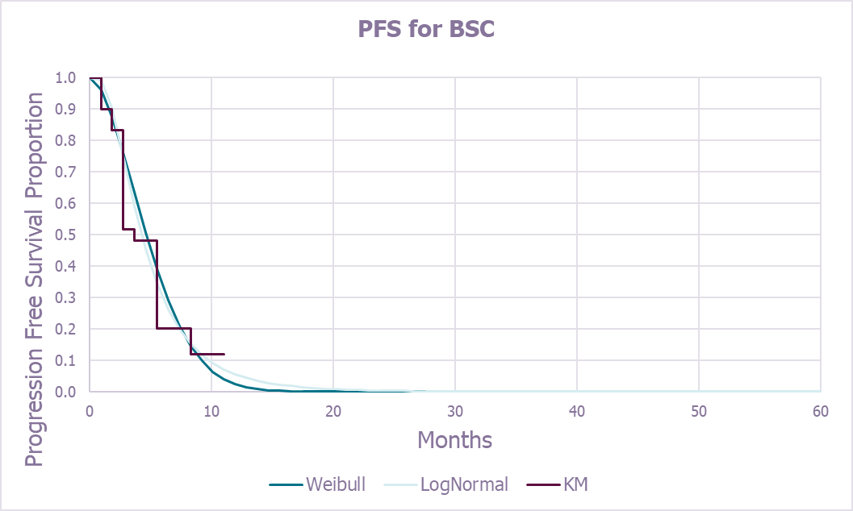
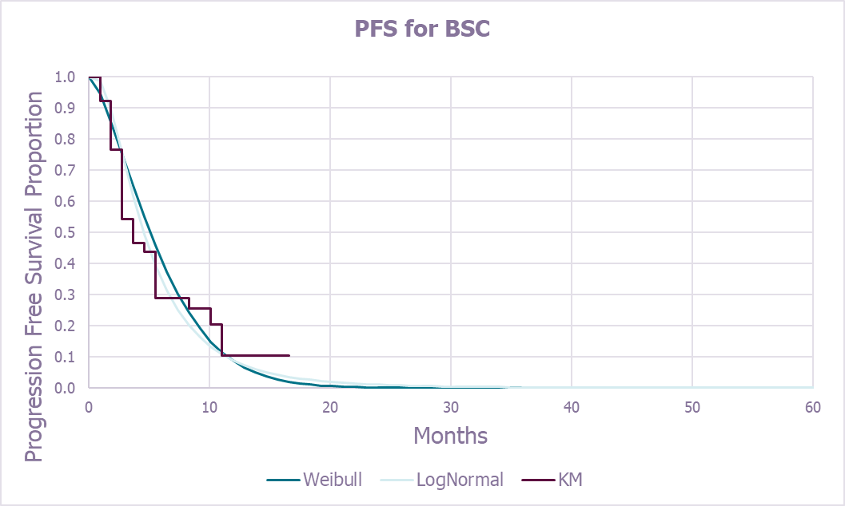
Issue 4 : Modelling progression-free survival
pNET: 10-year extrapolation and KM curve
epNET: 10-year extrapolation and KM curve
Company
EAG
Company
EAG
Are the company’s or EAG’s PFS curves more appropriate?
Abbreviations: BSC, best supportive care; epNETs, extra-pancreatic neuroendocrine tumours; KM, Kaplan-Meier; pNETs, pancreatic neuroendocrine tumours; NETs, neuroendocrine tumours,
Notes:
Source: Figure 28 and 29 EAG report

Slide 48
Issue 5 : Modelling overall survival – original DCO
Company OS extrapolations for pNETs and epNETs without lung using August 2023 DCO
Lung NETs: OS extrapolations (cabozantinib)
epNETs (w/o lung NET): OS extrapolations (cabozantinib)
Abbreviations: DCO, data cut off; epNETs, extra-pancreatic neuroendocrine tumours; KM, Kaplan-Meier; OS, overall survival; pNETs, pancreatic neuroendocrine tumours

Slide 49
Time to treatment discontinuation
pNET
epNET
Lung NET
epNET (w/o lung)
Abbreviations: BSC, epNETs, extra-pancreatic neuroendocrine tumours; pNETs, pancreatic neuroendocrine tumours; NETs, neuroendocrine tumours; QALE, quality-adjusted life expectancy; TTD, time-to-treatment discontinuation
Notes:
Table 88: EAG report

Slide 50
Subsequent treatments
Company: proportions having subsequent treatments informed clinical expert opinion
Subsequent treatment | pNETs |  | epNETs
 | Cabozantinib | BSC | Cabozantinib | BSC
Sunitinib | 22.5% | 22.5% | N/A | N/A
Everolimus | 10% | 10% | 10% | 10%
PRRT | 22.5% | 22.5% | 30% | 30%
CAPTEM | 22.5% | 22.5% | 30% | 30%
FOLFOX | 22.5% | 22.5% | 30% | 30%
Proportion of people having individual subsequent treatments in EAG analysis
Subsequent treatment | pNETs |  |  |  | epNETs, without lung |  |  | Lung NETs
 | Cabozantinib | BSC | Sunitinib | Everolimus | Cabozantinib | BSC | Everolimus | Cabozantinib | BSC | Everolimus
Sunitinib | 6.3% | 15.4% | 0% | 6.8% | 0% | 0% | 0% | 0% | 0% | 0%
Everolimus | 6.3% | 0% | 6.8% | 0% | 5.6% | 15.0% | 0% | 9.0% | 24.4% | 0%
PRRT | 18.8% | 23.1% | 20.5% | 20.5% | 18.3% | 25.0% | 20.7% | 0% | 0% | 0%
CAPTEM | 31.3% | 7.7% | 34.1% | 34.1% | 16.9% | 5.0% | 19.1% | 26.9% | 8.1.1% | 32.9%
FOLFOX | 12.5% | 7.7% | 13.6% | 13.6% | 8.5% | 20.0% | 9.5% | 13.4% | 32.5% | 16.4%
Abbreviations: CAPTEM, capecitabine and temozolomide; epNETs, extra-pancreatic neuroendocrine tumours; FOLFOX, folinic acid, fluorouracil, and oxaliplatin; NA, not available; pNETs, pancreatic neuroendocrine tumours; PRRT, peptide receptor radionuclide therapy

