Slide 1
Rucaparib for maintenance treatment of advanced ovarian, fallopian tube and peritoneal cancer after response to first-line platinum-based chemotherapy
For Zoom – CON information redacted
Technology appraisal committee A [11 June 2024]
Chair: Radha Todd
Lead team: Richard Ballerand, Ravi Ramessur, Min Ven Teo
External assessment group: Liverpool Reviews and Implementation Group (LRIG)
Technical team: Rachel Ramsden, Zoe Charles, Janet Robertson
Company: pharma&
© NICE 2024. All rights reserved. Subject to Notice of rights.

Slide 2
Rucaparib for maintenance treatment of advanced ovarian, fallopian tube and peritoneal cancer after response to first-line platinum-based chemotherapy
Background and key issues
Clinical effectiveness
Modelling and cost effectiveness
Other considerations
Summary

Slide 3
Background on advanced ovarian, fallopian tube and peritoneal cancer after response to first-line platinum-based chemotherapy
Causes
Most common in postmenopausal women. Increasing age, lifestyle and environmental factors (smoking, overweight, exposure to asbestos), hormone replacement therapy and certain medical conditions (e.g. endometriosis, diabetes) have been associated with elevated risk, as well as genetic factors*
Epidemiology (in England in 2021)
6,673 people were diagnosed with ovarian or fallopian tube cancer, 60% of whom had advanced disease (Stage III or IV)
8% of new ovarian cancer cases were classified as fallopian tube cancer
UK incidence of primary peritoneal cancer is unknown but ~10% of all women with ovarian, fallopian and peritoneal serous cancers have primary peritoneal cancer in the US
Symptoms and prognosis
Symptoms include bloating, early satiety, loss of appetite, persistent pain in the abdomen or lower abdomen, increased need to urinate, changes in bowel habits, symptoms of irritable bowel syndrome (IBS), unexplained fatigue and unexplained weight loss
In England (2016–2020), 5-year survival rates for people with Stage III and Stage IV ovarian cancer were 31.9% and 16.0%, respectively
* See appendix – Drivers of homologous recombination deficiency
Notes:
References
Causes - B.1.3.1.3 of company submission Epidemiology - B.1.3.1.1 of company submission; Section 2.2 of EAR
Symptoms - B.1.3.1.4 of company submission; B.1.3.1.2 of company submission

Slide 4
Patient perspectives
Submissions from Ovacome, Ovarian Cancer Action and Target Ovarian Cancer
Living with advanced ovarian, fallopian tube and peritoneal cancer after response to first-line platinum-based chemotherapy
The high recurrence rates mean that patients, family and friends live with the uncertainty, fear and anxiety of possible recurrence
Current treatment options
Ovarian cancer is frequently managed as a chronic condition rather than curative and therefore expanding choice of maintenance therapies is vital
People want longer breaks after the substantial side effects of initial chemotherapy
Unmet need and treatment with rucaparib
There is an unmet need for a choice of maintenance options to be available to patients earlier
People say rucaparib is convenient in terms of administration, and offers good quality of life for some people whose side effects are manageable
“Quality of life is poor – reasonable at best when on treatment. There is a desire to cram as much into life as possible due to not knowing what is going to happen next but being bound by the horrific side effects such as complete exhaustion, severe pain, nausea and vomiting and mouth ulcers that make it almost impossible to eat.”
Notes:
References
Quote: Ovarian Cancer Action submission (page 5)

Slide 5
Clinical perspectives
Clinical expert statement
Aim of treatment
Main aim is to keep people in remission for as long as possible
Improvement in PFS by several months is a clinically significant treatment response
Current treatment options
Some patients struggle with the side effects of treatment. Access to another option in this setting, as long as it has similar efficacy, would be beneficial
Treatment with rucaparib
A big difference in clinically meaningful benefits is not expected between the current standard of care and rucaparib; addition of rucaparib will allow clinicians and patients more choice if one of the drugs is not tolerated or several dose reductions are required
There is scope to reduce the dose in smaller steps than niraparib and this may improve the tolerability of the drug. Rucaparib also does not require weekly blood tests for the first 1-2 months whereas this is required for treatment with niraparib. But people may prefer the once daily dose of niraparib.
Abbreviations: PFS, progression free survival

Slide 6
Equality considerations
Stakeholders raised equality considerations:
Some people with ovarian cancer can struggle to access treatments if they do not fully understand the treatment options and choices. This may include people with learning disabilities, people who have English as a second language or who have low levels of literacy.
In general terms older patients with cancer are frequently disadvantaged and frequently not offered the same intensity treatment. Although there is no evidence that this subgroup is disadvantaged, the median age in the ATHENA-MONO is 61 years old which is younger that patients we would frequently see in clinical practice.
The company and EAG did not raise any equality issues during the appraisal process.
Abbreviations: EAG, External Assessment Group

Slide 7
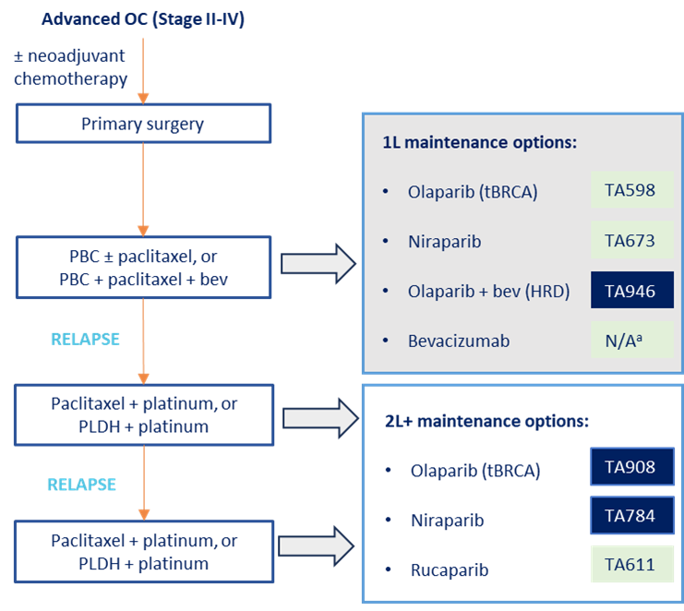
Treatment pathway
* See appendix – Maintenance treatment options and Decision problem
Clinical advice to the EAG: decisions about which first-line maintenance treatment to use in NHS clinical practice largely depend on:
a person’s genomic status (by HRD testing), and
prior treatment with bevacizumab
Clinical expert: rucaparib would be used instead of niraparib or olaparib (±bevacizumab)
Key:
Cancer Drugs Fund
Recommended
TA962
Company excluded the following comparators:
olaparib monotherapy as the tBRCA mutated population was excluded from company’s submission: EAG agrees not a relevant comparator
niraparib (as only available in CDF)
bevacizumab monotherapy at a dose of 7.5 mg/kg (as in NICE scope), instead modelling a dose of 15 mg/kg – see the bevacizumab dose issue
Platinum ± paclitaxel, or Platinum + paclitaxel + bev
Routine surveillance is also included as a comparator
ª Bevacizumab is included in the CDF List (BEV10) and is available in routine commissioning for maintenance monotherapy at a 7.5 mg/kg dose; Included as a comparator in company submission*
Abbreviations: 1L, first-line; 2L+, second or later-line; bev, bevacizumab; BRCA, breast cancer gene; CDF, Cancer Drugs Fund; HRD, homologous recombination repair deficiency; OC, ovarian cancer; PLDH, pegylated liposomal doxorubicin hydrochloride; tBRCA, tumour with BRCA mutation
Notes:
References
Figure 2 of company submission
National-Cancer-Drugs-Fund-list--version-1.287.pdf (england.nhs.uk) (PDF page 74)

Slide 8
Rucaparib (Rubraca, pharma&)
Marketing authorisation | Rucaparib is indicated as monotherapy for the maintenance treatment of adult patients with advanced (FIGO Stages III and IV) high-grade epithelial ovarian, fallopian tube, or primary peritoneal cancer who are in response (complete or partial) following completion of first-line platinum-based chemotherapy. MHRA approved the extension of the therapeutic indication in January 2024 Company narrowed the population of interest in this appraisal to 2 subgroups: non-tBRCA LOH^{high} non-tBRCA LOH^{low}
Mechanism of action | Rucaparib is an inhibitor of PARP enzymes, including PARP1, PARP2, and PARP3, which play a role in DNA repair
Administration | Recommended dose of rucaparib is 600 mg (two 300 mg tablets) taken orally twice daily (1,200 mg total daily dose) In ATHENA-MONO, rucaparib is administered up to 24 months or until disease progression or unacceptable toxicity
Price | List price: £3,562.00 per pack of 60, 300 mg, 250 mg or 200 mg tablets Estimated average cost per year is £105,869 from list-price A patient access scheme discount is applicable
Clinical expert: In the NHS, terminology based on LOH is not used. HRD is essentially the same as tBRCA/LOH (LOH^{high} = HRD positive, LOH^{low} = HRD negative)
Abbreviations: BRCA, breast cancer gene; DNA, deoxyribonucleic acid; FIGO, International Federation of Gynaecology and Obstetrics; HRD, homologous recombination deficiency; LOH, loss of heterozygosity; MHRA, Medicines and Healthcare Products Regulatory Agency; PARP, poly (ADP-ribose) polymerase; tBRCA, tumour with BRCA mutation
Notes:
References
Table 2 of company submission

Slide 9
Key issues
Large ICER impact
Small ICER impact
Unknown ICER impact
Issue | ICER impact
Positioning of rucaparib in the NHS: available comparators | Unknown
Bevacizumab dose | Large
Indirect treatment comparison overall survival results are uncertain | Unknown
Modelling survival: company assumption of long-term survivorship | Large
Modelling survival: relationship between PFS, PFS2 and OS | Large
Modelling survival: mortality hazards for patients treated with rucaparib and olaparib + bevacizumab | Small
Bevacizumab induction costs: include or exclude from maintenance costs | Large
Relative dose intensity: most appropriate method for all treatments | Large
Utility values: subgroup versus ITT values | Small
Abbreviations: ICER, incremental cost effectiveness ratio; ITT, intention to treat; OS, overall survival; PFS, progression-free survival; PFS2, progression-free survival 2

Slide 10
Key issues: Positioning of rucaparib in the NHS: available comparators
Background
Bevacizumab monotherapy is only available to NHS patients who have responded to induction treatment that included bevacizumab. Olaparib + bevacizumab is usually given after induction chemotherapy with bevacizumab but is also commissioned for patients who have not had bevacizumab as part of induction chemotherapy (about 32%)
Only 17.8% of ATHENA-MONO patients had responded to induction treatment that included bevacizumab
EAG comments
If bevacizumab induction treatment impacts the clinical effectiveness of maintenance treatments, then subgroup clinical effectiveness results (maintenance setting) are required for people who had prior bevacizumab and people who did not have prior bevacizumab who went on to have rucaparib or routine surveillance
Other considerations
Clinical advice to the EAG: inclusion or exclusion of bevacizumab as part of induction treatment does not influence clinical effectiveness results in the maintenance setting
Clinical expert: inclusion of bevacizumab as part of the induction treatment is perceived to improve PFS
CDF BEV10 Blueteq approval criteria: bevacizumab at a dose of 7.5 mg/kg (up to 18 cycles) as maintenance monotherapy after completion of 1st line induction chemotherapy in combination with bevacizumab 7.5 mg/kg for people with stage 4 disease, or stage 3 disease that is suboptimally debulked (residual disease >1cm), unsuitable for surgery or requiring neoadjuvant chemo
TA946 recommended olaparib with bevacizumab (15 mg/kg up to 15 months) for maintenance treatment after complete or partial response after first-line platinum-based chemotherapy with bevacizumab. CDF Blueteq approval criteria OLAP4
Is combining data for people who have responded to induction treatment with or without bevacizumab appropriate for decision making?
Abbreviations: CDF, Cancer Drugs Fund; PFS, progression free survival
Notes:
References
Table 10 in company submission
https://www.england.nhs.uk/wp-content/uploads/2017/04/National-Cancer-Drugs-Fund-list--version-1.287.pdf

Slide 11
Key issues: Bevacizumab dose
Background
Bevacizumab monotherapy dose in NICE scope is 7.5 mg/kg but the company presented a 15 mg/kg dose
Company
Bevacizumab 7.5 mg/kg is not an appropriate comparator
Identified no relevant evidence for efficacy of bevacizumab 7.5 mg/kg in the 1L maintenance setting
Identified no study which established the clinical equivalence of bevacizumab 7.5 mg/kg to 15 mg/kg
7.5 mg/kg dose considered outside the scope of TA284 (first-line treatment of advanced ovarian cancer)
EAG comments
EAG costed bevacizumab using 7.5 mg/kg dose, populated with bevacizumab 15 mg/kg data from PAOLA-1 (assuming efficacy is similar between the doses based on clinical advice)
Other considerations
Clinical expert: bevacizumab as a single agent is used at 7.5 mg/kg
No direct evidence comparing efficacy of both doses, but other antiangiogenic agents are dose dependent, and studies show higher doses have improved efficacy (example: TKIs in renal cancer)
Clinical advice to EAG: NHS patients will receive a bevacizumab monotherapy dose of 7.5 mg/kg
Efficacy and safety are similar for bevacizumab monotherapy doses of 7.5 mg/kg and 15 mg/kg
NICE tech team: 7.5 mg/kg is relevant comparator, available in routine commissioning for maintenance monotherapy
Which dose is appropriate? Is it reasonable to assume similar efficacy of the 2 doses?
Abbreviations: 1L, first line; TKI, tyrosine kinase inhibitors
Notes:
References
Section D of company’s clarification response
https://www.england.nhs.uk/wp-content/uploads/2017/04/National-Cancer-Drugs-Fund-list--version-1.287.pdf (PDF page 74)

Slide 12
Rucaparib for maintenance treatment for advanced ovarian, fallopian tube and peritoneal cancer after response to first-line platinum-based chemotherapy
Background and key issues
Clinical effectiveness
Modelling and cost effectiveness
Other considerations
Summary

Slide 13
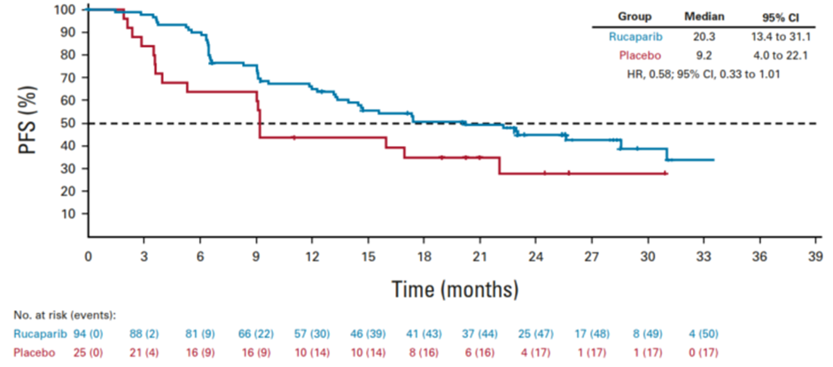
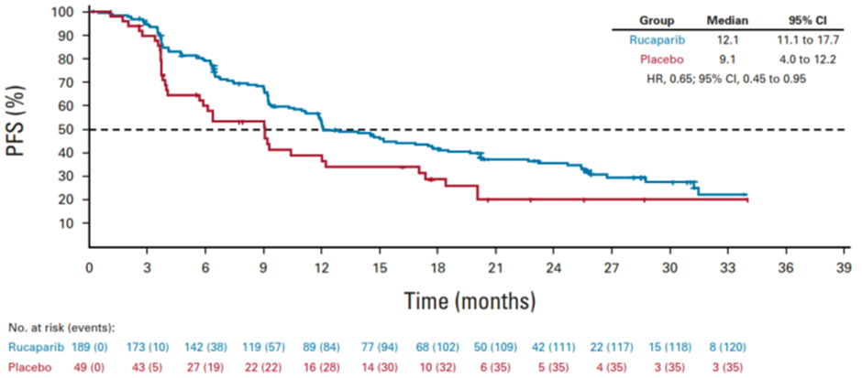
ATHENA-MONO results – invPFS (23 March 2022 data cut)
CONFIDENTIAL
See appendix – key clinical trials and ITT results
Rucaparib improves PFS compared to placebo (nominally significant in non-tBRCA/LOH^{low} subgroup)
non-tBRCA/LOH^{high}
non-tBRCA/LOH^{low}
HR: 0.58 (95% CI: 0.33 to 1.01) *** *** ***
HR: 0.65 (95% CI: 0.45 to 0.95) *** *** ***
Rucaparib
Rucaparib
Placebo
Placebo
No. at risk
No. at risk
Ruc
Plac
94 | 88 | 81 | 66 | 57 | 46 | 41 | 37 | 25 | 17 | 8 | 4
25 | 21 | 16 | 16 | 10 | 10 | 8 | 6 | 4 | 1 | 1 | 0
Ruc
Plac
189 | 173 | 142 | 119 | 89 | 77 | 68 | 50 | 42 | 22 | 15 | 8
49 | 43 | 2 | 22 | 16 | 14 | 10 | 6 | 5 | 4 | 3 | 3
 | Median PFS (95% CI)
Rucaparib | 20.3 months (13.4 to 31.1)
Placebo | 9.2 months (4.0 to 22.1)
 | Median PFS (95% CI)
Rucaparib | 12.1 months (11.1 to 17.7)
Placebo | 9.1 months (4.0 to 12.2)
Abbreviations: BRCA, breast cancer gene; CI, confidence interval; HR, hazard ratio; invPFS, investigator-assessed progression-free survival; ITT, intention to treat; LOH, loss of heterozygosity; PFS, progression-free survival; plac, placebo; ruc, rucaparib; tBRCA, tumour BRCA mutation
Notes:
References
Company submission Table 14, Figure 6 and Figure 7

Slide 14
ATHENA-MONO results – OS (9 March 2023 ad-hoc analysis)
CONFIDENTIAL
See appendix – ITT results
No statistically significant differences between treatments but data are immature
non-tBRCA/LOH^{high}
non-tBRCA/LOH^{low}
HR: 0.61 (95% CI: 0.29 to 1.30) p=0.2019
HR: 0.75 (95% CI: 0.48 to 1.17) p=0.2064
No. at risk
No. at risk
Ruc
Plac
** | ** | ** | ** | ** | ** | ** | ** | ** | ** | ** | ** | ** | ** | ** | ** | ** | **
** | ** | ** | ** | ** | ** | ** | ** | ** | ** | ** | ** | ** | ** | ** | ** | **
Ruc
Plac
** | ** | ** | ** | ** | ** | ** | ** | ** | ** | ** | ** | ** | ** | ** | ** | ** | **
** | ** | ** | ** | ** | ** | ** | ** | ** | ** | ** | ** | ** | ** | ** | ** | **
 | Median OS
Rucaparib | NR
Placebo | 41.0
 | Median OS
Rucaparib | 42.9
Placebo | 32.4
Note: KM curves generated by NICE tech team based on KM data in the economic model
Abbreviations: BRCA, breast cancer gene; CI, confidence interval; HR, hazard ratio; ITT, intention to treat; KM, Kaplan-Meier; LOH, loss of heterozygosity; OS, overall survival; plac, placebo; ruc, rucaparib; tBRCA, tumour BRCA mutation
Notes:
References
Company submission Table 16
Company response to clarification A4

Slide 15
Indirect comparisons and results^
CONFIDENTIAL
^ See appendix – Indirect comparison methodology
EAG: MAIC results more valid than unadjusted naïve ITC results (and piecewise MAICs more valid for non-tBRCA/LOH^{high}), but results are similar (adjustments had little effect)
Indirect comparisons are needed to compare rucaparib to olaparib+bevacizumab, and to bevacizumab
ITCs are not used in base case models: naïve comparisons were used in the model, assuming imbalances across trials did not impact survival curves remarkably – see MAIC approach
EAG considered the OS results for all comparisons/subgroups to be uncertain – see ITC OS issue
Outcome | Subgroup | Comparator | Naïve ITC, HR (95% CI); p-value | MAIC, HR (95% CI); p-value
InvPFS | non-tBRCA/LOH^{high} | Olaparib + bevacizumab | *************************** | ***************************
 | non-tBRCA/LOH^{high} | Bevacizumab | *************************** | ***************************
 | non-tBRCA/LOH^{low+unknown} | Bevacizumab | *************************** | ***************************
OS | non-tBRCA/LOH^{high} | Olaparib + bevacizumab | *************************** | ***************************
 | non-tBRCA/LOH^{high} | Bevacizumab | *************************** | ***************************
 | non-tBRCA/LOH^{low+unknown} | Bevacizumab | *************************** | ***************************
PFS2 | non-tBRCA/LOH^{high} | Olaparib + bevacizumab | *************************** | ***************************
 | non-tBRCA/LOH^{high} | Bevacizumab | *************************** | ***************************
 | non-tBRCA/LOH^{low+unknown} | Bevacizumab | *************************** | ***************************
For illustration purposes - ITC results not used in base case models
 | HR<1 favours rucaparib |  | HR>1 favours comparator
Statistically significant results are shown in bold; * Company concluded that the PH assumption was violated
Abbreviations: CI, confidence interval; HR, hazard ratio; invPFS, investigator-assessed progression-free survival; ITC, indirect treatment comparison; LOH, loss of heterozygosity; MAIC, matching adjusted indirect comparison; non-tBRCA, tumour without BReast Cancer gene mutation; OS, overall survival; PFS2, progression-free survival 2; PH, proportional hazards
Notes:
References
EAR Table 16

Slide 16
Rucaparib for maintenance treatment for advanced ovarian, fallopian tube and peritoneal cancer after response to first-line platinum-based chemotherapy
Background and key issues
Clinical effectiveness
Modelling and cost effectiveness
Other considerations
Summary

Slide 17
Key Issue: Modelling survival - assumption of long-term survivorship (1/5)
Background
Company assumed long-term survivorship in its PFS estimates for rucaparib, olaparib+bevacizumab and bevacizumab (non-tBRCA/LOH^{high}), and bevacizumab (non-tBRCA/LOH^{low})
Company
Slowing hazards in longer-term PFS observed in PAOLA-1 and in non-tBRCA/LOH^{high} population of PRIMA
ATHENA-MONO follow-up ends when slowing of the hazard was observed in PRIMA and PAOLA-1
Assumption that cure is possible for HRD-positive patients was accepted by TA946 Appraisal Committee
EAG comments
Acknowledges there is a precedence for PARP inhibitors to lead to curves that plateau
ATHENA-MONO PFS data for rucaparib do not currently show hazards slowing but may with more data
Company did not explain why assumption did not hold for rucaparib in tBRCA/LOH^{low} subgroup
Proportions with long-term survivorship are uncertain for olaparib + bevacizumab and bevacizumab
EAG fitted alternative parametric distributions without assumption of long-term survivorship
Other considerations
UK clinical expert advice to company: this is a class effect of PARP inhibitor use and long-term PFS is expected among a proportion of patients
Clinical expert: Small % of people will achieve long term remission, >5 years can be considered a “cure”
Is the assumption of long-term survivorship appropriate?
Abbreviations: BRCA, breast cancer gene; HRD, homologous recombination deficiency; LOH, loss-of-heterozygosity; PARP, poly ADP ribose polymerase; PFS, progression-free survival; tBRCA, tumour BRCA mutation

Slide 18
Key issue: Modelling survival - relationship between PFS, PFS2 and OS (2/5)
Background
Company applied constraints to PFS, PFS2 and OS extrapolations for each treatment:
OS conditional probability of death per cycle < background conditional probability of death per month
OS estimates ≥ PFS estimates
PFS2 estimates ≥ PFS estimates
From point of crossing, OS and PFS2 assumed to follow trajectory of PFS
Company
Anticipated OS and PFS2 crossing PFS after observation period due to immature OS data and high uncertainty in the long-term extrapolations
Constrained OS and PFS2 extrapolations to overcome crossing curves
EAG comments
Company’s constraints cast doubt on clinical plausibility PFS2 and OS estimates
Constraints are triggered relatively early - see appendix: Survival curves
Mortality hazards drop instantaneously in non-tBRCA/LOH^{high} subgroup - see appendix: OS hazards
EAG’s alternative PFS parametric distributions partially resolved this issue; curves still cross but later
What approach to modelling PFS is preferred?
Abbreviations: BRCA, breast cancer gene; LOH, loss-of-heterozygosity; OS, overall survival; PFS, progression-free survival; PFS2, progression-free survival 2; tBRCA, tumour BRCA mutation

Slide 19
Modelling survival (3/5)
long-term survivorship assumption
CONFIDENTIAL
* See appendix – survival curves and survival estimates over time
Company model: PFS extrapolations and KM curves (non tBRCA/LOH^{high})
EAG preferred: PFS extrapolations and KM curves (non tBRCA/LOH^{high})
Treatment | Company’s PFS extrapolation approach | EAG’s PFS extrapolation approach
Rucaparib | KM data to 28 months, then progression hazards assumed equal to olaparib + bevacizumab | Generalised gamma
RS | Lognormal | Lognormal
Olaparib + bev | KM data to 23 months, followed by loglogistic tail | Generalised gamma
Bevacizumab | KM data to 23 months, followed by lognormal tail | Loglogistic
Abbreviations: bev, bevacizumab; BRCA, breast cancer gene; KM, Kaplan-Meier; LOH, loss-of-heterozygosity; ola, olaparib; PFS, progression-free survival; RS, routine surveillance; tBRCA, tumour BRCA mutation
Notes:
References
Company submission figure 32
EAR Table 34

Slide 20
Modelling survival - (4/5)
long-term survivorship assumption
CONFIDENTIAL
* See appendix – survival curves and survival estimates over time
Company model: PFS extrapolations and KM curves (non tBRCA/LOH^{low})
EAG preferred: PFS extrapolations and KM curves (non tBRCA/LOH^{low})
Treatment | Company’s PFS extrapolation approach | EAG’s PFS extrapolation approach
Rucaparib | Lognormal | Log-normal
RS | Lognormal | Log-normal
Bevacizumab | KM data to 23 months, followed by exponential tail | Log-logistic (assumed same as for non-tBRCA/LOH^{high})
Abbreviations: bev, bevacizumab; BRCA, breast cancer gene; KM, Kaplan-Meier; LOH, loss of heterozygosity; PFS, progression-free survival; RS, routine surveillance; tBRCA, tumour BRCA mutation
Notes:
References
Company submission figure 36
EAR Table 34

Slide 21
Key issue: Mortality hazards for patients treated with rucaparib and olaparib + bevacizumab
See appendix: OS hazards
Background
In the log-normal curve underlying the company OS base case:
Up to 3 years, rucaparib mortality hazards > olaparib + bevacizumab mortality hazards
From 3 years, rucaparib mortality hazards < olaparib + bevacizumab mortality hazards (for people who survive to 3 years, survival with rucaparib is improved compared with survival with ola + beva)
EAG comments
There is no robust clinical evidence to support company’s assumption that the mortality hazard favours rucaparib versus olaparib + bevacizumab
Company’s modelling approach gives OS HRs beyond the end of ATHENA-MONO data that the EAG considers implausible and not supported by clinical evidence
EAG set rucaparib mortality hazards so that they are never lower than ola + beva mortality hazards
Company
Acknowledges uncertainty around long-term hazards for survival
EAG’s assumption that rucaparib mortality hazards ≥ olaparib + bevacizumab mortality hazards throughout the entire period is arbitrary and has no clinical basis
Is it plausible that the long-term mortality hazards for rucaparib would be lower than the mortality hazards for olaparib + bevacizumab?
Abbreviations: beva, bevacizumab; ola, olaparib; OS, overall survival

Slide 22
Key issue: Bevacizumab induction costs
Background
Company applied bevacizumab induction cost in first model cycle for olaparib + bevacizumab and bevacizumab monotherapy model arms (but not for rucaparib or routine surveillance arms)
Company
Additional cost of bevacizumab induction is an unavoidable additional cost associated with treatment pathway of olaparib + bevacizumab maintenance and bevacizumab maintenance, incurred by the NHS
TA693* committee preferred approach which applied a one-off induction treatment cost in the olaparib + bevacizumab and bevacizumab arms for 100% of patients
Costs of bevacizumab induction were removed in TA946*, likely due to cancelling out across treatment arms
EAG comments
Company’s approach is inappropriate because focus of appraisal is maintenance treatment, not induction
EAG recognises TA693* committee preference to include induction costs but clinical advice to EAG is that people treated with niraparib (and rucaparib, if recommended) may also receive bevacizumab as induction
EAG removed bevacizumab induction costs from the model but welcomes further discussion on this issue
*TA693 compared olaparib plus bevacizumab with bevacizumab monotherapy and routine surveillance (original submission; TA946 was a review of TA693)
Is it appropriate to include bevacizumab induction costs in the model?

Slide 23
Key issue: Relative dose intensity (RDI)
CONFIDENTIAL
Background
Company used constant RDI values to cost rucaparib, olaparib + bevacizumab and bevacizumab
Company
Treatment | RDI | Source
Rucaparib | *** | ATHENA-MONO
Olaparib (with bevacizumab) | 96.0% | Assumption based on TA693 (RDI>95%)
Bevacizumab (with olaparib) | 91.2% | TA693
Bevacizumab | 90.5% | TA693
EAG comments
ATHENA-MONO data shows rucaparib RDI differs over time (*** in month 1, reducing to *** in month 24) so RDI should be applied cycle-by-cycle
RDI data per cycle not available for comparators so EAG removed all RDI multipliers from the model
Other considerations
In TA962, committee preferred EAG’s approach to remove dose reductions
In TA673, niraparib costs were modelled according to actual dose level received per cycle in PRIMA
Company applied a constant RDI, EAG has removed all RDI – which is more appropriate?
Abbreviations: RDI, relative dose intensity
Notes:
References
EAR Table 36 and section 6.4.3 TA962 FAD (3.12)
TA673 FAD (3.8)

Slide 24
Key issue: Subgroup versus ITT utility values
CONFIDENTIAL
Background
Company base case utility values differ between non-tBRCA/LOH^{high} and non-tBRCA/LOH^{low} subgroups
Company
Utility change in non-tBRCA/LOH^{low} cohort was -0.015 (p=0.128) compared to non-tBRCA/LOH^{high} cohort
EAG comments
EAG used ATHENA-MONO ITT population utility values in the model for both subgroups
Other considerations
Clinical advice to EAG: HRQoL is not likely to differ by subgroup
Clinical expert: people with non-tBRCA/LOH^{high} expected to derive greater improvement in PFS and OS, so expected to have a better quality of life than people with non-tBRCA/LOH^{low} who relapse earlier
Health state | Company base case |  | EAG preferred |  | Source
 | non-tBRCA/LOH^{high} | non-tBRCA/LOH^{low} | non-tBRCA/LOH^{high} | non-tBRCA/LOH^{low}
Progression-free disease | ********* | ********* | ********* | ********* | ATHENA-MONO EQ-5D-5L mapped to 3L
Progressed disease-1 | ********* | ********* | ********* | *********
Progressed disease-2 | 0.6580 | 0.6580 | 0.6580 | 0.6580 | TA946
Should utility values differ between non-tBRCA/LOH^{high} and non-tBRCA/LOH^{low} subgroups?
Abbreviations: BRCA, breast cancer gene; EQ-5D, EuroQol 5 dimensions; LOH, loss of heterozygosity; HRQoL; health-related quality of life; ITT, intention to treat; tBRCA, tumour BRCA mutation
Notes:
References
EAR Table 35
Company submission B.3.4.5

Slide 25
Summary of company and EAG base case assumptions
Assumption |  | Comparator |  |  | Company base case | EAG preferred
 |  | O+B | B | RS
PFS | Long-term survivorship | ☑ | ☑ | ☑* | Included | Excluded
 | Extrapolations (for rucaparib, O+B and B) | ☑ | ☑ | ☑* | Piecewise KM + parametric | Parametric distributions
Bevacizumab induction costs |  | ☑ | ☑ |  | Included | Excluded
Dose costed for bevacizumab |  |  | ☑ |  | 15 mg/kg | 7.5 mg/kg
Utility values |  | ☑ | ☑ | ☑ | Non-tBRCA/LOH^{high} and non-tBRCA/LOH^{low} subgroups | ITT population
RDI multipliers |  | ☑ | ☑ | ☑ | Included | Excluded
Rucaparib mortality hazards (non-tBRCA/LOH^{high} only) |  | ☑ | ☑ | ☑ | To 3 years: higher than for olaparib + bevacizumab From 3 years: lower than for olaparib + bevacizumab | Never lower than olaparib + bevacizumab
*non-tBRCA/LOH^{high} population only (parametric PFS curves are used for rucaparib and RS in non-tBRCA/LOH^{low} population, in both the company and EAG base case analyses)
 | Assumption only included in EAG alternative base case 2
 | Assumption included in EAG alternative base case 1 and 2
Abbreviations: B, bevacizumab; BRCA, BReast CAncer gene; ITT, intention to treat; KM, Kaplan-Meier; LOH, loss of heterozygosity; O+B, olaparib + bevacizumab; PFS, progression-free survival; RDI, relative dose intensity; RS, routine surveillance; tBRCA, tumour BRCA mutation

Slide 26
Cost-effectiveness results
Cost-effectiveness results are reported in Part 2 slides because they include confidential discounts
Cost-effectiveness results are presented for:
Subgroups
Non-tBRCA/LOH^{high}: rucaparib versus routine surveillance, olaparib + bevacizumab and bevacizumab
Non-tBRCA/LOH^{low}: rucaparib versus routine surveillance and bevacizumab
Analyses
Company clarification base case
EAG alternative base case 1
EAG alternative base case 2
CMU prices
Lowest and highest available CMU prices for bevacizumab
For the non-tBRCA/LOH^{low} subgroup, all ICERs for rucaparib are towards the upper end of the range considered cost-effective, or >£30,000 per QALY gained (inc. deterministic and probabilistic, pairwise and fully incremental, company clarification and EAG alternative base cases, and lowest and highest CMU price analyses)
For the non-tBRCA/LOH^{high} subgroup, the probabilistic fully incremental ICERs for rucaparib are:
below £20,000 per QALY gained when using the company clarification base case
below or around £20,000 per QALY gained when using EAG base case 1
between £20,000 and £30,000 per QALY gained or extendedly dominated when using EAG base case 2
Rucaparib is less costly but less effective than olaparib + bevacizumab
Abbreviations: BRCA, breast cancer gene; CMU, Commercial Medicines Unit; ICER, incremental cost effectiveness ratio; QALY, quality-adjusted life year; LOH, loss of heterozygosity; tBRCA, tumour BRCA mutation

Slide 27
Rucaparib for maintenance treatment for advanced ovarian, fallopian tube and peritoneal cancer after response to first-line platinum-based chemotherapy
Background and key issues
Clinical effectiveness
Modelling and cost effectiveness
Other considerations
Summary

Slide 28
Managed access
Company provided a managed access proposal – NICE says further data collection would not resolve the key modelling uncertainties
Company:
OS is immature; minimum anticipated time for ATHENA-MONO to reach data maturity is 3 years (October 2027) (data cuts are event driven)
Managed access approach successful for other PARP inhibitors, either in the 1L setting (olaparib with bevacizumab [TA946]) or 2L setting (niraparib [TA784] and rucaparib [TA611])
Feasibility assessment from NICE Managed Access team concluded:
Committee judgement is required to consider if a positive recommendation would be a possibility at the end of a period of managed access with the remaining modelling uncertainties
Managed access checklist for committee:
The technology cannot be recommended for use because the evidence is too uncertain | To discuss
The technology has the plausible potential to be cost effective at currently agreed price | To discuss
New evidence that could sufficiently support the case for recommendation is expected from ongoing or planned clinical trials, or could be collected from people having the technology in clinical practice | To discuss
Data could be collected within reasonable timeframe (<5 years) without undue burden | Confirmed ✓
Abbreviations: 1L, first line; 2L, second line; OS, overall survival; PARP, poly (ADP-ribose) polymerases
Notes:
References
Company managed access proposal

Slide 29
Rucaparib for maintenance treatment for advanced ovarian, fallopian tube and peritoneal cancer after response to first-line platinum-based chemotherapy
Background and key issues
Clinical effectiveness
Modelling and cost effectiveness
Other considerations
Summary

Slide 30
Key issues
Key issue | ICER impact | Slide
Positioning of rucaparib in the NHS: available comparators | Unknown | 10
Bevacizumab dose | Large | 11
Indirect treatment comparison overall survival results are uncertain | Unknown | 42
Modelling survival: company assumption of long-term survivorship | Large | 17
Modelling survival: relationship between PFS, PFS2 and OS | Large | 18
Modelling survival: mortality hazards for people treated with rucaparib and olaparib + bevacizumab | Small | 21
Bevacizumab induction costs: include or exclude from maintenance costs | Large | 22
Relative dose intensity: most appropriate method for all treatments | Large | 23
Utility values: subgroup versus ITT values | Small | 24
Abbreviations: ICER, incremental cost effectiveness ratio; ITT, intention to treat; OS, overall survival; PFS, progression-free survival; PFS2, progression-free survival 2

Slide 31
Rucaparib for maintenance treatment for advanced ovarian, fallopian tube and peritoneal cancer after response to first-line platinum-based chemotherapy
Supplementary appendix

Slide 32
Maintenance treatment options by genomic status
Back to treatment pathway slide
Company states there is considerable unmet need among non-tBRCA populations
Subgroup | Did induction treatment include bevacizumab? | Maintenance treatment
tBRCA | Yes | Olaparib+bevacizumab (TA946) Bevacizumab monotherapy Niraparib (TA673)
 | No | Olaparib monotherapy (TA962) Niraparib (TA673)
non-tBRCA/LOH^{high} | Yes | Olaparib+bevacizumab (TA946) Bevacizumab monotherapy Niraparib (TA673) Rucaparib
 | No | Niraparib (TA673) Rucaparib
non-tBRCA/LOH^{low} | Yes | Bevacizumab monotherapy Niraparib (TA673) Rucaparib
 | No | Niraparib (TA673) Rucaparib
Company did not position for
In CDF
In CDF
In CDF
In CDF
In CDF
In CDF
Included as a comparator; Not included as a comparator; To be appraised
Abbreviations: BRCA, breast cancer gene; CDF, Cancer Drugs Fund; LOH, loss of heterozygosity; tBRCA, tumour with BRCA mutation
Notes:
Source:
EAR Table 3

Slide 33
Decision problem
Back to treatment pathway slide
Population, intervention, comparators and outcomes from the scope
 | Final scope | Company | EAG comments
Population | People with advanced ovarian, fallopian tube or primary peritoneal cancer that has responded (complete or partial) to first-line platinum-based chemotherapy. | Focused on 2 subgroups: non-tBRCA/LOH^{high} non-tBRCA/LOH^{low} tBRCA population not included because olaparib is a well-established treatment in people with tBRCA. The company anticipates that clinicians will be unlikely to switch to another treatment option for this population. Patients are routinely tested for BRCA mutation status and HRD status | Company focuses on specific subgroups
Intervention | Rucaparib | As per scope | As per scope
Comparators | Olaparib monotherapy (if BRCA mutation-positive) Olaparib + bevacizumab (if HRD) Bevacizumab monotherapy at a dose of 7.5 mg/kg Routine surveillance | Olaparib not included as the tBRCA population is excluded from the company’s submission 7.5 mg/kg of bevacizumab monotherapy not included as a comparator because this dose is not approved for use in UK. Instead, 15 mg/kg dose is included An anchored MAIC for niraparib monotherapy was presented by the company | Olaparib monotherapy not a relevant comparator for the subgroups of focus Niraparib only available through CDF, it is not a relevant comparator
Outcomes | OS, PFS, PFS2, response rate, time to first subsequent therapy, AEs and HRQoL | As per scope | As per scope
Abbreviations: AE, adverse event; BRCA, breast cancer gene; CDF, Cancer Drugs Fund; HRD, homologous recombination deficiency; HRQoL, health-related quality of life; LOH, loss of heterozygosity; MAIC, matching-adjusted indirect comparison; OS, overall survival; PFS, progression-free survival; PFS2, progression-free survival 2; tBRCA, tumour with BRCA mutation

Slide 34
Drivers of homologous recombination deficiency in ovarian cancer
Determination of HRD status is becoming part of routine assessment of patients with ovarian cancer
Back to background slide
HRD is characterised by a decreased ability to repair DNA damage, as occurs in cancerous cells
HRD testing can be measured by testing for LOH, whereby a normal gene or a group of genes has been lost or damaged
Abbreviations: BRCA, Breast cancer gene; DNA, deoxyribonucleic acid; gBRCA, germline breast cancer gene mutation; HRD, homologous recombination deficiency; HRP, homologous recombination repair proficiency; LOH, loss of heterozygosity; OC, ovarian cancer; sBRCA, somatic cell breast cancer gene mutation; tBRCA, tumour breast cancer gene mutation
Notes:
References
Figure 1 of company submission

Slide 35
Key clinical trials
CONFIDENTIAL
Back to subgroup results slide
Clinical trial designs and outcomes
 | ATHENA-MONO; NCT03522246 | PAOLA-1; NCT02477644
Design | International, double-blind phase III RCT | International, double-blind phase III RCT
Population | Patients with newly diagnosed advanced ovarian, fallopian tube or primary peritoneal cancer that had responded to 1L platinum-doublet treatment | Patients with newly diagnosed advanced ovarian, fallopian tube or primary peritoneal cancer that had responded to 1L chemotherapy with bevacizumab
Intervention | Rucaparib (n=427) | Olaparib + bevacizumab (n=537)
Comparators | Placebo (n=111) | Placebo + bevacizumab 15 mg/kg (n=269)
Duration (OS maturity) | 35% data maturity for ITT (2023 ad-hoc analysis) Median follow-up of **** months for rucaparib and **** months for placebo | 55% data maturity (2022 final OS analysis) Median follow-up of 61.7 months for olaparib + bevacizumab and 61.9 months for placebo
Primary outcome | invPFS (RECIST 1.1) | invPFS (RECIST 1.1)
HRD testing | FoundationOne CDx next-generation sequencing assay prior to randomisation | myChoice® HRD Plus assay with a cut-off score of ≥42 post-randomisation
Abbreviations: 1L, first-line; HRD, homologous recombination deficiency; invPFS, investigator-assessed progression-free survival; ITT, intention to treat; RCT, randomised controlled trial
Notes:
References
Company submission Table 23

Slide 36
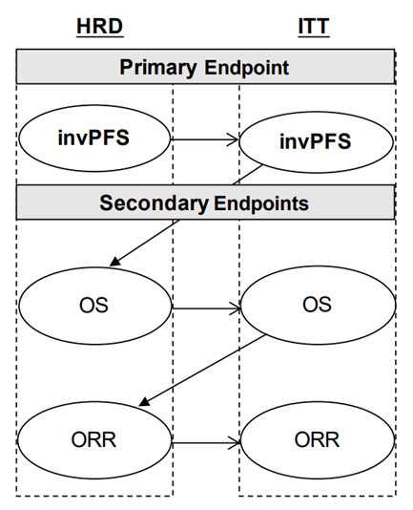
ATHENA-MONO hierarchical step-down procedure
Back to subgroup results slide
To preserve the overall type 1 error rate, while testing the primary and secondary endpoints for ATHENA–MONO, a hierarchical step-down procedure was specified. Statistical significance was only declared for any of the endpoints if the previous endpoints were also statistically significant at the significance level of two-sided 0.025.
To adjust for multiple analyses of OS at a later stage, a stopping rule was applied to the interim OS data presented in the company’s submission. A p-value of <0.001 was required to declare statistical significance of OS results from interim data cuts. This means that the company will be able to use a two-sided p-value < 0.025 to determine statistical significance at the final OS analysis.
Abbreviations: HRD, homologous recombination deficient; invPFS, investigator-assessed progression-free survival; ITT, intent-to-treat; ORR, objective response rate; OS, overall survival
Notes:
References
Company submission Figure 3

Slide 37
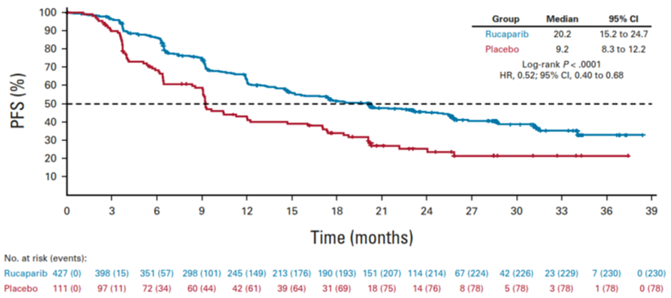
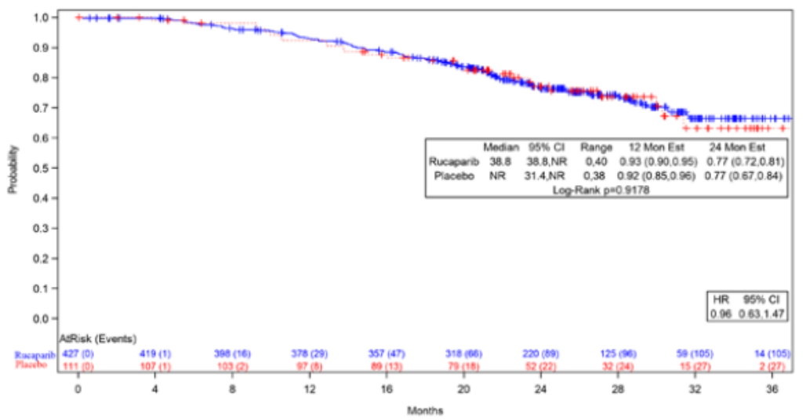
ATHENA-MONO results – ITT
Back to subgroup results slide
Rucaparib significantly reduced PFS compared to placebo; OS is still immature
invPFS (23 March 2022 data cut)
OS (23 March 2022 data cut)
HR: 0.52 (95% CI: 0.40 to 0.68) p<0.0001
Rucaparib
Placebo
Rucaparib
OS (%)
HR: 0.96 (95% CI: 0.63 to 1.47) p=0.8688
HR (2023): 0.83 (95% CI: 0.58 to 1.17) p=0.2804
Placebo
No. at risk
No. at risk
Ruc
Plac
427 | 398 | 351 | 298 | 245 | 213 | 190 | 151 | 114 | 67 | 42 | 23 | 7 | 0
111 | 97 | 72 | 60 | 42 | 39 | 31 | 18 | 14 | 8 | 5 | 3 | 1 | 0
Ruc
Plac
427 | 419 | 398 | 378 | 357 | 318 | 220 | 125 | 59 | 14
111 | 107 | 103 | 97 | 89 | 79 | 52 | 32 | 15 | 2
 | Median PFS (95% CI)
Rucaparib | 20.2 months (15.2 to 24.7)
Placebo | 9.2 months (8.3 to 12.2)
 | Median OS (95% CI)
Rucaparib | 38.8 months (2022); NR (2023)
Placebo | NR (2022); 46.2 months (2023)
Abbreviations: BRCA, breast cancer gene; CI, confidence interval; HR, hazard ratio; invPFS, investigator-assessed progression-free survival; ITT, intention to treat; LOH, loss of heterozygosity; NR, not reached; OS, overall survival; PFS, progression-free survival; plac, placebo; ruc, rucaparib; tBRCA, tumour BRCA mutation
Notes:
References
Company submission Table 14 and Table 16, Figure 4
Rubraca; INN-rucaparib (europa.eu) (Table 26 and Figure 27)

Slide 38
Indirect comparison methodology
Back to indirect comparisons and results slide
ATHENA-MONO
invPFS (March 2022 interim analysis)
OS and PFS2 (ad-hoc March 2023 analysis)
+
PAOLA-1
invPFS and OS (March 2022 analysis)
PFS2 (March 2020 analysis)
Unadjusted naïve ITCs
Bucher indirect comparison methods used
Unanchored MAICs
Population characteristics adjusted for:
Company did not adjust for age, prior bevacizumab use or complete resection/residual disease following surgery
Company concluded PH assumption was violated for all invPFS MAICs and so performed additional invPFS MAICs that assumed piecewise constant hazard ratios
ECOG PS
Primary tumour location
FIGO Stage
Histology type
History of surgery
Clinical response after platinum-based chemotherapy
CA-125 level at baseline
Unknown HRD status
Abbreviations: CA-125, cancer antigen 125; ECOG PS, Eastern Cooperative Oncology Group performance status; FIGO, International Federation of Gynecology and Obstetrics; HRD, homologous recombination repair deficient; invPFS, investigator-assessed progression-free survival; ITC, indirect treatment comparison; MAIC, Matching-adjusted indirect comparisons; OS, overall survival; PFS, progression-free survival
Notes:
EAR Table 12

Slide 39
MAICs in the economic model
Back to indirect comparisons and results slide
Company did not include MAICs in the economic model
The company did not include MAIC results in the model because:
a single average MAIC HR over time is an invalid measure to be used in the model due to the strongly time-dependent relationship observed between the hazards of outcomes in the rucaparib and comparator arms in the invPFS outcome
applicability of the piecewise HRs estimated are also limited due to the large difference in follow-up time across ATHENA-MONO and PAOLA-1
rucaparib follow-up is several years shorter that its comparators’ and an adequate comparison cannot be made of the long-term relationship
the unanchored MAIC against PAOLA-1 resulted in minor adjustment to the rucaparib KM curves across all outcomes and cohorts of interest
adjustment mostly moved rucaparib curves closer to the comparator so not using the adjusted HRs is likely a conservative approach
Naïve comparisons allow more flexibility with exploring different parametric models for the comparators
Abbreviations: HR, hazard ratio; invPFS, investigator-assessed progression-free survival; KM, Kaplan-Meier; MAIC, matching adjusted indirect comparison

Slide 40
Naïve comparisons - invPFS
CONFIDENTIAL
Back to indirect comparisons and results slide
non-tBRCA/LOH^{high}
non-tBRCA/LOH^{low}
Subgroup | Median PFS (95% CI)
 | Rucaparib | Placebo | Olaparib + bevacizumab | Bevacizumab
non-tBRCA/LOH^{high} | 20.3 months (13.4 to 31.1) | 9.2 months (4.0 to 22.1) | 30 months | 16.6 months
non-tBRCA/LOH^{low} | 12.1 months (11.1 to 17.7) | 9.1 months (4.0 to 12.2) | N/A | 16.2 months
Abbreviations: BRCA, breast cancer gene; CI, confidence interval; HR, hazard ratio; inv, investigator-assessed progression-free survival; LOH, loss of heterozygosity; PFS, progression-free survival; tBRCA, tumour BRCA mutation
Notes:
References
Company submission figures 27 and 33

Slide 41
Naïve comparisons – PFS2
CONFIDENTIAL
Back to indirect comparisons and results slide
non-tBRCA/LOH^{high}
non-tBRCA/LOH^{low}
Subgroup | Median PFS2 (95% CI)
 | Rucaparib | Placebo | Olaparib + bevacizumab | Bevacizumab
non-tBRCA/LOH^{high} | 39.0 months | NR | 50.3 months | 30.1 months
non-tBRCA/LOH^{low} | 24.4 months | 20.0 months | N/A | 26.4 months
Abbreviations: BRCA, breast cancer gene; CI, confidence interval; HR, hazard ratio; LOH, loss of heterozygosity; N/A, not applicable; NR, not reached; PFS2, progression-free survival 2; tBRCA, tumour BRCA mutation
Notes:
References
Company submission figures 37 and 39

Slide 42
Naïve comparisons - OS
CONFIDENTIAL
Back to indirect comparisons and results slide
non-tBRCA/LOH^{high}
non-tBRCA/LOH^{low}
Subgroup | Median OS (95% CI)
 | Rucaparib | Placebo | Olaparib + bevacizumab | Bevacizumab
non-tBRCA/LOH^{high} | NR | 41 months | NR | 53 months
non-tBRCA/LOH^{low} | 42.9 months | 32.4 months | N/A | 41 months
Abbreviations: BRCA, breast cancer gene; CI, confidence interval; HR, hazard ratio; LOH, loss of heterozygosity; NR, not reached; OS, overall survival; N/A, not applicable; NR, not reached; tBRCA, tumour BRCA mutation
Notes:
References
Company submission figures 42 and 46

Slide 43
Key issues: ITC OS results are uncertain
Back to indirect comparisons and results slide
Background
All OS unadjusted naïve ITCs and unanchored MAIC results showed no statistically significant difference between rucaparib and olaparib+bevacizumab or placebo+bevacizumab, with all reported HRs being close to 1
Company
ATHENA-MONO trial is expected to reach data maturity in October 2027
EAG comments
OS results for all comparisons/subgroups are uncertain, primarily due to lack of long-term rucaparib clinical effectiveness data
A smaller proportion of ATHENA-MONO ITT population received subsequent PARP inhibitor treatment compared with PAOLA-1
Subsequent PARP inhibitor following rucaparib or olaparib+bevacizumab is not in line with NHS practice
OS data from ad-hoc March 2023 analysis of ATHENA-MONO are immature
 | ATHENA-MONO (ITT, 2022) |  | PAOLA-1
 | Rucaparib | Placebo | Olaparib + bevacizumab | Bevacizumab
Subsequent PARP inhibitor therapy | 5.6% | 23.4% | 19.6% | 45.7%
Abbreviations: HR, hazard ratio; ITC, indirect treatment comparison; ITT, intention to treat; MAIC, matching-adjusted indirect comparisons; OS, overall survival; PARP, poly adenosine diphosphate ribose polymerase
Notes:
References
EAR Sections 3.4.2 and 3.4.6

Slide 44
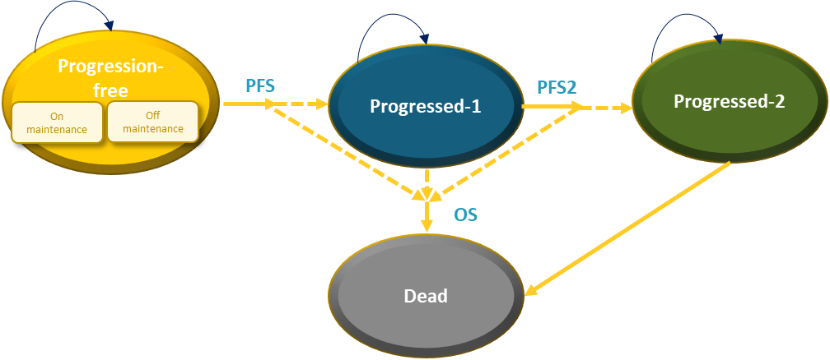
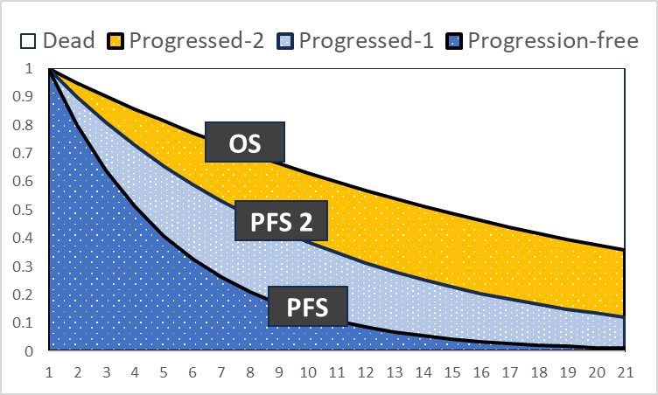
Company’s model overview: four-state partitioned survival model
EAG says model structure is appropriate
Back to modelling and cost effectiveness slides
Input | Assumption/source
Time horizon | Maximum of 40 years
Efficacy | ATHENA-MONO, PAOLA-1 (naïve comparisons)
AEs | ATHENA-MONO, ARIEL2 (duration)
Utilities | ATHENA-MONO EQ-5D-5L mapped to 3L (Hernández Alava 2023), TA946
Costs | BNF, eMIT, NHS reference costs
Resource use | TA946
Severity modifier | No
Stopping rule | Rucaparib 2-year treatment stopping rule
Abbreviations: BNF, British National Formulary; eMIT, electronic Market Information Tool; OS, overall survival; PFS, progression-free survival
Notes:
References
Company submission Figures 25 and 26

Slide 45
Comparison of extrapolations for PFS
Back to PFS extrapolation slides
CONFIDENTIAL
 | Company and EAG assumptions align
 | Company and EAG assumptions differ
Extrapolation of PFS - non tBRCA/LOH^{high} (%) |  | Time (years)
 |  | 1 | 2 | 3 | 5 | 7 | 10
Rucaparib | KM | 66.3% | 45.1% | 34.1% | - | - | -
 | Company base case: KM + log-logistic | ***** | ***** | ***** | ***** | ***** | *****
 | EAG preferred: generalised gamma | 65.1% | 44.6% | 34.7% | 24.8% | 19.7% | 15.4%
RS | KM | 44.0% | 28.2% | - | - | - | -
 | Company base case: log-normal | 47.2% | 24.6% | 14.7% | 6.6% | 3.6% | 1.7%
 | EAG preferred: log-normal | 47.2% | 24.6% | 14.7% | 6.6% | 3.6% | 1.7%
Ola+bev | KM | 83.0% | 52.9% | 48.5% | 41% | - | -
 | Company base case: KM + log-logistic | 86.2% | 53.2% | 44.5% | 37.8% | 34.0% | 30.4%
 | EAG preferred: generalised gamma | 82.6% | 61.6% | 50.1% | 37.8% | 31.3% | 25.5%
Bevacizumab | KM | 70.3% | 28.5% | 20.9% | 15.0% | - | -
 | Company base case: KM + log-normal | 70.3% | 30.2% | 21.1% | 15.3% | 12.6% | 10.2%
 | EAG preferred: log-logistic | 67.1% | 35.0% | 19.8% | 8.5% | 4.6% | 2.4%
Extrapolation of PFS - non tBRCA/LOH^{low} (%) |  | Time (years)
 |  | 1 | 2 | 3 | 5 | 7 | 10
Rucaparib | KM | 53.9% | 35.7% | 22.4% | ***** | ***** | *****
 | Company base case: log-normal | 56.9% | 32.8% | 21.0% | ***** | ***** | *****
 | EAG preferred: log-normal | 56.9% | 32.8% | 21.0% | ***** | ***** | *****
RS | KM | 38.8% | 20.1% | - | ***** | ***** | *****
 | Company base case: log-normal | 40.6% | 18.8% | 10.3% | ***** | ***** | *****
 | EAG preferred: log-normal | 40.6% | 18.8% | 10.3% | ***** | ***** | *****
Bevacizumab | KM | 64.4% | 19.8% | 14.9% | 11.9% | - | -
 | Company base case: KM + exponential | 65.7% | 21.8% | 16.4% | 9.4% | 5.3% | 2.3%
 | EAG preferred: log-logistic | 60.5% | 29.5% | 16.4% | 7.0% | 3.9% | 2.0%
Abbreviations: bev, bevacizumab; BRCA, breast cancer gene; KM, Kaplan-Meier; LOH, loss of heterozygosity; ola, olaparib; PFS, progression-free survival; RS, routine surveillance; tBRCA, tumour BRCA mutation
Notes:
References
Company submission table 38 and 43

Slide 46
PFS, PFS2 and OS curves for rucaparib: non-tBRCA/LOH^{high}
CONFIDENTIAL
Back to long-term survivorship slide
PFS and OS merge at ****** in the company’s curves
Company base case curves
EAG preferred curves
point of curves crossing
Abbreviations: EAG, External Assessment Group; KM, Kaplan-Meier; LOH, loss of heterozygosity; OS, overall survival; non-tBRCA, tumour without BReast Cancer gene mutation; PFS, progression-free survival; PFS2, progression-free survival 2
Notes:
EAR Figure 5
EAR Table 34

Slide 47
PFS, PFS2 and OS curves for olaparib + bevacizumab: non-tBRCA/LOH^{high}
CONFIDENTIAL
Back to long-term survivorship slide
PFS and OS merge at ******* in the company’s curves and ******* in EAG’s
Company base case curves
EAG preferred curves
point of curves crossing
Abbreviations: bev, bevacizumab; EAG, External Assessment Group; KM, Kaplan-Meier; LOH, loss of heterozygosity; ola, olaparib; OS, overall survival; non-tBRCA, tumour without BReast Cancer gene mutation; PFS, progression-free survival; PFS2, progression-free survival 2
Notes:
EAR Figure 6
EAR Table 34

Slide 48
PFS, PFS2 and OS curves for bevacizumab: non-tBRCA/LOH^{high}
CONFIDENTIAL
Back to long-term survivorship slide
PFS and OS merge at ******* in the company’s curves
Company base case curves
EAG preferred curves
point of curves crossing
Abbreviations: bev, bevacizumab; EAG, External Assessment Group; KM, Kaplan-Meier; LOH, loss of heterozygosity; ola, olaparib; OS, overall survival; non-tBRCA, tumour without BReast Cancer gene mutation; PFS, progression-free survival; PFS2, progression-free survival 2
Notes:
EAR Figure 7
EAR Table 34

Slide 49
PFS, PFS2 and OS curves for bevacizumab: non-tBRCA/LOH^{low}
CONFIDENTIAL
Back to long-term survivorship slide
Company base case curves
EAG preferred curves
point of curves crossing
Abbreviations: bev, bevacizumab; EAG, External Assessment Group; KM, Kaplan-Meier; LOH, loss of heterozygosity; ola, olaparib; OS, overall survival; non-tBRCA, tumour without BReast Cancer gene mutation; PFS, progression-free survival; PFS2, progression-free survival 2
Notes:
EAR Figure 8

Slide 50
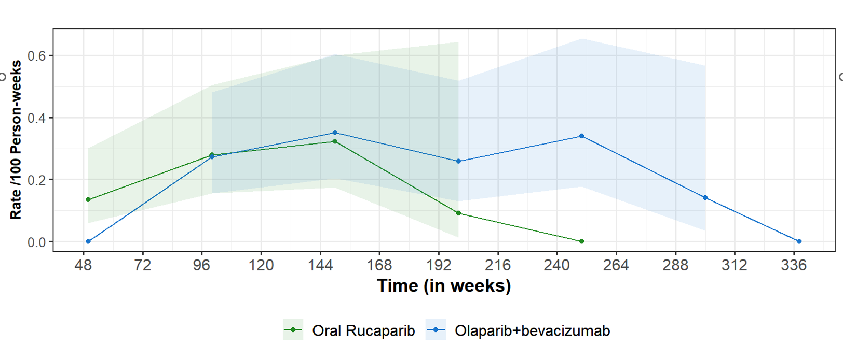
OS hazards: non-tBRCA/LOH^{high}
CONFIDENTIAL
Back to slide on relationship between PFS, PFS2 and OS or mortality hazards
Average mortality hazards for rucaparib versus olaparib + bevacizumab using 50-week windows
OS monthly hazards - company base case
Company: beyond week 100, the mortality hazard for rucaparib falls below olaparib + bevacizumab
EAG: only the mortality hazard intervals prior to 198 weeks are informative; these show a trend towards equal hazards
No statistical and little numerical basis to conclude differences in hazards from 98 to 148 weeks
Very few events and substantial right censoring from 148 to 198 weeks makes hazard calculation unreliable
No events between 198 weeks and trial data cut off that could be used to estimate a hazard
Abbreviations: bev, bevacizumab; LOH, loss of heterozygosity; ola, olaparib; OS, overall survival; non-tBRCA, tumour without BReast Cancer gene mutation; PFS, progression-free survival
Notes:
EAR Figure 2
Company FAC response, page 11

