Slide 1
Dostarlimab with carboplatin and paclitaxel for treating primary advanced or recurrent endometrial cancer with microsatellite stability or mismatch repair proficiency
PART 1: For PROJECTOR – contains no confidential information
Technology appraisal committee A [1 July 2025]
Chair: Radha Todd
Lead team: Richard Ballerand, Hugo Pedder, Ravi Ramessur
External assessment group: BMJ TAG
Technical team: Sharlene Ting, Yelan Guo, Ian Watson
Company: GlaxoSmithKline
© NICE 2025. All rights reserved. Subject to Notice of rights.

Slide 2
Dostarlimab with carboplatin and paclitaxel for treating primary advanced or recurrent endometrial cancer with microsatellite stability or mismatch repair proficiency
Background and key issues
Clinical effectiveness
Modelling and cost effectiveness
Other considerations
Summary

Slide 3
Background
Primary advanced or recurrent MMRp/MSS EC: often incurable and associated with high symptom burden, aggressive progression, low life expectancy
EC: most common (96%) uterine cancer, starts in endometrium or uterus (lining of womb)
  Primary advanced: diagnosed at first presentation with EC that has spread beyond endometrium (FIGO Stage 3 or Stage 4; 20% of new EC)
  Recurrent: tumour not detected after primary curative treatment that is then later radiologically or histologically detected (13% of initially treated)
MMR status (functionality of DNA mismatch repair system in tumour): routinely tested in EC
  MMR proficient (MMRp): DNA repair mechanisms remain intact so mutations are corrected; microsatellites (short, repeating sequences of DNA) remain stable and do not change in length (microsatellite stable [MSS]; 75% of EC)
  MMR deficient (dMMR): errors during DNA replication not properly corrected can lead to changes in microsatellites causing them to become unstable (microsatellite instability, MSI) – outside of scope of ID6415 (covered in TA1064)
Abbreviations: EC, endometrial cancer; dMMR, deficient mismatch repair; DNA, deoxyribonucleic acid; FIGO, International Federation of Gynaecology and Obstetrics; MMRp, mismatch repair proficient; MSI, microsatellite instability; MSS, microsatellite stable; TA, technology appraisal
Notes:
Source: Company submission, Document B, section B.1.3.1. EAR, section 2.2.

Slide 4
Patient perspectives
“It has had a huge impact on my work, family and social life. I have lost a lot of confidence due to the effects I still struggle with and rarely go out on an evening”
Submissions from Peaches Womb Cancer Trust
Significant impact on all aspect of life for person and their family: debilitating physical symptoms, psychological distress, financial impact
High unmet need for early, effective, innovative treatments for people with stage 3 and 4 cancer that delays or stops progression
Delay in access to effective treatment where 2L options available only after disease progression
Feelings of frustration and abandonment because of lack of effective 1L options compared to other types of cancer
Higher incidence of p53abn subtype of MMRp EC in women of Black ethnic background
“The carer takes over the huge burden of looking after the patient, the family, continuing work and providing emotional as well as physical support to the patient”
Abbreviations: 1/2L, first/second line; EC, endometrial cancer; MMRp, mismatch repair proficient; p53abn, p53-abnormal = mutation in TP53 gene
Notes:
Source: Peaches Womb Cancer Trust submission.

Slide 5
Clinical perspectives
“The one aspect of this technology that would be easier is that all patients could be given immunotherapy upfront in the metastatic setting and so standardising care. There are some centres struggling with full molecular sub classification of endometrial cancer”
Clinical expert statements
MMRp EC: molecularly heterogeneous group that includes ~75% advanced/recurrent disease
Routinely available molecular testing cannot further identify subgroup within MMRp EC that will more likely benefit from dostarlimab
1L standard of care (carboplatin plus paclitaxel) shows median OS <2 years
Immunotherapy at 1L will increase option for people who may not be fit enough after disease progression to have subsequent 2L immunotherapy regimens
Abbreviations: 1/2L, first/second line; EC, endometrial cancer; MMRp, mismatch repair proficient; OS, overall survival; QoL, quality of life
Notes:
Source: Clinical expert statements from Andrew Clamp and John McGrane.

Slide 6

Treatment pathway for MMRp/MSS EC and positioning of dostarlimab
Diagnosis with early-stage EC (stage 1 or 2)
Surgery ± neoadjuvant or adjuvant radiotherapy, chemotherapy or hormone therapy
Recurrent EC
First line
Beyond first-line PCC
Pembrolizumab + Lenvatinib (TA904)
Chemotherapy
Hormone therapy
Clinical trials
PCC: carboplatin + paclitaxel (CP)
Diagnosis with primary advanced EC (stage 3 or 4)
Addition of dostarlimab
EAG comments
Broadly agree with company’s treatment pathway, positioning and comparator but consider:
  most Stage 3 EC would have surgery + radiotherapy + chemotherapy
  small number not suitable for CP may have carboplatin monotherapy or hormone therapy
  people having dostarlimab at 1L would not be eligible for pembrolizumab + lenvatinib
Is the treatment pathway representative of NHS practice?
Is CP followed by routine surveillance the standard of care at first line for primary advanced or recurrent EC in the NHS?
Abbreviations: 1L, first line; CP, carboplatin plus paclitaxel; EC, endometrial cancer; MMRp, mismatch repair proficient; PCC, platinum-containing chemotherapy
Notes:
Source: Company submission, Document B, Figure 2. EAR, sections 2.2.1 and 2.2.1.1, Table 7.

Slide 7
Dostarlimab (JEMPERLI)
Marketing authorisation | With platinum-containing chemotherapy for treatment of primary advanced or recurrent endometrial cancer in adults who are candidates for systemic therapy Dec 2024: MHRA granted label extension to expand dostarlimab use in combination with PCC to include treating primary advanced or recurrent EC in people with MMRp/MSS, in addition to those with dMMR/MSI-H
Mechanism of action | Humanised monoclonal antibody that binds to and inhibits PD-1 receptors that obstructs T cell proliferation and function
Dostarlimab administration | 500mg IV every 3 weeks for first 6 treatment cycles 1000mg every 6 weeks for all cycles thereafter Continue until progression or unacceptable toxicity or up to 3 years
List price of dostarlimab | £5,887.33 per 500 mg vial Patient access scheme is applicable
Abbreviations: EC, endometrial cancer; dMMR, deficient mismatch repair; IV, intravenous; MHRA, Medicines and Healthcare products Regulatory Agency; MMRp, mismatch repair proficient; MSI-H, microsatellite instability-high; MSS, microsatellite stable; PD-1, programmed cell death protein 1
Notes:
Source: https://www.medicines.org.uk/emc/product/12669/smpc. Company submission, Document B, Table 2.

Slide 8
Key issues
Issue | Resolved? | ICER impact | Slide
Modelling time on treatment^ | Partially – for discussion | Small | 16
Health state resource use for dostarlimab + CP^ |  | Small | 17
Subsequent treatments - bevacizumab redistribution^ |  | Small | 18-19
Oral administration cost for lenvatinib^ |  | Small | 20
Immature overall survival data | No – for discussion | Unknown | 12
Treatment-effect waning |  | Variable | 21
^EAG key issues
Abbreviations: CP, carboplatin plus paclitaxel; ICER, incremental cost-effectiveness ratio

Slide 9
Dostarlimab with carboplatin and paclitaxel for treating primary advanced or recurrent endometrial cancer with microsatellite stability or mismatch repair proficiency
Background and key issues
Clinical effectiveness
Modelling and cost effectiveness
Other considerations
Summary

Slide 10
Dostarlimab + CP clinical evidence
RUBY-1: ongoing, phase 3, multinational, double-blind, randomised (stratified by MMR status) trial
494 (ITT) adults (≥18 years) with primary Stage 3 or Stage 4 EC or first recurrent EC with low potential for cure by radiotherapy or surgery alone or in combination, ECOG PS 0 or 1
Dual primary endpoints: investigator-assessed PFS and OS
Other outcomes in model: HRQoL, AEs, TTD
Data cuts/interim analysis:
IA1 Sep 2022 for PFS
IA2 Sep 2023 for OS
Dostarlimab + CP
(N=245 ITT; n=192 MMRp/MMS)
500mg
Dostarlimab monotherapy
1000mg every 6 weeks
6 x 3-week cycles
up to 3 years
Placebo + CP
(N=249 ITT; n=184 MMRp/MSS)
Placebo + routine surveillance
376 MMRp/MMS EC
End of treatment visit
Safety follow-up visit: 90±7 days after last study dose
Survival assessment period
Screening (Day –28 to –1)
Randomisation
Treatment period
Clinical efficacy data focused on MMRp/MMS subgroup, except for AEs that used safety population who had at least 1 treatment dose (N=487 including 370 MMRp/MMS)
MMRp/MSS subgroup: median duration of follow-up was XXXXX at IA1 and 37.5 months at IA2
Study ongoing – to complete Q3 2026
*Link to Appendix – RUBY-1
Abbreviations: AE, adverse event; CP, carboplatin plus paclitaxel; EC, endometrial cancer; ECOG PS, Eastern Cooperative Oncology Group Performance Status; HRQoL, health-related quality of life; IA1/2, interim analysis 1/2; ITT, intention-to-treat; MMRp, mismatch repair proficient; MSS, microsatellite stable; OS, overall survival; PFS, progression-free survival; Q3, 3rd quarter; TTD, time to treatment discontinuation
Notes:
Source: Company submission, Document B, section 2.2.2, Tables 3, 4 and 9. EAR, section 3.3.

Slide 11
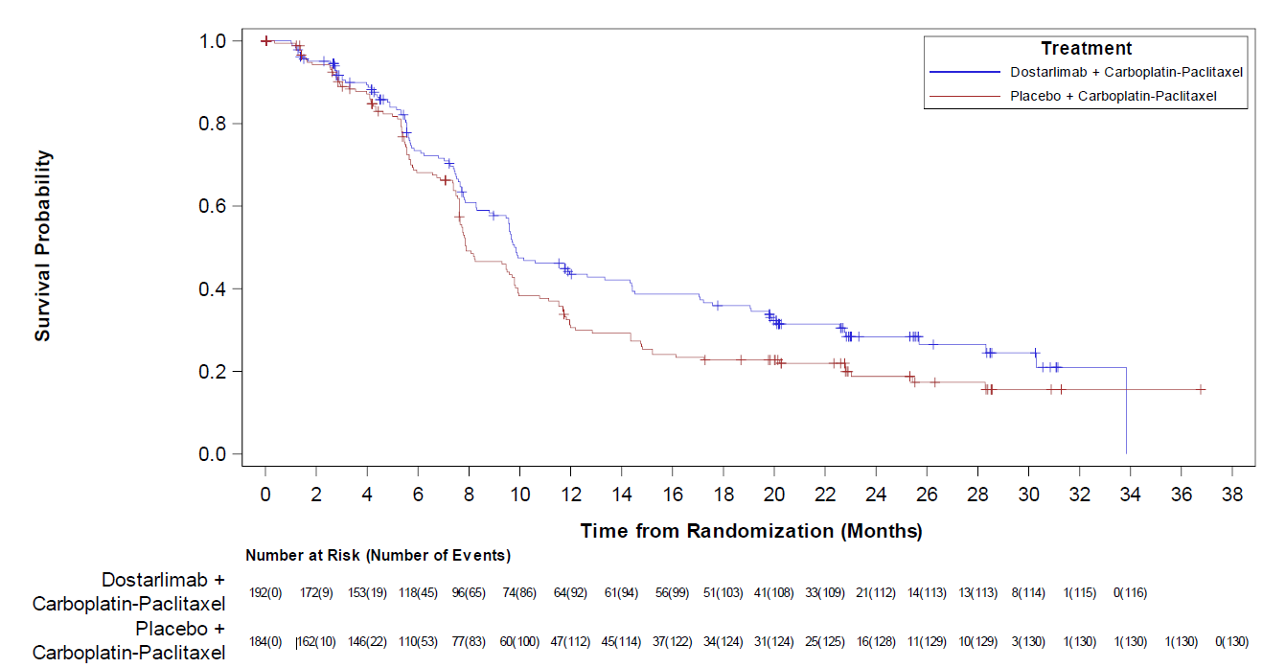
RUBY-1 results for MMRp/MMS: PFS at IA1 and IA2
PFS KM at IA1 (Sep 2022; median follow up XXXXXX)
PFS KM at IA2 (Sep 2023; median follow up 37.5 months)
HR (95% CI), p value log-rank test:
0.76 (0.59 to 0.98), 0.02
Outcome | IA1 |  | IA2
 | Dostarlimab + CP (n=192) | Placebo + CP (n=184) | Dostarlimab + CP (n=192) | Placebo + CP (n=184)
Median PFS, months (95% CI) | 9.9 (9.0 to 13.3) | 7.9 (7.6 to 9.8) | XXXX | XXXX
EAG: IA1 and IA2 curves similar XXXXXXXXXXXXXXXXXXXXXX → IA2 tail uncertain (censoring) → inappropriate to model XXXXXXXXXXXXXXXX because MMRp/MMS have poorer outcomes and likely to relapse → company’s use of PFS IA1 in base case is reasonable
Abbreviations: CI, confidence interval; CP, carboplatin plus paclitaxel; HR, hazard ratio; IA1/2, interim analysis 1/2; KM, Kaplan-Meier; MMRp, mismatch repair proficient; MSS, microsatellite stable; PFS, progression-free survival
Notes:
Source: Company submission, Document B, Figure 5. Company clarification response, A12, Figure 3. EAR section 3.3.1.

Slide 12
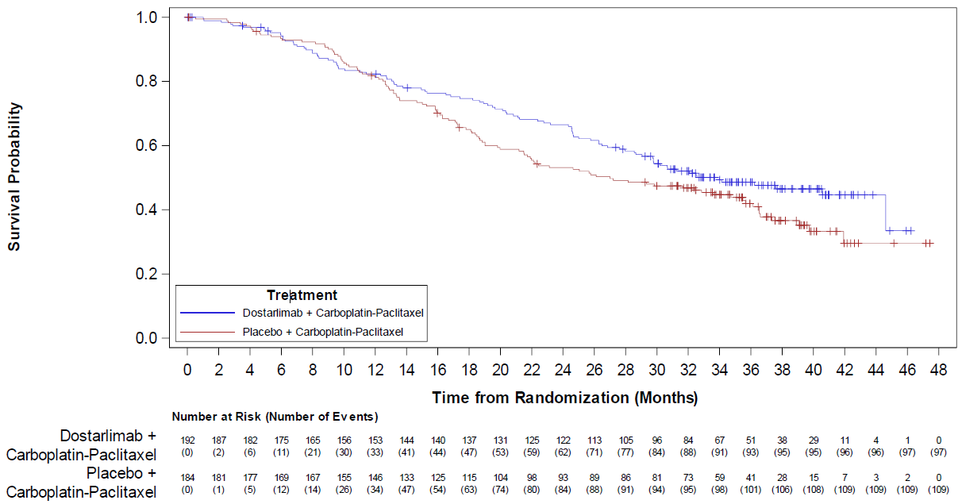
Key Issue: Immature RUBY-1 OS data at IA2
OS KM at IA2 (Sep 2023; median follow up 37.5 months)
Outcome | Dostarlimab + CP (n=192) | Placebo + CP (n=184)
Median OS, months (95% CI) | 34.0 (28.6 to NE) | 27.0 (21.5 to 35.6)
Hazard ratio (95% CI) | 0.79 (0.60 to 1.04)
Log rank test, p value | 0.049
EAG comments
IA2 OS data are immature with ~54.8% data maturity. Heavy censoring after ~30 months → OS uncertain (no further interim data cuts expected; RUBY-1 completion in Q3 2026)
RUBY-1 subsequent treatment use not wholly reflective of UK clinical practice → OS may not reflect outcomes in NHS
  Immunotherapy (e.g. pembrolizumab) would not be used after dostarlimab in the NHS
    RUBY-1 dostarlimab + CP arm: 11.5% had PEM+LEN and 4.7% had pembrolizumab
  Bevacizumab not used in EC in UK clinical practice
Abbreviations: CI, confidence interval; CP, carboplatin plus paclitaxel; IA2, interim analysis 2; KM, Kaplan-Meier; OS, overall survival; Q3, 3rd quarter
Notes:
Source: Company submission, Document B, Figure 6. EAR section 3.3.2.

Slide 13

RUBY-1: EAG comments
Well conducted RCT with low risk of bias
MMRp/MMS: subgroup of RUBY-1 (~76%) → not statistically powered, many outcomes from post hoc analyses
Data in economic model should be from same analysis but company used IA1 for PFS, HRQoL and TTD and IA2 for OS and AEs
RUBY-1 population had lower mean age and ECOG PS than in NHS but broadly representative of UK population
How generalisable are RUBY-1 results to people likely to have dostarlimab + CP in the NHS?
What is the impact of dostarlimab + CP on OS?
  What is the impact of subsequent immunotherapy use on OS in dostarlimab + CP arm in RUBY-1 compared to what would happen in the NHS?
*Link to Appendix – Baseline characteristics
Abbreviations: AE, adverse event; EC, endometrial cancer; ECOG PS, Eastern Cooperative Oncology Group Performance Status; HRQoL, health-related quality of life; IA1/2, interim analysis 1/2; MMRp, mismatch repair proficient; MSS, microsatellite stable; OS, overall survival; PFS, progression-free survival; RCT, randomised controlled trial; TTD, time to treatment discontinuation
Notes:
Source: EAR, sections 1.4 and 3.4.

Slide 14
Dostarlimab with carboplatin and paclitaxel for treating primary advanced or recurrent endometrial cancer with microsatellite stability or mismatch repair proficiency
Background and key issues
Clinical effectiveness
Modelling and cost effectiveness
Other considerations
Summary

Slide 15
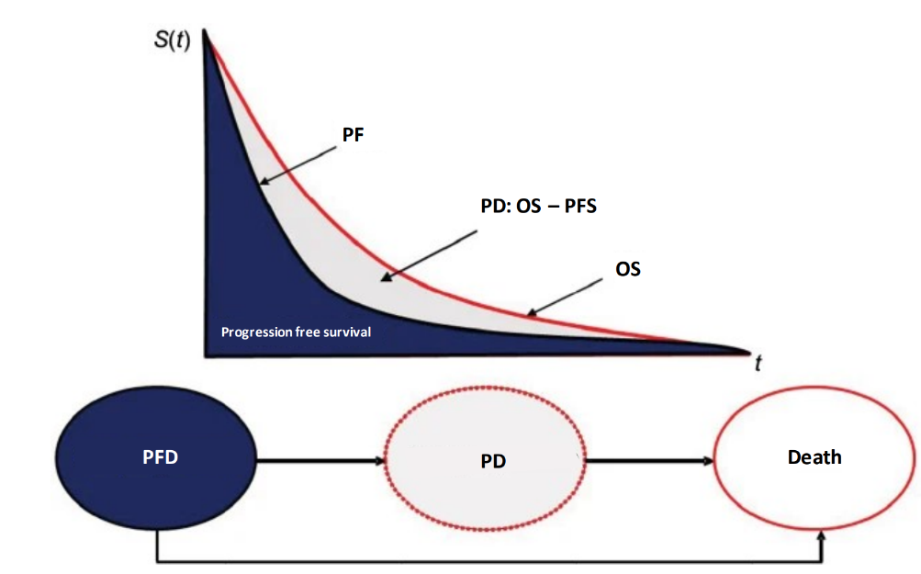
Company’s model
Technology affects QALYs by delaying disease progression and increasing survival
Technology affects costs by its higher total cost than current treatments
Assumption with greatest effect on ICER is how costs of subsequent treatments for CP arm are estimated
Model structure
*Link to Appendix – Company model
Abbreviations: CP, carboplatin plus paclitaxel; ICER, incremental cost-effectiveness ratio; QALY, quality-adjusted life year; OS, overall survival; PD, progressed disease; PFD/S, progression-free disease/survival
Notes:
Source: EAR, section 4.2.2. Company submission, Document B, Figure 13 and Table 20.

Slide 16
Key Issue: Modelling time on treatment
Company
Assumed same ToT for CP for both arms for first 6 treatment cycles (18 weeks)
Base case: used weighted completion rates for CP in both arms across first 6 cycles. For dostarlimab, used completion rates for first 6 cycles, then TTD KM data adjusted for RDI up to 3 years
Provided scenario using TTD KM data for both arms for first 6 cycles
Because some people had dostarlimab beyond 3 years, provided scenario using TTD KM data for dostarlimab + CP not capped at 3 years
EAG comments
Company’s approach of using completion rates does not capture full cost of starting treatment in either arms because ITT population included people randomised that did not start treatment → completion rate for first treatment cycle in model is not 100%
Base case: used TTD KM data for both arms and additionally, for dostarlimab RDI from cycle 1 up to 3 years to capture full treatment costs
How should time on treatment be modelled?
Abbreviations: CP, carboplatin plus paclitaxel; ITT, intention-to-treat; KM, Kaplan-Meier; RDI, relative dose intensity; ToT, time on treatment; TTD, time to treatment discontinuation
Notes:
Source: EAR, Table 2, sections 4.2.5.2 and 4.2.5.3.

Slide 17
Key Issue: Health state resource use for dostarlimab + CP
Company: elicited HS resource use from 6 UK clinicians. Table shows inputs in base case
Resource | Unit cost | Resource use per weekly cycle
 |  | Progression-free |  |  | PD (all arms)
 |  | All arms (up to week 18) | CP (week 19+) | Dostarlimab (week 19+)
Outpatient visit | £205.82 | 0.30 | 0.08 | 0.13 | 0.121
CT scan | £118.58 | 0.13 | 0.05 | 0.06 | 0.07
Complete blood count | £8.04 | 0.33 | 0.06 | 0.22 | 0.09
Specialist nurse visit | £61.01 | 0.11 | 0.07 | 0.07 | 0.10
GP visit | £50.30 | - | 0.01 | 0.01 | 0.01
Total cost per weekly cycle | - | £86.53 | £27.65 | £40.41 | £40.33
EAG comments
Clinical advice to EAG suggests that:
  After dostarlimab is stopped after up to 3 years and people are PF, resource use same as CP PF week 19+ (EAG base case)
  CT scans would be less frequent (for PF and PD, 1 every 3 and 6 months)
Corrected minor discrepancies in unit cost for band 6 nurse and GP visits in base case
Which approach of resource use reflects NHS practice? Company’s or EAG’s?
Abbreviations: CP, carboplatin plus paclitaxel; CT, computed tomography; GP, general practitioner; HS, health state; PD, progressed disease; PF, progression free
Notes:
Source: EAR, Tables 3 and 31, section 4.2.5.5.

Slide 18
Key Issue: Subsequent treatments – bevacizumab redistribution (1)
Company: at clarification, at EAG’s request, company redistributed bevacizumab (not used in NHS) usage to other options
EAG comments
Company’s approach of using adjusted RUBY-1 data to reflect NHS practice is reasonable
Company redistributed bevacizumab use in dostarlimab arm to the other treatments because PEM+LEN is not an option at later lines – EAG agrees with this approach
Disagree with company’s 2.4% bevacizumab use redistribution in CP arm to PEM+LEN
  Based on published data, bevacizumab is not a very effective treatment for EC → increased costs without the clinical benefit of immunotherapy → biased against CP arm
  Advice from NHS CDF lead: 48.8% on CP moving onto PEM+LEN from adjusted RUBY-1 data is reflective of NHS use
Base case: for CP arm, prefer to keep PEM+LEN at 48.8% and redistribute bevacizumab use to all other non-immunotherapy treatments
Abbreviations: CDF, Cancer Drugs Fund; CP, carboplatin plus paclitaxel; EC, endometrial cancer; PEM+LEN, pembrolizumab plus lenvatinib
Notes:
Source: EAR, Table 2, sections 4.2.6 and 4.2.6.1, Table 33. Company submission, Document B, Table 43.

Slide 19
Key Issue: Subsequent treatments – bevacizumab redistribution (2)
Subsequent treatment | Company original base case (adjusted RUBY-1) |  | Company updated base case after clarification |  | EAG base case
 | Dostarlimab + CP | CP | Dostarlimab + CP | CP | Dostarlimab + CP | CP
Carboplatin + doxorubicin | 4.4% | 0.8% | 4.8% | 0.8% | 4.8% | 0.9%
CP | 13.2% | 10.4% | 14.4% | 10.9% | 14.4% | 11.3%
Paclitaxel | 5.9% | 2.4% | 6.4% | 2.5% | 6.4% | 2.6%
Doxorubicin (and PLD) | 32.3% | 20.8% | 35.1% | 21.8% | 35.1% | 22.6%
Carboplatin | 5.9% | 1.6% | 6.4% | 1.7% | 6.4% | 1.7%
PEM + LEN | 0% | 48.8% | 0% | 51.2% | 0% | 48.8%
Cisplatin | 2.9% | 2.4% | 3.2% | 2.5% | 3.2% | 2.6%
Hormone therapy | 14.7% | 13.6% | 16% | 14.3% | 16% | 14.8%
Radiotherapy | 21.1% | 14.4% | 23% | 15.1% | 23% | 15.6%
Bevacizumab | 8.8% | 5.6% | 0% | 0% | 0% | 0%
No treatment | 8.3% | 0.0% | 8.3% | 0% | 8.3% | 0%
How should 2.4% bevacizumab use be redistributed in CP arm? Company’s PEM+LEN or EAG’s other non-immunotherapy treatments?
Which distribution more closely reflects subsequent treatment use in the NHS?
What is the impact of modelled subsequent treatment use on OS?
Abbreviations: CP, carboplatin plus paclitaxel; OS, overall survival; PEM+LEN, pembrolizumab plus lenvatinib; PLD, pegylated liposomal doxorubicin
Notes:
Source: EAR, Table 2, sections 4.2.6 and 4.2.6.1, Table 33. Company submission, Document B, Table 43.

Slide 20
Key Issue: Oral administration cost for lenvatinib
Company
Assumed oral administration cost for lenvatinib
Needs specialist oversight for procurement, prescribing, dispensing and administration
Consistent with previous appraisals of lenvatinib in other indications (TA498 and T858)
EAG comments
Based on published advice, patients likely take lenvatinib at home → likely no cost to administer lenvatinib in the NHS
Administration cost affects CP arm only as PEM+LEN not used after dostarlimab
Base case: exclude administration cost of lenvatinib
Does the administration of oral lenvatinib incur a cost to the NHS?
Abbreviations: CP, carboplatin plus paclitaxel; PEM+LEN, pembrolizumab plus lenvatinib
Notes:
Source: EAR, Table 2.

Slide 21
Key Issue: Treatment-effect waning
Company
Excluded treatment-effect waning in its base case because:
  RUBY-1 showed a sustained OS benefit with dostarlimab + CP over placebo + CP
  Independent OS models implicitly capture waning of treatment effect as observed in shape of implied HR over time between arms
For consistency with other NICE appraisals in EC, presented scenario analysis that included waning at 5-7 years (2-year stopping rule) and 8-10 years (3-year stopping rule)
EAG comments
Not a key issue: PFS plots demonstrate risk of progression is similar for both arms after ~2 years → treatment-effect waning may not be relevant based on modelled PFS hazards
Considers useful to explore treatment-effect waning scenario on OS, but highlighted that tails of OS KM curves are associated with considerable uncertainty because of high levels of censoring and that OS KM plot shows convergence in dostarlimab + CP and placebo + CP curves from month 30, that then diverge from month 36
Should treatment-effect waning be included?
Abbreviations: CP, carboplatin plus paclitaxel; EC, endometrial cancer; HR, hazard rate; KM, Kaplan-Meier; OS, overall survival; PFS, progression-free survival
Notes:
Source: Company submission, Document B, section 3.3.2.2.3. EAR, section 4.2.3.6.

Slide 22
Summary of company and EAG base case assumptions
Assumption | Company base case | EAG base case
Time on treatment | Used weighted completion rates for CP in both arms across first 6 cycles For dostarlimab, used completion rates for first 6 cycles, then TTD KM data adjusted for RDI up to 3 years | Used TTD KM data for both arms and additionally, for dostarlimab RDI from cycle 1 up to 3 years
Health state resource use | Used PF resource use specific for dostarlimab from week 19+ | Assumed PF use for dostarlimab after 3 years = PF use for CP from week 19+
Subsequent treatment – bevacizumab redistribution of CP arm | Redistributed to other options including PEM+LEN | Redistributed to only non-immunotherapy options
Oral administration cost for lenvatinib | Included | Excluded
EAG base case include following corrections/changes:
Used unit cost of carboplatin 450 mg for subsequent treatment cost
Corrected nurse and GP costs
Used ONS life tables from 2017-2019
Abbreviations: CP, carboplatin plus paclitaxel; KM, Kaplan-Meier; PEM+LEN, pembrolizumab plus lenvatinib; PF, progression free; RDI, relative dose intensity; TTD, time to treatment discontinuation
Notes:
Source: EAR, section 6.3.

Slide 23
Cost-effectiveness results
All ICERs are reported in PART 2 slides because they include confidential
comparator PAS discounts
Company and EAG base case ICERs: >£30,000 per QALY
All scenarios >£30,000 per QALY
Abbreviations: ICER, incremental cost-effectiveness ratio; PAS, patient access scheme; QALY, quality adjusted life year

Slide 24
Other considerations
Equality: Stakeholders highlighted higher incidence of p53abn subtype of MMRp EC in women of Black African or Caribbean background (more aggressive p53abn subtype associated with poorer outcomes)
Severity modifier: QALY shortfall calculations did not meet severity modifier threshold
Managed access: company has not submitted a managed access proposal. Committee can make a recommendation with managed access if:
  technology cannot be recommended for use because evidence is too uncertain
  technology has plausible potential to be cost effective at currently agreed price
  new evidence that could sufficiently support case for recommendation is expected from clinical trials, or could be collected from people having it in clinical practice
  data could feasibly be collected within a reasonable timeframe (up to a maximum of 5 years) without undue burden
Are there any equality issues or uncaptured benefits to consider?
Abbreviations: EC, endometrial cancer; MMRp, mismatch repair proficient; p53abn, p53-abnormal = mutation in TP53 gene; QALY, quality-adjusted life year
Notes:
Source: Company submission, Document B, section 1.4. Patient organisation submission from Peaches Womb Cancer Trust. Clinical expert statement from John McGrane. Company submission, Document B, sections 3.6 and 3.12.

Slide 25
Dostarlimab with carboplatin and paclitaxel for treating primary advanced or recurrent endometrial cancer with microsatellite stability or mismatch repair proficiency
Background and key issues
Clinical effectiveness
Modelling and cost effectiveness
Other considerations
Summary

Slide 26
Key issues
Issue | ICER impact | Slide
Modelling time on treatment^ | Small | 16
Health state resource use for dostarlimab + CP^ | Small | 17
Subsequent treatments - bevacizumab redistribution^ | Small | 18-19
Oral administration cost for lenvatinib^ | Small | 20
Immature overall survival data | Unknown | 12
Treatment-effect waning | Variable | 21
^EAG key issues
Abbreviations: CP, carboplatin plus paclitaxel; ICER, incremental cost-effectiveness ratio

Slide 27
End of Part 1

Slide 28
Dostarlimab with carboplatin and paclitaxel for treating primary advanced or recurrent endometrial cancer with microsatellite stability or mismatch repair proficiency
Supplementary appendix

Slide 29
 | RUBY-1 (NCT03981796) – to complete Q3 2026
Design | Ongoing, phase 3, multinational, double-blind, randomised (stratified by MMR status, prior external pelvic radiotherapy, disease status), placebo-controlled
Population | 494 (ITT) adults (≥18 years) with primary Stage 3 or Stage 4 EC or first recurrent EC with low potential for cure by radiotherapy or surgery alone or in combination, ECOG PS 0 or 1 376 MMRp/MMS EC
Intervention | Dostarlimab + CP (N=245 ITT; n=192 MMRp/MMS) First 6 cycles every 3 weeks (all IV): dostarlimab 500mg + CP as below Subsequent cycles every 6 weeks: dostarlimab 1,000mg IV
Comparator | Placebo + CP (N=249 ITT; n=184 MMRp/MSS) First 6 cycles every 3 weeks (all IV): carboplatin 5mg/ml/min + paclitaxel 175mg/m² Subsequent cycles every 6 weeks: placebo IV
Duration | MMRp/MSS: median duration of follow-up was XXXXXXX at IA1 and 37.5 months at IA2
Key outcomes used in model | Dual primary endpoint: investigator-assessed PFS and OS PFS: initial radiographic scan within 28 days before first dose, then scans every 6 weeks until Week 25 (±7 days), then every 9 weeks until Week 52 (±7 days), then every 12 weeks until radiographic PD confirmed, then 1 addotopma; scam 4–6 weeks later or on starting subsequent anticancer therapy Other outcomes: HRQoL, AEs, TTD
Locations | 19 countries: US, UK (5 sites), Belarus, Belgium, Canada, Czech Republic, Denmark, Finland, Germany, Greece, Hungary, Israel, Italy, Netherlands, Norway, Poland, Sweden, Turkey, Ukraine
*Link to RUBY-1
Notes:
Source: Company submission, Document B, sections 2.3.1.2 and 2.3.6, Table 3.

Slide 30
RUBY-1 MMRp/MMS subgroup baseline characteristics
Characteristic | Dostarlimab + CP (N=192) | Placebo + CP (N=184)
White, n (%) | XXXX | XXXX
Black or African American, n (%) | XXXX | XXXX
Mean age in years (SD) | XXXX | XXXX
Mean weight in kg (SD) | XXXX | XXXX
Mean height in cm (SD) | XXXX | XXXX
Mean BMI in kg/m² (SD) | XXXX | XXXX
Mean BSA in m² (SD) | XXXX | XXXX
ECOG PS 0, n (%) | XXXX | XXXX
Primary Stage 3, n (%) | XXXX | XXXX
Primary Stage 4, n (%) | XXXX | XXXX
Recurrent EC | XXXX | XXXX
Had external pelvic radiotherapy, n (%) | XXXX | XXXX
*Link to RUBY-1
Notes:
Source: Company submission, Document B, Tables 5, 7.

Slide 31
SUBSEQUENT TREATMENTS, n (%) | RUBY-1ª |  | RUBY-1^{b} |  | RUBY-1 adjusted^{b}
 | Dostarlimab + CP (N=192) | Placebo + CP (N=184) | Dostarlimab + CP | CP | Dostarlimab + CP | CP
Any follow-up anticancer therapy | 105 (54.7) | 134 (72.8) | - | - | - | -
Chemotherapy | XXXX | XXXX | - | - | - | -
Doxorubicin | XXXX | XXXX | 20.2% | 20.8% | 32.3% | 20.8%
Paclitaxel / carboplatin | XXXX | XXXX | 8.3% | 10.4% | 13.2% | 10.4%
Pegylated liposomal doxorubicin | XXXX | XXXX | - | - | - | -
Carboplatin | XXXX | XXXX | 3.7% | 1.6% | 5.9% | 1.6%
Paclitaxel | XXXX | XXXX | 3.7% | 2.4% | 5.9% | 2.4%
Immunotherapy | 34 (17.7%) | 68 (37.0%) | - | - | - | -
Pembrolizumab / lenvatinib | 22 (11.5%) | 43 (23.4%) | 27.5% | 48.8% | 0% | 48.8%
Pembrolizumab | 9 (4.7%) | 20 (10.9%) | - | - | - | -
Radiation therapy | XXXX | XXXX | - | - | - | -
Radiotherapy | XXXX | XXXX | 21.1% | 14.4% | 21.1% | 14.4%
External beam radiation | XXXX | XXXX | - | - | - | -
Hormone therapy | XXXX | XXXX | 14.7% | 13.6% | 14.7% | 13.6%
Megestrol acetate | XXXX | XXXX | - | - | - | -
Everolimus/letrozole | XXXX | XXXX | - | - | - | -
Letrozole | XXXX | XXXX | - | - | - | -
Other | XXXX | XXXX | - | - | - | -
Bevacizumab | XXXX | XXXX | 5.5% | 5.6% | 8.8% | 5.6%
Carboplatin and doxorubicin | - | - | 2.8% | 0.8% | 4.4% | 0.8%
Cisplatin | - | - | 1.8% | 2.4% | 2.9% | 2.4%
No treatment | - | - | 8.3% | 0.0% | 8.3% | 0.0%
Notes:
Source: Company submission, Document B, Tables 15 (a) and 43 (b).

Slide 32
Company’s model
3-state PSM: PF, PD, death
  % based on parametric survival curves extrapolated from RUBY-1 PFS and OS data
Constraints applied:
  Risk of progression or mortality risk per cycle > age-matched general population mortality
  PFS capped to OS (PFS ≤ OS)
  TTD ≤ PFS
  18-week duration cap for CP arm
  3-year duration cap for TTD KM dostarlimab curve
First 18 cycles: start in PF in either arm
After 18 cycles:
  Dostarlimab + CP have dostarlimab up to 3 years
  Placebo + CP have routine surveillance only
Lifetime horizon (36 years); 1-week cycle; NHS/PSS perspective, 3.5% discounting
Baseline characteristics (RUBY-1): XXXX years, XXXX kg, XXXX BSA, GFR XXXX ml/min
Model structure
*Link to Company model
Notes:
Source: EAR, section 4.2.2. Company submission, Document B, Figure 13 and Table 20.

Slide 33
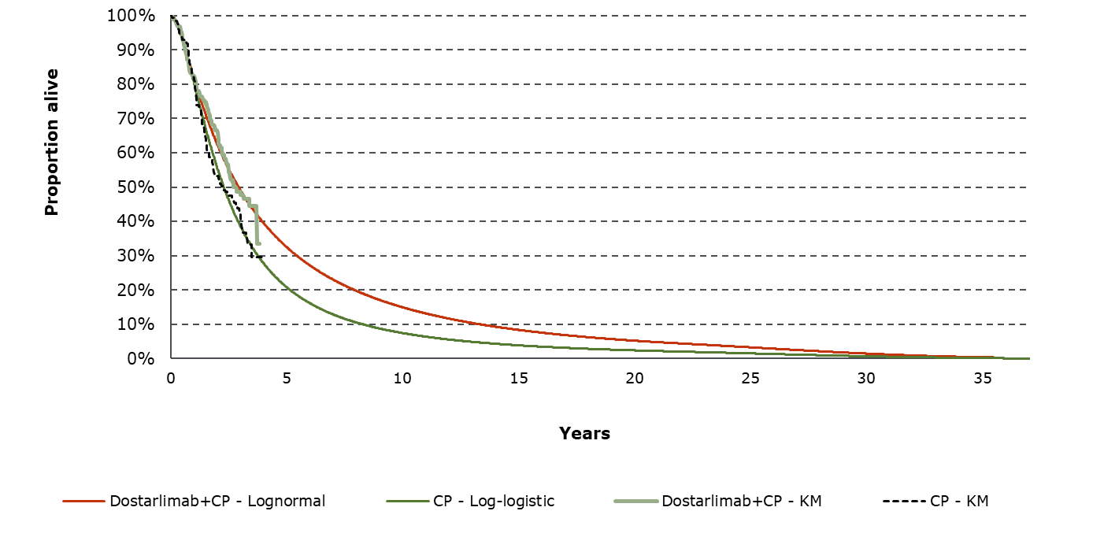
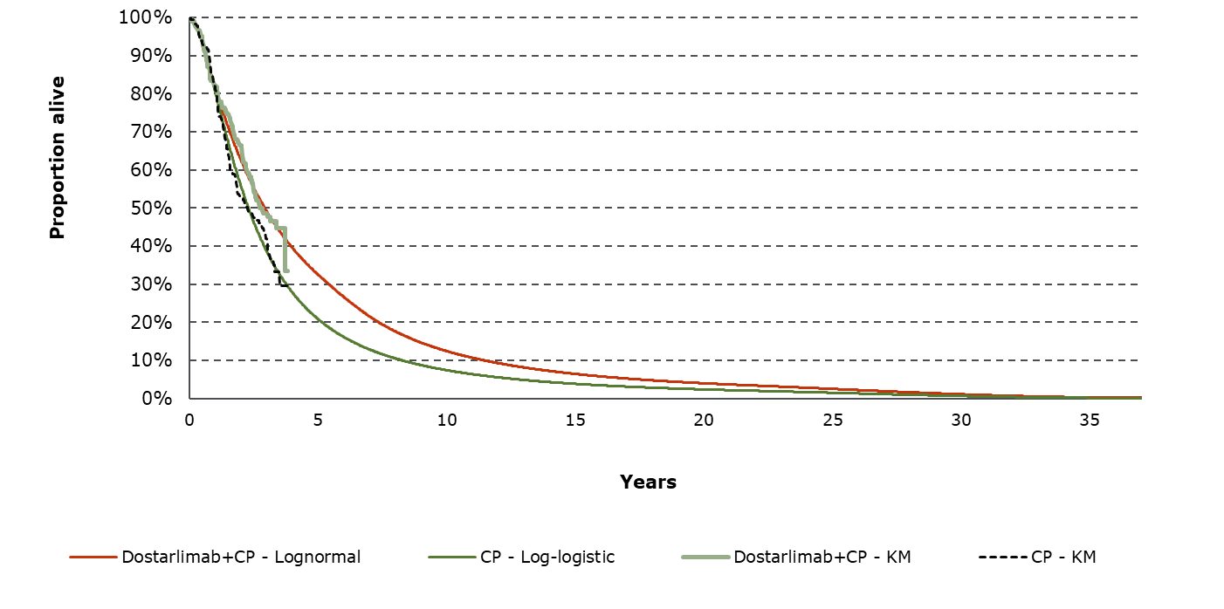
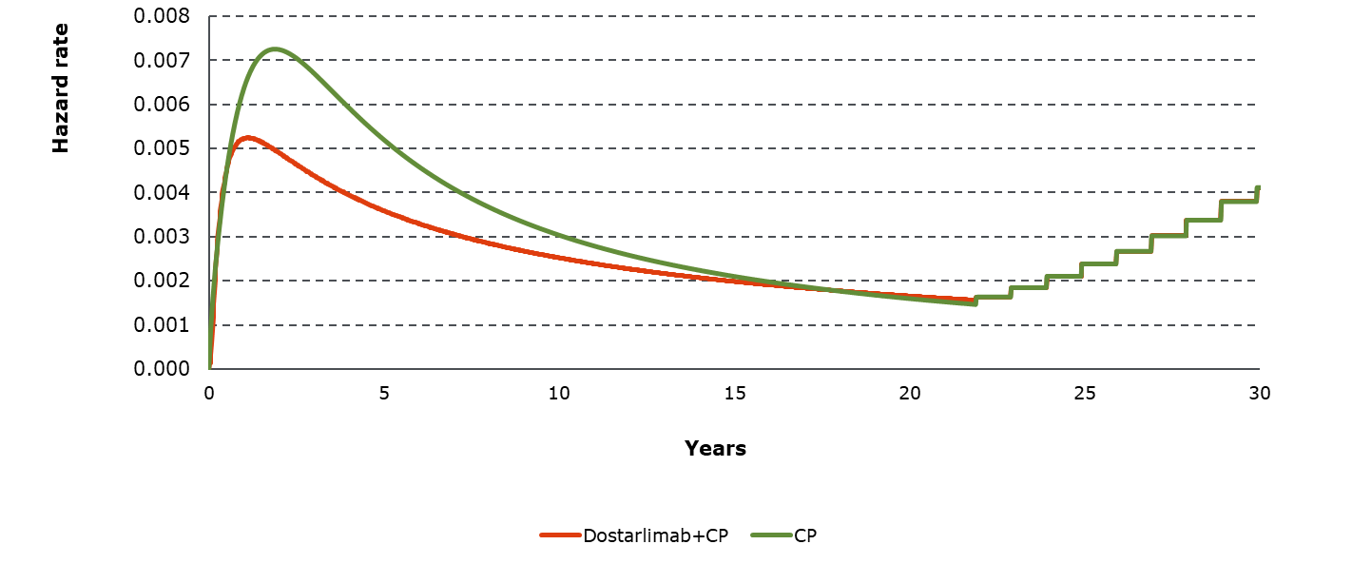
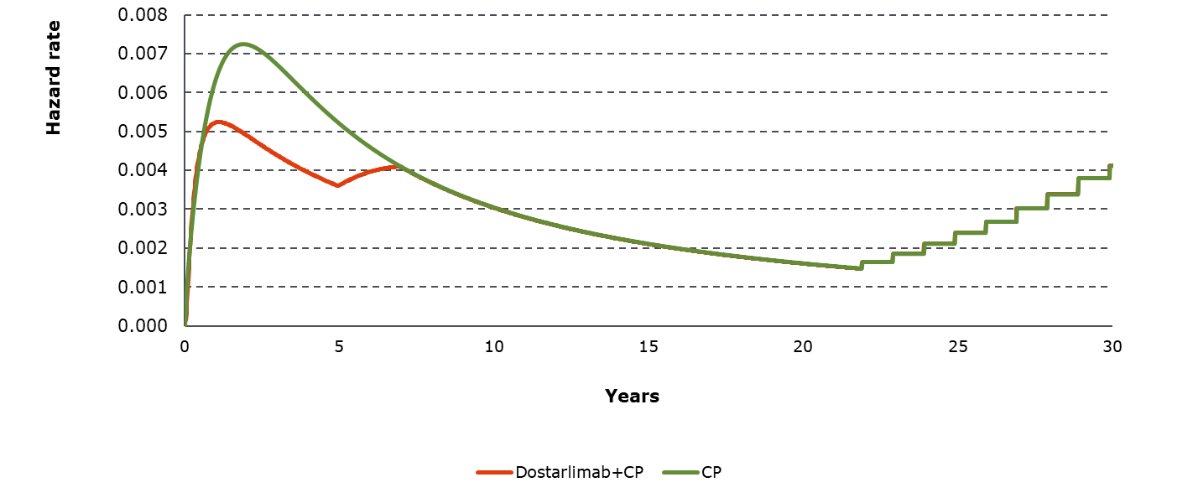
Company base case OS curves ± treatment-effect waning
OS KM and extrapolated curves
OS KM and extrapolated curves with waning (5-7 years)
Hazard rate plot over time using extrapolated OS curves
Hazard rate plot over time with waning (5-7 years)
*Link to Treatment-effect waning
Notes:
Source: EAR, Figures 12, 13, 14 and 15.

Slide 34
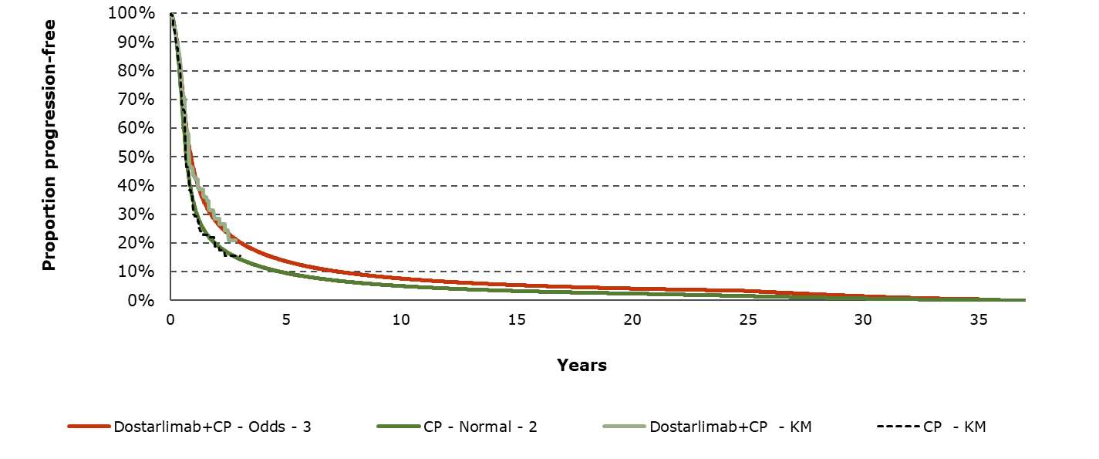
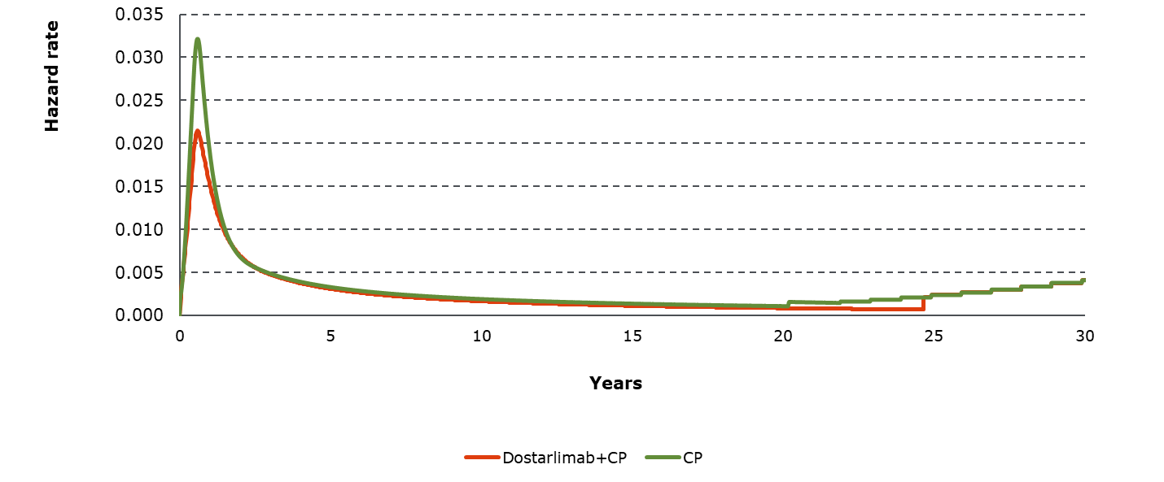
Company base case PFS curves
Company base case PFS curves for CP and Dostarlimab + CP arms
Hazard rate plot over time based on company’s base case PFS curves
EAG comments
Treatment-effect waning not considered a key issue: PFS plots demonstrate risk of progression is similar for both arms after ~2 years
*Link to Treatment-effect waning
Notes:
Source: EAR, section 4.2.3.4 and Figures 10 and 11.

