Slide 1
Dupilumab for treating moderate to severe chronic obstructive pulmonary disease [ID6235]
For public – contains redacted information
Technology appraisal committee D [1 April 2025]
Chair: Radha Todd
Lead team: Jacqueline Tomlinson, Hugo Pedder, Richard Ballerand
External assessment group: BMJ Technology Assessment Group
Technical team: Dilan Savani, Zoe Charles, Janet Robertson
Company: Sanofi
© NICE 2025. All rights reserved. Subject to Notice of rights.

Slide 2
Dupilumab for treating moderate to severe chronic obstructive pulmonary disease
Background and key issues
Clinical effectiveness
Modelling and cost effectiveness
Other considerations
Summary

Slide 3
Background on chronic obstructive pulmonary disease (COPD)
COPD is the name for a group of lung conditions that can cause breathing difficulties
Causes
Often caused by smoking although can be caused by long-term exposure to harmful fumes or dust and can also affect people who have never smoked
Epidemiology
Estimates of prevalence vary across the world, primarily due to the different definitions. In England, prevalence is approximately 4.9%
More common in men and people over the age of 40; becomes more common with increasing age
Symptoms and prognosis
Common symptoms: shortness of breath, chronic cough, sputum production, wheezing, chest tightness, exercise intolerance and episodic flare-ups of respiratory symptoms, known as exacerbations
COPD among the top 5 leading causes of death in England
Diagnosis and classification
Diagnosed using spirometry to detect persistent airflow obstruction
Severity of airflow obstruction is classified into 4 grades (1 - mild, 2 – moderate, 3 – severe, 4 - very severe), based on post-bronchodilator forced expiratory volume in the first second (FEV₁)
COPD, Chronic obstructive pulmonary disease; FEV_{1,} forced expiratory volume in the first second

Slide 4
Patient perspectives
COPD significantly impacts people’s ability to carry out everyday tasks
Submission from Asthma + Lung UK
Range of symptoms: breathlessness with significant impact on quality of life
Annual ‘Life with a Lung Condition’ 2024 survey demonstrates considerable impact of COPD on ability to: carry out family responsibilities, work, do hobbies, exercise and meet with friends
Impact on mental health → over 1 in 3 people with COPD report symptoms of anxiety and depression
Most people with COPD prescribed inhaled corticosteroid → side effects such as dry mouth, low bone density, cramps, oral infections and pneumonia
Potential advantage of dupilumab is ability to reduce inhaled corticosteroid dose, potentially leading to a reduction in adverse side effects
Unmet need to reduce rate of exacerbations and lung function decline through both pharmacological and non-pharmacological measures
“The inability to perform even basic physical functions causes me considerable stress and, at times depression. My wife is my carer and does almost everything for me.”
“The treatment that I’m on for my COPD doesn’t feel to be particularly effective and every day I struggle with breathlessness”
COPD, Chronic obstructive pulmonary disease

Slide 5
Clinical perspectives
Currently an unmet need for patients and healthcare professionals in COPD
Submissions from 2 clinical experts
Main aim of treatment: stop progression, reduce risk of moderate or severe exacerbations, minimise exposure to oral corticosteroids, reduce unscheduled care, improve quality of life and reduce risk of premature death
Clinically significant treatment response:
  Expert 1: FEV₁ to reflect natural decline, 50% reduction in oral corticosteroids (OCS), reduction of ≥2 points in COPD Assessment test score
  Expert 2: reduction of anything up to 20% reduction in risk of exacerbation
Unmet need in terms of treatments to: prevent exacerbations, treat exacerbations and improve lung function & quality of life
Current treatment pathway mostly based on NICE guidelines and GOLD Strategy. Pathway for care well defined but poorly applied and implemented
Dupilumab is innovative→ potential to be ‘truly transformative’. Different to current treatments: target specific phenotype (eosinophilic), injectable (easier to use than inhalers), lack of clear risks (in comparison with oral corticosteroids)
“Exacerbations of COPD cause a burden for COPD patients, healthcare professionals, healthcare systems and society”
“I hope biologics will not only transform outcomes in this group, but raise the standards of “basic” care by establishing what optimisation looks like”
COPD, Chronic obstructive pulmonary disease; FEV_{1,} forced expiratory volume in the first second; GOLD, Global Initiative for Chronic Obstructive Lung Disease; OCS, Oral corticosteroids

Slide 6
Equality considerations summary
See appendix for
further details
Raised by Company, clinical experts and Asthma + Lung UK
COPD disproportionately affects people of certain demographics
  Deprived areas have increased prevalence of smoking
  People from lower socioeconomic backgrounds more likely to develop COPD
  Age-standardised mortality rates due to COPD highest in the most deprived areas, and in men (especially men of Bangladeshi background)
Wide regional variation in outcomes:
  4-fold difference in mortality rate from COPD depending on geographic region
Disparities in quality of care:
  Differential prescribing of pharmacological treatments and rate of referral for COPD rehabilitation between people of different races/ethnicities, and depending on geographical location
  Higher rate of COPD exacerbations in people from lower socioeconomic backgrounds
  People from deprived areas find accessing healthcare difficult due to practicality and cost
Dupilumab can help to reduce health inequalities
  Can be provided in a “care at home” setting reducing cost of travel and obtaining healthcare for more deprived populations
  Enable better access to care and not discriminate against those from more deprived areas who tend to smoke more
COPD, Chronic obstructive pulmonary disease

Slide 7
Dupilumab (Dupixent®, Sanofi)
Marketing authorisation | Indicated in “adults as add-on maintenance treatment for uncontrolled COPD characterised by raised blood eosinophils (EOS) on a combination of an inhaled corticosteroid (ICS), a long-acting beta2- agonist (LABA), and a long-acting muscarinic antagonist (LAMA), or on a combination of a LABA and a LAMA if ICS is not appropriate” UK marketing authorisation granted September 2024
Mechanism of action | Recombinant human IgG4 monoclonal antibody that inhibits IL-4 and IL-13 signalling resulting in decrease in mediators of Type 2 inflammation
Administration | 300mg given every other week as self-administered subcutaneous injection
Price | List price per pack of 2 x 300mg pre-filled pens or pre-filled syringes: £1,264.89 List price for 12 months of treatment: £16,500 Agreed patient access scheme
COPD, Chronic obstructive pulmonary disease; EOS, Eosinophils; ICS, Inhaled corticosteroids; IgG4, Immunoglobulin G4; IL, Interleukin; LABA, Long-acting beta2- agonist; LAMA, Long-acting muscarinic antagonist

Slide 8

Treatment pathway
Proposed positioning for dupilumab is as an add-on therapy to triple therapy, or double therapy where inhaled corticosteroids is not appropriate
Initial
therapy
SABA or SAMA
No asthmatic features/ features suggesting steroid responsiveness
Limiting symptoms or exacerbations
Asthmatic features/ features suggesting steroid responsiveness
Double
therapy
LABA + LAMA
LABA + ICS
Day-to-day symptoms adversely impacting QoL
1 severe or 2 moderate exacerbations in a year
Day-to-day symptoms adversely impacting QoL, or 1 severe or 2 moderate exacerbations in a year
Triple
therapy
3 month trial:
LABA + LAMA + ICS
If no improvement:
LABA + LAMA
LABA + LAMA + ICS
LABA + LAMA + ICS
Choice of add-on therapy dependent on symptoms/clinical features of COPD –see next slide
Uncontrolled COPD
Proposed positioning
Is the treatment pathway reflective of clinical practice?
Add-on therapy
Dupilumab
Roflumilast
Azithromycin (off license)
COPD, Chronic obstructive pulmonary disease; EOS, Eosinophils; ICS, Inhaled corticosteroids; LABA, Long-acting beta2- agonist; LAMA, Long-acting muscarinic antagonist; QoL, Quality of life
Notes:
Source: adapted from CS Document B figure 11

Slide 9
Treatment pathway and comparators
Company: standard care without dupilumab is the only relevant comparator
Add on therapy | Positioning as add-on therapy | Company comments
Dupilumab | In line with licence: for uncontrolled COPD (≥1 severe exacerbation or ≥2 moderate exacerbations) characterised by raised blood EOS (≥300 cells/μL; Type 2 inflammation) | Primary comparator: standard care without dupilumab (triple inhaled therapy or double therapy where ICS is not appropriate)
Roflumilast | As per NICE TA461: for severe COPD (FEV₁<50%) with chronic bronchitis, if ≥2 exacerbations in previous 12 months | Not considered a comparator Limited overlap between target populations Very low clinical uptake Ability to conduct robust ITC limited by differences in study designs and placebo arms between relevant trials
Azithromycin | As per NG115: for non-smokers with ≥4 exacerbations per year and/or prolonged exacerbations with sputum production and/or exacerbations resulting in hospitalisation | Not considered a comparator Limited overlap between target populations Bacterial infection associated with only ~50% of acute exacerbations; use associated with antibiotic resistance Ability to conduct robust ITC limited by differences in populations and placebo arms between relevant trials
Is standard care without dupilumab the only relevant comparator?
COPD, Chronic obstructive pulmonary disease; EOS, Eosinophils; FEV_{1,} forced expiratory volume in the first second; ICS, Inhaled corticosteroids; ITC, Indirect treatment comparison

Slide 10



Key issues
Issue | ICER impact
Impact of COVID-19 on study design and results | Unknown
Minimal clinically important differences | Unknown
Reliability of ITC for comparison with roflumilast | Unknown
Long-term annual decline in FEV₁ | Small
Differences in the rate of severe exacerbations between treatment arms | Potentially large
Long-term treatment effect maintenance period of dupilumab | Moderate
Inclusion of excess mortality for severe exacerbations | Large
Use of treatment arm specific utility values | Small
FEV_{1,} forced expiratory volume in the first second; ITC, Indirect treatment comparison

Slide 11
Dupilumab for treating moderate to severe chronic obstructive pulmonary disease
Background and key issues
Clinical effectiveness
Modelling and cost effectiveness
Other considerations
Summary

Slide 12
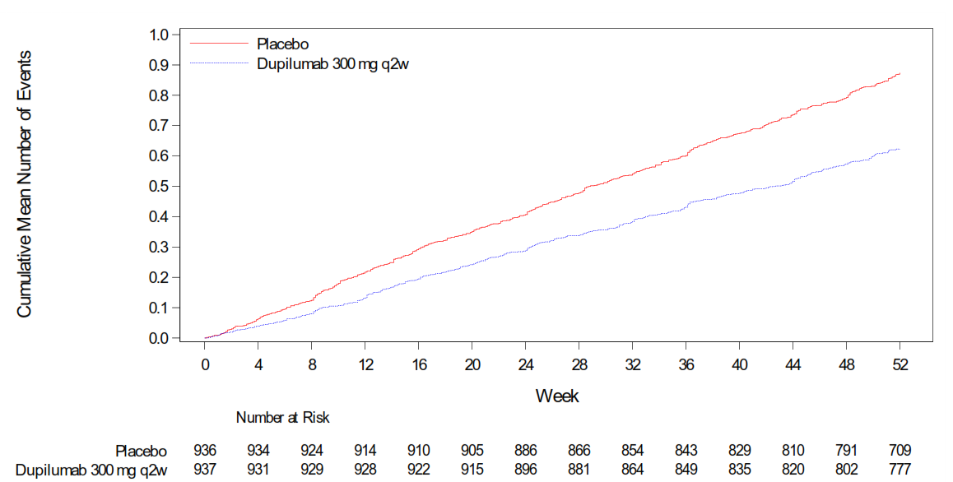
Pooled results, BOREAS and NOTUS: moderate or severe exacerbations
See appendix for
trial details
Dupilumab resulted in a statistically significantly reduction in annualised rate of moderate or severe exacerbations compared with placebo over 52 weeks
Primary endpoint: Annualised rate of moderate or severe exacerbations of COPD over the 52-week treatment period; pooled results
Pooled analysis of the cumulative mean number of moderate or severe COPD exacerbations
 | Dupilumab (95% CI) | Placebo (95% CI)
Adjusted annualised rate | 0.79 (0.69, 0.92) | 1.16 (1.01, 1.33)
Rate ratio (95% CI) | 0.69 (0.60, 0.79)
EAG: despite interim analysis used for NOTUS (21.3% did not reach 52-week assessment point), similar results reported as for BOREAS trial →pooled analysis is an accurate reflection of rate of exacerbations over 52-week treatment period
Results meet company’s threshold to indicate clinically meaningful difference between treatments – see key issue slide Effects may be modest reflecting difference of 0.37 exacerbations per patient per year or ~ 1 fewer every 3 years
COPD, Chronic obstructive pulmonary disease; CI, Confidence interval; Q2W, Every 2 weeks
Notes:
Figure source: CS document B figure 13

Slide 13
Pooled results, BOREAS and NOTUS: pre-bronchodilator FEV₁
Dupilumab resulted in statistically significantly improvements in pre-BD FEV₁ compared with placebo at both week 12 and week 52
Key secondary endpoint: week 12 change in pre-BD FEV₁; pooled results
 | Dupilumab | Placebo
Week 12 least square mean change from baseline | 147ml | 64ml
Least square mean difference (95% CI) | 83ml (53, 112)
Change in pre-BD FEV₁ smaller in NOTUS than BOREAS. But both reported significantly greater improvements with dupilumab than placebo at 12 and 52 weeks
EAG: results support use of pooled analysis despite interim analysis used for NOTUS.
Results meet part of company’s threshold to indicate clinically meaningful difference between treatments – see key issue slide
Key secondary endpoint: week 52 change in pre-BD FEV₁; pooled results
 | Dupilumab | Placebo
Week 52 least square mean change from baseline | 133ml | 59ml
Least square mean difference (95% CI) | 73ml (40, 107)
CI, Confidence interval; FEV_{1,} forced expiratory volume in the first second; Pre-BD, Pre-bronchodilator
Notes:
Company: Any statistically significant improvement in FEV1 might be considered clinically significant in the context of a disease characterised by progressive lung function decline.
UK clinical expert opinion noted that a 100 mL or more improvement in FEV would generally be considered clinically significant depending on the individual patient’s starting point – a lower FEV₁ improvement (e.g., 50 mL) might still be clinically significant for a patient who’s FEV₁ was already low

Slide 14

Key issues: Impact of COVID-19 on study design and results
Background
Key trials, BOREAS and NOTUS took place during COVID-19 pandemic
On-site visits replaced by telephone calls between weeks 16 and 62
9.0% in dupilumab group and 8.8% in placebo group experienced TEAEs associated with COVID-19
Company
Only 2.5% of total visits in the placebo arm and 2.1% of visits in the dupilumab arm were impacted (either delay or missing data) by COVID-19→ no meaningful impact on quality or quantity of trial data captured
Provided subgroup analyses for people who reported TEAEs due to COVID-19 for annualised rate of moderate or severe COPD exacerbations, pre-bronchodilator FEV₁ and SGRQ score – see appendix
EAG comments
Given relatively small proportion of visits impacted by change in methods of outcome assessment, unlikely to have had major impact on outcomes assessment
Research suggests that people with COPD had fewer exacerbations during pandemic → impact on results unclear; depends on extent to which placebo and dupilumab arms were affected
Similar results for key outcomes between subgroup who did not report COVID-19 TEAEs and overall results
Overall, precise effects of COVID-19 on trial results are unclear
What is the committee’s view on the impact of COVID-19 on outcome assessment and on trial results?
EAG, External Assessment Group; FEV_{1,} forced expiratory volume in the first second; SGRQ, Saint George's Respiratory Questionnaire; TEAE, Treatment-emergent adverse event

Slide 15
Key issues: Minimal clinically important differences
Background
Company provided minimal clinically important differences (MCID) for 4 outcomes, 3 of which are included in the economic model (exacerbation rate, change in FEV₁, SGRQ)
Company
COPD exacerbation rate: any statistically significant reduction may be considered clinically meaningful due to serious consequences from exacerbations. Clinical experts noted decrease in exacerbation rate of 20 to 25% often considered clinically significant and can be anchored to SGRQ MCID of 4 points
Change in FEV₁: any statistically significant improvement in FEV₁ might be considered clinically meaningful. MCID for FEV₁ improvement in COPD of 100 mL has been proposed but not widely accepted or validated. Clinical expert opinion: 100mL generally considered clinically meaningful depending on starting point
HRQoL - change in SGRQ: improvement of ≥ 4 points widely accepted and validated. Clinical experts: 2 to 2.5 point between-group differences may be clinically relevant – see appendix for SGRQ trial results
Overall, clinical experts consider results in BOREAS and NOTUS represent clinically meaningful benefits
EAG comments
No evidence of validation for MCID thresholds for exacerbation rate or change in FEV₁
Unclear whether trial represent clinically meaningful improvements→ potential risk that cost-effectiveness results are being driven by statistically significant differences that are not clinically meaningful
Do the trial results (NOTUS and BOREAS) represent clinically meaningful improvements with dupilumab compared with placebo?
COPD, Chronic obstructive pulmonary disease; EAG, External Assessment Group; FEV_{1,} forced expiratory volume in the first second; HRQoL, Health-related quality of life; MCID, Minimal clinically important differences; SGRQ, Saint George's Respiratory Questionnaire

Slide 16
Key issues: Reliability of ITC - comparison with roflumilast
See appendix for ITC overview
Background
Roflumilast included as comparator in NICE scope
No evidence directly comparing dupilumab with roflumilast→ company conducted Bucher ITC
Company
Roflumilast not considered a relevant comparator (see slide 9)→ ITC only provided as exploratory analysis
Key differences between dupilumab and roflumilast trials including background treatments and severity
Further concerns about breaking of randomisation in the post-hoc analysis used as the source of evidence for roflumilast (Martinez et al. 2018)
Substantial limitations of ITC→ results not considered robust and should not be used to draw conclusions about the relative efficacy and safety of dupilumab versus roflumilast
EAG comments
Agrees that differences between dupilumab and roflumilast trials, and breaking of randomisation in Martinez et al. 2018 result in a high degree of uncertainty in ITC results → unsuitable for decision making
EAG’s clinical experts highlighted very limited use of roflumilast in current practice, and limited overlap between populations who would be considered for both treatments
Considers direct evidence comparing dupilumab to placebo to be most relevant for this appraisal
Is the comparison of dupilumab versus roflumilast relevant for decision-making?
If so, are the results of the ITC sufficiently robust for decision-making?
EAG, External Assessment Group; ITC, Indirect treatment comparison

Slide 17
Dupilumab for treating moderate to severe chronic obstructive pulmonary disease
Background and key issues
Clinical effectiveness
Modelling and cost effectiveness
Other considerations
Summary

Slide 18
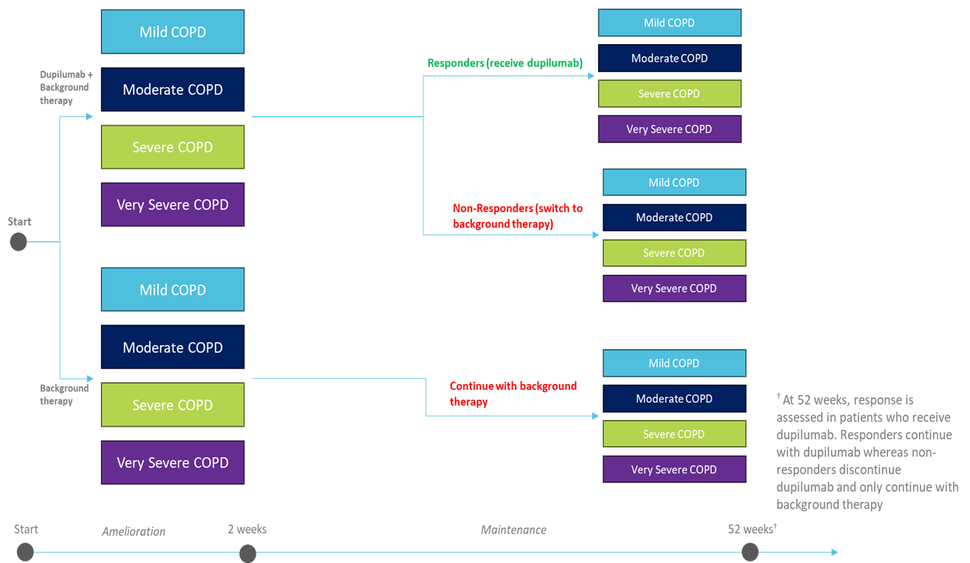
Company’s model (1)
Company produced a short-term decision-tree (52 weeks) leading to a Markov model
People are assigned to 1 of 4 health states at the end of the decision tree (based on severity of COPD):
1.GOLD stage 1: mild COPD, ppFEV₁ ≥80,
2. GOLD stage 2: moderate COPD, ppFEV₁ ≥50 and <80,
3. GOLD stage 3: severe COPD, ppFEV₁ ≥30 and <50,
4. GOLD stage 4: very severe COPD, ppFEV₁ <30.
Within COPD severity health states, people are further split based on exacerbation status (no exacerbation, moderate exacerbation and severe exacerbation) and number of exacerbations (1, 2 or ≥3)
COPD, Chronic obstructive pulmonary disease; GOLD, Global Initiative for Chronic Obstructive Lung Disease; ppFEV_{1,} percentage predicted forced expiratory volume in the first second
Notes:
Source: Company submission document B figure 24

Slide 19
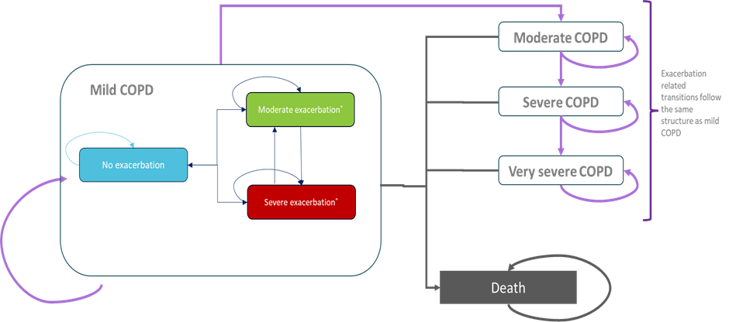
Company’s model (2)
Company produced a short-term decision-tree (52 weeks) leading to a Markov model
Lifetime time horizon and annual cycle length
Markov model health states split by both COPD severity and recent exacerbation status (none, ≥1 moderate, ≥1 severe).
12 health states plus absorbing death state
As per decision-tree, exacerbation states further split by number of exacerbations.
EAG: satisfied that model structure captures main features of COPD but limitations with annual cycle length
COPD, Chronic obstructive pulmonary disease; EAG, External Assessment Group
Notes:
Source: Company submission document B figure 25

Slide 20
Key Issue: Long-term annual decline in FEV₁
Background
To estimate transition probabilities between COPD severity health states, company used estimates of long-term decline in FEV₁ from Fenwick et al. 2021 (separate estimates based on recent exacerbation or not)
Company
Estimates of long-term decline in FEV₁ from Fenwick et al. not specifically based on population with EOS≥300 (BOREAS and NOTUS recruited people with EOS ≥300 cells/μL at screening)
Multiplier of 1.52 from CanCOLD study (COPD subgroup data comparing annual rate of decline based on EOS count) applied to FEV₁ decline to obtain increased rates of annual decline for people with EOS≥300
Results in annual decline in FEV₁ of 62.17ml (40.9 ml unadjusted) for people with no exacerbations and 108.68 ml (71.5 ml unadjusted) for people with a recent exacerbation
EAG comments
Estimates from Fenwick et al. based on people receiving dual background therapy→ may result in overestimate of rate of decline compared to people receiving triple background therapy
Further concerns with applicability of multiplier – see appendix. Applying multiplier may further overestimate rate of annual decline
Prefers to inform transition probabilities between COPD severity states based on Fenwick et al., without multiplier→ small impact on ICER
Does the committee prefer to inform transition probabilities between COPD states based on Fenwick et al. with or without a multiplier?
COPD, Chronic obstructive pulmonary disease; EAG, External Assessment Group; EOS, Eosinophil; FEV_{1,} forced expiratory volume in the first second; ICER, Incremental cost-effectiveness ratio

Slide 21
Key issue: Differences in the rate of severe exacerbations between treatment arms (1)
CONFIDENTIAL
Background
Primary trial outcome was annualised rate of moderate or severe exacerbations (combined)
Company modelled dupilumab treatment effect for exacerbations based on rate ratio of annual exacerbations in each treatment arm from pooled trials (different rate ratios applied for moderate and severe exacerbations)
Rate ratio for exacerbation by GOLD severity of dupilumab + background therapy vs. background therapy (ITT population)
GOLD severity | Dupilumab + background therapy vs background therapy alone
 | All Patients |  | Responders
 | Moderate Exacerbation | Severe Exacerbation | Moderate Exacerbation | Severe Exacerbation
Mild | xxx | xxx | xxx | xxx
Moderate | xxx | xxx | xxx | xxx
Severe | xxx | xxx | xxx | xxx
Very Severe | xxx | xxx | xxx | xxx
Company
Although no statistically significant difference in severe exacerbations between 2 treatment arms in 52-week trial period, appropriate to model different rate of severe exacerbations (based on rate ratio from trials)
Studies were not powered to measure differences in rate of severe exacerbations, and rate of severe exacerbations in trials lower than might be expected in clinical practice
Statistically significant differences between treatment arms in time to first severe exacerbation and adjusted annualised severe exacerbation rate
Clinical experts indicated that mechanism for moderate and severe exacerbations is broadly similar→ rate reduction would be expected to be similar
GOLD, Global Initiative for Chronic Obstructive Lung Disease; ITT, Intention-to-treat
Notes:
Source: Company submission doc B, table 42

Slide 22
Key issue: Differences in the rate of severe exacerbations between treatment arms
EAG comments
90% of exacerbations experienced were moderate
Company previously stated that trials were not a priori powered to detect a significant difference in severe exacerbations→ EAG assumes analysis for time to first severe exacerbation and adjusted annualised severe exacerbation rate are post-hoc assessments
Acknowledges limitations associated with small number of severe exacerbations observed in trial setting but still considers magnitude of reduction in severe exacerbations to be uncertain
Provides illustrative scenario analyses highlighting impact on ICER of 1) removing treatment effect for severe exacerbations - EAG agrees this is not appropriate; 2) halving treatment effect for severe exacerbations
Differences in rate of severe exacerbations are a key driver of ICER, due to the impact on costs, quality of life and mortality
Same assumption as per company base case applied in EAG base case but considered uncertain
What is the committee’s preferred assumption for the rate of severe exacerbations?
EAG, External Assessment Group; FEV_{1,} forced expiratory volume in the first second; ICER, Incremental cost-effectiveness ratio

Slide 23
Key issue: Long-term treatment effect maintenance period of dupilumab (1)
Background
People in dupilumab arms of BOREAS and NOTUS stopped treatment at end of 52-week trial period→ no long-term data available to observe long-term changes in FEV₁
Company’s base case assumes a treatment effect maintenance period for dupilumab of 3 years, during which annual FEV₁ does not decline
Representation of treatment effect for FEV₁ applied in the economic model
Company
3-year assumption based on TRAVERSE study from people with moderate/severe asthma receiving dupilumab → improvements in pre-BD FEV₁ maintained during 52-week trial period and 96-week follow-up (148 weeks total)
Mechanism of action of dupilumab same in asthma as in COPD
Dupilumab
FEV₁
Background therapy only
Time
trial period (52 weeks)
Maintenance (2 years)
Post-trial period (based on natural history FEV1 decline)
COPD, Chronic obstructive pulmonary disease; FEV_{1,} forced expiratory volume in the first second; Pre-BD, Pre-bronchodilator
Notes:
Source: EAG report figure 11

Slide 24
Key issue: Long-term treatment effect maintenance period of dupilumab (2)
Company
Conducted reweighted analysis of subgroup in TRAVERSE study matched to people in pooled BOREAS and NOTUS studies based on age and pre-BD FEV₁ → results suggest rate of lung function decline from TRAVERSE applicable to population in BOREAS and NOTUS
Structured expert elicitation with 7 experts suggested expected time until decline in FEV₁ may begin would be 3.04 months for background therapy alone and 6.6 months for dupilumab→ company rounded to 1 year for dupilumab due to annual cycle length and applied in a scenario analysis
EAG comments
EAG’s clinical experts: reasonable to apply a maintenance period for treatment effect but difficult to estimate exact period of time
Clinical experts also stated using asthma data may be reasonable but people with COPD would be older with more comorbidities and may expect to decline more quickly
Other possible treatment effect modifiers such as comorbidities not adjusted for in company’s reweighted analysis
Due to lack of alternative data, EAG agrees with use of the asthma trial data in base case but considers this to be optimistic and highly uncertain
Alternative scenarios using shorter treatment effect maintenance period explored
What is the committee’s preferred approach for modelling the long-term treatment effect for dupilumab?
COPD, Chronic obstructive pulmonary disease; EAG, External Assessment Group; FEV_{1,} forced expiratory volume in the first second; MAIC, Matching-adjusted indirect comparison; Pre-BD, Pre-bronchodilator

Slide 25
Key issue: Inclusion of excess mortality for severe exacerbations (1)
Background
In model, excess mortality associated with each COPD severity stage applied via standardised mortality ratio (SMR), sourced from Whittaker et al. 2024, applied to general population mortality. This study estimated all-cause mortality hazard ratios associated with COPD severity based on a UK dataset
Company
COPD mortality is associated with both COPD stage and exacerbations→ to account for increased risk of mortality due to exacerbations, separate case fatality rate (CFR) of 15.6% is applied per severe exacerbation
Acknowledged SMRs from Whittaker et al. 2024 may already include exacerbation risk but CFR appropriate:
  SMRs calculated by Whittaker et al. 2024 based on standard care treatment (dual and triple therapy only; not dupilumab). SMRs are not fully applicable to the dupilumab treatment arm, which would be expected to reduce mortality through reduced exacerbation rates
  CFR required to account for benefit of decrease in moderate and severe exacerbations due to dupilumab
  Two-thirds of Whittaker et al. 2024 population had no prior exacerbations→ risk of mortality may be lower in this population
Provided scenario with no CFR in which separate SMRs for each COPD severity health state were applied by treatment arm. For dupilumab arm, SMR multiplied by 0.72 (based on mortality hazard ratio of dual vs triple therapy from IMPACT trial (used as proxy for improvement in mortality due to dupilumab)
Also provided scenario with no CFR using mortality incidence rate ratio based on baseline frequency and severity of exacerbations from Whittaker et al. 2022 (to account for increased mortality risk from exacerbations)
COPD, Chronic obstructive pulmonary disease; CFR, Case fatality rate; IRR, Incidence rate ratio; SMR, standardised mortality ratio

Slide 26
Key issue: Inclusion of excess mortality for severe exacerbations (2)
EAG comments
Whittaker et al. 2024 regression controlled for recent exacerbations → applying separate CFR double counts impact of exacerbations on mortality
Whittaker et al. 2024 found that for people with poorer lung function, there was an increased risk of death within 30 days of an exacerbation→ increased risk of death due to exacerbations may already be captured
Source used for CFR inappropriate→ based on a meta-analysis of 6 non-UK based studies which are considered relatively out of date (latest study used data collected between 2000 to 2005)
Clinical experts stated they expect additional risk of mortality associated with severe exacerbations, but unsure if 15.6% was appropriate. 1 clinician noted 15.6% seemed higher than expected
No robust evidence to justify company’s alternative approach in scenario using treatment arm-specific SMRs:
  extent to which dupilumab may reduce mortality uncertain as dupilumab trials not powered to detect this
  applicability of the data from the IMPACT trial to adjust the SMRs also uncertain→ trial was not powered to examine the influence of triple therapy on mortality.
EAG does not apply the CFR in its base case (largest driver of ICER) but acknowledges this may underestimate the impact of severe exacerbations on mortality
Presents scenario using excess mortality for exacerbations from Whittaker et al. 2022 (used in model for incidence rate ratio of exacerbations) as prefers to use consistent data source with other model inputs.
Does the committee consider it appropriate to apply a separate mortality impact for severe exacerbations?
If so, what is the committee’s preferred approach to model this?
CFR, Case fatality rate; EAG, External Assessment Group; ICER, Incremental cost-effectiveness ratio; SMR, standardised mortality ratio

Slide 27
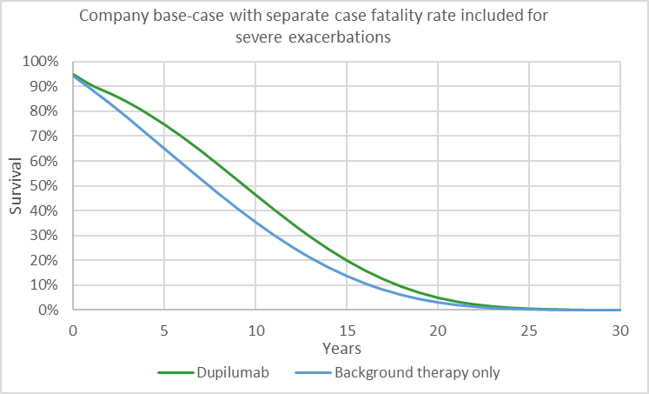
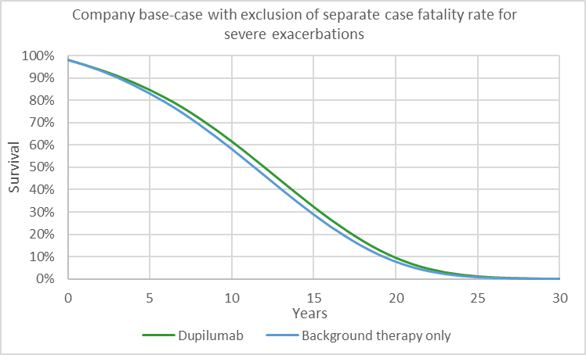
Difference in survival using alternative approaches to excess mortality
Modelled survival with and without separate case fatality rate
 | Separate case fatality rate applied |  | No separate case fatality rate applied
Year | Dupilumab | Background therapy only | Dupilumab | Background therapy only
5 | 75% | 65% | 85% | 83%
10 | 46% | 35% | 62% | 58%
15 | 20% | 14% | 32% | 29%
Diagrams depict difference in survival, estimated from company’s base case model, using different approaches to modelling impact of mortality from severe exacerbations.
EAG: considers substantially improved survival when separate CFR is applied to be inconsistent with observed trial data, where there is no statistically significant difference in severe exacerbations or survival.
Due to combination with other model assumptions, namely differences in utility values and resulting incremental QALYs, mortality modelling assumptions used in EAG’s base-case analysis have a greater impact on ICER than in company’s analysis.
CFR, Case fatality rate; EAG, External Assessment Group; ICER, Incremental cost-effectiveness ratio; QALY, Quality-adjusted life year
Notes:
Source: extracted from CEM

Slide 28
Key issue: Use of treatment arm specific utility values
Background
Health-related quality of life data in NOTUS and BOREAS collected using both SGRQ and EQ-5D-5L
Company
Low collection timepoints of EQ-5D-5L so company developed a mapping algorithm using data from visits where both SGRQ and EQ-5D-5L were collected to obtain EQ-5D utilities (cross-walked to EQ-5D-3L)
Utility regression model included a range of covariates – see appendix
Base case includes treatment arm specific utility values for each COPD severity health state
EAG comments
Linear regression for utilities showed that only SGRQ at baseline, severity of airflow obstruction, and exacerbation risk were statistically significant
Coefficient for treatment group and interaction terms between treatment & severity of airflow obstruction groups were not statistically significant
Lack of evidence of a separate treatment-related benefit to justify using treatment arm specific utilities
Prefers using utilities derived from utility regression model which includes only statistically significant covariates- see appendix → small impact on ICER
Does the committee prefer using treatment arm specific utility values or utility values independent of treatment arm?
COPD, Chronic obstructive pulmonary disease; EAG, External Assessment Group; ICER, Incremental cost-effectiveness ratio; SGRQ, Saint George's Respiratory Questionnaire

Slide 29
Summary of company and EAG base case assumptions
Assumptions in company and EAG base case
Assumption | Company base case | EAG base case
Long term decline in FEV₁ used to inform transition probabilities | Multiplier applied to Fenwick et al. FEV₁ decline | No multiplier applied to Fenwick et al. FEV₁ decline
Rate of severe exacerbations in dupilumab arm | Dupilumab treatment effect based on rate ratio of annual severe exacerbations from dupilumab trials | Dupilumab treatment effect based on rate ratio of annual severe exacerbations from dupilumab trials
Dupilumab treatment effect maintenance | Assumed treatment effect maintained for 3 years | Assumed treatment effect maintained for 3 years
Inclusion of excess mortality for severe exacerbations | Separate case fatality rate applied per severe exacerbation | No separate case fatality rate per severe exacerbation
Utility values | Treatment arm-specific utility values | Utility values independent of treatment arm
EAG, External Assessment Group; FEV_{1,} forced expiratory volume in the first second

Slide 30
Additional changes for EAG base case
Assumptions in company and EAG base case
Assumption | Company base case | EAG base case
Baseline distribution of COPD severity state at start of Markov model* | Informed by ITT trial data at end of treatment period | Informed by the distribution at trial baseline for background therapy only, with trial treatment effect applied to inform dupilumab distribution
Non-fatal cardiovascular event rates* | Different rates between treatment arms | No difference in rates between treatment arms
Cardiovascular event disutilities source* | Sterne et al. 2017 | Ara and Brazier. 2010
% requiring nurse home visit to administer dupilumab* | 0% | 5%
Follow-up appointment after severe exacerbation* | 18% within 30 days 37% within 90 days | 37% within 90 days
* not included as key issues due to less significant impact on results. See appendix for further details
COPD, Chronic obstructive pulmonary disease; EAG, External Assessment Group; FEV_{1,} forced expiratory volume in the first second; ITT, Intention-to-treat

Slide 31
Company base case results – post clarification
CONFIDENTIAL
See appendix for scenario analysis
Deterministic incremental base case results
Technology | Total costs (£) | Total QALYs | Incremental costs (£) | Incremental QALYs | ICER (£/QALY)
Background Therapy | xxxxxx | xxxx | - | - | -
Dupilumab + Background Therapy | xxxxxx | xxxx | xxxxx | xxxx | 25,515
Probabilistic incremental base case results
Technology | Total costs (£) | Total QALYs | Incremental costs (£) | Incremental QALYs | ICER (£/QALY)
Background Therapy | xxxxxx | xxxx | - | -
Dupilumab + Background Therapy | xxxxxx | xxxx | xxxxx | xxxx | 23,624
ICER, Incremental cost-effectiveness ratio; QALY, Quality-adjusted life year

Slide 32
EAG base case results
CONFIDENTIAL
Deterministic incremental base case results
Technology | Total costs (£) | Total QALYs | Incremental costs (£) | Incremental QALYs | ICER (£/QALY)
Background Therapy | xxxxxx | xxxx | - | - | -
Dupilumab + Background Therapy | xxxxxx | xxxx | xxxxx | xxxx | £68,832
Probabilistic incremental base case results
Technology | Total costs (£) | Total QALYs | Incremental costs (£) | Incremental QALYs | ICER (£/QALY)
Background Therapy | xxxxxx | xxxx | - | - | -
Dupilumab + Background Therapy | xxxxxx | xxxx | xxxxx | xxxx | £73,154
ICER, Incremental cost-effectiveness ratio; QALY, Quality-adjusted life year

Slide 33
EAG preferred assumptions applied to company base case
CONFIDENTIAL
See appendix for scenario analysis
EAG’s preferred model assumptions, cumulative ICER (probabilistic)
Preferred assumption | Cumulative inc. costs | Cumulative inc. QALYs | Cumulative ICER (£/QALY)
Company base case post clarification | xxxxxxx | xxxx | £23,624
Removal of FEV₁ trial effects | xxxxxxx | xxxx | £23,597
Key issue: COPD severity transition probabilities based on Fenwick et al. with no further multiplier applied | xxxxxxx | xxxx | £24,896
No difference in event rates in non-fatal CV events between treatment arms | xxxxxxx | xxxx | £24,816
Key issue: Utilities - mapping of SGRQ to EQ-5D-3L, analysis excluding non-significant covariates. | xxxxxxx | xxxx | £26,504
CV event disutilities using Ara and Brazier 2010 | xxxxxxx | xxxx | £26,129
Dupilumab administration support via nurse home visit (5%) | xxxxxxx | xxxx | £26,353
37% of severe exacerbation patients followed up after 90 days only | xxxxxxx | xxxx | £26,382
Key issue: No excess mortality due to severe exacerbations | xxxxxxx | xxxx | £73,154
EAG preferred base case | xxxxxxx | xxxx | £73,154
COPD, Chronic obstructive pulmonary disease; CV, cardiovascular; EAG, External Assessment Group; FEV_{1,} forced expiratory volume in the first second; ICER, Incremental cost-effectiveness ratio; QALY, Quality-adjusted life year; SGRQ, Saint George's Respiratory Questionnaire

Slide 34
Scenario analysis applied to EAG base case
CONFIDENTIAL
EAG base case results
scenario analyses (probabilistic)
Scenario (applied to company base case) | Inc. costs (£) versus background therapy | Inc. QALYs versus background therapy | ICER (£/QALY) versus background therapy
EAG base case | xxxxxx | xxxx | 73,154
FEV₁ treatment effect duration - dupilumab treatment effect maintenance period equal to one year | xxxxxx | xxxx | 137,497
FEV₁ treatment effect duration - dupilumab treatment effect maintenance period equal to two years | xxxxxx | xxxx | 94,424
Excess mortality due to exacerbation - Whittaker et al. 2022 | xxxxxx | xxxx | 41,919
Excess mortality due to severe exacerbations - NACAP report (6.1%) | xxxxxx | xxxx | 38,403
No difference in severe exacerbations between treatment arms | xxxxxx | xxxx | 101,763
Treatment benefit of dupilumab on severe exacerbations is halved* | xxxxxx | xxxx | 81,425
Utilities - TA461 (roflumilast) committee preference utility values for COPD health state and exacerbation disutility | xxxxxx | xxxx | 52,715
*due to arbitrary nature of scenario, results presented are only available deterministically
EAG, External Assessment Group; FEV_{1,} forced expiratory volume in the first second; ICER, Incremental cost-effectiveness ratio; NACAP, National Asthma and COPD Audit Programme; QALY, Quality-adjusted life year; TA, Technology appraisal
Notes:
Scenarios from EAG report table 49; scenarios presented based on key issues
Note hat due to the smaller incremental QALYs in the EAG base-case analysis, the treatment effect maintenance period scenario and excess mortality scenario using Whittaker 2022 have a much greater impact on the EAG base-case ICER compared to the company base case ICER

Slide 35
Dupilumab for treating moderate to severe chronic obstructive pulmonary disease
Background and key issues
Clinical effectiveness
Modelling and cost effectiveness
Other considerations
Summary

Slide 36
Potential uncaptured benefits
Benefits not captured in QALY calculation, as per company submission:
Winter pressures on NHS
  People with COPD can be significantly affected by cold weather and experience more breathlessness and coughing than usual
  Dupilumab has potential to relieve some of this healthcare system pressure through a reduction in symptoms and inpatient admissions for exacerbations
Holistic impact of dupilumab on symptoms
  Dupilumab associated with greater reduction in E-RS: COPD instrument (patient-reported outcome) in BOREAS and NOTUS trial compared with background therapy alone
  No mapping algorithm available to convert E-RS: COPD scores to EQ-5D→ benefit may not have been fully captured by the model in the same way as the SGRQ outcomes
Environmental impact
  Implementation of dupilumab for the treatment of COPD may be carbon neutral or carbon saving through reductions in healthcare resource use because of improved outcomes→ in particular, reduced hospitalisations
COPD, Chronic obstructive pulmonary disease; E-RS, Evaluating Respiratory Symptoms in COPD; SGRQ, SGRQ, Saint George's Respiratory Questionnaire; QALY, Quality-adjusted life year

Slide 37
Dupilumab for treating moderate to severe chronic obstructive pulmonary disease
Background and key issues
Clinical effectiveness
Modelling and cost effectiveness
Other considerations
Summary

Slide 38
Key committee questions
Parameter | Key Committee Questions
Comparators & Indirect treatment comparison | Is standard care without dupilumab the only relevant comparator? If so, are the results of the ITC sufficiently robust for decision-making?
Impact of COVID-19 | What is the committee’s view on the impact of COVID-19 on outcome assessment and on trial results?
Minimal clinically important differences | Do the trial results (NOTUS and BOREAS) represent clinically meaningful improvements with dupilumab compared with placebo?
Long-term annual decline in FEV₁ | Does the committee prefer to inform transition probabilities between COPD states based on Fenwick et al. with or without a multiplier?
Rate of severe exacerbations | What is the committee’s preferred assumption for the rate of severe exacerbations?
Long-term treatment effect maintenance | What is the committee’s preferred approach for modelling the long-term treatment effect for dupilumab?
Excess mortality for severe exacerbations | Does the committee consider it appropriate to apply a separate mortality impact for severe exacerbations? If so, what is the committee’s preferred approach to model this?
Utilities | Does the committee prefer using treatment arm specific utility values or utility values independent of treatment arm?

Slide 39
Key issues
Issue | ICER impact | Slide number
Impact of COVID-19 on study design and results | Unknown | 14
Minimal clinically important differences | Unknown | 15
Reliability of ITC for comparison with roflumilast | Unknown | 16
Long-term annual decline in FEV₁ | Small | 20
Differences in the rate of severe exacerbations between treatment arms | Potentially Large | 21,22
Long-term treatment effect maintenance period of dupilumab | Moderate | 23,24
Inclusion of excess mortality for severe exacerbations | Large | 25,26,27
Use of treatment arm specific utility values | Small | 28
FEV_{1,} forced expiratory volume in the first second; ICER, Incremental cost-effectiveness ratio; ITC, Indirect treatment comparison

Slide 40
Dupilumab for treating moderate to severe chronic obstructive pulmonary disease
Supplementary appendix

Slide 41
Equality considerations
Equality consideration summary
Raised by Company and Asthma + Lung UK
COPD disproportionately affects people of certain demographics
  People from the poorest 10% of households 1.7 to >2.5 times more likely to develop COPD than people from the most affluent 10% of households
  Age-standardised mortality rates due to COPD highest in the most deprived areas among people who had never worked or were in long term unemployment, and men of Bangladeshi background
  Age-standardised mortality rates due to COPD consistently higher in men
Wide regional variation in outcomes:
  Mortality rate from COPD ranged from 27.4 to 108.8 per 100,000 population depending on region
  Worst outcomes in the North and Northeast of England
Disparities in quality of care:
  Black people less likely to be prescribed SABAs, SAMAs, LAMAs and ICS + LABA than white people (2011 audit)
  People with South Asian heritage less likely to receive LAMAs than white people (2011 audit)
  Black and South Asian people less likely to be referred for COPD pulmonary rehabilitation than white people (2011 audit)
  Ethnic minorities underrepresented in populations diagnosed and treated for COPD
  Prescribing of oral corticosteroids 50% higher in people from most deprived areas
  Significant geographic variation in access to pulmonary rehabilitation across England, with substantially lower provision in North-West than South-East
  People from lower socioeconomic backgrounds have more COPD exacerbations
  People from deprived areas find accessing healthcare difficult both practically and as related to cost
COPD, Chronic obstructive pulmonary disease; ICS, Inhaled corticosteroids; LABA, Long-acting beta2- agonist; LAMA, Long-acting muscarinic antagonist

Slide 42
Key clinical trials
Key evidence for dupilumab came from 2 randomised-controlled trials, BOREAS and NOTUS
 | BOREAS | NOTUS
Design | Phase 3, placebo-controlled, double-blind, randomised multicentre, international trial
Population | People aged 40 to 80 with moderate-to-severe uncontrolled COPD* with evidence of Type 2 inflammation (blood EOS ≥300 cells/μL) | As per BOREAS but with people aged 40 to 85 years
Intervention | Dupilumab subcutaneous 300 mg every 2 weeks + background therapy
Comparator(s) | Placebo every 2 weeks + background therapy
Duration | 52-week study treatment period + 12-week post-treatment period NOTUS modified to include interim analysis (21.3% did not reach 52-week assessment point)
Primary outcome | Annualised rate of moderate or severe COPD exacerbations over 52-week treatment period
Key secondary outcomes | Change from baseline to week 12 and week 52 in FEV1; Change from baseline to week 52 in SGRQ total score and proportion with improvement of ≥4 points in SGRQ score
Locations | 275 sites in 24 countries | 329 sites in 29 countries
Used in model? | Yes: FEV₁, exacerbation rate, SGRQ
* ≥2 moderate or ≥1 severe historical exacerbations within 12 months on LABA + LAMA + ICS (or LABA + LAMA if ICS is not appropriate)
COPD, Chronic obstructive pulmonary disease; EOS, Eosinophil; FEV_{1,} forced expiratory volume in the first second; ICS, Inhaled corticosteroids; LABA, Long-acting beta2- agonist; LAMA, Long-acting muscarinic antagonist; SGRQ, Saint George's Respiratory Questionnaire
Notes:
Moderate exacerbations defined as exacerbations requiring systemic glucocorticoid treatment and/or antibiotic treatment.
Severe exacerbations defined as those requiring hospitalisation or emergency department visit, or resulting in death

Slide 43
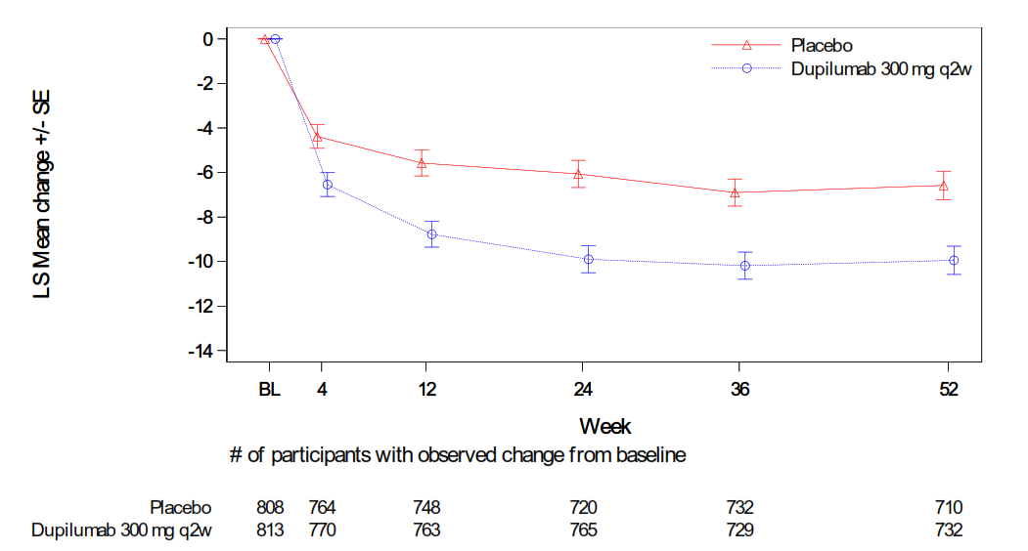
Pooled results, BOREAS and NOTUS: Saint George’s Respiratory Questionnaire
Pooled analysis LS mean change from baseline in SGRQ total score up to Week 52; pooled results
Dupilumab resulted in a greater reduction in SGRQ total score at week 52 compared with placebo
LS mean difference: −3.4; (95% CI: −5.0; −1.8;)
EAG: Although significant, difference between treatments did not reach the threshold of 4 points for a minimal clinically important difference
% of patients with reduction in SGRQ score of ≥4 points: dupilumab 51.4%, placebo 44.6%; p=0.0089
CI, Confidence interval; EAG, EAG, External Assessment Group; LS, Least squares; Q2W, Every 2 weeks; SGRQ, Saint George's Respiratory Questionnaire
Notes:
Figure source: CS document B figure 19

Slide 44
Indirect treatment comparison overview
Key issue – Reliability of ITC
Company does not consider roflumilast a relevant comparator (see slide 9). However, provided an exploratory ITC of dupilumab vs. roflumilast
Systematic literature review identified REACT and RE2SPOND trials, for roflumilast in COPD. However, neither used blood EOS count as inclusion criterion, nor provided subgroup analyses for people with raised blood EOS
Instead, company used Martinez et al. 2018 analysis which provided a pooled post-hoc analysis of roflumilast effectiveness in people with EOS ≥300 cells/µl (in line with dupilumab target population) from the 2 trials
Company noted Martinez et al. 2018 study broke randomisation to obtain EOS ≥300 cells/µl subpopulation
To align the dupilumab trials more closely with the REACT trial, populations in the dupilumab trials were restricted by characteristics, including FEV₁, smoking status and number of prior exacerbations
Company identified key differences between the roflumilast trials (REACT and RE2SPOND) and dupilumab trials (BOREAS and NOTUS), which it was not able to robustly adjust for:
  Differences in background therapies: 42% of patients in REACT and RE2SPOND were given triple therapy, compared to 98% in BOREAS and NOTUS
  Differences in disease severity: Only patients with severe or very severe COPD were included in REACT and RE2SPOND, compared to people with moderate or severe COPD in BOREAS and NOTUS
Overall, given differences between trials, company did not think that populations in each trial were sufficiently similar to allow for a robust ITC and considers the results highly uncertain
COPD, Chronic obstructive pulmonary disease; EOS, Eosinophil; FEV_{1,} forced expiratory volume in the first second; ITC, Indirect treatment comparison

Slide 45
TEAEs associated with COVID-19 subgroup (1)
CONFIDENTIAL
Key issue – impact of COVID-19
Annualised rate of moderate or severe COPD exacerbations - Pooled ITT population with an opportunity to reach Week 52
Patients who experienced a TEAE associated with COVID-19 during the 52-week treatment period | Yes (N=166) |  | No (N=1708)
 | Placebo (N=82) | Dupilumab (N=84) | Placebo (N=854) | Dupilumab (N=854)
Number of participants with >=1 moderate or severe exacerbation event
Number | xx | xx | xxx | xxx
No | xxxxxxx | xxxxxxx | xxxxxxx | xxxxxxx
Yes | xxxxxxx | xxxxxxx | xxxxxxx | xxxxxxx
Number of moderate or severe exacerbation events - Mean (SD) | xxxxxxx | xxxxxxx | xxxxxxx | xxxxxxx
Total number of moderate or severe exacerbation events | xx | xx | xxx | xxx
Adjusted annualised moderate or severe exacerbation event rateª
Estimate (95% CI) | Xxxxxxxxxxxx xxxxx | Xxxxxxxxxxxx xxxxx | Xxxxxxxxxxxx xxxxx | Xxxxxxxxxxxx xxxxx
Relative risk vs. placebo (95% CI) |  | Xxxxxxxxxxxx xxxxx |  | Xxxxxxxxxxxx xxxxx
P-value |  | xxxx |  | xxxxx
Risk difference vs. placebo (95% CI)^{b} |  | Xxxxxxxxxxxx xxxxx |  | Xxxxxxxxxxxx xxxxx
COPD, Chronic obstructive pulmonary disease; CI, Confidence interval; ITT, Intention-to-treat; SD, Standard deviation; TEAE, Treatment-emergent adverse event
Notes:
ª Derived using negative binomial model with the total number of the events occurring during the 52-week treatment period as the response variable, and treatment group, region (pooled country), ICS dose, baseline disease severity, study and number of moderate or severe COPD exacerbation events within one year prior to the study as covariates, and log-transformed treatment duration as an offset variable.
^{b} Derived using delta method.
Source: clarification questions table 9

Slide 46
TEAEs associated with COVID-19 subgroup (2)
CONFIDENTIAL
Key issue – impact of COVID-19
Pre - bronchodilator FEV₁ - Pooled ITT population with an opportunity to reach Week 52
Patients who experienced a TEAE associated with COVID-19 with an opportunity to reach Week 52 - Pre-bronchodilator FEV₁(L) | Yes (N=164) |  | No (N=1496)
 | Placebo (N=82) | Dupilumab (N=82) | Placebo (N=748) | Dupilumab (N=748)
Baseline
Number | xx | xx | xxx | xxx
Mean (SD) | xxxxxxx | xxxxxxx | xxxxxxx | xxxxxxx
Week 52 - Change from baseline
Number | xx | xx | xx | xxx
Mean (SD) | xxxxxxxx | xxxxxxxx | xxxxxxxx | xxxxxxxx
LS Mean (SE)ª | xxxxxxxx | xxxxxxxx | xxxxxxxx | xxxxxxxx
LS Mean Diff vs. placebo (95% CI)ª |  | Xxxxxxxxxxx xxxxx |  | Xxxxxxxxxxx xxxxx
P-value vs. placebo |  | xxxxxxx |  | xxxxxxx
COPD, Chronic obstructive pulmonary disease; CI, Confidence interval; FEV_{1,} forced expiratory volume in the first second; ITT, Intention-to-treat; LS, Least squares; SD, Standard deviation; SE, Standard error; TEAE, Treatment-emergent adverse event
Notes:
ª Derived from MMRM model with change from baseline up to week 52 as the response variable and corresponding baseline value, treatment group, age, sex, height, region (pooled country), ICS dose, smoking status at screening, study, visit, baseline-by-visit interaction and treatment-by-visit interaction as covariates.
Source: clarification questions table 11

Slide 47
TEAEs associated with COVID-19 subgroup (3)
CONFIDENTIAL
Key issue – impact of COVID-19
SGRQ total score - Pooled ITT population with an opportunity to reach Week 52
Patients who experienced a TEAE associated with COVID-19 during the 52-week treatment period ­- SGRQ total score | Yes (N=164) |  | No (N=1496)
 | Placebo (N=82) | Dupilumab (N=82) | Placebo (N=748) | Dupilumab (N=748)
Baseline
Number | xx | xx | xxx | xxx
Mean (SD) | xxxxxxxxxxx | xxxxxxxxxxx | xxxxxxxxxxx | xxxxxxxxxxx
Week 52 - Change from baseline
Number | xx | xx | xxx | xxx
Mean (SD) | xxxxxxxxxx | xxxxxxxxxx | xxxxxxxxxx | xxxxxxxxxx
LS Mean (SE)ª | xxxxxxxxxx | xxxxxxxxxx | xxxxxxxxxx | xxxxxxxxxx
LS Mean Diff vs. placebo (95% CI)ª |  | Xxxxxxxxxxx xxxxx |  | Xxxxxxxxxxx xxxxx
P-value vs. placebo |  | xxxxx |  | xxxxx
COPD, Chronic obstructive pulmonary disease; CI, Confidence interval; ITT, Intention-to-treat; LS, Least squares; SD, Standard deviation; SE, Standard error; SGRQ, Saint George's Respiratory Questionnaire; TEAE, Treatment-emergent adverse event
Notes:
ª Derived from MMRM model with change from baseline up to week 52 as the response variable and corresponding baseline value, treatment group, region (pooled country), ICS dose, smoking status at screening, study, visit, baseline-by-visit interaction and treatment-by-visit interaction as covariates.
Source: clarification questions table 10

Slide 48
Efficacy and extrapolation in company base case (1)
 | Background therapy only | Dupilumab + background therapy
Baseline | COPD severity health state: distribution based on the average outcomes observed across pooled (BOREAS and NOTUS) trials for both treatment arms combined Exacerbation rate: based on pooled data from both trial arms from the year prior to trial randomisation | As per background therapy only arm
Decision-tree (Weeks 0 to 52) | COPD severity health state: distribution based on pooled ITT data from placebo arms at 2 and 52 weeks Exacerbation rate: as per baseline | COPD severity health state: distribution based on pooled ITT data from dupilumab arms at 2 and 52 weeks Exacerbation rate: treatment effect calculated from pooled trial ITT data applied to background therapy only arm
Markov model (Weeks 52+): | COPD severity health state: annual rate of FEV₁ decline from Fenwick et al. 2021 converted to annual transition probability. Multiplier (1.52) from CanCOLD study applied to account for type 2 inflammation | COPD severity health state: assumed maintained treatment effect for 2 years (three years total) then same transition probabilities as background therapy only arm applied
FEV_{1,} forced expiratory volume in the first second; ITT, Intention-to-treat

Slide 49
Efficacy and extrapolation in company base case (2)
 | Background therapy only | Dupilumab + background therapy
Markov model (Weeks 52+): | Exacerbation rate: incidence rate ratio of exacerbations from Whittaker et al. 2022 adjusted by GOLD COPD severity stage based on Wallace et al. 2019 used to calculate annual transition probabilities | Exacerbation rate: treatment effect calculated from pooled trial ITT data applied to background therapy only arm transition probabilities
COPD, Chronic obstructive pulmonary disease; GOLD, Global Initiative for Chronic Obstructive Lung Disease; ITT, Intention to treat

Slide 50
Health state utility regression model – Company base case
CONFIDENTIAL
Key issue – utility values
Pooled ITT linear regression of utility based on SGRQ (UK crosswalk tariffs, Hernandez 2020)
- Parameter estimates
Parameter | Estimate (SE) | [95% CI] | p-value
Intercept | xxxxxxxxxxxx | xxxxxxxxxxxx | xxxxxx
Treatment = Dupilumab 300mg q2w | xxxxxxxxxxxx | xxxxxxxxxxxx | xxxxxx
Study | xxxxxxxxxxxx | xxxxxxxxxxxx | xxxxxx
Age | xxxxxxxxxxxx | xxxxxxxxxxxx | xxxxxx
Gender = Male | xxxxxxxxxxxx | xxxxxxxxxxxx | xxxxxx
SGRQ-based utility at baseline | xxxxxxxxxxxx | xxxxxxxxxxxx | xxxxxx
Health State - severity of airflow obstruction
Moderate FEV₁ | xxxxxxxxxxxx | xxxxxxxxxxxx | xxxxxx
Severe FEV₁ | xxxxxxxxxxxx | xxxxxxxxxxxx | xxxxxx
Very Severe FEV₁ | xxxxxxxxxxxx | xxxxxxxxxxxx | xxxxxx
Health State - exacerbation risk
Moderate | xxxxxxxxxxxx | xxxxxxxxxxxx | xxxxxx
Severe | xxxxxxxxxxxx | xxxxxxxxxxxx | xxxxxx
Treatment x Health State - severity of airflow obstruction
Dupilumab 300mg q2w x Moderate FEV₁ | xxxxxxxxxxxx | xxxxxxxxxxxx | xxxxxx
Dupilumab 300mg q2w x Severe FEV₁ | xxxxxxxxxxxx | xxxxxxxxxxxx | xxxxxx
Dupilumab 300mg q2w x Very Severe FEV₁ | xxxxxxxxxxxx | xxxxxxxxxxxx | xxxxxx
CI, Confidence interval; FEV_{1,} forced expiratory volume in the first second; ITT, Intention-to-treat; Q2W, Every 2 weeks; SE, Standard error; SGRQ, Saint George's Respiratory Questionnaire
Notes:
Source: company submission document B, table 54

Slide 51
Health state utility regression model – EAG base case
CONFIDENTIAL
Key issue – utility values
Pooled ITT linear regression of utility based on SGRQ (UK crosswalk tariffs, Hernandez 2020) –
Parameter estimates including only statistically significant covariates
Parameter | Estimate (SE) | [95% CI] | p-value
Intercept | xxxxxxxxxxxxx | xxxxxxxxxxxxx | <0.0001
SGRQ-based utility at baseline | xxxxxxxxxxxxx | xxxxxxxxxxxxx | <0.0001
Health State - severity of airflow obstruction
Moderate FEV₁ | xxxxxxxxxxxxx | xxxxxxxxxxxxx | <0.0001
Severe FEV₁ | xxxxxxxxxxxxx | xxxxxxxxxxxxx | <0.0001
Very Severe FEV₁ | xxxxxxxxxxxxx | xxxxxxxxxxxxx | <0.0001
Health State - exacerbation risk
Moderate | xxxxxxxxxxxxx | xxxxxxxxxxxxx | <0.0001
Severe | xxxxxxxxxxxxx | xxxxxxxxxxxxx | <0.0001
CI, Confidence interval; EAG, External Assessment Group; FEV_{1,} forced expiratory volume in the first second; ITT, Intention-to-treat; Q2W, Every 2 weeks; SE, Standard error; SGRQ, Saint George's Respiratory Questionnaire
Notes:
Source: clarification questions: table 43

Slide 52
Key Issue: Long-term annual decline in FEV₁ (2)
Key issue slide main deck
EAG comments
Number of concerns about applicability of multiplier estimated from CanCOLD study:
  majority of people in study had mild COPD, which is associated with a faster FEV₁ decline than people with more advanced COPD. Study authors note how this may explain differences to previous study findings which, “… failed to demonstrate a significant relationship between blood eosinophil counts and the rate of change in FEV₁ in people with moderate-to-severe COPD who were treated with various therapies, including inhaled corticosteroids (ICS), which may have further modified this relationship".
  Only 68 of the 466 patients included in the analysis were on ICS, which is associated with a reduction in the rate decline in FEV₁ for patients with EOS≥300. As majority population of current appraisal are receiving ICS, using CanCOLD study may overestimate the decline in population of interest
  Study controlled for exacerbations (at least 2 versus 1 or fewer) in regression analysis of FEV₁ decline→ applying multiplier to people with recent exacerbations may not be appropriate.
COPD, Chronic obstructive pulmonary disease; EOS, Eosinophil; FEV_{1,} forced expiratory volume in the first second; ICS, Inhaled corticosteroids

Slide 53
Other issues
Issue | Overview
Baseline distribution of COPD severity state at start of Markov model | Company used data on baseline rate of exacerbations from year prior to randomisation to account for any underestimation of exacerbation rate experienced in clinical practice. EAG notes that FEV₁ would also be expected to be higher during a trial period than a real-world setting. EAG prefers use of a starting distribution of people in each GOLD stage that removes any ‘trial effects’ on FEV₁
Non-fatal cardiovascular event rates | Company applied a difference in non-fatal cardiovascular events between treatment arms during the trial period. EAG assumed no difference in event rates between treatment arms due to uncertainty in incidence rates.
Cardiovascular event disutilities source | Company sourced disutilities associated with each type of non-fatal cardiovascular event from Sterne et al. 2017. EAG unable to validate as Sterne et al. sourced from previous study→ prefers using values from Ara and Brazier 2010
% requiring nurse home visit | Company assumed 100% of people will be able to self-administer dupilumab. EAG assumed 5% of people will need nurse home visit due to age, frailty or other complicating factors
Follow-up appointment after severe exacerbation | Company included follow-up appointment costs for 18% of people within 30 days, and for 37% of people within 90 days. EAG notes that 18% followed up within 30 days are also included in 37% followed up at 90 days. Prefers to only apply costs to the 37%
COPD, Chronic obstructive pulmonary disease; EAG, External Assessment Group; FEV_{1,} forced expiratory volume in the first second; GOLD, Global Initiative for Chronic Obstructive Lung Disease

Slide 54
Scenario analysis applied to company base case (1)
CONFIDENTIAL
Company base case results
scenario analyses (deterministic)
Scenario (applied to company base case) | Inc. costs (£) versus background therapy | Inc. QALYs versus background therapy | ICER (£/QALY) versus background therapy
Company base case | xxxxxx | Xxxx | 25,515
FEV₁ treatment effect duration - Dupilumab + background therapy - 1 year; background therapy - 0 year | xxxxxx | Xxxx | 27,704
FEV₁ treatment effect beyond the trial - Unadjusted FEV₁ trajectory according to Fenwick | xxxxxx | Xxxx | 26,970
Utilities - Mean adjusted CFB (LS-Regression-CW-NOTUS) for COPD as well as exacerbation disutilities | xxxxxx | Xxxx | 26,100
Utilities - Spencer et al. 2005 & Sadatsafavi et al. 2019 with exacerbation disutilities from Rutten Van Molken et al. 2009 | xxxxxx | Xxxx | 26,784
Utilities - Rutten Van Molken et al. 2006 with exacerbation disutilities from Rutten Van Molken et al. 2009 | xxxxxx | Xxxx | 25,294
CFB, Change from baseline; COPD, Chronic obstructive pulmonary disease; CV, cardiovascular; CW, Crosswalk; EAG, External Assessment Group; FEV_{1,} forced expiratory volume in the first second; ICER, Incremental cost-effectiveness ratio; LS, Least squares; QALY, Quality-adjusted life year
Notes:
Scenarios from EAG report table 45 and 46; scenarios presented based on key issues

Slide 55
Scenario analysis applied to company base case (2)
CONFIDENTIAL
Company base case results
scenario analyses (deterministic)
Scenario (applied to company base case) | Inc. costs (£) versus background therapy | Inc. QALYs versus background therapy | ICER (£/QALY) versus background therapy
Company base case | xxxxxx | xxxx | 25,515
Utilities - Borg et al. 2004 with exacerbation disutilities from Rutten Van Molken et al. 2009 | xxxxxx | xxxx | 24,642
Utilities - TA461 committee preference utility values for COPD health state and exacerbation disutility | xxxxxx | xxxx | 25,113
Excess mortality due to exacerbation - Whittaker et al. 2022. | xxxxxx | xxxx | 36,449
Treatment arm specific SMRs | xxxxxx | xxxx | 35,607
Dupilumab treatment benefit on severe exacerbations halved | xxxxxx | xxxx | 36,629
COPD, Chronic obstructive pulmonary disease; ICER, Incremental cost-effectiveness ratio; QALY, Quality-adjusted life year; SMR, Standardised mortality ratio; TA, Technology appraisal
Notes:
Scenarios from EAG report table 45 and 46; scenarios presented based on key issues

