Slide 1
Teplizumab for delaying the onset of stage 3 type 1 diabetes in people 8 years and over with stage 2 type 1 diabetes [ID6259]
Confidential information redacted
Technology appraisal committee A [06 May 2025]
Chair: James Fotheringham
Lead team: Richard Ballerand, Youssof Oskrochi, Dominic Pivonka
External assessment group: Kleijnen Systematic Reviews (KSR)
Technical team: Emma McCarthy, Caron Jones, Ian Watson
Company: Sanofi
© NICE 2025. All rights reserved. Subject to Notice of rights.

Slide 2
Teplizumab for delaying the onset of stage 3 type 1 diabetes in people 8 years and over with stage 2 type 1 diabetes [ID6259]
Background and key issues
Clinical effectiveness
Modelling and cost effectiveness
Cost effectiveness results
Summary

Slide 3
Background on Type 1 diabetes
Causes and epidemiology
Chronic metabolic disorder caused by the immune system destroying cells that make insulin, leading to elevated blood glucose levels (hyperglycaemia)
9,760 new cases of T1D in 2021-2022 – the average age of diagnosis is 12 years
Diagnosis and classification
T1D can be split into 3 progressive stages depending on blood glucose levels and presence of symptoms
Stages 1 and 2 of T1D are asymptomatic, and most people are diagnosed at stage 3 (defined by overt hyperglycaemia accompanied by clinical symptoms)
  No national screening programme to identify stage 1 and 2 T1D
Symptoms and prognosis
Symptoms at stage 3 include frequent urination, excessive thirst, weight loss and tiredness
People with stage 2 T1D expected to progress to stage 3 (lifelong risk is ~100%)
  At stage 3, lifelong insulin therapy is usually needed
  Can lead to various health complications including diabetic ketoacidosis (DKA), kidney failure, blindness, foot problems, and damage to the nervous system
T1D, type 1 diabetes
Notes:
Final scope, company submission section B1.3

Slide 4
Stages of Type 1 diabetes
T1D can be split into 3 progressive stages depending on blood glucose concentration, presence of autoantibodies and presence of clinical symptoms
Stage 1
≥2 islet autoantibodies,
Normal blood glucose levels,
Pre-symptomatic
Stage 2
≥2 islet autoantibodies,
Abnormal glucose tolerance without overt hyperglycaemia,
Pre-symptomatic
Stage 3
Overt hyperglycaemia,
Clinical symptoms present,
Insulin therapy needed
Plasma glucose levels by T1D stage:
 | Stage 1 | Stage 2 | Stage 3
Fasting plasma glucose | <5.6 mmol/L | 5.6 to 6.9 mmol/L | ≥7.0 mmol/L
2-hour plasma glucose following OGTT | <7.8 mmol/L | 7.8 to 11.1 mmol/L | ≥11.1 mmol/L
T1D, type 1 diabetes; OGTT, oral glucose tolerance test
Notes:
Adapted from Fig 1 of CS (section B1.3.1)
Normal blood glucose levels 4-8 mmol/L
Autoantibodies include: glutamic acid decarboxylase (GAD), tyrosine phosphatase-like insulinoma antigen 2 (IA2), zinc transporter 8 (ZnT8) and insulin autoantibodies (IAA)

Slide 5
Patient perspectives
People feel overwhelmed by the pressures of managing T1D over a long period
Submissions from Diabetes UK and Breakthrough T1D UK
Demands of lifelong self management of T1D cause significant psychological burden on people with the condition and their carers
Difficulties with disease management can lead to significant and potentially life-threatening health complications
  Complications may already have set in at point of diagnosis – around 25% of children and young people are diagnosed when in DKA
Potential clinical benefits of teplizumab
An intervention that delays the onset of symptoms will decrease the duration of symptomatic disease and allow people to better prepare for T1D management – reducing the risk of long-term complications
  Extra benefit in people who are less able to self-manage independently (e.g. younger children with stage 2 T1D)
“For those diagnosed with diabetes as children and young people, adapting to manage the condition is particularly demanding whilst also navigating the challenges of growing up”
“People identified as having stage 2 type 1 diabetes can be given an opportunity to prepare for the many challenges that come with managing the condition, and where possible delay onset to a time when they are better placed to do so.”
T1D, type 1 diabetes; DKA, diabetic ketoacidosis
Notes:
Pre-T1D is identified via autoantibody screening. In the UK, this is currently available only in research settings
T1D requires intensive lifelong self management with regular glucose checks, carbohydrate counting and insulin administration

Slide 6
Clinical perspectives
Delaying the onset of stage 3 T1D is beneficial but no current established pathway for stage 2 disease
Submissions from British Society for Paediatric Endocrinology and Diabetes (BSPED), Royal College of General Practitioners (RCGP), United Kingdom Clinical Pharmacy Association (UKCPA), and NHS England
Unmet need - no currently approved treatments to delay onset of T1D and no pathway of care currently exists for management of stages 1 and 2 of T1D
T1D has been associated with reduced life expectancy – delaying the onset of stage 3 disease is likely to have the biggest effect on children and adolescents
If recommended, a new clinical pathway in NHS practice would need to be established that includes:
  Eligibility assessment for teplizumab (with standardised screening methods)
  Administration of teplizumab in secondary care (which could be covered in day care units or potentially partially covered in home care delivery)
  Follow up of individuals after receiving teplizumab to monitor progression (this would likely require multidisciplinary teams)
“Delaying the need for insulin provides additional years for a child or young person to live a life free of the burden of T1D treatment. This provides additional time to allow a young person to become more mature and pass through key developmental milestones.”
T1D; type 1 diabetes

Slide 7
Equality considerations
Teplizumab is being considered in within its anticipated marketing authorisation
Ethnicity
Differences in clinical outcomes and CGM between ethnicities
Clinical trials for teplizumab had mainly White populations - differences in disease progression across ethnic groups may influence treatment effectiveness
Age
Teenagers and young adults at higher risk of more severe disease and premature death from T1D versus the general population – and poor glycaemic control frequently observed in teenagers
Teplizumab could potentially be more cost effective in people under 18
Disability
Some people may may find engaging with insulin therapy difficult (e.g. people who are neurodivergent or those with learning difficulties – delaying progression may be particularly beneficial in these groups)
Deprivation
People living in more deprived areas may get greater benefit from teplizumab due to having fewer opportunities for participation in structured diabetes education and specialist diabetes services
Other issues
Potential barriers to accessing teplizumab due to lack of national screening programme – particularly in areas with limited healthcare resources
If only available to people identified through research trials, variation in access to trials may introduce inequalities (e.g. based on family history of T1D , geography, or education/knowledge of early-stage diabetes)
  First-degree relatives of people with type 1 diabetes are more likely to have been screened for pancreatic islet autoantibodies
14-day infusion course of teplizumab could cause difficulties due to cost of travel and accommodation
CGM, continuous glucose monitoring; T1D, type 1 diabetes

Slide 8

Treatment pathway
Company positions teplizumab for people already diagnosed with stage 2 T1D – but most people diagnosed at stage 3
Stage 2 type 1 diabetes:
Established clinical management following diagnosis:
monitoring blood glucose
psychosocial support
education
Not usually identified in routine practice – diagnosis mostly from research studies
Teplizumab
Key issues relating to treatment pathway:
Identification of people with stage 2 disease
Relevant population for teplizumab
Appropriate comparator for teplizumab
Stage 3 type 1 diabetes:
Stage 3 management includes:
insulin
blood glucose monitoring
carbohydrate counting
exercise
Most people with T1D diagnosed at stage 3 following symptom onset and enter treatment pathway here
Is the company’s positioning of teplizumab clinically appropriate?
T1D, type 1 diabetes

Slide 9
Teplizumab (Tzield, Sanofi)
CONFIDENTIAL
Anticipated marketing authorisation | Teplizumab is anticipated to be indicated to delay the onset of Stage 3 T1D in adult and paediatric patients aged 8 years and older with Stage 2 T1D. MHRA licence not yet granted (application submitted)
Mechanism of action | Binds to CD3, may involve deactivation of pancreatic beta-cell autoreactive T lymphocytes. Also increases regulatory T cells.
Administration | IV infusion, once daily for 14 consecutive days based on BSA: Day 1: 65 mcg/m² Day 2: 125 mcg/m² Day 3: 250 mcg/m² Day 4: 500 mcg/m² Days 5 to 14: 1,030 mcg/m²
Price | List price - ******** per 14-vial treatment course A simple patient access scheme discount applies for teplizumab

Slide 10


Key issues
Key issue | ICER impact
Identification of people with Stage 2 T1D and defining population eligible for teplizumab | Unknown
Appropriateness of established clinical management as comparator | Unknown
Recruitment and generalisability of the teplizumab TN-10 trial population | Unknown
Treatment-emergent adverse events of special interest (AESI) | Unknown
Modelling progression to Stage 3 T1D | Large
Approach to estimating decline in utility | Large
Estimation of stage 3 T1D costs | Large
T1D, type 1 diabetes

Slide 11

Key issue: Identification of people with Stage 2 T1D and defining population eligible for teplizumab (1)
Background
Population in final scope and CS = people aged 8 and over with Stage 2 T1D
People with Stage 2 T1D are asymptomatic → no screening programme in NHS practice to identify people with Stage 2 T1D (screening programmes currently only available via research trials)
Company
Costs of screening not included in cost effectiveness estimates
Eligible individuals are already confirmed as having Stage 2 T1D (i.e. have been diagnosed)
Considers inclusion of screening outside scope of evaluation → responsibility of the NSC
Evidence from BSPED shows children and young people identified with Stage 2 T1D in both the NHS (53%) and research settings (47%) (based on n=111 reported as being managed across the UK)
EAG comments
Method of identifying patients eligible for treatment could significantly impact prognosis and expected treatment effect – important to identify selection criteria for diagnostic testing
  TN-10 clinical trial identified people with Stage 2 T1D by testing relatives of people with Stage 3 T1D – but unclear if testing based on familial relationship would also be done in NHS practice
How would individuals eligible for treatment with teplizumab in the NHS be identified?
Should the population be limited to people aged 8 and over in whom Stage 2 T1D has already been detected? If so, what are the implications for decision making?
Should screening and testing for Stage 2 T1D be included in the modelling and costs for teplizumab?
CS; company submission; T1D, type 1 diabetes; BSPED, British Society for Paediatric Endocrinology and Diabetes; NSC, National Screening Committee
Notes:
Recommendation of screening programmes is the remit of the NSC
Estimates of identification of Stage 2 T1D from question A6 of clarification response

Slide 12
Key issue: Identification of people with Stage 2 T1D and defining population eligible for teplizumab (2)
EAG comments (continued)
Considers that either screening/testing for Stage 2 T1D should be included in the intervention (and appropriately costed in the economic model) or the population should be limited to people aged 8 and over in whom Stage 2 T1D has been incidentally detected
NICE technical team/manual
NICE’s health technology evaluations manual (section 4.8) -“If a diagnostic test to identify patients or establish the presence or absence of a particular biomarker is not routinely used in the NHS but is introduced to support the treatment decision for the specific technology, include the associated costs of the diagnostic in the assessments of clinical and cost effectiveness.”
  If alternative diagnostic tests to those used in clinical trials of the technology are available in NHS practice, the impact on selection of the patient population for treatment and cost effectiveness should be highlighted
Intervention in the NICE final scope is defined as teplizumab – any recommendations made would apply to teplizumab only
How would individuals eligible for treatment with teplizumab in the NHS be identified?
Should the population be limited to people aged 8 and over in whom Stage 2 T1D has already been detected? If so, what are the implications for decision making?
Should screening and testing for Stage 2 T1D be included in the modelling and costs for teplizumab?
CS; company submission; T1D, type 1 diabetes; British Society for Paediatric Endocrinology and Diabetes
Notes:
Recommendation of screening programmes is the remit of the NSC

Slide 13
Key issue: Appropriateness of established clinical management as comparator
Background
Comparator in NICE final scope and CS is established clinical management without teplizumab – but people with Stage 2 T1D are not currently routinely identified in the NHS in England
EAG comments
Considers that if a condition is not routinely identified there cannot be established clinical management in place for that condition
Appropriate comparator is no screening/testing and no management
  If screening is included with teplizumab, then with no routine screening or management, Stage 2 T1D costs in comparator arm would be 0 since eligible patients are not being identified
  If Stage 2 T1D patients are identified incidentally then costs in comparator arm would align with the cost of managing this group of patients
NHSE submission
Pathway of care for identification and treatment of stage 1 and stage 2 T1D is not yet defined
For people with Stage 2 T1D there are no education or monitoring programmes, no provision for self-assessment of blood glucose and no provision for psychosocial assessment/support
What form of clinical management is the most appropriate comparator?
CS; company submission; T1D, type 1 diabetes; NHSE, NHS England

Slide 14
Key issue: Identification of people with Stage 2 T1D and defining population eligible for teplizumab
Company approach to decision problem:
Population
Intervention and comparator
Implications for modelling
Teplizumab
No additional costs of screening
People aged 8 and over with stage 2 T1D (already diagnosed)
Established clinical management
Costs of Stage 2 T1D in comparator arm align with ECM as in NICE final scope
EAG – If intervention does not include screening/testing, population should be limited to people aged 8 and over in whom Stage 2 T1D (2 or more pancreatic islet autoantibodies and dysglycaemia) has been incidentally detected’
EAG view of decision problem if patients eligible for teplizumab are identified by screening:
Population
Intervention and comparator
Implications for modelling
Teplizumab plus screening/testing*
Screening should be modelled and costed
People aged 8 and over with Stage 2 T1D (undiagnosed population)
No screening;
ECM = no management
Cost of Stage 2 T1D in comparator arm = 0 (stage 2 T1D not identified or managed)
*EAG – Small fraction of people may still be incidentally diagnosed in line with company approach
ECM; established clinical management; T1D, type 1 diabetes
NICE final scope and decision problem
Notes:
Costs of stage 2 T1D included in comparator arm in NICE scope

Slide 15
Teplizumab for delaying the onset of stage 3 type 1 diabetes in people 8 years and over with stage 2 type 1 diabetes [ID6259]
Background and key issues
Clinical effectiveness
Modelling and cost effectiveness
Cost effectiveness results
Summary

Slide 16
Key clinical trial - TN-10
CONFIDENTIAL
Clinical trial designs and outcomes
 | TN-10 (NCT01030861)
Design | Phase 2 randomised, placebo-controlled, double-blind trial
Population | People with Stage 2 T1D (≥8 years old) who were relatives of people with Stage 3 T1D (n=76) Inclusion criteria: ≥2 diabetes-related autoantibodies detected in 2 samples from within 6 months before randomisation, evidence of dysglycaemia during an OGTT
Intervention | Teplizumab (n=44)
Comparator(s) | Placebo (n=32)
Duration | Median follow up (all participants): 745 days Primary analysis: median follow up ******* for teplizumab arm, ******* for placebo
Primary outcome | Time from randomisation to onset of Stage 3 T1D according to following criteria: Symptoms of diabetes plus casual plasma glucose concentration >200 mg/dL (11.1 mmol/l), regardless of the time since last meal FPG ≥126 mg/dL (7 mmol/l) 2-hour plasma glucose ≥200 mg/dL (11.1 mmol/l)
Key secondary outcomes | C-peptide levels (surrogate marker for beta-cell function and endogenous insulin production), insulin secretion, adverse events
Locations | USA, Canada, Australia, Germany (no UK patients)
Used in model? | Yes
T1D, type 1 diabetes; OGTT; oral glucose-tolerance test, FPG; fasting plasma glucose
Notes:
Table 6 of company submission

Slide 17
Clinical trial results – TN-10
CONFIDENTIAL
In primary and extended follow up analysis, teplizumab increases the median time to Stage 3 T1D onset compared with placebo
Outcome | Teplizumab (n=44) | Placebo (n=32)
Primary analysis (median follow up = 745 days)
Median time from randomisation to Stage 3 T1D onset, months (95% CI) | 49.5 (32.2, NE) | 24.9 (9.5, 48.6)
Median difference in between arms, months (95% CI) | 24.6 (NE, NE)
Hazard ratio (95% CI); p-value | HR 0.41 (0.22 to 0.78); p=0.0066
Extended follow up analysis (median follow up = 923 days)
Median time from randomisation to Stage 3 T1D onset, months (95% CI) | 59.6 ******* | 27.1 *******
Median difference between arms, months (95% CI) | 32.5 *******
Hazard ratio (95% CI); p-value | 0.457 (NR); p=0.01
KM curve showing delayed onset of T1D
Key secondary outcomes (C-peptide function and insulin secretion)
CI = confidence interval; HR = hazard ratio; NE = not estimable; NR = not reported; T1D = type 1 diabetes; KM, Kaplan-Meier
Notes:
Table 3.7 of EAG report

Slide 18
Key issue: Recruitment and generalisability of teplizumab
TN-10 trial population
CONFIDENTIAL
Background
Evidence for clinical effectiveness of teplizumab came from TN-10 – trial population was people aged 8 and over with Stage 2 T1D, who were relatives of people with Stage 3 T1D
  Eligible participants identified through ongoing screening and monitoring study (TN-01) who were autoantibody positive and had dysglycaemia on OGTT
EAG comments
Number of participants in TN-10 is very small relative to number of potentially eligible participants from TN-01 and process for selection remains unclear
Uncertain how representative the trial population (i.e. relatives of people with Stage 3 T1D) is of the full population of people with Stage 2 T1D
Company
Family history of T1D is not significantly associated with risk of progression
  ******* ******* ******* ******* ******* ******* ******* ******* ******* ******* ******* ******* ******* ******* ******* *******
Would there be an expected difference in treatment response between the general population and first-degree relatives of people with Stage 3 T1D?
Is the data from TN-10 suitable for decision making?
T1D, type 1 diabetes; OGTT; oral glucose-tolerance test

Slide 19
Key issue: Treatment-emergent adverse events of special interest (AESI)
CONFIDENTIAL
Company
Treatment-emergent AESIs in TN-10 were experienced by ******* * of people in the teplizumab group and ******* * in the placebo group
  No incidence of multiple AESIs in the same participant
  Treatment-emergent AESIs included: ******* ******* ******* ******* ******* ******* ******* ******* ******* ******* ******* ******* ******* ******* ******* *******
Provided additional data on treatment-emergent AESIs from an integrated safety analysis combining data from five trials (n=1,018), covering 3 dosing regimens of teplizumab
  Blood and lymphatic system disorders occurred in ******* * of people who had teplizumab vs ******* in control groups; Grade 3 neutropenia ******* ******* ******* ******* ******* ******* ******* ******* ******* ******* ******* ******* ******* ******* ******* *******
EAG comments
Potential impact of AESIs in TN-10 is unclear in relation to immunosuppressive effects of teplizumab due to small size of study
Treatment with teplizumab appears to be associated with increased risk of infection and of blood and lymphatic system disorders, in particular severe (Grade ≥3) neutropenia
Does the committee require further data on AESIs?
T1D, type 1 diabetes; AESI; adverse events of special interest; OGTT; oral glucose-tolerance test

Slide 20
Teplizumab for delaying the onset of stage 3 type 1 diabetes in people 8 years and over with stage 2 type 1 diabetes [ID6259]
Background and key issues
Clinical effectiveness
Modelling and cost effectiveness
Cost effectiveness results
Summary

Slide 21
Company’s model overview
Model focuses on outcomes in stage 2 T1D - EAG considers model structure appropriate
Model structure
Teplizumab affects QALYs by:
  Delaying onset of Stage 3 T1D (which increases QALYs)
  Slightly improving caregiver quality of life
  Slightly reducing QALYs due to treatment-related adverse events
Teplizumab affects costs by:
  Reduced costs due to delay in stage 3 T1D onset
  Increased treatment acquisition costs
  Increased costs due to treatment-related adverse events
Assumptions with greatest ICER effect:
  Choice of extrapolation to model progression to Stage 3 T1D.
  Excluding extra utility decline depending on years since onset of Stage 3 T1D and retaining the decline in utility per year resulting from the general population.
  Applying the average monthly cost of Stage 3 disease from literature as a fixed health state cost
Stage 2 T1D
Death
Stage 3 T1D
EAG comment
Company approach considers aggregated stage 3 T1D complications
Most T1D models focused on stage 3 disease but company’s approach is reasonable since main benefit of teplizumab is delaying progression
T1D, type 1 diabetes; QALY, quality adjusted life year
Notes:
Figure 5 of CS

Slide 22
How company incorporated evidence into model
Input | Assumption and evidence source
Baseline characteristics | TN-10 study population (mean age 13.6 years, 44.7% female)
Intervention and comparator efficacy | TN-10, ITT population (n=78)
Time horizon | Lifetime (maximum age 100 years)
Cycle length and discount rate | 6-month cycle length (with half cycle correction), 3.5% discount for costs & QALYs
Utilities | Stage 2 T1D utility assumed equivalent to UK general population (due to being asymptomatic). Age-specific EQ-5D-3L utilities for general population based on regression model from 2022 DSU report. Stage 3 T1D utility modelled by applying disutilities from literature to general population utility Caregiver disutility applied for individuals <18 years in the Stage 3 T1D health state (average 1.76 carers)
Resource use | Costs in teplizumab arm = acquisition and administration, concomitant medicines, tests to confirm treatment eligibility, monitoring tests, and pre-treatment medicines. Costs of ECM (CGM, HbA1c testing and support consultations) applied to both arms.
Costs | Taken from literature, BNF and National Schedule of NHS Costs. Adjusted to 2023 prices using NHSCII inflation indices
AEs included in model | Lymphopenia, leukopenia, neutropenia, blood bicarbonate decrease, rash
ITT, intention to treat; QALY, quality adjusted life year; DSU, Decision Support Unit; BNF; British National Formulary; NHSCII, NHS Cost Inflation Index; ECM, established clinical management; CGM, continuous glucose monitoring

Slide 23
Key issue: Modelling of progression to Stage 3 T1D
Company = log-normal for teplizumab, exponential for ECM, EAG = gamma for both arms
Company
Fitted different types of parametric distributions to intervention and comparator arms – log-normal distribution for teplizumab and exponential for ECM
  Chosen extrapolations for each arm had best visual and statistical fits in terms of AIC and BIC (with all other distributions producing a good or reasonable fit to data)
Company’s clinical expert - exponential distribution appropriate for ECM and matches the proportion of individuals progressing from Stage 2 to Stage 3 T1D from the Diabetes Prevention Trial–Type 1 (DPT-1) study (which included first- and second-degree relatives of people with Stage 3 T1D)
EAG comments
Proportional hazards assumption does not hold→ NICE DSU 14 recommends that “if the proportional hazards assumption does not seem appropriate it is likely to be most sensible to fit separate parametric models of the same type”
EAG prefers a gamma distribution for both treatment arms – good fit to data and long-term projections of progression to stage 3 T1D are more conservative
Exponential distribution is not appropriate for ECM arm since non-constant hazards are observed
No range of estimates for long-term progression to Stage 3 T1D provided by company
ECM; established clinical management; AIC; Akaike information criterion; BIC, Bayesian information criterion; T1D, type 1 diabetes; DSU, Decision Support Unit

Slide 24
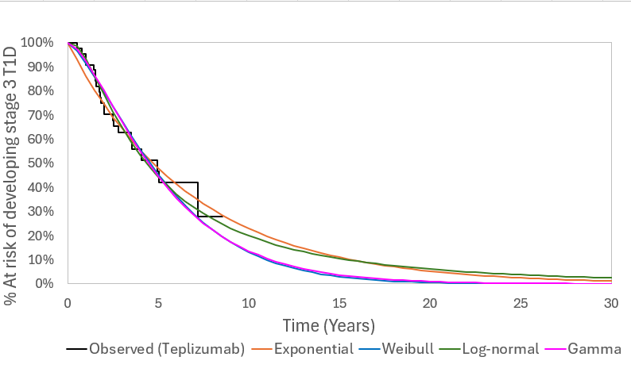
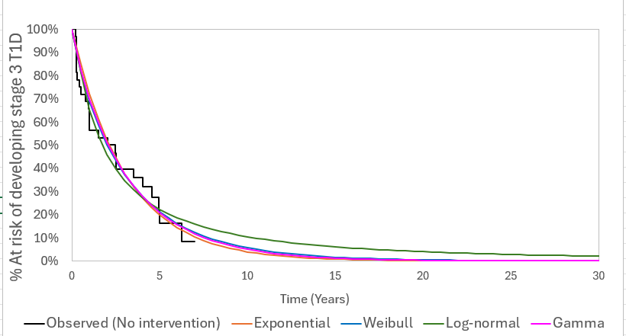
Key issue: Modelling of progression to Stage 3 T1D
CONFIDENTIAL
Company = log-normal for teplizumab, exponential for ECM, EAG = gamma for both arms
Time to Stage 3 T1D, teplizumab arm (ITT population)
Time to Stage 3 T1D, placebo arm (ITT population)
Projected proportions of people still in stage 2 T1D (teplizumab)
Projected proportions of people still in stage 2 T1D (placebo)
Time (years) | Log-normal | Gamma
0 | ******* | *******
5 | ******* | *******
10 | ******* | *******
15 | ******* | *******
Time (years) | Exponential | Gamma
0 | ******* | *******
5 | ******* | *******
10 | ******* | *******
15 | ******* | *******
Which approach to extrapolating progression to Stage 3 T1D does the committee prefer?
ECM; established clinical management; T1D, type 1 diabetes; ITT, intention to treat
Notes:
Figs 9 and 10 of EAG report
Tables 4.5 and 4.6 of EAG report

Slide 25
Key issue: Approach to estimating decline in utility
Background
Impact of Stage 3 T1D on QoL is modelled by applying 3 disutilities to age-dependent utility estimates of general population:
  Disutility of -0.025 during cycle of onset of Stage 3 T1D – to reflect patient adjustment to next stage of disease
  Disutility of -0.0621 during all cycles – to reflect impact of having symptomatic T1D vs general population and asymptomatic Stage 2 T1D
  Increasing disutility over time since onset of Stage 3 T1D – to reflect accumulating impact of T1D health complications on QoL (-0.023 at 8 years, -0.055 at 15 years, and -0.074 at 24 years since onset)
Company
Time-dependent complication-related disutility applied based on regression equation from literature
  Disutility is subtracted from age-dependent utility of general population
EAG comments
Literature from which regression is derived indicates that only time since onset of Stage 3 T1D was an explanatory variable – so age may already be counted
  EAG prefers to forgo the extra utility decline as a function of years since onset of Stage 3 T1D to avoid double counting of impact of age – age related decline in utility is accounted for by using general population utilities
EAG also prefers to remove one-off disutility on Stage 3 T1D onset – minimal impact on cost effectiveness
Should a time-dependent, complication-related disutility be included in the model for people with stage 3 T1D?
Should a one-off disutility on Stage 3 T1D onset be included in the model?
T1D; type 1 diabetes; QoL, quality of life
Notes:
Whilst the EAG considers this conceptually sound, the actual approach to estimating the time-dependent complication-related disutility appears to lead to double counting of the age-related decline in HRQoL associated to Stage 3 T1D.

Slide 26
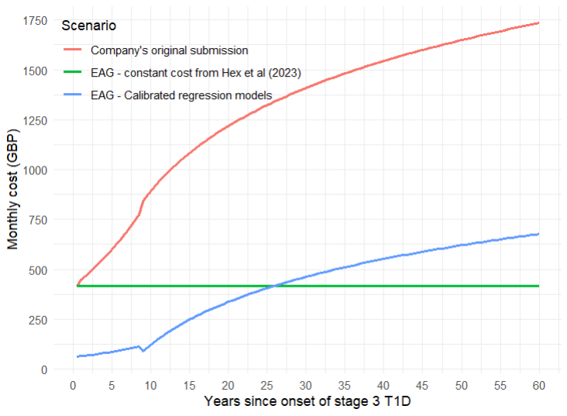
Key issue: Estimation of stage 3 T1D costs
CONFIDENTIAL
Company prefers to increase costs of stage 3 T1D over time, EAG believes this approach overestimates costs
Company
Initial cost of transitioning to Stage 3 T1D in model derived from literature on direct health costs of diabetes in the UK (Hex et al. 2024) - based on prevalent population
  Company assumes increase over time starting from £415.22
Projected costs of Stage 3 T1D estimated using piece-wise regression model based on data from literature – leads to annual cost per person of ******* over 60 years
Company versus EAG estimates of Stage 3 T1D healthcare costs
EAG comments
Company’s approach significantly overestimates costs in Stage 3 T1D - annual cost per person significantly higher than the cost in prevalent population from literature (£4,982)
EAG base case applies monthly cost of stage 3 T1D from Hex (£415.22) as a fixed value regardless of time in Stage 3 state
  Also based on prevalent population - EAG acknowledges that fixed approach overestimates costs in newly diagnosed people and underestimates costs later on
  Alternative approach – recalibration of regression models so average monthly cost over 60 years = £415.22 (but initial cost estimates not possible to validate)
How should stage 3 T1D costs be modelled?
T1D, type 1 diabetes
Notes:
Figure 4.14 of EAG report

Slide 27
Summary of company and EAG base case assumptions
Assumption | Company base case | EAG base case
Extrapolations for modelling time to progression to stage 3 T1D | Teplizumab: log-normal ECM: exponential | Teplizumab: gamma ECM: gamma
Time-dependent complication-related disutility | Included | Excluded
Costs of Stage 3 T1D | Values from literature, increasing over time | Values from literature, fixed
One-off disutility for progression to stage 3 T1D | Included | Excluded
Carer disutility (children only) | Included, based on 1.76 carers | Included, based on 1.76 carers
General population mortality* | 2020-2022 life tables | 2017-18 life tables
*Other issues with minimal impacts on cost effectiveness:
General population mortality – company highlighted that life tables based on 2020-22 data are concurrent with COVID-19 pandemic. For this reason, EAG preferred pre-pandemic life tables in revised base case
T1D, type 1 diabetes; ECM, established clinical management

Slide 28
Teplizumab for delaying the onset of stage 3 type 1 diabetes in people 8 years and over with stage 2 type 1 diabetes [ID6259]
Background and key issues
Clinical effectiveness
Modelling and cost effectiveness
Cost effectiveness results
Summary

Slide 29
Company and EAG base case results
CONFIDENTIAL
Company base case results between £20,000 and £30,000 per QALY – EAG base case significantly above £30,000 per QALY
Company deterministic incremental base case results
 | Total costs (£) | Total QALYs | Inc. costs (£) | Inc. QALYs | ICER (£/QALY)
Teplizumab | ******* | ******* | ******* | ******* | 27,534
ECM | ******* | ******* | - | -
Company probabilistic incremental base case results
 | Total costs (£) | Total QALYs | Inc. costs (£) | Inc. QALYs | ICER (£/QALY)
Teplizumab | ******* | ******* | ******* | ******* | 29,488
ECM | ******* | ******* | - | -
EAG deterministic incremental base case results
 | Total costs (£) | Total QALYs | Inc. costs (£) | Inc. QALYs | ICER (£/QALY)
Teplizumab | ******* | ******* | ******* | ******* | 165,387
ECM | ******* | ******* | - | -
EAG probabilistic incremental base case results
 | Total costs (£) | Total QALYs | Inc. costs (£) | Inc. QALYs | ICER (£/QALY)
Teplizumab | ******* | ******* | ******* | ******* | 171,788
ECM | ******* | ******* | - | -
ICER, incremental cost-effectiveness ratio; QALY, quality-adjusted life year; ECM, established clinical management
Notes:
Tables 5.4 and 5.5 of EAG report

Slide 30
Impact of EAG assumptions on company base case
CONFIDENTIAL
Applying the average monthly cost from Hex et al. and choice of extrapolation for modelling time to Stage 3 T1D onset had greatest impacts on ICER
No. | Scenario (applied to company base case) | Incremental costs (£) versus ECM | Incremental QALYs versus ECM | ICER (£/QALY) versus ECM
1 | Company base case | ******* | ******* | £27,534
2 | Time to Stage 3 T1D onset – individual fitting Gamma (both arms) | ******* | ******* | £61,078
3 | Life tables 2017-2018 | ******* | ******* | £27,368
4 | Extra utility decline depending on years since onset of Stage 3 T1D forgone | ******* | ******* | £46,208
5 | One-off disutility for progressing to Stage 3 T1D removed | ******* | ******* | £27,601
6 | Average monthly cost from Hex et al. 2024 for Stage 3 T1D | ******* | ******* | £75,114
7 | EAG base case | ******* | ******* | £165,387
Abbreviations: ICER, incremental cost-effectiveness ratio; QALY, quality-adjusted life year; T1D, type 1 diabetes; ECM, established clinical management
Notes:
Tabe

Slide 31
Impact of EAG exploratory scenarios on EAG base case
CONFIDENTIAL
 | Scenario assumption | Inc. costs (£) versus ECM | Inc. QALYs versus ECM | ICER (£/QALY) versus ECM
EAG base-case | - | ******* | ******* | 165,387
Time to Stage 3 T1D onset (individual fitting) | Exponential (both arms) | ******* | ******* | 129,385
 | Weibull (both arms) | ******* | ******* | 168,466
 | Log-normal (both arms) | ******* | ******* | 151,500
 | Log-normal (teplizumab) Exponential (ECM) | ******* | ******* | 127,392
HRQoL disutility dependent on time since Stage 3 T1D onset | Excess disutility (company base-case) | ******* | ******* | 105,358
Stage 3 T1D QoL one-off disutility at onset | Included (company base-case) | ******* | ******* | 164,814
Caregiver disutility (-0.04 in base case, 1.76 carers) | Number of caregivers = 1 | ******* | ******* | 189,851
 | Disutility = -0.02 | ******* | ******* | 194,391
Stage 3 T1D costs | Calibrated regression | ******* | ******* | 173,024
 | Initial costs from prevalent population increased over time (company base-case) | ******* | ******* | 97,118
Abbreviations: ICER, incremental cost-effectiveness ratio; QALY, quality-adjusted life year; T1D, type 1 diabetes; ECM, established clinical management; T1D, type 1 diabetes
Notes:
Tabe

Slide 32
Teplizumab for delaying the onset of stage 3 type 1 diabetes in people 8 years and over with stage 2 type 1 diabetes [ID6259]
Background and key issues
Clinical effectiveness
Modelling and cost effectiveness
Cost effectiveness results
Summary

Slide 33
Key issues
Key issue | ICER impact | Slide
Identification of people with Stage 2 T1D and defining population eligible for teplizumab | Unknown | 11-12, 14
Appropriateness of established clinical management as comparator | Unknown | 13
Recruitment and generalisability of the teplizumab TN-10 trial population | Unknown | 18
Treatment-emergent adverse events of special interest (AESI) | Unknown | 19
Modelling progression to Stage 3 T1D | Large | 23-24
Approach to estimating decline in utility | Large | 25
Estimation of stage 3 T1D costs | Large | 26
T1D, type 1 diabetes

Slide 34
Decision making framework – questions for committee
Key issue | Questions for committee
Identification of people with Stage 2 T1D and defining population eligible for teplizumab | How would individuals eligible for treatment with teplizumab in the NHS be identified? Should the population be limited to people aged 8 and over in whom Stage 2 T1D has already been detected? If so, what are the implications for decision making? Should screening and testing for Stage 2 T1D be included in the modelling and costs for teplizumab?
Appropriateness of established clinical management as comparator | What form of clinical management is the most appropriate comparator?
Recruitment and generalisability of the teplizumab TN-10 trial population | Would there be an expected difference in treatment response between the general population and first-degree relatives of people with Stage 3 T1D? Is the data from TN-10 suitable for decision making?
Treatment-emergent adverse events of special interest (AESI) | Does the committee require further data on AESIs?

Slide 35
Decision making framework – questions for committee
Key issue | Questions for committee
Modelling progression to Stage 3 T1D | Which approach to extrapolating progression to Stage 3 T1D does the committee prefer?
Approach to estimating decline in disutility | Should a time-dependent, complication-related disutility be included in the model for people with stage 3 T1D? Should a one-off disutility on Stage 3 T1D onset be included in the model?
Estimation of stage 3 T1D costs | How should stage 3 T1D costs be modelled?
Uncaptured benefits | Are there any uncaptured benefits of teplizumab?
Equalities | Are there any equalities issues that require consideration?
What is the committee’s preferred ICER? | What is the committee's preferred ICER threshold - and why? What is the committee's preferred ICER (is this a range)?

Slide 36
Teplizumab for delaying the onset of stage 3 type 1 diabetes in people 8 years and over with stage 2 type 1 diabetes [ID6259]
Supplementary appendix

Slide 37
Decision problem
Population, intervention, comparators and outcomes from the scope
 | NICE final scope | Company | EAG comments
Population | People aged 8 and over with Stage 2 T1D (2 or more pancreatic islet autoantibodies and dysglycaemia) | As per final scope | Important to establish how the eligible population would be identified in NHS practice, since there is no commissioned screening and monitoring programme to identify people with Stage 2 T1D
Intervention | Teplizumab | As per final scope | -
Comparators | Established clinical management without teplizumab, including, but not limited to: monitoring blood glucose psychosocial support education | As per final scope | No routine process to identify eligible patients in the NHS in England – so EAG considers there is currently no established clinical management.
Outcomes | Progression from Stage 2 to Stage 3 T1D, time to starting insulin treatment, levels of stimulated C-peptide, symptoms and complications of T1D including incidence of DKA, mortality, adverse effects of treatment, HRQoL | Progression from Stage 2 to Stage 3 T1D, time to starting insulin treatment, levels of stimulated C-peptide, mortality, adverse effects of treatment, HRQoL, impact on the patient, impact on the caregiver. | -
T1D, type 1 diabetes; DKA, diabetic ketoacidosis; HRQoL, health related quality of life
Back to main slides

Slide 38
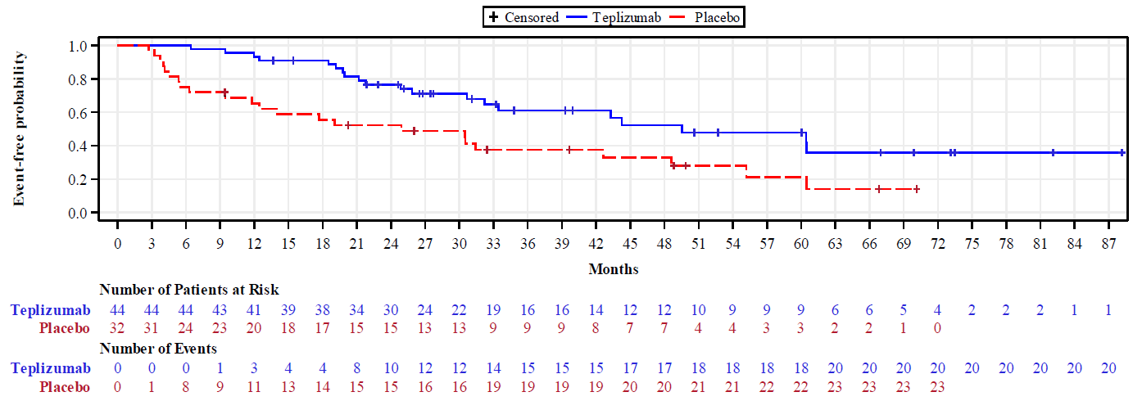
Clinical trial results –TN-10
In primary and extended follow up analysis, teplizumab increases the median time to Stage 3 T1D onset compared with placebo
KM curve for proportion of participants without Stage 3 T1D over time (TN-10; ITT population; primary analysis):
Back to main slides
KM; Kaplan-Meier; ITT; intention to treat; T1D = type 1 diabetes
Notes:
Figure 4 of CS

Slide 39
Clinical trial results – TN-10
C-peptide function better preserved and insulin secretion significantly higher with teplizumab at six months compared with placebo
C-peptide AUC at 6 months after enrolment (TN-10; ITT population)
 | Teplizumab (n=44) | Placebo (n=32)
C-peptide AUC at 6 months (pmol/ml), mean (IQR) | 2.06 (1.55, 2.58) | 1.68 (1.20, 2.15)
Difference between pre- versus post-treatment slopes | p=0.04 | p>0.05
Difference between post-treatment slopes | p=0.0015
Insulin interval secretion (2 hours) measured via OGTT at 6 months after enrolment (TN-10; ITT population)
 | Teplizumab (n=44) | Placebo (n=32)
Pre-treatment slope | −1,024.0 | −1,245.0
Post-treatment slope | 1,085.8 | −1,037.4
Difference between pre- and post-treatment slope | p=0.01 | p=0.80
Difference between post-treatment slopes | p=0.0004
IQR, interquartile range; AUC, area under the curve; ITT, intention to treat;
CI = confidence interval; HR = hazard ratio; NE = not estimable; NR = not reported; T1D = type 1 diabetes
Back to main slides
Notes:
Table 3

