Slide 1
Voxelotor for treating haemolytic anaemia in people with sickle cell disease
Part 1 slides for public – no confidential information
Technology appraisal committee D [4 April 2024]
4th Appraisal Committee Meeting – Post appeal
Chair: Dr Megan John
Evidence assessment group: Liverpool Reviews and Implementation Group
Technical team: Emily Leckenby, Nigel Gumbleton, Linda Landells
Company: Pfizer
© NICE 2024. All rights reserved. Subject to Notice of rights.

Slide 2
Appraisal history
Voxelotor with or without hydroxycarbamide is not recommended, within its marketing authorisation, for treating haemolytic anaemia caused by sickle cell disease in people 12 years and over
December 2022
June 2023
October 2023
February 2024
April 2024
ACM1 →
DG issued
ACM2 →
FDG issued
Appeal
ACM3 → appeal outcome considered
DG2 issued
ACM4 → consider consultation responses

Slide 3
Upheld appeal points
Link to details of upheld appeal points
Themes of upheld appeal points
Ground 1a: In making the assessment that preceded the recommendation, NICE has failed to act fairly
Unfair to not give any indication of what it considered as plausible cost-effectiveness
Unfair to not inform Pfizer in sufficient time in advance of ACM2, of the estimates generated by EAG’s exploratory scenario analyses
Ground 1b: In making the assessment that preceded the recommendation, NICE has exceeded its powers
Adjustment made by committee to reflect HIs in SCD welcome, but inadequate
Committee failed to recognise barriers to access/take into account HIs in SCD
Ground 2: The recommendation is unreasonable in light of the evidence submitted to NICE
Committee’s conclusion of ‘too much uncertainty’ to assess cost-effectiveness irrational
Committee misunderstood relationship between proposed positioning/NHS population
Abbreviations: HI, health inequalities; SCD, sickle cell disease

Slide 4
ACM3 meeting outcomes
CONFIDENTIAL
Company’s positioning of voxelotor (DG2 3.3)
Further clinical input on appropriateness of company’s positioning of voxelotor would be helpful
Acknowledged health inequalities associated with SCD and was willing to appraise voxelotor in line with the company’s chosen positioning, while remaining mindful of the large level of uncertainty.
This uncertainty could be reduced with further clinical expert input gained through consultation
Rate of RTT with voxelotor (DG2 3.11)
In the absence of further evidence, it should be assumed that the rate of RTT with voxelotor is equal to the rate with standard care from the modified Delphi panel (***%)
Welcome scenario analyses from company that estimate rates of RTT with standard care and voxelotor based on RWE
Ideally categorised into different possible reasons for people having RTT, focusing on where people receive it to treat haemolytic anaemia alone in line with MA
Would be willing to consider voxelotor’s suitability for managed access if a proposal was submitted with details on how evidence relating to rates of RTT would be collected
Abbreviations: DG, draft guidance; MA, marketing authorisation; RTT, regular transfusion therapy; RWE, real world evidence; SCD, sickle cell disease

Slide 5
DG2 recommendation
Voxelotor with or without hydroxycarbamide is not recommended, within its marketing authorisation, for treating haemolytic anaemia caused by sickle cell disease in people 12 years and over
Consultation responses received from:
Pfizer (company) – new evidence and base case provided
Patient and clinical organisations:
Sickle Cell Society
Anthonia Oyindamola Folakemi Afelumo Coshare (AOFAC) Foundation
National Haemoglobinopathy Panel, Haemoglobinopathy Coordinating Centres and Specialist Haemoglobinopathy Teams (NHP)
UK Forum on Haemoglobin Disorders (UKFHD)
Web comments (n=4)

Slide 6
Key issues
There are 2 outstanding issues to discuss, related to voxelotor’s positioning and RTT rates
Issue | ICER impact
Key issues identified and discussed at appeal
Positioning of voxelotor | Large
RTT rates for voxelotor arm | Large
Issue | ICER impact
Key issues identified, but not discussed at appeal
Long-term complications* | Unknown
*The issue associated with long-term complications was not discussed at appeal, so is not relevant to today’s meeting. It will therefore not be discussed further
Abbreviations: RTT; regular transfusion therapy

Slide 7
Voxelotor (Oxbryta, Pfizer)
Table 1. Voxelotor information
Marketing authorisation | Treatment of haemolytic anaemia due to sickle cell disease (SCD) in adults and paediatric patients 12 years of age and older as monotherapy or in combination with HC
Mechanism of action | Voxelotor is a haemoglobin S (HbS) polymerisation inhibitor increasing the affinity of Hb for oxygen. Voxelotor inhibits RBC sickling and improves RBC deformability.
Administration | Recommended dosage of voxelotor is 3 x 500mg film-coated tablets taken orally once daily with or without food
Price | List price 90 x 500mg tablets: £5,917.81 (BNF) An updated confidential patient access scheme in the form of a simple discount has been submitted and approved by NHS England
Abbreviations: BNF, British National Formulary; HC, hydroxycarbamide; RBC, red blood cell; SCD, sickle cell disease

Slide 8
RECAP
Treatment pathway
Figure 1. Treatment pathway for haemolytic anaemia in sickle cell disease
Haemolytic anaemia in sickle cell disease
Supportive care: lifestyle advice (adequate hydration, body temperature regulation), infection prevention and pain management (paracetamol, NSAIDs, opioids)
1st line
HC
Voxelotor? (not company preferred)
Hydroxycarbamide ineligible, intolerant, inadequate efficacy
2nd line
Voxelotor +/- HC
Regular blood transfusions
Company proposed positioning of voxelotor
Allogeneic stem cell transplant
(Severe SCD not responding to other therapies)
Abbreviations: HC, hydroxycarbamide; NSAIDs, non-steroidal anti-inflammatory drugs; SCD, sickle cell disease

Slide 9
Key clinical trial - HOPE
RECAP
Phase 3, multicentre, double-blind, placebo-controlled RCT
60 sites in 12 countries (UK, Canada, USA, France, Italy, Netherlands, Turkey, Egypt, Lebanon, Oman, Kenya and Jamaica)
Figure 2 HOPE study design
Population (n=274)
Aged 12 to 65 years with confirmed sickle cell disease
Had a Hb level between 5.5 and 10.5 g/dL during screening
Had between 1 to 10 VOCs in the past 12 months
Participants taking HC must be on stable dose for at least 3 months prior
Randomised 1:1:1
Voxelotor 1500mg (n=90)
Licensed dose
Voxelotor 900mg (n=92)
Not the licensed dose
Placebo (n=92)
72-week treatment-period
HOPE OLE trial (n=178)
Primary endpoint at week 24
Primary endpoint:
Hb response rate, % of people with > 1.0g/dL increase at 24 weeks
Key secondary endpoints:
Haemolysis markers, change from baseline to week 24
Hb level, change from baseline to week 24
Annualised incidence of VOCs, final analysis at 72 weeks
Abbreviations: Hb, haemoglobin; HC, hydroxycarbamide; OLE, open-label extension; RCT, randomised controlled trial; SCD, sickle cell disease; VOC, vaso-occlusive crisis

Slide 10
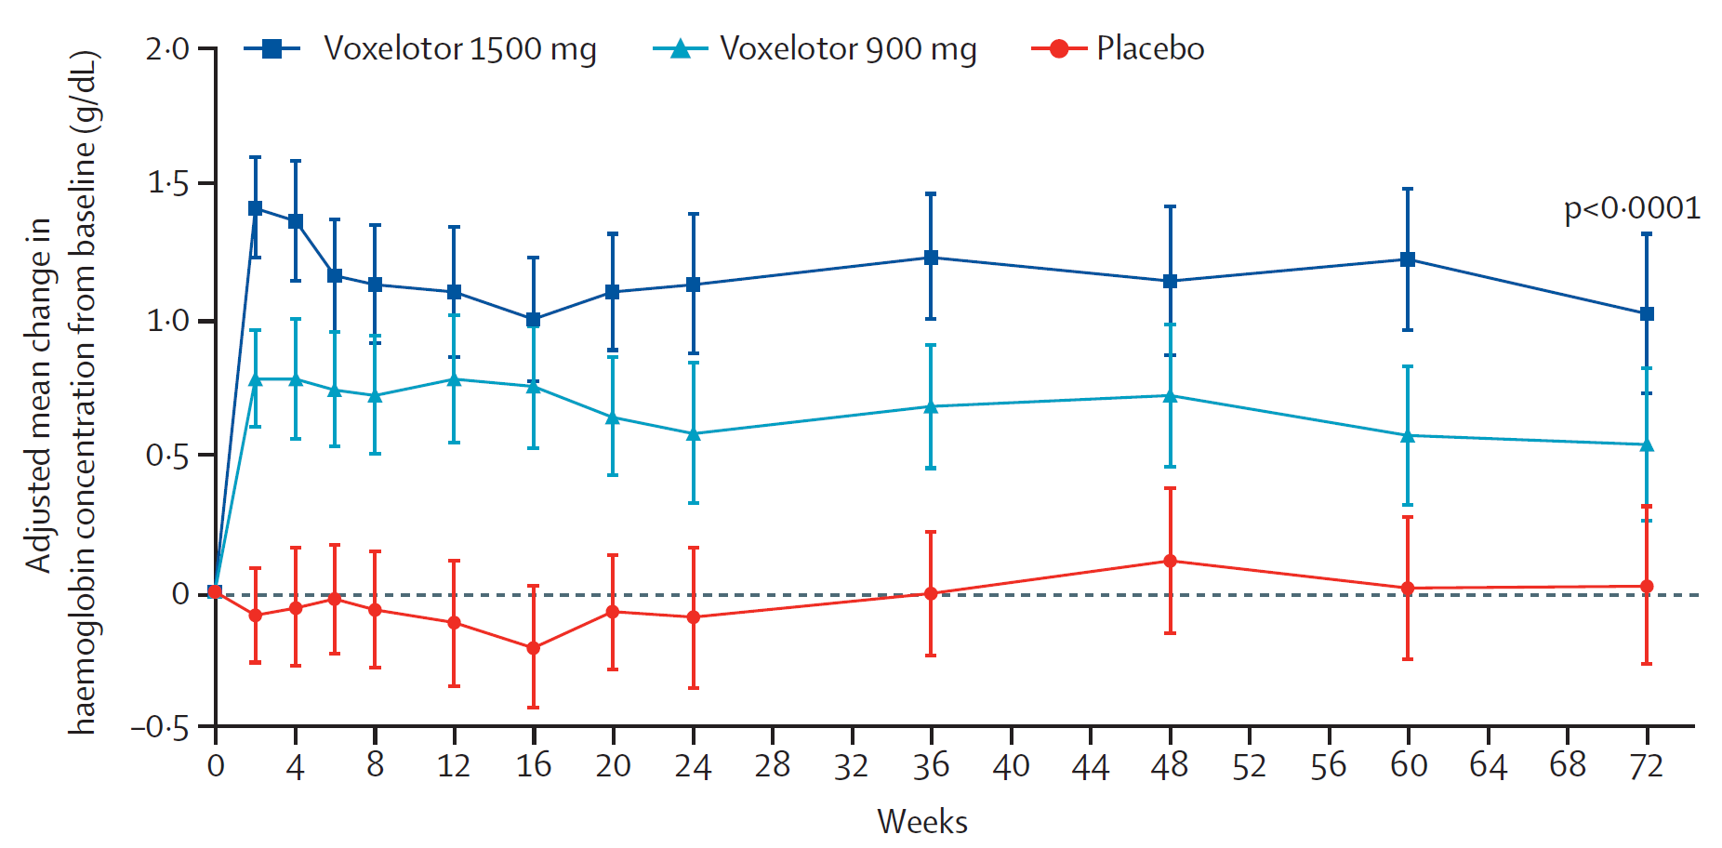
HOPE trial results At week 24, voxelotor 1500mg* has higher proportion of people with Hb increase of >1g/dL than placebo
RECAP
 | Voxelotor 1500mg (N = 90) | Voxelotor 900mg* (N = 92) | Placebo (N = 92)
Response, n (%) | 46 (51.1%) [95% CI: 41, 61] | 30 (32.6%) | 6 (6.5%) [95% CI: 1, 12 ]
Figure 3 Secondary outcome, Hb change from baseline, ITT population
To inform the economic model, treatment effect data from voxelotor 1500mg arm of HOPE stratified by use of HC. The impact of Hb changes on SCD complications is based on time-to-event analysis using evidence from UK CPRD-HES database
*1500mg is licensed dose. People on placebo & 900mg switched to 1500mg in OLE extension trial (next slide)
Abbreviations: CI, confidence interval; Hb, haemoglobin; ITT, intention to treat; SCD, sickle cell disease; VOC, vaso-occlusive crisis
Notes:
Table 9 company submission

Slide 11
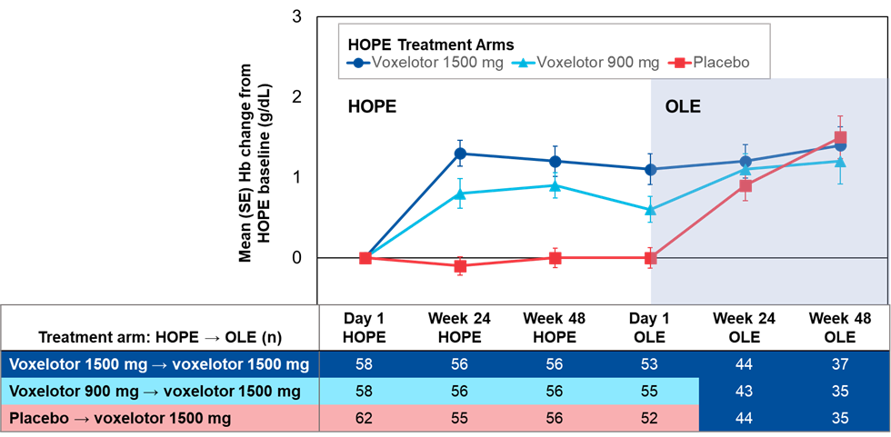
HOPE trial open-label extension (OLE)
RECAP
People in placebo and voxelotor 900mg* arms in HOPE switched to voxelotor 1500mg in HOPE OLE
Median duration of voxelotor exposure in HOPE OLE = 69.9 weeks (range: 1.9-102.0 weeks)
78 people treated for ≥72 weeks. Of these, 52 previously received voxelotor in HOPE
People who received placebo in HOPE and subsequently received voxelotor 1500mg as part of HOPE OLE had a 1.3 g/dL Hb increase from baseline to Week 48 in HOPE OLE
People who received voxelotor 1500mg in HOPE and in HOPE OLE maintained Hb response until end of OLE
Figure 4 change in Hb response from HOPE study baseline to HOPE OLE week 48
*900mg voxelotor dose is not the licensed dose
Abbreviations: CPRD, Clinical Practice Research Database; HES, hospital episode statistics; Hb, haemoglobin; OLE, open label extension; SCD, sickle cell disease

Slide 12
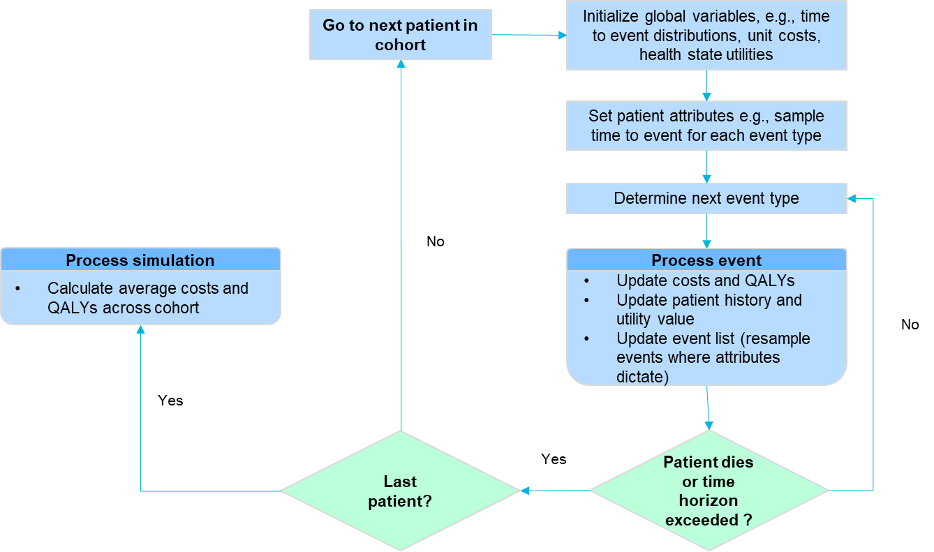
Company’s model overview
RECAP
Figure 5 Company model structure
DES model where possible events are modelled on time to event basis.
Events modelled were SCD-related complications and death, treatment discontinuations
Biggest model driver is proportions of people in voxelotor and SoC arms who receive RTT
Complications included: ARF, arrythmias, CKD, ESRD, gallstones, heart failure, leg ulcers, osteomyelitis, osteonecrosis, pulmonary hypertension, sepsis, stroke, VOC
Abbreviations: ARF, acute renal failure; CKD, chronic kidney disease; DES: Discrete Event Simulation; ESRD, end stage renal disease; HC, hydroxycarbamide; RTT, regular transfusion therapy; SCD, sickle cell disease; SoC, standard of care; VOC, vaso-occlusive crisis

Slide 13
Consultation responses

Slide 14
Consultation responses to draft guidance
Comments received from:
Patient and clinical organisations
Sickle Cell Society
Anthonia Oyindamola Folakemi Afelumo Coshare (AOFAC) Foundation
National Haemoglobinopathy Panel, Haemoglobinopathy Coordinating Centres and Specialist Haemoglobinopathy Teams (NHP)
UK Forum on Haemoglobin Disorders (UKFHD)
Company
Pfizer
Web comments (4)

Slide 15
Response themes: clinical and patient organisations
Consideration of evidence (RWE)
Not all relevant evidence has been taken into account
Summaries of clinical effectiveness not a reasonable interpretation of evidence
Recommendation does not consider RWE for the use of voxelotor in clinical practice
Confirm results from HOPE, and show reduction in mean transfusion rates
Representation of clinical practice
Recommendation does not recognise standard clinical practice in the UK - Hydroxycarbamide offered to any eligible patient; positioning voxelotor second line reflects practice
Unmet need for treatments
Large unmet need for those for whom hydroxycarbamide becomes ineffective/intolerable
Improving Hb levels has immediate benefit for people with SCD
Reduced utility of hydroxycarbamide in aging people, and people with other comorbidities
Transfusion also limited in some individuals (age, allo-immunisation, refuse blood on religious grounds)
EQ-5D inadequate at assessing QOL for SCD; fatigue, chronic pain, mental health burden, hospital attendances
SCD affects mostly people of Black ethnic group – recommendation widens health inequalities and unmet need
Little innovation in SCD means comprehensive cost-effectiveness data is lacking, and isn’t easily modelled
Abbreviations: Hb, haemoglobin; HI, health inequalities; QOL, quality of life; RWE, real world evidence, SCD, sickle cell disease

Slide 16
Response themes: web comments
Patient experiences
Individuals taking voxelotor report less fatigue and fewer crises, and less pain overall
They feel more able to contribute towards tasks e.g. cleaning, childcare
Many are increasingly dissatisfied with current treatments and would welcome an alternative
Voxelotor shown to provide benefit in HOPE and in real world experiences
Without voxelotor, need for frequent hospital attendance which can impact quality of life
Disadvantaged group
Underfunding of services have disadvantaged people with SCD
May lack confidence when advocating for themselves and how SCD impacts their lives
Advocacy is often taken on by the clinicians working in ethnic minority services
Feel SCD is underprioritised, underestimated and neglected
Recommendation fails to recognise overwhelming, urgent unmet need for new treatments for those with SCD
Abbreviations: SCD, sickle cell disease

Slide 17
Company response and EAG critique

Slide 18
Company response overview re: key issues at ACM3
CONFIDENTIAL
Key Issue | Committee conclusion | Company DG2 response | EAG critique of company
Positioning of voxelotor | Further clinical input on appropriateness of positioning of voxelotor would be helpful Acknowledged health inequalities associated with SCD; willing to appraise voxelotor in line with company’s chosen positioning, while remaining mindful of large level of uncertainty | Second line is not exact and is open for interpretation in the context of SCD, position has been widely supported by clinical experts All patients with SCD should be offered hydroxycarbamide; reflected in numerous guidelines including the British Society of Haematology | Key aspect of positioning of voxelotor is where it sits in treatment pathway in relation to people who require RTT HOPE trial excluded people who received RTT, so information is missing relating to people who require RTT
RTT rate for voxelotor arm | RTT with voxelotor equal to SoC from modified Delphi panel (***%); no reduction Welcome scenario analyses from company that estimate rates of RTT with standard care and voxelotor based on RWE | People requiring RTT in voxelotor arm would not remain at ***% after initiation RETRO shows ***% relative reduction in people requiring RTT on voxelotor Incorporated rate of people requiring RTT on voxelotor into base case (***%) | No evidence reduction in transfusions attributed to treatment with voxelotor RETRO should be used to estimate rate of people requiring RTT with SoC (***%) and voxelotor (***%), and annual transfusion rate prior to start of treatment (***)
Abbreviations: DG, draft guidance; RBC, red blood cell; RTT, regular transfusion therapy; RWE, real world evidence; SCD, sickle cell disease; SoC, standard of care; VOC, vaso-occlusive crisis

Slide 19
Positioning of voxelotor
RECAP
Appeal panel conclusion
177. “Overall, the panel concluded that the view from clinical experts throughout the appraisal was that Pfizer’s proposed positioning of voxelotor was appropriate in reflecting likely clinical practice.”
179. “Taking together the clinical expert views with the need for particular flexibility in this appraisal, the panel judged that it was unreasonable, in light of the evidence provided to it, for the committee to have placed such substantial weight on its concerns regarding Pfizer’s proposed positioning.”
181. “The panel noted it would expect NICE to reconsider the degree of weight it placed on concerns about the positioning of voxelotor.”
Committee conclusion in DG2
Further clinical input on appropriateness of company’s positioning of voxelotor would be helpful
Acknowledged health inequalities associated with SCD and was willing to appraise voxelotor in line with the company’s chosen positioning, while remaining mindful of the large level of uncertainty.
This uncertainty could be reduced with further clinical expert input gained through consultation
Abbreviations: SCD, sickle cell disease

Slide 20
Positioning of voxelotor
Company consultation response
International consensus that all patients with SCD should be offered HC
Reflected in numerous guidelines including the British Society of Haematology
Likely people not taking HC in HOPE were previously considered for HC and was not suitable or had been used in the past
At appeal, clinical experts said proposed position was appropriate in reflecting likely clinical practice
People would not take part in a trial if disease had been adequately controlled with HC, therefore HOPE included people who would otherwise have been eligible for RTT
HOPE trial is representative of patients who will use voxelotor in the NHS
Professional groups consultation response
Standard practice for all children with SCD is to be offered HC
Similar practice undertaken in adult services; HC offered to anyone eligible
While offered to people with SCD, only 20-40% of eligible adults are on regular HC therapy
Large unmet need for those where HC has become ineffective/intolerable
Voxelotor offers an alternative to these individuals
Small cohort of individuals who are difficult to transfuse due to alloimmunisation
Voxelotor would be very impactful to this group
Positioning voxelotor as second line therapy reflects standard practice in the UK
Abbreviations: HC, hydroxycarbamide; RTT, regular transfusion therapy

Slide 21
Positioning of voxelotor
EAG comments
Key aspects of the positioning of voxelotor is where voxelotor sits in the treatment pathway in relation to people who require RTT
The HOPE trial excluded patients who received RTT and so the trial provides no information about the proportion of patients who:
were receiving RTT prior to treatment with voxelotor
would have received RTT if they had not started treatment with voxelotor
would not, or no longer, receive RTT due to treatment with voxelotor
These issues are central to understanding the cost effectiveness of voxelotor
Following consultation, has any evidence been provided that allows the committee to reconsider the degree of weight placed on the positioning of voxelotor?
Abbreviations: RTT, regular transfusion therapy

Slide 22
RTT rates
RECAP
Appeal panel conclusion
39. In the FDG, the committee state that “any plausible ICER was highly uncertain but likely to be substantially above the range NICE considers an acceptable use of NHS resources”, suggesting that the committee had ICERs they considered plausible in mind.
During the hearing, the NICE committee quoted a range of ICERs that they considered in their deliberations. In particular, they gave a range of ICERs based on a range of RTT rates that they described as “plausible”, albeit that this range was wide.
The panel concluded that the NICE committee did have a range of ICERs in mind that informed their decision making. The panel therefore judged that fairness required that these ICERs should be provided to stakeholders (with caveats about degree of uncertainty).
Abbreviations: ICER, incremental cost effectiveness ratio; RTT, regular transfusion therapy; SCD, sickle cell disease

Slide 23
RTT rates
CONFIDENTIAL
RECAP
Committee conclusion in DG2
In the absence of further evidence, it should be assumed that the rate of RTT with voxelotor is equal to the rate with standard care from the modified Delphi panel (***%)
Welcome scenario analyses from company that estimate rates of RTT with standard care and voxelotor based on RWE
Ideally categorised into different possible reasons for people having RTT, focusing on where people receive it to treat haemolytic anaemia alone in line with MA
Would be willing to consider voxelotor’s suitability for managed access if a proposal was submitted with details on how evidence relating to rates of RTT would be collected
Abbreviations: MA, marketing authorisation; RTT, regular transfusion therapy; RWE, real-world evidence

Slide 24
RTT rates
CONFIDENTIAL
Company consultation response
Do not believe that people on RTT in voxelotor arm would remain at ***% once voxelotor initiated
New evidence from RETRO, multicentre, retrospective, observational study conducted at 9 sites in US
Reduction of ***% in RTT with voxelotor compared to standard care in subgroup with ≥6 prior RBC transfusions (aligned to definition of RTT in model)
Used to determine new RTT rate for voxelotor (************************), which has been applied in updated company base-case
Provided scenario analyses using ***% RTT rate with voxelotor at baseline and applying the relative reduction in RTT of ***% resulting in a rate of RTT with voxelotor of ***% after 1 and 2 years
Results from RETRO study
 | Overall population (n=***) |  | ≥2 prior RBC Transfusions (n=**) |  | ≥6 prior RBC Transfusion (n=**)
Measure | Before vox | After vox | Before vox | After vox | Before vox | After vox
RBC Transfusion Count | *** | *** | *** | *** | *** | ***
RBC Transfusion Rate per-person-per-year (SD) | ****** | ****** | ****** | ****** | ****** | ******
Mean absolute change in RBC transfusion rate (SD) | ********* |  | ********* |  | *********
Mean percentage change in per-person RBC transfusions (SD) | ********* |  | ********* |  | *********
Abbreviations: RTT, regular transfusion therapy; RBC, red blood cell; SD, standard deviation

Slide 25
RTT rates
CONFIDENTIAL
Company consultation response
Further evidence also provided from:
Shah 2022, retrospective analysis of people with SCD from Symphony Database - mean annualised transfusion rate decreased from 7.0 (95% CI, 6.4–7.5) to 3.3 (95% CI, 2.6–4.1) (-52%,P < 0.001)
Sanius Health UK RWE study of *** people with SCD. Prior to voxelotor, ** required transfusion, with ** requiring RTT; ** required any transfusion after voxelotor
Evidence supplemented by a number of single centre and case studies
Company consultation response – clinical expert opinion
Assumption on rates of RTT for voxelotor and SoC being equal doesn’t reflect advice from clinical experts
‘Most clinicians would not use voxelotor and chronic transfusion as a combination therapy’
Since voxelotor would be used as an alternative to chronic transfusion, reasonable to expect fewer RTT in voxelotor arm of the model
Conducted advisory board with ** haematologists; ** believed voxelotor would decrease RTT in SCD, ** believed there would be no change, ** did not respond.
Professional groups consultation response
Concern that recommendation doesn’t consider accumulating RWE on the use of voxelotor
Real world evidence has shown a reduction in transfusions – Shah et al. reported a 52% reduction in mean transfusion rate per year
Abbreviations: CI, confidence interval; RTT, regular transfusion therapy; RWE, real-world evidence; SCD, sickle cell disease; SoC, standard of care

Slide 26
RTT rates
CONFIDENTIAL
EAG comments
Agree RWE evidence presented demonstrates people treated with voxelotor experienced a reduction in annual transfusion rates, however:
Data were not comparative - no evidence to show whether any (or all) reductions in transfusion rates can be attributed to treatment with voxelotor
Not possible to estimate proportion who were not receiving RTT prior to treatment with voxelotor who would have received RTT if they had not been treated with voxelotor
Reduction in proportion of people receiving RTT based on only ** patients who were receiving RTT prior to starting treatment with voxelotor
Company and EAG preferred proportion of people receiving RTT with SoC and voxelotor
 | Company | Source | EAG | Source
Proportion of people receiving RTT with SoC | ***% | Delphi panel | ***% | % of people in RETRO received ≥6 RBC transfusions prior to voxelotor treatment
Proportion of people receiving RTT with voxelotor | ***% | ***% reduction in RTT with voxelotor from RETRO (using *** as annual transfusion rate for people who receive RTT) | ***% | ***% reduction in RTT with voxelotor from RETRO (using *** as annual transfusion rate for people who receive RTT)
Abbreviations: RTT, regular transfusion therapy; RWE, real-world evidence

Slide 27
RTT rates
CONFIDENTIAL
EAG comments
RTT is binary variable in model; company approach inappropriate as applies a reduction in a continuous variable as a reduction to a binary variable; has overestimated reduction in annual transfusion rate in the model vs RETRO
RETRO does not provide estimates of people who did not receive RTT prior to 2nd line treatment
Shah Symphony database analysis (n=3,109) estimates proportion of people receiving RTT prior to 2nd line treatment lies between 2% and 6.1%, whereas RETRO estimates this to be ***%
HOPE trial CSR data shows that during first 72 weeks of trial, *** ******* in placebo arm received ≥6 transfusions (the company definition of RTT)
Consider ***% as proportion of people in whole SoC arm receiving RTT is likely an overestimate
ICER sensitive to timing in reduction of proportion of people receiving RTT as a result of voxelotor; company base case assumes impact of voxelotor on RTT occurs as soon as treatment commences
Any delay in impact of treatment with voxelotor on RTT; company base case ICER would increase
HOPE shows, compared with placebo, treatment with voxelotor had no impact on transfusion rate over first 72 weeks (albeit in a non-RTT population)
True ICER likely to lie between voxelotor having an immediate impact on reducing proportion of people receiving RTT and the reduction taking 12 months
Which RTT rate in the standard of care and voxelotor arms is most plausible?
Abbreviations: RTT, regular transfusion therapy; RWE, real-world evidence

Slide 28
Cost-effectiveness results
Cost effectiveness results will be discussed in Part 2 as they contain confidential commercial discounts

Slide 29
Company’s updated cost-effectiveness analyses
CONFIDENTIAL
Model input | Committee preferred assumptions, ACM3 | Company’s base case assumptions, ACM4 | EAG base case assumptions, ACM4
RTT rate, vox | ****** | ****** | ******
RTT rate, SoC | ****** |  | ******
Utility increment | **** per 1g/dL increase in Hb
Increase in Hb | Increase in Hb with RTT of ***g/dL
Complications | Multiplicative utility values for SCD complications
TTE data | From HES-CPRD
Hb evaluation | 24 weeks
An updated PAS discount has been provided
Committee preferred ICER ACM3 > £30,000/QALY
Company base case ICER ACM4 < £30,000/QALY
EAG base case ICER ACM4 > £30,000/QALY
Abbreviations: Hb, haemoglobin; HES-CPRD, Hospital Episode Statistics-Clinical Practice Research Database; OLE, open-label extension; PAS, patient access scheme; RTT, regular transfusion therapy; SCD, sickle cell disease; SOC, standard of care; TTE, time to event; vox, voxelotor; VOC, vaso-occlusive crisis

Slide 30
Feasibility of managed access

Slide 31
Summary of managed access feasibility assessment
Company has engaged with registry and NICE to research its managed access proposal
Data collection is possible but requires:
Extensive staff and resource recruitment
Extensive (unknown) time to initiate
Data collection may not be useful because:
Missing data adds bias
Additional company evidence for this meeting reduces need for data collection
Managed access is rated not feasible overall because of the above, and:
Added burden to patients and system
Is the technology considered a potential candidate for managed access? | Yes
Is it feasible to collect data that could sufficiently resolve key uncertainties? | Unclear
Can data collection be completed without undue burden on patients or the NHS system | No
Are there any other substantive issues (excluding price) that are a barrier to a MAA | Yes - Major
Abbreviations: MAA, managed access agreement

Slide 32
Summary of managed access feasibility assessment (2)
Is the technology considered a potential candidate for managed access? | Yes
Is it feasible to collect data that could sufficiently resolve key uncertainties? | Unclear
Can data collection be completed without undue burden on patients or the NHS system | No
Are there any other substantive issues (excluding price) that are a barrier to a MAA | Yes - Major
New, effective treatment for SCD at any line would be welcomed – level of unmet need
Access to 2nd line effective treatment step-change for people with SCD and their clinicians
New evidence could resolve some uncertainties; level of success in gathering sufficient data to resolve uncertainties is unclear
Abbreviations: MAA, managed access agreement; SCD, sickle cell disease

Slide 33
Summary of managed access feasibility assessment (3)
Is the technology considered a potential candidate for managed access? | Yes
Is it feasible to collect data that could sufficiently resolve key uncertainties? | Unclear
Can data collection be completed without undue burden on patients or the NHS system | No
Are there any other substantive issues (excluding price) that are a barrier to a MAA | Yes - Major
Some uncertainty can be resolved with data collection, but not all
Further data collection will not address uncertainties relating to the positioning of voxelotor
Large datasets would be needed to determine the risk of RTT in both arms, and outside of a specifically designed trial setting, this would pose ethical problems
Flagged by committee as one of areas where managed access may help, particularly in voxelotor arm
Abbreviations: MAA, managed access agreement; RTT, regular transfusion therapy

Slide 34
Summary of managed access feasibility assessment (4)
Is the technology considered a potential candidate for managed access? | Yes
Is it feasible to collect data that could sufficiently resolve key uncertainties? | Unclear
Can data collection be completed without undue burden on patients or the NHS system | No
Are there any other substantive issues (excluding price) that are a barrier to a MAA | Yes - Major
Some trial data will continue to be available from the trial open label extension; however main trial has been complete for many years – little more data is expected beyond ACM4
Data collection would be through the NHR combined with Blueteq
NHR, given sufficient resource, would be able to support MAA for voxelotor
Limitations around retrieving baseline data
Major issues are increased burden on the system, especially clinicians, and need for NHR to significantly expand its resource level to perform its role
Increasing resource may delay initiating managed access
Abbreviations: MAA, managed access agreement

Slide 35
Summary of managed access feasibility assessment (5)
Is the technology considered a potential candidate for managed access? | Yes
Is it feasible to collect data that could sufficiently resolve key uncertainties? | Unclear
Can data collection be completed without undue burden on patients or the NHS system | No
Are there any other substantive issues (excluding price) that are a barrier to a MAA | Yes - Major
Several issues remain requiring resolution during the implementation phase of MAA
Clinicians would gain substantial work from the need to gather data
Unclear if:
Existing patients able to continue to use voxelotor in the event of negative NICE guidance following MAA
Implementation would subject the NHS to irrecoverable costs, and if there is an existing service specification that would cover voxelotor
There is a plan to monitor patient safety/if any additional patient safety monitoring processes are required
Issues of access are often raised for conditions relating to SCD as there are specific groups disproportionally affected that can be additionally, disproportionally, impoverished
Abbreviations: MAA, managed access agreement; SCD, sickle cell disease

Slide 36
Thank you.
© NICE 2024. All rights reserved. Subject to Notice of rights.

