Slide 1
Chair’s presentation
Eliglustat for treating type 1 Gaucher disease
For part 1 and public
Highly Specialised Technology Evaluation Committee
Third committee meeting
Peter Jackson
19th April 2017

Slide 2
History
Sept 2016
1st committee meeting
ECD drafted
Oct 2016
2nd committee meeting
Nov/Dec 2016
Company advises of revised list price and PAS application
ECD on hold
Jan 2017
Company submits analyses; ERG prepares critique
Feb 2017
Committee meeting planned but issues with quoracy; rescheduled for earliest next availability
ECD published for consultation in March
2

Slide 3
Eliglustat
Ceramide analogue
Inhibits enzyme glucosylceramide synthase
  Reduced production of glucosylceramide (and Gaucher cells)
  Oral, administered twice daily
  Marketing authorisation:
    Type 1 Gaucher disease in adults who are CYP2D6 poor (PM), intermediate (IM) or extensive (EM) metabolisers
      84mg* twice daily in IM & EM
      84mg* once daily in PM
  Cost
    £342.23 for one capsule, confidential patient access scheme discount available
* equivalent to 100mg eliglustat tartrate

Slide 4
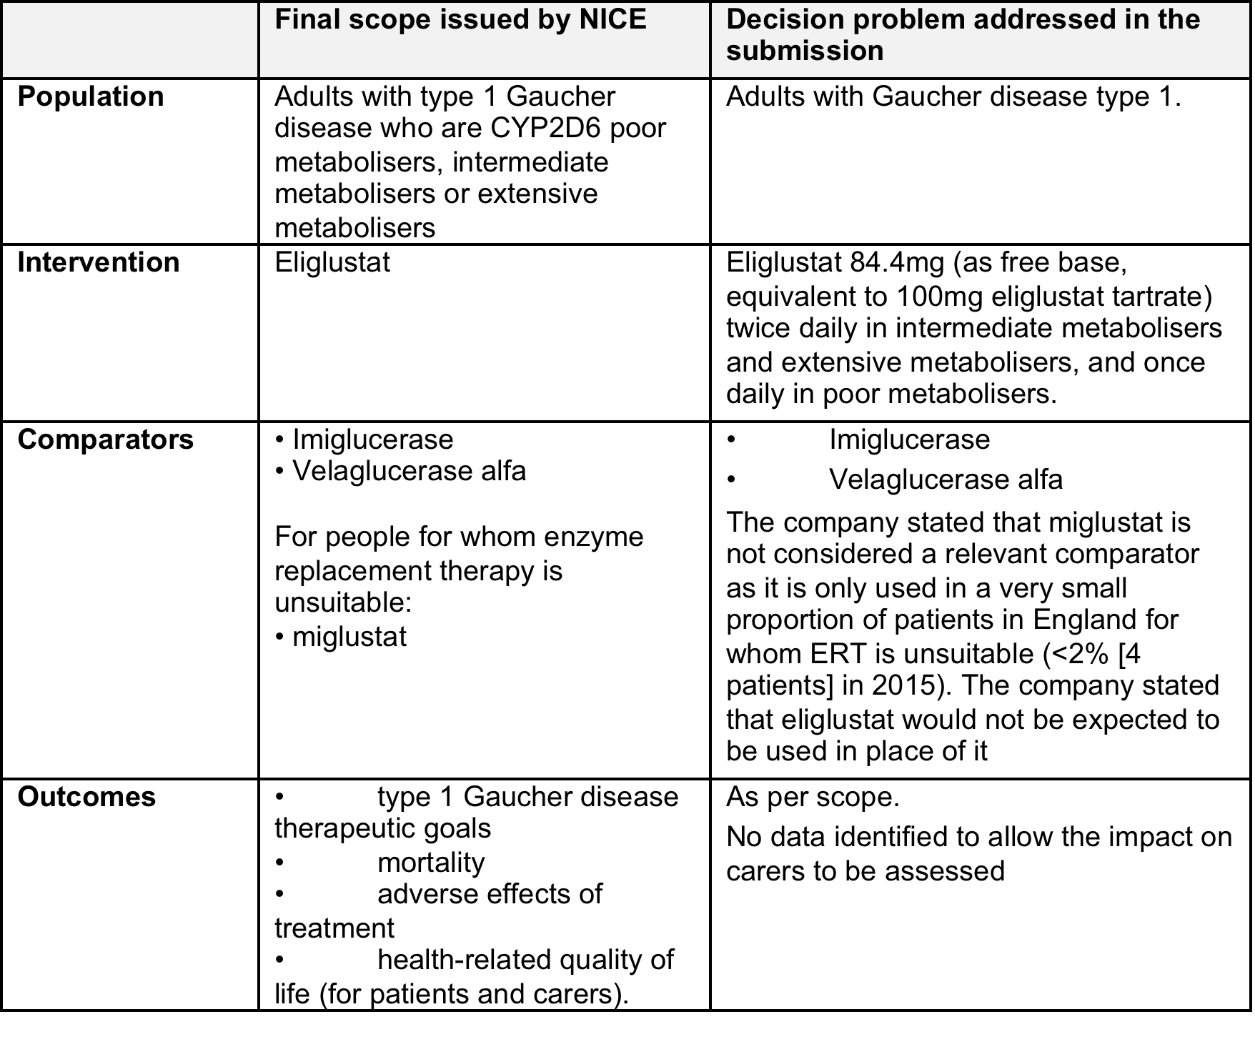
Decision problem

Slide 5
ENCORE – trial design
Phase 3, open label, non-inferiority trial
Key: BID, twice daily; ERT, enzyme replacement therapy; SRT, substrate reduction therapy.

Slide 6
ENCORE – primary outcome and results
Primary composite endpoint
  % patients who remained stable for 52 weeks in all of the following parameters:
    Haemoglobin levels ↓ ≤1.5g/dL from baseline
    Platelet counts ↓ ≤25% from baseline
    Spleen volume ↑ ≤25% from baseline
    Liver volume ↑ ≤20% from baseline
Eliglustat
  84.8% (95% CI 76.2%-91.3%) met endpoint criteria
  Imiglucerase
  93.6% (95% CI 82.5-98.7%) met endpoint criteria

Slide 7
ENGAGE
Double-blind, placebo controlled, phase 3, with open label extension phase
Treatment naïve population (n=40)
  n.b. inclusion criteria allowed people who had previous treatment with ERT as long as they were not being treated at time of recruitment to trial
Week 4 to 39, 50-100mg BD
Statistically significant and clinically meaningful improvement in spleen volume at 39 weeks
  mean difference of 30.03% compared with the placebo group (-27.8% eliglustat, 2.3% placebo)
  Statistically significant efficacy on all secondary endpoints

Slide 8
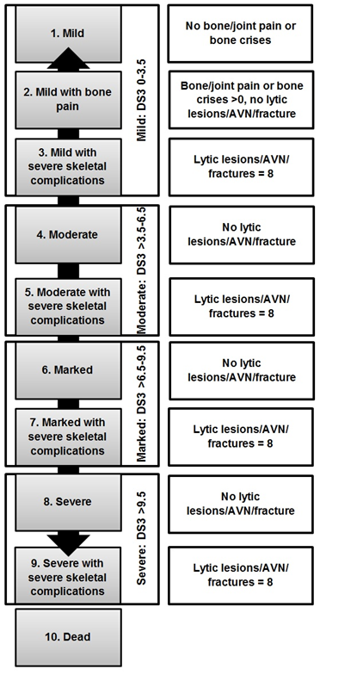
Model Structure
10 state Semi-Markov model comparing eliglustat with imiglucerase and velaglucerase
States defined by DS3 severity scoring system (a validated measure of disease severity)
2 populations: stable ERT and treatment-naïve
Metaboliser status considered as subgroups
Time horizon 70 years
Cycle length 1 year
Costs and benefits discounted at 3.5%
8

Slide 9
Assumptions
Transition probabilities:
  Stable ERT population: differential clinical effectiveness assumed in the 1st year (based on ENCORE) and then equal effectiveness in subsequent years (based on DS3 score study)
  Treatment naïve population: effectiveness assumed equal and based on eliglustat arm of ENGAGE
Discontinuation: rate of 1.9%
  For both eliglustat and ERT in treatment-naïve population
  For eliglustat only in stable ERT group
Outcomes at 39 weeks from ENGAGE used for people at 1 year in model
Mortality – same for all treatments and health states
Differential monitoring and management costs applied to each health state, broadly increasing with severity of disease.
No costs associated with adverse events included
Neither eliglustat nor the comparators required additional training of healthcare staff
No administration costs included for eliglustat

Slide 10
Company’s base case results based on list prices
Eliglustat vs. imiglucerase
 | Incremental QALYs | Incremental Cost
ERT stable IM/EM | 2.28 | £687,837
ERT stable PM | 2.28 | -£1,698,539
ERT naïve IM/EM | 2.43 | £672,251
ERT naïve PM | 2.43 | -£1,855,035
Eliglustat vs. velaglucerase
ERT stable IM/EM | 2.28 | -£519,226
ERT stable PM | 2.28 | -£2,905,602
ERT naïve IM/EM | 2.45 | -£467,818
ERT naïve PM | 2.45 | -£2,995,104
Note – results based on eliglustat PAS and confidential discounts for ERT presented in part 2

Slide 11
ERG exploratory analyses
Additional administration costs for eliglustat (£14.40 monthly dispensary cost)
Revised administration costs for ERT (Home therapy cost equal to hospital cost rather than higher);
Revised estimate of utility benefits of oral therapy (Estimate of ‘0.05’);
Revised modelling of mortality to allow for increased mortality risk for marked and severe patients;
Reduction in dose of ERT in line with UK practice (25 units per kilogram);
Using ENCORE effectiveness data in the treatment naïve population during the first cycle

Slide 12
ERG base case results based on list prices
Eliglustat vs. imiglucerase
 | Incremental QALYs | Incremental Cost
ERT stable IM/EM | 1.05 | £2,638,293
ERT stable PM | 1.05 | -£6,825
ERT naïve IM/EM | 1.04 | £2,605,712
ERT naïve PM | 1.04 | -£49,688
Eliglustat vs. velaglucerase
ERT stable IM/EM | 1.05 | £1,849,412
ERT stable PM | 1.05 | -£795,706
ERT naïve IM/EM | 1.06 | £1,900,060
ERT naïve PM | 1.06 | -£755,340
Key drivers remain:
Costs – ERT dose
QALYs – Utility increment

Slide 13
Company budget impact analysis
5 year budget impact model estimating costs to NHS
Based on estimates of total costs generated cost consequence model
  Newly diagnosed patients are assumed to start treatment on eliglustat rather than imiglucerase/velaglucerase
  Costs based on the licensed dose of eliglustat and the dosing of ERTs used in the ENCORE clinical trial
  Effects of mortality and discontinuation are included in the estimated total costs
  Model results for people who are intermediate or extensive metabolisers were used (majority of patients in the trials)
Company results, using list prices and based on revised patient numbers
 | 2017 | 2018 | 2019 | 2020 | 2021
Total | £84,559 | £193,784 | £331,078 | £442,311 | £571,487

Slide 14
ERG exploratory analyses – budget impact
The ERG explored the impact of:
All the assumptions explored in cost-consequence model (see slide 11)
Zero mortality
  Including mortality means that total costs of treating patients represents the average over a lifetime, not the cost of treating one patient for 5 years, thereby underestimating costs
No treatment discontinuation

Slide 15
ERG budget impact results
(based on list prices)
Based on revised patient numbers
 | 2017 | 2018 | 2019 | 2020 | 2021
Total | £2,321,945 | £5,058,377 | £7,688,503 | £9,682,106 | £11,677,472
Additionally, the ERG explored the impact of assuming that 4% of eliglustat patients are PM, based on the proportion of PM in the ENGAGE trial → reduced budget impact
ERG base case, based on revised patient numbers
 | 2017 | 2018 | 2019 | 2020 | 2021
Total | £2,211,946 | £4,818,731 | £7,324,191 | £9,223,107 | £11,123,765

Slide 16
ECD draft recommendation
Eliglustat is not recommended within its marketing authorisation for treating type 1 Gaucher disease, that is, for long-term treatment in adults who are cytochrome P450 2D6 poor, intermediate or extensive metabolisers.

Slide 17
Recap of ECD considerations – clinical
Debilitating condition with significant impact on quality of life
Intravenous ERT, such as velaglucerase and imiglucerase, were established treatments in the NHS, but an oral option would be of significant value
48% of patients in ENCORE had a higher dosage of eliglustat (150 mg twice daily) than recommended in the SPC. Efficacy data from ENCORE were used in the model, committee concluded that model predictions were subject to bias.
Dose of ERT recommended in the standard operating procedure was reflective of clinical practice (lower than in SPCs)
Eliglustat potentially an effective treatment, but concerned about robustness of results
Eliglustat likely to have a significant impact on people’s lives beyond its direct health benefits
Impact of eliglustat on delivery of specialised services relatively negligible

Slide 18
Recap of ECD considerations – model
Important uncertainties in model:
  Evidence from the ENCORE trial more appropriate for patients who had not previously had treatment rather than assuming equal efficacy for eliglustat and ERT
  Not appropriate to assume long-term equivalence of eliglustat and ERT
  Dose of ERT in model higher than in practice
  Unrealistic to assume that mortality risk does not increase with disease severity
  Unrealistic to assume no administration costs with eliglustat
  Unlikely that administration costs for ERT are higher than costs of hospital administration
  Utility increment of 0.12 for oral therapy too high, 0.05 more appropriate
Satisfied that ERG presented results based on assumptions preferred by committee
Eliglustat did not offer value for money for people with intermediate and extensive metaboliser status
Not convinced it offered value for money in people with poor metaboliser status (very few patients in trials, ERT itself not evaluated)

Slide 19
Recap of ECD considerations – budget impact
Company’s revised patient numbers sufficiently reflected the expectations in clinical practice in England
Company’s estimates of budget impact too uncertain, considered ERG’s exploratory analyses in its decision-making
  concluded that there was a considerable budget impact with eliglustat compared with ERT, and these costs had been underestimated by the company
Concluded that it had not been given enough justification for the high cost per person of eliglustat, or for the overall cost of eliglustat. The committee was not convinced that these could be justified solely based on the benefits of an oral treatment.

Slide 20
Consultation responses
Consultees
  Sanofi-Genzyme (including updated PAS; results in part 2)
  Gauchers Association
  Clinical expert (Dr Tim Cox)
  Patient experts (n=2)
Commentators
  Shire

Slide 21
Consultation responses
Relating to process – company and clinical expert
Date of the second meeting changed at short notice; none of the experts could attend
  N.b. teleconference organised separately with experts prior to meeting following agreement; feedback presented at meeting via slides and minutes from TC included in committee papers
  N.b main focus of second meeting was to discuss company’s updated results (based on PAS) and updated patient estimates – clinical issues remained as discussed at 1st meeting
ECD not issued after 1st meeting – could have resulted in clinical issues being resolved earlier
  N.b. company advised change to list price the intention to submit a PAS at the end of the first meeting – ECD cannot be issued in the absence of a list price; results discussed at the 1st meeting no longer relevant. Not part of process to run a separate consultation on clinical aspects.
While the HST process recognises the challenges associated with developing a treatment for a rare and life-long disease
  ECD criticises data on the basis that the studies are not larger (ENGAGE is the largest study ever conducted in treatment-naïve Gaucher patients) and longer term data (data up to 8 years have been submitted) are not available.

Slide 22
Consultation responses
Value for money of ERT – company
Questioning the value for money of an established and effective treatment is out of scope for this evaluation

Slide 23
Consultation responses
Patient experts
Disappointed
ERT
  significant side effects, poor quality of life and mental well-being
  Hospital infusions result in carer burden
  Poor intravenous access ‘constant trauma’
Miglustat – patients stated that it resulted in
  Permanent kidney damage
  Peripheral neuropathy
Eliglustat
  Far superior, ‘relief was overwhelming’
  Improved health, side effects, ‘promise of normality’

Slide 24
Consultation responses
Patient organisation
Venous access is a real challenge for patients
  long term may result in not being able to continue on ERT with potentially severe consequences
There are sanctuary sites where ERT is not effective, for example lung involvement and mesenteric lymph nodes
Some patients may not be suitable for ERT
  No treatment option except miglustat – tolerability and safety issues
  ‘unethical’ when eliglustat is available
Burden on centres of homecare services has not been quantified – significant.
Section 1.2: patients currently receiving eliglustat are receiving this treatment through the company’s compassionate programme and not being funded by NHS England.

Slide 25
Consultation responses
Clinical expert
Largest programme of therapeutic investigation conducted in any ultra-orphan disease
Patients’ voice has been inadequately heard in relation to oral therapy
‘Given the weight of evidence for its tolerability, safety and efficacy and the huge advantage for most patients of a first-line oral agent, I can only comment from experience, that the case for its acceptance for NHS reimbursement is incredibly strong….subject to reasonable cost negotiations, it would be an injustice and disservice to UK patients were the drug to be denied them…’
ENCORE:
  non-inferiority margin based on real life data, accepted by EMA and FDA
  evaluation of therapeutic responses were objective
  clinical stability was maintained for up to 4 years - well beyond the interval that might be attributed to residual effects of prior long-term ERT
  in the subset of patients with 4-year data, there were small but statistically significant reductions in least-square mean liver (3%, P=0.02) and spleen volumes (13%, P<0.001). Also, lumbar spine least-square mean Z scores of BMD increased by 0.29 (significantly).

Slide 26
Consultation responses
Commentator - Shire
Adherence to oral therapies is inconsistent; risk in achieving full benefits for patients.
Adverse effects of eliglustat may have a negative impact on adherence rates and subsequently, on health outcomes.

Slide 27
Consultation responses
Company – effectiveness
The primary endpoint for ENCORE was demonstrated. While the pre-specified non-inferiority margin was 25%, the lower 95% confidence interval was actually -17.6%, therefore within the 20% non-inferiority range requested by the CHMP.
  moving to a 90% powered trial with a non-inferiority margin of 20% would have required an extra 174 patients
Failure to meet the trial endpoint did not mean that the patient had deteriorated clinically
  Based on the GD1 therapeutic goals for patients receiving ERT, 12 out of 15 patients in the eliglustat group who did not meet the primary endpoint maintained stability from a clinically meaningful perspective
4 year data from ENCORE now available
  data for mean haemoglobin concentration, platelet count, and spleen and liver volumes remained stable for up to 4 years
  Year to year, all four measures remained collectively stable (composite endpoint) in ≥85% of patients, as well as individually in ≥92%

Slide 28
Consultation responses
Company – Dose
Eliglustat dose
  results of PK/PD modelling based on eliglustat trial programme data show that the 100 mg BID dose is not associated with clinically meaningful differences in efficacy, compared with 150mg BID in either ERT-stable or treatment naïve patients
  has a more favourable risk/benefit profile because patients would be at lower risk for elevated exposures resulting from drug-drug interactions in the real-word (post-marketing) setting
ERT dose
  Accept 25U/kg is a reasonable estimate
  However, dose is a product of dose and weight; inconsistent to use real world dose data but not real world weight data
  Using real world weight data (71.8kg to 75kg) results in a mean total dose of 5 vials, instead of 4 vials estimated by ERG based on ENCORE weight (67.5kg)
  ERG comment: dose of 25U/kg in ERG base-case estimated using average units per month reported from English prescribing data. Therefore, because units per kilogram are estimated from average units given per month the average weight used in the model is irrelevant.
  However, ERG explored impact of using real world weight estimates (reduces costs/increases cost savings)

Slide 29
Consultation responses
Company – ERT dose (cont’d)
No discussion of adjusting ERT efficacy data to account for usual UK dose being more than 40% lower than trial dose
‘committee heard that there were no differences in the effect of eliglustat in the ENCORE trial when stratified according to ERT dose’
  Misinterpretation of data
  ENCORE data were analysed by doses ≥35U and <35U; shows that if patients are well managed on doses uniquely tailored to their characteristics then ERT leads to maintained stability over 52 weeks
  Does not show that if all patients received 27U the same outcomes would be achieved
ERG comments:
  data provides evidence that patients on lower doses still respond well to treatment and indicates there is little difference in clinical performance between those on the lower and those on the higher dose.

Slide 30
Consultation responses
Company – treatment naïve patients (1)
ENCORE data not appropriate for this population – mean duration of treatment on ERT prior to the ENCORE trial is about 10 years
Possibility of a non-inferiority study comparing eliglustat with ERT was explored
  would have needed at least 76 treatment-naïve patients to gain sufficient power; CHMP agreed that given rareness of the disease this was not feasible
Ibrahim et al 2016 presents results from an indirect comparison of efficacy data of eliglustat with imiglucarase. Data for eliglustat was from a Phase II study (12 months) and ENGAGE (9 and 12 month data) and imiglucarase data (up to 12 months) from a cohort of treatment-naïve patients with comparable baseline haematologic and visceral parameters from the International Collaborative Gaucher Group (ICGG) Registry.
  the CHMP concluded, ‘a reasonable percentage of patients treated with eliglustat will achieve comparable results as are to be expected for the already registered ERT’
Supports assumption in model that for treatment-naïve patients eliglustat and ERT can be considered clinically similar

Slide 31
Consultation responses
Company – treatment naïve patients (2)
ERG comment:
Agree using data from patients stable on ERT for treatment naïve population is flawed but improvement on company approach.
Company approach: using data from the single-arm ENGAGE study to estimate transition probabilities for eliglustat patients, and applying these probabilities to both treatment arms in the first cycle of the model
  not justified
  does not capture any of the potential differences between eliglustat and imiglucerase

Slide 32
Consultation responses
Company – poor metabolisers
Acknowledge PM population is small – 14 patients across all trials
Observed data and outputs of PK/PD modelling suggests that at the dose of 100mg QD there will be no difference in clinical outcomes or TEAEs

Slide 33
Consultation responses
Company – comparability of eliglustat and ERT long term
Company explored different approaches to transition within the model, impacting the frequency of time in mild vs. moderate health states
  distribution of patients at the end of the 52 weeks of ENCORE determines where patients enter the transition matrices, thereafter applied as in base case
  using ENCORE four-year eliglustat data, so that the final state distribution is based on the completion of 4 years of eliglustat therapy
Results in total QALYs of 2.27 and 2.29 (base case: 2.28)
  Supports that ‘given the similarity in clinically meaningful disease control, in the long-term similar outcomes would be expected with both eliglustat and ERT’
ERG comment: unable to validate analyses because updated model not available
  However, assumption of long-term equivalence not underpinned by how transition probabilities are calculated but by the fact that the same probabilities are utilised in the long-term in both the treatment and comparator arm. Short-term non-inferiority data not adequate justification for such a strong assumption.
  ‘never claimed that the products have clinically meaningful difference in effectiveness but instead highlighted the limitations of what we can conclude from the clinical data’

Slide 34
Consultation responses
Company – value of oral treatment
QALY gain associated with ERGs preferred assumptions was 1.05 per patient over the lifetime of the model
  notable QALY gain in a population ‘that is well-managed to a large extent’
This QALY gain is a summation of HRQoL benefit of an oral treatment of 0.05 over a lifetime of treatment
  ‘reflecting how much more than convenience an oral option is,… genuine influence on an individual’s quality of life’
Committee conclusion that ‘The committee was not convinced that these [costs] could be justified solely based on the benefits of an oral treatment’ does not recognise this value

Slide 35
Consultation responses
Company – budget impact
ERG approach excludes mortality and treatment stopping
  But if a patient dies or stops treatment within the 5 year timeframe of the BI analysis they are no longer costing the NHS money
  For simplicity, appropriate to exclude treatment breaks
ERG comment:
  Although there will be some mortality over five years there will also be new incident patients who will begin therapy
  More accurate to focus on the costs of one patient over five years rather than the applying the average cost of treating a patient over a lifetime to a five year period

Slide 36
Consultation responses
Company – costs
‘Committee considered that the ERG’s exploration including a monthly dispensary cost for eliglustat was appropriate’
  treatment would be sent out every one, two or three months, therefore frequency of dispensary costs may need to be adjusted
  ERG comment: due to the uncertainty about frequency and lack of sensitivity of model to adjusting administration costs, ERG approach pragmatic
‘Administration costs for ERT were likely to be overestimated in the company’s model because they were higher than the costs of hospital administration. The committee agreed that this was implausible’
  Accept that cost attributed to home delivery may be too high in base case but dispute conclusion that this is implausible ; depends on perspective of costing analysis. Potential for ERG costs to be higher than estimated.
  ERG comment: several studies comparing cost-effectiveness of home vs hospital administration of IV therapies consistently show home administration to be cheaper; data from CMU on rates charged by homecare companies suggest lower costs than those used in the company’s base-case
  assumption that they are equal, although an improvement on the company’s values, still over-estimates the administrative costs of home IV

Slide 37
ERG exploratory analyses (list prices)
Exploring real world average weight for ERT dose – 71.8kg from the International Collaborative Gaucher Group registry and 73.29kg from the Royal Free Hospital
Eliglustat vs. imiglucerase
 | Incr QALYs | Incr Cost (71.8kg) | Incr Cost (73.29kg)
ERT stable IM/EM | 1.05 | £2,479,345 | £2,424,268
ERT stable PM | 1.05 | -£165,773 | -£220,850
ERT naïve IM/EM | 1.04 | £2,443,398 | £2,387,154
ERT naïve PM | 1.04 | -£212,002 | -£268,246
Eliglustat vs. velaglucerase
ERT stable IM/EM | 1.05 | £1,640,209 | £1,567,718
ERT stable PM | 1.05 | -£1,004,909 | -£1,077,400
ERT naïve IM/EM | 1.06 | £1,692,793 | £1,620,973
ERT naïve PM | 1.06 | -£962,607 | -£1,034,427
37
37
37

Slide 38
Issues for discussion
Is eliglustat effective compared with ERT in the short and long term?
For treatment naïve patients, is the committee satisfied with the company’s assumption that eliglustat and ERT can be considered clinically similar (rather than using ENCORE data)?
Is the committee satisfied that 100 mg BID dose for eliglustat is not associated with clinically meaningful differences in efficacy compared with 150mg BID?
Does the committee consider that any adjustments need to be considered to ERT efficacy data?
Should mortality be included in the budget impact analyses?
Should ERT dose be based on ENCORE weight or real world weights?
Is the ERG approach to exploring costs still appropriate?

