Slide 1
Tebentafusp for treating advanced (unresectable or metastatic) uveal melanoma
For committee – contains ACIC information​
Technology appraisal committee 3 10th September 2024
Chair’s presentation
External assessment group: Kleijnen Reviews LTD (KSR)
Technical team: Vicky Gillis-Elliott, Vicky Kelly, Janet Robinson
Company: Immunocore
© NICE 2024. All rights reserved. Subject to Notice of rights.

Slide 2
Key issues for committee discussion
Key issues | Impact
Are the methods used by the DSU to capture expert opinion on OS modelling appropriate? | High
What is the committee’s preferred approach to extrapolate long-term OS? | High
Are the methods used by the DSU to capture expert opinion on BSC resources costing appropriate? | High
Should BSC costs include a one-off cost for BSC or monthly costs per cycle? | High
Abbreviations, BSC, best supportive care; DSU, Decision support unit, OS overall survival
t

Slide 3
Tebentafusp for treating uveal melanoma
Appraisal recap and appeal history
DSU Expert elicitation
Long-term overall survival
BSC resource use
Abbreviations: DSU, Decision Support Unit; BSC, best supportive care;

Slide 4
Appraisal history (1)
RECAP
FDG: Tebentafusp is not recommended, within its marketing authorisation, for treating HLA-A*02:01-positive unresectable or metastatic uveal melanoma in adults
DG issued
FDG issued
Appeal outcome
Actions following appeal
ACM 1
May 2022
ACM 2
July 2023
Appeal
October 2023
Expert elicitation
ACM 3
Outline of meeting:
Consider outcome of appeal based on DSU elicitation exercise and company response to DSU exercise
Consider whether any changes to FDG are needed
Not recommended Not cost effective
OS population key driver
Company updated OS extrapolations. EAG and committee preferred standard parametric approach
Appeal upheld: 6 Upheld points related to OS estimates and BSC resource costs
DSU carry out an exercise to elicit expert opinions on overall survival estimates and best supportive care provision
Abbreviations: ACM, appraisal committee meeting; BSC, best supportive care; DG, draft guidance; DSU, decision support unit; FDG, final draft guidance; OS, overall survival

Slide 5
Appraisal history (2)
RECAP
Key considerations made by committee
Appraisal follows the Technology appraisal methods and processes used before 2022
Table showing key considerations made by committee in FDG
Line of treatment | Tebentafusp would primarily be used as first line in line with trial
Comparator | Pembrolizumab most common treatment option but no standard of care
End-of-life criteria | Tebentafusp meets the end of life criteria for treating advanced uveal melanoma
Cost-effectiveness Threshold | For tebentafusp to be an effective use of NHS resources, the ICER should not be above £50,000 per quality-adjusted life year (QALY) gained.*
Cost-effectiveness results | Company base case > £50,000 per QALY* EAG base case > £250,000 per QALY*
Commercial pricing discounts | Tebentafusp has a patient access scheme Comparator (pembrolizumab) also has a confidential arrangement
*when taking into consideration commercial pricing discounts

Slide 6
Uveal melanoma: disease background
RECAP
Rare cancer arising from blood-rich structures in the middle of the eye
Uveal melanoma is biologically distinct from skin melanoma; detection, surveillance, treatment, prognosis and quality of life all differ
Around 600 to 700 people a year diagnosed with ocular melanoma (95% uveal melanoma)
“Median patient age of diagnosis is 62 years; peak age range for diagnosis is between 70 and 79 years” – company submission
Approximately 50% of people with uveal melanoma go on to develop metastatic disease
Approximately 50% of people with metastatic uveal melanoma are HLA-A*02:01 positive
Most metastatic disease occurs firstly in the liver and eventual liver failure is the predominant cause of death from the disease
Notes:
Slide originally presented at ACM1

Slide 7
Professional group perspectives*
RECAP
Royal College of Ophthalmologists and Royal College of Pathologists
Current care:
Treatment of metastatic disease is limited with poor outcomes
Long term control and treatment of metastatic disease would be ground breaking in this condition
Prognostic markers (such as HLA) are well understood, but no guidelines on differential treatment of this group
Tebentafusp:
Expected to prolong life and prolong the time that minimal medical intervention needed, due to better tumour control
Treatment may require travel to be supervised by specialists in uveal melanoma
Side effects similar to other chemotherapeutic agents
*Slide represents professional group perspectives provided at ACM 1 and fresh perspectives have not been sought
Abbreviations: ACM, appraisal committee meeting; HLA, human leukocyte antigen
Notes:
Slide originally presented at ACM1

Slide 8
Patient group perspectives: living with the condition
RECAP
OcuMel UK and Melanoma Focus
Vision loss or difficulties and long-term fatigue is common
May experience symptoms associated with liver cancer (if tumours spread to liver) and bone metastases are typically very painful
No cure for metastatic uveal melanoma – know that cancer recurrence will come with a terminal diagnosis, so patients live with an immense psychological burden
Rare cancer and little known, which complicates the patient journey
Treatment options for metastatic disease are lacking: options include liver resection, immunotherapies and chemotherapy (which have side effects)
Some people with metastatic disease have few symptoms and live active lives; others experience severe symptoms
“What do I think of treatments for stage 4 disease? Scared, as they are hardly in existence.”
“At every corner we received conflicting advice, as there is so little known.”
“We need some hope to reduce the despair of knowing we have no effective treatments available.”
Notes:
Slide originally presented at ACM1

Slide 9
Tebentafusp (KIMMTRAK, Immunicore)
RECAP
Table Recap of details of the technology
Mechanism of action | Targets human leukocyte antigen-A*02:01 (HLA-A*02:01) uveal melanoma tumour cells, and activates T-cell anti-tumour activity
Marketing authorisation | Tebentafusp is indicated as monotherapy for the treatment of human leukocyte antigen (HLA)-A*02:01-positive adult patients with unresectable or metastatic uveal melanoma
Administration & dose | Intravenous infusion Day 1: 20 µg; Day 8: 30 µg; Day 15 and then once a week: 68 µg First 3 doses to be followed by monitoring for at least 16 hours for the signs and symptoms of cytokine release syndrome
List price | £10,114 per vial; average cost of treatment course £326,888
PAS | PAS discount agreed
*1 vial is 100 µg per 0.5ml
Abbreviations: ACM, appraisal committee meeting; HLA, human leukocyte antigen; PAS, patient access scheme; µg, microgram

Slide 10
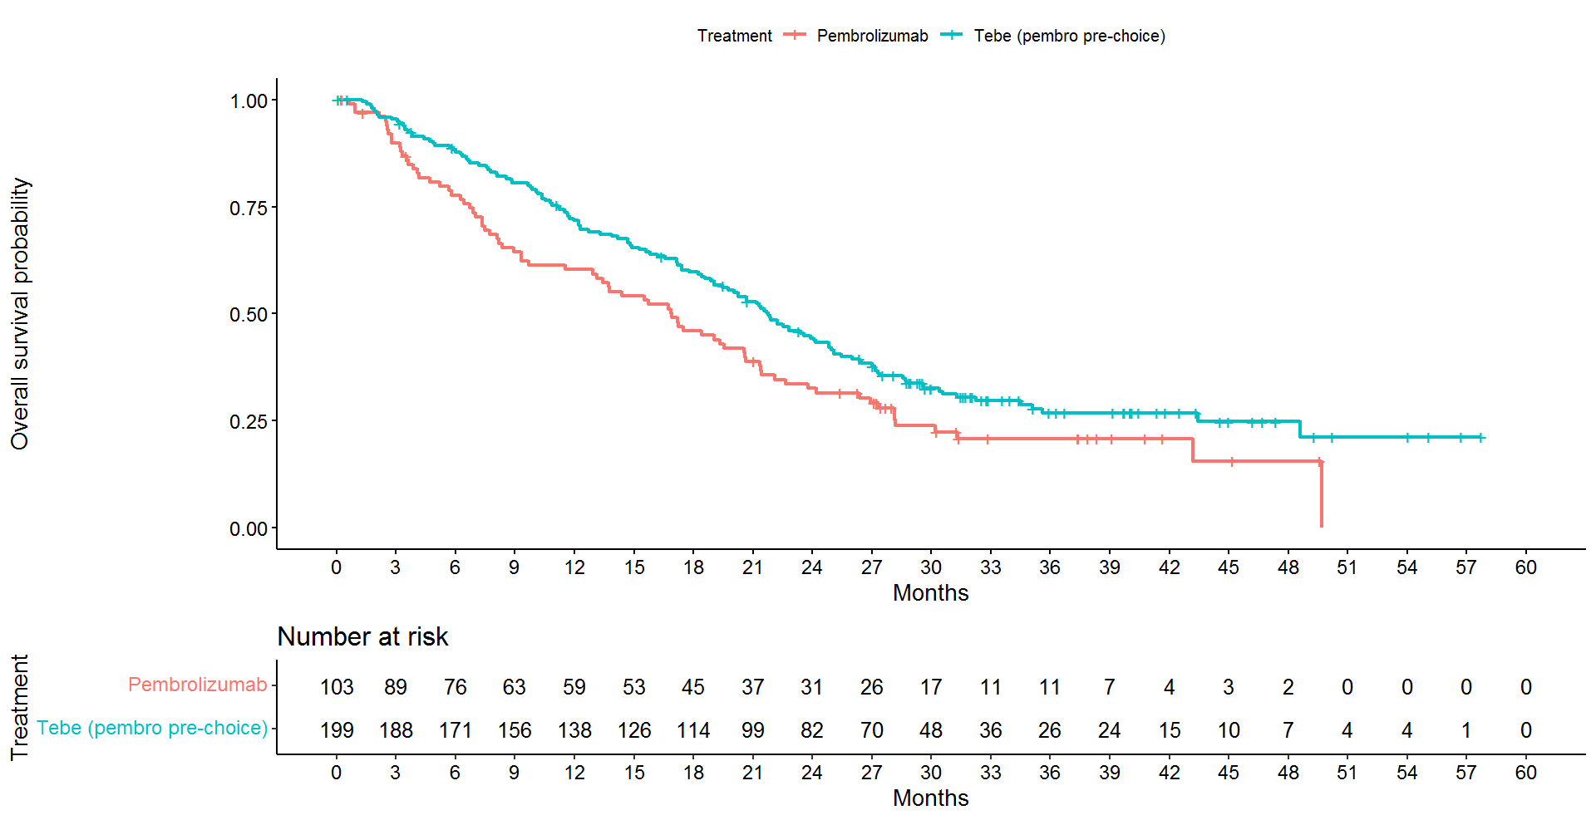
Overall survival for subgroup tebentafusp PCP vs pembrolizumab
CONFIDENTIAL
RECAP
IMCgp100-202 OS (PCP subgroup- Nov 2022 cut-off )
 | Median (months) KM estimates (95% CI)
Tebentafusp PCP (n=252) | 21.7 (19.5 to 24.8)
Pembrolizumab (n=103) * | 16.9 (13.1 to 20.6)
*includes 14 patients who crossed over to tebentafusp arm
KM OS Nov 2022 PCP subgroup
Company KM data show survival probability reaches 0 at 5 years in pembrolizumab arm
EAG:
Sudden drop in numbers at risk in pembrolizumab arm at same time point can explain sudden reduction but data uncertain due to lack of precision estimates
See appendix for KM estimates April 2022, April 2024 and fitted post appeal piecewise model
Abbreviations: CI, confidence interval; OS, overall survival.;
PCP, pre choice pembrolizumab
Notes:
Data on slide originally presented at ACM 2- based on company’s ACD comments response; data sweep Nov 2022 (table 1) ) and fig 2 in EAG response to CS addendum 2

Slide 11
Appraisal hearing outcome conclusions
Appraisal recap and appeal history
DSU Expert elicitation
Long-term overall survival
BSC resource use
Abbreviations: DSU, Decision Support Unit; BSC, best supportive care

Slide 12

Post appeal considerations- DSU elicitation of expert opinion
Appeal panel view
Reasonableness is required to seek expert clinical input on areas of important residual uncertainty:
  the most appropriate choice, and interpretation of survival curve models to interrogate the available data,
  the most appropriate means of allocating supportive care costs in the model.
NICE commissioned the DSU to use a structured approach to:
elicit expert estimates of the expected survival of people with uveal melanoma treated with pembrolizumab and those treated with tebentafusp and the uncertainty around these estimates.
  DSU used a structured elicitation approach: (one online and one face to face workshop)
elicit expert opinion on the resources used in the provision of best supportive care for people with uveal melanoma over the course of their disease after progression
  DSU used an online survey
DSU focused on identifying experts affiliated with specialist centres (identified by NICE)
Input from the company, EAG, NICE and patient groups (Melanoma Focus and OcuMel)
Experts with prior involvement (attendance at ACMs or advisory board meetings) with the topic were excluded
See appendix for expert identification flow diagram
Are the methods used by the DSU to capture expert opinion on OS appropriate?
Abbreviations: ACM, appraisal committee meeting; DSU, decision support unit; EAG, external assessment group; ITT, intention to treat population; OS, overall survival; PCP, pre-choice pembrolizumab; PFS, progression- free survival;

Slide 13
Long-term overall survival
Appraisal recap and appeal history
DSU Expert elicitation
Long-term overall survival
BSC resource use
Abbreviations: DSU, Decision Support Unit; BSC, best supportive care

Slide 14
Post appeal considerations- DSU approach to elicit survival estimates
Appeal panel conclusion
Reasonableness is required to seek expert clinical input on areas of important residual uncertainty:
  the most appropriate choice, and interpretation of survival curve models to interrogate the available data,
  the most appropriate means of allocating supportive care costs in the model.
NICE commissioned the DSU to use a structured approach to:
elicit expert estimates of the expected survival of people with uveal melanoma treated with pembrolizumab and those treated with tebentafusp and the uncertainty around these estimates.
  DSU used a structured elicitation approach: (one online and one face to face workshop)
elicit expert opinion on the resources used in the provision of best supportive care for people with uveal melanoma over the course of their disease after progression
  DSU used an online survey which asked specific questions to obtain opinions on health care resources used by people with advanced uveal melanoma after disease progression
DSU focused on identifying experts affiliated with specialist centres (identified by NICE)
Input from the company, EAG, NICE and patient groups (Melanoma Focus and OcuMel)
Experts with prior involvement (attendance at ACMs or advisory board meetings) with the topic were excluded
See appendix for DSU evidence dossier
Does the DSU approach appropriately capture the appeal panel’s views?
Abbreviations: ACM, appraisal committee meeting; BSC, best supportive care DSU, decision support unit; EAG, external assessment group; ITT, intention to treat population; OS, overall survival; PCP, pre-choice pembrolizumab; PFS, progression- free survival;

Slide 15
Long-term overall survival
Appraisal recap and appeal history
DSU Expert elicitation
Long-term overall survival
BSC resource use
Abbreviations: DSU, Decision Support Unit; BSC, best supportive care

Slide 16
Upheld appeal points relating to overall survival
Appellant | Upheld appeal point | Appeal panel conclusions
Immunocore | Concluding that OS modelling is highly uncertain and standard parametric approaches are most appropriate for both treatment arms cannot be reasonably justified | Unreasonable to not consider clinical expert opinion in understanding plausibility of the 5-year survival
 | Applying standard parametric modelling to OS not justified as led to clinically implausible results: in EAG's model the estimate of 5-year survival in the comparator arm is 4-fold higher than published historical data. | Unreasonable in not ensuring adequate input from clinical experts in helping them resolve areas of important residual uncertainty
 | Concluding company's modelling overestimated proportion surviving long term as extrapolations suggest people did not die in the parametric section is incorrect - demonstrates committee misunderstood modelled survival data, and committee's conclusion cannot reasonably be justified. | Experts input essential before conclusions can be drawn about plausibility of modelled estimates of long-term survival.
Melanoma focus | FDG misinterprets expert opinion and makes an inappropriate conclusion to justify use of parametric curves (3.11 FDG)
Abbreviations: EAG, evidence assessment group; FDG, final draft guidance; OS, Overall Survival

Slide 17
Elicitation Exercise: Overall survival – Background and method (1)
Background
At ACM2 tebentafusp was compared with pembrolizumab in the PCP subgroup using survival data from IMCgp100-202 (April 2022 DCO)
Company base case: piecewise model for tebentafusp arm (KM to 28 months and lognormal for 28 months onwards) and standard parametric model (Weibull) for the pembrolizumab arm
EAG exploratory base case: Standard parametric approaches (generalised gamma or log logistic in both arms).
Committee preferred the standard parametric approach
DSU elicitation: Based on evidence using SHELF protocol
Experts asked to consider perspective of a “Rational Impartial Observer”*, assumed to have listened to discussion, saw all evidence and impartially consider their own uncertainty, then agree a set of probability judgements an observer would make on long term survival
Used evidence from IMCgp100-202 (June 2023 DCO) and supporting evidence from earlier data cut off
Additional supporting data from a meta analysis by Rantala et al.2019**and other trials***
Table: Quantities of Interests elicited in the online and face-to-face workshops
Quantity of interest 1 | PCP subgroup population of IMCgp100-202 tebentafusp arm: Proportion who would still be alive at year 8 after randomisation¹
Quantity of interest 2 | PCP subgroup population of IMCgp100-202 pembrolizumab arm²: Proportion who are still alive at year 8 after randomisation¹
* assumed to have reviewed Evidence Dossier and observed individual judgements and group discussion**Previously presented in ACM 1&2 ; *** reviewed by company and other experts prior to workshop ¹expressed as a number per 1000; ² excluding effect of tebentafusp as a subsequent treatment
Abbreviations: DCO, data cut-off; OS, overall survival; PCP, pre-choice pembrolizumab; RIO, rational impartial observer; SHELF, Sheffield elicitation framework v4

Slide 18
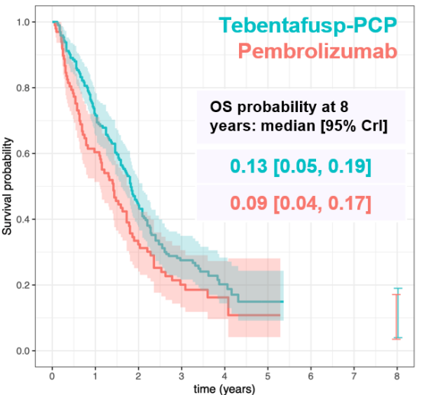
Elicitation Exercise: Overall survival – Results (2)
Figure: Kaplan-Meier of reconstructed OS data (DCO June 2023)
Reconstructed OS data (DCO June 2023) with the plotted RIO 95% credible
interval from the face-to-face workshop [n=5]
All experts considered tebentafusp was more effective than pembrolizumab with a difference in OS at 8 years.
All experts were hesitant to suggest a cure potential due to the limited data.
In the online group [n=6] OS probability at 8 years:
Tebentafusp 0.10 [0.04,0.18]
Pembrolizumab 0.07 [0.02,0.17]
See appendix for percentiles of OS probability from RIO distribution for both workshops
Abbreviations: CrI, credible interval: DCO, data cut-off; KM, Kaplan-Meier; OS, overall survival; PCP, pre-choice pembrolizumab; RIO, rational impartial observer
Notes:
See fig 1 and table 1 in DSU main report

Slide 19
Elicitation Exercise: Overall survival – company critique (3)
Company raised several concerns regarding the DSU elicitation
Table: Company comments on elicitation approach
Issue | Concern | Specific comments
Methodology | No guidance on how results should be interpreted | No direction on how best to ensure clinical plausibility in combining or interpreting outputs Wide variability in experts’ opinion on the 8-year survival estimate Most experienced clinicians were excluded 8-year outcome seemed arbitrary. Estimates at a single time point and single scenario did not consider if other estimates could influence results
Face validity of OS estimates | Marginal difference in CrI between arms | OS estimates in DSU report differ significantly from published primary analysis and 3-year analysis of IMCgp100-202 Historical data is most robust evidence for survival with advanced uveal melanoma without tebentafusp
Impact of subsequent treatment on OS estimates | Survival with pembrolizumab is over-estimated in DSU analysis | Historical data shows 0 to 5% survival at 5 years - inconsistent with DSU Using tebentafusp as a subsequent therapy to pembrolizumab can confound OS of the pembrolizumab group Choice of alternative immunotherapies after pembrolizumab is limited so most recent data from IMCgp100-202 do not reflect current practice
Abbreviations: CrI, credible interval; DSU, decision support unit; OS, overall survival
See appendix for published OS estimates for IMCgp100-202 in primary analysis, and 3 year follow-up and 3-year follow-up for tebentafusp vs pembrolizumab
Notes:
See addendum 3 p12 to 20

Slide 20
Elicitation Exercise: Overall survival – Other comments
Other comments- Melanoma Focus response
8 years as a landmark is curious because uncertainty at this time point will be significant given the lack of precedent with this new class of agent. Would like to understand why a 5 year landmark was not chosen
There was no discussion on whether other studies would be relevant especially to reflect control arm performance of the control arm, whether extrapolations reflect historical data and whether cross-over of patients from the experimental to the control arm had an impact on control arm performance.
Abbreviations, KM, Kaplan-Meir , OS overall survival

Slide 21
Elicitation Exercise: Overall survival – company model updates
Company OS modelling updates | Company rationale | EAG critique
Retained IMCgp100-202 (DCO April 2022) overlaid OS extrapolations with recent data cuts from IMCgp100-202 (DCO June 2023) and (April 2024). | April 2024 (latest DCO) OF IMCgp100-202 data is confounded because of High censoring in tebentafusp group due to study closure 19% in pembrolizumab arm had tebentafusp after stopping pembrolizumab | Censoring and crossover could affect estimate but unclear what direction of effect is - likely that crossover to tebentafusp would increase survival. Rantala et al. 2019 data is limited by differences in treatment mix - EAG recommends attempt made to adjust for crossover despite data limitations
Tebentafusp: Retained piecewise (cut 26 months, log-logistic distribution); Pembrolizumab: Fully parametric (lognormal) | Earlier cut-point and larger dataset addresses uncertainty from ACM2. But this approach gave 8-year OS probability within 95%CI of DSU elicitation Lognormal best fitting and produced long-term OS aligned with DSU elicitation | log-logistic is plausible approximation for the OS of tebentafusp and pembrolizumab. EAG also propose 2 additional scenario analyses, in line with evidence from the DSU elicitation, to further explore impact of alternative OS extrapolations No apparent justification for using same data but updating the cut point
Abbreviations: DCO, data cut-off; DSU, decision support unit; KM Kaplan Meier OS, overall survival; PCP, pre-choice pembrolizumab
See appendix for OS overlay and company OS base case distributions

Slide 22
Elicitation Exercise: Overall survival – EAG critique of company response (1)
Additional EAG critique
EAG preferred a standard parametric approach in its base-case:
  Maintains view that KM curves might overfit trial data and seems suboptimal for decision-making
  Reiterated view that company’s piecewise approach had limitations (estimating from baseline not the cut-point)
Does not consider Rantala et al (2019) an appropriate source of validating extrapolations with external data:
  Appeal panel had noted few people in study had pembrolizumab and majority received as 2nd line treatment
  Reiterated Rantala study was useful as a ‘lower limit benchmark’
  Considered difference in 8-year OS between treatments in company’s updated base case does not seems plausible and/or in line with the DSU expert elicitation results
See appendix for comparison of predicted OS at 8 years
Abbreviations, KM, Kaplan-Meir , OS overall survival

Slide 23
Elicitation Exercise: Overall survival – EAG critique of company response (2)
Table: Comparison of predicted OS at 8 years
 | Predicted 8-year OS probability (PCP)
 | Tebentafusp | Pembrolizumab | Increment
DSU (online expert elicitation) | 0.100 (CI: 0.040-0.19) | 0.070 (CI: 0.020-0.170) | 0.030
DSU (face-to-face expert elicitation) | 0.130 (CI: 0.05-0.19) | 0.090 (CI: 0.040-0.170) | 0.040
Company - ACM 2 ª | 0.199 | 0.006 | 0.193
EAG (generalised gamma) - ACM 2 | 0.043 | 0.044 | -0.001
EAG (log-logistic) - ACM 2 | 0.077 | 0.062 | 0.014
Company - post appeal ^{b} | 0.162 | 0.056 | 0.106
EAG - post appeal scenario 1^{c} | 0.079 | 0.056 | 0.023
EAG - post appeal scenario 1^{d} | 0.077 | 0.044 | 0.032
ªTebentafusp: Kaplan-Meier + log-normal cut-off point:28 months , pembrolizumab: Weibull distribution
^{b} Tebentafusp: Kaplan-Meier + log-logistic; cut-off point: 26 months, pembrolizumab: log-normal distribution
^{c} Tebentafusp and pembrolizumab: log-normal distribution
^{d} Tebentafusp: log-logistic distribution, pembrolizumab: generalised Gamma distribution
What is the committee’s preferred approach to extrapolate long-term OS?
Abbreviations, ACM, appraisal committee meeting; CI, 95% credible interval; KM, OS overall survival
Notes:
See table 2.1 in EAG post appeal response

Slide 24
BSC Resource use
Appraisal recap and appeal history
DSU Expert elicitation
Long-term overall survival
BSC resource use
Abbreviations: DSU, Decision Support Unit; BSC, best supportive care

Slide 25
Upheld appeal points relating to best supportive care resource use
Appellant | Upheld appeal point | Appeal panel conclusions
Immunocore | Committee’s endorsement of a monthly best supportive care costs model was unreasonable in the light of clinical experts’ comments in support of a one-off aggregated cost model. | Input from clinical and patient experts is essential to understand the best approach to applying best supportive care costs in the model, No evidence that the EAG had sought expert input in determining their preferred approach to applying best supportive care costs Panel were not convinced that the committee had made sufficient effort to consider additional expert advice before arriving at their own conclusions
OcuMel | Decision to adopt modelling using monthly best supportive care costs is unreasonable because the ERG and/or the Committee did not take due account of appropriate experts in reaching their views
Abbreviations: EAG, evidence assessment group; FDG, final draft guidance

Slide 26
DSU Elicitation Exercise: BSC resource use – Background and method (1)
Background
Company and EAG had used different approaches to apply BSC costs
Company implemented one-off cost (equating to costs associated to 4-months BSC resource use)
  BSC costs were independent to the amount of time spent in progressed disease state and included end-of-life costs in the model
EAG implemented monthly cost dependent on the amount of time spent in the progressed disease state and removed end of life costs due to concerns about double-counting
DSU elicitation
DSU carried out an online survey (12 experts responded)
Provided background on how BSC resource use was modelled and asked the following:
Would patients start receiving BSC when they have progressed, irrespective of the level of deterioration in their quality of life?
2. Would the sub-population of longer-term survivors be receiving BSC after progression?
3. Would the rest of the population (i.e. non-long-term survivors) receive BSC after progression?
Participants were asked to provide any additional information or comments relating to BSC in advanced uveal melanoma patients that they felt was relevant to the technology appraisal
Abbreviations: BSC, best supportive care

Slide 27
DSU Elicitation Exercise: BSC resource use – DSU participant comments
Issue | Comments
Mixed views on allocation of BSC use at progression | Progressive symptoms would need palliative care and monitoring Asymptomatic would be monitored for deterioration and progression-associated symptoms but may not have other BSC Some experts stated that all patients would be referred to community palliative care units to plan long-term care regimes
Long term / non- long- term survivors | BSC resource use based on symptoms. Non-long-term survivors were expected to have BSC after progression, but also dependent on their symptoms
BSC duration | Length of time BSC would be provided for would be correlated with the severity/complexity of symptoms at progression
Abbreviations BSC, best supportive care; DSU Decision support unit

Slide 28
Elicitation Exercise: BSC resource use – Stakeholder responses
Company critique
DSU report results do not provide any clinical justification for applying monthly costs from progression onwards.
DSU results are consistent with BSC costing applied in the company base case so So BSC costs is unchanged
  Company base case assumed all patients have 4 months of BSC
  Clinical expert opinion in DSU report considered BSC would be provided for a few weeks to 12 months.
Company rationale | Supportive notes in DSU report
Responses highlighted that an individualised approach is based on symptomatic status which may not correlate with radiological progression | “The experts believed intensity of BSC resource use would increase in the final months of life, and for some patients having BSC immediately after radiological progression, BSC use will be minimal due to the lack of symptoms” “Experts expressed that patient referral for BSC is an individualised decision based on patient symptoms”
OcuMel response to DSU report results
BSC is a broad term and questions could have been clearer. Varied responses reflect ambiguity in phrasing
More questions could have helped understand ‘resources used in the provision of BSC after progression’
Worry the committee will still be unclear on what supportive care looks like for people with uveal melanom
Are the methods used by the DSU to capture expert opinion on BSC resources costing appropriate?
Abbreviations BSC, best supportive care, DSU, Decision Support Unit

Slide 29
Elicitation Exercise: BSC resource use – EAG Critique
EAG critique
DSU survey does not really address appropriateness of whether BSC costs would be dependent on time between progression and death but individual responses indicated that BSC would be started at point of progression and would be given until death
EAG still prefer incorporating monthly BSC costs per cycle in the PD health state but remove end of life costs to prevent potential double counting
EAG rationale | Supportive notes in DSU report
Statements supported assumption that BSC costs are dependent on time between progression and death | A range of durations of BSC provided by experts were described in the report Referral for BSC is an individualised decision based on patient symptoms All patients will have regular reviews in order to monitor disease progression Patients with symptoms associated with progression would require palliative care and further monitoring Asymptomatic patients would be monitored for deterioration and development of progression-associated symptoms but may not have other aspects of BSC.
BSC would be started at point of progression until death | “Those with progression would need ongoing BSC until death from disease or the development of a suitable treatment for them” “BSC initiated at point of progression and duration would be for the anticipated life expectancy (median 9-12 months)”
Should BSC costs include a one-off cost for BSC or monthly costs per cycle?
Abbreviations BSC, best supportive care, DSU, Decision Support Uni, EAG, evidence assessment group

Slide 30
Summary of company and EAG base case assumptions
Table: Assumptions in company and EAG base case
Company post appeal base case | Company post appeal scenario analyses | EAG post appeal preferred approach | EAG post appeal alternative approach
Overall survival: At ACM 2 Committee preferred standard parametric approach to extrapolate OS data in both arms
Tebentafusp = piecewise (KM to 26 months and log-logistic) Pembrolizumab = standard parametric (log-normal) | Standard parametric Tebentafusp = log-logistic or generalised gamma * Pembrolizumab = Weibull, Exponential or Gompertz, Weibull and log-normal ** Log-logistic or generalised gamma to both arms *** | EAG presented a range of alternative scenarios Standard parametric: Log-normal to both arms Log-logistic to both arms Tebentafusp = log- logistic Pembrolizumab = generalised gamma
Stopping rule: At ACM 2 Committee concluded it was not appropriate to have a 2 year stopping rule
No stopping rule | 2 year stopping rule in both arms **** | No stopping rule | Explored alternative treatment effect waning assumptions
Best supportive care costs: At ACM2 Committee concluded estimated costs of subsequent treatment are uncertain
One-off cost at point of progression ^{1, 2} | N/A | Monthly BSC costs per cycle^{1, 3} | N/A
Treatment adherence: At ACM2 Committee concluded treatment adherence in both arms should be consistent
Tebentafusp arm = 92% pembrolizumab not adjusted¹ | N/A | Consistent approach to including adherence correction for calculation treatment acquisition costs¹
* consistent with DSU estimates, **to align with Rantala et al (2019), ***to align with EAG preferred OS from ACM2, **** consistent with 2-year stopping rule in TA950
¹Retained assumption presented at ACM2;² includes end-of-life costs to reflect additional management in final year of life, ³ removed end of life costs to prevent potential double counting

Slide 31
Cost-effectiveness results
All ICERs are reported in PART 2 slides because they include confidential comparator PAS discounts
Summary of base case results
Base case | ICERs
Company post appeal base case | Over £50,000 per QALY
EAG post appeal alternate scenarios* | Over £100,000 per QALY
* EAG presented 3 different extrapolation scenarios (see slide 30)
Abbreviations ICER, incremental cost-effectiveness ratio; QALY, quality-adjusted life year;

Slide 32
Key issues for committee discussion
Key issues | Impact
Are the methods used by the DSU to capture expert opinion on OS modelling appropriate? | High
What is the committee’s preferred approach to extrapolate long-term OS? | High
Are the methods used by the DSU to capture expert opinion on BSC resources costing appropriate? | High
Should BSC costs include a one-off cost for BSC or monthly costs per cycle? | High
Abbreviations, BSC, best supportive care; DSU, Decision support unit
t

Slide 33
Thank you.
© NICE 2024. All rights reserved. Subject to Notice of rights.

Slide 34
Tebentafusp for treating advanced unresectable or metastatic uveal melanoma [ID1441]
Supplementary appendix

Slide 35
Elicitation Results: Overall survival
Percentiles of overall survival probability at 8 years post-randomisation from the fitted RIO distribution from both workshop groups
Percentile | 1% | 2.5% | 10% | 25% | 50% | 75% | 90% | 97.5% | 99%
Online (Tebentafusp) | 0.04 | 0.04 | 0.06 | 0.08 | 0.10 | 0.12 | 0.15 | 0.18 | 0.20
Face-to-face (Tebentafusp) | 0.03 | 0.05 | 0.08 | 0.10 | 0.13 | 0.15 | 0.17 | 0.19 | 0.20
Online (Pembrolizumab) | 0.02 | 0.02 | 0.04 | 0.05 | 0.07 | 0.10 | 0.13 | 0.17 | 0.19
Face-to-face (Pembrolizumab) | 0.03 | 0.04 | 0.05 | 0.07 | 0.09 | 0.11 | 0.14 | 0.17 | 0.19
Factors that could increase hazard over time¹ | Factors that could decrease hazard over time¹
aging and medical comorbidities; less effective subsequent therapies volume of disease and long-term toxicity effects² | biology results in longer-term survival³ disease progression despite appearing clinically well good disease control
¹ based on expert conclusion; ² experts considered this unlikely for single-agent immunotherapies; ³ irrespective of treatment
Link to Elicitation results Overall survival (2)
Notes:
See table 1 in DSU main report

Slide 36
Elicitation Results: Overall survival critique
Face validity of OS estimates
Table: OS estimates in published primary analysis and 3-year analysis for IMCgp100-202
IMCgp100-202 OS (data cut off Nov 2020) |  |  | IMCgp100-202 OS (data cut off June 2023)
 | Median (months) KM (95% CI) | Hazard ratio (95% CI) | Median (months) KM (95% CI) | Hazard ratio (95% CI)
Tebentafusp | 21.7 (18.6 to 28.6) | 0.51 (0.37 to 0.71) | 21.6 (19.0 to 24.3) | 0.68 (0.54 to 0.87)
Control | 16.0 (9.7 to 18.4) |  | 16.9 (12.9 to 19.5)
Link to Elicitation results Overall survival (3)
Notes:
See fig 2 in company response (addendum 3)

Slide 37
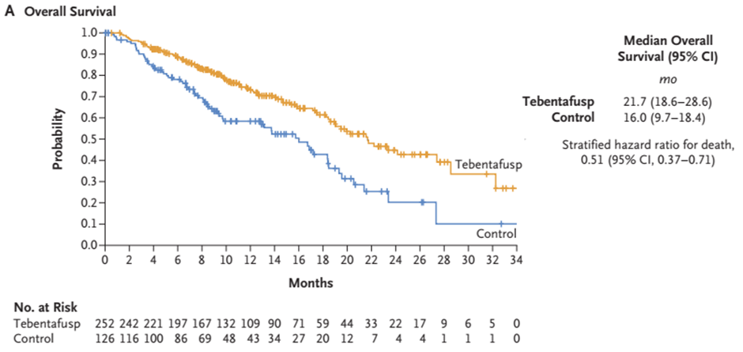
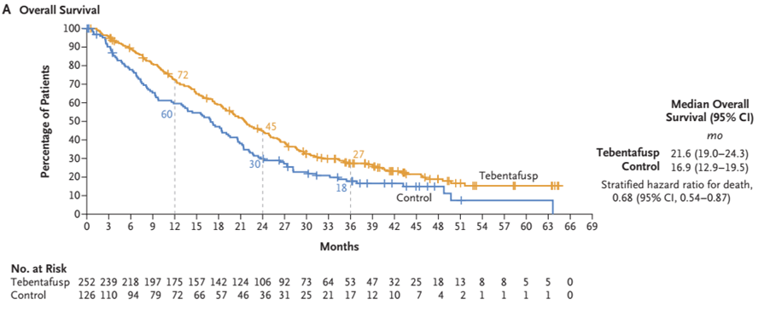
Elicitation Results: Company critique (1)
Figure: Overall survival in study IMCgp100-202 in Primary analysis, (Nathan et al, 2021; data cut-off October 2020)
Figure: Overall survival in study IMCgp100-202 in 3-year analysis, data cut-off June 2023
Link to Company critique
Notes:
See fig 2 in company response (addendum 3)

Slide 38
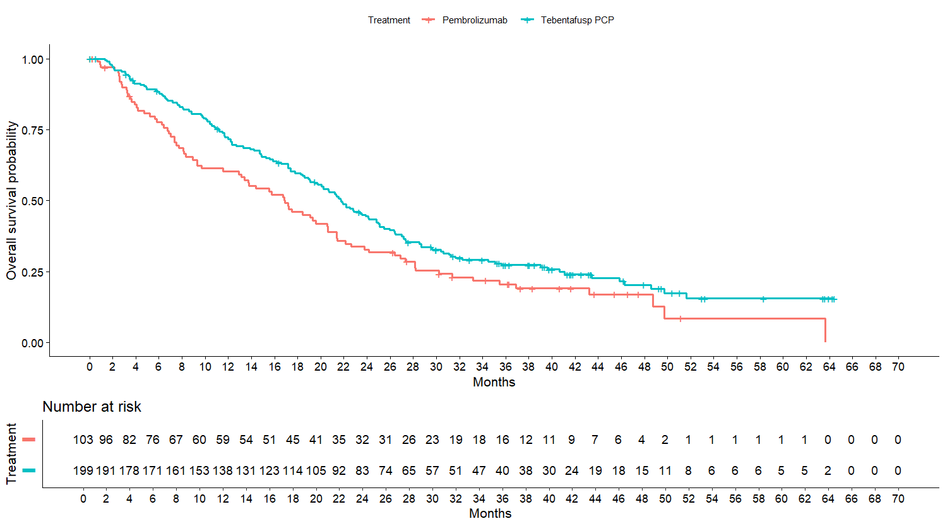
Elicitation Results: Company critique (2)
Figure: Overall survival in study IMCgp100-202 in 3-year analysis for PCP tebentafusp compared to pembrolizumab
Link to Company critique
Notes:
See fig 2 in company response (addendum 3)

Slide 39
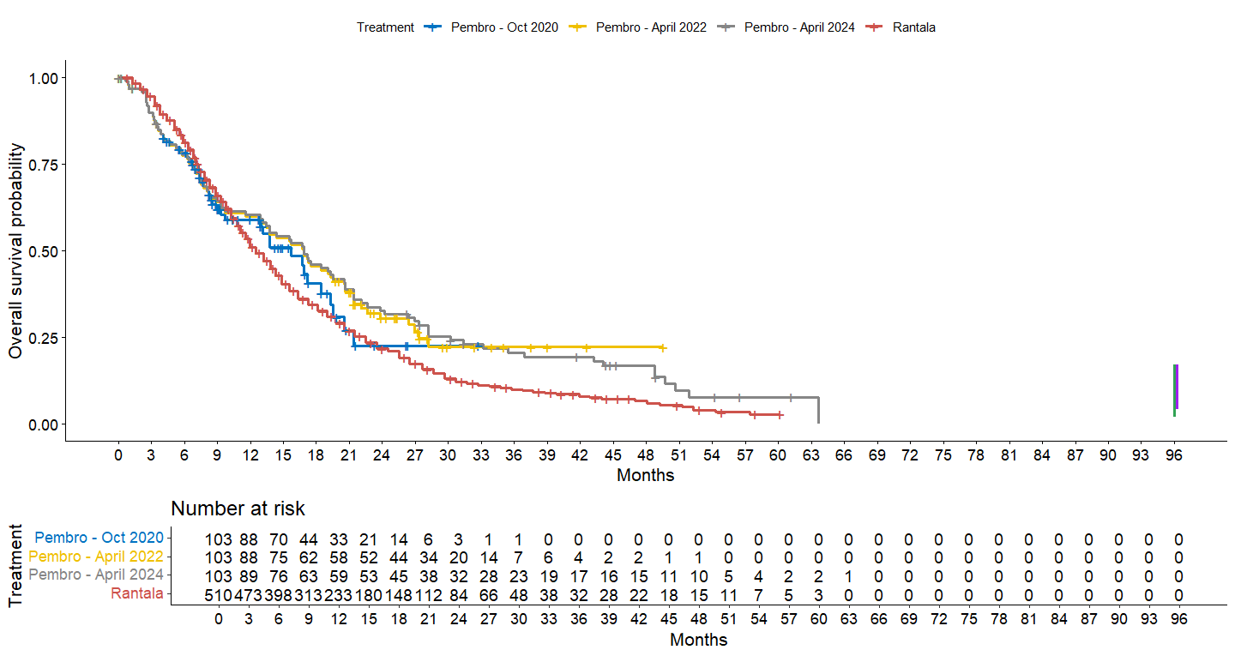
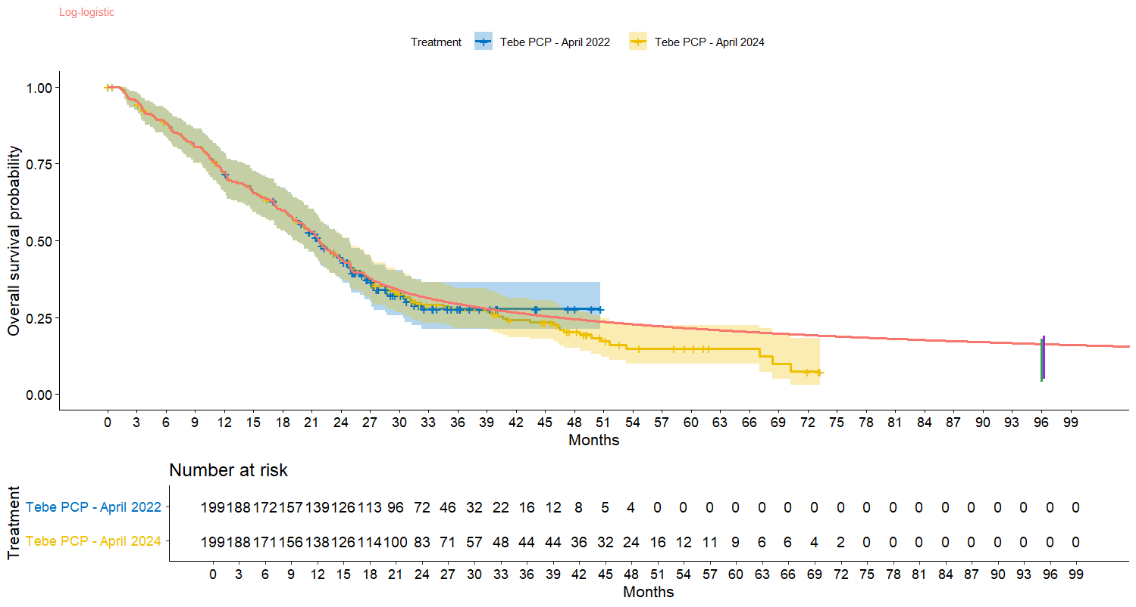
Elicitation Results: Company model updates
Figure: OS overlay in IMCgp100-202 (pembrolizumab group Oct 2020, April 2022 and April 2024 with Rantala et al. 2019)
Figure: OS overlay in IMCgp100-202 (Tebentafusp PCP KM estimates April 2022, April 2024 and fitted piecewise model 26-month log-logistic)
Link to Company model updates and recap of OS data
Notes:
See fig 8 and fig 9 in company response (addendum 3)

Slide 40
Elicitation Results: Company model updates
Table: Company’s updated base case distributions
Parameters | Previous modelling |  | Revised modelling July 24
Treatment | Tebentafusp PCP | Pembrolizumab | Tebentafusp PCP | Pembrolizumab
Distribution | Piecewise 28-months lognormal | Weibull | Piecewise 26 months log logistic* | Lognormal*
5-year OS | 23.4% | 5.0% | 21.2% | 11.6%
8-year OS | 19.9% | 0.6% | 16.2% | 5.6%
10-year OS | 18.5% | 0.2% | 14.3% | 3.8%
* carried out additional scenario analysis based on ERG preferred scenario (Log-logistic or generalised gamma in both arms for the complete dataset)
Link to Company model updates
Notes:
See table 1 in company response (addendum 3)

Slide 41
Post appeal considerations- DSU evidence dossier
DSU action | Source
Evidence Dossier of IMCgp100-202 data and additional sources identified | IMCgp100-202 data: Baseline characteristics OS for tebentafusp PCP subgroup (June 2023 data);TTD for tebentafusp PCP subgroup (April 2022 data) and PFS for the ITT group (August 2021 data) Additional IMCgp100-202 data and IMCgp100-102 data External meta-analyses (Rantala et al. 2019, Khoja et al. 2019) Additional tebentafusp data and data for other interventions
See appendix for post appeal considerations
Abbreviations: DSU, decision support unit; EAG, external assessment group; ITT, intention to treat population; OS, overall survival; PCP, pre-choice pembrolizumab; PFS, progression- free survival

Slide 42
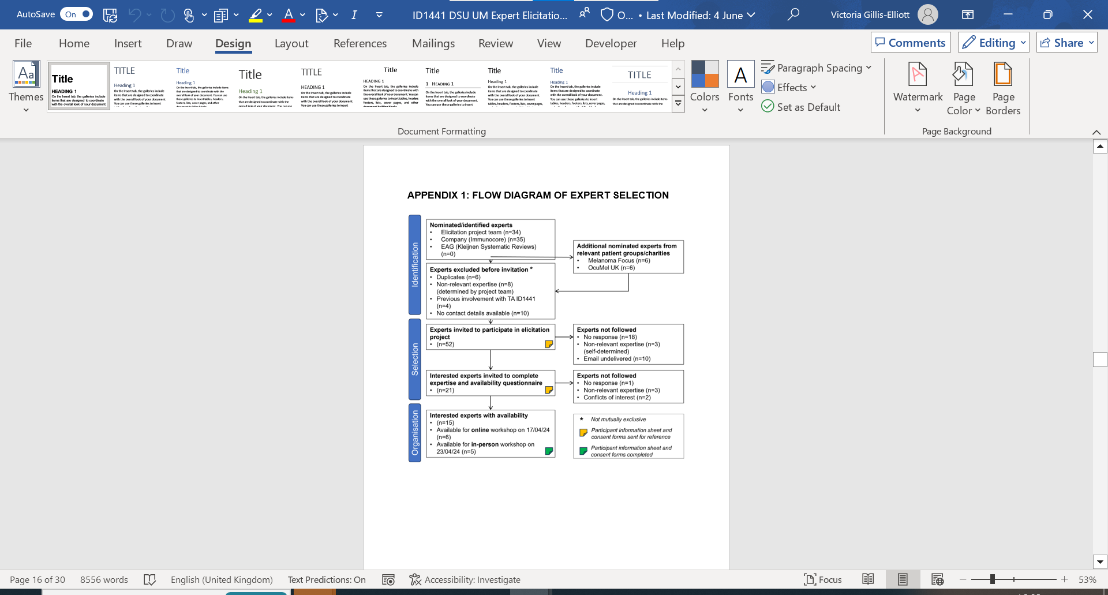
Post appeal considerations- DSU expert identification flow diagram
See appendix for post appeal considerations
Notes:
See appendix 1 in DSU main report

Slide 43
Post appeal considerations- DSU evidence dossier
DSU action | Source
Evidence Dossier of IMCgp100-202 data and additional sources identified | IMCgp100-202 data: Baseline characteristics OS for PCP subgroup (June 2023 data);TTD for PCP subgroup (April 2022 data) and PFS for the ITT group (August 2021 data) Additional IMCgp100-202 data and IMCgp100-102 data External meta-analyses (Rantala et al. 2019, Khoja et al. 2019) Additional tebentafusp data and data for other interventions
1 online and 1 face to face workshop | Experts reviewed evidence dossier and agreed a set of probability judgements from a “Rational Impartial Observer” perspective
See appendix for post appeal considerations
Abbreviations: DSU, decision support unit; EAG, external assessment group; ITT, intention to treat population; OS, overall survival; PCP, pre-choice pembrolizumab; PFS, progression- free survival

