Slide 1
Cladribine for treating relapsing multiple sclerosis [ID6263]
Redacted – for screen
Technology appraisal committee B, 5th February 2025
Chair: Charles Crawley
Lead team: Rhiannon Owen, Alistair Patton, Nigel Westwood
External assessment group: Warwick Evidence
Technical team: Lorna Dunning, Rufaro Kausi, Sammy Shaw
Company: Merck Serono
© NICE 2025. All rights reserved. Subject to Notice of rights.

Slide 2
Technology (Mavenclad, company)
Marketing authorisation | Extended marketing authorisation approved by MHRA in March 2024: Treatment of adult patients with relapsing forms of multiple sclerosis with active disease as defined by clinical or imaging features
Mechanism of action | Immune reconstitution therapy; temporarily depletes immune system, allowing it to regenerate Deaminase-resistant nucleoside analogue of deoxyadenosine Selectively reduces dividing and non-dividing T and B cells, which interrupts the cascade of immune events central to MS
Administration | Tablets are administered orally Cumulative dose is 3.5 mg/kg body weight over 2yrs (1.75 mg/kg per year) Two treatment weeks per year; beginning of the first month and beginning of second month (same for second year) Each treatment week consists of 4 or 5 days on which a patient receives 10mg or 20 mg (one or two tablets) as a single daily dose, depending on body weight No further treatment is required in Years 3 and 4 (see dosing diagram in appendix)
Price | Confirmed list price for cladribine tablets: 10 mg x 1 tablet £2,047.24 Annual cost: approximately £13,000 per annum, based on £52,000 (complete treatment cost spread over 4-yr period) No PAS agreed
Abbreviations: MHRA, Medicines and Healthcare products Regulatory Agency; MS, multiple sclerosis; PAS, patient access scheme.
Notes:
PRICE - The approximate treatment cost of £52,000 was calculated based on the average of 12.7 tablets per patient per year, based on the results of the CLARITY trial. The number of tablets per patient, and therefore total annual cost, may vary depending on patient’s weight, as cladribine tablets are an oral medication where the recommended cumulative dose is 3.5 mg/kg body weight over 2 years. Annual cost: approximately £13,000 per annum when the complete treatment cost of approximately £52,000 is spread over a 4-year period

Slide 3
Cladribine appraisals recap
Dec 2017
TA493 Cladribine recommended for adults with highly active relapsing multiple sclerosis
Nov 2019
TA616 (Review of TA493 to accelerate uptake)
Same population as TA493, but removed barriers to accessing cladribine, namely, the requirement for gadolinium-enhancing MRI before treatment
May 2024
Recommendation 1.1 of TA616 was updated to address concerns that definition of rapidly evolving severe (RES) multiple sclerosis was overly restrictive
Nov 2024
ACM1 for ID6263
Population addressed by company is ‘Adults with active relapsing-remitting multiple sclerosis’
Won’t consider highly active relapsing multiple sclerosis as this is covered in TA616
Abbreviations: MRI, magnetic resonance imaging; ACM1, appraisal committee meeting 1.

Slide 4
Types of multiple sclerosis
50%-60% in 15-20 yrs
Primary progressive MS
10-15% people at diagnosis
Gradual disability progression from onset with no obvious relapses or remission
Relapsing-remitting MS (RRMS)
85% of people at diagnosis
Treatment strategy: patient choice, number of relapses, MRI activity and response to previous treatment
Secondary progressive MS (SPMS)
Steady progression of neurological damage with or without relapses
Comes after RRMS for many people
Active
At least two clinically significant relapses occur within the last 2 years
Highly active
1 relapse in previous year and MRI evidence of disease activity despite treatment with DMT
Rapidly evolving severe (RES)
2 or more relapses in the previous year
baseline MRI evidence of disease activity
TA616
Abbreviations: MRI, magnetic resonance imaging; DMT, disease-modifying therapy.
Notes:
Source: Peginterferon beta-1a technical report and company submission document B section B.1.3.1 (p16)
The Consortium of Multiple Sclerosis Centers (CMSC) states that you’re more likely to have highly active MS if:
You reach an EDSS score of 4 within five years of your MS symptoms beginning.
Your EDSS score changes by two or more points within one year.
Your EDSS score changes and results in new disability.
Should You Take an Advanced MS Treatment? 5 Symptoms To Look For | MyMSTeam
Classifications: ~85% relapsing-remitting (incl. RES) which develop secondary progressive and 15%
85% relapsing-remitting MS
On average, most will develop secondary progressive MS after 20 years
15% primary progressive MS
MS can be active (recent flare up), not active, and highly active (flare ups more often, also see slide notes)

Slide 5
Recap from ACM1
Preliminary decision
Cladribine is not recommended, within its marketing authorisation, for treating relapsing forms of multiple sclerosis with active disease, as defined by clinical and imaging features, in adults.

Slide 6
Committee’s conclusions at ACM1
Draft guidance
RECAP
Draft guidance section | Committee’s conclusion
3.2 Benefits of cladribine | Cladribine’s dosing schedule has benefits compared with existing treatment options.
3.3 Clinical management | Cladribine would be a welcome additional treatment option for people with MS.
3.4 Comparators | Most appropriate comparators for cladribine were dimethyl fumarate, diroximel fumarate, ocrelizumab, ofatumumab and ponesimod.
3.5 Clinical-effectiveness data sources | CLARITY and CLARITY-EXT were generalisable to the NHS.
3.6 Clinical effectiveness | Cladribine leads to longer delays in time to qualifying relapse and a reduction in annualised relapse rates compared with placebo.
3.7 Network meta-analysis | Uncertainty in the NMA results, noting that they were for the whole RRMS population, but concluded that the company’s NMAs were sufficient for decision making. It welcomed comparison and best-fit assessment of adjusted and unadjusted NMAs.
Abbreviations: ACM1, appraisal committee meeting 1; MS, multiple sclerosis; NMA, network meta-analysis; RRMS, relapsing-remitting multiple sclerosis.

Slide 7
Committee’s conclusions at ACM1 continued…
Draft guidance
RECAP
Draft guidance section | Committee’s conclusion
3.8 The company’s model structure | The model structure and inputs broadly aligned with appraisals in MS. But it thought that the model had considerable structural uncertainty.
3.9 Source of natural history data | Welcomed validation for the existing BCMS registry data and support showing that it reflects outcomes for people with active RRMS in the NHS.
3.10 Treatment discontinuation probabilities | The company should use time to next treatment data from CLASSIC-MS, which has over 10 years of follow-up data. It recommended using this study for stopping cladribine and comparator treatments or, when not applicable, the company’s NMA.
3.11 Mortality rates | More recent data, such as Harding et al. (2018), should be used to inform the mortality rates used for each EDSS state in the cost-effectiveness model.
3.12 Self-injection training for comparator treatments | The cost of injection device training for patients should not have been included.
3.13 Cladribine monitoring costs | The committee preferred the company’s approach of including 1 MRI scan and 2 neurology appointments in total for the 2-year period of active cladribine treatment.
Abbreviations: ACM1, appraisal committee meeting 1; MS, multiple sclerosis; BCMS, British Columbia Multiple Sclerosis; RRMS, relapsing-remitting multiple sclerosis; NMA, network meta-analysis; EDSS, Expanded Disability Status Scale; MRI, magnetic resonance imaging.

Slide 8
Consultation comments

Slide 9
Multiple Sclerosis Society and Multiple Sclerosis Trust
Disappointed with initial decision which limits wider access to an effective DMT for many groups
Key theme: Unmet need and equalities
Cladribine would fill an unmet need for highly effective oral DMTs not requiring travel
For patients, the distinction between active and highly active is irrelevant and negative guidance takes patient choice away when it is not clear why some DMTs work for some people but not others
The low administration burden offers practicality and minimal disruption to people’s lives
Not recommending cladribine could differentially impact young people, women considering pregnancy, minoritised groups, people with disabilities and other groups with characteristics protected by equalities legislation
WHO added cladribine to Essential Medicine List for MS in 2023
Abbreviations: DMT, disease-modifying therapy; WHO, World Health Organisation; MS, multiple sclerosis.

Slide 10
Clinical expert, ABN and UKCPA Neuroscience Committee
Cladribine is an effective DMT which can help with strained MS services and meet unmet need
Subclassifications of RRMS in clinical trials do not necessarily relate to NHS clinical prescribing
Dimethyl fumarate and diroximel fumarate are not relevant comparators as rarely started in NHS practice
Cladribine demonstrates efficacy with comparably mild side effect profile and has the benefit of a short administration with durable effect – expansion of MA is welcomed
Full positive impact on service delivery has not been considered – e.g. staffing, workdays lost
MS has a better prognosis today than historically, but BCMS registry remains the most appropriate way to reflect untreated people – UK MS register may reflect mild cases/those who no longer need treatment
Negative recommendation limits first-line treatment options for certain groups of patients (e.g. when travel is difficult) and adversely impacts protected groups (e.g. younger people, women considering pregnancy, people with disabilities, minority racial groups, and more)
Abbreviations: ABN, Association of British Neurologists; UKCPA, UK Clinical Pharmacy Association; DMT, disease-modifying therapy; MS, multiple sclerosis; RRMS, relapsing-remitting multiple sclerosis; MA, market authorisation; BCMS, British Columbia Multiple Sclerosis.

Slide 11
More draft guidance responders
Biogen Idec Ltd (comparator manufacturer)
Committee should consider approaches used in ongoing appraisal of natalizumab in RRMS [ID6369] to model treatment sequencing and analysis of UK MS registry
Biogen agrees that EDSS specific mortality rates should apply
Concerned that Hawton et al. underestimates the costs of managing RRMS
NICE Medicines Optimisation Team
Title should read ‘relapsing-remitting’ for consistency
Title of this appraisal needs amending to clearly distinguish it from TA616
‘Active’ definition not clear in practice, and ambiguity that cladribine remains an option in highly active
Abbreviations: RRMS, relapsing-remitting multiple sclerosis; MS, multiple sclerosis; EDSS, Expanded Disability Status Scale.

Slide 12
Company Response
Draft guidance Section | Committee’s preferred assumptions at ACM1 (Section 3.15) | Implemented in company base case?
3.9 | Use an updated data source for the natural history model or validate the current BCMS registry data | Explored alternatives and continued with BCMS registry
3.10 | Include the waning assumption agreed by the company and EAG | Agreed and implemented
3.11 | Use variable EDSS-specific mortality rates based on more recent data validated for the population with active RRMS in the UK | Agreed and implemented
3.12 | Use the EAG’s assumption to exclude nurse-led self-administration costs for injectables because the analysis ought to reflect NHS clinical practice | Agreed and implemented
3.13 | Use 1 MRI scan and 2 neurology appointments across the first 2 years of cladribine to capture accurate monitoring costs in line with NHS clinical practice | Agreed and implemented
3.14 | Remove beta interferons and glatiramer acetate as comparators | Agreed and implemented
Abbreviations: ACM1, appraisal committee meeting 1; BCMS, British Columbia Multiple Sclerosis; EAG, external assessment group; EDSS, Expanded Disability Status Scale; RRMS, relapsing-remitting multiple sclerosis; MRI, magnetic resonance imaging.

Slide 13
Company Response
Draft guidance section | Committee’s additional analysis request in Draft Guidance (Section 3.16) | Provided by company in Response to Draft Guidance? | For discussion
3.9 | New analysis that uses validated natural history data and EDSS transition probabilities for the population with active RRMS in the NHS | Yes | Yes
3.10 | Data on time to next treatment from CLASSIC-MS for treatment discontinuation probabilities for cladribine and the comparator treatments or, when not available or applicable, use of the company’s NMA | Yes | Yes
3.10 | Subsequent treatment lines in the model to appropriately model time to next treatment | No, basket treatment sequencing approach | Yes
3.11 | More recent data, such as Harding et al. 2018, to inform the mortality rates used for each EDSS state in the cost-effectiveness model | Yes | No
3.11 | Graphs showing health-state occupation that reflects EDSS state progression and mortality | Yes | No
Details of the company’s response are presented throughout the key issues slides
Abbreviations: EDSS, Expanded Disability Status Scale; RRMS, relapsing-remitting multiple sclerosis; NMA, network meta-analysis.

Slide 14
Key issues – to discuss
Key issue | Issue | ICER impact
1 | Adjusted versus unadjusted network meta-analysis | Small
2 | Validation of source of natural history data for the NHS | Large
3 | Limitations in the model structure | Large
4 | Modelling of treatment discontinuation | Small
5 | More recent EDSS-specific mortality rates | Small

Slide 15
Key issue 1: Adjusted versus unadjusted network meta-analysis (1/2)
Recap (see DG section 3.7)
A network meta-analysis (NMA) was done for each outcome of interest for the whole RRMS population.
Differences (e.g. diagnostic criteria, treatment history of patients) across trials in the NMAs contributed to uncertainty on the reliability of the NMA estimates
Company’s NMA aligned with prior appraisals in RRMS
Committee concluded that NMAs were sufficient for decision making and welcomed comparison and best-fit assessment of baseline risk-adjusted and unadjusted NMAs
Company
At clarification, carried out a baseline risk-adjusted NMA and submitted model fit statistics
Best-fit assessment found the unadjusted (original) NMAs to better fit the data than the baseline risk-adjusted (new) NMAs (see tables with comparison of results from fixed, random effects and baseline risk-adjusted NMAs for ARR, CDP and treatment discontinuation).
For baseline risk-adjusted NMAs, the DIC values are significantly higher than the fixed effect and random effect NMAs which signifies a worse fit in the adjusted models
Scenario analysis using adjusted NMAs increased ICERs for (list price) cladribine across comparator DMTs
Abbreviations: DG, draft guidance; NMA, network meta-analysis; RRMS, relapsing-remitting multiple sclerosis; ARR, annualised relapse rate; CDP, confirmed disability progression; DIC, deviance information criterion.
Notes:
The explanatory scenario using results of the baseline-risk adjusted NMA, mean values (ARR table) were used in the revised base case for ARR, as per the originally submitted economic model.

Slide 16
Key issue 1: Adjusted versus unadjusted network meta-analysis (2/2)
EAG
Supports continued use of company’s unadjusted NMAs for outcome estimates
Acknowledges that baseline risk-adjustment can remove variability across studies, but the lack of placebo arms for ARR (38%), CDP (50%), and treatment discontinuation (43.5%) studies leads to more studies requiring data imputation, limiting the reliability of the model fit and estimates (compared to unadjusted)
Not able to determine if company used missing at random (MAR) assumption
Challenges sole use of DIC to justify FE model over RE model as small differences not meaningful
Difference between FE and RE models falls below the minimal difference threshold of 3 points to indicate a difference in model fit
Is the committee satisfied by the comparison of adjusted and unadjusted NMAs? Does committee prefer to use the original NMA results or the baseline risk-adjusted NMA results?
Abbreviations: DG, draft guidance; NMA, network meta-analysis; RRMS, relapsing-remitting multiple sclerosis; ARR, annualised relapse rate; CDP, confirmed disability progression; DIC, deviance information criterion; FE, fixed-effects; RE, random-effects.
Notes:
The explanatory scenario using results of the baseline-risk adjusted NMA, mean values (ARR table) were used in the revised base case for ARR, as per the originally submitted economic model.

Slide 17
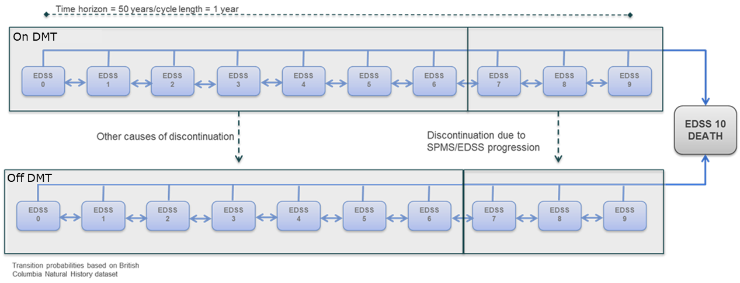
Model structure
11 health state model, based on EDSS scores
Markov state cohort simulation model
EAG agrees the model structure is appropriate for decision making
EDSS measures your current level of disability
EDSS 0 = no disability; higher states indicate worsened/progressed disability
Abbreviations: EDSS, Expanded Disability Status Scale.
Notes:
Section B.3.2.2.1., company submission
Overall, the technology is modelled to affect QALYs by:
• Reducing the annualised relapse rate
• Slowing the progression of disease-related disability over time.
• Lessening the care burden associated with more severe disability states.
• Improving treatment persistence, which in turn reduces relapses and slows the progression from healthier to more severe disability health states.
Overall, the technology is modelled to affect costs by:
• One-off drug acquisition, administration and monitoring costs
• Hospitalisation costs associated with occurrence of relapses requiring hospitalisation
• Management and treatment of ill-health associated with worsening disease progression and disability
• Adverse events costs
The modelling assumptions that have the greatest effect on the ICER are:
• Probability of treatment discontinuation
• Assumptions about waning of treatment effect
• Acquisition and monitoring costs of cladribine

Slide 18
Impact of treatment on QALYs and costs
Treatments impact QALYs by:
Reducing annualised relapses (hospitalisations) Prolonging transitions (lowering probability) to higher EDSS (disease progression) Having a different adverse event profile Reducing caregiver QALY decrement through slower progression*
Model features:
Time horizon: 50 years (lifetime)
Cycle length: 1 year
Sequencing: No treatment sequencing. If people discontinue treatment, they move to BSC arm.
Waning: Efficacy wanes across DMTs to 75% after yr4 and to 50% after yr5 onwards
* Caregiver disutility worsens from EDSS 3, peaks at EDSS 6, and worsens from EDSS 7 to 9
Treatments impact costs by:
Reducing annualised relapse (hospitalisations and rescue therapy) Prolonging transitions (lowering probability) to higher EDSS (disease progression) Having different acquisition, administration and monitoring costs Having different adverse event profile
Abbreviations: DMT, disease-modifying therapy; QALY, quality-adjust life year; EDSS, expanded disability status score; RMSS, relapsing-remitting multiple sclerosis; BSC, best supportive care.
Notes:
Table 28 & section B.3.2.2.1., company submission

Slide 19
Key issue 2: Validation of source of natural history data (1/3)
Recap (see DG section 3.8 and 3.9)
There were 2 key features to the model:
a natural history reference model that modelled the baseline transitions of people with MS regardless of treatment
a treatment-adjusted model that incorporated treatment effects for cladribine and all comparators from company's NMAs.
Clinical experts' opinion was that people with MS in today’s NHS have a much better prognosis than before; spend less time in higher EDSS states and typically die from non-MS-related causes
The committee concerned that BCMS registry data not representative of the UK RRMS population with active disease and welcomed validation of the BCMS registry data or other relevant sources
Company
Conducted a rapid review and provided further justification for the use of BCMS
BCMS registry was used to model the disability progression of people with RRMS in the absence of treatments for this appraisal and prior RRMS appraisals (TA533, TA624, TA767, TA699)
BCMS registry remains the most valid data for untreated MS (supported by Tilling et al. 2016 for the UK)
BCMS registry data used in base case and scenarios explored using 10%, 20% and 30% greater probability of staying in an EDSS state over a cycle to reflect slower disability progression in untreated population
London Ontario data (typically used for RRMS transition to SPMS) also used to model state transitions in a scenario analysis, considered flawed due to post-hoc data censoring and no ability to improve (move to lower EDSS state, e.g. EDSS 5 → EDSS 4)
Abbreviations: DG, draft guidance; MS, multiple sclerosis; NMA, network meta-analysis; MS, multiple sclerosis; BCMS, British Columbia Multiple Sclerosis; RRMs, relapsing-remitting multiple sclerosis; EDSS, Expanded Disability Status Scale; SPMS, secondary progressive multiple sclerosis.
Notes:
Current economic model structure
The economic model structure requires a baseline set of EDSS transition probabilities upon which the treatment effect of cladribine tablets and comparator DMTs can be applied onto. In all previous MS appraisals (TA533, TA624, TA767, TA699), this natural history data set has been based on an untreated population to reflect a ‘placebo’ control.⁸⁻¹¹ In this way, the NMA results for each DMT vs. placebo (for ARR and CDP outcomes) can be applied to this ‘placebo’ control group to generate a new set of transition probabilities for each DMT to inform comparative efficacy

Slide 20
Key issue 2: Validation of source of natural history data (2/3)
Company
Prior analyses of the BCMS dataset looking at trends of disability progression in MS within 15 years from onset has shown that disability progression has not substantially changed over time (Shirani et al 2012)
TA624, the scientific advisory group (SAG) to the UK RSS scheme concluded that the BCMS dataset is the best natural history dataset in terms of the methodology used to capture EDSS score (EDSS prospectively captured) and registry completeness (an estimated 80% coverage of the BCMS population)
The use of a more recent dataset to generate EDSS transition probabilities for an untreated population is associated with potential indication bias, as untreated patients are more likely to have milder disease and patients with more severe disease are more likely to be treated with a DMT given their availability. As a result, a historical dataset, like BCMS, capturing disability progression in an untreated population prior to availability of DMTs, is likely to be more reflective of a broader untreated population, and less subject to bias
Retrieving and analysing data from the UK MS Register for application in the natural history transition matrix would be a resource- and time-intensive exercise and therefore not feasible within the timeframe
Scenarios using 10-30% slower or London Ontario reduces ICERs for cladribine (at list price)
See health state occupation graphs in appendix
EAG
Conducted rapid review for more alternative sources for natural history data and found no further sources
Approves of company’s validation of the BCMS registry data for today’s untreated MS population
Welcomes use of (or validation using) UK MS Register but acknowledges timely access impracticalities
Time and model structure constraints impeded use of company’s 10-30% slower scenarios in EAG revised base case scenarios
Abbreviations: BCMS, British Columbia Multiple Sclerosis; MS, multiple sclerosis; RSS, risk sharing scheme; EDSS, Expanded Disability Status Scale; DMT, disease-modifying therapy.
Notes:
The use of a more recent dataset to generate EDSS transition probabilities for an untreated population — in other words, an untreated population that are potentially eligible for a DMT in a time when DMTs are readily available, but remain untreated— is associated with potential indication bias, as untreated patients are more likely to have milder disease and patients with more severe disease are more likely to be treated with a DMT given their availability.13 As a result, a historical dataset, like BCMS, capturing disability progression in an untreated population prior to availability of DMTs, is likely to be more reflective of a broader untreated population, and less subject to bias

Slide 21
Key issue 2: Validation of source of natural history data (3/3)
BCMS registry data, used in prior RRMS appraisals, may not reflect active RRMS in the NHS
Database (n) | Data collected up to | Country | Company comments
BCMS registry (898) | 1995 | Canada | Used in ACM1 and other RRMS appraisals Disability progression of untreated MS population has not substantially changed (Shirani et al. 2011) More recent data for untreated group, when more treatments are available, may be biased as those untreated are milder case who may not seek or need treatment
UoWMS database (404) | 2011 | UK | Untreated MS population in Wales Comparable disability progression trajectory to BCMS registry (Tilling et al. 2016)
MSBase registry (1,453) | 2024 | Australia | EDSS grouped into 4 states (no disability, mild, moderate and severe) unsuitable for current model (Campbell et al. 2024)
UK MS register (recommended by committee) | 2024 | UK | Gaining access to the data was not possible in the time frame from the draft guidance (at least 3 months from request to access decision)
London Ontario | 1984 | Canada | Data has been used in prior appraisals for transitions from RRMS to SPMS and during SPMS Limited by post-hoc data censoring and no EDSS state improvements (e.g. transition EDSS 5 to EDSS 4)
Does the committee think that the BCMS natural history data sufficiently reflects people with untreated active RRMS in the NHS?
Abbreviations: BCMS, British Columbia Multiple Sclerosis; RRMS, relapsing-remitting multiple sclerosis; ACM1, appraisal committee meeting 1; MS, multiple sclerosis; UoWMS, University of Wales Multiple Sclerosis; EDSS, Expanded Disability Status Score; SPMS, secondary progressive multiple sclerosis.

Slide 22
Key Issue 3: Model limitations – lack of treatment switching or sequencing (1/3)
Recap (see DG section 3.8)
At ACM1, company’s model assumed that patients who discontinue DMTs transition directly to BSC, but in the NHS patients who discontinue a DMT typically switch to an alternative DMT
Committee noted that lack of treatment switching is an oversimplification and does not reflect NHS practice (concern raised in prior MS technology appraisals)
Model had considerable structural uncertainty namely (lack of treatment switching, the validity of the fixed waning assumptions and the relevance of the source of mortality data to NHS)
Company
People with MS younger and likely to receive multiple lines of treatment over their lifetime which are highly individualised with no clearly established rule for sequencing
Acknowledges that the single-line model may not reflect the complexity of treating MS but direct evidence not available
Implementing treatment switching or sequencing would add greater uncertainty, making it difficult to attribute results to specific treatments
Incorporating multiples lines of DMT use would demonstrate the cost-effectiveness of treatment sequences rather than that of cladribine tablets vs. comparators
Scenario analyses have been conducted using “basket” treatment sequencing approach
Abbreviations: DG, draft guidance; ACM1, appraisal committee meeting 1; DMT, disease-modifying therapy; BSC, best supportive care; MS, multiple sclerosis.

Slide 23
Key issue 3: Model limitations – lack of treatment switching or sequencing (2/3)
Company “Basket” treatment sequencing approach
People who discontinue a DMT transition to a “basket” of other treatments instead of BSC
2 different fixed “basket” scenarios capture costs and benefits of treatments (weighted by market share):
Basket 1 (high-efficacy DMTs) ocrelizumab, ofatumumab and ponesimod in place of BSC when people discontinued any treatment
Basket 2 (all comparator DMTs) dimethyl fumarate, diroximel fumarate, ocrelizumab, ofatumumab, ponesimod and teriflunomide in place of BSC when discontinued any treatment
In both “baskets”, cladribine tablets were not included as a potential subsequent therapy to avoid unnecessary uncertainty given that is not currently recommended
Treatment waning for the second-line baskets assumed to follow the same yearly waning as applied in the first-line
Acknowledge limitations of approach as:
“basket” approach is still a simplification of treatment sequencing
adverse events costs and disutilities were not included in the “basket” treatment sequencing approach (including adverse events rates would also require the assumption that the safety profile of a subsequent DMT is the same as for DMT for untreated patients, which may not be true)
clinical efficacy data to inform efficacy of the subsequent treatment “baskets” is not exclusively in second line treatment and therefore may not reflect the true efficacy of a previously treated population.
Across both basket scenarios, list price cladribine becomes more cost saving (with a QALY loss) against ocrelizumab and ofatumumab, and more cost effective over the other comparators (at list price)
Abbreviations: DMT, disease-modifying therapy; BSC, best supportive care; QALY, quality-adjusted life year.
Notes:
Basket 1 (high-efficacy DMTs) applied weighted costs and benefits of ocrelizumab, ofatumumab and ponesimod in place of BSC when people discontinued any treatment ( cladribine or comparator DMTs)

Slide 24
Key issue 3: Model limitations – lack of treatment switching or sequencing (3/3)
EAG
EAG agrees that attempting treatment switching/sequencing in this model may not be feasible and would introduce uncertainty
Basket approach better reflects treatment switching in clinical practice than BSC, but:
side-effect profiles of basket DMTs not accounted for, impacts switching behaviour and costs of managing side effects
allows comparator DMTs to be their own subsequent treatment but not cladribine
the treatment waning assumption being the same for baskets as second-line is problematic
Clinical advice indicates that transitioning to Basket 1 (high-efficacy DMTs) is more reflective of NHS practice than to Basket 2 because of the infrequent prescribing of the additional DMTs
EAG supports Basket 1 approach over BSC in second-line for base case
Time constraints did not allow sensitivity analysis to determine if basket approach biases against cladribine
Does the basket treatment sequencing approach sufficiently address the structural uncertainty concern?
Does the committee find the company approach (BSC at second-line) or the new EAG approach (Basket 1 at second-line) more appropriate?
Abbreviations: EAG, external assessment group.
Notes:
Basket 1 (high-efficacy DMTs) applied weighted costs and benefits of ocrelizumab, ofatumumab and ponesimod in place of BSC when people discontinued any treatment ( cladribine or comparator DMTs)

Slide 25
Key issue 4: Modelling of treatment discontinuation (1/2)
Recap (see DG section 3.10)
At ACM1, company base case used treatment discontinuation probabilities from NMA for comparators and from CLARITY for cladribine
Discontinuation for cladribine applied to 1st cycle only (discontinuation between the 1st & 2nd courses). No active treatment after 2nd course, so no discontinuation
EAG used parametric survival modelling of treatment persistence based on observational RWE from UK
The committee thought that the lack of treatment switching was a limitation and that treatment switching for cladribine after year 2 could be accounted for
The committee concluded that neither (EAG/company) approach reflected NHS and recommended CLASSIC-MS for stopping cladribine and comparator treatments or, when not applicable, company’s NMA
Company
Company base case has adopted the committee’s preferred source for treatment discontinuation probabilities, CLASSIC-MS, for cladribine and used their NMA for discontinuation of comparators
CLASSIC-MS provides long-term follow-up for people treated with cladribine: median time to subsequent treatment was 12 years, this equates to an annualised discontinuation probability of XXX
Treatment discontinuation probabilities for comparators sourced from NMA and respective probabilities applied uniformly across all years
In new base case, cladribine dominant over all other comparator DMTs (at list price)
Abbreviations: DG, draft guidance; NMA, network meta-analysis; EAG, external assessment group; RWE, real world evidence; DMT, disease-modifying therapy.
Notes:
Source: Table 4: Annualised probability of discontinuation

Slide 26
Key issue 4: Modelling of treatment discontinuation (2/2)
Base case adopted committee’s preferred source
Using CLASSIC-MS time to next treatment for cladribine and all-cause discontinuations from their NMA may contribute to uncertainty
Includes a scenario analysis with the original 4.85% annual discontinuation for cladribine (from CLARITY) but also applied in years 2 onwards – comparator probabilities taken from NMA
Scenario analysis using CLARITY for cladribine and NMA for comparators found slightly increased ICERs for cladribine against all comparators (at list price)
EAG
Supports CLASSIC-MS data for cladribine discontinuation due to long-term follow-up
Company calculation method for cladribine probability assumes exponential distribution without validation
Recommends applying hazard ratios (from the NMA) to cladribine discontinuation (derived from CLASSIC-MS) for comparator DMTs to ensure internal consistency
This preserves within-trial randomised comparisons generated by the NMA while addressing uncertainties related to treatment discontinuation rates
Rejects company rationale for 4.85% cladribine discontinuation from CLARITY, saying it undermines the advantages of randomised NMA comparisons and introduces biases associated with observational studies
If not CLASSIC-MS, the cladribine estimate should come from the NMA (XXX) for consistency
What is committee’s preferred approach to modelling treatment discontinuation?
See approaches in appendix
Abbreviations: NMA, network meta-analysis; EAG, external assessment group; DMT, disease-modifying therapy.
Notes:
Note to Chair: see appendix for company and EAG’s approaches. Clinical validation of presented discontinuation probabilities may be helpful in discussion
Source: Company response, Table 4: Annualised probability of discontinuation
EAG critique, Table 1: Probability of treatment discontinuation generated by applying hazard ratios from the CS NMA to probability of treatment discontinuation for cladribine generated from CLASSIC-MS data

Slide 27
Key Issue 5: More recent EDSS-specific mortality rates (1/2)
Committee prefers mortality rates to vary with EDSS progression using more recent data sources
Recap (see DG section 3.11)
Company applied standardised mortality ratios from the UK (Jick et al. 2014) across EDSS states
EAG applied an additional mortality multiplier to adjust mortality rates based on EDSS state
The committee concluded that those in higher EDSS states have a higher mortality risk than lower EDSS
The committee was concerned that the original data underpinning MS mortality (Pokorski et al. 1997) was not generalisable to today’s NHS MS population, so it recommended using data from Harding et al. 2018
The committee asked for justification and validation of selected mortality data
Company
Company base case now uses committee’s preference, Harding et al. 2018, and is supplemented with Pokorski et al. 1997 where EDSS states 0-3 were missing
Company notes SMRs from Harding were considerably higher than other sources for EDSS 8 and 9
Scenario analyses, using Pokorski et al. 1997 and the more recent Eliasdottir et al. 2023, slightly decreased cladribine ICERs against all comparators (at list price)
See health state occupation graphs in appendix
Abbreviations: EAG, external assessment group; SMR, standardised mortality rate; EDSS, expanded disability status scale; DMT, disease-modifying therapy; ICER, incremental cost effectiveness ratio; RMSS, relapsing-remitting multiple sclerosis; BSC, best supportive care.
Notes:
Source: Company response, Table 29: SMR by EDSS in people with MS across different studies

Slide 28
Key Issue 5: More recent EDSS-specific mortality rates (2/2)
Committee prefers mortality rates to vary with EDSS progression using more recent data sources
EAG
EAG welcomes the use of mortality rates from more recent sources that vary with EDSS progression
Harding et al. 2018 better aligns with modern MS prognosis and overcomes the higher mortality in Pokorski’s lower EDSS states
Pokorski et al. 1997 is a widely used historical dataset which contains data for all EDSS states, but may not reflect substantial advancements in MS care meaning many no longer die from MS-related causes
Harding et al. 2018 is more recent and captures increased mortality risks from severe disability, but does not report specific mortality rates for EDSS 0 to 3
Approves continued use of Pokorski et al. 1997 for EDSS 0 to 3 as a pragmatic approach but indicates this may lead to inconsistencies in the modelling
Unable to determine the impact of possible inconsistencies on the cost-effectiveness estimates
Is the committee satisfied that the best evidence for informing mortality rates has been used?
Abbreviations: EAG, external assessment group; SMR, standardised mortality rate; EDSS, expanded disability status scale; DMT, disease-modifying therapy; ICER, incremental cost effectiveness ratio; RMSS, relapsing-remitting multiple sclerosis; BSC, best supportive care.
Notes:
Source: Company response, Table 29: SMR by EDSS in people with MS across different studies

Slide 29
Summary of company base case assumptions at ACM2
Assumption | Company base case at ACM1 | Company base case at ACM2 | EAG base case at ACM2
Treatment discontinuation | CLARITY for cladribine and NMA RCT data for comparators | CLASSIC-MS for cladribine and NMA RCT data for comparators | CLASSIC-MS for cladribine and HRs indexed on cladribine from CLASSIC-MS
Second-line treatment | BSC | BSC | Basket 1
Treatment waning | 0% in the first 0-4 years 25% in years 4-5 50% beyond year 5. | 0% in the first 0-4 years 25% in years 4-5 50% beyond year 5. | 0% in the first 0-4 years 25% in years 4-5 50% beyond year 5.
Mortality rate | Fixed standardised mortality rate (SMR); mortality does not vary with disability progression | EDSS-specific mortality rate; mortality varies with disability progression | EDSS-specific mortality rate; mortality varies with disability progression
Injection device training for patients* | 3 hours | 0 hours | 0 hours
Treatment monitoring costs for cladribine | No MRI scan 1 neurology visit (in year 2) | 1 MRI scan (in year 1) 2 neurology visits (1 in each of year 1 and 2) | 1 MRI scan (in year 1) 2 neurology visits (1 in each of year 1 and 2)
* Applies to glatiramer acetate, interferon betas, teriflunomide, and ofatumumab; Abbreviations: ACM1/2, appraisal committee meeting 1/2; ICER, incremental cost-effectiveness ratio; BSC, best supportive care; NMA, network meta-analysis; RCT, randomised controlled trial; HR, hazard ratio; MRI, magnetic resonance imaging.

Slide 30
Cost-effectiveness results
All ICERs are reported in PART 2 slides
because they include confidential
comparator PAS discounts

Slide 31
Equality considerations
Cladribine uniquely offers DMT access to groups that other treatments may not
MS affects women at 2-3 times the rate of men
Cladribine offers fewer restrictions than comparators for family planning, so a negative recommendation could disproportionately impact younger people
Delivery burden of cladribine is comparatively insignificant, offering greater access to groups including homeless, travelling communities, disability groups, lower socioeconomic groups, others who find it hard to attend appointments.
Abbreviations: DMT, disease-modifying therapy.
Notes:
Scoping EIA

Slide 32
Cladribine for treating relapsing multiple sclerosis
Background and key issues
Clinical effectiveness
Modelling and cost effectiveness
Other considerations
Summary

Slide 33
Cladribine for treating relapsing multiple sclerosis
Background and key issues
Clinical effectiveness
Modelling and cost effectiveness
Other considerations
Summary

Slide 34
Cladribine for treating relapsing multiple sclerosis
Supplementary appendix

Slide 35
Dosing regimen and treatment effect for cladribine tablets
Cladribine is administered over a 2yr period, but treatment effect persists beyond this
No active treatment
Re-initiation of therapy after Year 4 has not been studied
Blue dots represent the number of days on which treatment should be administered in the month
Full treatment effect (based on CLARITY-EXT)
Treatment effect waning begins to occur
25% in Years 4-5
50% beyond year 5
Same assumptions for all DMTs
Image from company submission
Abbreviations: DMT, disease-modifying therapy.
Notes:
Figure 1, company submission

Slide 36
Background on multiple sclerosis
Chronic, lifelong, neurological with no cure, resulting in progressive, irreversible disability
Causes
Risk factors include age, female sex, common infections, smoking and vitamin D deficiency
Epidemiology
130,000 people with MS in the UK, 7,000 new diagnoses annually, onset typically 25-35yrs
Disproportionately affects women (3 females:1 male)
Diagnosis and classification
Diagnosis using the McDonald criteria, blood tests, lumbar puncture and MRI
3 main types of MS: relapsing-remitting (RRMS), primary progressive (PPMS), secondary progressive (SPMS)
Symptoms and prognosis
Pain, fatigue, unsteady gait, speech problems, incontinence, visual disturbance and cognitive impairment
Progression and prognosis can differ significantly between people
Disability can accumulate gradually, either due to incomplete recovery from relapse or progression
Symptoms managed by disease-modifying therapies; aim to reduce frequency of relapses & slow progression
Abbreviations: MRI, magnetic resonance imaging.

Slide 37
Treatment pathway for active RRMS
Diagram from company submission
Considered high-efficacy DMTs
Recap (see DG section 3.4)
Clinical experts indicated that ofatumumab and ocrelizumab are the most commonly prescribed
Ponesimod, dimethyl fumarate and diroximel fumarate are common oral treatments
Active
RRMS
Considered low-moderate-efficacy DMTs (e.g. platform therapies)
Glatiramer acetate and beta interferons are not routinely prescribed so have been removed as comparators
#Active disease not specified. Recommendation for patients with RRMS Abbreviations: RRMS, relapsing-remitting multiple sclerosis; DMT, disease-modifying therapy.
See table of recent NICE appraisals in appendix
Notes:
Figure 6, company submission. Based on NHS treatment algorithm: treatment-algorithm-for-multiple-sclerosis-disease-modifying-therapies-july-23.pdf

Slide 38
Key issue 1: Adjusted versus unadjusted network meta-analysis
Comparison of results from fixed, random effects and baseline risk-adjusted NMAs
ARR
6M-CDP
Treatment vs. placebo | Fixed effect | Random effect | Baseline risk-adjusted | Baseline risk-adjusted
 | Median HR (95% Crl) |  |  | Mean (SD)
Cladribine tablets | XXX | XXX | XXX | XXX
Dimethyl fumarate | XXX | XXX | XXX | XXX
Teriflunomide | XXX | XXX | XXX | XXX
Ocrelizumab | XXX | XXX | XXX | XXX
Ofatumumab | XXX | XXX | XXX | XXX
Ponesimod | XXX | XXX | XXX | XXX
Diroximel fumarate* | XXX | XXX | XXX | XXX
DIC | 144.8 | 145.51 | 657.44
Treatment vs. placebo | Fixed effect | Random effect | Baseline risk-adjusted
 | Median HR (95% Crl)
Cladribine tablets | XXX | XXX | XXX
Dimethyl fumarate | XXX | XXX | XXX
Teriflunomide | XXX | XXX | XXX
Ocrelizumab | XXX | XXX | XXX
Ofatumumab | XXX | XXX | XXX
Ponesimod | XXX | XXX | XXX
Diroximel fumarate* | XXX | XXX | XXX
DIC | 68.12 | 68.82 | 267.001
Lower DIC values indicate a better model fit
* Diroximel fumarate assumed the same as dimethyl fumarate. Abbreviations: ARR, annualised relapse rate; HR, hazard ratio; CrI, credible interval; SD, standard deviation; DIC, deviance information criterion.
Notes:
Source: Company response
Table 8: Comparison of results from fixed, random effects and baseline risk-adjusted NMAs for ARR
Table 9: Comparison of results from fixed, random effects and baseline risk-adjusted NMAs for 6-month CDP

Slide 39
Key issue 1: Adjusted versus unadjusted network meta-analysis
Comparison of results from fixed, random effects and baseline risk-adjusted NMAs
NMA treatment discontinuation estimates
Treatment discontinuation probabilities in the model
Treatment vs. placebo | Fixed effect | Random effect | Baseline risk-adjusted
 | Median HR (95% Crl)
Cladribine tablets | XXX | XXX | XXX
Dimethyl fumarate | XXX | XXX | XXX
Teriflunomide | XXX | XXX | XXX
Ocrelizumab | XXX | XXX | XXX
Ofatumumab | XXX | XXX | XXX
Ponesimod | XXX | XXX | XXX
Diroximel fumarate | XXX | XXX | XXX
DIC | 116.02 | 110.38 | 388.669
Treatment vs. placebo | Mean | Upper 95% CrI value | Lower 95% CrI value
Cladribine tablets* | XXX | XXX | XXX
Dimethyl fumarate | XXX | XXX | XXX
Teriflunomide | XXX | XXX | XXX
Ocrelizumab | XXX | XXX | XXX
Ofatumumab | XXX | XXX | XXX
Ponesimod | XXX | XXX | XXX
Diroximel fumarate | XXX | XXX | XXX
* Not applied in the base case
Lower DIC values indicate a better model fit
Abbreviations: ARR, annualised relapse rate; HR, hazard ratio; CrI, credible interval; SD, standard deviation; DIC, deviance information criterion.
Notes:
Source: Company response
Table 10: Comparison of results from fixed, random effects and baseline risk-adjusted NMAs for probabilities of discontinuation
Table 11: Absolute probabilities of discontinuation based on the random effects model from baseline risk-adjusted NMA

Slide 40
Key Issue 4: Treatment discontinuation probability approaches
 | Company’s preferred treatment discontinuation sources |  | EAG’s preferred treatment discontinuation sources
DMT | Cladribine | CLASSIC-MS | Cladribine | CLASSIC-MS
 | Comparators | Company NMA | Comparators | HRs indexed on cladribine from CLASSIC-MS
Cladribine Tablets | XXX |  | XXX
Dimethyl fumarate | XXX |  | XXX
Teriflunomide | XXX |  | XXX
Ocrelizumab | XXX |  | XXX
Ofatumumab | XXX |  | XXX
Ponesimod | XXX |  | XXX
Diroximel fumarate | XXX |  | XXX
Abbreviations: NMA, network meta-analysis; EAG, external assessment group; DMT, disease-modifying therapy; HR, hazard ratios.
Notes:
Source: Company response, Table 4: Annualised probability of discontinuation
EAG critique, Table 1: Probability of treatment discontinuation generated by applying hazard ratios from the CS NMA to probability of treatment discontinuation for cladribine generated from CLASSIC-MS data

Slide 41
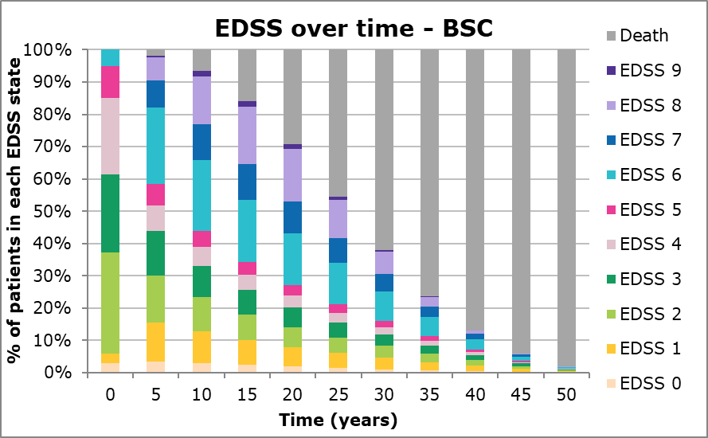
Key Issue 5: More recent EDSS-specific mortality rates
Natural history cohort (BSC)
Time | EDSS 0 | EDSS 1 | EDSS 2 | EDSS 3 | EDSS 4 | EDSS 5 | EDSS 6 | EDSS 7 | EDSS 8 | EDSS 9 | Death
0 | 3% | 3% | 31% | 24% | 24% | 10% | 5% | 0% | 0% | 0% | 0%
5 | 3% | 12% | 15% | 14% | 8% | 7% | 24% | 8% | 7% | 1% | 2%
10 | 3% | 10% | 10% | 10% | 6% | 5% | 22% | 11% | 15% | 2% | 7%
15 | 2% | 8% | 8% | 8% | 5% | 4% | 19% | 11% | 18% | 2% | 16%
20 | 2% | 6% | 6% | 6% | 4% | 3% | 16% | 10% | 16% | 2% | 29%
25 | 1% | 5% | 5% | 5% | 3% | 3% | 13% | 8% | 12% | 1% | 45%
30 | 1% | 3% | 4% | 4% | 2% | 2% | 9% | 5% | 7% | 0% | 62%
35 | 1% | 3% | 3% | 2% | 2% | 1% | 6% | 3% | 3% | 0% | 76%
40 | 1% | 2% | 2% | 2% | 1% | 1% | 3% | 2% | 1% | 0% | 87%
45 | 0% | 1% | 1% | 1% | 0% | 0% | 1% | 1% | 0% | 0% | 94%
50 | 0% | 0% | 0% | 0% | 0% | 0% | 0% | 0% | 0% | 0% | 98%
Notes:
Source: Company response, supplementary information Figure 1: EDSS distribution – BSC (base case)
Table 1: Health state occupancy (numerical values) – BSC (base case)

Slide 42
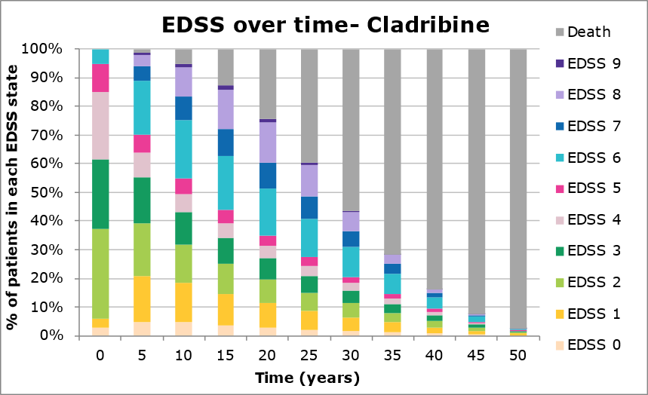
Key Issue 5: More recent EDSS-specific mortality rates
Cladribine (revised base case)
Time | EDSS 0 | EDSS 1 | EDSS 2 | EDSS 3 | EDSS 4 | EDSS 5 | EDSS 6 | EDSS 7 | EDSS 8 | EDSS 9 | Death
0 | 3% | 3% | 31% | 24% | 24% | 10% | 5% | 0% | 0% | 0% | 0%
5 | 5% | 16% | 19% | 16% | 9% | 6% | 19% | 5% | 4% | 0% | 1%
10 | 5% | 14% | 13% | 11% | 6% | 5% | 20% | 8% | 10% | 1% | 5%
15 | 4% | 11% | 10% | 9% | 5% | 4% | 19% | 9% | 14% | 1% | 13%
20 | 3% | 8% | 8% | 7% | 4% | 4% | 17% | 9% | 14% | 1% | 24%
25 | 2% | 6% | 6% | 6% | 3% | 3% | 14% | 8% | 11% | 1% | 40%
30 | 2% | 5% | 5% | 4% | 3% | 2% | 10% | 6% | 7% | 0% | 56%
35 | 1% | 3% | 3% | 3% | 2% | 2% | 7% | 4% | 3% | 0% | 72%
40 | 1% | 2% | 2% | 2% | 1% | 1% | 4% | 2% | 1% | 0% | 84%
45 | 0% | 1% | 1% | 1% | 1% | 0% | 2% | 1% | 0% | 0% | 93%
50 | 0% | 0% | 0% | 0% | 0% | 0% | 0% | 0% | 0% | 0% | 98%
Notes:
Source: Company response, supplementary information Figure 1: EDSS distribution – BSC (base case)
Table 1: Health state occupancy (numerical values) – BSC (base case)

Slide 43
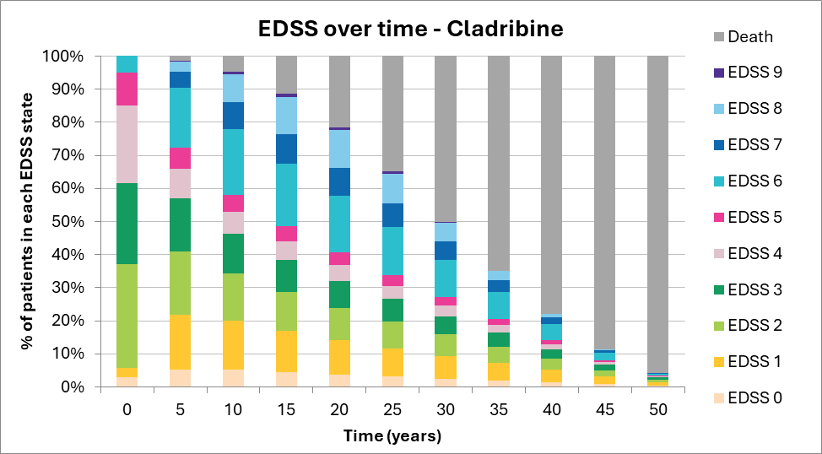
Key Issue 5: More recent EDSS-specific mortality rates
Cladribine (Basket 1)
Time | EDSS 0 | EDSS 1 | EDSS 2 | EDSS 3 | EDSS 4 | EDSS 5 | EDSS 6 | EDSS 7 | EDSS 8 | EDSS 9 | Death
0 | 3% | 3% | 31% | 24% | 24% | 10% | 5% | 0% | 0% | 0% | 0%
5 | 5% | 17% | 19% | 16% | 9% | 6% | 18% | 5% | 3% | 0% | 1%
10 | 5% | 15% | 14% | 12% | 7% | 5% | 20% | 8% | 8% | 1% | 5%
15 | 5% | 13% | 12% | 10% | 6% | 5% | 19% | 9% | 11% | 1% | 11%
20 | 4% | 11% | 10% | 8% | 5% | 4% | 17% | 8% | 11% | 1% | 21%
25 | 3% | 9% | 8% | 7% | 4% | 3% | 14% | 7% | 9% | 1% | 34%
30 | 3% | 7% | 7% | 6% | 3% | 3% | 11% | 5% | 5% | 0% | 49%
35 | 2% | 6% | 5% | 4% | 2% | 2% | 8% | 4% | 3% | 0% | 64%
40 | 2% | 4% | 4% | 3% | 2% | 1% | 5% | 2% | 1% | 0% | 77%
45 | 1% | 2% | 2% | 2% | 1% | 1% | 2% | 1% | 0% | 0% | 88%
50 | 0% | 1% | 1% | 1% | 0% | 0% | 1% | 0% | 0% | 0% | 95%
Notes:
Source: Company response, supplementary information Figure 1: EDSS distribution – BSC (base case)
Table 1: Health state occupancy (numerical values) – BSC (base case)

Slide 44
Key Issue 5: More recent EDSS-specific mortality rates
Cladribine (Basket 2)
Time | EDSS 0 | EDSS 1 | EDSS 2 | EDSS 3 | EDSS 4 | EDSS 5 | EDSS 6 | EDSS 7 | EDSS 8 | EDSS 9 | Death
0 | 3% | 3% | 31% | 24% | 24% | 10% | 5% | 0% | 0% | 0% | 0%
5 | 5% | 17% | 19% | 16% | 9% | 6% | 18% | 5% | 3% | 0% | 1%
10 | 5% | 15% | 14% | 12% | 7% | 5% | 20% | 8% | 8% | 1% | 5%
15 | 5% | 13% | 12% | 10% | 5% | 5% | 19% | 9% | 11% | 1% | 11%
20 | 4% | 10% | 10% | 8% | 5% | 4% | 17% | 9% | 11% | 1% | 22%
25 | 3% | 9% | 8% | 7% | 4% | 3% | 14% | 7% | 9% | 1% | 35%
30 | 3% | 7% | 6% | 6% | 3% | 3% | 11% | 6% | 6% | 0% | 50%
35 | 2% | 5% | 5% | 4% | 2% | 2% | 8% | 4% | 3% | 0% | 65%
40 | 1% | 4% | 3% | 3% | 2% | 1% | 5% | 2% | 1% | 0% | 78%
45 | 1% | 2% | 2% | 2% | 1% | 1% | 2% | 1% | 0% | 0% | 89%
50 | 0% | 1% | 1% | 1% | 0% | 0% | 1% | 0% | 0% | 0% | 96%
Notes:
Source: Company response, supplementary information Figure 1: EDSS distribution – BSC (base case)
Table 1: Health state occupancy (numerical values) – BSC (base case)

Slide 45
Cladribine for treating relapsing multiple sclerosis
Background and key issues
Clinical effectiveness
Modelling and cost effectiveness
Other considerations
Summary

Slide 46
Key clinical trials
 | CLARITY | CLARITY-EXT
Design | Phase III double-blind, placebo-controlled, 96-week RCT | Phase IIIb double-blind, 96-week RCT; safety extension
Population | RRMS with ≥1 relapses within 12 months Clinically stable and no relapses within 28 days prior to day 1 of study MRI lesions consistent with MS EDSS score between 0 to 5.5, inclusive | Patients who were enrolled in CLARITY and either completed treatment and/or completed scheduled visits for the full 96 weeks
Intervention | Cladribine 5.25 mg/kg Cladribine 3.5 mg/kg | Patients randomised to receive either cladribine (5.25 mg/kg or 3.5 mg/kg) or placebo
Comparator | Placebo | N/A
Outcomes | Qualifying ARR Disability progression (3-month CDP) Mortality Adverse effects of treatment HRQoL NEDA-3 (post-hoc) 6-month CDP (post-hoc) | Safety and tolerability
3/6-month CDP = sustained progression (for at least 3/6 months) as defined by a 1.0 point increase in EDSS score - or a 1.5 point increase when the baseline EDSS score was 0.
Abbreviations: RCT, randomised controlled trial; RRMS, relapsing-remitting multiple sclerosis; EDSS, expanded disability status scale; ARR, annualised relapse rate; HRQoL, health-related quality of life; NEDA, no evidence of disease activity; CDP, confirmed disease progression.
Notes:
Table 4, company submission
3-month CDP = sustained progression (for at least 3 months) as defined by a 1.0 point increase in EDSS score - or a 1.5 point increase when the baseline EDSS score was 0.

Slide 47
CLARITY clinical trial results
Cladribine more effective than placebo in patients with active RRMS across a spectrum of outcomes
Qualifying ARR at 96 weeks in CLARITY
Qualifying relapse-free at 96 weeks, n (%)
 | Cladribine (N=433) | Placebo (N=437)
Qualifying ARR (95% CI) | 0.14 (0.12, 0.17) | 0.34 (0.30, 0.38)
Relative reduction in ARR, % | 58.22 (p value <0.0001)
Rate ratio (95% CI) | 0.42 (0.33, 0.52)
Time to first qualifying relapse
% relapse-free, K-M estimate (95% CI) | 80.3 (76.1, 83.8) | 61.1 (56.2, 65.6)
HR (95% CI) | 0.45 (0.34, 0.58) (p value <0.0001)
 | Cladribine (N=433) | Placebo (N=437)
Relapse | XXXX | XXXX
Relapse-free | XXXX | XXXX
Unknown* | XXXX | XXXX
Time to 3-month CDP
% progression-free, KM estimate (95% CI) | XXXX | XXXX
HR (95% CI) | XXXX (p value = XXXX
Time to 6-month CDP
% progression-free, KM estimate (95% CI) | XXXX | XXXX
HR (95% CI) | XXXX (p value = XXXX)
Cladribine group had statistically significant 58% relative reduction in qualifying ARR vs placebo
Cladribine associated with significant delay in the time to first qualifying relapse vs. placebo (HR: 0.45)
% patients who were relapse-free at 96wks was higher in cladribine vs placebo group (XXXX vs. XXXX)
% patients who were 3M CDP-free at 96wks was significantly higher in cladribine vs placebo (XXXXvs. XXXX)
CLARITY-EXT extension study demonstrates sustained safety over 4-year follow-up
Abbreviations: ARR, annualised relapse rate; CDP, confirmed disability progression; KM = Kaplan-Meier, RRMS, relapsing-remitting multiple sclerosis;
Notes:
Table 12, 13 & 14, company submission
https://pmc.ncbi.nlm.nih.gov/articles/PMC6460686/pdf/10.1177_1352458518771875.pdf

Slide 48
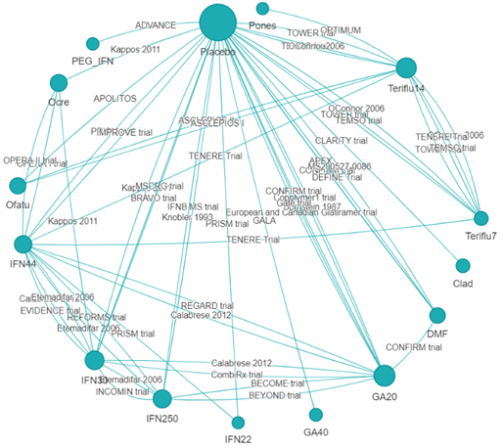
Network meta-analysis
NMA conducted to assess effectiveness of cladribine vs comparators
61 studies identified in the SLR; 38 trials were included in the NMA
CLARITY study was included in the NMA, however, the CLARITY-EXT study could not be considered due to the lack of a common treatment arm with competitor trials and heterogeneity of the study designs
Outcomes were:
Annualised relapse rate (ARR)
3-month confirmed disease progression (CDP)
6-month confirmed disease progression (CDP)
Treatment discontinuations
Network diagram for the base case NMA of ARR
From company submission
Abbreviations: SLR, systematic literature review.
Notes:
Section B.2.9.3., company submission

Slide 49
NMA results – Cladribine vs. DMTs in active RRMS
Change in ARR vs DMTs
Cladribine showed statistically significant benefit compared to teriflunomide, glatiramer acetate, beta interferon, peginterferon beta-1a
No statistically significant difference vs ofatumumab, ocrelizumab, ponesimod and dimethyl fumarate
Change in CDP vs DMTs
Inconclusive results given statistically non-significant estimates, wide and overlapping credible intervals
Results vs placebo
Cladribine significantly improved ARR, 3 & 6 month CDP vs placebo, but not treatment discontinuations
EAG: NMA are consistent to those in the previous NICE submission of cladribine in RRMS, but should be interpreted with caution due to statistical and clinical uncertainties
See forest plot of NMA results in the appendix
Abbreviations: NMA, network meta-analysis; DMT, disease-modifying therapy; ARR, annualised relapse rate; CDP, confirmed disability progression; EAG, external assessment group.
Notes:
Source: EAR Tables 8 and 9

Slide 50
NMA results – Summary of efficacy outcomes
Cladribine has significant benefit over most comparators for ARR, other results mixed
Cladribine tablets, 3.5 mg/kg vs. | ARR | 3-month CDP 24M | 6-month CDP |  | Treatment discontinuation (all-cause)
 |  |  | Without INCOMIN study | With INCOMIN study
Placebo | á | á | á | á | á
PEG-IFN-β1a, 125 µg, q2w | á | - | â* | â* | -
DMF, 240 mg, bid | á | â | á* | á* | á
DRF, 462 mg, bid | - | - | - | - | á
Ofatumumab, 20 mg | â | â | â | â | á
Teriflunomide,14 mg, qd | á | á | á | á | á
GA, 20 mg, qd | á | á | á | á | á
IFN-β1b, 250 µg, eod | á | á | â* | â* | á
IFN-β1a, 30 µg, q1w | á | á | á | á | á
IFN-β1a, 44 µg, tiw | á | â | á* | á* | á
GA, 40 mg, tiw | á | - | - | - | á
Ocrelizumab, 600 mg | â | â | â | â | á
Teriflunomide, 7 mg, qd | á | á | á | á | á
Ponesimod, 20 mg | á | â | á* | á* | á
IFN-β1a, 22 µg, tiw | á | ↔ | - | - | á
= statistically significant results in favour of cladribine.
↑ favours cladribine;
↓ favours comparator;
“↔” equivalent efficacy;
“-“ analyses not feasible
There were no significant results in favour of comparators.
* Direction of numerical benefit at 6-month CDP not consistent with 3-month CDP
The ranking of treatment effects in the NMA may differ from the ranking in the model due to differences in discontinuation rate
Table from company submission. Abbreviations: ARR, annualised relapse rate; bid, twice a day; CDP, confirmed disability progression; DMF, dimethyl fumarate; eod, every other day; GA, glatiramer acetate; IFN, interferon; ITT, intention to treat; qd, once a day; q1w, once a week; q2W, every 2 weeks; q4w, every 4 weeks; RF, relapse-free; tiw, three times a week.
Notes:
Table 11, appendix, company submission

