Slide 1
Dostarlimab with carboplatin and paclitaxel for treating primary advanced or recurrent endometrial cancer with high microsatellite instability or mismatch repair deficiency (MA review of TA963)
For presentation – all confidential information redacted
Technology appraisal committee A [04 March 2025]
Chair: Radha Todd
Lead team: Richard Ballerand, Jacqueline Tomlinson, Min Ven Teo
External assessment group: Birmingham Centre for Evidence and Implementation Science
Technical team: Luke Cowie, Samuel Slayen, Janet Robertson
Company: GSK
© NICE 2025. All rights reserved. Subject to Notice of rights.

Slide 2
Dostarlimab with carboplatin and paclitaxel for treating primary advanced or recurrent endometrial cancer with high microsatellite instability or mismatch repair deficiency
Background and key issues
Clinical effectiveness
Modelling and cost effectiveness
Summary

Slide 3
Patient perspectives
Patients welcome a targetted treatment option at earlier stage in the pathway
Submissions from Peaches Womb Cancer Trust
Effective treatment options at this stage are limited, leaving people feeling frustrated, hopeless and abandoned: high unmet need.
Women want treatment options that will increase life expectancy and give them hope of living a meaningful life for longer
People should have equal access to the potential survival benefits of newer cancer treatments, regardless of their cancer type
Chemotherapy is challenging and access to immunotherapy for people with dMMR/MSI-H EC is only available as a second-line treatment.
The impact of current treatments differs between individuals, but many would accept some increase in treatment side effects for improved long-term survival
“Current approach is geared towards expecting a recurrence and then adding a more effective second line treatment. It is paramount to offer patients a first line treatment which will further reduce the chance of the cancer recurring.”
dMMR/MSI-H = mismatch repair deficient or high microsatellite instability; EC = Endometrial cancer;

Slide 4
Background on Endometrial cancer
Primary advanced or recurrent endometrial cancer has a poor prognosis
Causes
Endometrial cancer (EC) is a type of uterine cancer that starts in the lining of the uterus
Risk factors include age, excessive oestrogen, obesity, family history, diabetes and polycystic ovary syndrome
Epidemiology
Of the 8,323 new EC cases diagnosed in England every year:
  ~2,454 have primary advanced or recurrent endometrial disease
  ~539 of these have dMMR/MSI-H disease; a subtype of EC
Diagnosis and classification
EC is assessed according to tumour location, volume and spread and histological and molecular subtype
Primary advanced endometrial cancer (stages 3 and 4) is cancer which started in the uterus but has spread to other parts of the body. Approx 20% of cases diagnosed at this stage, with ~14% experiencing recurrence
Recurrent (after surgery) EC regarded as incurable, with 20% surviving beyond 5 years
dMMR/MSI-H in approximately 25–30% of EC cases: highly immunogenic subtype, more responsive to immunotherapies than some other types of EC
Symptoms and prognosis
Symptoms include unusual vaginal bleeding, pelvic pain, lump in abdomen or pelvis, unintended weight loss
5yr survival rate is 98% for stage I cancer, dropping to 15% for stage 4, 20% for recurrent disease
dMMR/MSI-H = mismatch repair deficient or high microsatellite instability; EC = Endometrial cancer;
Notes:
~96% uterine cancers are endometrial cancer (so the terms are often used interchangeably)
https://www.cancerresearchuk.org/health-professional/cancer-statistics/statistics-by-cancer-type/uterine-cancer

Slide 5
Clinical perspectives
Adding dostarlimab to 1st line treatment would deliver durable and meaningful clinical benefits
Submissions from clinical experts:
Urgent need to improve survival in this patient group (median OS typically <2yrs)
Data shows durable benefit from dostarlimab when compared to chemotherapy alone - reported benefits likely to continue with additional follow-up
Some additional resource/capacity implications if recommended (longer chair time, additional dostarlimab monotherapy maintenance cycles and monitoring for IO-related AEs) – but limited by 30-minute infusion and Q6W dosing
Some cases with low-grade hormone receptor positive recurrent disease of low volume may be suitable for treatment with hormone therapy
Immunotherapies associated with additional adverse events not seen with chemotherapy alone
Data on other checkpoint inhibitors in similar population (pembrolizumab, atezolizumab and durvalumab) has shown large, significant improvements in PFS, indicating robustness of benefit
‘Durable responses seen with first line dostarlimab are a step-change in the treatment of dMMR/MSI-H disease, offering potential for long-lasting disease control and extended survival’
AEs = adverse events; dMMR/MSI-H = mismatch repair deficient or high microsatellite instability; IO = immuno-oncology; OS = overall survival; PFS = progression free survival; Q6W = every 6 weeks

Slide 6
Equality considerations
Widespread access to more effective treatment could help address inequalities
Black people have substantially higher mortality rates for endometrial cancer than people from other ethnic groups in the UK
Access to innovative treatment on the NHS for late-stage disease can help address severe inequalities in survival outcomes by ethnicity or socio-economic deprivation

Slide 7
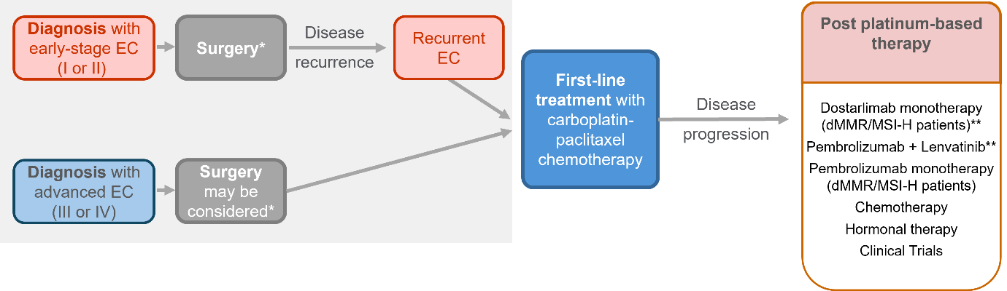
Treatment pathway
TA779
TA904
TA914
Addition of dostarlimab for people with dMMR/MSI-H disease
*At any stage, patients may also receive neoadjuvant or adjuvant radiotherapy, chemotherapy, or hormone therapy, in addition to surgery.
**As per pivotal trial inclusion/exclusion criteria, anti-PD-L1 not used in post platinum setting if treated with anti-PDL-1 in the first-line
dMMR/MSI-H = mismatch repair deficient or high microsatellite instability; EC = Endometrial cancer

Slide 8
Dostarlimab (Jemperli, GSK)
Marketing authorisation granted Oct 2023 | ‘Dostarlimab is indicated in combination with platinum containing chemotherapy for the treatment of adult patients with mismatch repair deficient/microsatellite instability-high primary advanced or recurrent endometrial cancer and who are candidates for systemic therapy.’
MHRA license extension Dec 2024 | ‘Dostarlimab is indicated in combination with platinum-containing chemotherapy for the treatment of adult patients with primary advanced or recurrent endometrial cancer and who are candidates for systemic therapy.’
Stopping rule | Treatment should ‘continue until disease progression or unacceptable toxicity, or for a duration of up to 3 years’.
Mechanism of action | Dostarlimab is a humanised, monoclonal antibody which binds to PD-1, a cell surface receptor expressed on activated T-cells. It blocks the PD-1 signalling resulting in an increased anti-tumour immune response and cancer cell death.
Administration | Dostarlimab 500 mg is administered via IV infusion every 3 weeks for the first 6 cycles, followed by dostarlimab 1,000 mg administered via IV infusion every 6 weeks for subsequent cycles.
Price | The list price of dostarlimab is £5,887.33 per 500 mg vial. There is a simple discount PAS for dostarlimab.
PD-1 = programmed cell death protein 1; IV = intravenous; PAS = patient access scheme

Slide 9
Key issues
Overall survival has the largest impact on cost effectiveness estimates
Issue | ICER impact
Limitations of RUBY-1 trial and most recent data-cut | Unknown
Modelling of progression-free survival | Small
Modelling of overall survival: choice of distributions | Moderate
Modelling of overall survival: treatment waning | Large
Modelling of time to treatment discontinuation | Moderate
Modelling of subsequent therapies received | Unknown
ICER = incremental cost effectiveness ratio

Slide 10
Dostarlimab with carboplatin and paclitaxel for treating primary advanced or recurrent endometrial cancer with high microsatellite instability or mismatch repair deficiency
Background and key issues
Clinical effectiveness
Modelling and cost effectiveness
Summary

Slide 11
Key clinical trial: RUBY-1
Clinical trial design and outcomes
 | RUBY-1
Design | Multicentre, randomised, double-blinded, placebo-controlled Phase 3 study
Population | Primary Stage III or Stage IV endometrial cancer or first recurrent endometrial cancer, with low potential for cure by radiation therapy or surgery alone or in combination (ITT N=494, dMMR/MSI-H n=118)
Intervention | Dostarlimab + CP (n=53 dMMR/MSI-H)
Comparator | Placebo + CP (n=65 dMMR/MSI-H)
Duration | 3 years (follow up to ~46 months)
Primary outcomes | PFS (assessed by investigator), OS
Key secondary outcomes | PFS (assessed by BICR), ORR, DOR, DCR, QoL, PFS2, safety
Locations | US, UK, Belarus, Belgium, Canada, Czechia, Denmark, Finland, Germany, Greece, Hungary, Israel, Italy, Holland, Norway, Poland, Sweden, Turkey, Ukraine
Datacuts | Interim analysis 1 (IA1): 28 September 2022 Interim analysis 2 (IA2): 22 September 2023 No further interim analyses expected, final datacut (OS + safety) to be confirmed
dMMR/MSI-H = mismatch repair deficient or high microsatellite instability; ITT = intention to treat population; CP = carboplatin + paclitaxel; PFS = progression-free survival; OS = overall survival; ORR = overall response rate; DOR = duration of response; DCR = disease control rate; QoL = quality of life; PFS2 = progression-free survival 2

Slide 12
Clinical trial results from RUBY-1: PFS (dMMR/MSI-H)
CONFIDENTIAL
Dostarlimab extends PFS compared to placebo
PFS from RUBY-1 interim analyses 1 and 2*
Dostarlimab+CP – IA2
 | PFS HR (95%CI)
IA1 | 0.28 (0.16 to 0.50)
IA2 | xxxxxxxxxxxxxx
Company did not submit full updated PFS data from IA2, only descriptive
Xxxxxxxxxxxxxxxxxxxxxxxx xxxxxxxxxxxxxxxxxxxxxxxxxxx xxxxxxxxxxxxxxxxxxxxxxxx
Xxxxxxxxxxxxxxxxxxxxxxxxxx xxxxxxxxxxxxxxxxxxxxxxxxxx xxxxxxxxxxxxxxxxxxxxxxxxxx xxxxxxxxxxxxxxxxxxxxxxxx
Dostarlimab+CP – IA1
Placebo+CP – IA1 and IA2 are overlaid
* Figure produced by EAG, PFS at IA2 constructed from company descriptive results
CP = carboplatin plus paclitaxel; dMMR/MSI-H = mismatch repair deficient or high microsatellite instability; PFS = progression free survival; IA1 = interim analysis 1, IA2 = interim analysis 2

Slide 13
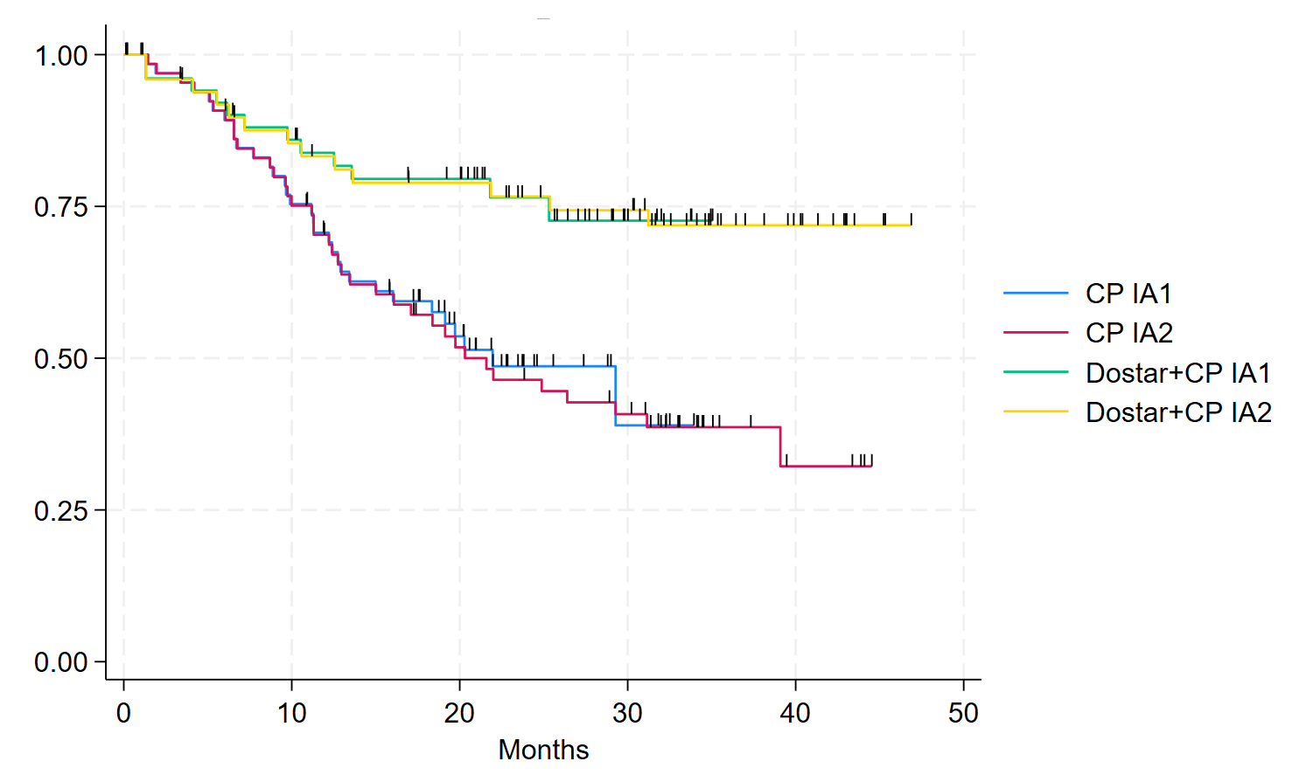
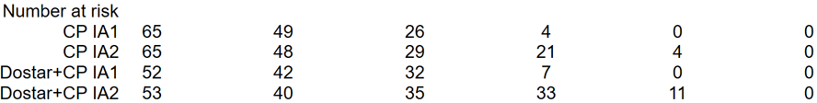
Clinical trial results from RUBY-1: PFS2 (dMMR/MSI-H)
Dostarlimab extends PFS2 compared to placebo in all patients
PFS2 from RUBY-1 interim analyses 1 and 2
IA2 Median PFS2 was 21.6 months (95% CI 13.4, 39.1) in placebo arm, not reached for dostarlimab arm
PFS2 results suggests post-progression benefit of dostarlimab+CP vs CP
More immunotherapy in later lines of treatment in placebo arm (41.5% v 15.1% for dostarlimab+CP arm)
Dostarlimab+CP – IA1
Dostarlimab+CP – IA2
Placebo+CP – IA1
 | PFS2 HR (95%CI)
IA1 | 0.37 (0.19 to 0.73)
IA2 | 0.33 (0.18 to 0.63)
Placebo+CP – IA2
EAG: the extent of PFS2 censoring makes the results highly uncertain
CP = carboplatin plus paclitaxel; dMMR/MSI-H = mismatch repair deficient or high microsatellite instability; PFS2 = progression free survival 2; (time from randomisation to death or progression on first subsequent therapy [including best supportive care]) CI = confidence interval

Slide 14
Clinical trial results from RUBY-1: PFS2 (dMMR/MSI-H)
CONFIDENTIAL
No clear difference in PFS2 in people who received a subsequent therapy
PFS2 for people who received subsequent therapies only
EAG:
Despite groups not being balanced, this gives a better representation of efficacy of subsequent therapies received.
This questions the generalisability of RUBY-1 to the NHS population, where patients having CP would then be eligible for more effective subsequent treatments such as anti PD-1/L1 therapies
Chemotherapy (n=65)
Dostarlimab-chemo (n=15)
CP = carboplatin plus paclitaxel; dMMR/MSI-H = mismatch repair deficient or high microsatellite instability; PFS2 = progression free survival 2; PD-1/L1 = programmed cell death protein 1/ligand 1

Slide 15
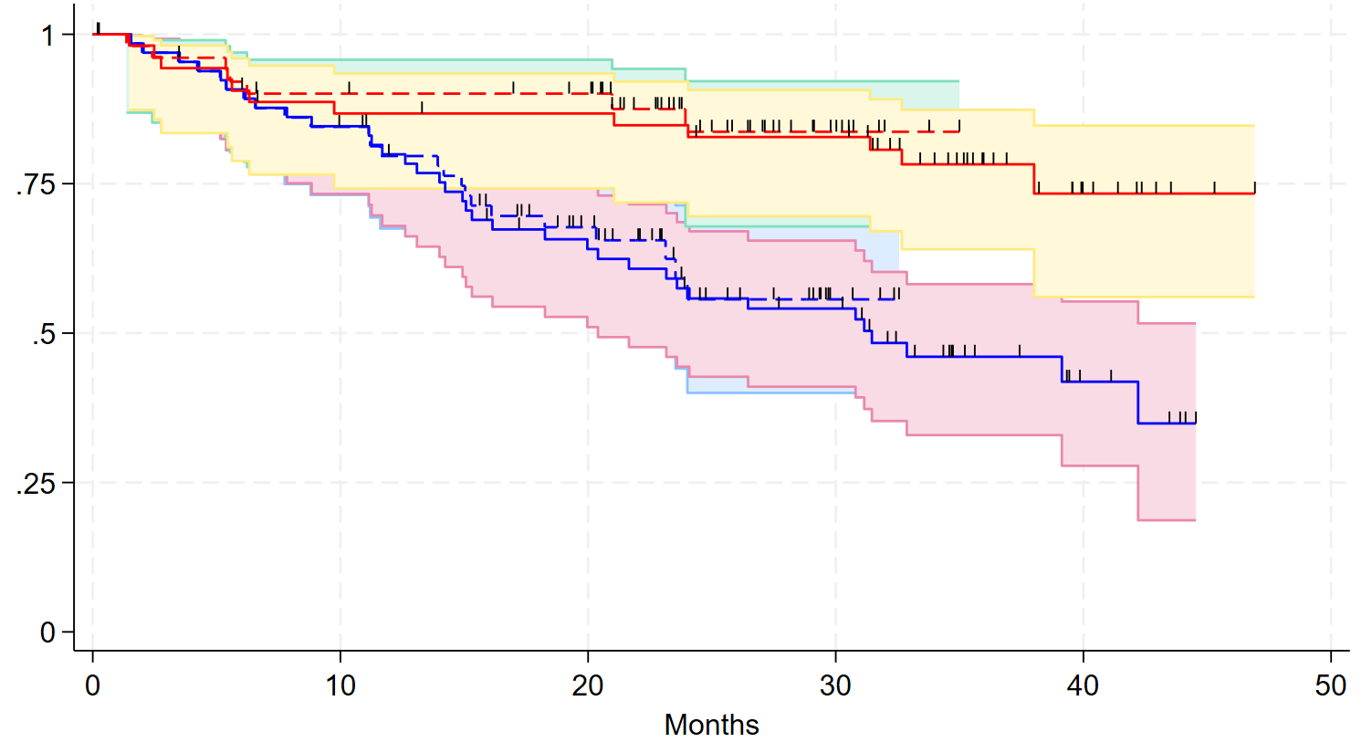
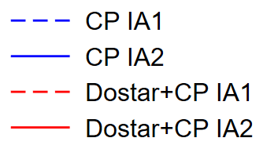
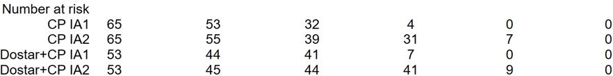
Clinical trial results from RUBY-1: OS (dMMR/MSI-H)
CONFIDENTIAL
Dostarlimab extends OS compared to placebo
Kaplan-Meier plot of OS from IA1 and IA2 of RUBY-1
 | Dostarlimab+CP vs CP - IA1 | Dostarlimab+CP vs CP - IA2
Median OS, months (95% CI) | Xxx xxx xxx vs xxx xxxx xxxxxx | NR (NR, NR) vs 31.4 (20.3, NR)
OS Hazard Ratio (95% CI) | 0.30 (0.13, 0.70) | 0.32 (0.166, 0.629)
OS data maturity | 26% | 40.2%
CP = carboplatin plus paclitaxel; dMMR/MSI-H = mismatch repair deficient or high microsatellite instability; OS = overall survival; IA1 = interim analysis 1, IA2 = interim analysis 2; HR = hazard ratio; CI = confidence interval; NR = not reached

Slide 16

Key issues: Limitations of RUBY-1 and IA2 data-cut
CONFIDENTIAL
ICER impact: Unknown
Background
Population for this appraisal is dMMR/MSI-H; a pre-specified subgroup of the full RUBY-1 population
EAG concerns remain from TA963 regarding the reliability of information from RUBY-1
Company
Evidence submission focuses on IA2 of RUBY-1 trial to address outstanding uncertainties
EAG comments
Same limitations apply to the evidence as were raised in TA963, the evidence provided more closely resembles a technology entering rather than emerging from managed access:
  Low average age of the trial population (xxxx) compared to expected real-world use (67)
  Small dMMR/MSI-H subgroup (dostarlimab+CP n=53 vs placebo+CP n=65, total n=118)
  Some misclassification of dMMR/MSI-H status, may confound results (exacerbated by small sample)
  Limited follow-up and lack of data beyond dostarlimab treatment duration (see Key Issue 4)
  Benefits of subsequent immunotherapy in the CP arm unlikely to be captured (see Key Issue 5)
  EAG base case uses different starting age in the economic model, but unable to meaningfully explore impact of other generalisability concerns
What starting age should be used in the model?
Is the pre-specified dMMR/MSI-H subgroup from RUBY-1 suitable for decision making?
dMMR/MSI-H = mismatch repair deficient or high microsatellite instability; IA2 = interim analysis 2; CP = carboplatin plus paclitaxel

Slide 17
Dostarlimab with carboplatin and paclitaxel for treating primary advanced or recurrent endometrial cancer with high microsatellite instability or mismatch repair deficiency
Background and key issues
Clinical effectiveness
Modelling and cost effectiveness
Summary

Slide 18
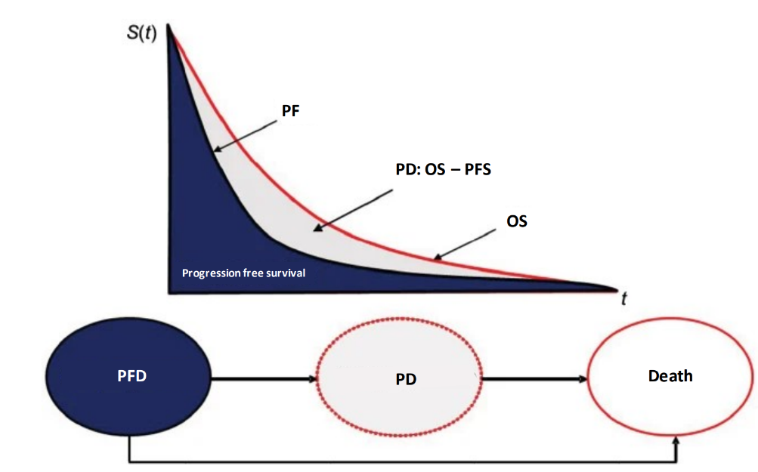
Company’s model overview: Partitioned Survival model
CONFIDENTIAL
EAG says model structure is appropriate
3 health states (progression-free survival, post-progression survival, and death)
Area | Company assumptions/sources
Time horizon | Lifetime (xxxx years)
Source of clinical effectiveness data | RUBY-1 (dMMR/MSI-H)
Source of AEs | RUBY-1 (ITT)
Source of utilities | RUBY-1 (ITT)
Source of resource use | Clinical opinion and RUBY-1
Source of costs | BNF, NHS reference costs, PSSRU
Severity Modifier | No
Treatment effect waning | No
Stopping rule | 3 years
BNF = British National Formulary; dMMR/MSI-H = mismatch repair deficient or high microsatellite instability; EAG = External Assessment Group; ITT = Intention-to-treat; OS = overall survival; PD = progressed disease; PFD = progression-free disease; PFS = progression-free survival; PSSRU = Personal Social Services Research Unit

Slide 19
Key issues: Modelling of PFS
CONFIDENTIAL
ICER impact: Small
Background
The company’s modelling of PFS uses data from IA1
Company
Submission focuses on updated OS and PFS2, no new PFS data but descriptive analysis provided
xxxxxxxxxxxxxxxxxxxxxxxxxxxxxxxxxxxxxxxxxxxxxxxxxxxxxxxxxxxxxxxxxxxxxxxxxxxxxxxxxxxxxxx
EAG comments
Company modelling of PFS based on old data, doesn’t capture increased hazard rate at end of follow-up
For CP arm the EAG, company and committee all accepted the 2 knot odds spline model in TA963, EAG remain content with this choice of model but fit the model to reconstructed data from IA2
For dostarlimab+CP arm, company uses a 1 knot odds spline model (as in TA963) fitted to data from IA1: EAG notes that long-term trajectory when fitted to IA2 data is more optimistic than the previous model
EAG uses models fitted to IA2 data, and applies treatment effect waning from 36 months, over 2 years
This sets hazard rates equal in both arms from 5 years because people remaining free of progression on CP will be unlikely to have a higher risk of disease progression beyond this point
Choice of datacut and treatment effect waning (applied to PFS alone) has a small effect on the ICER
Is the company’s or EAG’s modelling of PFS preferred for decision making?
PFS: Hazard rates
PFS: Extrapolation
CP = carboplatin + paclitaxel; PFS = progression-free survival; PFS2 = progression-free survival 2; OS = overall survival; IA2 = interim analysis 2; ICER = incremental cost effectiveness ratio

Slide 20
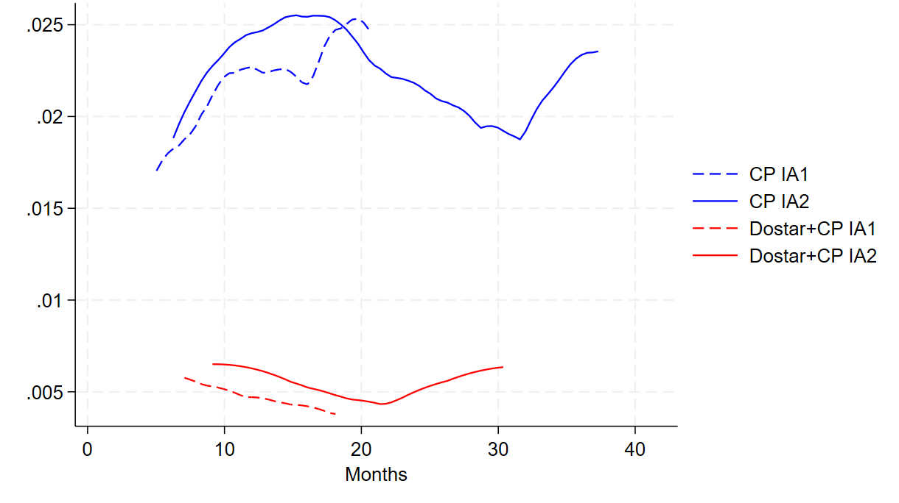
Key issues: Modelling of OS
EAG apply treatment effect waning apply and explore constant hazards
ICER impact: Moderate
Background
Company extrapolates by fitting log-logistic curves to the IA2 OS data for both arms considering it offers the best statistical fit with plausible hazard rates. This differs from the approach in TA963.
EAG comments
For dostarlimab+CP, all curves have a similar visual fit, as is common with such immature data
Hazards in both arms could be interpreted as constant, justifying exponential curves: this could be considered pessimistic but may be preferable when data is so immature (long term log-logistic v exponential)
Outcomes beyond 5 years likely to be independent of initial treatment received justifying effect waning
Base case is log-logistic for both arms applying treatment effect waning at 3 to 5 years (hazards equalise by 5 years). Waning scenarios explored: 4 to 6 and 5 to 7 years for loglogistic and exponential
Smoothed hazard rates for OS from RUBY-1
What is the committee preferred distribution to extrapolate OS for each arm?
Should treatment effect waning be applied, and if so, over what timescale?
CP = carboplatin + paclitaxel; OS = overall survival; IA2 = interim analysis 2; ICER = incremental cost effectiveness ratio

Slide 21
ICER impact: Moderate
Key issues: Modelling of OS: extrapolations
Comparison of long-term OS predictions and extrapolations for dostarlimab
Time | EAG Expert Estimates | Log-logistic | Log-logistic 4-5 year waning | Exponential | Exponential 4-5 year waning
5 years | 40%-60% | 68.5% | 62.9% | 64.0% | 58.4%
10 years | 20%-30% | 55.2% | 28.0% | 41.0% | 15.6%
15 years | 18%-20% | 46.9% | 16.5% | 26.3% | 4.2%
20 years | 15%-20% | 37.8% | 11.2% | 16.8% | 1.1%
Comparison of long-term OS predictions and extrapolations for chemotherapy
Time | Company expert estimates | Log-logistic | Exponential
5 years | 21% | 27% | 27%
10 years | 9% | 12% | 7%
15 years | 5% | 7% | 2%
20 years | 4% | 5% | 1%
See appendix for hazard rate and implied hazard ratio for log-logistic extrapolation
CP = carboplatin + paclitaxel; PFS = progression-free survival; OS = overall survival

Slide 22
Key issues: Modelling of overall survival
EAG explore treatment effect waning from log-logistic base case
ICER impact: Large
EAG’s expert opinion (dostarlimab)
CP = carboplatin + paclitaxel; OS = overall survival; IA2 = interim analysis 2; ICER = incremental cost effectiveness ratio

Slide 23
Key issues: Modelling of overall survival
EAG explore constant hazards using exponential distribution and effect waning
ICER impact: Large
(loglogistic)
(loglogistic)
(loglogistic)
EAG’s expert opinion (dostarlimab)
Company clinical expert opinion
CP = carboplatin + paclitaxel; OS = overall survival; IA2 = interim analysis 2; ICER = incremental cost effectiveness ratio

Slide 24
Key issues: Modelling of OS: treatment effect waning
CONFIDENTIAL
ICER impact: Large
Modelled “cure” proportion for log-logistic OS with waning
Extrapolation rising above general population mortality implies cure
Complete response (CR) IA1: xxx% for dostarlimab v xxx% for placebo at IA1
CR maintained in xxx% of people (dostarlimab) at 24 months (optimistic estimate noting high censoring)
EAG expert suggests optimistic dostarlimab cure rates of ~66% of those with CR (~xxx%)
EAG: log-logistic with treatment effect waning at discontinuation may be more reasonable than exponential (may slightly underestimate long term OS for dostarlimab)
Waning | Waning duration | Proportion cured | Alive at age 77
None | xxx | xxx | xxx
After 3 years | xxx | xxx | xxx
 | xxx | xxx | xxx
 | xxx | xxx | xxx
After 4 years | xxx | xxx | xxx
 | xxx | xxx | xxx
 | xxx | xxx | xxx
After 5 years | xxx | xxx | xxx
 | xxx | xxx | xxx
 | xxx | xxx | xxx
See appendix for hazard rate and implied hazard ratio for log-logistic extrapolation
OS = overall survival; IA1 = interim analysis 1

Slide 25
Key issues: Modelling of TTD
CONFIDENTIAL
ICER impact: Moderate
Background
Company’s modelling of TTD shows large separation between PFS and TTD for dostarlimab+CP
Company
Company fits standard parametric curves, but unlike PFS and OS, TTD modelling consists of 3 parts:
  Weeks 1 to 16: Applies proportion of people in dostarlimab arm who have dostarlimab (IA1)
  Week 16 to week 145: Applies TTD Kaplan Meier IA1 curve directly
  Week 146 to week 150: Extrapolates TTD KM IA1 curve using Weibull distribution. In base case this only applies to last Q6W dostarlimab treatment so the choice of curve has little bearing upon costs
EAG comments
No obvious justification for difference in modelling TTD (piecewise) and PFS curves to 3 year point
Proportion of people in PFS who are modelled as incurring cost of dostarlimab xxxxxxx over first 3 years of model from xx% at model start to xx% at end of year 3
Expert opinion suggests people doing well on dostarlimab would continue up to 3 years (allowed by SmPC)
Different censoring rules for PFS and TTD implicitly assume people withdrawing from dostarlimab sustain benefits of treatment without incurring costs. EAG notes that within RUBY-1, almost all people having dostarlimab and remaining free of progression also remain on treatment
Prefers approach based on ratio of numbers at risk in TTD and PFS outcomes, and applies this to the PFS extrapolation, avoiding a large separation of these outcomes in the model
CP = carboplatin + paclitaxel; PFS = progression-free survival; OS = overall survival; IA1 = interim analysis 1; TTD = time to treatment discontinuation; KM = Kaplan Meier; Q6W = every 6 weeks

Slide 26
Key issues: Modelling of TTD
CONFIDENTIAL
EAG solutions:
Explicit modelling of “non-progression discontinuation” – requires more data
Re-analysis of PFS and OS assuming people lost to follow up have same risk of events as placebo arm – requires more data
EAG exploratory base case applies IA2 ratio of number remaining on treatment to number remaining in PFS to determine proportion of those in PFS who incur costs of dostarlimab during each treatment cycle (see next slide)
This increases company base case ICER
IA2 Dostarlimab: Kaplan Meier estimates TTD S(t) and PFS S(t) and the ratio between these (company approach)
Company:
EAG’s preference to disregard observed TTD and derive a TTD-PFS relationship based on absolute numbers at milestone timepoints is not a suitably robust method of inferring TTD
CP = carboplatin + paclitaxel; PFS = progression-free survival; TTD = time to treatment discontinuation; IA2 = interim analysis 2; ICER = incremental cost effectiveness ratio

Slide 27
Key issues: Modelling of TTD
CONFIDENTIAL
IA2: Dostarlimab: Number of Patients on treatment and Number of patients in PFS and the ratio between these (EAG approach)
EAG comments:
Company’s 2 curves for PFS and TTD are constructed on different bases (due to different censoring rules) and so are not directly comparable
EAG instead prefers to use the IA2 ratio between number in RUBY-1 who remained in PFS and number who remained on treatment, to determine the proportion of those in PFS who incur the costs of dostarlimab during each treatment cycle
Is it appropriate to apply a TTD curve estimated independently from the PFS curve?
PFS = progression-free survival; TTD = time to treatment discontinuation; IA2 = interim analysis 2

Slide 28
Key issues: Modelling of subsequent therapies
CONFIDENTIAL
Costs:
Small
Efficacy:
Unknown
Background
Company’s modelling of subsequent therapies based on clinical expert opinion and is inconsistent with evidence from RUBY-1
Company
Since TA963 treatment landscape has changed with availability of pembrolizumab monotherapy (TA914), treatment for people who progress after treatment with CP now better resembles that of the RUBY-1 trial
Updated clinical insight was sought to inform the updated version of the model (see next slide)
EAG comments
Inconsistency between clinical evidence and cost-effectiveness modelling introduces bias in favour of dostarlimab, because benefits of subsequent immunotherapies are modelled but not costed
Large discrepancy in 2nd line cost (£xxxxxxx for dostarlimab+CP, £xxxxxxx for placebo+CP) because x% who progress in dostarlimab+CP arm have 2nd line pembrolizumab, compared to xx% in placebo arm
EAG applies the distribution of subsequent treatments based on RUBY-1 and assumes only xx% of people in the PD health state get a subsequent treatment: increases company base case ICER by around 10%
Would people have an immunotherapy after discontinuing dostarlimab in NHS practice?
Is it more appropriate to model subsequent treatment costs based on clinical expert opinion or data from RUBY-1?
CP = carboplatin + paclitaxel; ICER = incremental cost effectiveness ratio

Slide 29
2nd line treatments: RUBY-1 versus the NHS
CONFIDENTIAL
Clinical effectiveness estimates incorporate benefits of subsequent treatment with pembrolizumab
Balance between 2nd line treatments
 | Company Experts |  | RUBY-1 IA2
 | DOST | PLAC | DOST | PLAC
Dost. | xxxx | xxxx | xxxx | xxxx
Carb+Pacl | xxxx | xxxx | xxxx | xxxx
Pembro. | xxxx | xxxx | xxxx | xxxx
Doxo. | xxxx | xxxx | xxxx | xxxx
Beva. | xxxx | xxxx | xxxx | xxxx
Pemb+L | xxxx | xxxx | xxxx | xxxx
Letrozole | xxxx | xxxx | xxxx | xxxx
Med.Acet. | xxxx | xxxx | xxxx | xxxx
Radio. | xxxx | xxxx | xxxx | xxxx
Cost | xxxx | xxxx | xxxx | xxxx
EAG comments:
Current EAG expert opinion is divided about balance between subsequent treatments.
One suggests differing proportions but that some patients would receive pembrolizumab after dostarlimab
Another that the same proportions would apply in both arms and that none would get pembrolizumab
EAG applies RUBY-1 proportions for subsequent treatments in its base case
Dost: Dostarlimab, Carb+Pacl: carboplatin plus paclitaxel, Pembro. : pembrolizumab, Doxo.: doxorubicin, Beva.: bevacizumab, Pemb+L: pembrolizumab plus lenvatinib, Med.Acet.: medroxyprogesterone acetate, Radio.: radiotherapy

Slide 30
Summary of company and EAG base case assumptions
CONFIDENTIAL
Parameter | Company base case | EAG base case
PFS CP | 2-knot odd spline (IA1) | 2-knot odd spline (IA2 reconstructed)
PFS Dostar+CP | 1-knot odd spline (IA1) | 1-knot odd spline (IA2)
OS CP | Log-logistic (IA2) | Same as company
OS Dostar + CP | Log-logistic (IA2) | Same as company
Treatment effect waning | No waning | Applied from years 3 to 5
Age at baseline | xxx years (based on RUBY-1) | 67.1 years (based on Pennington et al)
Discontinuation | 3 stage TTD modelling (see key issue) | RUBY-1 IA2 N on treatment to N in PFS ratio (+ RDI of 100%)
Week 157 treatment | Not included in model | Included in model to align with SmPC
2nd line treatment proportions | Proportions from clinical expert opinion | Proportions from IA2 of RUBY-1
2nd line % treated | 100% | xx%, to align with 1st line
Admin costs | NHS reference costs SB13Z/SB12Z for complex/simple chemo | Weighted average SB13Z/SB12Z costs
dMMR = mismatch repair deficient; CP = carboplatin + paclitaxel; PFS = progression-free survival; OS = overall survival; TTD = time to treatment discontinuation; IA1 = interim analysis 1; IA2 = interim analysis 2; ICER = incremental cost effectiveness ratio; BNF = British national formulary; eMIT = drugs and pharmaceutical electronic market information tool

Slide 31
Additional modelling considerations
CONFIDENTIAL
Parameter | EAG exploratory scenario | Rationale
Ongoing resource use from TA963 | Using costs from TA963 for ongoing outpatient visits in PFS | Possible that original expert opinion from TA963 is more applicable to NHS
Blood pressure monitoring costs | Removing these costs | Unclear whether additional costs are justified given that frequency aligns with outpatient visits
2L dostarlimab treatment duration | Use of xxx rather than xxx months for 2L dostarlimab | xxx based only on those in GARNET who had minimum 14 months of follow up (67%), xxx based on assumption of quick progression for other 33%
PFS = progression-free survival; 2L = second line

Slide 32
Cost-effectiveness results:
Cost effectiveness results cannot be reported here because of confidential discounts for included technologies
Company base case ICER is below £30,000 per QALY gained
EAG base case ICER is above £30,000 per QALY gained
All results are presented in Part 2 slides for committee
Abbreviations: ICER; incremental cost effectiveness ratio, QALY; quality adjusted life year

Slide 33
Dostarlimab with carboplatin and paclitaxel for treating primary advanced or recurrent endometrial cancer with high microsatellite instability or mismatch repair deficiency
Background and key issues
Clinical effectiveness
Modelling and cost effectiveness
Summary

Slide 34
Key issues
Overall survival has the largest impact on cost effectiveness estimates
Issue | Questions for committee
Limitations of RUBY-1 trial and most recent data-cut | What starting age should be used in the model? Is the pre-specified dMMR/MSI-H subgroup from RUBY-1 suitable for decision making?
Modelling of progression-free survival | Is the company’s or EAG’s modelling of PFS preferred?
Modelling of overall survival: choice of distributions | What is the preferred distribution to extrapolate OS for each arm?
Modelling of overall survival: treatment waning | Should treatment effect waning be applied, and if so, over what timescale?
Modelling of time to treatment discontinuation | Is it appropriate to apply a TTD curve estimated independently from the PFS curve?
Modelling of subsequent therapies received | Would people have an immunotherapy after discontinuing dostarlimab in the NHS? Is it more appropriate to model subsequent treatment costs based on clinical expert opinion or from RUBY-1?
PFS = progression-free survival; OS = overall survival; TTD = time to treatment discontinuation

Slide 35
Dostarlimab with carboplatin and paclitaxel for treating primary advanced or recurrent endometrial cancer with high microsatellite instability or mismatch repair deficiency
Supplementary appendix

Slide 36
RUBY-1 baseline characteristics (dMMR/MSI-H)
CONFIDENTIAL
Back to Key Issue
EAG noted people in placebo arm were older, had higher BMI but better ECOG performance status
 | Dostarlimab plus CP (N=53) | Placebo plus CP (N=65)
Median Age | 61.0 | 66.0
Age >=65 | xxxxxxx | xxxxxxx
Median BMI | 30.55 | 35.50
ECOG Performance Status, n (%) 0 1 | 28 (53.8) 24 (46.2) | 39 (60.0) 26 (40.0)
Disease status
Primary stage III | 10 (18.9) | 14 (21.5)
Primary stage IV | 16 (30.2) | 19 (29.2)
Recurrent | 27 (50.9) | 32 (49.2)
EAG comments:
Unclear if randomisation was appropriate for dMMR/MSI-H subgroup
Differences between arms in some potential prognostic factors
  BMI higher in placebo arm
  Proportion aged ≥65yrs higher in the placebo arm
  Proportion with ECOG PS 1 is higher in the dostarlimab arm
  Imbalance in number of participants in each arm -some moved into/out of dMMR/MSI-H group post-randomisation. Characteristics unknown.
Impact of these differences on estimate is unclear
PFS and OS hazard ratios were stable when adjusted for weight/age differences
Differences in age and ECOG score make generalisability uncertain
BMI = body mass index; dMMR/MSI-H = mismatch repair deficient or high microsatellite instability; ECOG = Eastern Cooperative Oncology Group; OS = overall survival; PFS = progression free survival

Slide 37
Comparison of IA1 and IA2 outcomes
CONFIDENTIAL
Data from IA2 appears consistent with previous data-cut
Comparison of outcomes across RUBY-1 IA1 and IA2
 | Dostarlimab+CP vs CP - IA1 | Dostarlimab+CP vs CP - IA2
Median OS, months (95% CI) | NR (NR, NR) vs NR (23.2, NR) | NR (NR, NR) vs 31.4 (20.3, NR)
OS Hazard Ratio (95% CI) | 0.30 (0.13, 0.70) | 0.32 (0.166, 0.629)
Median PFS2, months (95% CI) | NR (NA, NA) vs xxxxxxxxxxxx | xxxxxxxxx vs 21.6 xxxxxxxxxxxx
PFS2 Hazard Ratio (95% CI) | 0.37 (0.19, 0.73) | 0.33 (0.175, 0.627)
PFS Investigator Hazard Ratio (95% CI) | 0.28 (0.16, 0.50) | xxxxxxxxxxxx
EAG comments:
Data from IA2 appears consistent with previous data-cut
Dostarlimab demonstrates a benefit for OS and PFS2
Estimated hazard ratios remain similar with a wide 95% confidence interval
CP = carboplatin + paclitaxel; PFS = progression-free survival; PFS2 = progression-free survival 2; OS = overall survival; IA1 = interim analysis 1; IA2 = interim analysis 2; CI = confidence interval; NR = not reached; NA = not available

Slide 38
Additional information on cohort age
CONFIDENTIAL
Back to Key Issue
Updated RWE estimates to inform the mean age of the eligible population (and starting age of model)
Source | Population details | Mean age (years) | Notes
Company NCRAS study | dMMR/MSI-H subgroup (n=158) | 64.4 64.75 | Mean age at advanced diagnosis or recurrence
RUBY-1 | dMMR/MSI-H subgroup (xxxxxxx) | xxxxx | ICI eligible 1L cohort
EAMS dostarlimab cohort | Xxxxx (xx advanced, xx recurrent) | xxxx
Company NCRAS study | Not tested subgroup | 67.6 | ICI eligible 1L cohort
Company NCRAS study | Not tested subgroup | 67.7 | ICI eligible 1L chemotherapy cohort
Pennington et al study (2016) | UK prospective cohort study (N=39) | 67.1** | Committee base case in TA963
CP = carboplatin + paclitaxel; PFS = progression-free survival; PFS2 = progression-free survival 2; OS = overall survival; IA1 = interim analysis 1; IA2 = interim analysis 2; CI = confidence interval; NR = not reached; NA = not applicable
*Company base case, **EAG base case

Slide 39
Key issues: Modelling of PFS: Hazard rates
CONFIDENTIAL
Back to Key Issue
Long term PFS Hazard Rates using company’s preferred models for CP (blue) and dostarlimab+CP (red) from RUBY-1 IA2
PFS hazard rate from IA1 and IA2 of RUBY-1
EAG Comment:
Xxxxxxxxxxxxxxxxxxxxxxxxxxxxxxxxxxxxxxxxxxxxxxxxxxxxxxxxxxxxxxxxxxxxxxxxx xxxxxxxxxxxxxxxxxxxxxxxxxxxxxxxxxxxxxxxxxxxxxxxxxxxxxxxxxxxxxxxxxxxxxxx
CP = carboplatin + paclitaxel; PFS = progression-free survival; IA2 = interim analysis 2; IA1 = interim analysis 1; IA2 = interim analysis 2

Slide 40
Key issues: Modelling of PFS: Extrapolation
CONFIDENTIAL
Back to Key Issue
Impact of fitted 2-knot odds model to IA2 data (red) versus IA1 (blue) for CP arm of RUBY-1
Impact of fitted 1-knot odds model to IA2 data (red) versus IA1 (blue) for dostarlimab+CP arm of RUBY-1
For CP, 2-knot odds spline model accepted in TA963, maintained in the current submission
For dostarlimab+CP, company prefers 1-knot odds spline model. Fitted to updated IA2 data, long-term trajectory xxxxxxxxxxxxxxxxxxxxx
CP = carboplatin + paclitaxel; PFS = progression-free survival; IA2 = interim analysis 2; IA1 = interim analysis 1; IA2 = interim analysis 2

Slide 41
Key issues: OS modelling in TA963 and ID6426
Back to Key Issue
TA963
ID6426
 | Company | EAG
OS (PCC) | KM for follow up (up to week 147) then log-logistic | Loglogistic
OS (Dostarlimab) | KM for dostar then PCC extrapolation with HR applied (sustained benefit) | Exponential
Treatment effect waning | None | From 80 weeks, over 3 years
 | Company | EAG | EAG scenario
OS (PCC) | Log-logistic (IA2) | Loglogistic | Exponential
OS (Dostarlimab) | Log-logistic (IA2) | Log-logistic | Exponential
Treatment effect waning | None | TEW years 3 to 5 | TEW years 4 to 6 and 5 to 7 (both curves)
PFS = progression-free survival; TTD = time to treatment discontinuation; IA2 = interim analysis 2; TEW, treatment effect waning (3 to 5 means hazards begin to converge at year 3 and equalise at year 5)

Slide 42
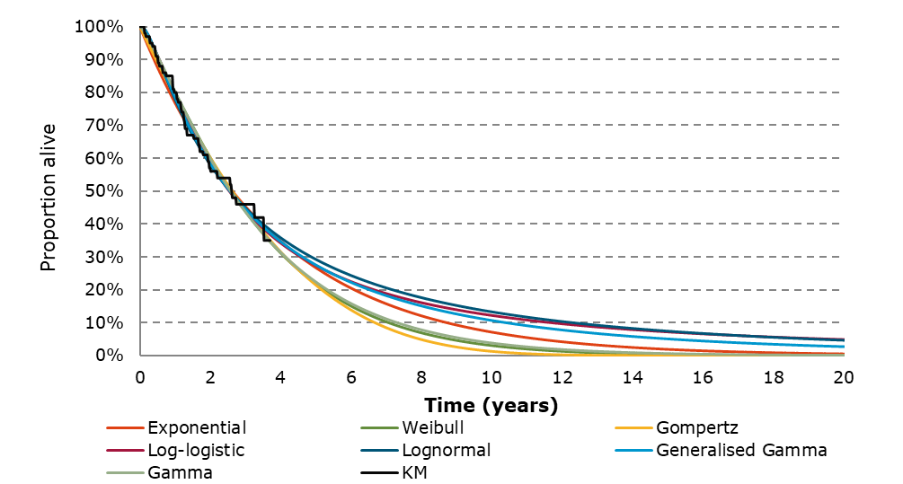
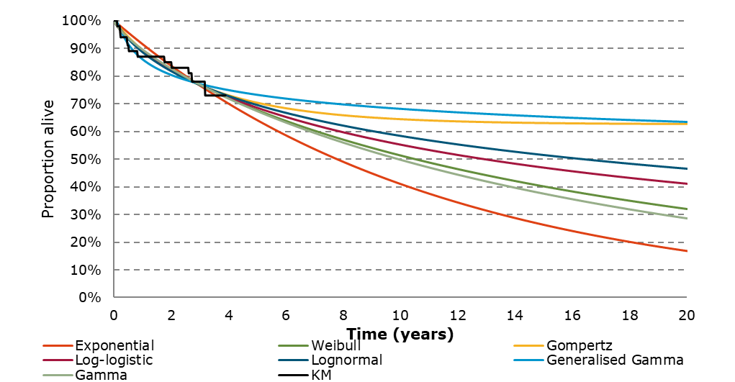
Key issues: Modelling of overall survival
EAG apply treatment effect waning apply and explore constant hazards
Back to Key Issue
Company and EAG base case
Log-logistic
EAG scenario
Exponential
CP = carboplatin + paclitaxel; OS = overall survival; IA2 = interim analysis 2; ICER = incremental cost effectiveness ratio

Slide 43
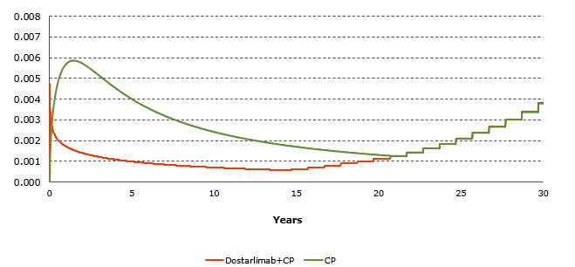
Key issues: Modelling of overall survival
Hazard rate and implied hazard ratio: log-logistic (company base case)
CONFIDENTIAL
Back to Key Issue
Hazard rate
Implied hazard ratio
CP = carboplatin + paclitaxel

Slide 44
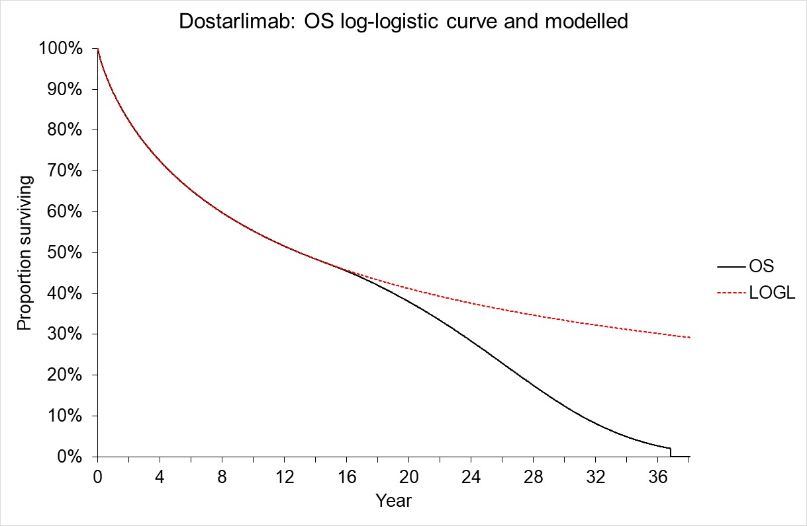
Key issues: Modelling of overall survival
Implied cure in the model
Back to Key Issue
Modelled OS deviates from the chosen extrapolation due to general population mortality capping
People from this point have general population mortality which implies they are cured (depending on definition of cure)
CP = carboplatin + paclitaxel; OS = overall survival; IA2 = interim analysis 2; ICER = incremental cost effectiveness ratio

