Slide 1
Ribociclib with an aromatase inhibitor for adjuvant treatment of hormone receptor-positive, HER2-negative early breast cancer [ID6153]
Part 1 – Redacted
Chair presentation
Technology appraisal committee A [03 June 2025] – 2nd Committee meeting
Chair: Radha Todd
Lead Team: Richard Ballerand, Andrew Champion, Hugo Pedder
Evidence review group: Liverpool Reviews and Implementation Group (LRiG)
Technical team: Harsimran Sarpal, Nigel Gumbleton, Ian Watson, Janet Roberston
Company: Novartis
© NICE 2025. All rights reserved. Subject to Notice of rights.

Slide 2
Ribociclib with an aromatase inhibitor for adjuvant treatment of hormone receptor-positive, HER2-negative early breast cancer [ID6153]
ACM1 recap
Draft guidance recommendations
Issues from ACM1 and committee’s conclusion
ACM2
Consultation responses
Other considerations
Summary

Slide 3
Draft guidance recommendation
Recap
Committee recommendation
“Ribociclib with an aromatase inhibitor can be used as an option for the adjuvant treatment of hormone receptor-positive, HER2-negative, early breast cancer at high risk of recurrence in adults. It can only be used if the cancer is lymph-node positive and present in:
• at least 4 axillary lymph nodes, or
• 1 to 3 axillary lymph nodes and the cancer:
  is grade 3, defined as at least 8 points on the modified Bloom–Richardson grading system or equivalent, or
  has a primary tumour size of at least 5 cm.”
Abbreviations: HER2:human epidermal growth factor receptor 2

Slide 4
Committee preferred assumptions at 1st meeting & requested scenarios (ACM1)
Recap
Assumption |  |  | Committee preferred
IDFS event distribution |  |  | ET = Ribociclib + AI
Survival in DR substate | ET-resistant | PFS | Exponential
 |  | OS | Weibull
 | ET-sensitive | PFS | Exponential
 |  | OS | Gamma
% CDK4/6 retreated DR substate | ET-resistant |  | 90%
 | ET-sensitive |  | 90%
PFS utility values in DR substate |  |  | ET-sensitive PFS utility values = NMR utilities
Treatment waning |  |  | Maintained for 8 years before waning
AE costs |  |  | Grade ≥3 AEs according to severity
Committee requested analyses
Generate cost-effectiveness results using population 5 data
Explore treatment waning scenarios and alternative iDFS extrapolations
Abbreviations: AE, adverse events; AI, aromatase inhibitor; CDK, cyclin-dependent kinase; DR, distant recurrence; ET, endocrine therapy; iDFS, invasive disease-free survival;NMR , non-metastatic recurrence; OS, overall survival; PFS, progression-free survival

Slide 5
NATALEE trial: relevant populations
CONFIDENTIAL
Recap
Population (% NATALEE) | Description | Comparator
1 – ITT (100%) | Node-negative or node-positive, HR-positive, HER2-negative EBC at high risk of recurrence | ET
NATALEE subgroups provided by company (all HR-positive, HER2-negative EBC at high risk of recurrence)
2 (88%) | Node-positive abemaciclib eligible and ineligible | ET
3 (12%) | Node-negative, abemaciclib ineligible | ET
4 (XX %) | Node-positive, abemaciclib eligible – unweighted (4a) and reweighted to match monarchE (4b) | Abemaciclib +ET and ET
5 EAG requested (XX %) | Abemaciclib ineligible | ET
EAG
People who are not eligible for abemaciclib + ET are treated with ET regardless of nodal status
NATALEE ITT population problematic because comparator was only ET but most people in clinical practice will have abemaciclib + ET
Consider population 4 and 5 most representative of NHS clinical practice
Abbreviations: ET, endocrine therapy; EBC, early breast cancer; HER2, human epidermal growth factor receptor 2; ITT, intention-to-treat; HR, hormone receptor
Notes:
Overall, all subgroups are at high risk of recurrence and some subgroups have node + , node-
People who are eligible for ABE +ET are treated based on presence of nodal involvement only while people eligible for ET will receive it regardless of node involvement
People who are eligible for ABE +ET , should have :
at least 4 positive axillary lymph nodes, or
1 to 3 positive axillary lymph nodes, and at least one of the following criteria:
grade 3 disease (defined as at least 8 points on the modified Bloom-Richardson grading system or equivalent), or
primary tumour size of at least 5 cm.
NATALEE ITT population (population 1) include all people who are either eligible for ABE + ET and people not eligible for ABE + ET. However, RIBO +AI is only compared with ET alone and not ABE + ET, So this may not be reflective of clinical practice because in NHS people majority of people eligible for ABE + AI would get it instead of ET
Population 2: some people have ABE + ET while some have only ET alone
Population 3: will have only ET in clinical practice
Population 4 (TA810- population 4): who have pathological node involvement will usually have ABE +ET in clinical practice but may include minority of patients who prefer not to have ABE +ET and so receive ET
Population 5 is grouping together of population 3 and a small proportion of population 2 who are not eligible for ABE+ET

Slide 6
Key issues for committee discussion
Issue | Question for the committee
General mortality rate | Is company or EAG’s approach to account for general mortality more appropriate?
iDFS extrapolation | Which iDFS extrapolation is preferred?
ET-resistant and ET-sensitive DR substate: PFS and OS | What PFS and OS extrapolations are preferred?
ET-resistant DR substate: CDK4/6 retreatment | What % of people in ET-resistant DR sub-state would be re-treated with CDK4/6 inhibitor?
Cancer Drugs Fund (CDF) | Would an additional 2 years of iDFS data resolve the uncertainty? What is the committee’s view on ribociclib’s suitability for the CDF?
Abbreviations: AI, aromatase inhibitor; CDK, cyclin-dependent kinase; DR, distant recurrence; ET, endocrine therapy; iDFS, invasive disease-free survival;OS, overall survival; PFS, progression-free survival

Slide 7
Ribociclib with an aromatase inhibitor for adjuvant treatment of hormone receptor-positive, HER2-negative early breast cancer [ID6153]
ACM1 recap
Draft guidance recommendations
Consultation responses
Other considerations
Summary

Slide 8
Responses to draft guidance consultation
Company (Novartis)
Patient organisation (Breast Cancer Now)
Experts
Eli Lilly (comparator)
Web comments

Slide 9
Consultation responses – Patient organisation, experts & comparator company
Breast Cancer Now
Concerned that draft guidance will not allow people with node-negative disease at high risk of recurrence, or people with 1-3 positive nodes and no other high-risk characteristics, to benefit from ribociclib
People in these groups do not currently have access to a CDK4/6 inhibitor to reduce the risk of their breast cancer returning; ribociclib could meet an unmet need and help reduce anxiety about recurrence
Clinical experts
Appropriate to use population 5 data to generate CE results instead of using proxy data
Ribociclib could be a viable option for people when abemaciclib is not an option, so suggest revisiting and potentially broadening the recommendation beyond abemaciclib eligibility criteria
Eli Lilly
Recommendation should specify “positive axillary lymph nodes”
Consider not appropriate to use proxy data: small changes in clinical effectiveness in early survival outcomes can cause considerable changes in downstream costs and outcomes in later-stage advanced disease
Abbreviations: CDK, cyclin-dependent kinase; CE, cost-effectiveness; DR, distant recurrence;

Slide 10
Consultation responses – Online web comments
Comments raised concern about toxicities, serious adverse reactions (particularly cardiovascular), deaths and reimbursement of ribociclib

Slide 11
Overview of Consultation responses – Company
Conducted requested cost-effectiveness analysis of ribociclib + AI vs. ET in population 5 (NATALEE high-risk ineligible for abemaciclib) using updated data instead of proxy data
Updated base case using some of the committee-preferred assumptions (see slide)
More evidence exploring the scenarios on:
  Alternative iDFS extrapolations
  Treatment effect waning
  Efficacy of post-progression therapies in the DR health state
Abbreviations: AI, aromatase inhibitor;; DR, distant recurrence; ET, endocrine therapy;

Slide 12
Company response to DG
Conducted requested CE analysis of ribociclib + AI vs. ET in population 5 (NATALEE high-risk ineligible for abemaciclib) using population 5 rather than population 1
Updated base case using committee-preferred assumptions and presented scenarios
Assumption |  |  | Committee preferred | Company base case aligned with committee?
IDFS event distribution |  |  | ET = Ribociclib + AI | Yes – NATALEE trial ITT population pooled events
Survival in DR substate | ET-resistant | PFS | Exponential | No (PFS: Lognormal) (OS: Log-logistic)
 |  | OS | Weibull
 | ET-sensitive | PFS | Exponential
 |  | OS | Gamma
% CDK4/6 retreated DR substate | ET-resistant |  | 90% | No (used 60%)
 | ET-sensitive |  | 90% | Yes
PFS utility values in DR substate |  |  | ET-sensitive PFS utility values = NMR utilities | Yes
Treatment waning |  |  | Maintained for 8 years before waning | Yes
AE costs |  |  | Grade ≥3 AEs according to severity | Yes
Abbreviations: AE, adverse events; AI, aromatase inhibitor; CDK, cyclin-dependent kinase; DR, distant recurrence; ET, endocrine therapy; iDFS, invasive disease-free survival; ITT, intent- to treat; OS, overall survival; PFS, progression-free survival

Slide 13
Population 5: IDFS results
CONFIDENTIAL
Kaplan-Meier plot for iDFS in Population 5 (NATALEE high-risk ineligible for abemaciclib [April 2024 data cut]) from NATALEE
Company
Derived iDFS results for population 5 from NATALEE (ineligible for abemaciclib)
Statistically significant improvement in the risk of an iDFS event (HR: X )
 | Ribociclib plus AI (N=XX ) | AI (N=XX )
Number of events, n (%) | XX | XX
p-value log-rank | XX
HR (95% CI) | X X
EAG
Only XX % events in ribociclib + AI arm, long term impact remains uncertain for population 5
Abbreviations: AI, aromatase inhibitor; CI, confidence intervals; ET, endocrine therapy; HR, hazard ratio; iDFS, invasive disease-free survival;
Notes:
Source: table 18 & 22

Slide 14

Issue: iDFS event rate and general mortality rate
CONFIDENTIAL
EAG
Consider company inappropriately accounted for general population mortality when calculating transition probabilities from fitted iDFS curves - general mortality rate included in addition to iDFS event rate, rather than incorporated into it
HR used was always higher than the hazard rate from the selected curve, which increased over time
Updated probability calculations to include the general mortality rate within the fitted iDFS curve cycle probability
State | Company cycle hazard calculation | EAG cycle hazard calculation
Death | Change in iDFS multiplied by proportion of events that are deaths (XX per cycle) | Change in iDFS multiplied by proportion of events that are deaths (XX per cycle), plus general mortality
NMR | Change in iDFS multiplied by proportion of events that are NMR (XX per cycle) | Change in iDFS multiplied by proportion of events that are NMR out of events that are not death events (XX % per cycle)
DR | Change in iDFS multiplied by proportion of events that are DR (XX per cycle) | Change in iDFS multiplied by proportion of events that are DR out of events that are not death events (XX per cycle)
SPM | Change in iDFS multiplied by proportion of events that are SPM (XX per cycle) | Change in iDFS multiplied by proportion of events that are SPM out of events that are not death events (XX per cycle)
Is company or EAG’s approach to account for general mortality more appropriate?
Abbreviations; DR, distant recurrence; HR, hazard ratio; iDFS, invasive disease-free survival; NMR, non-metastatic recurrence; SPM, second primary malignancy

Slide 15
iDFS extrapolations 1/2
CONFIDENTIAL
Committee conclusion at ACM1
“Long-term iDFS extrapolation was highly uncertain”
Company DG response
Identified O'Shaughnessy et al 2025, a real-world study in people with stage II EBC (similar population to population 5)-reported 59.5% 10-year iDFS & median time to iDFS event of 160.2 months
Based on O’Shaughnessy et al, determined Lognormal and Gompertz not clinically plausible.
Most extrapolations predicted similar 10- and 20-year iDFS. Gamma preferred because of second-best BIC fit, excellent visual fit and RMST of XX months (close to median of XX months across all distributions)
XX and fitted a parametric model to each arm independently: provided scenario analyses with 8 other extrapolations
Company base case iDFS distributions (including company general mortality adjustments and base case treatment effect waning)
Abbreviations; AI, aromatase inhibitor; BIC, Bayesian Information Criterion; EBC, early breast cancer ET, endocrine therapy; iDFS, invasive disease-free survival; PH, proportional hazard; RMST, restricted mean survival time

Slide 16
iDFS extrapolations 2/2
CONFIDENTIAL
EAG
Reiterate immature iDFS data, patterns in long-term relative hazard may not be apparent, and current proportionality test results may not hold in the long term
Company pairs of curves not fitted using treatment as a covariate: no HR reported, nor are any HRs presented as inputs
Consider substantial difference in long term iDFS estimates between treatment arms: EAG presented 4 scenarios using lower and upper plausible bounds for incremental iDFS assuming:
  same parametric distribution is appropriate for both arms
  different parametric distributions are chosen for each comparator (see slides 28-36)
But excluded Gompertz and lognormal. Additionally, for ribociclib + AI and ET distributions, any survival results where the survival curves crossed were excluded from scenarios
Parametric distribution | Upper bound | Lower bound
Same for intervention and comparator | Weibull (R) | Generalised gamma (R)
Different for intervention and comparator | Ribociclib+AI: exponential ET: Weibull (R) | Ribociclib+AI: Weibull ET: exponential (R)
Which iDFS extrapolation is preferred?
Abbreviations; AI, aromatase inhibitor; ET, endocrine therapy; iDFS, invasive disease-free survival; HER2, human epidermal growth factor receptor 2; HR, hormone receptor; RMST, restricted mean survival time

Slide 17
ET-resistant and ET-sensitive DR substate: PFS and OS
Committee conclusion at ACM1
Exponential PFS and Gamma OS used in ET-sensitive DR, and exponential PFS and Weibull OS used in ET-resistant DR sub-states
Company DG response
Prefer log-logistic for OS and Lognormal for PFS - Consider long-term estimation of OS and PFS for population 5 in ET-resistant and ET-sensitive DR substates appropriate and aligned with population 1
Conducted literature searches to validate OS and PFS curves - Identified Rugo et al 2025 (real-world study) with >100 months of follow-up and a large sample size – used to validate OS in ET-sensitive DR substate.
Unable to identify published studies for PFS in ET-sensitive substate, nor OS or PFS in ET-resistant substate
Rugo et al suggested OS rates of ~30% at 9 years post-treatment with a CDK4/6 inhibitor (palbociclib) + AI in first-line (metastatic) treatment setting. Higher than 10 year OS estimates in both company (25%) and committee (20%) preferred extrapolations
Consider company preferred extrapolations most appropriate. Provide scenarios with the committee-preferred extrapolations and long-term PFS and OS to fall between that predicted by company’s base case and committee’s preferred choices
Abbreviations; AI, aromatase inhibitor; CDK, cyclin-dependent kinase; DR, distant recurrence; ET, endocrine therapy; HR, hazard ratios; OS, overall survival; PFS, progression-free survival,

Slide 18
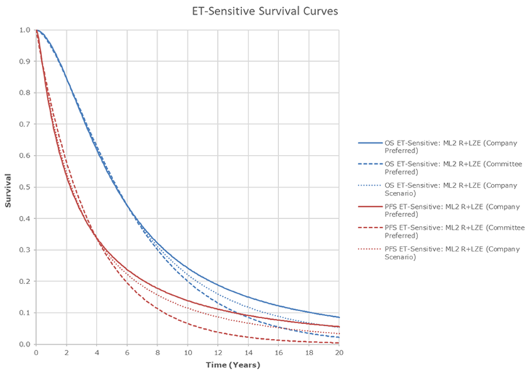
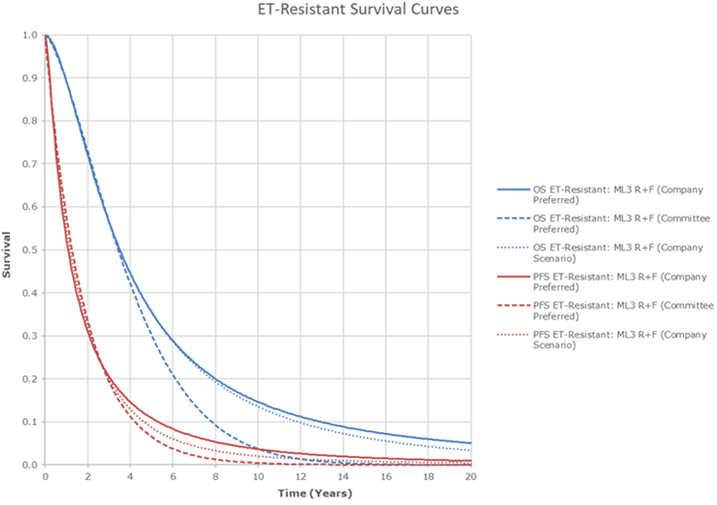
ET-resistant and ET-sensitive DR substate: PFS and OS
Company preferred
Company preferred
Committee preferred
Committee preferred
EAG
Consider the committee’s preferred distribution most appropriate to estimate PFS and OS in DR substate
What PFS and OS extrapolations are preferred?
Abbreviations; ET, endocrine therapy; OS, overall survival; PFS, progression-free survival,

Slide 19
ET-resistant DR substate: CDK4/6 retreatment
Committee conclusion at ACM1
Limited evidence of retreatment with CDK4/6 inhibitors preferred to assume 90% of people would have retreatment with CDK 4/6 inhibitors in ET-sensitive and ET-resistant DR sub-state
Company DG response
Accept committee preference of 90% retreated in ET-sensitive CDK4/6 inhibitor sensitive DR substate
For ET-resistant DR substate, company consider 90% not reflective of NHS clinical practice. Acknowledged uncertainty; performed a validation exercise with 11 UK-based experts
Experts considered no direct evidence to support use of retreatment with a CDK4/6 inhibitor, adjuvant CDK4/6 since 2022, people would not yet be categorised as ET-resistant CDK4/6 inhibitor-sensitive. Experts indicated they consider retreatment on a case-by-case basis and timing of relapse
  2 experts gave no estimate; 2 experts would retreat people the same as if they had prior ET monotherapy in adjuvant setting; 4 experts estimated retreatment in 50%-75%; 3 experts would retreat most people;
Company base case ET-resistant DR substate retreatment = 60%. Provide scenario analyses 75% and 90%
EAG
Consider no indication of consensus among experts, nor is there a suggestion that the committee preferred (90%) should be revised: used committee preferred in its base case
What % of people in ET-resistant DR sub-state would be re-treated with CDK4/6 inhibitor?
Expert results slide
Abbreviations; CDK; cyclin-dependent kinase; DR, distant recurrence; ET, endocrine therapy;

Slide 20
Ribociclib with an aromatase inhibitor for adjuvant treatment of hormone receptor-positive, HER2-negative early breast cancer [ID6153]
ACM1 recap
Draft guidance recommendations
Consultation responses
Other considerations
Summary

Slide 21
Other considerations
Equality
No issues identified by the stakeholders

Slide 22
Cancer Drugs Fund
ACM1: The company did not make a managed access proposal for ribociclib plus an aromatase inhibitor
ACM1: iDFS data was relatively immature and further follow-up with more mature data was needed to fully assess ribociclib with an AI
Company: submitted an MA proposal taking effect from July 2025 to May 2026 to collect iDFS from NATALEE, expect increase in the number of events by ~40% compared to the data shown in ACM1
Eli Lilly: Estimates of people entering DR health state are key driver; it may take longer than usual managed access period to inform these transitions due to slow progression from early to later stages of breast cancer
Key uncertainty | Can CDF data collection help reduce uncertainty? | Source
Outcome | iDFS (primary end point) | NATALEE (until May 2026)
 | TNM classification and tumour grade | NHS England BlueTeq database
NICE Managed Access Team: Additional data collection is likely to help resolve the outstanding uncertainty following a period in managed access
What is the committee’s view on ribociclib’s suitability for the CDF?
Would an additional 2 years of iDFS data resolve the uncertainty?
Abbreviations: AI, aromatase inhibitor; CDF, Cancer Drugs Fund; IDFS; invasive disease-free survival; TNM, tumour,node, metastates; MA, managed access

Slide 23
Committee preferred assumptions (ACM1)
Assumption |  |  | Committee preferred | Company base case aligned with committee?
IDFS event distribution |  |  | ET = Ribociclib + AI | Yes - NATALEE trial ITT population pooled events
Survival in DR substate | ET-resistant | PFS | Exponential | No (OS: Log-logistic) (PFS: Lognormal)
 |  | OS | Weibull
 | ET-sensitive | PFS | Exponential
 |  | OS | Gamma
% CDK4/6 retreated DR substate | ET-resistant |  | 90% | No (used 60%)
 | ET-sensitive |  | 90% | Yes
PFS utility values in DR substate |  |  | ET-sensitive PFS utility values = NMR utilities | Yes
Treatment waning |  |  | Maintained for 8 years before waning | Yes
AE costs |  |  | Grade ≥3 AEs according to severity | Yes
Abbreviations: AE, adverse events; AI, aromatase inhibitor; CDK, cyclin-dependent kinase; DR, distant recurrence; ET, endocrine therapy; iDFS, invasive disease-free survival; ITT, intent-to treat; OS, overall survival; PFS, progression-free survival

Slide 24
Cost-effectiveness results
All ICERs are reported in PART 2 slides due to confidential prices
Base case
Company base case
Committee preferred with & without general mortality adjustment
EAG scenario analyses
iDFS extrapolations:
  using lower & upper mean difference (iDFS) with adjusted general mortality +
  Treatment effect waning scenarios
Under £30,000/QALY
Some scenarios under £20,000/QALY gained, some over £30,000 QALY
Abbreviations:; iDFS, invasive disease-free survival; QALY, quality adjusted life years

Slide 25
Thank you.
© NICE [2025]. All rights reserved. Subject to Notice of rights.

Slide 26
Supplementary appendix

Slide 27
Other issues: treatment waning & IDFS event distribution
CONFIDENTIAL
Treatment waning
Company updated treatment effect waning in model with committee preferred approach with waning starting from 8 years and continuing for a duration of XX years
Scenarios: treatment effect constant for up to 8 years and then wanes over 5 -17.5 years
IDFS event distribution
Company derived iDFS event distributions from NATALEE ITT for population 5 and updated distribution for ET = ribociclib + AI (committee preferred)
iDFS event distributions in AI arm and ribociclib + AI arm of NATALEE ITT trial have been pooled across two treatments, with pooled iDFS event distributions informing cost-effectiveness
Treatment arm | Number of events | % iDFS events that are NMR | % iDFS events that are death | % iDFS events that are DR | % iDFS events that are SPM
Ribociclib plus AI | XX | XX | XX | XX | XX
ET | XX | XX | XX | XX | XX
Pooled | XX | XX | XX | XX | XX
What treatment waning approach is preferred? Are pooled iDFS event distributions appropriate for decision making?
Abbreviations: AI, aromatase inhibitor; DR, distant recurrence;ET, endocrine therapy; iDFS, invasive disease-free survival; ITT, intention-to-treat; NMR, non-metastatic recurrence; SPM, second primary malignancy

Slide 28
Difference in mean survival times for 'pairs' of iDFS curves in company model
Years |  | Ribociclib+AIª
 |  | Exponential | Gamma | Gen. F | Gen. gamma | Gomp | Log-log | Lognorm | RCS Log-log | RCS Weibull | Weibull
ET | Exponential | 2.9 | 1.0 | 2.4 | 2.4 | - | 1.7 | - | 2.4 | 1.8 | 0.7
 | Gamma | 5.3 | 3.4 | 4.8 | 4.8 | - | 4.1 | - | 4.8 | 4.2 | 3.1
 | Gen. F | 3.0 | 1.1 | 2.4 | 2.4 | - | 1.8 | - | 2.5 | 1.9 | 0.7
 | Gen. gamma | 3.0 | 1.1 | 2.4 | 2.4 | - | 1.8 | - | 2.5 | 1.9 | 0.7
 | Gomp | - | - | - | - | - | - | - | - | - | -
 | Log-log | 3.9 | 2.0 | 3.4 | 3.4 | - | 2.7 | - | 3.4 | 2.8 | 1.7
 | Lognorm | 1.2 | - | 0.7 | 0.7 | - | - | - | 0.7 | - | -
 | RCS Log-log | 3.1 | 1.2 | 2.5 | 2.5 | - | 1.9 | - | 2.6 | 2.0 | 0.8
 | RCS Weibull | 4.4 | 2.5 | 3.9 | 3.9 | - | 3.2 | - | 3.9 | 3.3 | 2.2
 | Weibull | 5.9 | 4.0 | 5.4 | 5.4 | - | 4.7 | - | 5.4 | 4.8 | 3.7
Abbreviations; AIC, Akaike information criterion; BIC, Bayesian Information criterion; iDFS, invasive-disease free survival; RCS, radar cross section
parametric distributions both arms
Curve pairs used in EAG scenarios
Main deck

Slide 29
Company fitted iDFS curves, including base case general mortality adjustments
CONFIDENTIAL
Ribociclib+AI, including general mortality, base case treatment effect waning
ET, including general mortality
Abbreviations; AT, aromatase inhibitor; ET, endocrine therapy; Ribo: ribociclib; iDFS, invasive-disease free survival; RCS, radar cross section
Main deck

Slide 30
EAG’s iDFS scenarios with general mortality adjustment
CONFIDENTIAL
Company base case iDFS distributions, base case treatment effect waning
Company base case iDFS distributions, lower treatment effect waning scenario
Company base case iDFS distributions, upper treatment effect waning scenario
Abbreviations; AT, aromatase inhibitor; ET, endocrine therapy; Ribo: ribociclib; iDFS, invasive-disease free survival; RCS, radar cross section

Slide 31
EAG’s lower mean survival time difference, matching iDFS distributions
CONFIDENTIAL
Lower mean survival time difference, matching iDFS distributions, base case treatment effect waning [EAG S1]
Lower mean survival time difference, matching iDFS distributions, lower treatment effect waning scenario [EAG S7]
Lower mean survival time difference, matching iDFS distributions, higher treatment effect waning scenario [EAG S8]
Main deck
Abbreviations; AT, aromatase inhibitor; ET, endocrine therapy; Ribo: ribociclib; iDFS, invasive-disease free survival; RCS, radar cross section

Slide 32
EAG’s upper survival time difference, matching iDFS distributions
CONFIDENTIAL
Upper mean survival time difference, matching iDFS distributions, base case treatment effect waning [EAG S2]
Lower mean survival time difference, matching iDFS distributions, lower treatment effect waning scenario [EAG S9]
Upper mean survival time difference, matching iDFS distributions, higher treatment effect waning scenario [EAG S10]
Main deck
Abbreviations; AT, aromatase inhibitor; ET, endocrine therapy; Ribo: ribociclib; iDFS, invasive-disease free survival; RCS, radar cross section

Slide 33
EAG’s lower survival time difference, independent iDFS distributions
CONFIDENTIAL
Lower mean survival time difference, independent iDFS distributions, base case treatment effect waning [EAG S3]
Lower mean survival time difference, independent iDFS distributions, lower treatment effect waning scenario [EAG S11]
Upper mean survival time difference, independent iDFS distributions, higher treatment effect waning scenario [EAG S12]
Main deck
Abbreviations; AT, aromatase inhibitor; ET, endocrine therapy; Ribo: ribociclib; iDFS, invasive-disease free survival; RCS, radar cross section

Slide 34
EAG’s upper survival time difference, independent iDFS distributions
CONFIDENTIAL
Upper mean survival time difference, independent iDFS distributions, base case treatment effect waning [EAG S4]
Lower mean survival time difference, independent iDFS distributions, lower treatment effect waning scenario [EAG S13]
Upper mean survival time difference, independent iDFS distributions, higher treatment effect waning scenario [EAG S14]
Main deck
Abbreviations; AT, aromatase inhibitor; ET, endocrine therapy; Ribo: ribociclib; iDFS, invasive-disease free survival; RCS, radar cross section

Slide 35
iDFS extrapolation (company base and scenarios) – ET
CONFIDENTIAL
Which iDFS extrapolation is preferred?
Abbreviations; AI, aromatase inhibitor; ET, endocrine therapy; iDFS, invasive disease-free survival; HER2, human epidermal growth factor receptor 2; HR, hormone receptor

Slide 36
Issue: ET-resistant and ET-sensitive DR substate: treatment mix
Clinical Expert | Would you consider retreatment with a CDK4/6 inhibitor? | Estimated proportion of patients you would rechallenge with a CDK4/6 inhibitor?
1 | Potentially | No estimate given
2 | Yes | No estimate given
3 | Yes | 50%
4 | Yes | 60%
5 | Yes | 60-70%
6 | Yes | 60-75%
7 | Yes | Most
8 | Yes | Most
9 | Yes | Most
10 | Yes | Same as ET monotherapy
11 | Yes | Same as ET monotherapy
Main deck
Abbreviations; DR, distant recurrence; CDK; cyclin-dependent kinase ET, endocrine therapy

Slide 37
Treatment pathway: Hormone receptor-positive, HER2-negative early breast cancer
Recap
HR+/HER2-EBC at high risk of recurrence
Surgery and/or adjuvant chemotherapy/radiotherapy
Adjuvant ET
Adjuvant CDK4/6 inhibitor + ET
Tamoxifen (for men and premenopausal women)
AIs* (Anastrozole, exemestane or letrozole for pre and post menopausal women)
Abemaciclib + ET
TA810 (at high risk of recurrence, node-positive only)
Ribociclib + AI (ID6153)
*Only ET in NATALEE permitted were AI’s anastrozole and letrozole
Is the treatment pathway reflective of NHS clinical practice?
Abbreviations: AI, aromatase inhibitor; CDK, cyclin-dependent kinase; ET, endocrine therapy; HER2, human epidermal growth factor receptor 2; HR, hormone receptor; ITT, intention-to-treat; TA technology appraisal
Notes:
Adapted from : Figure 4 CS:
Abemaciclib + ET criteria:
at least 4 positive axillary lymph nodes, or
1 to 3 positive axillary lymph nodes, and at least one of following criteria:
grade 3 disease (defined as at least 8 points on the modified Bloom-Richardson grading system or equivalent), or
primary tumour size of at least 5 cm

Slide 38
Ribociclib (Kisqali, Novartis)
Recap
Technology details
Marketing authorisation | ‘Ribociclib in combination with an aromatase inhibitor (AI) for the adjuvant treatment of adult patients with hormone receptor (HR) positive (+)/human epidermal growth factor receptor 2 (HER2) negative (–) early breast cancer (EBC) at high risk of recurrence’
Mechanism of action | Selective inhibitor of cyclin-dependent kinase 4 and 6 (CDK4/6) By preventing interaction between CDK4/6 and cyclin D, ribociclib inhibits the phosphorylation of retinoblastoma tumour suppressor protein thereby blocking the progression from the G1 to the S phase of the cell cycle
Administration | Oral: 400 mg tablet once daily for 21 days followed by 7 days off treatment Maximum treatment duration 3 years or until disease recurrence or unacceptable toxicity occur
Price | List price: £1,966.67 for 42 tablets (200 mg) There is an existing simple patient access scheme (PAS) discount for ribociclib
Notes:
Source: table 2, CS

Slide 39
Decision problem – Issue 3: iDFS v DDFS proxy for OS
Recap
 | Final scope | EAG comments
Population | Adults with HR-positive, HER2-negative early breast cancer after surgery of primary breast tumour | Adults with HR-positive, HER2-negative early breast cancer at high risk of recurrence after surgery of the primary breast tumour. Company’s definition of high risk appropriate
Intervention | Ribociclib + AI | Appropriate
Comparators | Full population: Standard ET For node-positive early breast cancer at high risk of recurrence: abemaciclib (+ET) | EAG agrees that abemaciclib + ET and ET alone: relevant comparators
Outcomes | iDFS, DDFS, OS, AEs & HRQoL | Company iDFS a clinically meaningful surrogate endpoint for OS as disease recurrence is associated mortality Improvements in iDFS and DDFS translate to improvements in OS EAG: DDFS more appropriate proxy for OS than iDFS
Subgroups | Node positive/negative disease Risk of recurrence Presence of germline BRCA1 or 2 mutations | EAG: node-positive high-risk eligible for abemaciclib and high risk ineligible for abemaciclib are most representative of people seen in NHS
Abbreviations: AI, aromatase inhibitor; BRCA, breast cancer gene; DDFS, distant disease-free survival; ET endocrine therapy; iDFS, invasive disease-free survival; HRQoL, health-related quality of life; OS, overall survival; RFS, recurrence-free survival;
Notes:
Source: TablE1 EAG report: SUPPLEMENTARY

Slide 40
monarchE: trial
Recap
 |  | monarchE
Design |  | Phase III, multi-centre, open-label, randomised controlled trial
Location |  | International: 603 centres across 38 countries (including UK)
Population |  | Adults with with HR-positive, HER2-negative, node-positive, early breast cancer at a high-risk of recurrence; ECOG PS 0 to 1 Cohort 1 (n=5120); Pathological tumour involvement in: ≥4 positive ALNs, or 1 to 3 positive ALNs, and at least one of the following criteria: grade 3 disease (defined as ≥8 points on the modified Bloom–Richardson grading system or equivalent), or primary tumour size ≥5cm
Intervention |  | Abemaciclib 150mg BID continuously for ≤24 months AND ET (tamoxifen, toremifene, letrozole anastrozole or exemestane, with or without ovarian suppression) for 5 to 10 years
Comparator |  | ET (tamoxifen, toremifene, letrozole anastrozole or exemestane, with or without ovarian suppression) for 5 to 10 years
Outcomes | Primary | iDFS
 | Secondary | DRFS, OS, PROs (EQ-5D-5L FACT-B, FACT-ES, FACIT- F), safety and pharmacokinetics/pharmacodynamics
Abbreviations: ALN, axillary lymph node; BID, twice per day; DRFS, distant relapse-free survival; ECOG PS, Eastern Cooperative Oncology Group performance status; EQ-5D-5L, EuroQol-5 Dimensions-5 Levels; ET, endocrine therapy; FACIT-F: Functional Assessment of Chronic Illness Therapy-Fatigue; FACT-B, Functional Assessment of Cancer Therapy-Breast; FACT-ES, Functional Assessment of Cancer Therapy-Endocrine Subscale; HER2, human epidermal growth factor receptor 2; HR, hormone receptor; 3; Idfs,invasive disease-free survival; OS, overall survival; PROs, patient-reported outcomes
Notes:
Source: table 13, EAG report

Slide 41
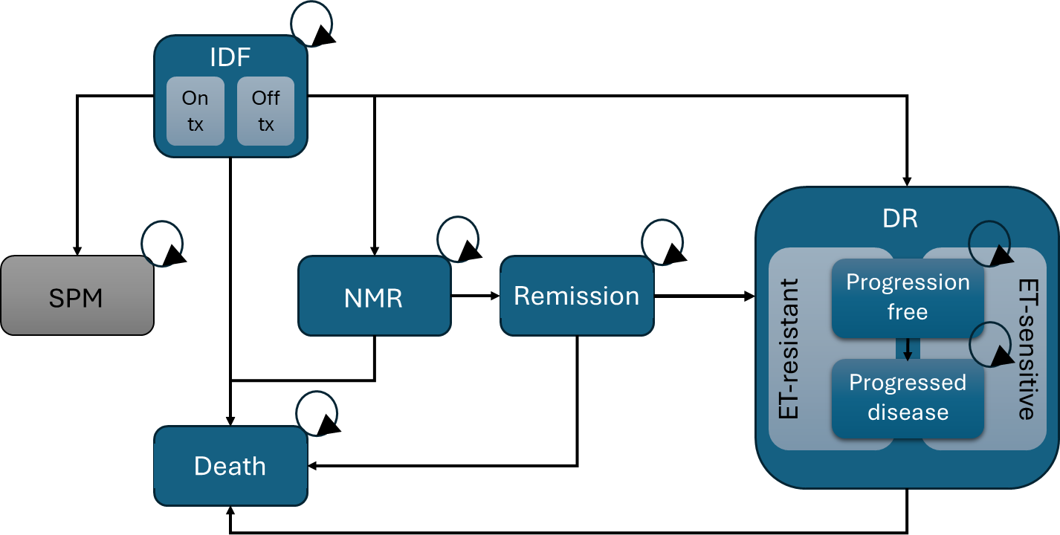
Company’s model overview
Issue 6: EAG: company’s model OS results may not be robust
Recap
Company
Semi-Markov model with de novo partitioned survival sub-model for DR health states. Structure in line with previous TA and clinical experts agreed with proposed structure:
6 – mutually exclusive states (IDF, SPM, NMR, remission, DR and death)
IDF split in 2 sub states: on-treatment and off-treatment
DR split in 2 sub states: ET-resistant and ET-sensitive
People enter the model in iDFS health state and are at risk of moving to SPM, NMR, DR and death health states
Model assumed equal effectiveness of ribociclib+ AI and abemaciclib + ET based on ITC except AEs
EAG
Broadly agree with model structure. EAG unable to directly estimate OS in the model due to the approach used to calculate life years in DR health state
People transitioning to SPM exit the model without deaths being included in life-year calculations and was not included in any OS estimates for ribociclib + AI vs. ET
Is the company model structure appropriate?
Abbreviations; AI, aromatase inhibitor; AEs, adverse events; DR, distant recurrence; ET, endocrine therapy; IDF, invasive disease-free survival; ITC, indirect treatment comparison; NMR, non-metastatic recurrence; OS: overall survival; SPM, second primary malignancy; TA, technology appraisal
Notes:
Source: Figure 1 EAG report

Slide 42
Thank you.
© NICE [insert year]. All rights reserved. Subject to Notice of rights.

