Slide 1
Mirvetuximab soravtansine for treating folate receptor alpha-positive platinum-resistant advanced epithelial ovarian, fallopian tube or primary peritoneal cancer
Part 1: For screen – contains redacted CON information
Technology appraisal committee A [04 November 2025]
Chair: Radha Todd
Lead team: Matthew Walton, Elizabeth Adeyeye, Richard Ballerand
External assessment group: Peninsula Technology Assessment Group
Technical team: Chris Shah, Emily Leckenby, Lizzie Walker
Company: AbbVie
© NICE 2025. All rights reserved. Subject to Notice of rights.

Slide 2
Mirvetuximab soravtansine for treating folate receptor alpha-positive platinum-resistant advanced epithelial ovarian, fallopian tube or primary peritoneal cancer
Background and key issues
Clinical effectiveness
Modelling and cost effectiveness
Summary

Slide 3
Background on folate receptor alpha-positive platinum-resistant advanced epithelial ovarian, fallopian tube or primary peritoneal cancer
Causes
No specific causes but risk increases with age, family history of ovarian cancer, and inherited gene mutations
Epidemiology
Around 2,000 women in England develop high-grade serous platinum-resistant epithelial ovarian cancer yearly
Of those tested, 32% are estimated to have high FRα expression
Diagnosis and classification
Early-stage ovarian cancer is underdiagnosed because of lack of specific symptoms
  Most patients have advanced disease at diagnosis
While many patients initially respond to treatment, most become resistant to platinum-based therapy
Symptoms and prognosis
At diagnosis, symptoms can be non-specific and may include gastrointestinal issues, ascites, pleural effusion and venous thromboembolism
  Symptoms worsen as disease progresses
5-year survival rate for those diagnosed with advanced disease (stage III/IV): 14% to 26%
Abbreviations: FRα, folate receptor alpha

Slide 4
Patient perspectives
There is an unmet need for new treatments for platinum-resistant ovarian cancer
Submissions from Ovacome, Ovarian Cancer Action and Target Ovarian Cancer
Ovarian cancer has a significant impact on the quality of life of people with the condition and their families and most people are diagnosed with advanced stage disease
People experience physical symptoms, such as ascites and gastrointestinal issues, and chemotherapy can have long-lasting side effects
There is a lack of effective treatment options available for platinum-resistant ovarian cancer, which has a severe psychological and emotional impact
A new treatment option that could improve survival in a population with limited options would offer hope
People with ovarian cancer reported that mirvetuximab has a broadly manageable safety profile and that good quality of life is possible while on treatment, although some people experienced ocular side effects
  More research needed to understand these side effects because idea of reducing dose to avoid these is concerning to those with the condition
“It’s a brutal disease, and so many women are left with few or no options once standard chemotherapy stops working”
“Many women diagnosed are in their 50s/60s, leading active lives with work and dependent family”
“It was devastating… particularly knowing the survival rate and the fact there is no absolute cure”

Slide 5
Clinical perspectives
New treatments are urgently needed for platinum-resistant ovarian cancer
Submission from British Gynaecological Cancer Society
Some patients develop platinum resistance after first-line treatment and others will receive several courses of chemotherapy before platinum resistance develops
For treating platinum-resistant ovarian cancer most clinicians will opt for either liposomal doxorubicin or weekly paclitaxel with or without bevacizumab (bevacizumab not available in NHS setting)
There is an unmet need in platinum-resistant ovarian cancer; new treatments are urgently needed
Mirvetuximab would be the first drug to offer a survival advantage in the platinum-resistance setting and would give hope to hundreds of people who suffer from platinum-resistant ovarian cancer
“Very few drugs are effective in platinum-resistant ovarian cancer”
“Once platinum-resistance develops, life expectancy is in the range of months”

Slide 6
Equality considerations
Company raised equality issues relating to gender health gap, rarity and equity of access:
  Women experience an additional 3 years of ill health and disability compared with men
    In July 2024, 46% of gynaecology patients were on waiting lists longer than the NHS target of 18 weeks, and nearly 30,000 women were waiting for over a year
    Longer wait times lead to delayed diagnosis and worse outcomes
  Mirvetuximab granted orphan designation by FDA and EMA
    Indicative of rarity of condition
  People from more deprived areas less likely to receive surgery or chemotherapy
    50% more likely to die within 2 months of diagnosis in most deprived areas vs least deprived
EAG commented that it was unclear how introducing mirvetuximab alone would reduce health inequalities:
  Company did not present evidence or rationale to demonstrate that mirvetuximab would lead to earlier detection of those eligible for treatment
  However, EAG agrees that availability of alternative to chemotherapy would be valuable to people with platinum-resistant ovarian cancer
Abbreviations: EAG, external assessment group; EMA, European Medicines Agency; FDA, Food and Drug Administration

Slide 7
Mirvetuximab soravtansine (Elahere, AbbVie)
Marketing authorisation | Indicated for the treatment of adult patients with folate receptor-alpha (FRα) positive, platinum-resistant high grade serous epithelial ovarian, fallopian tube, or primary peritoneal cancer who have received 1 to 3 prior systemic treatment regimens. MHRA marketing authorisation granted in July 2025
Mechanism of action | First-in-class FRα-targeted antibody-drug conjugate comprising a monoclonal antibody that binds to the FRα protein and an anticancer medicine called DM4 After mirvetuximab soravtansine attaches to the FRα protein, it enters the cancer cell and releases DM4 to kill the cell
Administration | Intravenous infusion administered every 21 days until disease progression or unacceptable toxicity
Price | List price per 100mg vial: £4,950 Average cost of a course of treatment (at list price):********* A patient access scheme has been agreed
Abbreviations: FRα, folate receptor alpha; MHRA, Medicines and Healthcare products Regulatory Agency

Slide 8

Treatment pathway and proposed positioning of mirvetuximab
1L
Platinum-based chemotherapy (TA55)
Platinum-based chemotherapy plus bevacizumab
Maintenance therapy: Olaparib (TA962, BRCA+), Niraparib (TA673, HRD+/-, CDF), Rucaparib (TA1055, BRCA-, HRD +/-)
Maintenance therapy: Olaparib + bevacizumab (TA946, HRD+), bevacizumab (HRD+/-)
Platinum sensitive (progression >6 months)
Platinum resistant (progression ≤ 6 months)
2L to 4L
Platinum-based chemotherapy* (TA389)
FRα positive
FRα negative
Maintenance therapy: Olaparib (TA908, BRCA+), Niraparib (TA784, BRCA +/-), Rucaparib (TA1007, BRCA+/-)
Mirvetuximab (proposed)
PLD or paclitaxel (TA389)*
PLD or paclitaxel (TA389)*
*Topotecan not recommended by NICE in TA389
Is the proposed positioning of mirvetuximab appropriate?
The comparator in the company analysis is pooled chemotherapy (including PLD, paclitaxel and topotecan). Is topotecan used in clinical practice as a treatment option for platinum-resistant FRα-positive disease?
Abbreviations: 1L, first line; 2L, second line; 4L, fourth line; BRCA, Breast Cancer gene; CDF, Cancer Drugs Fund; HRD, homologous recombination deficient; PLD, pegylated liposomal doxorubicin; TA, technology appraisal

Slide 9



Key issues
Issue | Resolved? | ICER impact
Generalisability of MIRASOL | No – for discussion | Unknown
Subgroup analyses | No – for discussion | Moderate
OS extrapolations | No – for discussion | Large
Health state utilities for chemotherapy | No – for discussion | Large
Severity modifier | No – for discussion | Large
Adverse events | No – for discussion | Small
Wastage | No – for discussion | Small
Disease management costs | No – for discussion | Small
Other issues with small impact on ICER (in appendix):
Modelling mirvetuximab DoT
Subsequent therapy
Abbreviations: AE, adverse event; DoT, duration of treatment; FRα, folate receptor alpha; ICER, incremental cost-effectiveness ratio; OS, overall survival

Slide 10
Mirvetuximab soravtansine for treating folate receptor alpha-positive platinum-resistant advanced epithelial ovarian, fallopian tube or primary peritoneal cancer
Background and key issues
Clinical effectiveness
Modelling and cost effectiveness
Summary

Slide 11
Key clinical trials: MIRASOL and FORWARD-1
Comparison of MIRASOL and FORWARD-1 trials
Company
Focused on MIRASOL because FORWARD-1 population based on broader range of FRα expression than licence
Provided FORWARD-1 post-hoc analysis including only participants who met licence requirement (rescored population)
Provided meta-analysis pooling both studies
 | MIRASOL | FORWARD-1
Design | Phase 3, randomised, open-label | Phase 3, randomised, open-label
Population | Adults with platinum-resistant HGS epithelial ovarian, primary peritoneal, or fallopian tube cancers, high FRα expression and 1-3 prior lines of therapy | Adults with platinum-resistant epithelial ovarian, primary peritoneal, or fallopian tube cancers, positive FRα expression and 1-3 prior lines of therapy
Intervention | Mirvetuximab | Mirvetuximab
Comparator | ICC: paclitaxel, PLD or topotecan | ICC: paclitaxel, PLD or topotecan
Median FU | 28.35 months (Sep 2024 cut-off) | 12.45 months
Key outcomes | PFS, PFS2, OS, EQ-5D-5L, DoT, ORR, subsequent therapies | PFS, PFS2, OS, EQ-5D-5L, DoT, ORR, subsequent therapies
EAG:
Not clear why pooled analysis not considered for use in model but not expected to impact economic analysis
Abbreviations: DoT, duration of treatment; FRα, folate receptor alpha; FU, follow-up HGS, high-grade serous; ICC, investigator choice of chemotherapy; OS, overall survival; ORR, objective response rate; PFS, progression-free survival; PFS2, time to second disease progression; PLD, pegylated liposomal doxorubicin; PS2+, positive staining intensity ≥2

Slide 12
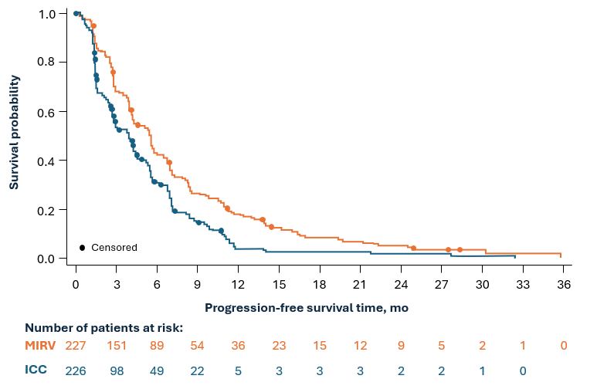
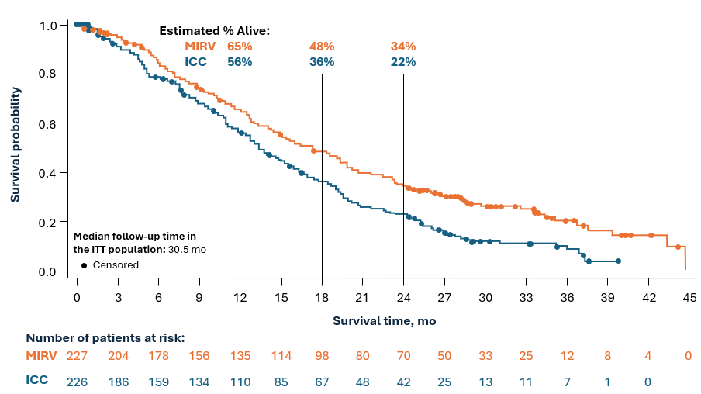
Key clinical trial results
In MIRASOL, mirvetuximab had a statistically significant PFS and OS benefit compared with chemotherapy
MIRASOL PFS_{INV}: Mirvetuximab vs chemotherapy
MIRASOL OS: Mirvetuximab vs chemotherapy
 | PFS_{INV} HR (95% CI) | OS HR (95% CI)
MIRASOL | 0.63 (0.51, 0.79) | 0.68 (0.54, 0.84)
FORWARD-1* | 0.65 (0.41, 1.03) | 0.68 (0.41, 1.12)
EAG:
Results of pooled analysis statistically significant and consistent with MIRASOL and FORWARD-1
Higher rate of censoring in chemotherapy arm than mirvetuximab arm (8.9% vs 3.5%) due to higher use of subsequent treatments
*Post-hoc analysis including only ‘rescored’ population to align with licence
Abbreviations: CI, confidence interval; DCO, data cut-off; HR, hazard ratio; ICC, investigator’s choice of chemotherapy; INV, investigator-assessed; MIRV, mirvetuximab; OS, overall survival; PFS, progression-free survival

Slide 13

Key issue: Generalisability of MIRASOL
Unknown ICER impact
EAG highlighted uncertainties associated with generalisability to UK clinical practice
EAG:
Age of participants: Median age in MIRASOL lower than target population in clinical practice (64 in mirvetuximab arm and 62 in chemotherapy arm vs median age at diagnosis of 68 in Pickwell-Smith et al 2025)
PARP inhibitors: Prior treatment with PARP inhibitors is likely underrepresented in MIRASOL (54.6% in mirvetuximab arm, 57% in ICC arm), but EAG unsure to what extent. Prior treatment with PARP inhibitors can reduce sensitivity to subsequent chemotherapy, therefore trial results may overestimate potential benefits of chemotherapy
Topotecan use: 23.5% of participants in comparator arm of MIRASOL received topotecan but EAG received clinical advice that topotecan is rarely used in clinical practice.
  Topotecan has similar effectiveness to other chemotherapy regimens so this issue not expected to affect generalisability
Is topotecan similarly effective to other chemotherapy regimens?
Is MIRASOL generalisable to UK clinical practice?
Is MIRASOL acceptable to inform decision making?
Abbreviations: FRα, folate receptor alpha; ICC, investigator’s choice of chemotherapy; PARP, poly-ADP polymerase; RCT, randomised controlled trial

Slide 14
Key issue: Subgroup analyses
Moderate ICER impact
EAG: Clinical rationale for different prognosis in subgroups but should be interpreted with caution
Primary platinum-free interval (≤6 months vs >6 months):
  Suggestion of a statistically significant effect on OS (interaction effect: p=0.0057) but not PFS (interaction effect: p=0.6417).
  Clinical advice indicates it is plausible that longer platinum-free interval would lead to a better response to treatment
  Impact should be interpreted with caution because of lack of consistency between OS and PFS, and lack of adjustment at alpha level for multiple comparisons
BRCA mutation status:
  Positive BRCA status yielded more favourable HR of OS for mirvetuximab vs chemotherapy (OS interaction effect: p=0.0592; PFS interaction effect: p=0.0223)
  Clinical advice indicated that people who are BRCA positive tend to be more chemotherapy-sensitive and tend to have a better prognosis
  Results indicate small impact on ICER and should be interpreted with caution because of small sample size and lack of adjustment at alpha level for multiple comparisons
MIRASOL subgroup analysis results
Subgroup | OS HR (95% CI)
Primary platinum-free interval > 6 months (n=305) | 0.54 (0.415, 0.707)
Primary platinum-free interval ≤ 6 months (n=147) | 1.07 (0.735, 1.562)
Positive BRCA status (n=65) | 0.42 (0.237, 0.759)
Negative (or unknown) BRCA status (n=388) | 0.73 (0.582, 0.928)
Company
Subgroup analysis not applicable
Exploratory only, not included in economic model
Is it appropriate to consider any subgroup analyses?
Abbreviations: BRCA, breast cancer gene; EAG, external assessment group; HR, hazard ratio; ICER, incremental cost-effectiveness ratio; OS, overall survival; PFS, progression-free survival

Slide 15
Mirvetuximab soravtansine for treating folate receptor alpha-positive platinum-resistant advanced epithelial ovarian, fallopian tube or primary peritoneal cancer
Background and key issues
Clinical effectiveness
Modelling and cost effectiveness
Summary

Slide 16
Overview of company’s model
3-state partitioned survival model
40.8-year time horizon (almost no patients alive at end)
3.5% discounting rate
1-week cycle length and half-cycle correction for OS and PFS
Uses clinical data from MIRASOL
Mirvetuximab is modelled to affect QALYs by:
Increasing OS and PFS vs chemotherapy
Using different utility values by treatment arm, resulting in x1.7 severity weight
Mirvetuximab is modelled to affect costs by:
Higher drug acquisition costs
Reduced costs in post-progression stage due to delayed progression
Increased testing, administration and monitoring costs
Reduced AE costs and reduced terminal care costs
Company’s model structure
Pre-progression
Death
Post-progression
EAG:
Partitioned survival model structure appropriate given high level of maturity of observed data
Abbreviations: AE, adverse event; DoT: duration of treatment; EAG, external assessment group; OS, overall survival; PFS, progression-free survival; PLD, pegylated liposomal doxorubicin; QALY, quality-adjusted life year

Slide 17
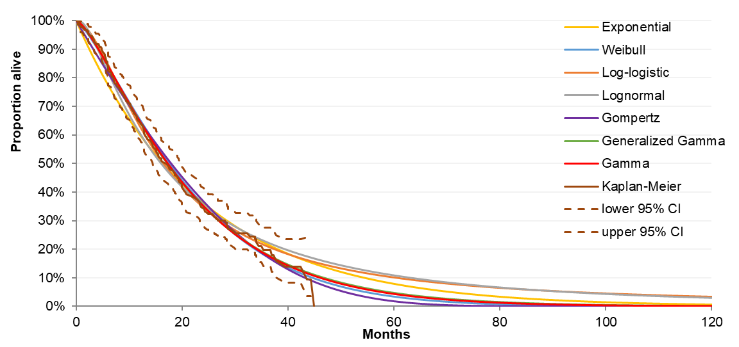
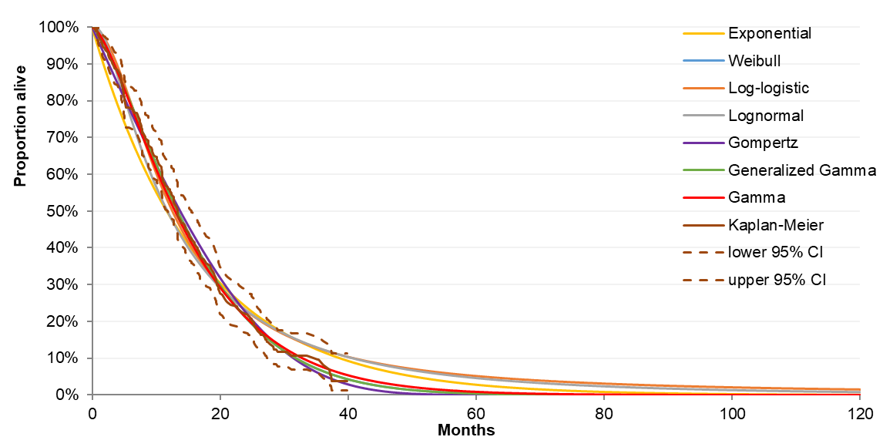
Key issue: OS extrapolations (1/2)
Link to treatment effect over time
Large ICER impact
For mirvetuximab OS, company prefers log-logistic distribution and EAG prefers gamma
Mirvetuximab OS KM and parametric extrapolations
Chemotherapy OS KM and parametric extrapolations
Company preferred curve (Weibull –identical to generalised gamma)
EAG preferred curve
EAG preferred curve (gamma)
Company preferred curve
5- and 10-year survival estimates
 | Mirvetuximab OS |  |  | Chemotherapy OS
Year | Log-logistic (Company) | Gamma (EAG) | Clinical expert opinion | Weibull (Company) | Gamma (EAG) | Clinical expert opinion
5 | 10% | 4% | Company: 8 to 12% | 0% | 1% | Company: 0 to 5%
10 | 3% | 0% | Company: “Uncertain” EAG: 0% | 0% | 0% | Company: 0% EAG: 0%
Which survival estimates are most realistic?
Abbreviations: EAG, external assessment group; OS, overall survival; PH, proportional hazards

Slide 18
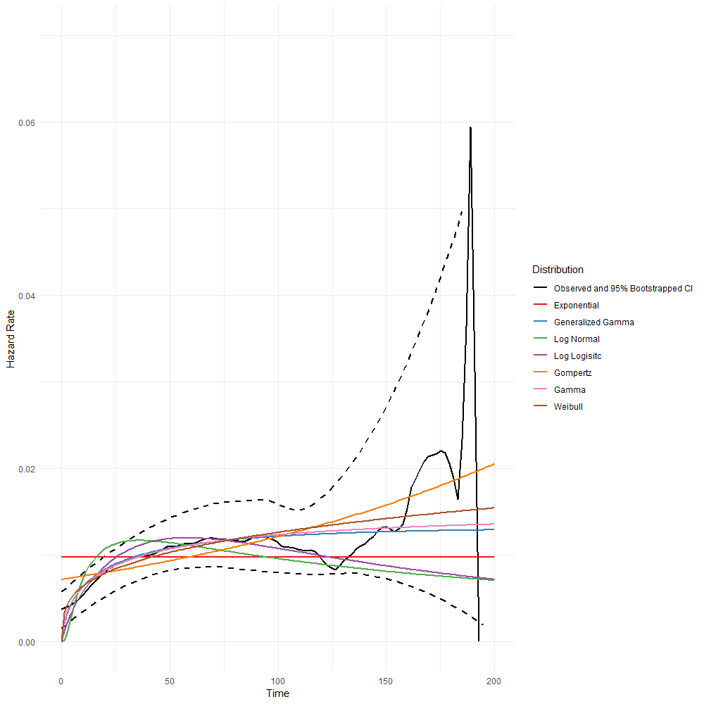
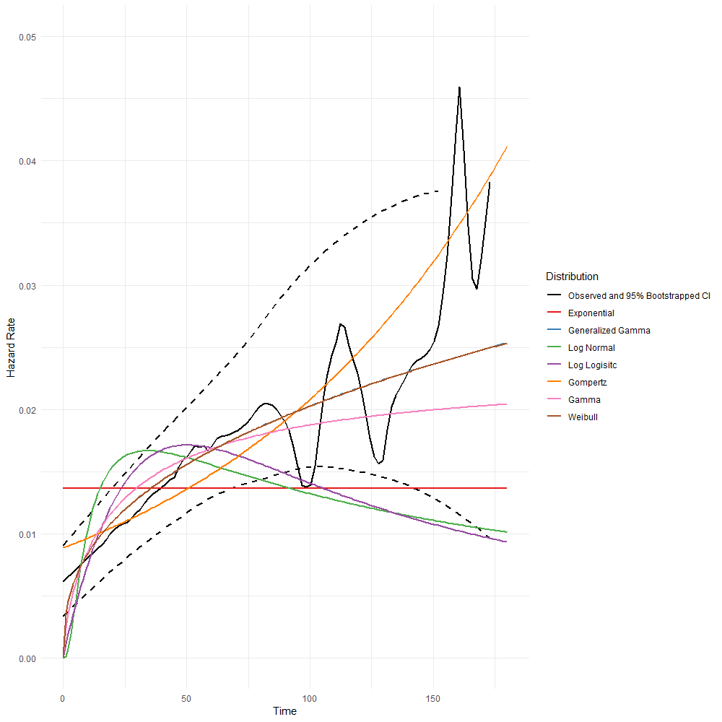
Key issue: OS extrapolations (2/2)
EAG
Mirvetuximab: gamma and generalised gamma provide better statistical and visual fit to observed data, company’s clinical expert considered both plausible
Chemotherapy: gamma has good fit to hazard
KM curves demonstrated increasing censoring beyond month 24, especially in mirvetuximab arm → KM tail should be interpreted with caution due to limited numbers
OS smoothed hazard and parametric models
Mirvetuximab
Chemotherapy
Company
Mirvetuximab: log-logistic implies hazard function consistent with observed hazard (initially increasing then decreasing)
Chemotherapy: Weibull has best statistical fit
Is there a rationale for choosing different distributions for each treatment arm?
What are committee’s preferred extrapolations for mirvetuximab and chemotherapy OS?
Abbreviations: KM, Kaplan-Meier; OS, overall survival

Slide 19
Key issue: Health state utilities for chemotherapy (1/2)
Large ICER impact
For chemotherapy, company prefers utilities from literature and EAG prefers utilities from MIRASOL
Company- and EAG-preferred utility values
Health state | Treatment arm | Company base case | EAG base case | EAG scenario (TA389)
Pre-progression | Mirvetuximab | 0.737 (MIRASOL) | 0.737 (MIRASOL) | 0.718
 | Pooled chemotherapy | 0.500 (Literature) | 0.706 (MIRASOL) | 0.718
Post-progression | Mirvetuximab | 0.655 (MIRASOL) | 0.655 (MIRASOL) | 0.649
 | Pooled chemotherapy | 0.400 (Literature) | 0.625 (MIRASOL) | 0.649
Company
Utility values for chemotherapy from MIRASOL may have overestimated QoL → EQ-5D questionnaire administered at start of each treatment cycle, so may not have captured impact of side effects
Preferred to use utility values from Havrilesky et al (2009), which were based on TTO exercise using vignettes valued by mixed sample of patients and members of general public
Utilities expected to differ substantially between mirvetuximab and chemotherapy in pre-progression state:
  Mirvetuximab associated with higher response rates and reduced time to response vs pooled chemotherapy, which would translate to improve QoL
  Statistically significant improvements observed for mirvetuximab vs ICC in EORTC QLQ-OV28
  Differing AE profiles, e.g. mirvetuximab showed lower frequency of Grade 3+ TEAEs and SAEs
Abbreviations: AE, adverse event; EAG, external assessment group; EORTC QLQ-OV28, European Organisation for Research and Treatment of Cancer-Quality of Life Questionnaire-OV30; ICC: investigator’s choice of chemotherapy; PLD, pegylated liposomal doxorubicin; SAE, serious adverse event; TEAE, treatment-emergent adverse event; TTO, time trade-off; QoL, quality of life

Slide 20
Key issue: Health state utilities for chemotherapy (2/2)
Large ICER impact
For chemotherapy, company prefers utilities from literature and EAG prefers utilities from MIRASOL
Company (continued)
Utilities likely to differ substantially between mirvetuximab and chemotherapy arms in post-progression state:
  At point of progression, mirvetuximab patients expected to have better QoL than pooled chemotherapy patients because of reduced tumour volume and disease burden
  Affords opportunity of postponing chemotherapy to later line of therapy, providing period of recovery from chemotherapy-related side effects
  Mirvetuximab associated with improved PFS2 results compared with pooled chemotherapy (HR: 0.59, 95% CI: 0.480 to 0.728), and therefore expected to contribute to better QoL
EAG
Company’s approach not consistent with NICE reference case, is implausible and lacks face validity:
  Mirvetuximab post-progression utility (0.655) higher than chemotherapy pre-progression utility (0.500)
  Large difference in post-progression utilities between MIRASOL and literature not supported by clinical logic
  Inconsistencies in results, e.g. higher utility for patients experiencing grade 3-4 AEs than for grade 1-2
Timing of EQ-5D not meaningful source of bias: compared MIRASOL utilities for chemotherapy with those from OVA-301 trial (used in TA389) where EQ-5D collected at start and end of each cycle → utilities were similar
MIRASOL utilities showed difference in QoL between mirvetuximab and chemotherapy that was more plausible
What is committee’s preferred source of utilities for chemotherapy?
Note: source of utilities for chemotherapy impacts severity modifier
Abbreviations: AE, adverse events; CI, confidence interval; EAG, external assessment group; HR, hazard ratio; PFS2, time to second disease progression; PLD, pegylated liposomal doxorubicin; QoL, quality of life

Slide 21
Issue: Adverse events
Small ICER impact
Link to adverse events data
Company and EAG have differing approaches to modelling AE disutilities, duration, frequency and costs
Comparison between company and EAG assumptions for AEs
 | Company assumption | EAG assumption
Disutilities from AEs | Excluded from base case Provided scenario analysis using values from published literature | Included in base case ****************** pre-progression QALY loss associated with AEs for mirvetuximab and pooled chemotherapy, respectively Acknowledges risk of double counting but likely mitigated due to missing EQ-5D data in MIRASOL Scenario analysis exploring disutility of 0.16 for ocular AEs
Duration of grade ≥2 ocular AEs | 4 weeks | 8 weeks: unlikely to resolve in 4 weeks
Frequency of ophthalmology visits for grade ≥2 ocular AEs | Once every 6 weeks | Once every 3 weeks
Costs for managing anaemia and neutropenia | Weighted average of day case, non-elective inpatient long-stay, non-elective inpatient short-stay | Day case
Cost for managing fatigue | Parenteral nutrition | Excluded (assumed to self manage)
Is it appropriate to include disutilities from AEs?
What are committee’s preferred assumptions for:
Duration of grade ≥2 ocular AEs and frequency of ophthalmology visits for managing these?
Costs for managing anaemia, neutropenia and fatigue?
Abbreviations: AE, adverse events; EAG, external assessment group; QALY, quality-adjusted life year

Slide 22
Key issue: Severity modifier
Large ICER impact
Link to starting age information
Main drivers of severity weighting: source of utilities for chemotherapy and starting age
Company and EAG absolute and proportional QALY shortfall analyses
 | QALYs of people without condition | QALYs with the condition on current treatment | Absolute QALY shortfall | Proportional QALY shortfall | QALY weighting
Company base case 59.2 as starting age (Parikh et al 2018) Utilities from literature for chemotherapy Chemotherapy OS: Weibull | 12.861 | 0.552 | 12.309 | 0.96 | x1.7
EAG base case 62.8 as starting age (MIRASOL) Utilities from MIRASOL for chemotherapy Chemotherapy OS: Gamma | 11.644 | 0.819 | 10.826 | 0.93 | x1.2
What is the appropriate starting age for this population?
Based on committee’s preferred inputs, which QALY weighting is appropriate for severity?
Abbreviations: EAG, external assessment group; OS, overall survival; QALY, quality-adjusted life year

Slide 23
Issue: Wastage
Small ICER impact
Company and EAG have differing approaches to modelling RDI and vial sharing
Company
RDI: used single average RDI value in model
Vial sharing: assumed 50% vial sharing for mirvetuximab and chemotherapy
  In TA862 (trastuzumab deruxtecan for treating HER2-positive unresectable or metastatic breast cancer after 1 or more anti-HER2 treatments), NHSE CDF clinical lead said that vial sharing is encouraged by NHSE; committee concluded that vial sharing should be assumed in 50% of cases
    A similar degree of vial sharing may be expected for mirvetuximab
  Clinical experts consulted by company said vial sharing was common for paclitaxel and PLD
EAG:
RDI: preferred using cycle-specific RDI which separately accounted for proportion of patients receiving treatment each cycle and average RDI among those treated. Allows for more accurate estimate of drug usage and wastage by explicitly incorporating missed doses, reduced dosing and time dependency
Vial sharing: assumed no vial sharing for mirvetuximab and 50% vial sharing for chemotherapy
  Clinical experts uncertain about plausibly of vial sharing for mirvetuximab as it would not be reasonable to delay treatment so that vials could be shared
What is committee’s preferred approach for RDI?
Is vial sharing anticipated in NHS practice?
Abbreviations: CDF, Cancer Drugs Fund; NHSE, NHS England; PLD, pegylated liposomal doxorubicin; RDI, relative dose intensity

Slide 24
Issue: Disease management costs
Small ICER impact
EAG clinical advice indicated that visit frequency depends on whether a patient was on or off treatment
Company
Sourced resource use frequencies from NICE TA285 (bevacizumab in combination with gemcitabine and carboplatin for treating first recurrence of platinum-sensitive advanced ovarian cancer, 2013), assuming:
  Pre-progression state: gynaecological oncology consultation once monthly and CT scan once every 2 months
  Post-progression state: gynaecological oncology consultation once every 3 months
EAG:
Clinical experts indicated that visit frequency depended on whether a patient was on or off treatment:
  Gynaecological oncology consultation takes place once monthly while on treatment, and once every 3 months while off treatment
  CT scan once every 3 months while on treatment
Company pre-progression frequency broadly consistent with clinical expectation
EAG adjusted post-progression frequencies:
  Assumed on-treatment frequencies for average duration of post-progression chemotherapy
  Assumed off-treatment frequencies for remainder of post-progression survival
How often would people be expected to have gynaecological oncology consultations?
How should disease management costs in the post-progression state be modelled?
Abbreviations: CT, computed tomography; EAG, external assessment group; FRα, folate receptor alpha

Slide 25
Summary of company and EAG base case assumptions (1/2)
Assumption | Company base case | EAG base case
Mirvetuximab OS distribution | Log-logistic | Gamma
Chemotherapy OS distribution | Weibull | Gamma
Source for health state utilities | MIRASOL for mirvetuximab and literature for chemotherapy | MIRASOL for both arms
Starting age in model | 59.2 (Parikh 2018) | 62.8 (MIRASOL)
Severity modifier | x1.7 | x1.2
OS crossover | Not adjusted for | Adjusted for using RPSFTM
Mirvetuximab as subsequent therapy | Included | Excluded
Topotecan cost in pooled chemotherapy | Included based on use of topotecan in MIRASOL | Excluded
Mirvetuximab DoT | Exponential extrapolation | KM followed by exponential extrapolation at 120 weeks
Abbreviations: DoT, duration of treatment; EAG, external assessment group; OS, overall survival

Slide 26
Summary of company and EAG base case assumptions (2/2)
Assumption | Company base case | EAG base case
Relative dose intensity | Single average value | Cycle-specific
Vial sharing | 50% for mirvetuximab and chemotherapy | No vial sharing for mirvetuximab and 50% for chemotherapy
Disutilities from AEs | Excluded | Included
Duration of grade ≥2 ocular AEs | 4 weeks | 8 weeks
Frequency of ophthalmologist visits | Once every 6 weeks | Once every 3 weeks
AE costs | Anaemia and neutropenia: weighted average of day case, inpatient long stay, inpatient short say Fatigue: parenteral nutrition | Anaemia: day case Neutropenia: day case Fatigue: cost excluded
Disease management costs in post-progression state | Gynaecological oncology consultation once every 3 months | Gynaecological oncology consultation once every month for average duration of post-progression chemotherapy, and once every 3 months for remainder of post-progression survival
Abbreviations: AE, adverse event; EAG, external assessment group; OS, overall survival; RPSFTM, rank preserving structural failure time model

Slide 27
Mirvetuximab soravtansine for treating folate receptor alpha-positive platinum-resistant advanced epithelial ovarian, fallopian tube or primary peritoneal cancer
Background and key issues
Clinical effectiveness
Modelling and cost effectiveness
Summary

Slide 28
Key issues and questions for committee (1/2)
Key issue | ICER impact
Generalisability of MIRASOL Is topotecan similarly effective to other chemotherapy regimens? Is MIRASOL generalisable to UK clinical practice? Is MIRASOL acceptable to inform decision making? | Unknown
Subgroup analyses Is it appropriate to consider any subgroup analyses? | Moderate
OS extrapolations Which survival estimates are most realistic? Is there a rationale for choosing different distributions for each treatment arm? What are committee’s preferred extrapolations for mirvetuximab and chemotherapy OS? | Large
Health state utilities for chemotherapy What is committee’s preferred source of utilities for chemotherapy? | Large
Severity modifier What is the appropriate starting age for this population? Based on committee’s preferred inputs, which QALY weighting is appropriate for severity? | Large
Abbreviations: ICER, incremental cost-effectiveness ratio; OS, overall survival; QALY, quality-adjusted life year

Slide 29
Key issues and questions for committee (2/2)
 | ICER impact
Adverse events Is it appropriate to include disutilities from AEs? What are committee’s preferred assumptions for: Duration of grade ≥2 ocular AEs and frequency of ophthalmology visits for managing these? Costs for managing anaemia, neutropenia and fatigue? | Small
Wastage What is committee’s preferred approach for RDI? Is vial sharing anticipated in NHS practice? | Small
Disease management costs How often would people be expected to have gynaecological oncology consultations? How should disease management costs in the post-progression state be modelled? | Small
Abbreviations: DoT; duration of treatment; FRα, folate receptor alpha; ICER, incremental cost-effectiveness ratio; RDI, relative dose intensity

Slide 30
Other issues and questions for committee
 | ICER impact
Mirvetuximab DoT What is committee’s preferred approach to modelling DoT for mirvetuximab? | Small
Subsequent therapy Is it appropriate to include mirvetuximab as a subsequent treatment in the chemotherapy arm? | Small
Abbreviations: AE, adverse event; ICER, incremental cost-effectiveness ratio

Slide 31
Cost-effectiveness results are presented in Part 2 of the committee meeting because of the confidential discount for mirvetuximab

Slide 32
Mirvetuximab soravtansine for treating folate receptor alpha-positive platinum-resistant advanced epithelial ovarian, fallopian tube or primary peritoneal cancer
Supplementary appendix

Slide 33
Issue: Modelling mirvetuximab DoT
Small ICER impact
Company and EAG mirvetuximab DoT curves
Company
Modelled mirvetuximab DoT using exponential curve based on statistical fit
EAG:
Company’s approach underestimates DoT, especially in the early part of KM curve
Preferred to use the observed KM data up to 120 weeks, followed by exponential extrapolation
What is committee’s preferred approach to modelling DoT for mirvetuximab?
Abbreviations: DoT, duration of treatment; KM, Kaplan-Meier

Slide 34
Issue: Subsequent therapy
Small ICER impact
Company
Base case: included mirvetuximab as a subsequent treatment for 9% of patients in the chemotherapy arm who received a subsequent therapy, based on crossover in MIRASOL
Provided scenario analysis using RPSFTM to adjust for crossover and removal of mirvetuximab costs post-progression in chemotherapy arm
EAG:
Considered inclusion of mirvetuximab as subsequent treatment in chemotherapy arm inappropriate
Incorporated RPSFTM-adjusted survival in its base case and excluded the cost of mirvetuximab post-progression in both arms
Is it appropriate to include mirvetuximab as a subsequent treatment in the chemotherapy arm?
Abbreviations: RPSFTM, rank preserving structural failure time model

Slide 35
Other considerations
Uncaptured benefits
Company notes:
Contributes to addressing some of UK’s ongoing health priorities in cancer, including women’s health
Value of hope as expressed by patients in a disease area that has seen no new treatments for decades
The incidence of alopecia was lower with mirvetuximab compared with chemotherapy in MIRASOL
Potential productivity benefits associated with reduced carer burden

Slide 36
Definitions of high and positive FRα expression
In MIRASOL, high FRα expression was defined as membrane staining intensity level PS2+ in ≥ 75% viable tumour cells.
In FORWARD-1, positive FRα expression was defined as ≥50% of tumour cells with any FRα membrane staining visible at ≤×10 microscope objective.

Slide 37


QALY weightings for severity
Severity modifier calculations and components:
QALY weight | Absolute shortfall | Proportional shortfall
1 | Less than 12 | Less than 0.85
X 1.2 | 12 to 18 | 0.85 to 0.95
X 1.7 | At least 18 | At least 0.95
QALYs people without the condition (A)
QALYs people with the condition (B)
Health lost by people with the condition:
Absolute shortfall: total = A – B
Proportional shortfall: fraction = ( A – B ) / A
*Note: The QALY weightings for severity are applied based on whichever of absolute or proportional shortfall implies the greater severity. If either the proportional or absolute QALY shortfall calculated falls on the cut-off between severity levels, the higher severity level will apply
Abbreviations: QALY, quality-adjusted life year

Slide 38
OS treatment effect over time
Link to main slides
Company base case
EAG base case (uses RPSFTM-adjusted data)
Abbreviations: EAG, external assessment group; HR, hazard ratio; OS, overall survival; RPSFTM, rank-preserving structural failure time model

Slide 39
Chemotherapy OS extrapolation
Link to main deck
Chemotherapy KM plot and OS extrapolations
Company preferred curve (Weibull – almost identical to generalised gamma)
EAG preferred curve (gamma)
Abbreviations: OS, overall survival

Slide 40
Adverse event data
Link to main deck
Treatment-related Grade 3+ AEs with incidence ≥5% – MIRASOL
Adverse event | Average number of AEs per patient - MIRASOL |  |  | Disutility
 | Mirvetuximab | Pooled chemotherapy |  | Value | Reference
Anaemia | 0.01 | 0.21 |  | –0.120 | Shah et al, 2022
Cataract | 0.07 | 0.00 |  | –0.140 | Brown et al, 2007
Fatigue | 0.02 | 0.05 |  | –0.115 | Lloyd et al, 2006
Keratopathy | 0.12 | 0.00 |  | –0.008 | Sullivan et al, 2006
Neutropenia | 0.01 | 0.37 |  | –0.090 | Shah et al, 2022
Thrombocytopenia | 0.03 | 0.11 |  | –0.110 | Shah et al, 2022
Vision blurred | 0.13 | 0.00 |  | –0.005 | Sullivan et al, 2006
EAG scenario analysis considered disutility of 0.16 for all ocular AEs (cataract, keratopathy, vision blurred), after clinical expert advice suggested that company disutilities were not large enough
  Considers that this value likely overestimates impact, as source of 0.16 is old (2003)
  Value of disutility likely lies between company estimates and 0.16
The median time to onset of ocular adverse events was 5.4 weeks (range, 0.1 to 68.6).
AE, adverse event

Slide 41
Starting age of population
Link to main deck
Comparison of sources for starting age of population
 | Pickwell-Smith et al 2025 | Parikh et al 2018
Data source | National Cancer Registration and Analysis Service (NCRAS, England), linked to Hospital Episode Statistics (HES), Systemic Anti-Cancer Therapy Dataset (SACT), Cancer Pathway, and Diagnostic Imaging Dataset. | Physician-abstracted medical records from a convenience sample of oncologists in the United States, United Kingdom, and Canada. Data collected directly from patient charts at cancer centres, academic/non-teaching hospitals, and private clinics.
Study period | 2016-2017 | January 2010 - June 2014
Country / setting | England (NHS), population-based | Multinational: US (392), UK (296), Canada (82)
Number of patients | 9,572 | 296 (UK)
Study population | All women newly diagnosed with ovarian cancer (ICD-10 C56, C57, C48, D39.1) | Women aged ≥18 years with platinum-refractory or platinum-resistant epithelial ovarian, fallopian-tube, or primary-peritoneal cancer (PRROC). Excluded trial participants or those with other malignancies.
Age reporting | Median 68 years | Mean 59.2 years for UK cohort
Clinical advice to EAG: starting age from Parikh likely underestimates age of people eligible for mirvetuximab
  Those receiving mirvetuximab expected to have lived several years since initial diagnosis
  People enrolled in MIRASOL (Median age = 64) several years younger than those in NHS clinical practice
EAG: study by Pickwell-Smith more recent with large cohort than Parikh, but chose MIRASOL to remain consistent with source of effectiveness data

