Slide 1
Chair’s presentation
PART 1 – for public observers
Liposomal cytarabine and daunorubicin for untreated acute myeloid leukaemia [ID1225]
– 2nd appraisal committee meeting
Lead team: David Chandler, John Hampson, Natalie Hallas
ERG: CRD and CHE, University of York
NICE technical team: Kirsty Pitt and Alex Filby
Company: Jazz Pharmaceuticals
27th September 2018

Slide 2
Key issues for consideration
Does the additional evidence improve the clinical plausibility of the results?
Are the post-HSCT cure models plausible?
Is the model structure adequate for decision-making?
What is the most plausible ICER?
Is liposomal cytarabine and daunorubicin cost-effective?

Slide 3
Liposomal cytarabine and daunorubicin (CPX-351, Jazz Pharmaceuticals)
Marketing authorisation | Treatment of adults with newly diagnosed, therapy-related AML (t-AML) or AML with myelodysplasia-related changes (AML-MRC)
Mechanism of action | Liposomal cytarabine and daunorubicin is a liposomal delivery system which uses nanoparticle technology. The liposomes are taken up inside the leukaemic cells where they release a fixed molar ratio of 1:5 of daunorubicin: cytarabine.
Administration and dosage | Daunorubicin 44 mg/m² and cytarabine 100 mg/m², administered intravenously over 90 minutes on days 1, 3, and 5 for the first course of induction therapy and on days 1 and 3 for subsequent courses of induction therapy, if needed. The recommended dosing schedule for consolidation is daunorubicin 29 mg/m² and cytarabine 65 mg/m² administered intravenously over 90 minutes on days 1 and 3.
List price | £4,581 per 50ml vial. The company estimates that XXXXXXXXXXXXXXXX There is a simple discount patient access scheme.
NB. Received Promising Innovative Medicine designation from the MHRA in Oct 17

Slide 4
ACD: preliminary recommendation
Liposomal cytarabine and daunorubicin is not recommended, within its anticipated marketing authorisation, for treating newly diagnosed, therapy-related acute myeloid leukaemia or acute myeloid leukaemia with myelodysplasia-related changes in adults

Slide 5
Conclusions from ACD: Study 301 results: Overall survival
Median increase in overall survival = 3.61 months
ACD conclusion:
- liposomal cytarabine and daunorubicin increases overall survival

Slide 6
Conclusions from ACD: Overall survival from time of HSCT
ACD conclusion:
- additional benefit after stem cell transplant lacks clinical plausibility

Slide 7
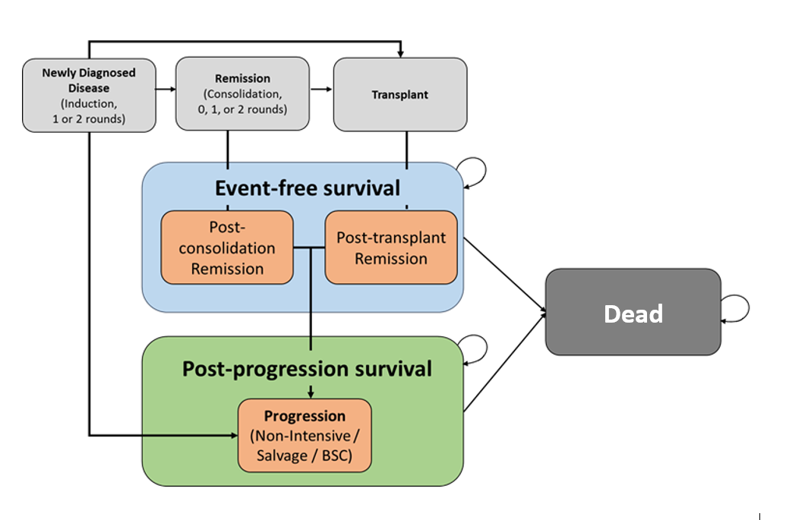
Conclusions from ACD: Company’s model structure [1]
Company modelled parametric curves separately by treatment group
Overall survival and relapse-free survival outcomes were modelled separately for 3 groups:
people in remission who had a stem cell transplant
people in remission who did not have a transplant
people who were not in remission

Slide 8
Conclusions from ACD: Company’s model structure [2]
Post-transplant overall survival extrapolation for people who had a complete response (liposomal cytarabine and daunorubicin group)
ACD conclusions about overall survival extrapolation for people in remission who had a stem cell transplant, in the liposomal cytarabine and daunorubicin group:
data from Study 301 was not mature enough to justify extrapolation
plateau in treatment group appears overly optimistic
modelled curve for the comparator group did not reach a plateau (clinical experts said they would expect to see plateau in both groups)
ACD conclusion: Committee would prefer to see
cure model for the whole population, whether or not they had had a stem cell transplant
updated analysis for overall survival based on a more mature data cut of Study 301
survival plateau captured in both groups

Slide 9
Committee's further considerations in ACD
Issue | Committee's conclusion
Event-free survival | The whole population should be modelled together, whether or not they had a stem cell transplant
Mortality rate after HSCT | Mortality rates are higher after stem cell transplant than in the general population and increased mortality rates should be included in the model
Utility values | Do not have a big effect on the cost-effectiveness results Changes made by ERG: Estimated the mean utility for each treatment phase and applied this utility value to both treatment groups Used utility value of 0.75 from Hensen et al. for post-transplant remission health state Adjusted utility values for ageing
Costs and resource use | Do not have a big effect on the cost-effectiveness results Changes made by ERG: Used alternative method to calculate vial use Reduced the number of hospital days in consolidation period Lowered cost of stem cell transplant (not accepted by committee)
End of life | Both end of life criteria met. Study 301 results: Median survival in 3+7 group = 5.95 months Median increase in survival with liposomal cytarabine and daunorubicin = 3.61 months

Slide 10
ACD consultation responses
Consultee comments from:
Leukaemia Care
NCRI-ACP-RCP
Jazz Pharmaceuticals
Updated analysis of overall survival
Implemented a cure model post-HSCT
Updated patient access scheme
Web comments

Slide 11
Patient and professional group comments
People with high-risk AML currently have limited options
Extension to life is significant
Liposomal cytarabine and daunorubicin allowed more people to receive stem cell transplant
Access through the Cancer Drugs Fund could be considered to provide more long-term data
Results of the NCRI AML 18 and 19 trials may be useful (currently recruiting)

Slide 12
Summary of web comments
It is clinically plausible that liposomal cytarabine and daunorubicin could offer an improvement in post-transplant survival, although scientific rationale not understood – current trials may explain
The 3+7 group may not achieve the same plateau if disease relapse risk of treatment-related mortality is higher
Useful, easy to administer and well-tolerated treatment
Outcome may be slightly better in younger patients using liposomal cytarabine and daunorubicin because have less expression of MDR gene and fewer comorbidities
Reduced cardiotoxicity with liposomal cytarabine and daunorubicin may improve outcomes for older patients in particular

Slide 13
Committee preferences and company’s revised analysis
Committee preference: | Did company include?
Updated analysis for overall survival based on a more mature data cut of Study 301 | ✓ (updated trial data)
Survival plateau captured in both groups | ✓
Model based on overall survival data from a more recent data cut of the Study 301 trial | x
Cure model for the whole population, whether or not they had had a stem cell transplant | x (no ICER results presented)
Company also submitted a revised Patient Access Scheme discount

Slide 14
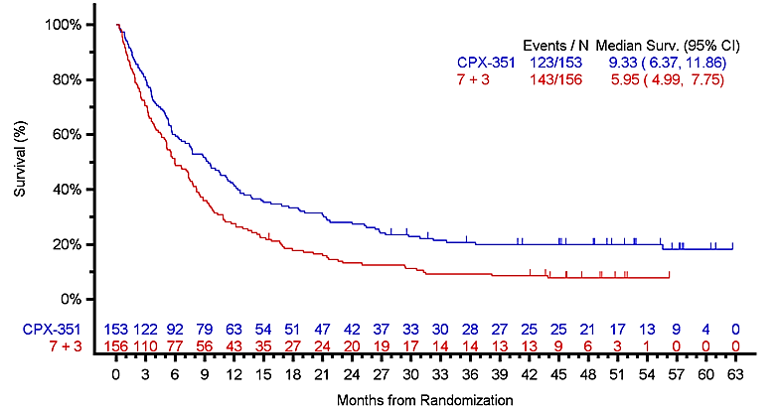
Company’s new evidence 1a. Updated analysis of overall survival
Using drug safety update report data from 3 August 2018

Slide 15
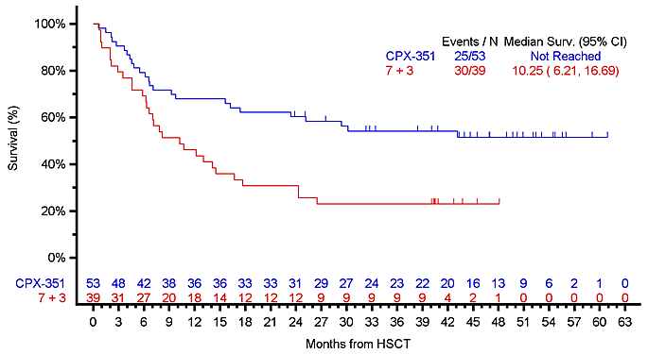
Company’s new evidence 1b. Updated analysis of overall survival from time of HSCT
Using drug safety update report data from 3 August 2018
Company reports that 8 UK AML experts confirmed the majority of transplant-related mortality and relapse deaths would be expected within first year after transplant
Does the additional evidence improve the clinical plausibility of the results?

Slide 16
Company’s new evidence 2. New cure form for post-HSCT survival in model
Company based new analysis on ERG base case from first meeting (except alternative cost for HSCT)
Used original trial data to extrapolate survival post-HSCT (due to lack of individual patient data for updated KM curves)
Compared the extrapolated curves with updated KM curves
None of the analyses for 3+7 group converged, so company applied 20% (aligned with updated KM curves) cure fraction manually for this group in the model
Fit cure models to liposomal cytarabine and daunorubicin and 3+7 groups separately for post-HSCT overall survival – used in cost-effectiveness results
Fit statistical cure model for full ITT populations using original data
Used to compare to modelled outcomes and updated KM data
Not used in cost-effectiveness results

Slide 17
Company’s new evidence 2. Updated extrapolations for post-HSCT overall survival [1]
Post-HSCT overall survival extrapolations for liposomal cytarabine and daunorubicin group
Scenario a: Original ERG base case (from first meeting)
Scenario b: Original ERG base case with Gompertz for liposomal cytarabine and daunorubicin
Scenario d: Original ERG base case with cure model for liposomal cytarabine and daunorubicin and 3+7 groups

Slide 18
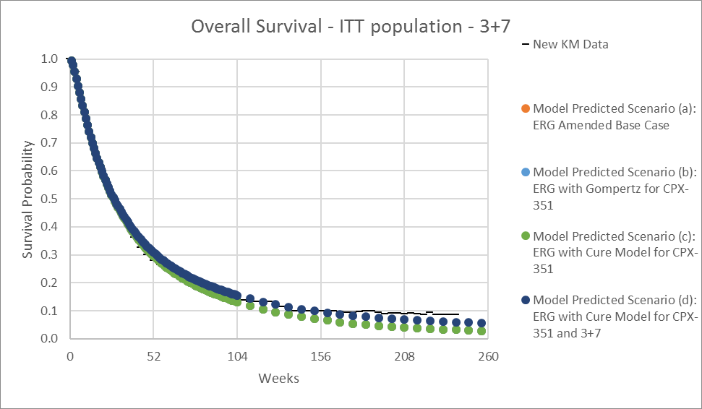
Company’s new evidence 2. Updated extrapolations for post-HSCT overall survival [2]
Post-HSCT overall survival extrapolations for 3+7 group
Scenario c: Original Gompertz model for 3+7
Scenario d: Original ERG base case with cure model for liposomal cytarabine and daunorubicin and 3+7 groups

Slide 19
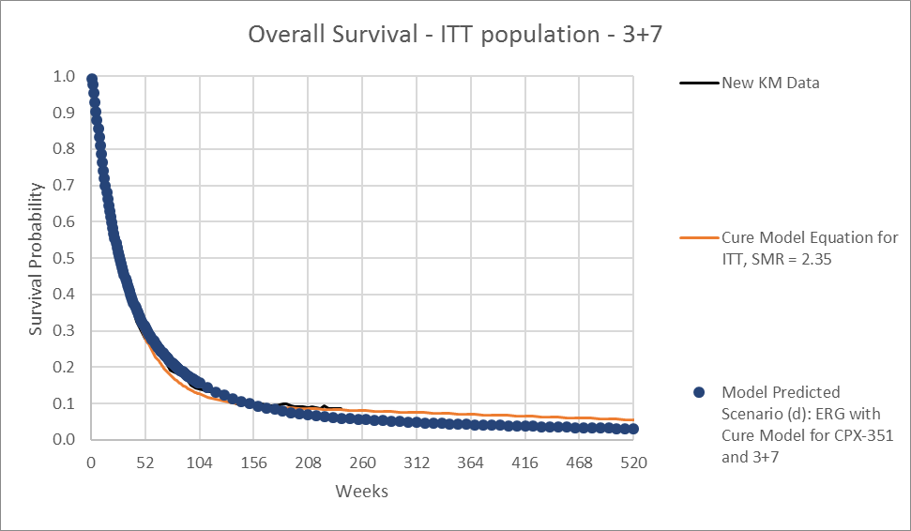
Company’s new evidence 2. Updated extrapolations [3]
Overall survival extrapolation for full 3+7 group
Company comments that the cure method and model projections remain close, suggesting that differences in OS outcomes between the current modelling approach and one based on a cure model of the ITT population would be modest.

Slide 20
Company’s new evidence 2. Updated extrapolations [4]
Overall survival extrapolation for full liposomal cytarabine and daunorubicin group
Company states that this cure model of OS from the original data set overestimated survival and gave an overly favourable and unrealistic ICER for liposomal cytarabine and daunorubicin – so used cure models for post-HSCT OS instead.
Are the post-HSCT cure models plausible?
Is the model structure adequate for decision-making?

Slide 21
Company’s updated base case and scenario analyses, including updated PAS
Company’s updated base case uses scenario (d): cure model for post-HSCT survival with forced cure fraction for 3+7 group (liposomal cytarabine and daunorubicin and 3+7 groups modelled separately)
Also includes 20% of people in model as under 60 years – in original company and ERG base cases, all patients were over 60
Company states this scenario has best fit to trial data and is consistent with literature on post-transplant survival
Scenario | ICER | Population
Base case (scenario d) (cure model applied to CPX-351 and 3+7) | £42,681 | 20% of patients below age 60
Base case with trial population | £48,991 | All patients > 60
Assuming no cure fraction post-transplant for 3+7 | £33,755 | 20% of patients below age 60
Assuming Gompertz survival function for both groups | £46,523* | All patients > 60
*result omitted from company report - calculated by ERG

Slide 22
ERG comments
Clinical data
Updated evidence is more robust and reduces uncertainty
Post-stem cell transplant cure modelling approach
Not clear how general population mortality was taken into account
The ERG noted that the cure fractions for liposomal cytarabine and daunorubicin applied in the model were higher than those in the company’s response document and were higher than what might be expected from visual inspection of the Kaplan–Meier curves
The 20% cure rate for 3+7 appears to be based on visual inspection, and no other cure fractions were explored – ERG considered 25% → this increases the ICER
For liposomal cytarabine and daunorubicin, the cure model curves provide higher survival estimates and produces more life years than all simple parametric curves in the original company model
Other modelling scenarios
ERG does not consider company’s age adjustment appropriate as it also increases the number of patients who achieve remission (OR = 1.35) – an impact of age on response was not significant in the trial and trial did not include people under 60
ERG considered using a body surface area of 2.0m² as in the trial instead of 1.83 as in the ERG base case → this increases the ICER

Slide 23
ERG comments Post-HSCT OS for liposomal cytarabine and daunorubicin

Slide 24
ERG comments Post-HSCT OS for 3+7

Slide 25
Key issues for consideration
Does the additional evidence improve the clinical plausibility of the results?
Are the post-HSCT cure models plausible?
Is the model structure adequate for decision-making?
What is the most plausible ICER?
Is liposomal cytarabine and daunorubicin cost-effective?

