Slide 1
Chair’s presentation
Slides for projector and public – noACIC
Gilteritinib for treating relapsed or refractory acute myeloid leukaemia [ID1484]
2nd appraisal committee meeting
Committee C
ERG: School of Health and Related Research (ScHARR)
Chair: Stephen O’Brien
NICE technical team: Orsolya Balogh, Alex Filby, Linda Landells
Company: Astellas Pharma
2 June 2020

Slide 2


Key issues for consideration
Key issues
1. Gilteritinib maintenance therapy | Should an additional benefit of gilteritinib maintenance therapy after HSCT be included in the model?
2. Cure point | Is a 2- or 3-year cure point more plausible to include in the model?
3. Quality of life and costs for administration | Should the company’s updated disutilities and costs be included in the model?
4. Drug wastage | Should 7 or 14 days’ wastage be included for gilteritinib in the model?
5. Best supportive care | Should best supportive care be included in the weighted comparator arm?
6. Cost-effectiveness results | Is gilteritinib cost effective?
7. CDF considerations | Is gilteritinib a candidate for CDF?
Model driver
Small impact

Slide 3
Gilteritinib
RECAP
Marketing authorisation | Gilteritinib as monotherapy for the treatment of adult patients who have relapsed or refractory acute myeloid leukaemia (AML) with a FLT3 mutation
Mechanism of action | Tyrosine kinase-3 (FLT3) and AXL inhibitor
Administration | Oral tablet
Price | List price: £14,188 per 28-day pack The average cost of a course of treatment of gilteritinib is anticipated to be XXXXXXX per patient (at list price) A patient access scheme has been agreed

Slide 4
Background
RECAP
Comparators | Salvage chemotherapy, BSC
Clinical trial | ADMIRAL (n=371). Open-label, randomised trial comparing gilteritinib and salvage chemotherapy
Key results | Statistically significant improvement in overall survival (OS) Gilteritinib: 9.3 months; salvage chemotherapy: 5.6 months; hazard ratio (HR): 0.64 (95% CI 0.49 to 0.83, p<0.001)
Comparison with BSC | Naive indirect comparison
Key result of indirect comparison | HR 2.86 applied to gilteritinib OS Highly uncertain due to several issues with methods
Model | Decision tree followed by a partitioned survival-based model. 3 health states: pre-progression, post-progression, death – modelled separately for patients who have HSCT* and do not have HSCT
Company ICER | £43,346/QALY gained
Technical team preferred ICER | £98,498/QALY gained
ICER ranges across plausible scenarios | £50,897/QALY gained to £102,085/QALY gained
*HSCT: haematopoietic stem cell transplantation

Slide 5
ACD: preliminary recommendation
RECAP
  Gilteritinib is not recommended, within its marketing authorisation, for treating relapsed or refractory FLT3‑mutation-positive acute myeloid leukaemia in adults

Slide 6
Committee’s considerations in ACD
Committee’s considerations on the clinical evidence presented
RECAP
Issue | Committee's conclusion
Comparators | Best supportive care is a relevant comparator but the evidence presented to support its relative efficacy is not reliable
Prior midostaurin use | The proportion of people with relapsed or refractory disease who may have received prior midostaurin treatment in clinical practice in England is higher than the proportion of people with prior midostaurin treatment in the ADMIRAL study
Cure assumptions | A 3 year cure point is plausible and no evidence was presented for a 2 year cure point
Gilteritinib effectiveness after HSCT | Data from ADMIRAL should be used to model post-stem cell transplant overall survival

Slide 7
Committee's considerations in ACD
Committee’s considerations on modelling assumptions
RECAP
Issue | Committee's conclusion
Wastage | Wastage of 14 days’ supply of gilteritinib should be accounted for in the model
Drug costs | Drug costs should be applied in each cycle of the model
Quality of life | The potential benefit of taking an oral tablet at home compared with having chemotherapy in hospital had not been adequately captured in the model
End of life | Criteria met Life expectancy <24 months: median OS in salvage chemotherapy group of ADMIRAL 5.6 months; clinical experts: median OS around 2-3 months Extension to life ≥ 3 months: gilteritinib extends mean OS by 2.34 years and 0.98 years more compared to BSC and salvage chemotherapy, respectively (ERG’s model)
Committee’s preferred ICER | Above £98,000/QALY gained (contains a confidential patient access scheme discount, so exact number cannot be reported here)

Slide 8
ACD consultation responses
Consultee comments from:
  Astellas Pharma (company) – new evidence
  Royal College of Pathologists
  Leukaemia Care

Slide 9
Patient and professional group comments
Gilteritinib is the only FLT3 inhibitor for relapsed/refractory AML being considered for use on NHS and considerable unmet need in this group
Stakeholders said 2-year cure point seems reasonable
  One stakeholder said that relapses occur earlier in this population, likely within the first 12 month
  One stakeholder said that few events occur after 12 months, patients alive and in remission 12 months post-transplant are mostly cured
Quality of life gains from outpatient, oral treatment not fully represented in disutility value
Reference costs for FLAG-IDA* administration (£1,418.51) are not an accurate reflection of NHS costs
  Would be about £30,000 (conservative estimate) in NHS due to inpatient therapy, possible ITU admission and associated anti-fungal therapy
    Assuming a minimum stay in hospital for 30 days
*high-intensity salvage regimen

Slide 10
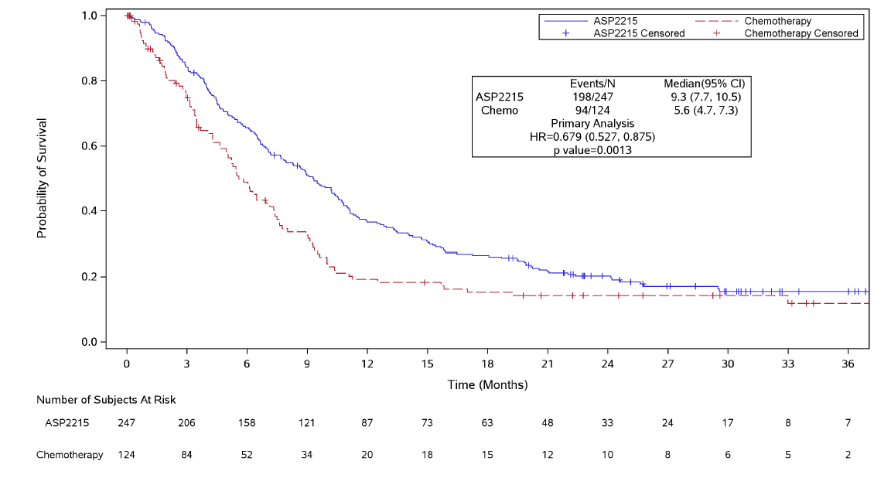
Company’s new evidence
Updated ADMIRAL data – overall survival
Updated data cut from September 2019 (previously Sept 2018)
Key
Gilteritinib: median OS 9.3 months
Chemotherapy: median OS 5.6 months
Hazard ratio = 0.679
95% CI 0.527 to 0.875
P = 0.0013
Gilteritinib
Source: Figure 1 of company additional evidence document

Slide 11
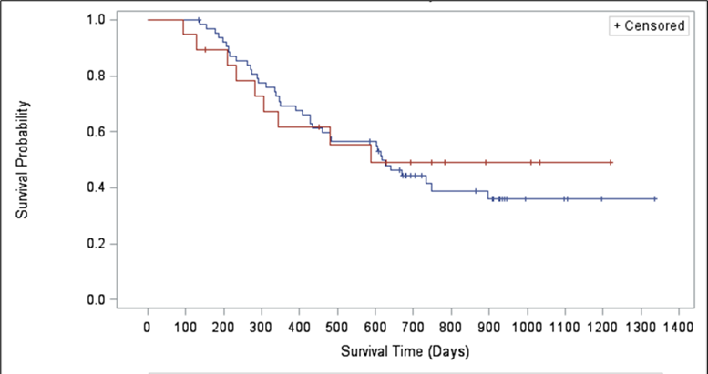
Company’s new evidence
Updated ADMIRAL data – overall survival post-HSCT (ITT population)
Key:
Gilteritinib: median OS post-HSCT 610 days
Chemotherapy: median OS post-HSCT 482 days
Hazard ratio = 1.108
95% CI 0.534 to 2.292
P < 0.7836
25.5% vs 15.3% of people had HSCT in the gilteritinib and chemotherapy arm, respectively
ERG comment: company states time origin is time of randomisation in dataset but ERG believes time of transplant was used in the model
Gilteritinib
Source: Figure 2 of company additional evidence document

Slide 12
Company’s new evidence
1. Gilteritinib maintenance therapy after HSCT
Company re-introduced hazard ratio for additional benefit of gilteritinib maintenance therapy
HR=0.69, calculated from comparison of ADMIRAL ‘restarters’ and Evers data (chemotherapy)
ACD: hazard ratio for additional benefit was not relevant if ADMIRAL data were used to model post-stem cell transplant OS
ERG comments
Still considers the indirect comparison is not robust; and not updated with ADMIRAL 2019 data
ADMIRAL 2019 data does not suggest a benefit for gilteritinib vs chemotherapy for post-stem cell transplant OS (see slide 11 for relevant KM curves)
Company estimates HR of 0.46 based on gilteritinib restarters vs non-restarters, however in trial people could only restart gilteritinib in certain conditions so selection bias possible - Appropriate to include costs of maintenance therapy even if no additional benefit because costs were included in ADMIRAL
HR leads to more favourable survival projection than observed in both arms of ADMIRAL
At 2019 data cut off, 19 patients still receiving gilteritinib (13 of whom restarted after HSCT –20.63% of all gilteritinib-treated patients proceeded to HSCT) - ongoing costs of treatment not included in company’s model for these patients
ERG base case includes maintenance HR of 1 (no additional benefit)

Slide 13
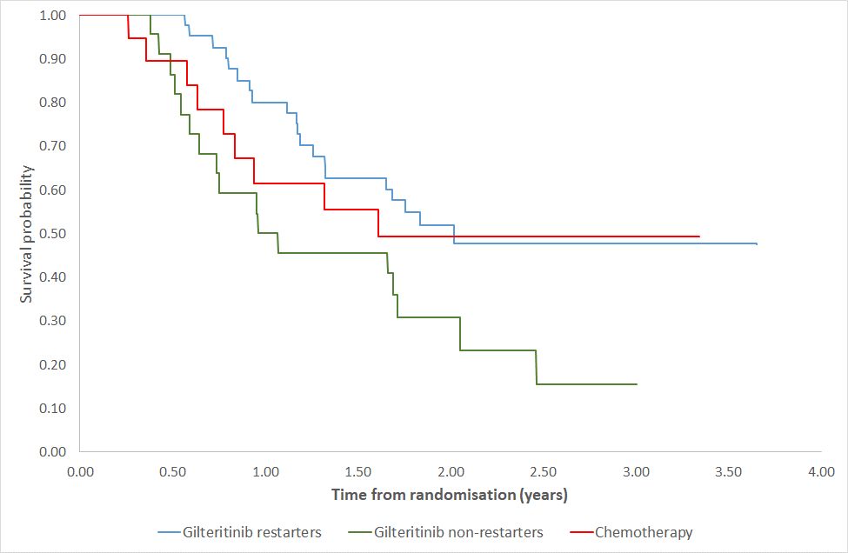
ERG comments on company’s new evidence
1. Gilteritinib maintenance therapy
Observed OS data for gilteritinib restarters and non-restarters, and chemotherapy (generated by ERG)
Key
Gilteritinib pre and post HSCT: N=40/63
Gilteritinib pre HSCT: N=23/63
Chemotherapy pre-HSCT: N=19
ERG comments:
Gilteritinib restarters had better OS compared with gilteritinib non-restarters
However, OS for salvage chemo group better than for gilteritinib non-restarters
In ADMIRAL patients had to be in complete composite remission after HSCT to restart gilteritinib (see full criteria in Clinical Study Report)
Source: Figure 5 of ERG addendum
  Should an additional benefit of gilteritinib maintenance therapy be included in the model?

Slide 14
Company’s new evidence
2. Cure point [1]
Company has used data from several identified studies to present argument for 2-year cure point, rather than the previous assumption of 3 years
Study | Population | No. of patients in survivor function | Number of UK patients
ADMIRAL | FLT3+, relapsed/refractory AML | 82 | 4 of 107 centres in overall trial population
Evers et al | Relapsed/refractory (CR2) AML (not FLT3+) | 128 | Not reported
Ustun et al | Sibling and URD HSCT in FLT3+ AML (mostly in CR1 [77%]) | 91 | Not reported
Dillon et al | FLT3+, NPM1-mutated AML (not relapsed/refractory) | XX | 107
Gilleece et al | Relapsed/refractory AML receiving myeloablative conditioning (MAC) Unspecified number with FLT3 mutation | 314 | Not reported
Poire et al | FLT3+ AML in CR2 | 37 | Not reported
CR1: first complete remission; CR2: second complete remission; URD: unrelated donor; NPM1-mutated: nucleophosmin gene mutation

Slide 15
Company’s new evidence
2. Cure point [2]
Company argues that post-HSCT curves generally flatten at 18 – 24 months
Source: Figure 4 of company additional evidence document

Slide 16
ERG comment on company’s new evidence
2. Cure point [3]
Dillon and Gilleece studies do not specifically report long-term OS outcomes for patients with relapsed or refractory FLT3+ AML
Updated data-cut (2019) of ADMIRAL trial shows more censoring occurs towards the tails of the curves (but 3 death events in gilteritinib group after 2 years)
Applying a cure point at 2 years appears to overestimate long-term OS for the gilteritinib group within the observed period of the trial
ERG would have preferred a mixture cure model
ERG presents scenarios at 2 years and 3 years as exploratory analyses
  Is a 2- or 3-year cure point plausible to include in the model?

Slide 17
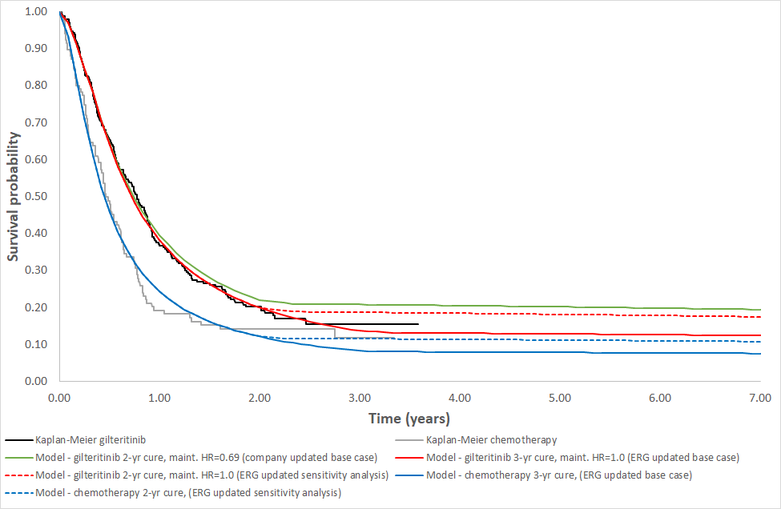
ERG comments on company’s new evidence
Updated ADMIRAL data and cure point (2.)
Observed vs predicted OS, ITT population – comparison of company’s updated model (2-year cure point, maintenance HR=0.69) and ERG’s preferred assumptions (3-year cure point, maintenance HR=1.0) vs Kaplan-Meier plots (generated by ERG)
ERG comments
Company has only fitted standard parametric models to available time-to-event data, no attempt made to model cure point using the ADMIRAL 2019 dataset
Additional information influencing tail of ‘with HSCT’ group ignored as cure point brought forward to 2 years rather than 3
ERG considers company’s model overestimates OS in gilteritinib group after 1 year
Source: Figure 4 of ERG critique

Slide 18
Company’s new evidence
3. Quality of life and costs associated with administration
Additional disutility for time spent in hospital for people receiving high-intensity chemotherapy (FLAG-IDA and MEC) previously taken from Wehler et al. 2018 paper
Wehler also reports disutility values for patients receiving:
  High-intensity chemotherapy: -0.190
  Hypomethylating agents: -0.225
  Low-intensity chemotherapy: -0.166
These values applied for first 3 cycles to relevant groups in updated analysis to reflect time-on-treatment (patients in chemotherapy group had 2.24 cycles of azacitidine)
Increased costs for high-intensity chemotherapy also included for first 1-month cycle
ERG comments
In original model, hospitalisation costs conditional on time spent event-free
Updated model includes higher cost for first cycle but original costs for subsequent cycles – New approach could overestimate true costs of hospitalisation (23.39 vs 45.90 days)
Unclear how Wehler study identified
Model already included a disutility for adverse events so this could be double counting
Error in calculation of utility values for patients receiving BSC (corrected in ERG scenarios)
In ADMIRAL patients received fewer cycles of other chemotherapy regimens (FLAG-IDA=1.02 cycles; MEC=1.13 cycles; LDAC=1.68 cycles) – not clear whether the decrement applies to exposure time or longer
  Should the company’s updated disutilities and costs be included in the model?

Slide 19
Company’s new evidence
4. Drug wastage
ACD considerations:
  Reasonable to assume 14 days’ supply of gilteritinib may be wasted if someone died before the 3-year cure point
Company agrees that random events such as death could be a cause of drug wastage, and it could be appropriate that 14 days’ wastage could be applied for these patients
  However, company believes most patients would discontinue treatment in a managed way following consultation with clinician where no further treatment would be prescribed
  Company incorporates cost of 7 days’ wastage in revised base case
  Company highlights TA451 (ponatinib for CML) where clinical experts stated that people whose disease responded to treatment would have prescriptions for several months but would be monitored during that period to ensure a response was being maintained
    In TA451 it is assumed that prescriptions are at three-monthly intervals when assessing drug wastage
ERG comments: in ERG scenario analysis of 14 days’ wastage was only applied to those who died before 3-year cure point
Appropriateness of the assumption depends on how gilteritinib prescribing is managed in usual practice
  Should 7 or 14 days’ wastage be included for gilteritinib?

Slide 20
Company’s new evidence
5. Including best supportive care in weighted comparator
ACD considerations:
  BSC is a relevant comparator but indirect evidence presented for efficacy not reliable
  Company’s method of including BSC in the blended comparator was not appropriate
Company’s ACD response adopts same approach
  Company suggests 20% of patients currently receive best supportive care and half of them could receive gilteritinib and would achieve same outcomes as gilteritinib arm – 10% BSC included in weighted comparator arm
ERG comments
BSC should not be included in weighted comparator because:
  Weaknesses in indirect comparison remain unchanged from ACM1
  Not included in salvage chemotherapy arm in ADMIRAL
  Company’s model assumes people receiving BSC would not receive stem cell transplant so probability of receiving transplant in weighted comparator group is reduced by 10%. Gilteritinib group stem cell transplant rate unchanged
    Assumes that patients who choose to have best supportive care would have same likelihood of receiving stem cell transplant if they had had gilteritinib
  Should best supportive care be included in the weighted comparator arm?

Slide 21
Gilteritinib PAS price
Company updated PAS price of gilteritinib after 1st committee meeting
It also signalled willingness to further increase the PAS price, although this hasn’t been approved yet
ICERs showing on slides 22 and 23 include updated (but not latest) PAS price
ICERs incorporating the latest proposed PAS price and cPAS for azacitidine will be presented in part 2

Slide 22
Revised company base case
Including PAS price for gilteritinib and 2019 ADMIRAL data
Scenario (including ERG corrections) | ICER (£/QALY)
Updated NICE Technical Team preferred model (2019 ADMIRAL data-cut) | £90,803
Maintenance HR=0.69 | £67,685
2-year cure point | £70,473
Wastage=0.25 packs | £88,458
BSC included in comparator | £82,752
Include additional disutilities for chemotherapy | £85,535
Include additional costs for chemotherapy | £85,460
All amendments combined (with ERG corrections) | £46,961*
ACD considerations:
HR=1, maintenance therapy not relevant
3-year cure point is plausible
Source: Table 1 of ERG addendum
* ERG corrected some programming errors in the company’s model, company’s updated base case ICER originally was £49,968

Slide 23
ERG additional analyses, deterministic results
All analyses include PAS for gilteritinib
Scenario (including ERG corrections) | ICER (£/QALY)
NICE technical team preferred model (2018 ADMIRAL data-cut) | £90,468
NICE technical team preferred model (2019 ADMIRAL data-cut) | £90,803
NICE technical team preferred model (2019 ADMIRAL data-cut) + additional chemotherapy disutilities included - ERG preferred analysis | £85,535
ERG preferred analysis includes the following assumptions: Maintenance HR = 1 Cure point = 3 years BSC not included in weighted comparator Gilteritinib wastage of 14 days No additional hospitalisation costs for chemotherapy
ERG sensitivity analysis ERG preferred analysis with cure point = 2 years | £67,210
ERG sensitivity analysis ERG preferred analysis excluding costs of gilteritinib maintenance therapy | £64,576
  Is gilteritinib cost effective?

Slide 24
7. CDF considerations
Starting point: drug not recommended
for routine use due to uncertainty about long-term survival, particularly after stem cell transplant
No CDF proposal submitted by company
MORPHO ongoing trial, no other ongoing trials identified
  Phase III, multi-centre, randomized, double-blind trial
Expected completion date April 2025
  Population: patients with AML and FLT3-ITD mutations in their first complete remission following allogeneic HSCT
  Intervention: gilteritinib
  Comparator: placebo
  Primary outcome: relapse-free survival
    Overall survival secondary outcome
1. Is the model structurally robust for decision making?
2. Does the drug have plausible potential to be cost-effective at the offered price, taking into account end of life criteria?
3. Could further data collection reduce uncertainty?
4. Will ongoing studies provide useful data?
5. Is CDF data collection via SACT relevant and feasible?
&
Consider recommending entry into CDF
(invite company to submit CDF proposal)
Define the nature and level of clinical uncertainty. Indicate the research question, analyses required , and number of patients in NHS in England needed to collect data.
  Is gilteritinib a candidate for CDF?

Slide 25
Key issues for consideration
Key issues
1. Gilteritinib maintenance therapy | Should an additional benefit of gilteritinib maintenance therapy after HSCT be included in the model?
2. Cure point | Is a 2- or 3-year cure point more plausible to include in the model?
3. Quality of life and costs for administration | Should the company’s updated disutilities and costs be included in the model?
4. Drug wastage | Should 7 or 14 days’ wastage be included for gilteritinib in the model?
5. Best supportive care | Should best supportive care be included in the weighted comparator arm?
6. Cost-effectiveness results | Is gilteritinib cost effective?
7. CDF considerations | Is gilteritinib a candidate for CDF?
Model driver
Small impact

