Slide 1
Tirzepatide for the treatment of patients with type 2 diabetes
Slides for public – contains no ACIC or CPAS information
Technology appraisal committee A [1st August 2023]
Chair: Radha Todd
Lead team: Alan Thomas, Fiona MacPherson Smith, Min Ven Teo
External assessment group: Kleijnen Systematic Reviews (KSR) Ltd. in collaboration with Erasmus University Rotterdam (EUR) and Maastricht University Medical Center (UMC+)
Technical team: Giacomo De Guisa, Ewa Rupniewska, Janet Robertson
Company: Eli Lilly
© NICE 2025. All rights reserved. Subject to Notice of rights.

Slide 2
ACM1 – Preliminary recommendation
Tirzepatide is not recommended, within its marketing authorisation, for treating type 2 diabetes alongside diet and exercise in adults when it is insufficiently controlled:
alone when metformin cannot be taken because of intolerance or contraindications, or
with other antidiabetic drugs.

Slide 3
ACM1 resolved issues
ACM1 recap
Issue | Committee Resolution
Mismatch between scope and decision problem: line of therapy and comparators | Accepted GLP-1 RAs are relevant comparators
Mismatch between decision problem and evidence: line of therapy + prior oral antidiabetic drug intensity | Noted discrepancy, which contributed to decision uncertainty
Mismatch between tirzepatide administration in clinical practice and trial | Acknowledged this was the best evidence available
Modelling of long-term risk factor progression | Accepted company’s approach
Only one criterion (HbA1c threshold) for treatment discontinuation/intensification applied in the model | No concerns raised
Not all adverse events incorporated for all treatments | Accepted company’s approach
Potentially inappropriate probabilistic sensitivity analyses | Noted mean ICERs should be accurate
Abbreviations: HbA1c, glycated haemoglobin; GLP-1 RA, Glucagon-Like Peptide-1 receptor agonist; ICER, incremental cost-effectiveness ratio.

Slide 4


ACM1 key issues for discussion today
Issue | Provided? | ICER impact
NMA results uncertain: scenario analysis based on direct comparison between semaglutide and tirzepatide would be useful | Yes | Small
Economic model verification: EAG unable to fully scrutinise the model; full deterministic one-way sensitivity analyses, further info on model validation and comparison with other recognised diabetes models would be useful | Yes | N/A
Micro- and macrovascular complications: Company’s model averagingª approach uncertain; scenario analysis using single-risk prediction models would be useful | Yes | Small
Treatment intensification: GLP-1 RAs use in clinical practice may deviate from NICE recommendations; scenario analysis assuming treatment is intensified by adding insulin to tirzepatide and GLP-1 RAs would be useful | Yes | Small
Baseline utility value: lower value preferred for decision making | Yes | Small
Combining disutilities: multiplicative method preferred, unless additive method adequately justified | Yes | Moderate
Abbreviations: GLP-1 RA, Glucagon-Like Peptide-1 receptor agonist; NMA, network meta-analysis.
ª Model averaging: estimates the risk in a range of simulation populations, combining risk equations, and automatically weighing the risk equations for different populations.

Slide 5
Background on type 2 diabetes mellitus
CONFIDENTIAL
ACM1 recap
Chronic metabolic disorder: reduced tissue sensitivity to insulin (known as insulin resistance) → loss of endogenous insulin production → elevated blood glucose levels (hyperglycaemia)
UK prevalence of T2D is rising, due to increasing prevalence of obesity
If not managed effectively, it can lead to devasting, life-changing complications
Technology details: tirzepatide (Mounjaro, Eli Lilly)
Marketing authorisation | Treatment of adults with insufficiently controlled type 2 diabetes mellitus as an adjunct to diet and exercise as monotherapy when metformin is considered inappropriate due to intolerance or contraindications in addition to other medicinal products for the treatment of diabetes
Mechanism of action | Dual receptor agonist of GIP and GLP-1 hormones which act to stimulate insulin secretion
Administration | Weekly subcutaneous injection
Price | Proposed list price per pack of 4 pre-filled single-dose autoinjector pen devices 5 mg, 10 mg and 15 mg: XXXXXXXX, respectively; for 12 months of treatment: XXXXXX XXX, respectively Note: price will be disclosed when guidance is published, XXXXXXXXXXXX
Abbreviations: GIP, Glucose-Dependent Insulinotropic Polypeptide; GLP-1, Glucagon-Like Peptide-1; T2D, type 2 diabetes.

Slide 6
Treatment pathway and proposed positioning of tirzepatide
Depends on HbA1c level, cardiovascular risk, kidney function and other factors
Treatment intensified when HbA1c not controlled or change in cardiovascular risk/status
ACM1 recap
1st line
Chosen individually, based on multiple factors and patients circumstances, including HbA1c level, cardiovascular risk and kidney function; generally includes:
metformin (not at high CVD risk)
metformin plus SGLT2 inhibitor (chronic heart failure or established atherosclerotic CVDª)
DPP-4 inhibitor, pioglitazone, sulfonylurea or SGLT2 inhibitor (if metformin contraindicated)
Tirzepatide’s marketing authorisation spans entire treatment pathway
2nd line
Treatment intensified when:
person's HbA1c not controlled below individually agreed threshold: switching to or adding DPP-4 inhibitor, pioglitazone, sulfonylurea or SGLT2 inhibitor
person develops CVD or a high risk of CVD (switching to or adding SGLT2 inhibitor)
3rd
& further lines
Insulin-based therapy (with or without other drugs): when dual therapy has not continued to control HbA1c to below the person's individually agreed threshold
GLP-1 mimetic treatments: if triple therapy with metformin and 2 other oral drugs is not effective, not tolerated or contraindicated^{b}; for adults with type 2 diabetes who have:
  BMI of ≥35^{c} kg/m² and specific psychological or other medical problems associated with obesity
  BMI <35 kg/m² and for whom insulin therapy would have significant occupational implications or weight loss would benefit other significant obesity related comorbidities.
Company positions tirzepatide as alternative to GLP-1 mimetics
Relevant comparators: GLP-1 mimetics used in NHS practice
ª SGLT2 inhibitor can also be considered for people at high risk of CVD; ^{b} switching one of the drugs to a GLP-1 mimetic; ^{c} adjusted accordingly for people from Black, Asian and other minority ethnic groups; Source: NICE guideline 28. Abbreviations: CVD, cardiovascular disease; DPP-4, Dipeptidyl-Peptidase 4; GLP-1, glucagon-like peptide-1; HbA1c, Glycated Haemoglobin SGLT2, Sodium-Glucose Co-Transporter-2.
Notes:
medications-review-protocol-guidelines-v01.pdf (knowdiabetes.org.uk)

Slide 7
Clinical effectiveness data: SURPASS 2-5 trials
ACM1 recap
Randomised, multicentre phase 3 trials; open-label (SURPASS-2 to -4) or placebo-controlled (SURPASS-5)
Included people with HbA1c of ≥7.0% (≥7.5% in SURPASS-4) to ≤10.5%; stable weight for 3 months and BMI ≥25 kg/m² (≥23 kg/m² in SURPASS-5)
Excluded people receiving triple therapy (except SURPASS-4 – but only XXX% patients had it)
People were randomised to their maximum dose of tirzepatide (note: treatment would be titrated as needed in clinical practice)
Comparators (prior/background therapy):
  SURPASS‑2: semaglutide (metformin);
  SURPASS‑3: insulin degludec (metformin +/- SGLT-2 inhibitor);
  SURPASS‑4: insulin glargine (≥1 to ≤3 oral antidiabetic drugs);
  SURPASS‑5: placebo (insulin glargine +/- metformin).
Tirzepatide (all doses) showed statistically significant reductions in HbA1c and weight vs comparators
  Higher tirzepatide doses→higher weight reductions (dose-dependent effect less pronounced for HbA1c)
Abbreviations: BMI, body mass index; HbA1c, glycated haemoglobin; SGLT-2, Sodium-Glucose Co-Transporter-2.

Slide 8
Clinical effectiveness data: network meta-analysis
ACM1 recap
  Included RCTs in people on 1-2 oral antidiabetic drugs → misaligned with decision problem
  Studies varied greatly in prior treatment and patient characteristics → results uncertain
  Tirzepatide showed significantly greater reductions in HbA1c and BMI vs GLP-1 RAs – but size of treatment effect uncertain
Tirzepatide 10 mg vs comparators (example)
Forest plots (median difference [95% CrI]; random effects model) for change from baseline in:
HbA1c (%)
Body mass index (kg/m²)
Abbreviations: BMI, body mass index; CrI, credible interval; GLP-1 RA, Glucagon-Like Peptide-1 receptor agonist; HbA1c, glycated haemoglobin; RCT, randomised controlled trial.

Slide 9
Company’s model overview
ACM1 recap
PRIME T2D model: discrete time event, patient-level simulation (developed in Java)
Technology affects costs by:
Additional treatment costs
Reductions in diabetes-related complication costs (especially cardiovascular events avoided)
Technology affects QALYs by:
Reductions in diabetes-related complications
Reductions in BMI
Complication Risk models informed by Risk factors including HbA1c, BMI and SBP
Note: Model structure from Company response to EAG report, May 2023; *Model averaging used in controller; †,complications with increased risk of mortality in year of complication onset and subsequent years; ‡, complications with increased risk of mortality associated with history of this complication
Abbreviations: BMI, body mass index; HbA1c, glycated haemoglobin; QALYs, quality-adjusted life years; QoL, quality of life; RNG, random number generator; SBP, systolic blood pressure SPSL, severe pressure sensation loss.
Notes:
Source: company response to EAG report

Slide 10
Consultation comments

Slide 11
ACD consultation responses – summary
Consultation comments
Comments received from: Eli Lilly (the company) Diabetes UK (patient organisation) Association of British Clinical Diabetologists (ABCD; professional organisation) Web comment (competitor company employee)
Abbreviations: ACD, appraisal consultation document, GLP-1 RA, Glucagon-Like Peptide-1 receptor agonist.

Slide 12
ACD consultation responses – Diabetes UK
Would be supportive of a positive tirzepatide recommendation due to strong supportive trial data
Concerned that a negative recommendation will lead to fewer and less effective treatment options for people with T2D
Tirzepatide increases treatment options where other medications may not be viable due to existing contraindications
There is a current shortage of GLP-1 RAs in the UK which is unlikely to be resolved until mid-2024
  Latest guidance from NHS England and the Department of Health and Social Care is not to issue any new prescriptions of GLP-1 RAs until the shortage is resolved
  A positive tirzepatide recommendation would increase the options for prescribers and potentially provide solutions to the GLP-1 RA shortage
Abbreviations: ACD, appraisal consultation document; GLP-1 RA, Glucagon-Like Peptide-1 receptor agonist; T2D, type 2 diabetes.

Slide 13
ACD consultation responses – ABCD
All GLP-1 RAs have a broad licence but have been allocated a niche and late positioning in current NICE guidance. Therefore, it is harsh to criticise the company for not applying for use in the totality of tirzepatide’s licenced indication. Also, for this reason, the global phase 3 clinical trial programme of tirzepatide does not focus on the patient cohort of greatest interest to the committee.
Tirzepatide is directly compared to the most potent GLP-1 RA currently available (semaglutide) in the SURPASS-2 trial (semaglutide’s potency is supported by head-to-head clinical trial directly comparing comparators)
Regrets that issues with model validation could not be resolved ahead of first committee meeting
Abbreviations: ABCD, Association of British Clinical Diabetologists; ACD, appraisal consultation document; GLP-1 RA, Glucagon-Like Peptide-1 receptor agonist.

Slide 14
ACD consultation responses – Web comment (Pharma)
Unclear if company’s SLRs includes all available evidence for tirzepatide:
Sattar et al. 2022 reports data from a pre-specified cardiovascular meta-analysis and post-hoc safety analysis across one phase 2 and five 3 trials (prospectively collected and centrally adjudicated MACE events from the trials)
SURMOUNT-2 and SURMOUNT-CN were not included in the company’s submission
Unclear if resource utilisation associated with prolonged titration/up-titration of tirzepatide has been considered:
Slower up-titration of tirzepatide would be more resource intensive for NHS
If patients are not moved on to maintenance doses (i.e. remain on non-maintenance doses) due to gastrointestinal tolerability or blood glucose optimisation, further NHS resources would likely be required
Concerns with modelling of adverse events (only nausea included; hypoglycaemic rates only for basal insulin)
Diarrhoea is very common with GLP-1 RAs and tirzepatideª
GLP-1 RAs are known to increase the risk of hypoglycaemia-related adverse events when used in combination with sulphonylurea or insulin, e.g. in SURPASS 5, all doses of tirzepatide added on top of insulin glargine, had higher rates of hypoglycaemia than placebo^{b}
ª In SURPASS 2, the rates of diarrhoea were 13.2%, 16.4%, 13.8% and 11.5%, tirzepatide 5 mg, 10 mg and 15 mg, and semaglutide 1 mg, respectively
^{b} proportion of patients experiencing hypoglycaemia were 15.5%, 19.3%, 14.2% and 12.5% for tirzepatide 5 mg, 10 mg, 15 mg and placebo, respectively
Abbreviations: ACD, appraisal consultation document; GLP-1 RA, Glucagon-Like Peptide-1 receptor agonist; MACE, major adverse cardiovascular event; SLR, systematic literature review.

Slide 15
ACD consultation responses – Web comment (Pharma)
Comment
Sattar et al. 2022 reports data from a pre-specified cardiovascular meta-analysis and post-hoc safety analysis across one phase 2 and five 3 trials (prospectively collected and centrally adjudicated MACE events from the trials)
ACM1:
No excess risk for CV events with tirzepatide, based on meta-analysis of positively adjudicated major adverse cardiovascular events (MACE) in SURPASS trialsª
Further data on CV outcomes expected from SURPASS-CVOT trial in 2025
Comment
Diarrhoea is very common with GLP-1 RAs and tirzepatide
ACM1:
Incorporating rates of diarrhoea from NMA showed modest QALY differences from base case analysisª
Note: Company submitted updated scenario analysis in addendum to draft guidance consultation – minor impact on ICER (higher than base case)
ª Source: company response to EAG report and ACM slide 34. ^{b} Source: ACM1 slide 38 and company clarification response.
Abbreviations: CV, cardiovascular; ICER, incremental cost-effectiveness ratio; MACE, major adverse cardiovascular event; NMA, network meta-analysis; QALY, quality-adjusted life year; T2D, type 2 diabetes.

Slide 16
ACD consultation responses – Web comment (Pharma)
Comment
SURMOUNT-2 and SURMOUNT-CN were not included in the company’s submission
Company rationale
SURMOUNT trials are recent studies in a different indication (weight loss); not relevant for this appraisal
Only SURMOUNT-2 included patients with diabetes, although this trial was specifically designed to assess weight reduction as the primary outcome rather than HbA1c reduction; T2D was secondary to the trial
SURMOUNT-2 would not have been included in the NMA for the current appraisal, as the definition of background therapies permitted is not directly relevant to the current decision problem
SURMOUNT-2 data published on 26th June 2023; SURMOUNT-CN not yet published
EAG comments
Substantial differences between SURMOUNT-2 and SURPASS 2-5 trials – direct comparison not advisable
Key difference: SURMOUNT-2 allowed change in concomitant medication during trial (SURPASS trials not)
Participants in SURMOUNT-2 were not required to have inadequate glycaemic control on with metformin monotherapy (with or without other antidiabetic medication) on entry, unlike in SURPASS 2-4 trials
People treated with insulin were excluded from SURMOUNT-2
Differences in baseline characteristics: duration of diabetes (years) and the level of HbA1c (% and mmol/mol) was less in SURMOUNT-2, while weight (Kg) and BMI (% and category) was higher.
Abbreviations: HbA1c, glycated haemoglobin; NMA, network meta-analysis; T2D, type 2 diabetes.

Slide 17
Comparison between: SURPASS-2, -5 and SURMOUNT-2
 | SURPASS-2 | SURPASS-5 | SURMOUNT-2
Design | Randomised, multicentre phase 3
 | Open-label | Double-blind | Double-blind
Population | Patients with T2D, who had inadequate glycaemic control with metformin monotherapy | Patients with T2D, with background therapy of insulin glargine with or without metformin | Patients (aged ≥18 years) with a body mass index of 27 kg/m2 or higher and glycated haemoglobin (HbA1c) of 7–10%
Intervention | Tirzepatide | Tirzepatide | Tirzepatide
Comparator | Injectable semaglutide 1 mg | Placebo
Background therapy | Metformin | Insulin glargine ± metformin | Any oral glycaemic lowering agent (except DPP-4 inhibitors and GLP-1 RAs)*
Primary outcomes | Mean change in HbA1c values from baseline to 40 weeks for tirzepatide 10 mg and 15 mg | Mean change in HbA1c values from baseline to 40 weeks | Mean percent change from randomisation in body weight and percentage of participants who achieve ≥5% body weight reduction
*Could be changed during trial
Abbreviations: CVD, cardiovascular disease; DPP-4, Dipeptidyl Peptidase 4; GLP-1 RA, glucagon-like peptide-1 receptor agonist; HbA1c, glycated haemoglobin; SGLT2i, Sodium-Glucose Co-Transporter-2 inhibitor; SU, sulphonylurea; T2D, type 2 diabetes.
Notes:
Source: ACM1 slides and company response to ACD (appendix B)

Slide 18

Key results: SURMOUNT-2
 | Tirzepatide 10mg | Tirzepatide 15mg | Placebo
N | 312 | 311 | 315
Change in HbA1c, percentage
Change from baseline to 72 weeks | -2.07 | -2.08 | -0.51
Estimated treatment difference from placebo (95% CI) at 72 weeks | -1.55* (-1.74, -1.37) | -1.57 * (-1.76, -1.37) | N/A
Body weight change from baseline, percentage (kg)
Change from baseline to 72 weeks | -12.8 | -14.7 | -3.2
Estimated treatment difference from placebo (95% CI) at 72 weeks | -9.6* (-11.1, -8.1) | -11.6* (-13, -10.1) | N/A
Is it appropriate that SURMOUNT-2 was excluded from company submission? What may be the impact of excluding it?
*p<0.0001 vs. comparator
Abbreviations: CI, confidence interval; HbA1c, glycated haemoglobin; T2D, type 2 diabetes.
Notes:
Source: EAG comparison of SURMOUNT-2 and SURPASS studies

Slide 19
ACD consultation responses – Company
CONFIDENTIAL
Provided additional analyses and justification for approaches
Summary of company response to ACD – company provided:
Results of analysis run in CORE Diabetes Model
Validation of PRIME T2D model against other models and published studies
One-way deterministic sensitivity analyses
Justification for using model averaging approach for estimating risk of micro- and macrovascular complications & justification for risk equations chosen
Justification for additive approach when combining disutilities
Scenario analyses for:
  SURPASS-2 results directly comparing tirzepatide to semaglutide
  Insulin being added to GLP-1 RA therapy or tirzepatide (instead of switching)
  Using only UKPDS risk equations to predict the risk of micro- and macrovascular complications
  Using lower baseline utility values for people with T2D
  Using a multiplicative approach to combining disutilities
  Note: Company responses to ACD also included XXXXXXXXXXXXXXXXXXXX
  Note: The company agreed with NICE that additional scenario and sensitivity analyses can focus mainly on tirzepatide 10mg vs semaglutide 1mg for illustration of the impact on ICERs
Abbreviations: ACD, appraisal consultation document; GLP-1 RA, Glucagon-Like Peptide-1 receptor agonist; ICER, incremental cost-effectiveness ratio; T2D, type 2 diabetes; UKPDS, UK Prospective Diabetes Study.

Slide 20
Key issue: Uncertainty around network meta-analysis (NMA)
Committee comments at ACM1
Studies included in NMA varied greatly in prior treatment and patient characteristics: results uncertain
Direct comparison between tirzepatide and semaglutide possible based on SURPASS-2 results → scenario analysis based on this data may be useful for decision making, despite misalignment with company’s target population in terms of prior treatments received
Company response to ACD
Scenario analysis provided using cohort characteristics and treatment effects from the SURPASS-2 trial
For all tirzepatide doses, ICERs were <£20,000 per QALY gained vs semaglutide 1.0mg, and slightly lower than the base case ICERs
EAG comments
An overview of input parameters that were modified for this scenario (as well as updated parameter values) would have helped understanding of this scenario
Abbreviations: ACD, appraisal consultation document; ICER, incremental cost-effectiveness ratio; NMA, network meta-analysis; QALY, quality-adjusted life year.

Slide 21
Key issue: Economic model verification
Company provided additional information and analyses to validate model
Committee comments at ACM1
Hypothetically, company’s PRIME T2D model might be an improvement over other diabetes models
EAG was not able to scrutinise the model to the usual rigorous standard because of model complexity and non-standard software
Could not be confident that the company cost-effectiveness results were accurate
Confidence could be improved by:
  Deterministic one-way sensitivity analyses on the full set of model parameters
  Comparison with cost-effectiveness analysis run in the CORE Diabetes Model or UKPDS outcomes model
Company response to ACD – company provided
One-way sensitivity analyses for key model inputs for tirzepatide 10 mg vs semaglutide 1.0 mg
Validation of PRIME T2D model against other models and published studies
Cost-effectiveness results run in CORE Diabetes Model
Abbreviations: ACD, appraisal consultation document; T2D, type 2 diabetes; UKPDS, UK Prospective Diabetes Study.

Slide 22
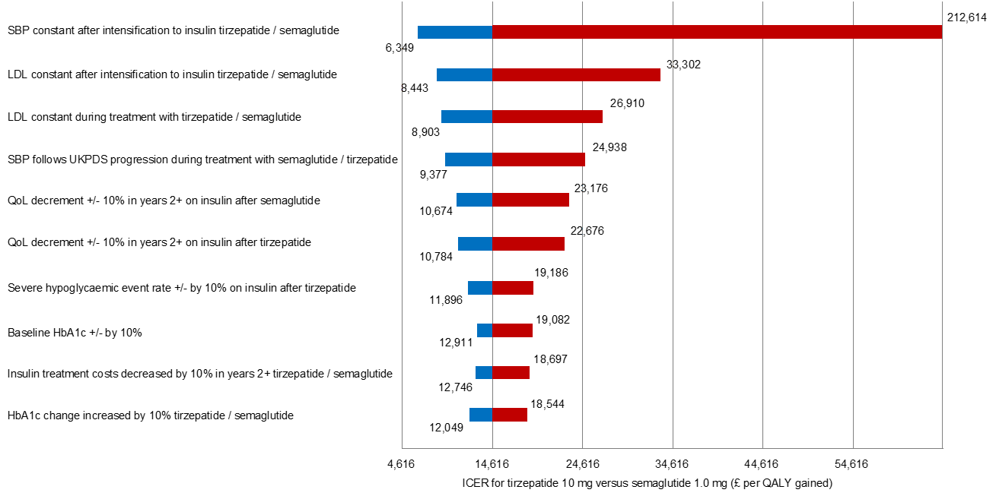
Deterministic one-way sensitivity analyses (1)
ICERs <£20,000 per QALY for 224 out of 232 analyses
Tornado diagram of the 10 most influential input parameters (tirzepatide 10 mg versus semaglutide 1.0 mg)
Company:
Two scenarios where semaglutide was dominant involved substantial changes to the HbA1c profile to favour semaglutide
High ICERs were observed when certain risk factors were held constant over time for semaglutide and allowed to increase for tirzepatide
These were not considered a reflection of a possible clinical scenarios
SBP constant after intensification to insulin tirzepatide / semaglutide
212,614
6,349
LDL constant after intensification to insulin tirzepatide / semaglutide
33,302
8,443
LDL constant during treatment with tirzepatide / semaglutide
26,910
8,903
SBP follows UKPDS progression during treatment with tirzepatide / semaglutide
24,938
9,377
QoL decrement +/- 10% in years 2+ on insulin after semaglutide
23,176
10,674
22,676
QoL decrement +/- 10% in years 2+ on insulin after tirzepatide
10,784
19,186
Severe hypoglycaemic event rate +/- 10% in years 2+ on insulin after tirzepatide
11,896
19,082
Baseline HbA1C +/- 10% in years
12,911
18,697
Insulin treatment costs decreased 10% in years 2+ tirzepatide / semaglutide
12, 746
18,544
HbA1C change increased by 10% tirzepatide / semaglutide
12, 049
4,616
14,616
24,616
34,616
44,616
54,616
ICER for tirzepatide 10m vs semaglutide 1.0mg (£ per QALY gained)
Abbreviations: HbA1c, glycated haemoglobin; ICER, incremental cost effectiveness ratio; LDL, low density lipoprotein; QALY, quality-adjusted life year; QoL, quality of life; SBP, systolic blood pressure; UKPDS, UK Prospective Diabetes Study

Slide 23
Deterministic one-way sensitivity analyses (2)
Key ICER drivers noted by EAG
EAG comments – one-way sensitivity analyses
Risk factors (HbA1c, SBP, LDL, HDL), the utility decrement on insulin years 2+, insulin treatment costs, hypoglycaemia rate and treatment costs can have a substantial impact on the estimated ICER
One-way sensitivity analyses were predominantly performed using alternative assumptions (e.g. assuming 10% increase or decrease rather on the estimated standard error ) of the specific parameter of interest
Individual parameters of the risk models (including the UKPDS risk factor progression) were not included in the one-way sensitivity analyses
Abbreviations: HbA1c, glycated haemoglobin; HDL, high-density lipoprotein; ICER, incremental cost effectiveness ratio; LDL, low density lipoprotein; SBP, systolic blood pressure; UKPDS, UK Prospective Diabetes Study

Slide 24
Model verification against other models/published studies (1)
Company response to ACD
Validation analysis compared projections using PRIME T2D Model with published results from a broad range of studies in T2D populations, including UK cohort studies, CVOTs and studies in South East Asian populations
All RMSD values (a measure of difference between the modelling results and observed outcomes) were ≤1.1% for internal validations (against published studies used to develop the model) and ≤3.7% for external validations
EAG comments
Analyses are supportive of predictive performance of PRIME T2D model
Company considered multiple UK populations to compare with, including long term cohorts and cohorts with other GLP-1 RAs
Applicability to this specific decision problem (i.e. for adults with T2D that is inadequately controlled with 3 or more antidiabetic agents) is uncertain, potentially due to the unavailability of data to provide evidence of predictive performance in this specific population
Abbreviations: CVOT, cardiovascular outcomes trials, GLP-1 RA, Glucagon-Like Peptide-1 receptor agonist; QALY, quality-adjusted life year; T2D, type 2 diabetes; QoL, quality of life; RMSD, root mean squared deviation.
Notes:
RMSD: The measure of the average difference between the modelled value and the observed value

Slide 25
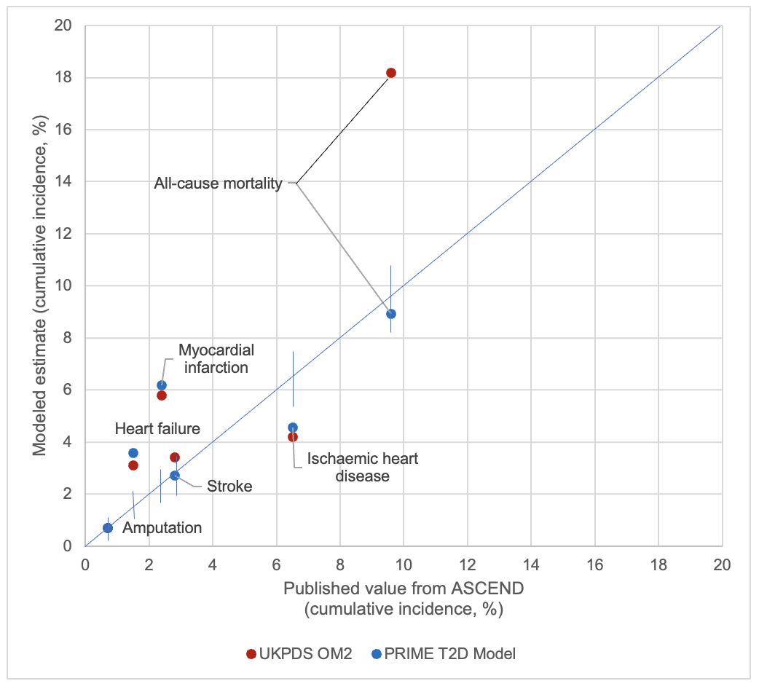
Model verification against other models/published studies (2)
Comparison of PRIME T2D Model and UKPDS OM2 against ASCEND outcomes
Company:
Notable difference is in terms of mortality estimation, where the PRIME T2D Model was close to the published estimate but the UKPDS OM2 overestimated mortality risk
The RMSD value for the UKPDS OM2 validation was 3.95% compared with 1.96% with the PRIME T2D Model
Even when the notable outlier for the UKPDS OM2 model is taken out (i.e. all-cause mortality), the RMSD value was 1.99% with the UKPDS OM2, still a little higher than the PRIME T2D Model.
Note: Each point on the graph represents a cumulative incidence value from a model and the corresponding published study value for validation (expressed as cumulative incidence of a given diabetes-related complication). A perfect match between the model and the studies would see all points on the y=x line.
Abbreviations: RMSD, root mean squared deviation; UKPDS, UK Prospective Diabetes Study

Slide 26
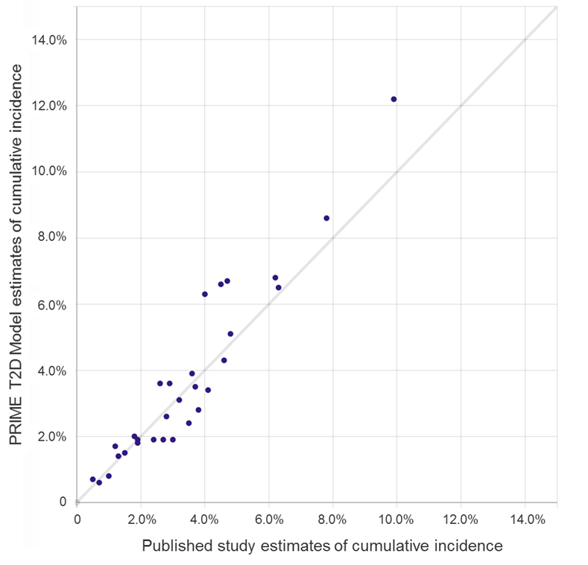
Model verification against other models/published studies (3)
PRIME T2D Model overall validation
Further validation analysis was also performed against:
  MI, stroke, IHD and heart failure against the EMPA-REG OUTCOME study
  Mortality, MI and stroke against the REWIND study
  MI, stroke and ischaemic heart disease again the LEADER study
  Stroke and heart failure against the Shah et al. cohort study
  First and second MI, first and second stroke, ischaemic heart disease, heart failure, foot ulcer, amputation and renal failure against the LDS UKPDS OM2 dataset
  Published data from the Action to Control Cardiovascular Risk in Diabetes (ACCORD) trial, which was the derivation cohort for the risk formulae for the BRAVO Model
  The DEVOTE study, the cardiovascular safety trial of insulin degludec
Note: Each point on the graph represents a cumulative incidence value from the PRIME T2D Model and the corresponding published study value for validation (expressed as cumulative incidence of a given diabetes-related complication). A perfect match would see all points on the y=x line.
Abbreviations: IHD, ischemic heart disease; LDS, Lipids in Diabetes Study; MI, myocardial Infarction; UKPDS, The United Kingdom Prospective Diabetes Study

Slide 27
Results run in CORE model
CONFIDENTIAL
ICERs around £20,000 per QALY
 | PRIME T2D model (tirzepatide vs semaglutide 1.0 mg) |  |  |  | CORE Diabetes model (tirzepatide vs semaglutide 1.0 mg)
 | Inc. costs (£) | Incr. LYs | Incr. QALYs | ICER (£/QALY) | Inc. costs (£) | Incr. LYs | Incr. QALYs | ICER (£/QALY)
Tirzepatide 5 mg | **** | 0.026 | 0.042 | 16,817 | **** | 0.020 | 0.053 | 19,779
Tirzepatide 10 mg | **** | 0.059 | 0.095 | 14,616 | **** | 0.035 | 0.096 | 19,204
Tirzepatide 15 mg | **** | 0.080 | 0.135 | 15,209 | **** | 0.049 | 0.128 | 20,286
Base case ICERs for tirzepatide vs semaglutide 1.0 mg from PRIME T2D Model and CORE Diabetes Model
EAG comments
Analyses has increased credibility of the PRIME T2D Model
Unclear how QoL was calculated in case of multiple complications
CORE Diabetes model predicts less LYs gained but more QALYs gained – company: this could be due to age-adjusting utility values in PRIME T2D model
Has confidence in the PRIME T2D model been improved?
Abbreviations: ICER, incremental cost-effectiveness ratio; LY, life years; QALYs, quality-adjusted life years

Slide 28
Key issue: Estimating risk of micro- and macrovascular complications (1)
Company maintains model averaging approach is most appropriate
Committee comments at ACM1
Company used model averaging to estimate the risk of micro- and macrovascular complications (which estimated the risk in a range of simulation populations, combining risk equations from 3 different models, and automatically weighing the risk equations for different populations)
Hypothetically, the company’s approach may be better than using single-risk equations but this is uncertain
Sensitivity analyses in which a single-risk prediction is selected would help it understand how these approaches compare and the impact on cost-effectiveness estimates
Company response to ACD
Model averaging supported by published validation analyses [shown on previous slide]
Model averaging offers the potential to increase the predictive power of disease models and the ability to average out the influence of background risk modifiers
Also allows the model to derive weights on a per-patient basis to tailor the overall modelling approach to the target population, and to change this over model time frame, as simulated patients progress from having early to advanced disease
Scenario analysis using only UKPDS risk equations → results aligned with base case (minor ICER increase)
Abbreviations: ICER, incremental cost-effectiveness ratio; UKPDS, UK Prospective Diabetes Study

Slide 29
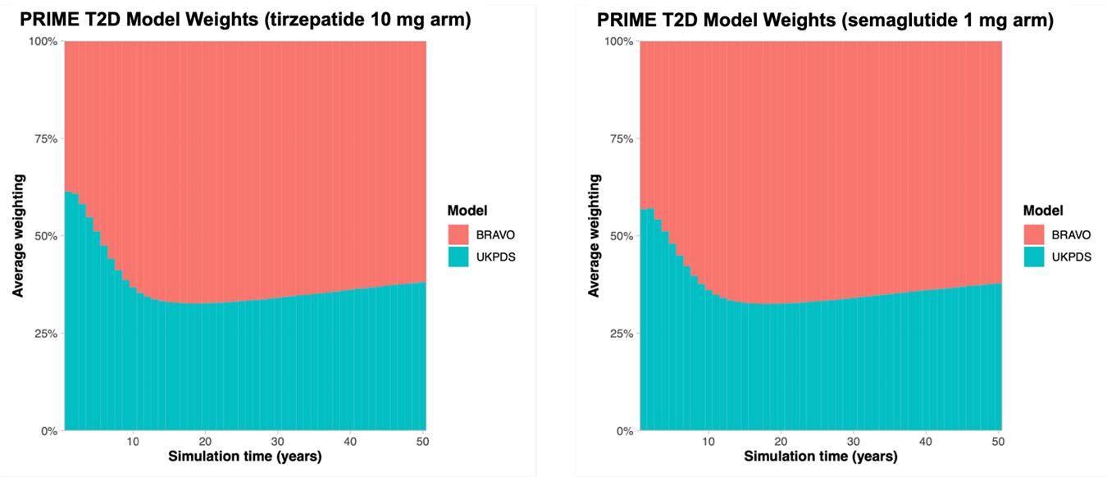
Key issue: Estimating risk of micro- and macrovascular complications (2)
Average weighting of risk equations over time (tirzepatide 10 mg vs semaglutide 1.0 mg)
EAG
PRIME T2D Model simulates events according to a predicted risk that lies between the predictions of BRAVO and UKPDS
Company:
UKPDS OM2 risk equations were used predominantly over the first 4–5 years
Company:
Cohort characteristics were more closely matched to the BRAVO derivation population in subsequent years
Company:
As patients with more advanced disease have greater mortality risk, the weighting towards BRAVO risk equations gradually diminishes after year 15 of the simulation

Slide 30
Key issue: Estimating risk of micro- and macrovascular complications (3)
EAG reassured but some information still missing
EAG comments
Reassured that scenario analysis using UKPDS OM2 risk equation only has minor impact on ICER
Ideally, a scenario analysis including the BRAVO model would also have been provided
Risk equation selection process based on a systematic literature review and clear inclusion criteria
Sampling of events in individual patients is driven by a mixture of BRAVO and UKPDS; may be undesirable if these two models substantially differ
Although the model averaging approach seems to have a good prediction of cardiovascular events, there are many elements that could affect the face validity and applicability of these equations
Appropriateness of models is not justified in detail e.g. using PROBAST checklist
What is the best approach to estimate risk of micro- and macrovascular complications?
Abbreviations: PROBAST, Prediction model Risk Of Bias Assessment Tool ; UKPDS, The United Kingdom Prospective Diabetes Study

Slide 31
Key issue: Treatment intensification
ICER < £20,000 per QALY but EAG unclear on certain points
Committee comments at ACM1
NICE’s guideline on managing T2D in adults states GLP-1 RAs should only be continued if the person with type 2 diabetes has had a beneficial metabolic response: accordingly, company model assumes people switch to insulin when people’s HbA1c targets are not met
Clinical practice may deviate from this recommendation: people usually have insulin added on to an existing GLP-1 RA, rather than the GLP-1 RA being stopped
Scenario analysis assuming treatment is intensified by adding insulin to tirzepatide and GLP-1 RAs would allow it to explore the impact of this deviation on cost-effectiveness estimates
Company response to ACD
Provided scenario analysis where GLP-1 RA therapy (or tirzepatide) was continued after the initiation of basal insulin
ICER <£20,000 per QALY (marginally higher than base case) for tirzepatide 10mg vs semaglutide 1mg
EAG comments
Unclear how treatment effectiveness was modelled in this scenario, e.g. whether treatment effectiveness was based on the NMA (or only SURPASS-2) and what are company’s assumptions regarding treatment effectiveness of continuation with tirzepatide or GLP-1 RAs
Abbreviations: ACD, appraisal consultation document; GLP-1 RA, Glucagon-Like Peptide-1 receptor agonist; ICER, incremental cost effectiveness ratio; NMA, network meta-analysis; QALY, quality-adjusted life year; T2D, type 2 diabetes; UKPDS, UK Prospective Diabetes Study.

Slide 32
Key issue: Baseline utility value
Company provided scenario analyses using lower baseline utilities
Committee comments at ACM1
The company’s baseline utility value for people with T2D (0.815) was higher than the utility score for the general population at the same age (0.804)
Preferred the lower baseline utility based on the pooled mean of 3-level version of EQ-5D studies value identified by the EAG (0.772; Redenz et al. 2023)
Company response to ACD
Noted a recent SLR (Redenz et al. 2023) reported a utility value of 0.815 (95%CI 0.808-0.823) for) based on pooled data from 5-level version of EQ-5D studies people with T2D and no complications
Provided scenario analysis using a lower baseline utility (0.785) based on Clarke et al. (2002): all tirzepatide doses had ICERs <£20,000 per QALY (lower than base case)
Also provided scenario analysis EAG preferred value (0.772): all tirzepatide doses had ICERs <£20,000 per QALY (lower than base case)
Changing the baseline utility has a very modest impact on cost-effectiveness
EAG comments: ICERs increase slightly (and more with higher doses of tirzepatide) when EAG preferred baseline utility used, compared to using 0.785 value
Which baseline utility value should be used?
Abbreviations: ACD, appraisal consultation document; CI, confidence interval; ICER, incremental cost effectiveness ratio; QALY, quality-adjusted life year; SLR, systematic literature review; T2D, type 2 diabetes UKPDS, The United Kingdom Prospective Diabetes Study

Slide 33
Key issue: Combining disutilities
Company maintains additive approach is most appropriate
Committee comments at ACM1
Multiplicative approach is preferred to combine disutilities, in line with the NICE methods manual
Previous technology appraisals that have used an additive approach were published before the new NICE methods manual applied
The company did not provide clear rationale for why the multiplicative approach was not appropriate
Company response to ACD
The disutilities used in modelling were derived as additive disutilities using the EQ-5D instrument
Gough et al. (2009) concluded that HRQoL decrements associated with T2D and obesity showed no significant interaction and could be assumed to be additive
Sullivan et al (2011) and Hayes et al. (2016) reported multiple co-morbidities for diabetes and considered it reasonable to treat co-morbidities as independent and add utility decrements
Provided scenario analysis using a multiplicative approach to combining disutilities for tirzepatide 10mg: had ICERs <£20,000 per QALY (higher than base case)
EAG comments
Use of additive or multiplicative approach is a matter of judgement
Scenario increases ICER for tirzepatide 10mg vs. semaglutide 1mg by £3,721 per QALY
Which approach (multiplicative or additive) should be used to combine disutility values?
Abbreviations: HRQoL, health-related quality of life; ICER, incremental cost effectiveness ratio; QALY, quality-adjusted life year

Slide 34
Company revised base case results
CONFIDENTIAL
Tirzepatide 5 mg: Deterministic incremental revised base case results XXXXXXXXXXXXXX
 | Total costs (£) | Total QALYs | Incremental costs (£)ª | Incremental QALYsª | ICERª (£/ QALY) | NHBª (QALYs)
Tirzepatide 5 mg | XXXXX | 8.715 | -- | -- | -- | --
Dulaglutide 1.5 mg* | XXXXX | 8.615 | **** | 0.100 | 7,073 | 0.064
Dulaglutide 3.0 mg | XXXXX | 8.636 | **** | 0.079 | 8,182 | 0.047
Dulaglutide 4.5 mg | XXXXX | 8.657 | **** | 0.058 | 10,891 | 0.026
Semaglutide 0.5 mg* | XXXXX | 8.634 | **** | 0.081 | 8,401 | 0.047
Semaglutide 1.0 mg | XXXXX | 8.673 | **** | 0.042 | 16,817 | 0.007
Oral semaglutide 7 mg* | XXXXX | 8.595 | **** | 0.120 | 6,202 | 0.083
Oral semaglutide 14 mg | XXXXX | 8.642 | **** | 0.073 | 9,873 | 0.037
Liraglutide 1.2 mg* | XXXXX | 8.581 | **** | 0.134 | 5,021 | 0.100
Liraglutide 1.8 mg | XXXXX | 8.600 | **** | 0.115 | Dominant | 0.135
ª tirzepatide versus comparator; *comparisons considered most relevant by company.
Abbreviations: ICER, incremental cost-effectiveness ratio; NHB, net health benefit; QALYs, quality-adjusted life years.

Slide 35
Company revised base case results
CONFIDENTIAL
Tirzepatide 10 mg: Deterministic incremental revised base case results XXXXXXXXX
 | Total costs (£) | Total QALYs | Incremental costsª (£) | Incremental QALYsª | ICERª (£/ QALY) | NHBª (QALYs)
Tirzepatide 10 mg | XXXXX | 8.768 | -- | -- | -- | --
Dulaglutide 1.5 mg | XXXXX | 8.615 | **** | 0.153 | 9,091 | 0.083
Dulaglutide 3.0 mg* | XXXXX | 8.636 | **** | 0.132 | 10,073 | 0.065
Dulaglutide 4.5 mg | XXXXX | 8.657 | **** | 0.111 | 11,843 | 0.045
Semaglutide 0.5 mg | XXXXX | 8.634 | **** | 0.134 | 10,171 | 0.066
Semaglutide 1.0 mg* | XXXXX | 8.673 | **** | 0.095 | 14,616 | 0.026
Oral semaglutide 7 mg | XXXXX | 8.595 | **** | 0.173 | 8,254 | 0.102
Oral semaglutide 14 mg* | XXXXX | 8.642 | **** | 0.126 | 11,140 | 0.056
Liraglutide 1.2 mg | XXXXX | 8.581 | **** | 0.187 | 7,254 | 0.119
Liraglutide 1.8 mg* | XXXXX | 8.600 | **** | 0.168 | 1,642 | 0.154
ª tirzepatide versus comparator; *comparisons considered most relevant by company.
Abbreviations: ICER, incremental cost-effectiveness ratio; NHB, net health benefit; QALYs, quality-adjusted life years.

Slide 36
Company revised base case results
CONFIDENTIAL
Tirzepatide 15 mg: Deterministic incremental revised base case results XXXXXXXXXXXXXXXX
 | Total costs (£) | Total QALYs | Incremental costs (£) | Incremental QALYsª | ICERª (£/ QALY) | NHBª (QALYs)
Tirzepatide 15 mg | XXXXX | 8.808 | -- | -- | -- | --
Dulaglutide 1.5 mg | XXXXX | 8.615 | **** | 0.192 | 10,642 | 0.090
Dulaglutide 3.0 mg | XXXXX | 8.636 | **** | 0.171 | 11,586 | 0.072
Dulaglutide 4.5 mg* | XXXXX | 8.657 | **** | 0.150 | 13,104 | 0.052
Semaglutide 0.5 mg | XXXXX | 8.634 | **** | 0.174 | 11,641 | 0.073
Semaglutide 1.0 mg* | XXXXX | 8.673 | **** | 0.135 | 15,209 | 0.032
Oral semaglutide 7 mg | XXXXX | 8.595 | **** | 0.212 | 9,815 | 0.108
Oral semaglutide 14 mg* | XXXXX | 8.642 | **** | 0.166 | 12,453 | 0.062
Liraglutide 1.2 mg | XXXXX | 8.581 | **** | 0.227 | 8,893 | 0.126
Liraglutide 1.8 mg* | XXXXX | 8.600 | **** | 0.208 | 4,498 | 0.161
ª tirzepatide versus comparator; *comparisons considered most relevant by company.
Abbreviations: ICER, incremental cost-effectiveness ratio; NHB, net health benefit; QALYs, quality-adjusted life years.

Slide 37
Deterministic scenario analyses
Clinical drivers and duration of therapy: tirzepatide 10 mg vs semaglutide 1.0 mg
No. | Scenario* | Incremental costs (£) | Incremental QALYs | ICER (£/QALY gained)
 | Company revised base case | **** | 0.095 | 14,616
1 | Direct head-to-head results from SURPASS-2 | **** | 0.092 | 12,019
2 | Using only UKPDS risk equations | **** | 0.087 | 15,521
3 | GLP-1 RAs and tirzepatide continued (while adding insulin) | **** | 0.125 | 14,720
4 | Lower baseline utility value for people with T2D (0.785) | **** | 0.100 | 13,902
5 | Lower baseline utility value for people with T2D (0.772) | **** | 0.099 | 14,007
6 | Multiplicative method for combining disutilities | **** | 0.076 | 18,337
7 | Including diarrhoea disutility | **** | 0.093 | 14,978
*Source: Company response to ACD
Abbreviations: GLP-1 RAs, Glucagon-like peptide-1 receptor agonists; ICER, incremental cost-effectiveness ratio; QALYs, quality-adjusted life years; T2D, type 2 diabetes; UKPDS, UK Prospective Diabetes Study

Slide 38
Thank you.
© NICE 2023. All rights reserved. Subject to Notice of rights.

