Slide 1
Tirzepatide for the treatment of patients with type 2 diabetes
Slides for the public – contains no ACIC or CPAS information
Technology appraisal committee A [6th June 2023]
Chair: Radha Todd
Lead team: Alan Thomas, Fiona MacPherson Smith, Min Ven Teo
External assessment group: Kleijnen Systematic Reviews (KSR) Ltd. in collaboration with Erasmus University Rotterdam (EUR) and Maastricht University Medical Center (UMC+)
Technical team: Janet Boadu, Ewa Rupniewska, Janet Robertson
Company: Eli Lilly
© NICE 2025. All rights reserved. Subject to Notice of rights.

Slide 2
Key issues (1)
Submissions
Company (Eli Lilly)
Diabetes UK
No technical engagement
(but ACM delayed by 1 month to allow company to address issues raised by EAG)
Decision problem and clinical effectiveness evidence
Issues
Mismatch between scope and decision problem: line of therapy and comparators
Network meta-analysis at high risk of bias due to lack of feasibility assessment, assessment of trial comparability and insufficient sensitivity analyses
Mismatch between decision problem and evidence: line of therapy + prior oral antidiabetic drug intensity
Mismatch between tirzepatide administration in clinical practice (by titration) and in the trials, network meta-analysis and cost-effectiveness analyses (according to maintenance dose strata)

Slide 3
Key issues (2)
Cost effectiveness evidence
Issues
Company’s modelling approach not adequately justified
Technical verification of company model insufficient
No comparative evidence on treatment effects on macro- and micro-vascular complications - modelling used. Selection and use of risk models to estimate complications not adequately justified
No justification for no treatment effect waning when extrapolating treatment effectiveness data
Only one criterion (HbA1c threshold) for treatment discontinuation/intensification applied in model
Not all adverse events incorporated for all treatments
Potentially inappropriate probabilistic sensitivity analyses
No full deterministic one-way sensitivity analyses
Notes:
Note* Issues 11 and 12 now resolved

Slide 4
Background on type 2 diabetes mellitus
Type 2 diabetes mellitus:
Chronic metabolic disorder: reduced tissue sensitivity to insulin (known as insulin resistance) → loss of endogenous insulin production → elevated blood glucose levels (hyperglycaemia)
Epidemiology: UK prevalence of type 2 diabetes is rising
Around 3 million diagnosed in England in 2019; plus estimated 1 million undiagnosed in the UK
UK prevalence is rising due to increasing prevalence of obesity
People from Black African, African Caribbean and South Asian family backgrounds at a higher risk, and from a younger age
Complications, if not managed effectively, include:
kidney disease (including failure)
eye problems (including blindness)
foot problems (can lead to amputation)
nerve damage
cardiovascular disease (including heart attack and stroke)
treatment-related: low blood glucose (hypoglycaemia)

Slide 5
Treatment pathway: summary
Depends on HbA1c level, cardiovascular risk, kidney function and other factors
Treatment intensified when HbA1c not controlled or change in cardiovascular risk/status
1st line
Chosen individually, based on multiple factors and patients circumstances, including HbA1c level, cardiovascular risk and kidney function; generally includes:
metformin (not at high CVD risk)
metformin plus SGLT2 inhibitor (chronic heart failure or established atherosclerotic CVD*)
DPP-4 inhibitor, pioglitazone, sulfonylurea or SGLT2 inhibitor (if metformin contraindicated)
Tirzepatide’s marketing authorisation spans entire treatment pathway- discussed later
2nd line
Treatment intensified when:
person's HbA1c not controlled below individually agreed threshold: switching to or adding DPP-4 inhibitor, pioglitazone, sulfonylurea or SGLT2 inhibitor
person develops CVD or a high risk of CVD (switching to or adding SGLT2 inhibitor)
3rd
& further lines
Insulin-based therapy (with or without other drugs): when dual therapy has not continued to control HbA1c to below the person's individually agreed threshold
GLP-1 mimetic treatments: if triple therapy with metformin and 2 other oral drugs is not effective, not tolerated or contraindicated^{c}; for adults with type 2 diabetes who have:
  BMI of ≥35^{b} kg/m² and specific psychological or other medical problems associated with obesity
  BMI <35 kg/m² and for whom insulin therapy would have significant occupational implications or weight loss would benefit other significant obesity related comorbidities.
Company positions tirzepatide as alternative to GLP-1 mimetics
ª SGLT2 inhibitor can also be considered for people at high risk of CVD (QRISK2 of 10% or higher or elevated lifetime risk); ^{b} adjusted accordingly for people from Black, Asian and other minority ethnic groups; ^{c} switching one of the drugs to a GLP-1 mimetic.
Source: NICE guideline 28. Abbreviations: CVD, cardiovascular disease; DPP-4, Dipeptidyl-Peptidase 4; GLP-1, glucagon-like peptide-1; HbA1c, Glycated Haemoglobin; QRISK2, cardiovascular risk score; SGLT2, Sodium-Glucose Co-Transporter-2.
Notes:
medications-review-protocol-guidelines-v01.pdf (knowdiabetes.org.uk)

Slide 6
Patient perspectives
People feel overwhelmed by the pressures of having the condition over a long period of time
Submissions from Diabetes UK
Serious and sometimes progressive condition that deeply impacts health and wellbeing; can cause devasting, life-changing complications
Estimated 90% of adults with type 2 diabetes are living with overweight or obesity at diagnosis. Carrying excess weight strongly tied to difficulties managing blood glucose levels and to increased risk of complications
Reducing blood glucose levels and weight loss are proven ways to improve condition and reduce risk of complications so an additional treatment with these benefits is very important for many people living with type 2 diabetes
Tirzepatide offers another welcome option for people with type 2 diabetes when developing an individualised treatment plan with their healthcare team
“There is an unmet need given the increasing prevalence of type 2 diabetes in the population”
“[Tirzepatide] would offer patients more choice for their care, reduce the risk of people feeling a sense of hopelessness and could encourage a shared-decision making approach where a full range of options are discussed”

Slide 7
Clinical perspectives
Submissions from clinical experts: Association of British Clinical Diabetologists and Portsmouth Hospitals University Trust (Diabetes and Endocrinology)
Aims of therapy: reversal of symptoms of high glucose level, avoiding negative effects of therapy, and reducing the risk of micro- and macrovascular complications
International guidelinesª now cite reduction of obesity as a major aim of therapy; over 90% people with T2D have excess weight which is associated with insulin resistance and health issues per se
Unmet need: despite availability of 8 different classes of glucose lowering therapies (in addition to lifestyle interventions), less than 2/3rds of people with T2D in the UK achieve an HbA1c <53 mmol/mol (<7%)
Tirzepatide:
First in class glucose lowering therapy which stimulates GLP-1 and GIP receptors
Expected to be positioned as alternative to GLP-1 RAs (although current BMI threshold for GLP-1 RAs use is too restrictive and not based on clinical evidence)
Gives better reduction of HbA1c, weight and BMI than placebo and other active glucose lowering therapies (shown in SURPASS trials)
Has similar safety and side-effect profile to GLP-1 RAs
“Additional glucose lowering therapies are warranted to assist individuals and populations to achieve optimal glycaemic control”
“Tirzepatide is a once weekly injectable glucose lowering therapy that offers a unique approach to improve glycaemic control and is associated with weight loss”
ª American (ADA) and European (EASD) guidelines, updated September 2022; Abbreviations: BMI, body mass index; HbA1c, glycated haemoglobin; GIP, glucose-dependent insulinotropic polypeptide; GLP-1, glucagon-like peptide-1; RA; receptor agonist; T2D, type 2 diabetes.

Slide 8
Equality considerations
Equality considerations (patient organisation)
Higher risk of being diagnosed with type 2 diabetes, and at a younger age, for people of South Asian, Black Caribbean and Black African ethnic background
Higher prevalence of the condition amongst those in more deprived areas and they receive poorer care which is borne out in consistently poorer achievement of care processes and treatment targets. Obesity also disproportionately impacts these groups
People with type 2 diabetes who experience weight stigma are less likely to receive good care and seek help from a healthcare professional to support weight loss

Slide 9
Tirzepatide (Mounjaro, Eli Lilly)
CONFIDENTIAL
Technology details
Marketing authorisation | treatment of adults with insufficiently controlled type 2 diabetes mellitus as an adjunct to diet and exercise as monotherapy when metformin is considered inappropriate due to intolerance or contraindications in addition to other medicinal products for the treatment of diabetes
Mechanism of action | Dual receptor agonist of the GIP and GLP-1 hormones which act to stimulate insulin secretion
Administration | Weekly subcutaneous injection
Price | Proposed list price per pack of 4 pre-filled single-dose autoinjector pen devices disposable injection 5 mg, 10 mg and 15 mg: £****************, respectively Proposed list price for 12 months of treatment 5 mg, 10 mg and 15 mg: £*********** ************, respectively Note: price will be disclosed when guidance is published
Note: Marketing authorisation granted by MHRA in September 2022.
Abbreviations: GIP, Glucose-Dependent Insulinotropic Polypeptide; GLP-1, Glucagon-Like Peptide-1.

Slide 10
Decision problem: company submission deviates from scope
 | Final scope | Company submission | EAG comments
Population | Tirzepatide monotherapy: Adults with T2D, inadequately controlled with diet & exercise alone & metformin considered inappropriate Tirzepatide with other antidiabetic agents: Adults with T2D, inadequately controlled with one or more antidiabetic agents | People with T2D, inadequately controlled with 3 or more antidiabetic agents, as an option whenever GLP-1 RAs would otherwise be considered | Company target population narrower than NICE scope
Intervention | Tirzepatide alone or with other antidiabetic agents | Tirzepatide with other antidiabetic agents | Company submission limited to combination therapy
Comparators | Sulfonylureas, DPP-4 inhibitors, pioglitazone, GLP-1 RAs, SGLT-2 inhibitors, insulin (all as monotherapy or in combination) | GLP-1 RAs | Company have not presented a convincing argument for restricting to GLP-1 RAs
Outcomes | HbA1c/glycaemic control, complications of diabetes, including CV, renal and eye, mortality, BMI, frequency and severity of hypoglycaemia, changes in CV risk factors, adverse effects of treatment, HRQoL | Aligned with final NICE scope | Some outcomes are modelled (details later)
Abbreviations: GLP-1, glucagon-like peptide-1; HRQoL, health-related quality of life; OAD, oral antidiabetic drug; RA, receptor agonist; T2D, type 2 diabetes.

Slide 11

Key issue: Mismatch between scope and decision problem: line of therapy and comparators
Line of therapy – EAG comments:
Company target population narrower than NICE scope
No evidence to assess tirzepatide in wider population
Use of GLP-1 RAs more precise than only according to treatment experience (NICE guideline 28)
Company: Population narrower as expected tirzepatide would be used as alternative to GLP-1 RAs in clinical practice (both in combination with 2 OADs) + this population has highest unmet need
“If triple therapy with metformin and 2 other oral drugs is not effective, not tolerated or contraindicated, consider triple therapy by switching one drug for a GLP-1 mimetic for adults with type 2 diabetes who:
have a body mass index (BMI) of 35 kg/m² or higher (adjust accordingly for people from Black, Asian and other minority ethnic groups) and specific psychological or other medical problems associated with obesity or
have a BMI lower than 35 kg/m² and for whom insulin therapy would have significant occupational implications or weight loss would benefit other significant obesity-related comorbidities.”
Comparators – EAG comments:
Company included only GLP-1 RAs: dulaglutide, liraglutide, oral semaglutide, injectable semaglutide
Some GLP-1 RAs (lixisenatide, standard & modified-release exenatide) excluded due to limited market share
Company: comparators dictated by proposed positioning
Is company positioning clinically appropriate?
Would we expect people at third line to respond as well as those at earlier stage in disease?
If alternative to GLP-1 RAs, should the same criteria for use apply?
Are all relevant comparators included?
Abbreviations: GLP-1, Glucagon-Like Peptide-1; RA, receptor agonist

Slide 12
Clinical effectiveness

Slide 13
Key clinical trials: SURPASS-2 to 5 (1)
Clinical trial designs and outcomes
 | SURPASS-2 | SURPASS-3 | SURPASS-4 |  | SURPASS-5
Design | Randomised, multicentre phase 3 | Randomised, open-label, international, multicentre phase 3 | Randomised, open-label, international, multicentre phase 3
 | Open-label |  |  |  | Double-blind
Population | People with T2D, stable treatment, unchanged dose of metformin >1500 mg/day for ≥3 months before screening | People with T2D, stable treatment, unchanged dose of metformin/ metformin plus an SGLT-2 inhibitor for ≥3 months before screening | People with T2D, stable treatment, unchanged dose of at least 1 and no more than 3 types of oral antihyperglycemic drugs, (only include metformin, SGLT-2 inhibitors, and/or sulfonylureas) for at least 3 months before screening | People with T2D with high CV disease risk, stable treatment, unchanged dose of at least 1 and no more than 3 types of oral antihyperglycemic drugs, (only include metformin, SGLT-2 inhibitors, and/or sulfonylureas) for ≥3 months before screening | People with T2D, stable dose of insulin glargine (U100) once daily, with/ without metformin ≥3 months before screening
Key inclusion criteria | HbA1c of ≥7.0% (≥7.5% in SURPASS-4) to ≤10.5% Stable weight for 3 months and BMI ≥25 kg/m² (≥23 kg/m² in SURPASS-5)
Key exclusion criteria | Prior history of proliferative diabetic retinopathy, diabetic maculopathy, or non-proliferative diabetic retinopathy that requires acute treatment
Note: SURPASS-1 population and treatment not relevant to submission
Abbreviations: CV, cardiovascular; HbA1c, glycated haemoglobin; SGLT2, Sodium-Glucose Co-Transporter-2; T2D, type 2 diabetes.

Slide 14
Key clinical trials: SURPASS-2 to 5 (2)
Clinical trial designs and outcomes
 | SURPASS-2* | SURPASS-3 | SURPASS-4 | SURPASS-5
Intervention | Tirzepatide 5 mg, 10 mg, 15 mg | tirzepatide 5 mg, 10 mg, 15 mg | tirzepatide 5 mg, 10 mg, 15 mg | tirzepatide 5 mg, 10 mg, 15 mg
Comparator | Semaglutide | Insulin degludec | Insulin glargine | Placebo
Duration | 40 weeks | 52 weeks | 52 weeks | 40 weeks
Primary outcome | Mean change from baseline in HbA1c (10 mg and 15 mg) | Mean change in HbA1c (10 mg and 15 mg) | Mean change in HbA1c (10 mg and 15 mg)
Key secondary outcomes | Mean change from baseline in HbA1c (tirzepatide 5 mg) Mean change from baseline in body weight (all tirzepatide doses) Proportion of patients achieving HbA1c <7% (53 mmol/mol; all tirzepatide doses) Proportion of patients achieving HbA1c <5.7% (39 mmol/mol; tirzepatide 10 mg and 15 mg) |  | Mean CfB: HbA1c (tirzepatide 5 mg) Mean CfB: body weight (all tirzepatide doses) Proportion achieving a target of HbA1c <7% (all tirzepatide doses)
Locations | 128 centres across 8 countries | 121 sites across 12 countries | 187 sites in 14 countries | 45 sites in 8 countries
Abbreviations: HbA1c, glycated haemoglobin.

Slide 15
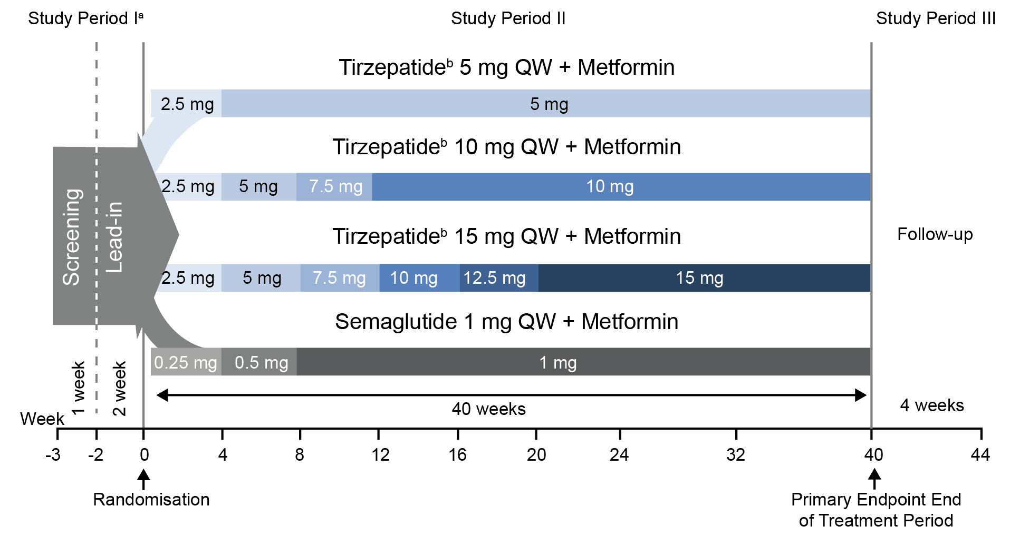
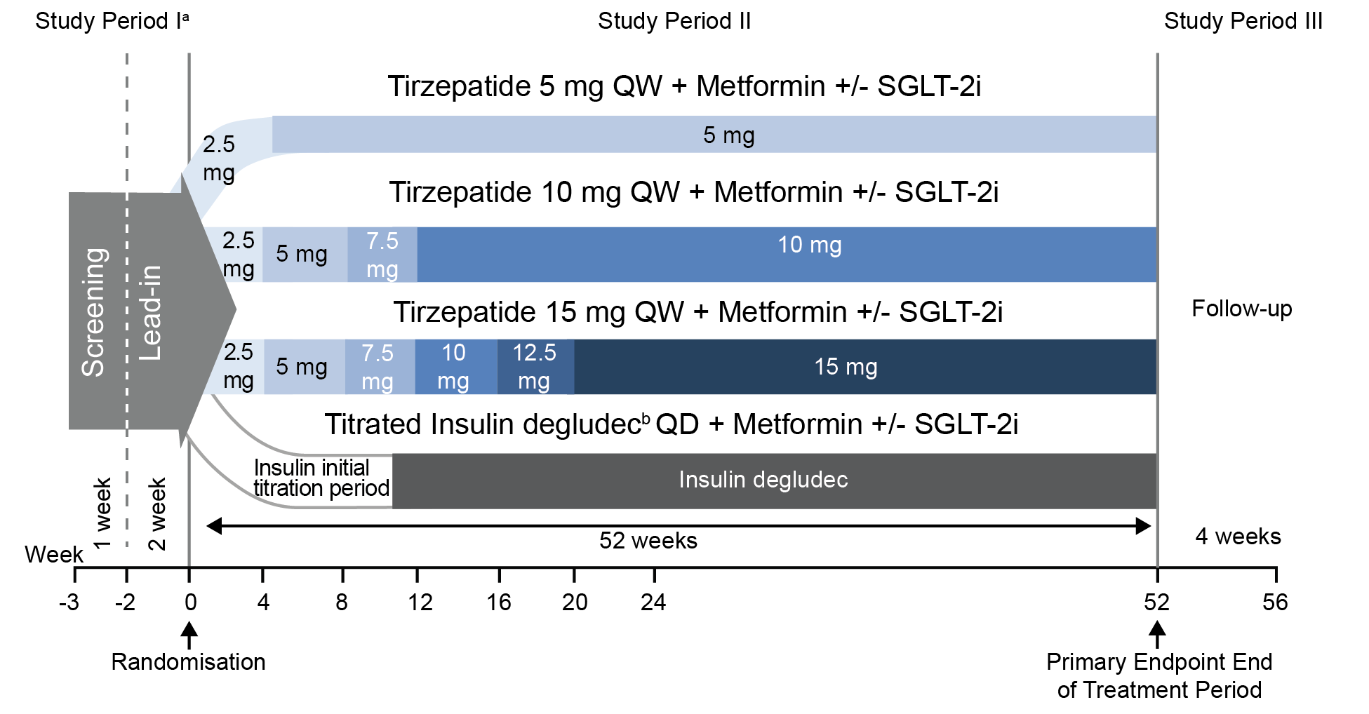
SURPASS trials study design (1)
SURPASS-2
SURPASS-3
Is this dose escalation schedule representative of how tirzepatide will be dosed in clinical practice? Does this matter?
Abbreviations: QD, once a day; QW, once weekly; SGLT2i, sodium-glucose co-transporter-2 inhibitor.
Notes:
Note to presenter about EAG's comment to be mindul about how we refer to dose increases in SURPASS - dose escalation rather than titration

Slide 16
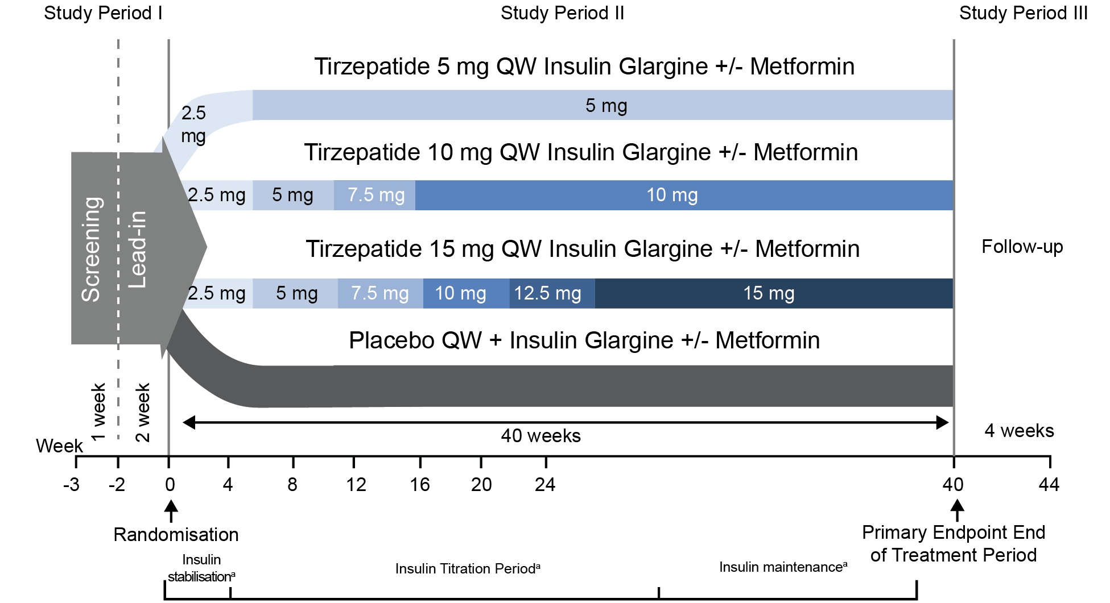
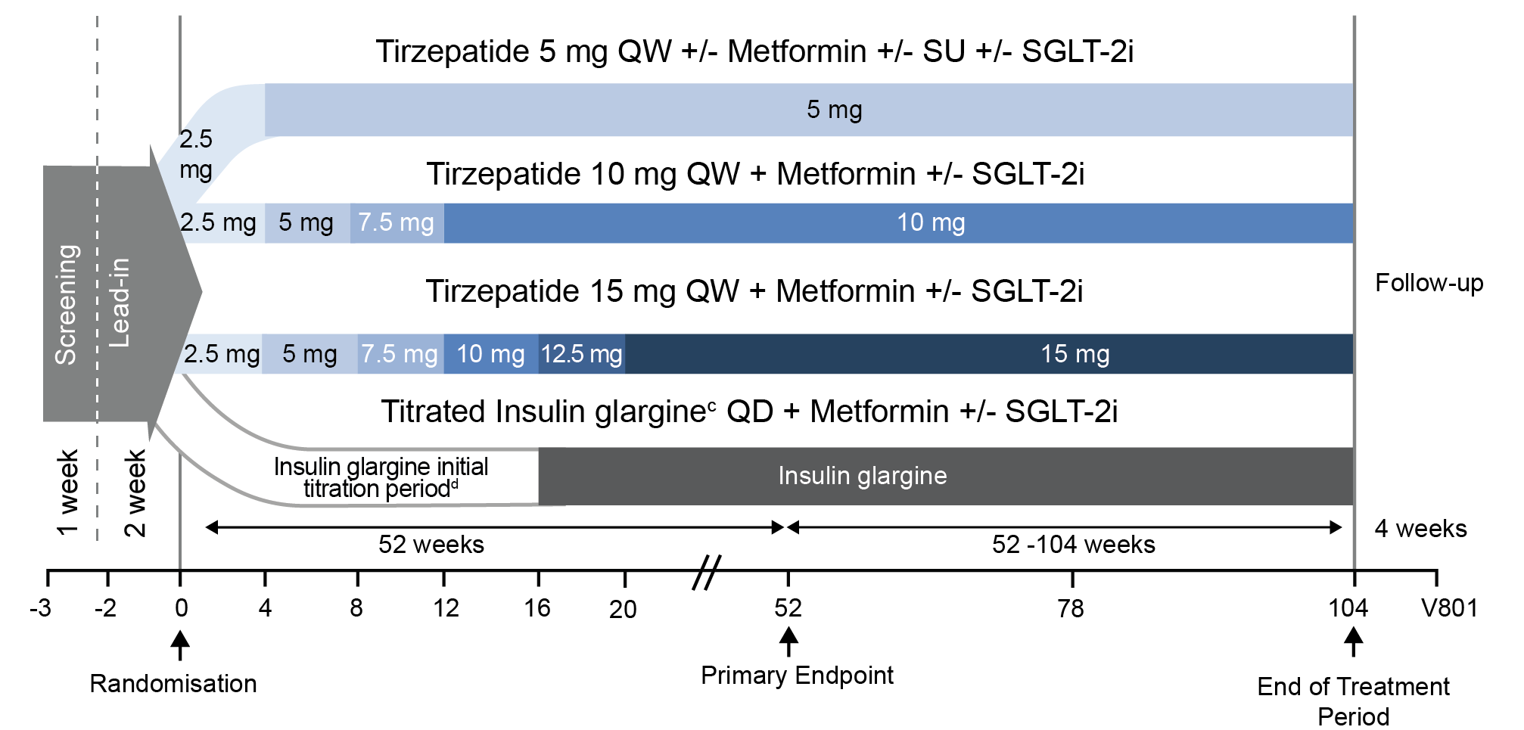
SURPASS trials study design (2)
SURPASS-4
SURPASS-5
Abbreviations: QD, once a day; QW, once weekly; SGLT2i, sodium-glucose co-transporter-2 inhibitor; SU, sulfonylurea.

Slide 17
Clinical trials baseline characteristics (overall population)
SURPASS trial, N | 2 (N=1,878) | 3 (N= 1,437) | 4 (N=1,995) | 5 (N= 475)
Age (years), mean ± SD | 56.6 ± 10.4 | 57.4 ± 10.0 | 63.6 ± 8.6 | 60.6 ± 9.9
Female, n (%) | 996 (53.0) | 635 (44.2) | 749 (37.5) | 211 (44.4)
White, n (%) | 1551 (82.6) | 1307 (91.0) | 1629 (81.8) | 380 (80.0)
Weight (kg), mean ± SD | 93.7 ± 21.9 | 94.28 ± 20.06 | 90.3 ± 18.7 | 95.2 ± 21.6
BMI (kg/m²), mean ± SD | 34.2 ± 6.9 | 33.52 ± 6.06 | 32.6 ± 5.5 | 33.4 ± 6.1
BMI category, n (%)
<30 | ******** | 446 (31.0) | ******** | ********
30 to <35 | ******** | 496 (34.5) | ******** | ********
≥35 | ******** | 495 (34.4) | ******** | ********
Duration of diabetes (years), mean ± SD | 8.6 ± 6.5 | 8.38 ± 6.24 | 11.78 ± 7.51 | 13.3 ± 7.3
HbA1c (%), mean ± SD | 8.28 ± 1.03 | 8.17 ± 0.91 | 8.52 ± 0.88 | 8.31 ± 0.85
HbA1c (mmol/mol), mean ± SD | 67.03 ± 11.25 | 65.78 ± 9.99 | 69.65 ± 9.65 | ********
HbA1c category, n (%)
≤8.5% (69 mmol/mol) | 1192 (63.5) | 1005 (69.9) | ******** | ********
>8.5% (69 mmol/mol) | 686 (36.5) | 432 (30.1) | ******** | ********
History of CV disease | ******** | ******** | 1738 (86.8) | ********
Generalisable to NHS practice?
Abbreviations: BMI, body mass index; CV, cardiovascular; HbA1c, glycated haemoglobin; SD, standard deviation.
Notes:
Question to committee- Are these baseline characteristics generalisable to NHS clinical practice?

Slide 18
Clinical trials (concomitant treatments at baseline)
Characteristics | TZP 5 mg | TZP 10 mg | TZP 15 mg | Comparator | Overall population
SURPASS-2
Metformin | 100%
SURPASS-3
Metformin alone, n (%) | ******** | ******** | ******** | ******** | ********
Metformin + SGLT-2i, n (%) | ******** | ******** | ******** | ******** | 458 (31.9)
Metformin dose (mg/day), mean ± SD | ************* | ************* | ************* | ************* | *************
SURPASS-4
Metformin alone, n (%) | ********* | ********* | ********* | ********* | *********
Metformin + SU, n (%) | ********* | ********* | ********* | ********* | *********
Metformin + SGLT-2i, n (%) | ********* | ********* | ********* | ********* | *********
Metformin + SU + SGLT-2i, n (%) | ********* | ********* | ********* | ********* | *********
SU alone, n (%) | ********* | ********* | ********* | ********* | *********
SGLT-2i alone, n (%) | ********* | ********* | ********* | ********* | *********
SU + SGLT-2i, n (%) | ********* | ********* | ********* | ********* | *********
SURPASS-5
Insulin dose mean ± SD | 39.1 ± 25.4 | 34.7 ± 15.4 | 40.5 ± 29.1 | 36.3 ± 18.0 | 37.6 ± 22.7
Metformin, n (%) | 99 (85.3) | 99 (83.2) | 97 (80.8) | 99 (82.5) | 394 (82.9)
Triple therapy
Abbreviations: SD, standard deviation; SGLT-2i, sodium-glucose co-transporter-2 inhibitor; SU, sulfonylurea; TZP, tirzepatide.
Notes:
Source: Tables 12, 14 and 16 of the CS³

Slide 19
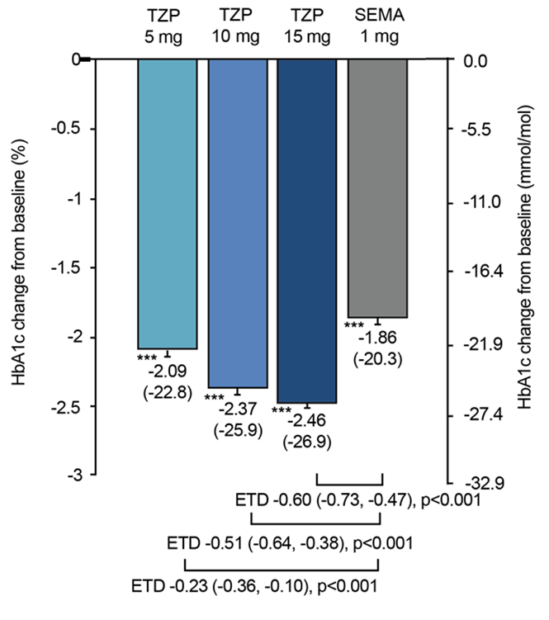
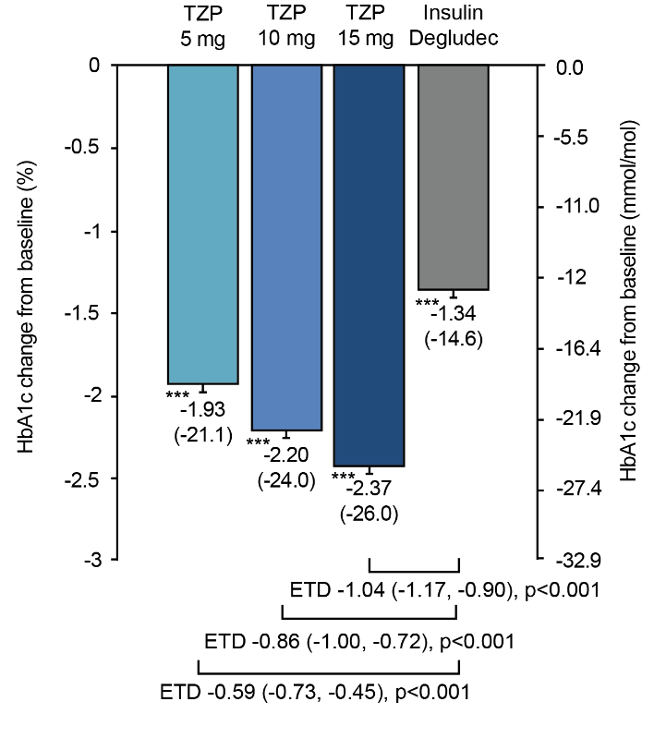
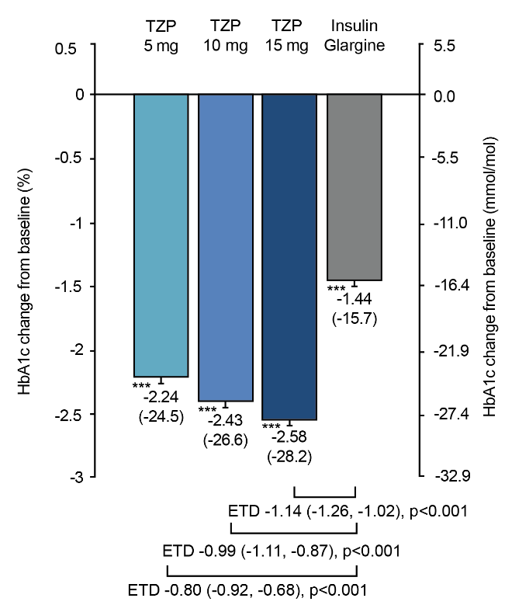
Results: change from baseline in HbA1c (primary endpoint)
Tirzepatide showed statistically significant reductions in HbA1c vs comparator (all doses)
SURPASS-2
(baseline to 40 weeks)
SURPASS-3
(baseline to 52 weeks)
SURPASS-4
(baseline to 52 weeks)
SURPASS-5
(baseline to 40 weeks)
Note: efficacy estimand presented (assesses on-treatment efficacy using data up to the time of initiating rescue therapy); ***p<0.001 versus baseline
Abbreviations: ETD, estimated treatment difference; HbA1c, glycated haemoglobin; PBO, placebo; SEMA, semaglutide; TZP, tirzepatide.
Notes:
Source: Company submission

Slide 20
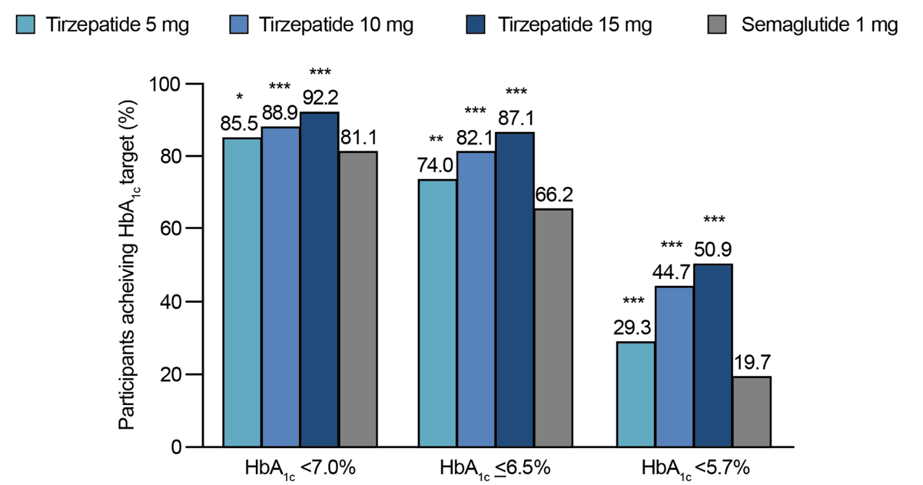
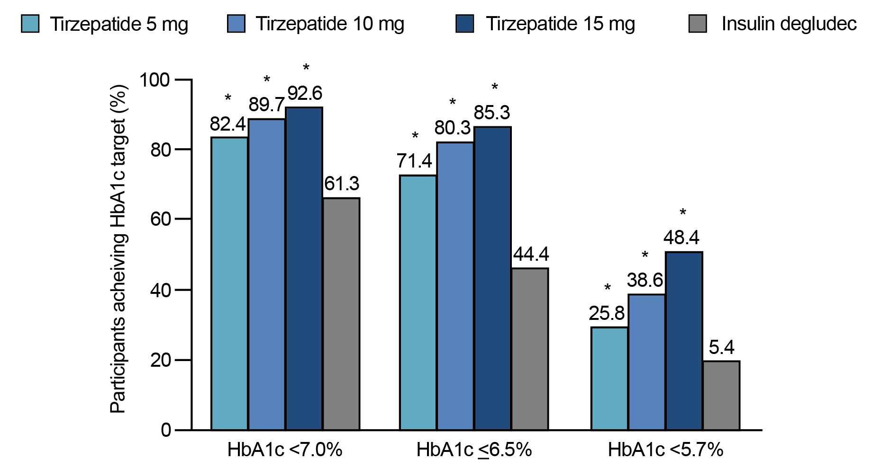
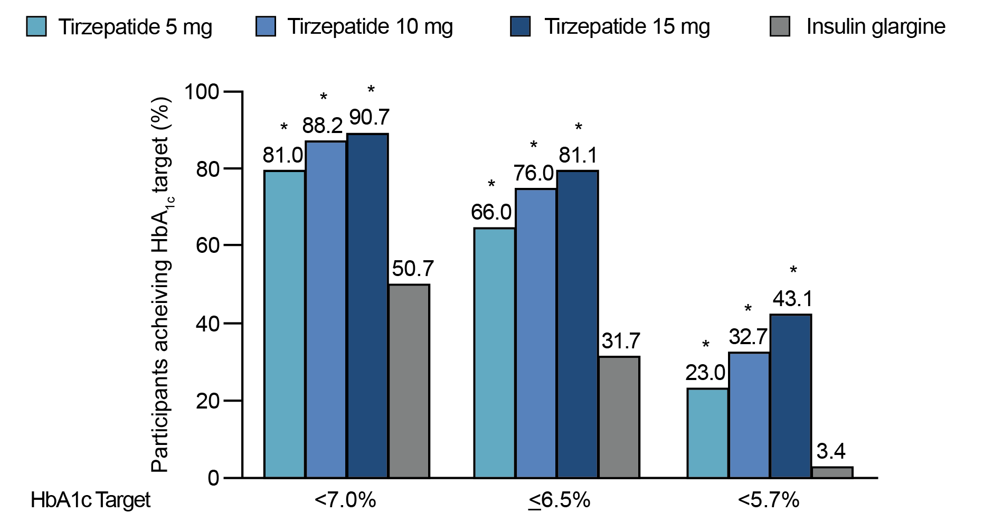
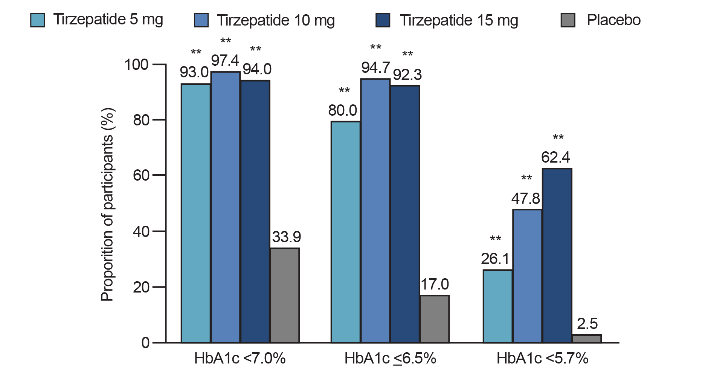
Trial results: % patients who reached HbA1c targets
Tirzepatide: statistically significantly more people met their HbA1c targets
SURPASS-2 (at 40 weeks)
SURPASS-3 (at 52 weeks)
SURPASS-4 (at 52 weeks)
SURPASS-5 (at 40 weeks)
*p<0.05 vs comparator; **p<0.01 vs comparator; ***p<0.001 vs comparator. Note: HbA1c ≤6.5% comparisons not controlled for type 1 error for any doses of tirzepatide. HbA1c <5.7% comparisons not controlled for type 1 error for tirzepatide 5 mg [SURPASS-2 and -5] or all doses [SURPASS-2 and-3].
Notes:
Note: efficacy estimand presented as for HbA1c

Slide 21
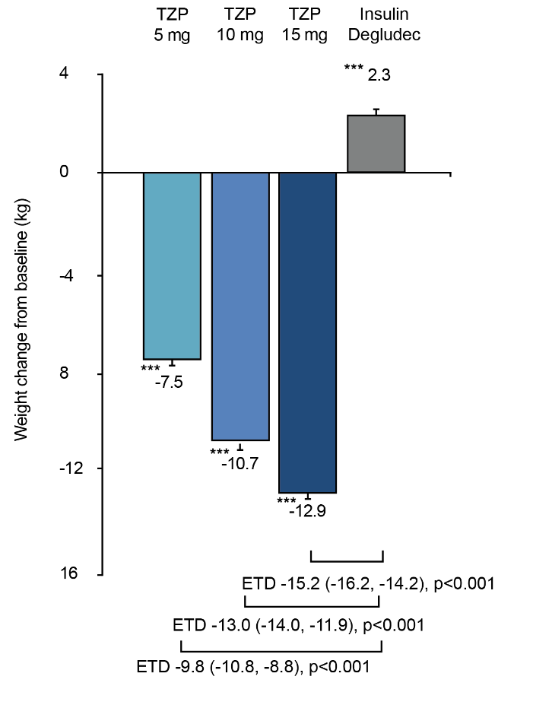
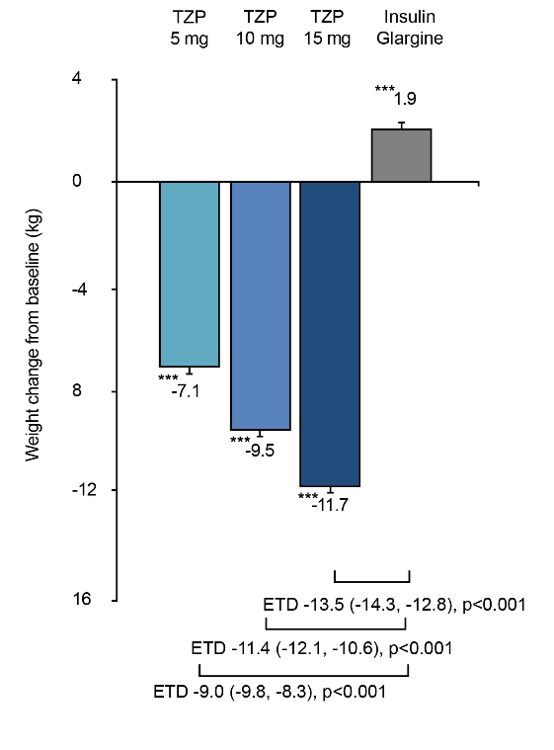
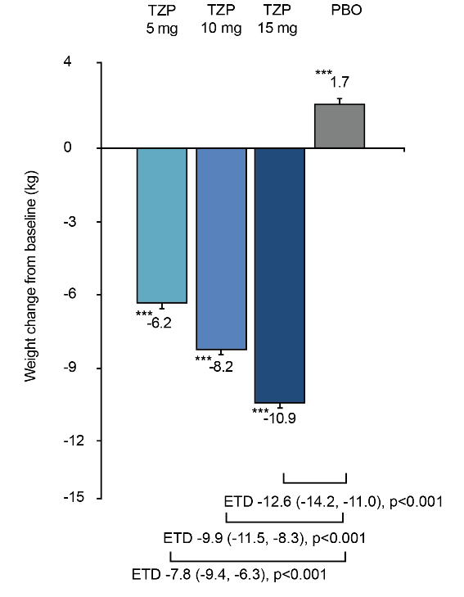
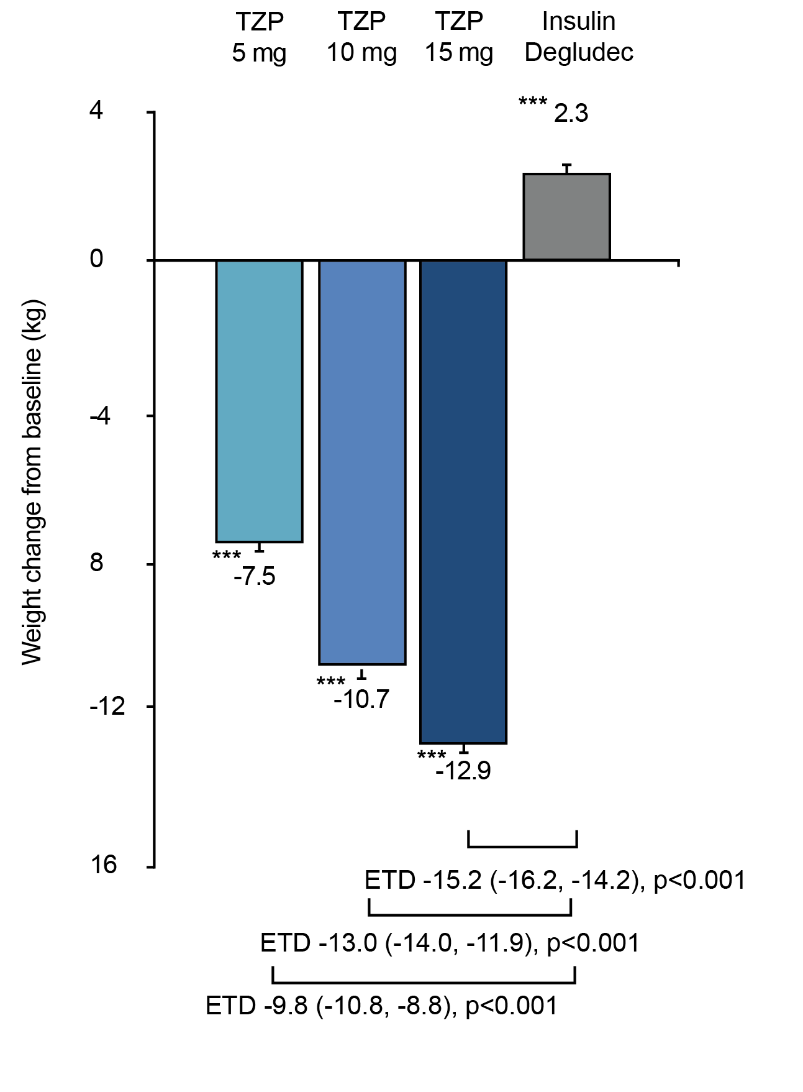
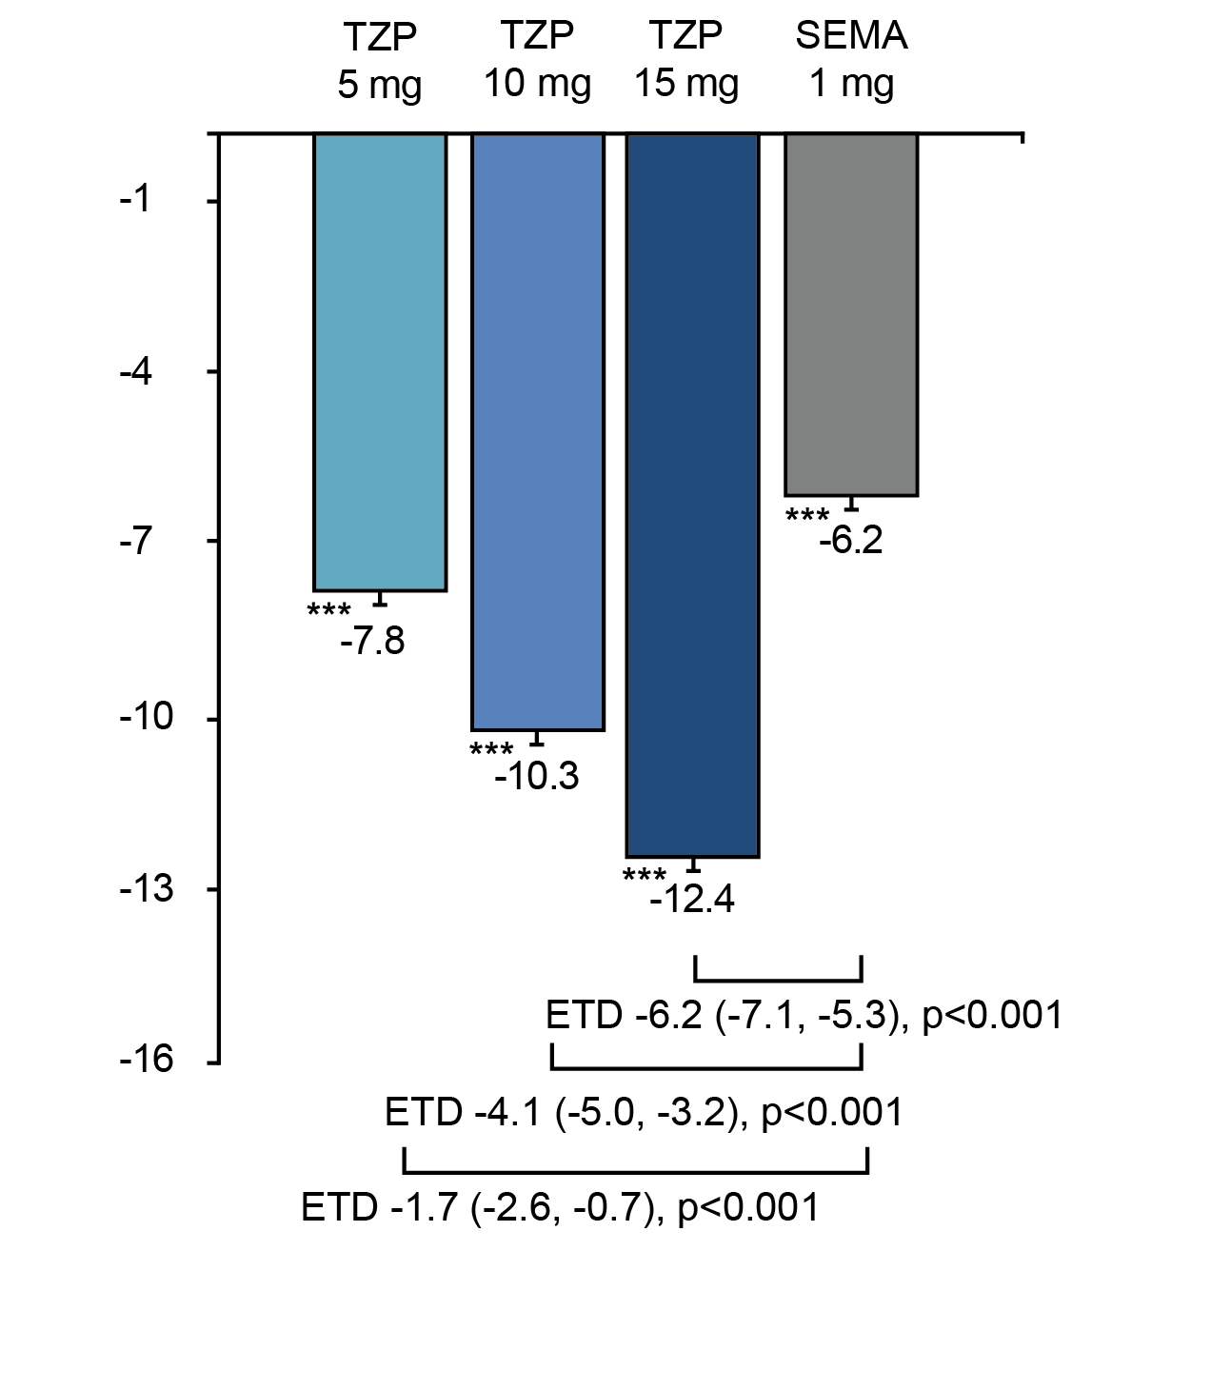
Trial results: change in body weight from baseline
Tirzepatide showed statistically significant reductions in body weight vs comparators (all doses)
SURPASS-2
(baseline to 40 weeks)
SURPASS-3
(baseline to 52 weeks)
SURPASS-4
(baseline to 52 weeks)
SURPASS-5
(baseline to 40 weeks)
***p<0.001 versus baseline; Abbreviations: ETD, estimated treatment difference; TZP, tirzepatide
Notes:
Note: efficacy estimand presented as for HbA1c

Slide 22
Adverse events
Most common treatment-emergent adverse events occurring in at least 5% of patients in any treatment group (placebo-controlled analysis set; tirzepatide all doses [N=718] vs placebo [N=235]):
Nausea (********vs *************
Diarrhoea (********vs *************
Nasopharyngitis (********vs **************
Decreased appetite (********vs **************
Dyspepsia (********vs **************
Vomiting (********vs **************
Constipation (********vs **************
Hyperglycaemia (********vs **************
Notes:
Source: Table 62 65 of the CS³

Slide 23
Network meta-analysis (methods)
Done to assess relative efficacy and safety of tirzepatide vs GLP-1 RAs available in NHS practice
Network defined to align with SURPASS-2 and 3 trials → included RCTs in people on 1-2 oral antidiabetic drugs:
  53 studies in the main analysis
  72 studies in sensitivity analyses
Two-stage analytical approach
Frequentist meta-analysis to assess heterogeneity and understand the data
NMA conducted using Bayesian Mixed Treatment Comparisons as described in NICE DSU
Analysis time window
Dose escalation in SURPASS trials longer than in comparator trials: 0-20ª weeks compared to 0-12 weeks
Comparator data analysed at 26 ± 4 (22–30) weeks
Tirzepatide data analysed at 40 weeks (42 for SURPASS4)
ª 5 weeks for tirzepatide 5 mg, 13 weeks for tirzepatide 10 mg and 21 weeks for tirzepatide 15 mg dose.
Abbreviations: NMA, network meta-analysis; RCTs, randomised controlled trials.
Notes:
Source: Table 46, CS.³

Slide 24
Network meta-analysis results
TZP: significantly greater reductions in HbA1c and BMI from baseline compared to GLP-1 RAs
Tirzepatide 10 mg vs comparators (example)
Forest plots (median difference [95% CrI]; random effects model) for change from baseline in:
HbA1c (%)
Body mass index (kg/m²)
Note: Semaglutide 2.0 mg not currently available in NHS but included for completeness. Degludec, glargine, sitagliptin 100 mg and glimepiride used as nodes to connect other treatments and not included in PICOTS, results for these treatments should not be interpreted. Abbreviations: BMI, body mass index; CrI, credible interval; GLP-1, Glucagon-Like Peptide-1; HbA1c, glycated haemoglobin; RA, receptor agonist; TZP, tirzepatide.
Notes:
Note: BMI data for studies in the main analyses were limited

Slide 25
Key issue: Lack of feasibility assessment/assessment of comparability in the NMA (1)
Company
NMA provides robust results that are generalisable to UK clinical practice
Studies with extreme values of baseline characteristics, such as BMI and diabetes duration were excluded from NMA
Acknowledges heterogeneity identified for some outcomes but adequate feasibility assessment done, and heterogeneity thoroughly tested – limited concerns identified
Meta-regression analysis on treatment effect modifiers gives similar results to main analysis, supporting that treatment effect is not influenced by differences between baseline characteristics
Additional sensitivity analyses on HbA1c, body weight and BMIª in which studies that contributed to increased heterogeneity were removed → results similar to main NMA for HbA1c and body weight (BMI analysis had sigma convergence issues and should be interpreted with caution)
ª Company response to EAG report May 2023.
Abbreviations: NMA, network meta-analysis.

Slide 26
Key issue: Lack of feasibility assessment/assessment of comparability in the NMA (2)
EAG comments
NMA criteria (1-2 OADs) don’t match company’s target population
External and internal validity of NMA in question → high risk of bias
Validity of NMA based on assumption that all the studies included in network are similar in all factors that may affect the relative effects (i.e. disease and patient characteristics that are potentially effect modifiers), but:
  No analysis of degree of variation between trials included, which appeared large, e.g. mean baseline HbA1c values varied from 7.4% to 10.3% and baseline diabetes duration from 0.6 - 10.1 years
  Substantial/considerable heterogeneity (I² results > 60%) identified in 21 of 91 pairwise comparisons across 7 characteristicsª
Concerns about meta-regression and sensitivity analyses presented by company:
  Meta-regression results limited to only one factor (i.e. number of prior OADs: 1 vs 2)
  Sensitivity analysis around background therapy mixed 2 unrelated populations: trials with unclear proportion of people receiving metformin (n=1 study), and trials including people on 3 OADs (n=6 studies) + does not address heterogeneity in background OADs (i.e. type rather than number of OADs)
Notes company’s additional sensitivity analyses, in which all trials making the same direct comparison with high heterogeneity between them are excluded, seem to show little difference to the main analysis
Tirzepatide and GLP-1 RA: precise treatment effect that would be observed in clinical practice unknown, as treatments would be titrated in NHS, not given as fixed maintenance doses (discussed in next slides)
How applicable is company NMA to decision problem? Is it suitable for decision-making?
ª BMI, body weight, eGFR, HbA1c, HDL, nausea and SBP. Abbreviations: NMA, network meta-analysis.

Slide 27
Key issue: Mismatch between decision problem and evidence: line of therapy and prior oral antidiabetic drug therapy intensity
Company decision problem: 3 or more prior OADs (as alternative to GLP-1 RAs)
Source | Prior antidiabetic drug therapy allowed
SURPASS-2 | Metformin
SURPASS-3 | Metformin or metformin plus SGLT-2i
SURPASS-4 | Triple OADs, which could only include metformin, SGLT2i, and/or sulfonylurea inhibitor
SURPASS-5 | Insulin glargine with/without metformin
NMA | Aligned with SURPASS-2 and 3 trials: 1-2 OADs
Company
Trials designed to meet global regulatory evidence requirements
Similar mismatch between GLP-1 RA trials and their use in NHS
Following analyses support generalisability of tirzepatide results:
  SURPASS-4 subgroup analyses of baseline OADs for change from baseline in HbA1c, weight and BMI → in line with main analyses
  NMA meta-regression analysisª → results adjusted for number of background OADs similar to unadjusted results
  NMA sensitivity analysis including studies including patients on 3 OADs → aligned with main analysis
EAG comments
SURPASS trial evidence generally at earlier line of therapy than company decision problem - more aligned with broader population in NICE scope
Only SURPASS-4 allowed prior triple therapy (but only ~*****people had it)
SURPASS subgroup analysis: showed significant effect on HbA1c; had limited ability to test hypothesis of baseline OAD independence as so few people had 3 OADs at baseline
Critique of NMA-related analyses on previous slide
ª for change from baseline in HbA1c and weight. Abbreviations: OADs, oral antidiabetic drugs; SGLT2i, sodium-glucose co-transporter-2 inhibitor.
Notes:
Source: Company submission, Document B, EAG report, company response to clarification (p39)

Slide 28
Key issue: Mismatch between tirzepatide administration in clinical practice and in trials, NMA and cost-effectiveness analyses
Background
Tirzepatide MA: titrated as needed to recommended maintenance doses of 5 mg, 10 mg, or 15 mg
Company’s analyses stratified by maximum maintenance dose into 5 mg, 10 mg and 15 mg groups, without titration permitted between maintenance doses
Company
Accepts an issue – but notes it applies to all relevant comparator trials
Clinical practice: patients titrate to maintenance doses of GLP-1 RAs; few patients de-escalate to lower doses
Most important comparisons are within each recommended maintenance dose step, rather than between them (but all analyses provided) – because GLP-1 RAs and tirzepatide exhibit dose-response relationship in terms of efficacy and GI side-effects; patients unable to tolerate higher doses of one GLP-1 RA not expected to tolerate higher doses of another GLP-1 RA or tirzepatide
EAG comments
Concerned lack of applicability to clinical practice where titration is permitted
Mismatch applies even if there is no de-escalation as comparison between treatments depend both on relative effectiveness between two maintenance doses and proportion of patients who escalate (which may vary)
In the absence of titrated treatment evidence, comparison in tirzepatide 10 mg stratum might be closest approximation: efficacy likely underestimated for 5 mg and overestimated for 15 mg strata
How is an individual’s optimal dose determined in clinical practice?
ª Company response to EAG report May 2023. Abbreviations: CEA, cost effectiveness analysis; GI, gastrointestinal; GLP-1, glucagon-like peptide-1; HbA1c, glycated haemoglobin; MA, marketing authorisation; NMA, network meta-analysis; RA, receptor agonist

Slide 29
Cost effectiveness

Slide 30
Company’s model overview
PRIME T2D model structureª
Technology affects costs by:
Additional treatment costs
Reductions in diabetes-related complication costs (especially cardiovascular events avoided)
Technology affects QALYs by:
Reductions in diabetes-related complications
Reductions in BMI
ª source: Company response to EAG report, May 2023
*Model averaging used in controller; †,complications with increased risk of mortality in year of complication onset and subsequent years; ‡, complications with increased risk of mortality associated with history of this complication
Abbreviations: QALYs, quality-adjusted life years; QoL, quality of life; RNG, random number generator; SPSL, severe pressure sensation loss.
Notes:
Source: company response to EAG report

Slide 31
How company incorporated evidence into model
Company agreed with some EAG assumptions (marked with*) but discrepancy remains
Input | Assumption and evidence source (revised base case) | EAG concerns
Baseline characteristics | THIN second intensification cohort and SURPASS-2 clinical trial cohort (if data from THIN missing) | Some: scenario using SURPASS-2 characteristics
Efficacy | NMA (1-2 OADs) (BMI directly from NMA when available*) | Yes: NMA high risk of bias + mismatch with decision problem
Long-term risk factor progression | Model averaging for macrovascular complications and blindness risks; based on UKPDS OM2 for all other risk factors* (except SBP and BMI while on treatment) | Yes: about model averaging
Discontinuation | Switch to basal insulin therapy when HbA1c rise above 7.5% | Yes: include further reasons for discontinuation
Utilities | Literature review; disutility for complications, adverse events and overweight (additive method); no utility benefit for weight loss and administration*; adjusted for ageing* | Yes: multiplicative preferred; baseline utility value seems high
Adverse events | Only nausea included (from NMA) | Yes: include also vomiting
Intervention and comparators costs and resource use | NHS Electronic Drug Tariff, NICE NG28 2022 model, PSSRU Unit Costs of Health and Social Care (all inflated to 2022*; errors fixed*) | -
Abbreviations: AEs, adverse events; eGFR, estimated Glomerular Filtration Rate; NMA, network meta-analysis; PSSRU, Personal Social Services Research Unit.
Notes:
Source: Company submission Table 75, 82, 86

Slide 32
Key issue: Model approach adopted by the company
EAG: Technical implementation of company’s model unclear
Company
Developed PRIME T2D model (in JAVA): discrete time event, patient-level simulation
  Uses data exclusively from populations with type 2 diabetes
  Meets ISPOR good modelling practice guidelines, underwent PRIMA review
  Shown to project long-term patient outcomes consistent with those reported for several long-term studies, including cardiovascular outcome trials, during validation analyses
Models developed before 2016 performed poorly in validations against cardiovascular outcomes trials at the Ninth Mount Hood Challenge Meeting; need calibration with hazard ratios from CVOTs → complex due to heterogeneity of trials; can lead to misleading results (Evans et al. 2023)
PRIME T2D Model includes a revascularization endpoint (CORE Diabetes Model and UKPDS OM2 don’t) – shown important to predict cardiovascular risk in a modern UK population (Keng et al. 2022)
‘Discrete time event model’ misunderstood by EAG - term analogous to ‘discrete-time illness-death’ description of UKPDS Outcomes Model
EAG comments
No comparison of Ninth Mount Hood Diabetes Challenge results and current implementation of PRIME T2D Model – not clear it better predicts cardiovascular complications than existing diabetes models
Prefers CORE Diabetes model
Prefers discrete event simulation or individual-patient state transition model
Abbreviations: CVOTs, cardiovascular outcomes trials; PRIMA, Preliminary Independent Model Advice; T2D, type 2 diabetes; UKPDS, UK Prospective Diabetes Study.

Slide 33
Key issue: Technical verification insufficient/model results not reproducible
Background
EAG had issues to run the model locally (without using the online version of the model). Requested description of how BMI-related utility is implemented in model & full overview of all input parameters
Company
Notes it explained how to implement BMI-related utilities at clarification stage
EAG given full access to base case simulations and settings via model interface in August 2022
All model inputs for base case analysis given in JSON files to run model off-line
EAG comments
EAG able to run model locally, reproducing company's base-case results. But this is typically only starting point of EAG model assessment. Validating and scrutinizing model via online interface is challenging: e.g., not all input parameters can be adjusted, and model implementation/assumptions difficult to examine
Still unclear how BMI related utility implemented in model
No complete overview of all model inputs → face, internal and external validity checks likely incomplete
Is company model suitable for decision making?
Abbreviations: BMI, body mass index; JSON, JavaScript Object Notation

Slide 34
Key issue: Lack of comparative evidence on micro and macrovascular complications
Background
No comparative data on micro- and macrovascular complications of diabetes, including CV outcomes
Company estimated rates of micro- and macrovascular complications using risk models instead (next slide)
Company
Further data on CV outcomes expected from SURPASS-CVOT trial in 2025
Ongoing addendum study to SURPASS-CVOT will assess impact on diabetic retinopathy progression
No excess risk for CV events with tirzepatideª
EAG comments
Risk models based on surrogate outpoints such as HbA1c → treatment effect on final endpoints uncertain
ª as per meta-analysis of positively adjudicated major adverse cardiovascular events (MACE) in SURPASS trials.
Abbreviations: CV, cardiovascular; CVOT, Cardiovascular Outcomes Trial.

Slide 35
Key issue: Selection and use of risk models to estimate complications
Background
PRIME T2D Model uses model averaging approach to estimate risk of macrovascular complications
Company
Establishing which model is “best match” to decision problem is challenging → averaging allows model to draw on data derived from populations with diverse risk profiles
Approach to model averaging documented in Pollock et al. 2022; risk equations from:
  UKPDS OM2 → for patients with a low risk profile and short duration of disease
  BRAVO Model → better suited to patients with more advanced disease and higher risk profile (derived from the ACCORD trial population which was at high risk of cardiovascular complications)
  Hong Kong Diabetes Registry → applicable to South East Asian populations (not influential)
PRIME T2D Model, using the model averaging approach, shown to compare well to published outcomes
EAG comments
Justification for model averaging approach not compelling, justification for selection of individual predictive models is limited
Company did not provide any scenario analyses examining impact of approach (e.g. selecting a single predictive model based on the best match of derivation cohort to decision problem)
What is the best approach to estimate risk of micro- and macrovascular complications? Should sensitivity analyses be presented?
Abbreviations: T2D, type 2 diabetes; UKPDS, UK Prospective Diabetes Study.

Slide 36
Key issue: Extrapolation of treatment effectiveness
Revised base case follows UKPDS OM2 risk factor progression for all risk factors except SBP and BMI
Background
QALY gains mainly after the first year (beyond trial time horizon) and mostly likely related to utilities for weight
Company
For most risk factors other than HbA1c, only modest changes over time
HbA1c key driver of cost-effectiveness; progression based on UKPDS data that leads to relative reduction in treatment benefit whilst on treatment
Agreed with EAG suggestion - UKPDS OM2 progression assumed for:
  all risk factors while on insulin therapy
  HbA1c, LDL, HDL, eGFR, white blood cells count, heart rate and haemoglobin levels while on tirzepatide or GLP-1 RAs
For SBP and BMI, no change assumed while on tirzepatide or GLP-1 RAs:
  in line with published data for GLP-1 RAs showing maintained benefit while on treatment – if UKPDS OM2 progression applied, levels would return to baseline in 5 years (at odds with published data)
EAG comments
Risk factor progression follows EAG’s suggestion
Notes company’s justification for assuming no treatment waning for SBP and BMI while on treatment
Company approach appropriate?
Note: After switching to basal insulin, BMI assumed to return to baseline levels in first year, all other risk factors assumed to return to baseline levels immediately. Company considers these to be conservative assumptions as no data were available to inform BMI, and due to absence of evidence to support continued benefit (other risk factors).
Abbreviations: BMI, body mass index; eGFR, estimated Glomerular Filtration Rate; HbA1c, Glycated Haemoglobin; HDL, high density lipoprotein; LDL, low density lipoprotein; SBP, systolic blood pressure; UKPDS, UK Prospective Diabetes Study.

Slide 37
Key issue: Treatment discontinuation/intensification
EAG: prefers including other causes for treatment discontinuation
Background
Patients assumed to intensify therapy, that is, discontinue initial treatment and switch to basal insulin therapy when HbA1c rose above 7.5%. No other causes for treatment discontinuation were included
Company
This approach taken to avoid potential for rescue medication influencing outcomes
Patients who do not tolerate the interventions well are likely to miss doses, leading to poorer glycaemic control and meeting the criterion for intensification
Aligned with NG28 evaluation approach and NICE Guidance
Changing intensification criteria has modest effect on ICERs
EAG comments
Disagrees as changing intensification criteria increases ICERs by ~£9,000 and ~£15,000 when HbA1c threshold increased to 8.5% and 9.5%, accordingly (for tirzepatide 10 mg vs semaglutide 1.0 mg)ª
EAG prefers to include other causes for treatment discontinuation
When would treatment be discontinued/ intensified in clinical practice?
ª compared with revised company base case. Source: Additional sensitivity analyses, May 2023.
Abbreviations: HbA1c, Glycated Haemoglobin; ICER, incremental-cost effectiveness ratio.

Slide 38
Key issue: Adverse events: not all incorporated for all treatments
EAG concerned only nausea included in the model
Background
Base-case included only nausea rates for tirzepatide and comparators (hypoglycaemia rates set to zero)
Severe and non-severe hypoglycaemic rates included for basal insulin therapy only (NG28 2022 report)
Company
Rates of hypoglycaemia were not reported in NMA as many studies reported zero events. Assuming zero events reasonable considering low rates of hypoglycaemia in SURPASS and GLP-1 RAs trials
  Included in SURPASS-2 scenario analysis → negligible impact on projected outcomes
Incorporating rates of diarrhoea from NMA showed modest QALY differences from base case analysisª
Including both nausea and vomiting rates from NMA would create risk of double-counting events; conservative approach used: 1) assumed NMA rate of nausea represents combined nausea and vomiting endpoint, and 2) applied disutility of more severe health state of nausea and vomiting to this rate
EAG comments
Agrees hypoglycaemia likely not influential due to very low number of events
Prefers to include both nausea and vomiting
Which AEs should be included in the model?
ª Source: company clarification response; compared to initial company base case. Abbreviations: AEs, adverse events; GI, gastrointestinal; ICER, incremental-cost effectiveness ratio; NMA, network meta- analysis; QALYs, quality-adjusted life years.
Notes:
Source: company clarification response, Tirzepatide 5 mg vs

Slide 39

Health state utility values
EAG prefers multiplicative method of combining utility values in base case
Background
Base utility score of 0.815, per NG28 2022 model
Disutility applied for complications, adverse events and overweight (combined using additive method)
No utility benefit for weight loss in first year and administration in revised base case per EAG suggestion
Utilities adjusted for ageing (Ara and Brazier 2010) in revised base case per EAG suggestion
Company
Additive approach aligns with previous health economic evaluations, including NG28, TA288, TA418, TA390ª, and TA336ª modelling
NICE health technology evaluations: the manual (2022)
“4.3.7. In some circumstances adjustments to utility values may be needed, for example for age or comorbidities. […] A multiplicative approach is generally preferred.”
EAG comments
Base utility score of 0.815 seems high:
  utility score of 0.804 for general population at the same age
  average utility of 0.772 in recent meta-analysis (n=19 studies; 0.037 reduction compared to general population)
Prefers multiplicative approach: considered best approach overall and more conservative than additive method (although best method to combine multiple disutility values still debated)
Using multiplicative methods increases ICER by almost £7,000 (compared with revised company base case)^{b}
What is the best method to model health state utility values in type 2 diabetes?
ª Approach not reported (assumed additive based on data presented). ^{b} Additional sensitivity analyses May 2023.
Abbreviations: ICER, incremental-cost effectiveness ratio.
Notes:
Source: NICE final scope. Company submission, Document B, Table 1. EAG report, sections 2.2.1, 2.3.
Additive approach to combining utilities: Dapagliflozin in combination therapy for treating type 2 diabetes. Technology appraisal guidance [TA288], 26 June 2013. https://www.nice.org.uk/guidance/ta288
Additive approach to combining utilities: Dapagliflozin in triple therapy for treating type 2 diabetes. Technology appraisal guidance [TA418], 23 November 2016. https://www.nice.org.uk/guidance/ta418
Approach not reported (assumed additive based on data presented): Canagliflozin, dapagliflozin and empagliflozin as monotherapies for treating type 2 diabetes. Technology appraisal guidance [TA390], 25 May 2016. https://www.nice.org.uk/guidance/ta390
Approach not reported (assumed additive based on data presented): Empagliflozin in combination therapy for treating type 2 diabetes. Technology appraisal guidance [TA336], 25 March 2015. https://www.nice.org.uk/guidance/ta336

Slide 40
Key issue: Potentially inappropriate probabilistic sensitivity analysis (PSA)
Company - PSA includes bootstrapping
PSA in PRIME T2D Model aims to capture uncertainty around all aspects of simulation, not only uncertainty around model parameters/coefficients (but every class of uncertainty can be separated out in model)
Patient characteristics, sub-model execution order, sub-model coefficients treatment effects, costs and utilities are all sampled or randomised
Then, uncertainty around outcomes evaluated using non-parametric bootstrapping
Unclear why EAG suggests Corro-Ramos et al 2020: impossible to implement as not transparent enough, and not feasible with PRIME T2D model.
PSA in Corro-Ramos simulated 100 patients over 300 PSA iterations, versus 300,000 patients over 1,000 bootstrap iterations in PRIME T2D Model
EAG comments
Company’s approach not standard in PSAs - NICE TSD 15: “it is usually necessary to run two nested simulation loops” in patient-level simulation using PSA
Literature: combining first and second order uncertainty (like in company model) can deliver expected value (e.g. estimate of ICER), but nested simulations needed to get distribution of expected outcomes (reflecting parameter uncertainty)
Potential implications: estimated mean results might be correct but distribution around results distorted; likely underestimates uncertainty
Suggests PSA implemented considering recommendations by Corro-Ramos et al 2020
Is company’s probabilistic sensitivity analysis appropriate for decision-making?

Slide 41
Key issue: No full deterministic one-way sensitivity analyses provided
Background
Company performed some deterministic sensitivity analyses and scenario analyses
Company
Providing sensitivity analysis for all input parameters impracticable (over 185 inputs; 1,110 simulations needed) → all key model inputs that influence cost-effectiveness were explored in sensitivity analyses
Tornado diagrams provided for these key inputs at clarification stage
EAG comments
Initially, sensitivity and scenario analyses provided only for tirzepatide 10 mg against semaglutide analysisª
No deterministic one-way sensitivity analyses exploring impact of all input parameters individually → needed to identify all potentially influential parameters (presented in tornado diagrams; for all doses of tirzepatide)
One-way sensitivity analyses also very informative to validate that model behaves as you would expect/to increase model understanding
Are sensitivity analyses provided sufficient for decision-making?
ª Additional scenario analyses reported in company response to EAG report, May 2023 included all comparisons.

Slide 42

Summary of company and EAG base case assumptions (1)
Assumptions in company and EAG base case
Assumption | Company initial base case | EAG base case | Revised base case
Comparators | GLP-1 RAs only | Including all comparators described in scope | No changes
Treatment strategies | Comparisons made within each recommended maintenance dose step (titration not allowed) | Comparisons made between all maintenance doses (titration allowed) | All comparisons reportedª (titration not allowed)
Costs | 2022 and 2021 values (treatment costs and complication costs respectively) | Inflating all costs to the same price year, preferably 2022 | EAG
BMI inputs | BMI changes calculated from body weight changes^{b} (from NMA) | BMI directly from NMA when available (calculated from body weight otherwise) | EAG
Device utility | Device utility added for tirzepatide and dulaglutide (except for comparison with oral semaglutide) | No device utility associated with tirzepatide or dulaglutide | EAG
ª Company maintains ‘within dose step’ comparisons most relevant. ^{b} Assuming average height of 1.68cm reported for THIN population.
Abbreviations: BMI, body mass index; GLP-1, Glucagon-Like Peptide-1; NMA, network meta-analysis; RA, receptor agonist.
Notes:
Source: EAG report, company submission, company response to clarification
Note- utility discrepancies- eag- resolve discrepancies related to utility values and costs

Slide 43
Summary of company and EAG base case assumptions (2)
Assumption | Company base case | EAG base case | Revised base case
Combining multiple disutility values | Additive method | Multiplicative approach preferred | No changes
Risk factor progression | Assumed constant for SBP, HDL, LDL and BMI after a year up to treatment intensification | Assuming UKPDS OM2 risk factor progression for all risk factors | EAG (constant for SBP and BMI but justification given)
Treatment discontinuation/ intensification | When 7.5% HbA1c threshold reached (no other causes included) | Including additional causes for treatment discontinuation (than reaching the HbA1c threshold) | No changes
Adverse events | Only nausea included (hypoglycaemia only for basal insulin therapy) | Including all relevant adverse events (also vomiting) | No changes
Age adjustment | No age-adjustment | Including age-adjustment* | EAG (higher than general population at the same age)
*EAG notes company’s high baseline utility for T2D (higher than general population and higher than in identified review)
Abbreviations: BMI, body mass index; T2D, type 2 diabtes; HbA1c, Glycated Haemoglobin; HDL, high density lipoprotein; LDL, low density lipoprotein; SBP, systolic blood pressure; UKPDS, UK Prospective Diabetes Study.

Slide 44
Company revised base case results
CONFIDENTIAL
Tirzepatide 5 mg: Deterministic incremental revised base case results
 | Total costs (£) | Total QALYs | Incremental costs (£)ª | Incremental QALYsª | ICERª (£/ QALY) | NHBª (QALYs)
Tirzepatide 5 mg | ******* | 8.715 | -- | -- | -- | --
Dulaglutide 1.5 mg* | ******* | 8.615 | ******* | 0.100 | 7,073 | 0.064
Dulaglutide 3.0 mg | ******* | 8.636 | ******* | 0.079 | 8,182 | 0.047
Dulaglutide 4.5 mg | ******* | 8.657 | ******* | 0.058 | 10,891 | 0.026
Semaglutide 0.5 mg* | ******* | 8.634 | ******* | 0.081 | 8,401 | 0.047
Semaglutide 1.0 mg | ******* | 8.673 | ******* | 0.042 | 16,817 | 0.007
Oral semaglutide 7 mg* | ******* | 8.595 | ******* | 0.120 | 6,202 | 0.083
Oral semaglutide 14 mg | ******* | 8.642 | ******* | 0.073 | 9,873 | 0.037
Liraglutide 1.2 mg* | ******* | 8.581 | ******* | 0.134 | 5,021 | 0.100
Liraglutide 1.8 mg | ******* | 8.600 | ******* | 0.115 | Dominant | 0.135
ª tirzepatide versus comparator; *comparisons considered most relevant by company.
Abbreviations: ICER, incremental cost-effectiveness ratio; NHB, net health benefit; QALYs, quality-adjusted life years.

Slide 45
Company revised base case results
CONFIDENTIAL
Tirzepatide 10 mg: Deterministic incremental revised base case results
 | Total costs (£) | Total QALYs | Incremental costsª (£) | Incremental QALYsª | ICERª (£/ QALY) | NHBª (QALYs)
Tirzepatide 10 mg | ******* | 8.768 | -- | -- | -- | --
Dulaglutide 1.5 mg | ******* | 8.615 | ******* | 0.153 | 11,272 | 0.067
Dulaglutide 3.0 mg* | ******* | 8.636 | ******* | 0.132 | 12,599 | 0.049
Dulaglutide 4.5 mg | ******* | 8.657 | ******* | 0.111 | 14,851 | 0.029
Semaglutide 0.5 mg | ******* | 8.634 | ******* | 0.134 | 12,651 | 0.049
Semaglutide 1.0 mg* | ******* | 8.673 | ******* | 0.095 | 18,115 | 0.009
Oral semaglutide 7 mg | ******* | 8.595 | ******* | 0.173 | 10,183 | 0.085
Oral semaglutide 14 mg* | ******* | 8.642 | ******* | 0.126 | 13,786 | 0.039
Liraglutide 1.2 mg | ******* | 8.581 | ******* | 0.187 | 9,038 | 0.102
Liraglutide 1.8 mg* | ******* | 8.600 | ******* | 0.168 | 3,625 | 0.138
ª tirzepatide versus comparator; *comparisons considered most relevant by company.
Abbreviations: ICER, incremental cost-effectiveness ratio; NHB, net health benefit; QALYs, quality-adjusted life years.

Slide 46
Company revised base case results
CONFIDENTIAL
Tirzepatide 15 mg: Deterministic incremental revised base case results
 | Total costs (£) | Total QALYs | Incremental costs (£) | Incremental QALYsª | ICERª (£/ QALY) | NHBª (QALYs)
Tirzepatide 15 mg | ******* | 8.808 | -- | -- | -- | --
Dulaglutide 1.5 mg | ******* | 8.615 | ******* | 0.192 | 10,642 | 0.090
Dulaglutide 3.0 mg | ******* | 8.636 | ******* | 0.171 | 11,586 | 0.072
Dulaglutide 4.5 mg* | ******* | 8.657 | ******* | 0.150 | 13,104 | 0.052
Semaglutide 0.5 mg | ******* | 8.634 | ******* | 0.174 | 11,641 | 0.073
Semaglutide 1.0 mg* | ******* | 8.673 | ******* | 0.135 | 15,209 | 0.032
Oral semaglutide 7 mg | ******* | 8.595 | ******* | 0.212 | 9,815 | 0.108
Oral semaglutide 14 mg* | ******* | 8.642 | ******* | 0.166 | 12,453 | 0.062
Liraglutide 1.2 mg | ******* | 8.581 | ******* | 0.227 | 8,893 | 0.126
Liraglutide 1.8 mg* | ******* | 8.600 | ******* | 0.208 | 4,498 | 0.161
ª tirzepatide versus comparator; *comparisons considered most relevant by company.
Abbreviations: ICER, incremental cost-effectiveness ratio; NHB, net health benefit; QALYs, quality-adjusted life years.

Slide 47
Company revised base case results
CONFIDENTIAL
Probabilistic revised base case results (tirzepatide vs comparator)
 | Total costs (£) | Total QALYs | Incremental costs (£) | Incremental QALYs | ICER (£/ QALY) | Probability of tirzepatide being cost-effectiveª
Tirzepatide 5 mg | ******** | 7.224
Semaglutide 0.5 mg | ******** | 7.138 | ******* | 0.087 | 8,149 | 70.6%
Tirzepatide 10 mg | ******** | 7.286
Semaglutide 1.0 mg | ******** | 7.174 | ******* | 0.112 | 14,137 | 65.3%
Tirzepatide 15 mg | ******** | 7.331
Semaglutide 1.0 mg | ******** | 7.174 | ******* | 0.157 | 11,506 | 77.3%
ª assuming a willingness to pay threshold of £20,000 per QALY gained.
Abbreviations: ICER, incremental cost-effectiveness ratio; QALYs, quality-adjusted life years.

Slide 48
Deterministic scenario analyses
CONFIDENTIAL
Clinical drivers and duration of therapy: tirzepatide 10 mg vs semaglutide 1.0 mgª
No. | Scenario* | Incremental costs (£) | Incremental QALYs | ICER (£/QALY gained)
 | Company revised base case | 1,726 | 0.095 | 18,115
1 | No HbA1c difference | ****** | ****** | 39,085
2 | No SBP difference | ****** | ****** | 19,474
3 | No serum lipids difference | ****** | ****** | 18,433
4 | No BMI difference | ****** | ****** | 30,878
5 | HDL and LDL changes for tirzepatide matched to dulaglutide | 1,745 | 0.088 | 19,724
6 | Only HbA1c difference between treatments | ****** | ****** | 35,059
7 | Intensification to insulin after 3 years | ****** | ****** | 17,512
8 | Intensification to insulin after 5 years | ****** | ****** | 23,939
9 | Second intensification to basal-bolus therapy | ****** | ****** | 15,845
10 | Intensification at HbA1c 8.5% threshold | ****** | ****** | 27,251
11 | Intensification at HbA1c 9.5% threshold | ****** | ****** | 33,008
*Sources: Scenario 5: company response to EAG report, May 2023; Scenarios 1-4, 6-11: additional sensitivity analyses, May 2023.
Abbreviations: BMI, body mass index; HDL, high-density lipoprotein; ICER, incremental cost-effectiveness ratio; LDL, low-density lipoprotein; QALYs, quality-adjusted life years; SBP, systolic blood pressure.
Notes:
Sensitivity analyses presented for all TZP doses and all comparisons:
HDL and LDL changes for tirzepatide matched to dulaglutide

Slide 49
Deterministic scenario analyses
CONFIDENTIAL
Other clinical assumptions: tirzepatide 10 mg vs semaglutide 1.0 mg
No. | Scenario* | Incremental costs (£) | Incremental QALYs | ICER (£/QALY gained)
 | Company revised base case | 1,726 | 0.095 | 18,115
1 | SURPASS-2 population characteristics | 1,286 | 0.090 | 14,236
2 | Sulfonylurea added to background therapy | ****** | ****** | 18,416
3 | BMI changes estimated from body weight changes | ****** | ****** | 18,846
4 | UKPDS OM2 renal failure estimation | ****** | ****** | 17,939
5 | UKPDS OM2 mortality risk estimation | ****** | ****** | 18,157
6 | Cause-subtracted life tables for mortality risk | ****** | ****** | 14,278
*Sources: Scenario 1: company response to EAG report, May 2023; Scenarios 2-6: additional sensitivity analyses, May 2023.
Abbreviations: BMI, body mass index; ICER, incremental cost-effectiveness ratio; QALYs, quality-adjusted life years.
Notes:
Sensitivity analyses presented for all TZP doses and all comparisons:
HDL and LDL changes for tirzepatide matched to dulaglutide

Slide 50
Deterministic scenario analyses
CONFIDENTIAL
Health state utility values: tirzepatide 10 mg vs semaglutide 1.0 mg
No. | Scenario* | Incremental costs (£) | Incremental QALYs | ICER (£/QALY gained)
 | Company revised base case | 1,726 | 0.095 | 18,115
1 | Weight loss utilities included in year 1 | 1,726 | 0.106 | 16,337
2 | No weight/BMI utilities | ****** | ****** | 27,997
3 | Device utility included | ****** | ****** | 16,893
4 | No nausea utilities | ****** | ****** | 17,577
5 | No hypoglycaemia utilities | ****** | ****** | 21,224
6 | No age-adjustment on utilities | ****** | ****** | 16,938
7 | Multiplicative approach to combining utilities (with age-adjustment) | ****** | ****** | 24,911
*Sources: Scenario 1: company response to EAG report, May 2023; Scenarios 2-7: additional sensitivity analyses, May 2023.
Abbreviations: BMI, body mass index; ICER, incremental cost-effectiveness ratio; QALYs, quality-adjusted life years.
Notes:
Sensitivity analyses presented for all TZP doses and all comparisons:
Weight loss utilities included in year 1

Slide 51
Deterministic scenario analyses
CONFIDENTIAL
Costs, time horizon and discounting: tirzepatide 10 mg vs semaglutide 1.0 mg
No. | Scenario* | Incremental costs (£) | Incremental QALYs | ICER (£/QALY gained)
 | Company revised base case | 1,726 | 0.095 | 18,115
1 | Costs associated with nausea included | 1,735 | 0.095 | 18,205
2 | Health state costs associated with T2D included | 1,791 | 0.095 | 18,792
3 | Complication costs taken from alternative sources (lit. review) | ****** | ****** | 17,685
4 | 5-year time horizon | ****** | ****** | 33,518
5 | 10-year time horizon | ****** | ****** | 24,853
6 | 15-year time horizon | ****** | ****** | 20,693
7 | 20-year time horizon | ****** | ****** | 19,331
8 | 0% discount rate (costs and clinical benefits) | ****** | ****** | 14,602
9 | 6% discount rate (costs and clinical benefits) | ****** | ****** | 20,391
*Sources: Scenarios 1-2: company response to EAG report, May 2023; Scenarios 3-9: additional sensitivity analyses, May 2023.
Abbreviations: ICER, incremental cost-effectiveness ratio; QALYs, quality-adjusted life years; T2D, type 2 diabetes.
Notes:
Sensitivity analyses presented for all TZP doses and all comparisons:
Costs associated with nausea included
Health state costs associated with T2D included
Sensitivity analyses presented for all TZP doses (vs semaglutide 0.5/1mg):
Time horizon
Discount rate

Slide 52
Thank you.
© NICE 2023. All rights reserved. Subject to Notice of rights.

Slide 53
Back-up slides

Slide 54
Adverse events
Categoryª Placebo-controlled analysis set n (%) | TZP all doses (N=718) | Placebo (N=235) | TZP all doses vs placebo p-value
Deaths^{b} | ******* | ******* | *******
Serious adverse events | ******* | ******* | *******
Discontinuation from study due to AE | ******* | ******* | *******
Discontinuation from study drug due to AE^{c} | ******* | ******* | *******
TEAEs | ******* | ******* | *******
TEAEs occurring in at least 5% of patients in any treatment group
Nausea | ******* | ******* | *******
Diarrhoea | ******* | ******* | *******
Nasopharyngitis | ******* | ******* | *******
Decreased appetite | ******* | ******* | *******
Dyspepsia | ******* | ******* | *******
Vomiting | ******* | ******* | *******
Constipation | ******* | ******* | *******
Lipase increased | ******* | ******* | *******
Hyperglycaemia | ******* | ******* | *******
a Patients may be counted in more than one category; b Deaths also included as SAEs and discontinuations due to AEs; c Patients remained in study after permanent discontinuation of study drug and initiation of an alternative antihyperglycaemic medication so additional data could be collected; such patients may have subsequently discontinued study for same or a different reason
Abbreviations: AE, adverse event; SAEs, serious adverse events; TEAEs, treatment-emergent adverse events; TZP, tirzepatide
Notes:
Source: Table 62 65 of the CS³

Slide 55
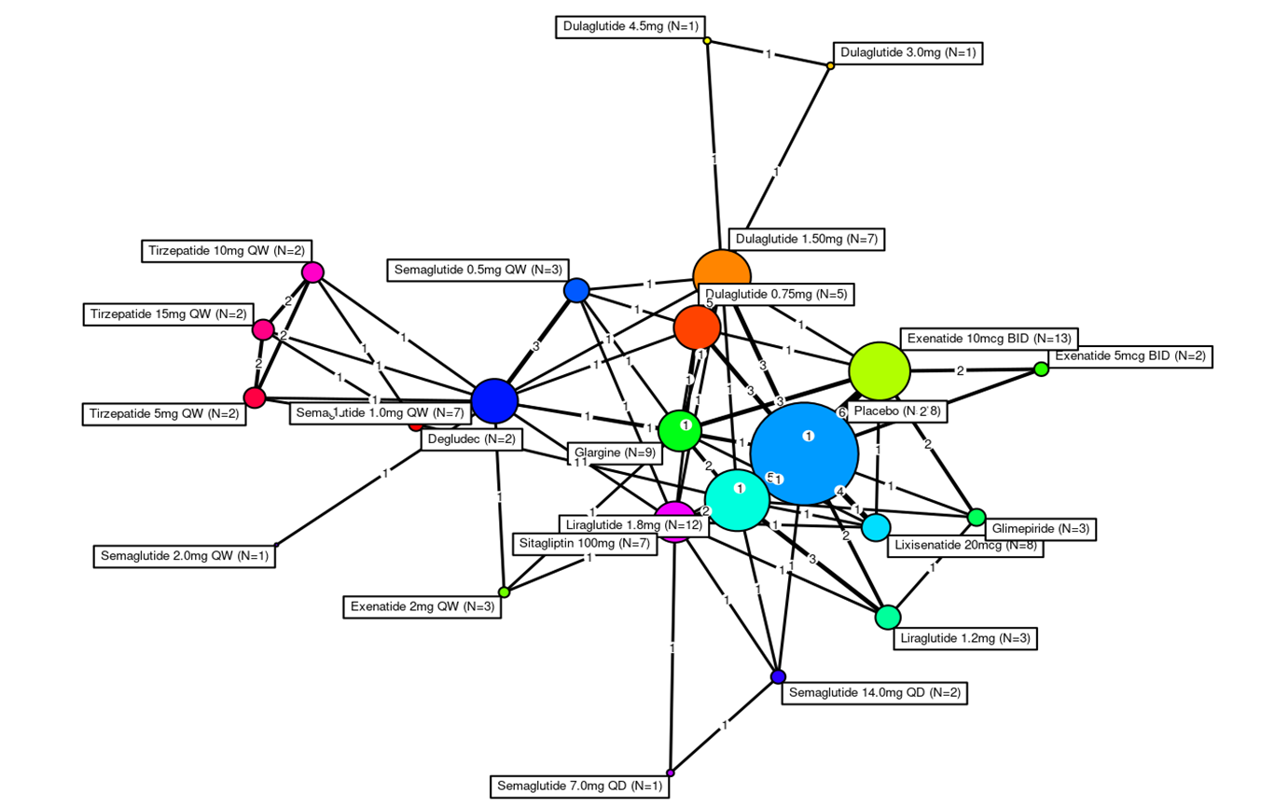
NMA/ITC network diagram
Main analysis network for HbA1c (%) change from baseline
Abbreviations: BID, twice a day; CS, company submission; Hb1Ac, glycated haemoglobin; QD, once a day; QW, once weekly
Notes:
Source: Based on Figure 40 of the CS.³

Slide 56
NMA/ITC results: Pairwise results- HbA1c (%) change from baseline
Column versus row | TZP 5 mg | TZP 10 mg | TZP 15 mg
Placebo | ********************** | ********************** | **********************
Tirzepatide 5 mg QW | - | ********************** | **********************
Tirzepatide 10 mg QW | ********************** | - | **********************
Tirzepatide 15 mg QW | ********************** | ********************** | -
Semaglutide 0.5 mg QW | ********************** | ********************** | **********************
Semaglutide 1.0 mg QW | ********************** | ********************** | **********************
Liraglutide 1.2 mg | ********************** | ********************** | **********************
Liraglutide 1.8 mg | ********************** | ********************** | **********************
Dulaglutide 0.75 mg | ********************** | ********************** | **********************
Dulaglutide 1.5 mg | ********************** | ********************** | **********************
Dulaglutide 3.0 mg | ********************** | ********************** | **********************
Dulaglutide 4.5 mg | ********************** | ********************** | **********************
Semaglutide 7.0 mg QD | ********************** | ********************** | **********************
Semaglutide 14.0 mg QD | ********************** | ********************** | **********************
Exenatide 2 mg QW | ********************** | ********************** | **********************
Exenatide 5 mcg BID | ********************** | ********************** | **********************
Exenatide 10 mcg BID | ********************** | ********************** | **********************
Lixisenatide 20 mcg | ********************** | ********************** | **********************
Abbreviations: BID, twice a day; CrI, credible interval; HbA1c, glycated haemoglobin; QD, once a day; QW, once weekly; TZP, tirzepatide
Notes:
Table 55, CS.³

Slide 57
Key issue: Age-adjustment for utility values: none for older age
EAG: Prefers base case utility score to include age-adjustment
Background
Company use base utility score of 0.815 for patients for each year they were alive in the simulation
No age-adjustment used in base-case analysis but explored in sensitivity analyses (Ara and Brazier 2010)
NICE methods guide: If baseline utility values are extrapolated over long time horizons, they should be adjusted so they don’t exceed general population values at a given age
Company - adjusting utilities for age:
Poses risk of double-counting the effect of age on QoL, as unadjusted utilities already reflect impact of complications on aging population
Not included to align with NG28 economic modelling
Explored in sensitivity analysis → little impact on cost-effectiveness
 | Utility value
Company base case | 0.815
UK general population utility (64 years old) | 0.804
UK general population utility (65-74 years old) | 0.785
EAG comments
Base-case utility score is relatively high, and overtime potential overestimation will likely increase due to lack of age-adjustment
Prefers base-case scenario to include age-adjustment (ensuring that utility does not exceed the age-matched general population utility as these estimates will provide a more conservative ICER estimate
Should utilities be adjusted for age?
Abbreviations: ICER, incremental-cost effectiveness ratio, QoL, quality of life

